Slide 1
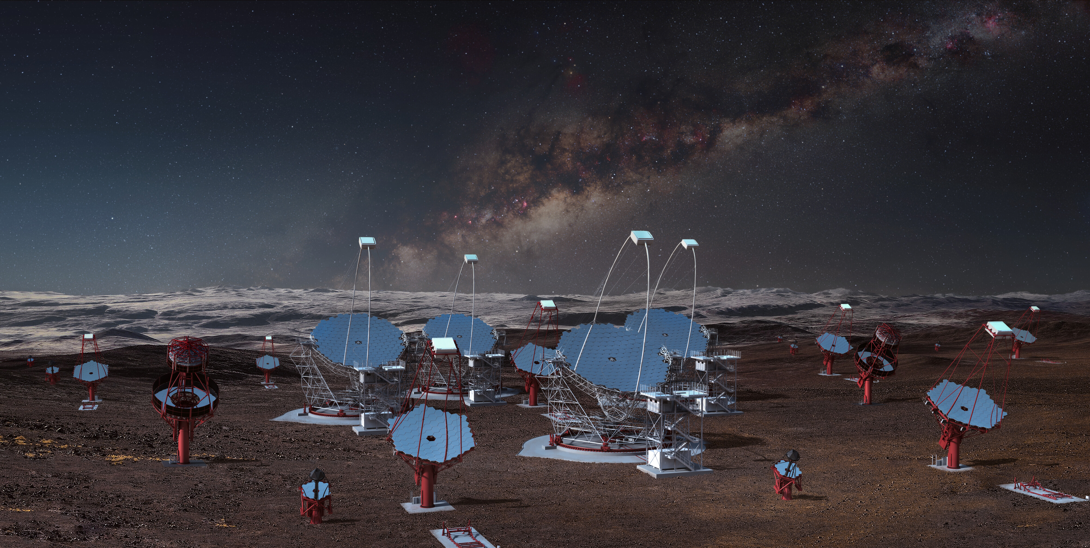
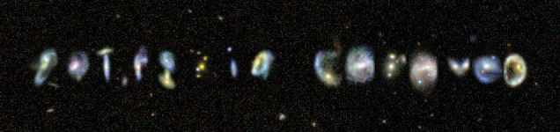
CTA science in the multimessenger era

Slide 2
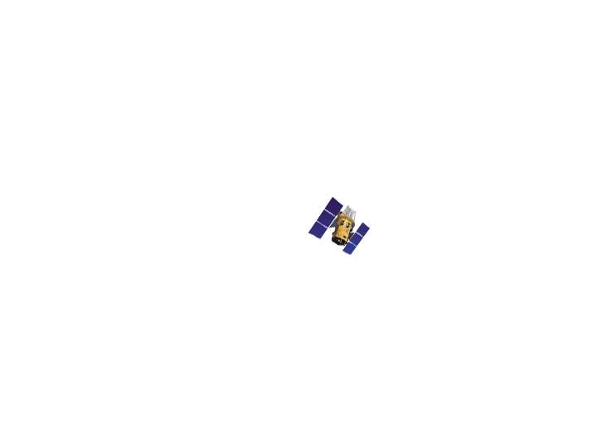

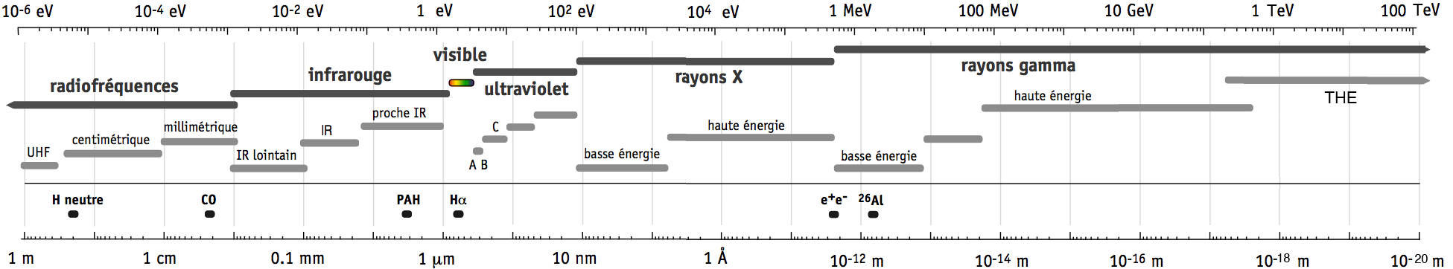
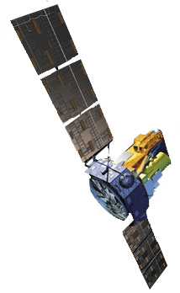
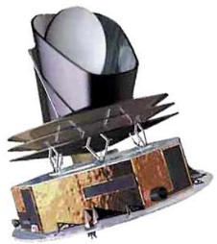
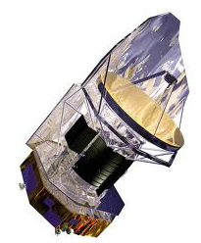
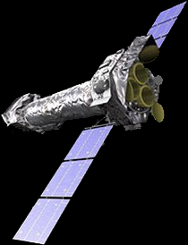
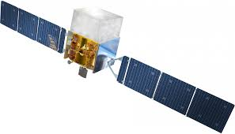
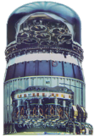

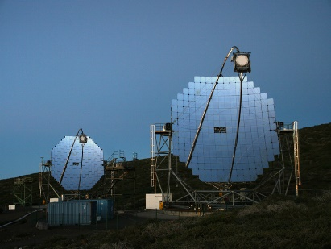
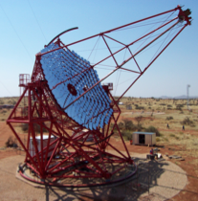
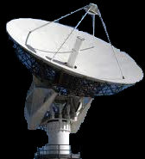
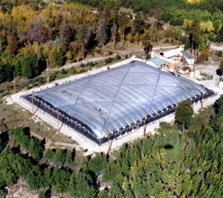

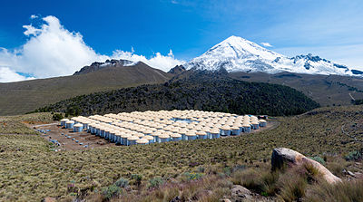
Electromagnetic Astronomy
total external reflection
tracking
coded apertures
pair production
Limited angular resolution
mirror
telescopes
grazing
incidence
Compton
scattering
air
MeV
sub-mm/IR
UV
x-rays
gamma-rays
Cherenkov
water

Slide 3
Gamma-ray astronomy limitations had a remarkable outcome
First multiwavelength campaign was on a gamma ray source

Slide 4

GEMINGA GEMINi GAmma
Gh’è minga
Nanni Bignami

Slide 5
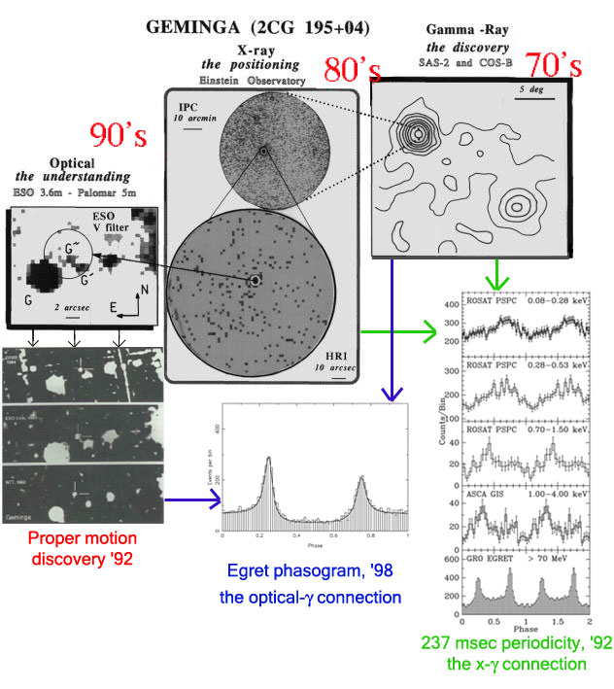
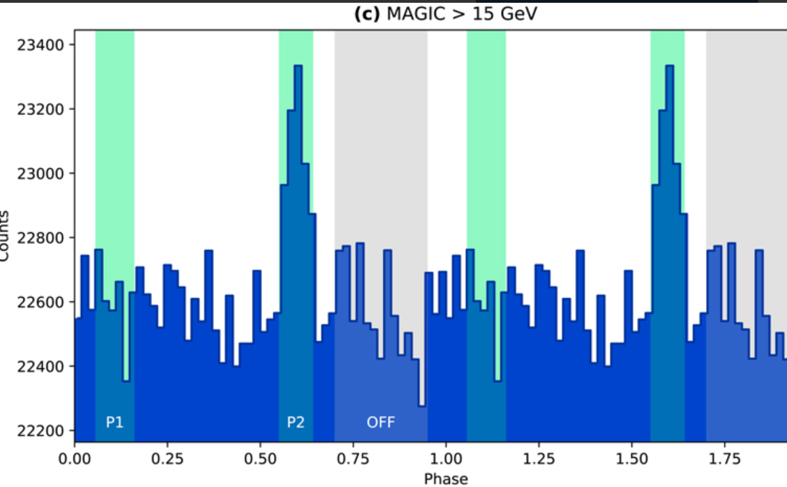
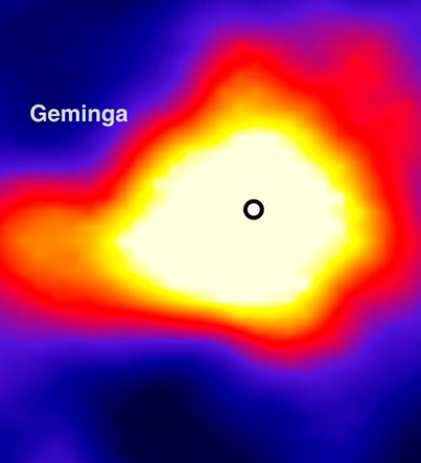
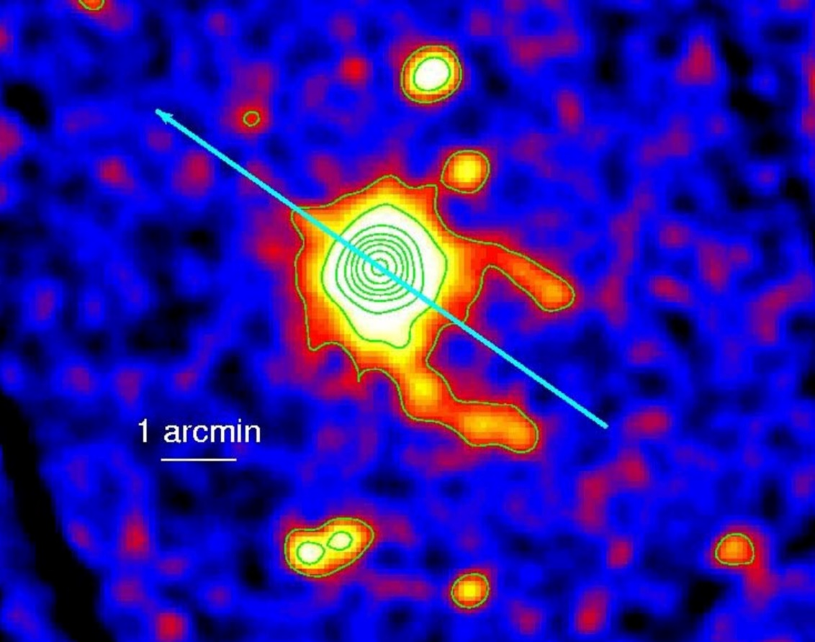
It took 20+ years to understand Geminga.

Slide 6
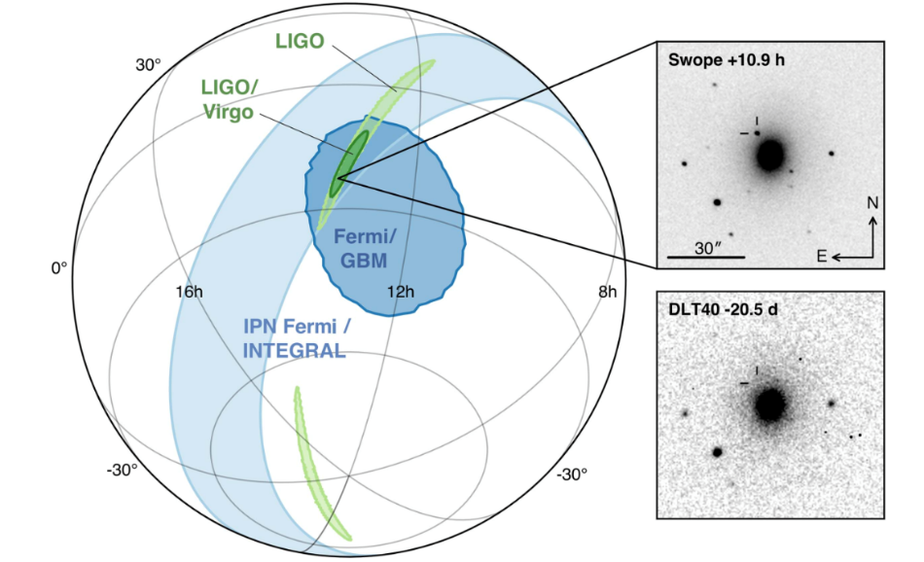
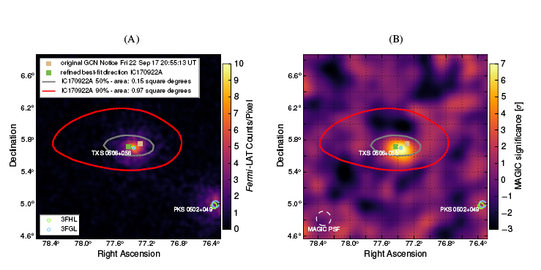
Gamma-photons have been crucial for multimessenger astronomy in 2017

Slide 7
Gamma-rays provide a natural link
photons- ground and space telescopes
cosmic rays
neutrinos
gravitational waves
Which gamma-rays?

Slide 8
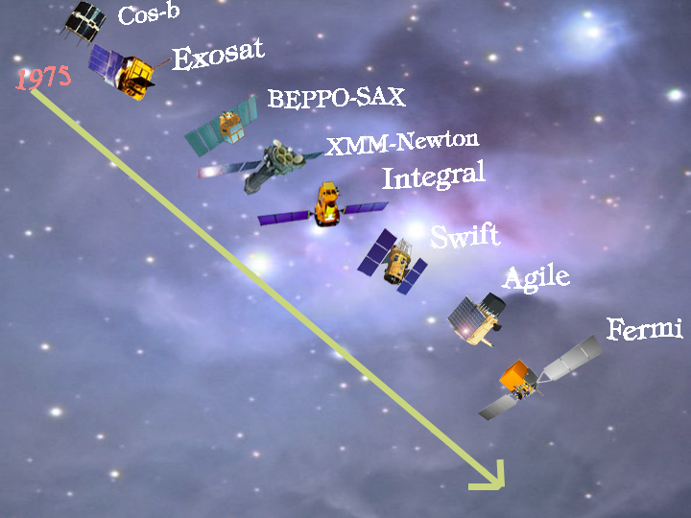
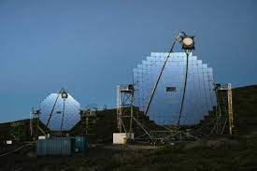
>40 years of Italy &High-Energy Astrophysics
5 missions currently active
today

Slide 9
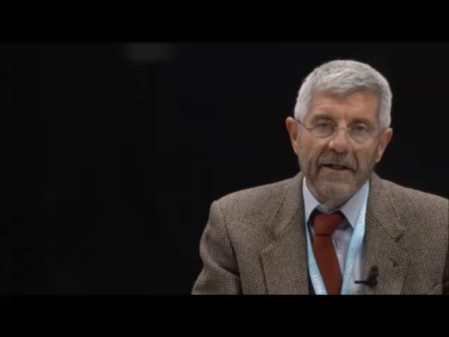
Sept 23
Milano
Nanni’s vision

Slide 10
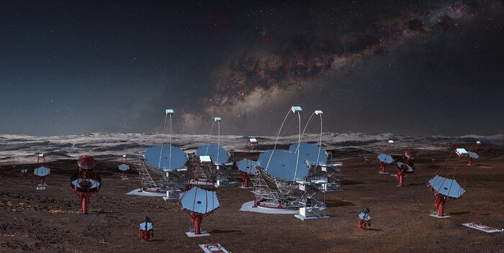
Cherenkov telescope science perspectives

Slide 11
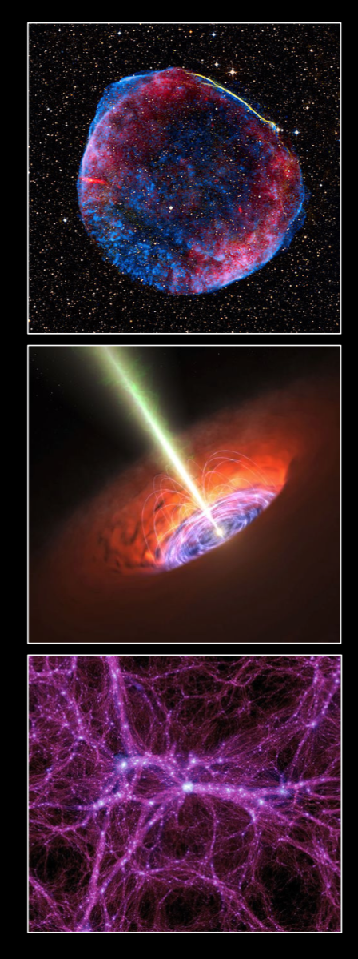
Theme 1: Cosmic Particle Acceleration
How and where are particles accelerated?
How do they propagate?
What is their impact on the environment?
Theme 2: Probing Extreme Environments
Processes close to neutron stars and black holes?
Characteristics of relativistic jets, winds and explosions?
Cosmic voids: their radiation fields and magnetic fields
Theme 3: Physics Frontiers
What is the nature of Dark Matter?
Is the speed of light a constant?
Do axion-like particles exist?

Slide 12
Addressing these questions requires
large and coherent data sets, including
Sky surveys for a census of cosmic accelerators
Deep observations of key objects
Long-term observations of variable sources
Rapid follow-up of transient phenomena
➜ Key Science Projects

Slide 13
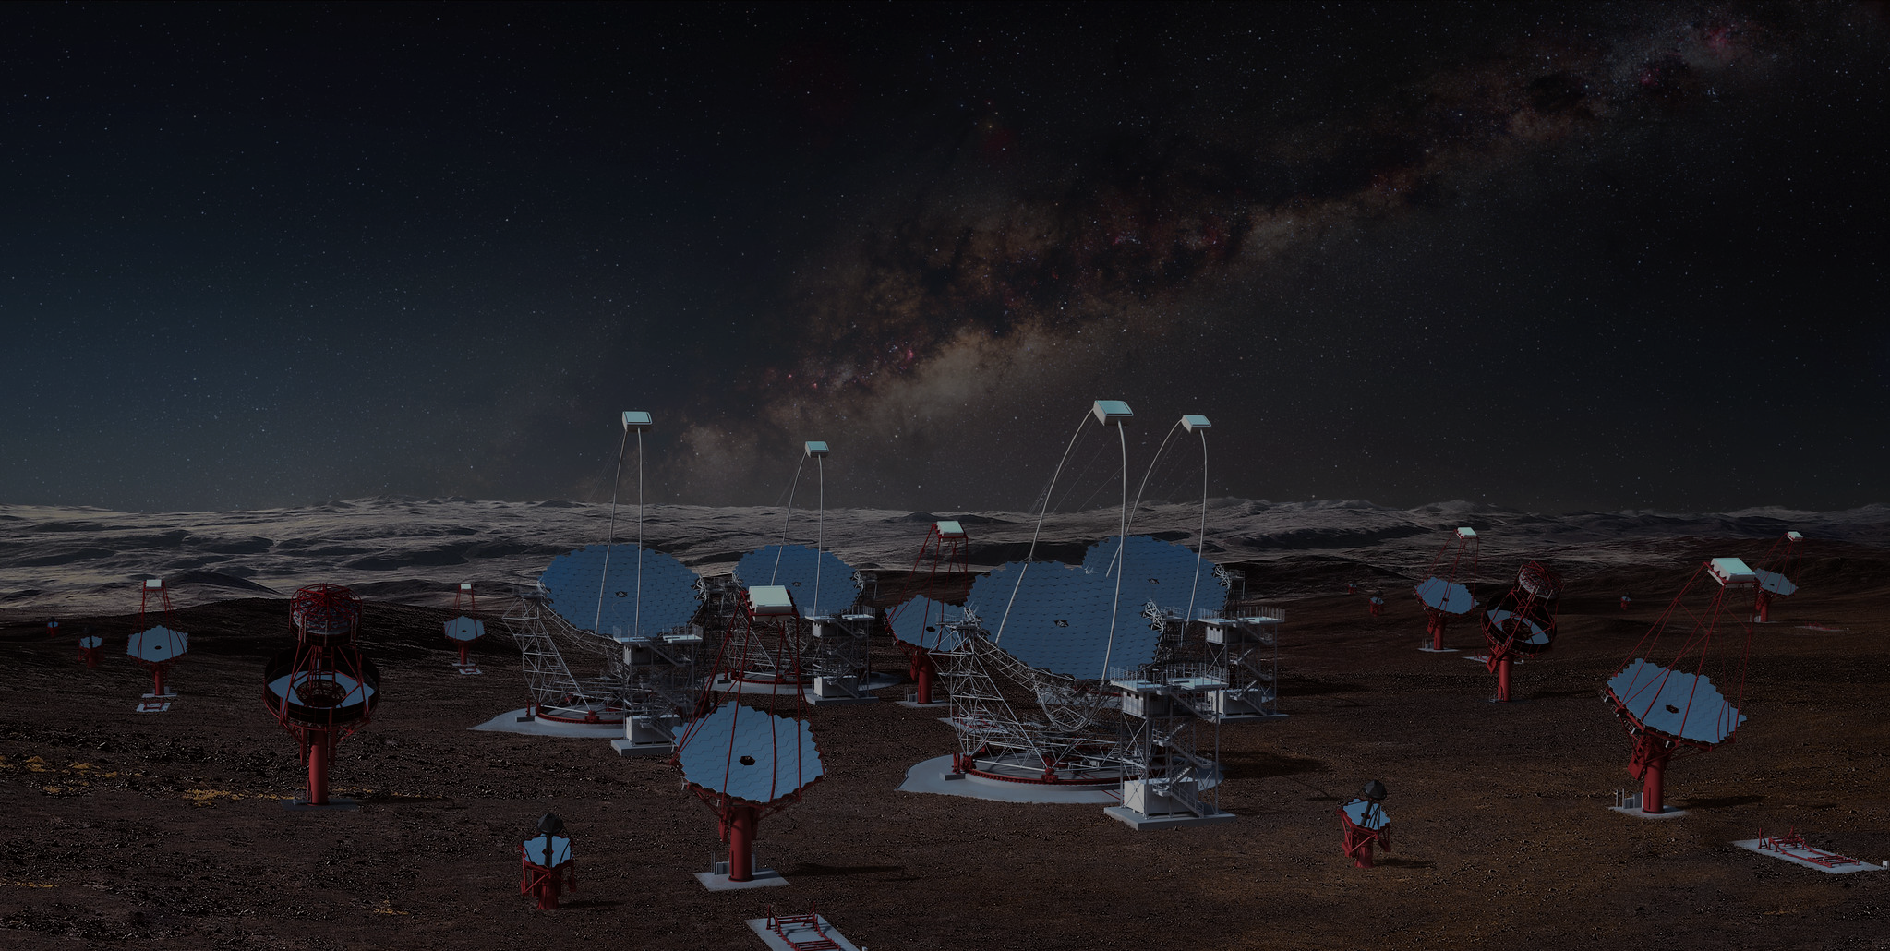
Key science projects
Key Science
Projects
Dark Matter Programme
Galactic Centre
Galactic Plane Survey
Large Magellanic Cloud Survey
Extragalactic Survey
Transients
Cosmic-ray PeVatrons
Star-forming Systems
Active Galactic Nuclei
Cluster of Galaxies
Beyond Gamma Rays
Surveys
Key objects
www.worldscientific.com/worldscibooks/10.1142/10986
www.worldscientific.com/worldscibooks/10.1142/10986

Slide 14
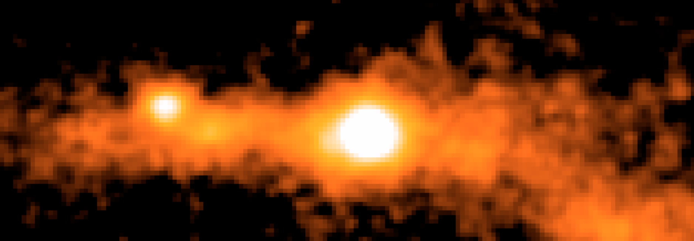
Galactic center & Dark matter KSPs
Weakly Interacting
Dark Matter Particles
τ
τ
Annihilation
cross section
“known” from
Dark Matter
abundance
Characteristic spectral signature
known from particle physics

Slide 15
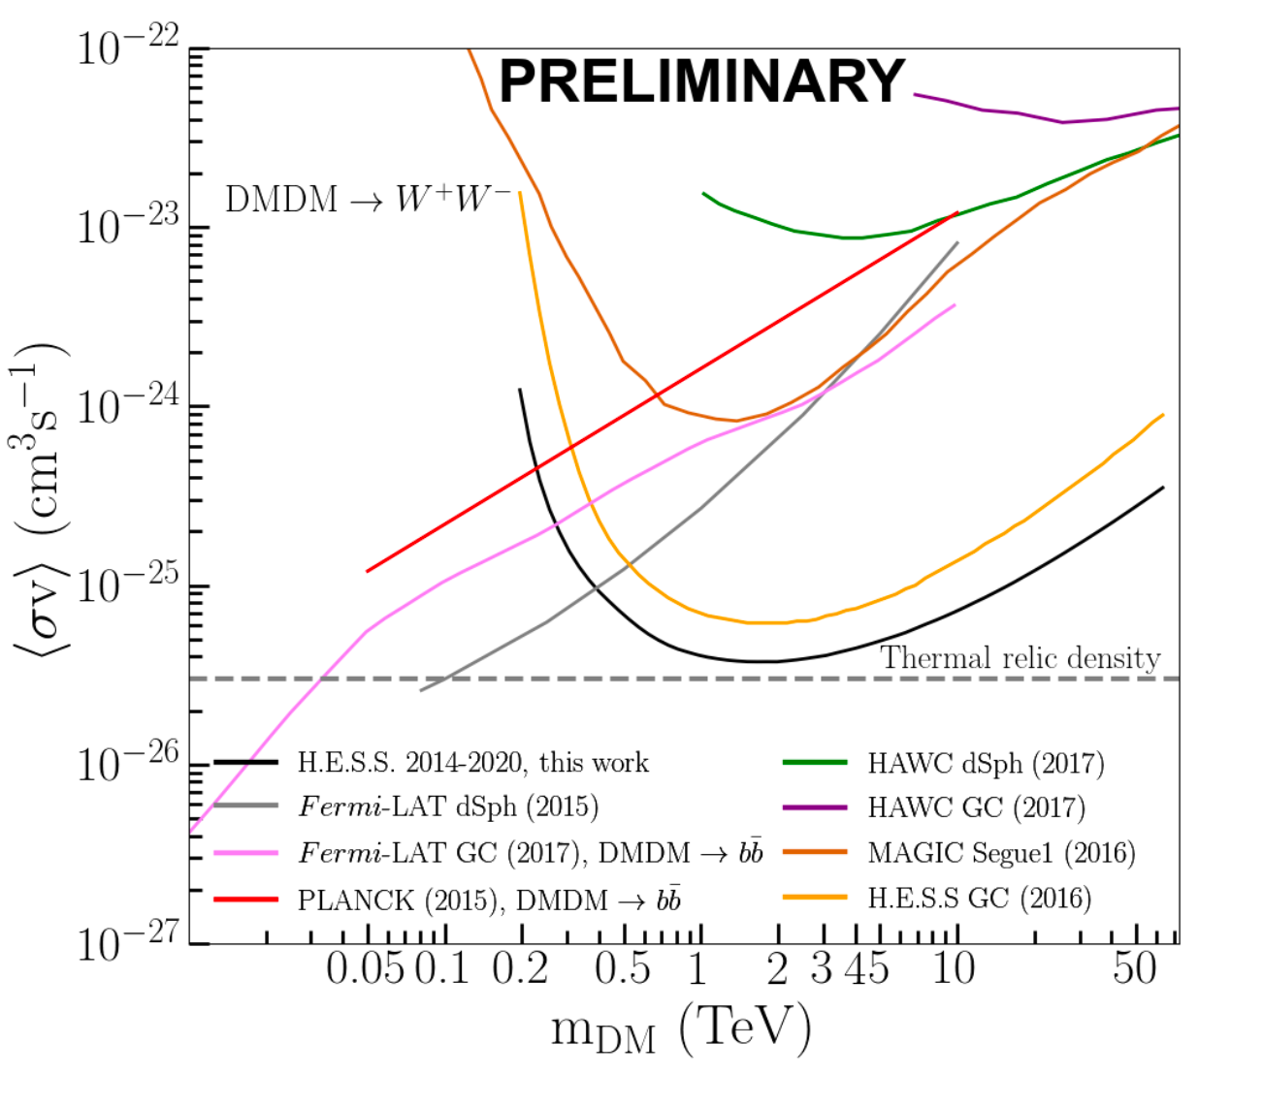
Galactic center & Dark matter KSPs
Weakly Interacting
Dark Matter Particles
Observation time:
about 800 hours
EXCLUDED
τ
τ
Annihilation
cross section
“known” from
Dark Matter
abundance
arXiv:2007.16129
A. Montanari et al, PoS (ICRC2021)511

Slide 16
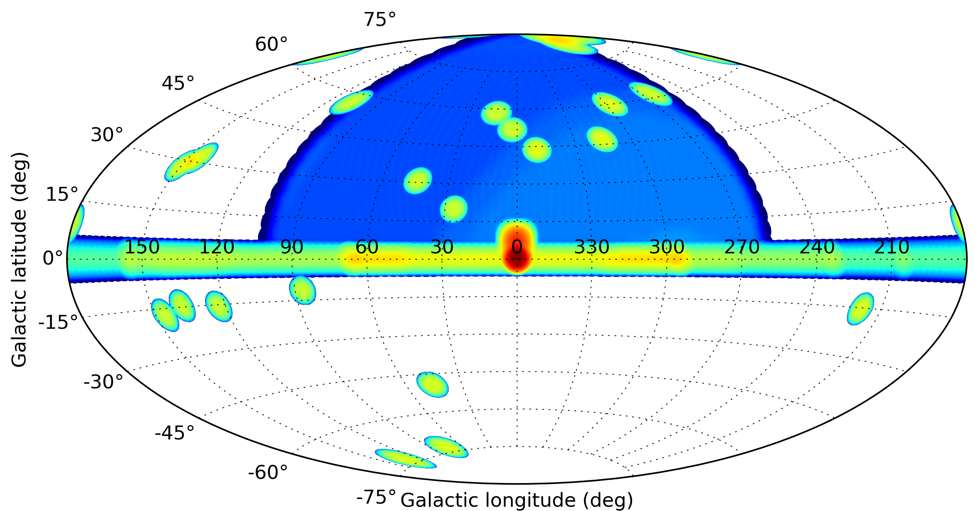
survey KSPs
Extragalactic
Survey
Galactic Centre
Survey
Galactic Plane
Survey
AGN
Monitoring
Exposure
1st CTA Data Challenge

Slide 17
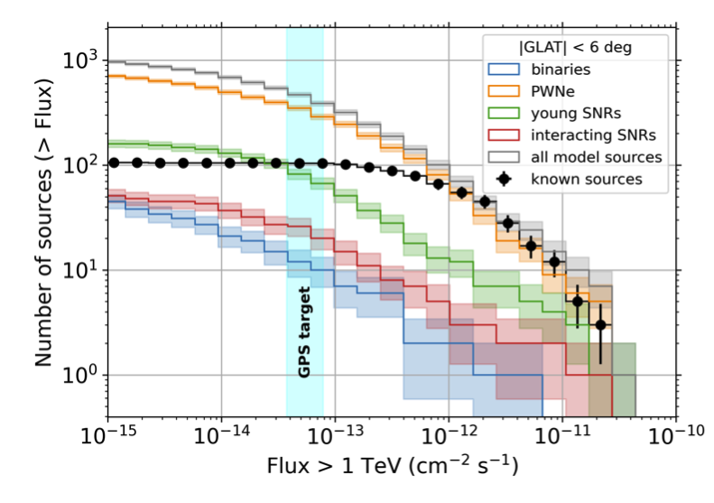
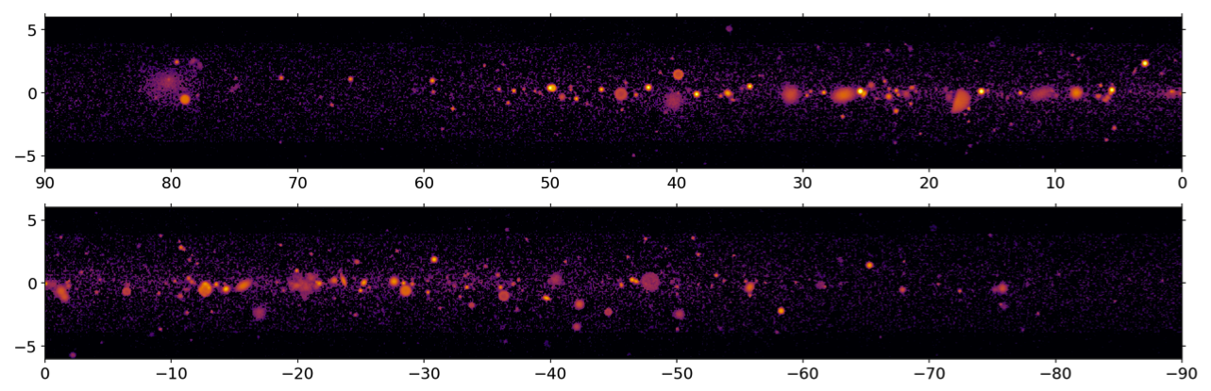
Galactic plane survey
PoS(ICRC2021)886
angular resolution
expect about
500 source detections
Observation time:
about 1600 hours
about 1600 h of observing time
HESS field of view
CTA

Slide 18
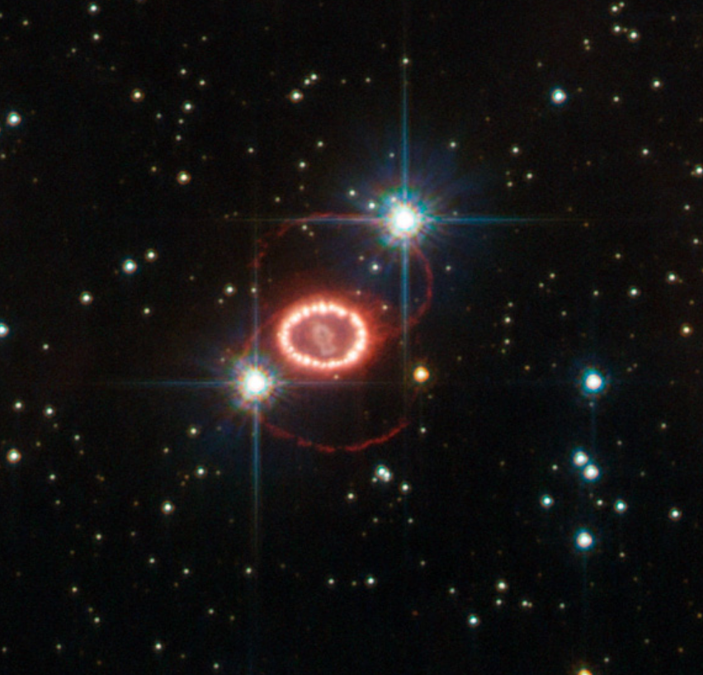
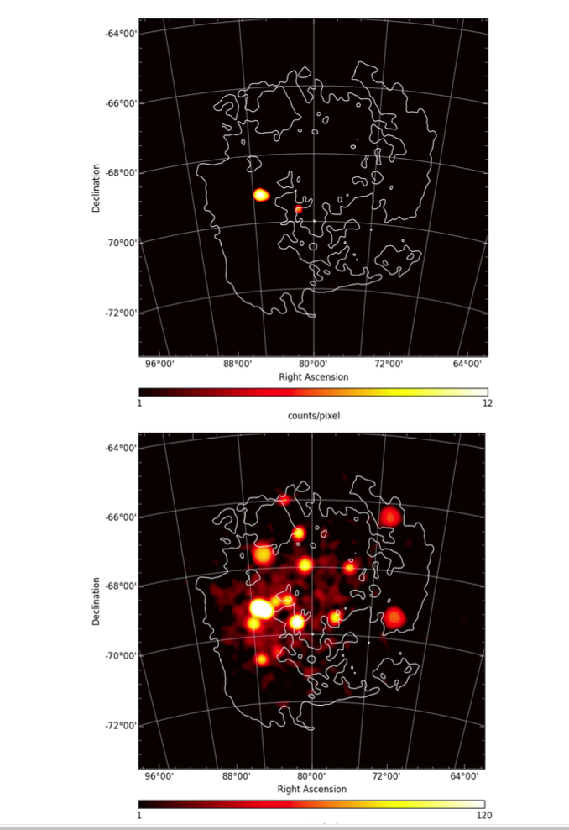
Large magellanic cloud
SN 1987a
Observation time:
about 300 hours
H.E.S.S.
CTA

Slide 19
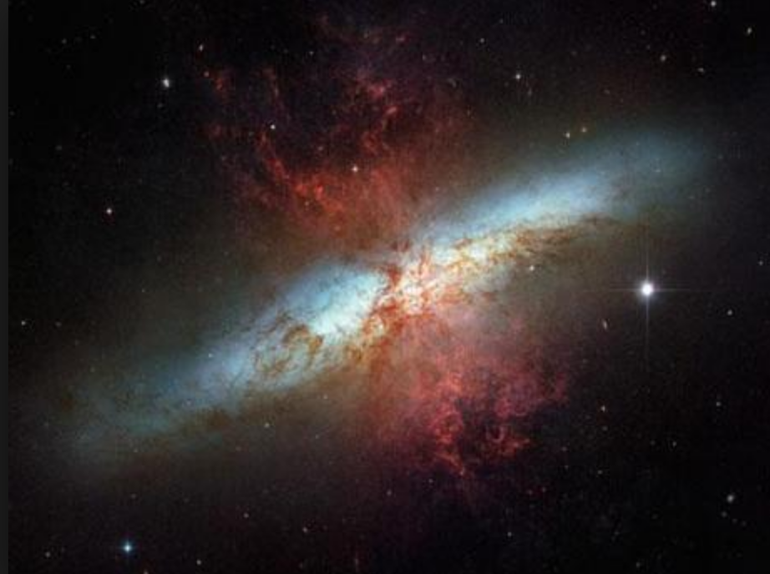
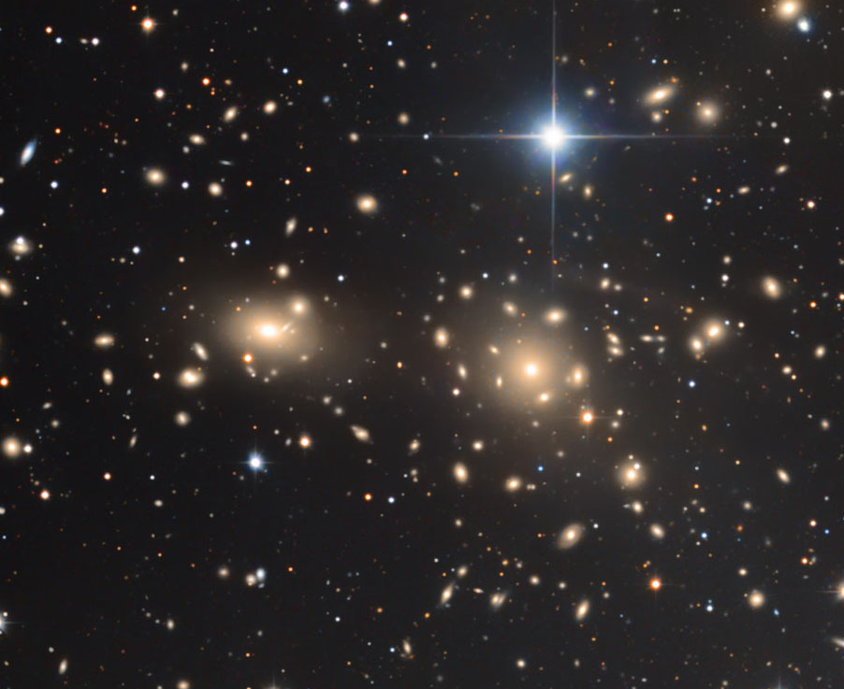
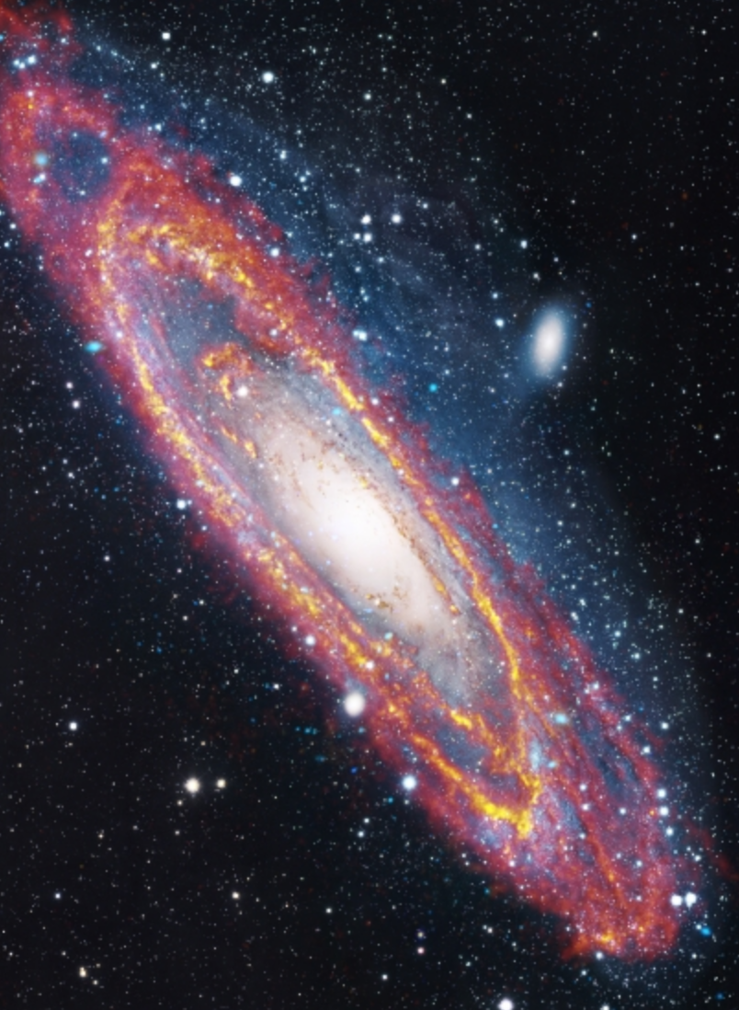
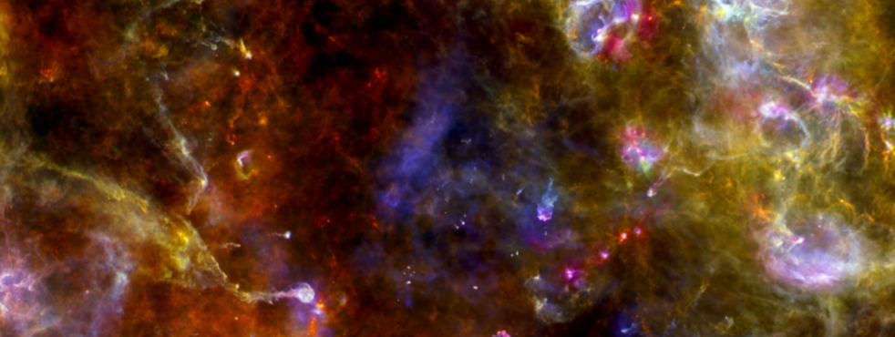
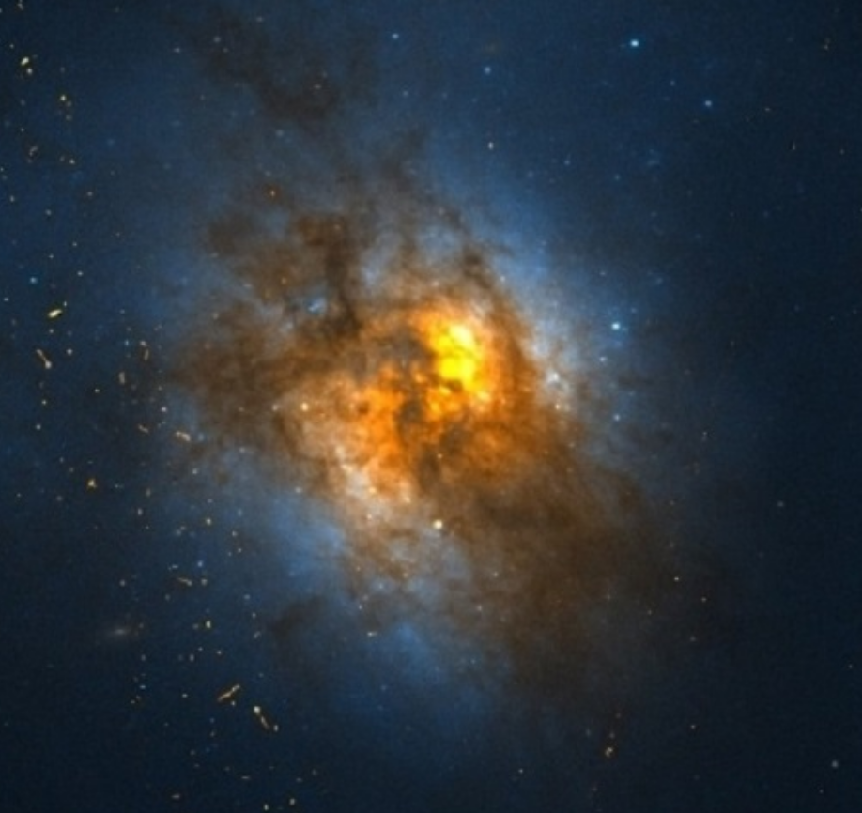
a census of cosmic particle accelerators
M82
Coma Cluster
M31
Cygnus
Region
Hubble Heritage Team
R. Carroll,
R. Gendler
B. Franke
Arp 220
J.Fritz,
W. Pietsch,
R. Gendler
across all
cosmic scales
Univ. of Oklahoma
& NASA

Slide 20

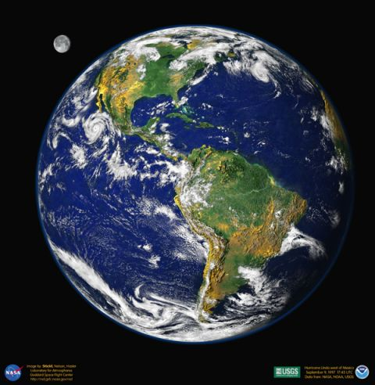
AGN KEY SCIENCE PROJECT
What is the jet made of?
How is it launched?
What causes the variability?
Long-term monitoring of selected AGN over 10 years
Follow-up of flaring AGN
High-quality measurement of selected AGN spectra
Total observation time:
about 3000 hours

Slide 21
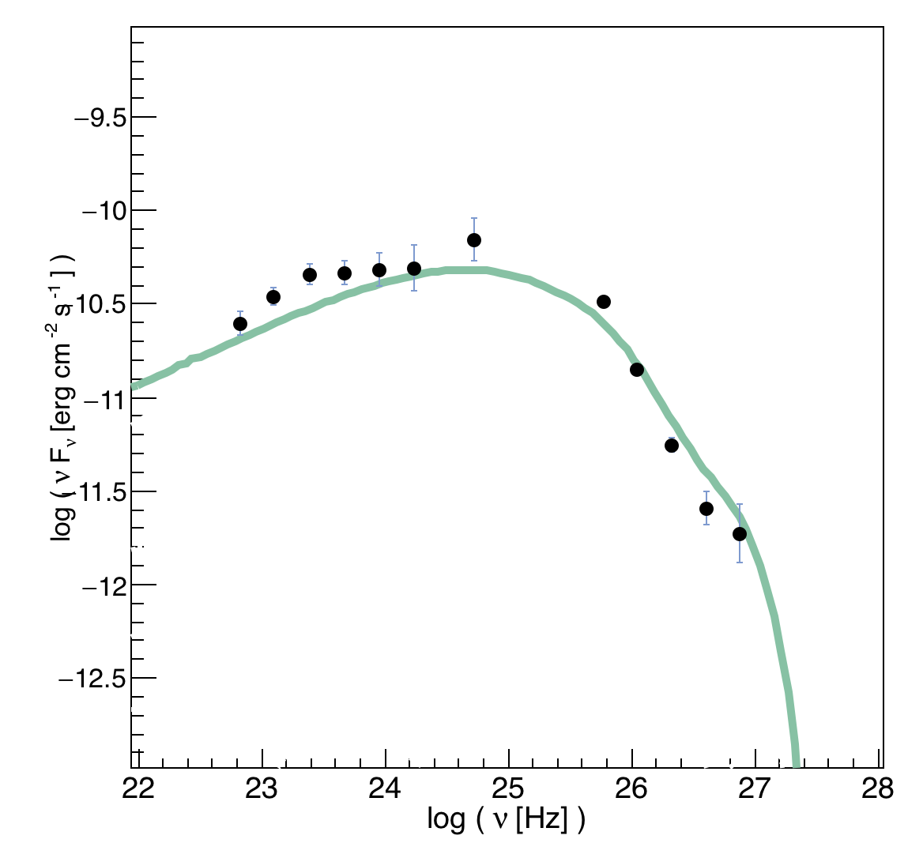
AGN KEY SCIENCE PROJECT
What is the jet made of?
How is it launched?
What causes the variability?
from: Science with CTA
www.worldscientific.com/worldscibooks/10.1142/10986
Electron-Positron Jet
Nuclei
in Jet
Nuclei
in Jet
Current data

Slide 22
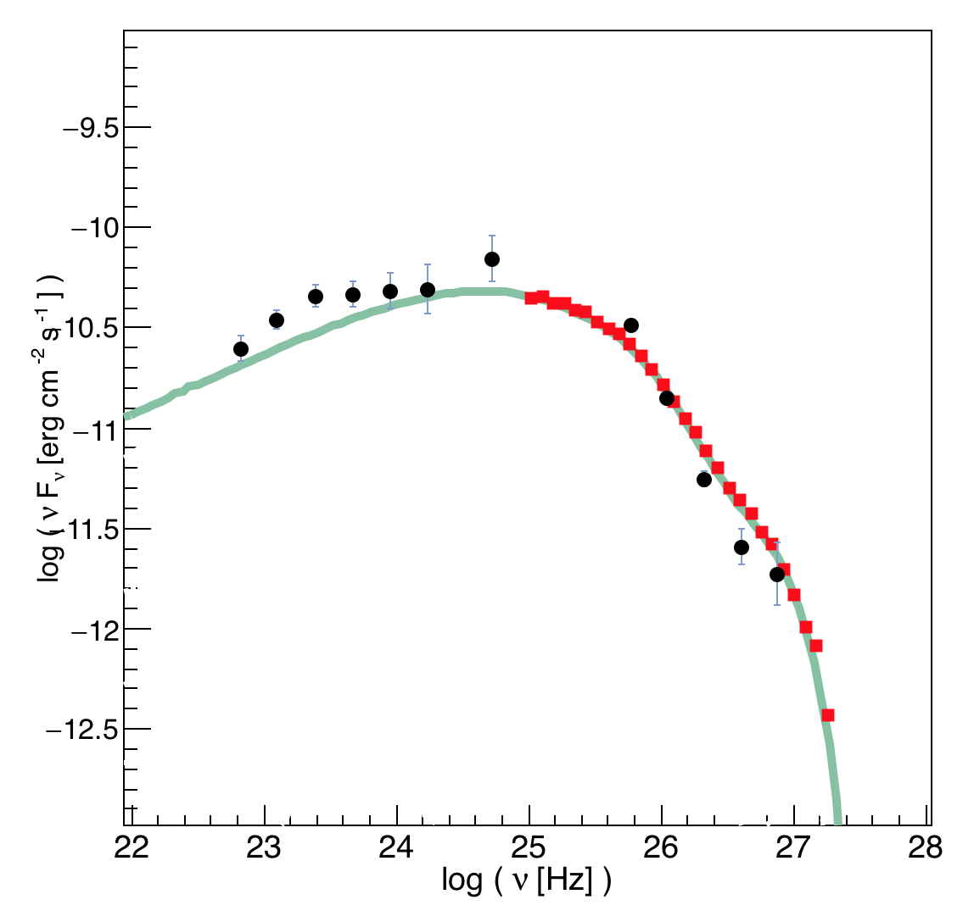
AGN KEY SCIENCE PROJECT
What is the jet made of?
How is it launched?
What causes the variability?
from: Science with CTA
www.worldscientific.com/worldscibooks/10.1142/10986
Electron-Positron Jet
Electron-Positron Jet
Nuclei
in Jet
Nuclei
in Jet
Nuclei
in Jet
Nuclei
in Jet
CTA
Current data

Slide 23
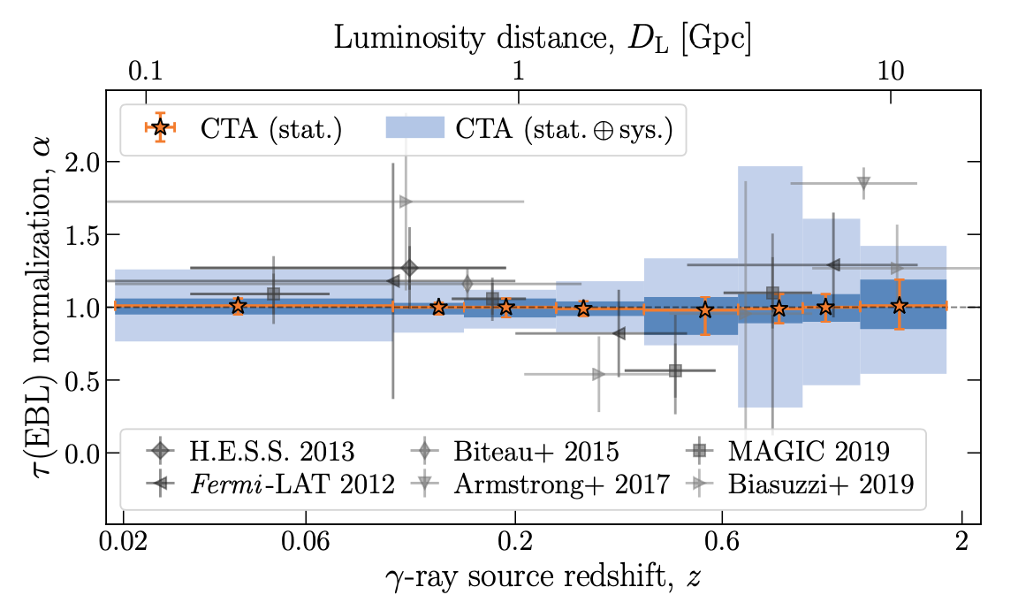
Photon propagation:
Extragalactic Background light
arXiv:2010.01349
e⁺
starlight
photon
TeV gamma ray
e–
Absorption depends on the
intensity of background light

Slide 24
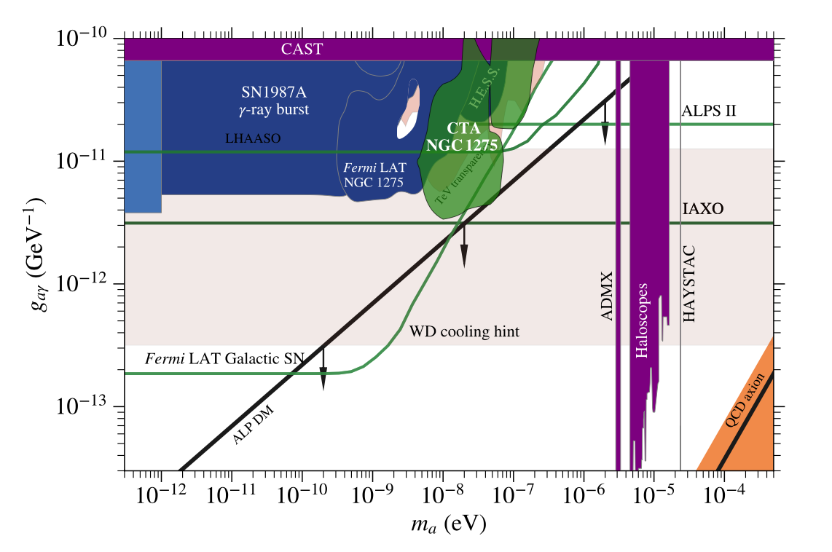
Photon propagation: photon-axion oscillations
arXiv:2010.01349
Axion
TeV gamma ray
B

Slide 25
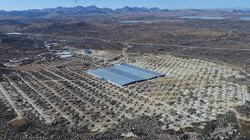
Key science projects
Key Science
Projects
Dark Matter Programme
Galactic Centre
Galactic Plane Survey
Large Magellanic Cloud Survey
Extragalactic Survey
Transients
Cosmic-ray PeVatrons
Star-forming Systems
Active Galactic Nuclei
Cluster of Galaxies
Beyond Gamma Rays
Surveys
Key objects
March 2019
www.worldscientific.com/worldscibooks/10.1142/10986
www.worldscientific.com/worldscibooks/10.1142/10986

Slide 26
In preparing for battle
I have always found that plans are useless but planning is indispensable.
Dwight D. Eisenhower

