Slide 1
Status of
Jim Hinton
MPIK, Heidelberg
Jim Hinton
www.swgo.org
for the SWGO Collaboration

Slide 2
Very high energy
gamma-ray
~100% duty-cycle
Steradian field of view
Modest precision
Modest collection area
~15% duty-cycle
~4 degree field of view
High precision
Large collection area

Slide 3
Very high energy
gamma-ray

Slide 4
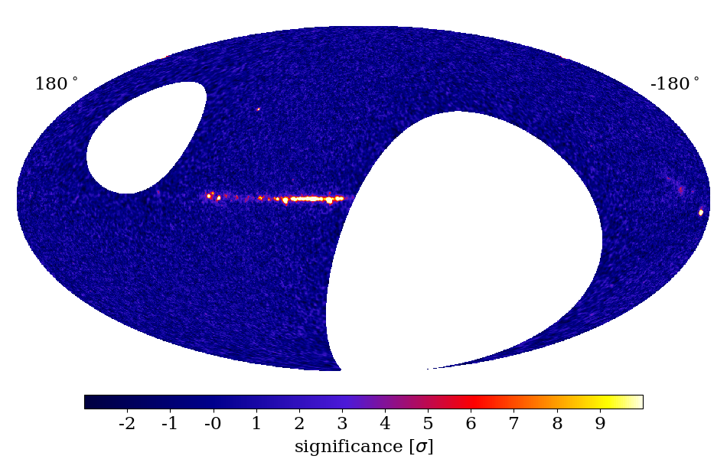
HAWC
LHAASO
4
For 0.4º sources

Slide 5
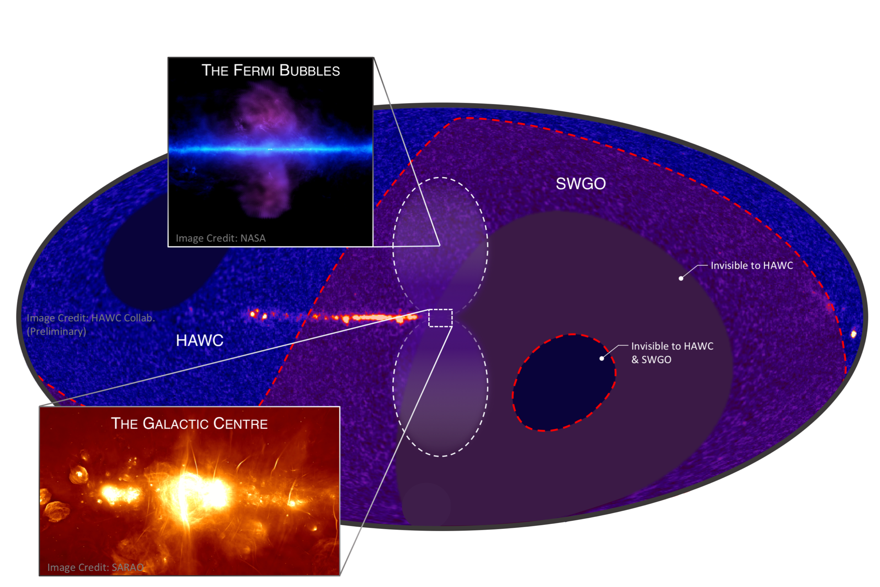

Slide 6
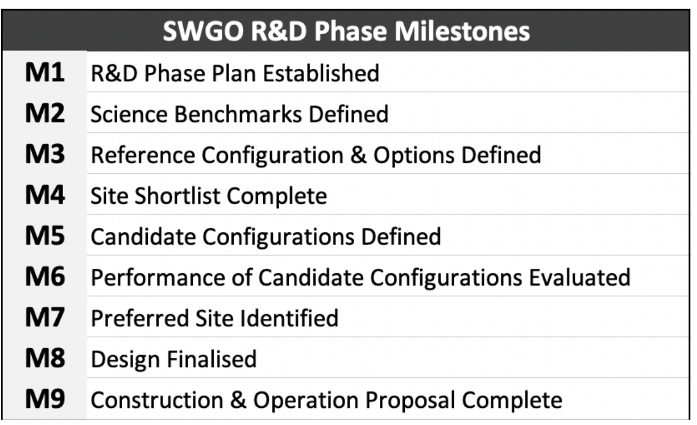
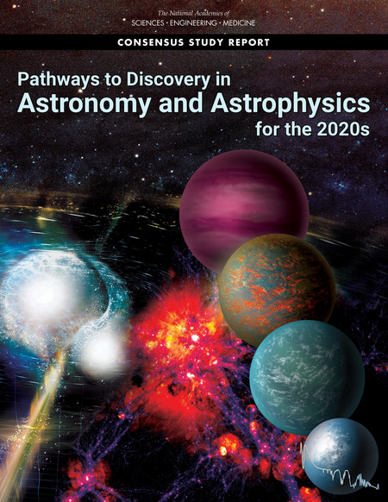
Status & Plan
R&D Phase
Kick off meeting Nov 2019
Expected completion 2023
Site and Design Choices made
Then:
Preparatory Phase
Detailed construction planning
Engineering Array
(Full) Construction Phase
2026+
✓
✓
✓
✓
20M$
SWGO partners
47 institutes in 12 countries*
+ supporting scientists

Slide 7
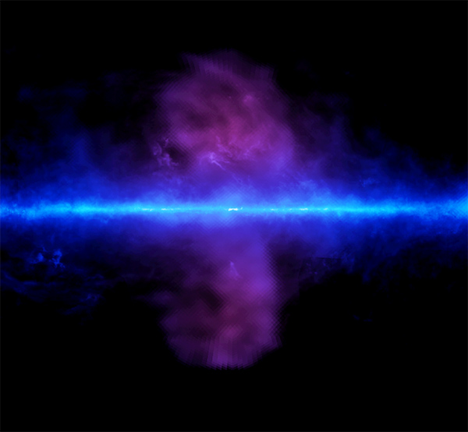
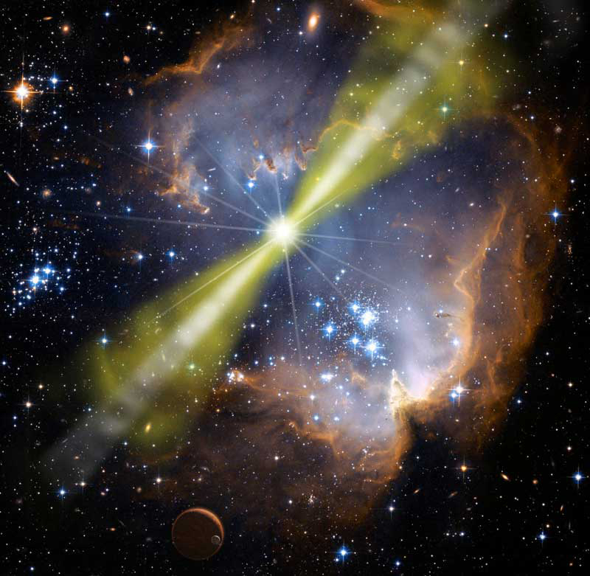
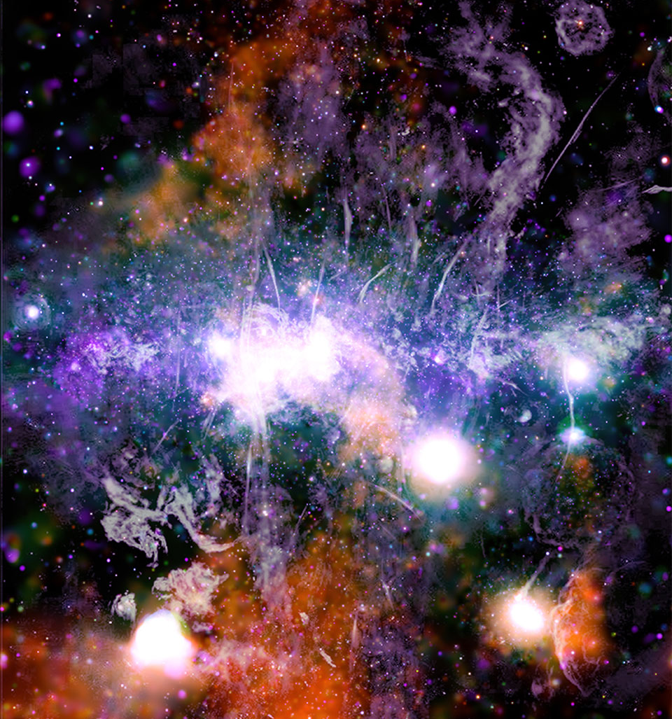
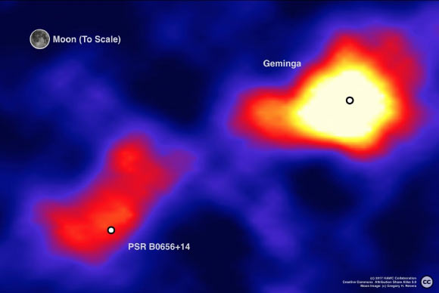
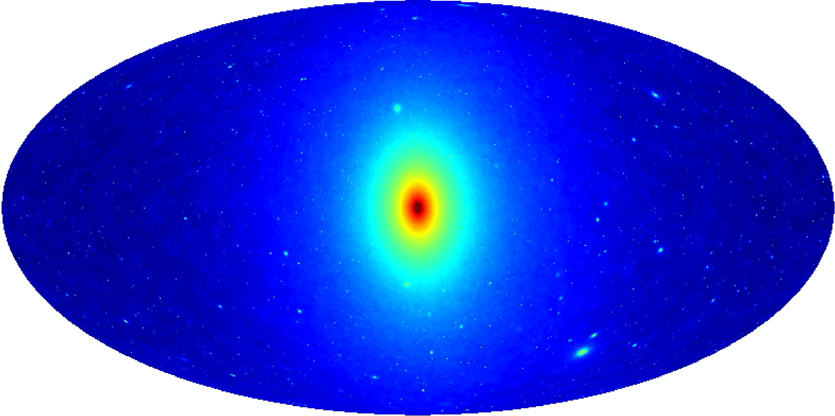
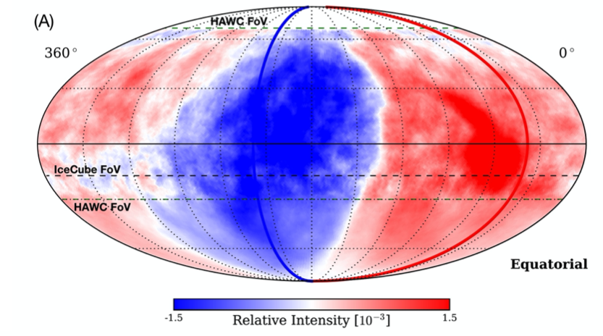

Slide 8
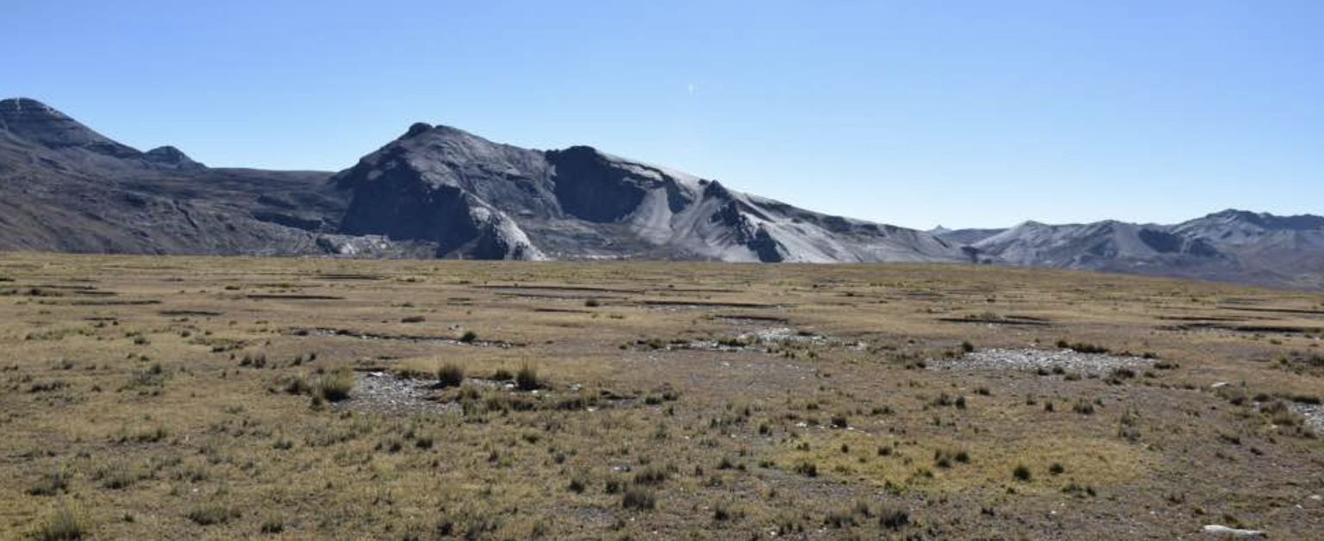
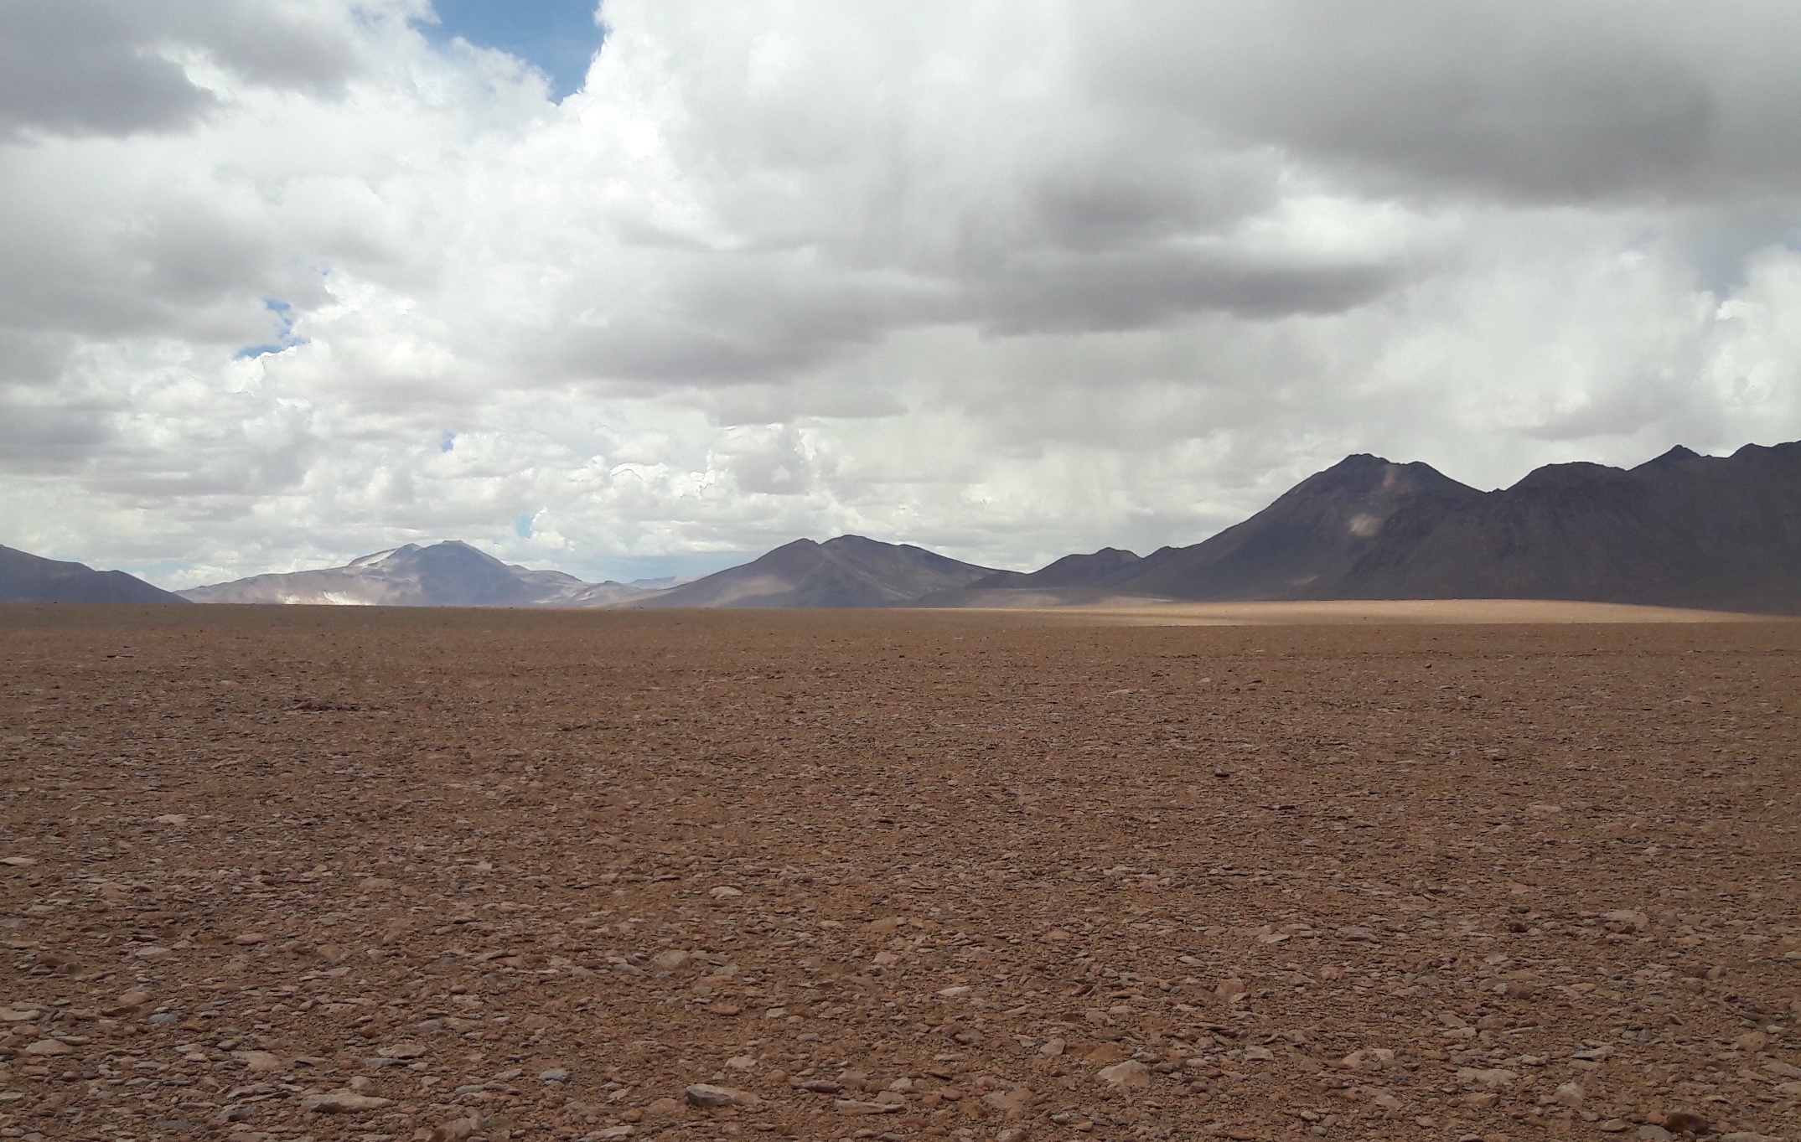
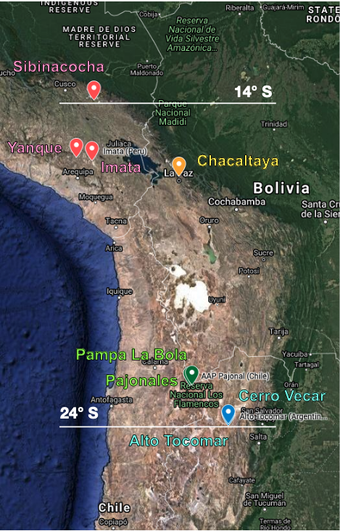
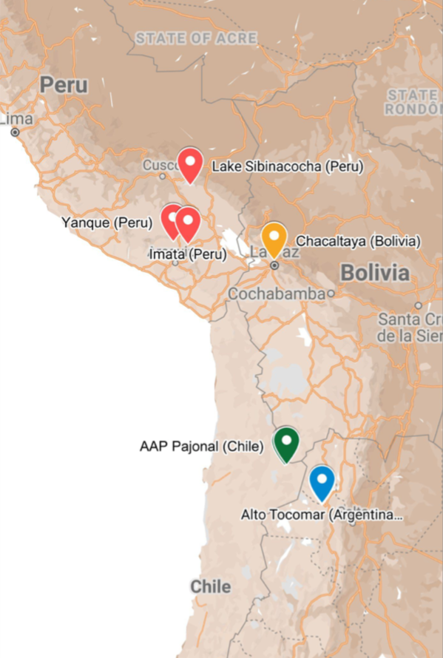
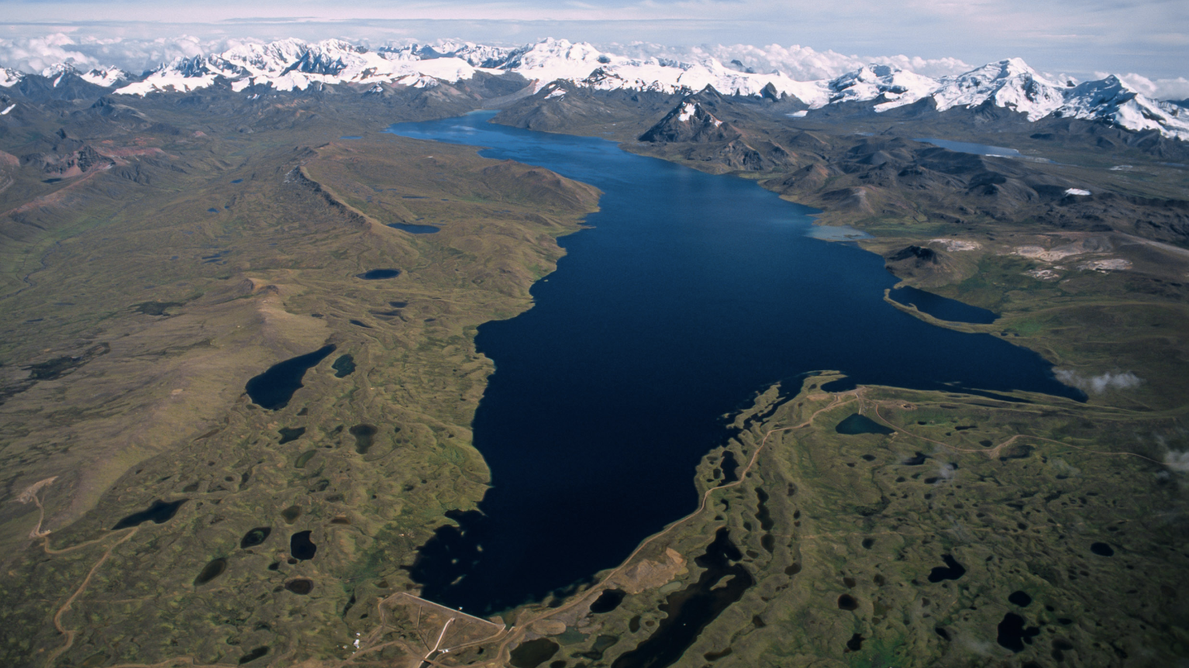
Bolivia 4.7k
Chile 4.8 k
13º S
24º S
Argentina 4.8 k
Peru 4.9 k

Slide 9
Bolivia 4.7k
Chile 4.8 k
13º S
Site shortlisting: September 2022
Site team visits: October 2022
Preferred Site identified: Autumn 2023
On-site prototyping activities: from 2022
24º S
Argentina 4.8 k
Peru 4.9 k

Slide 10
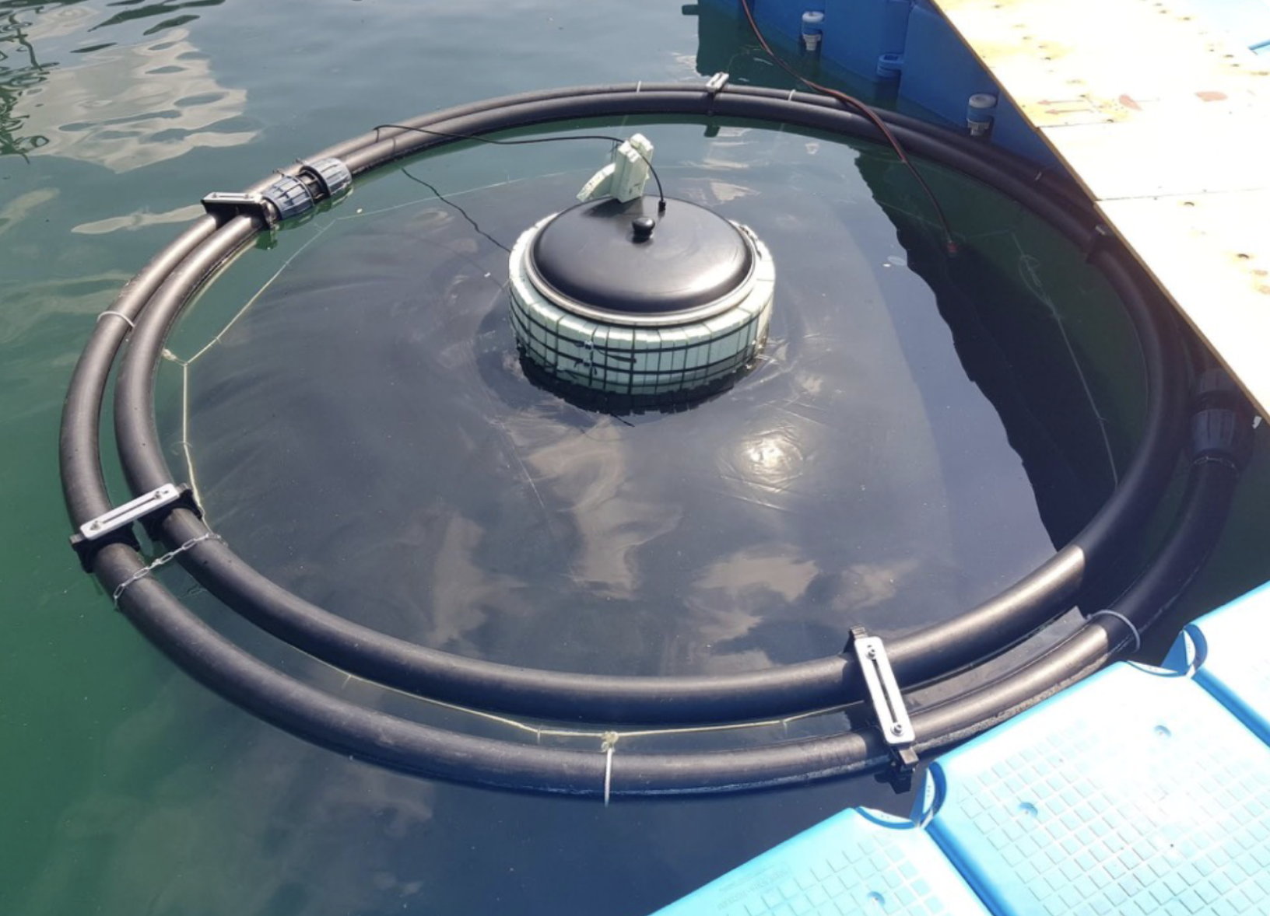
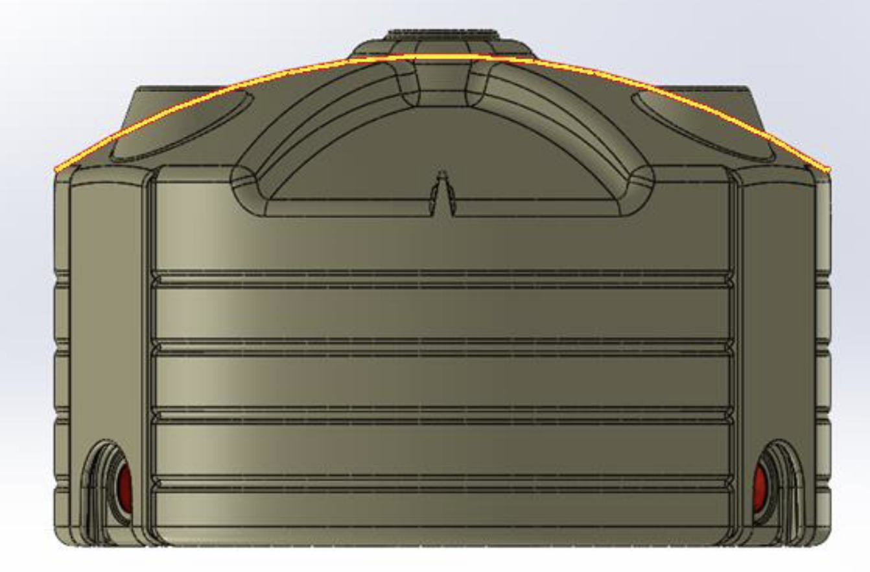

Slide 11
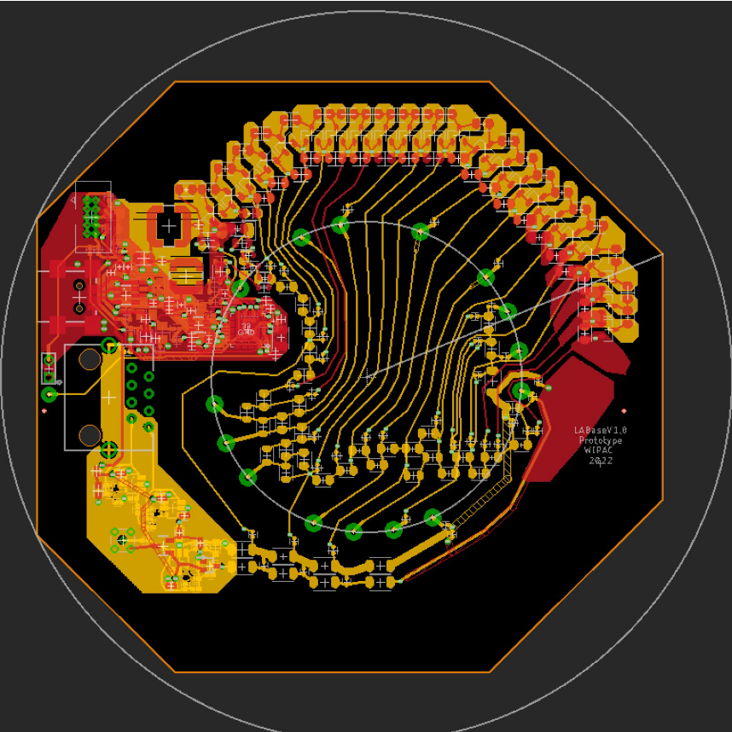
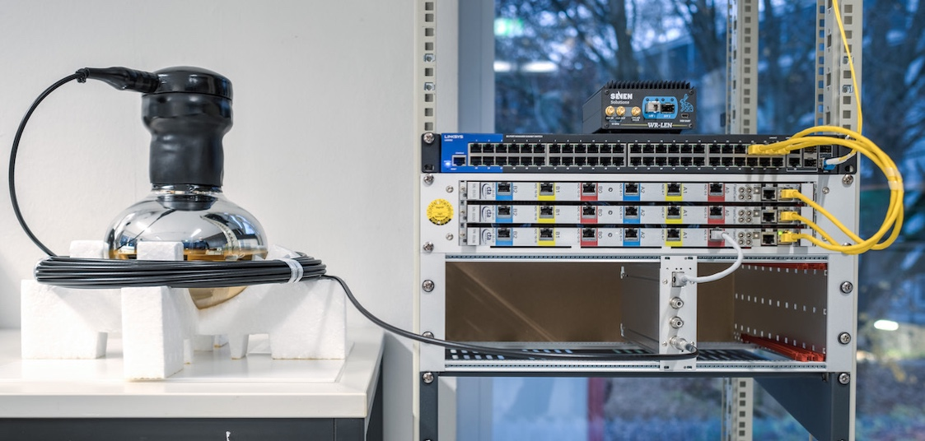
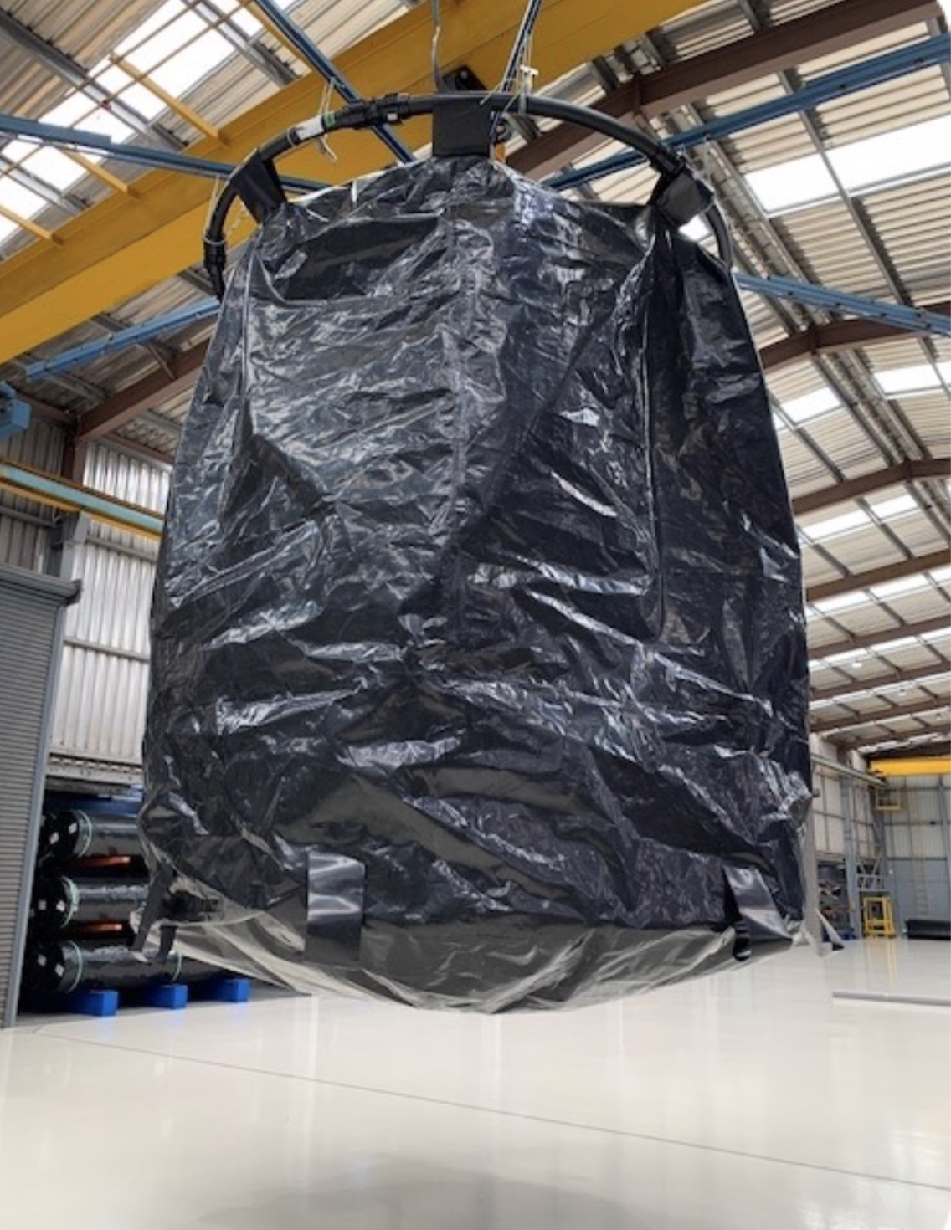
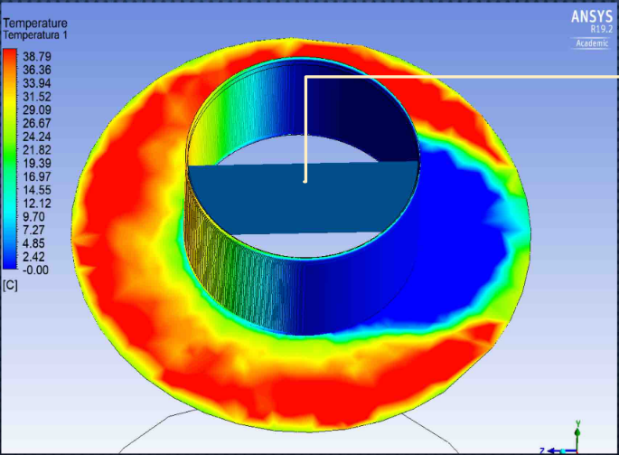
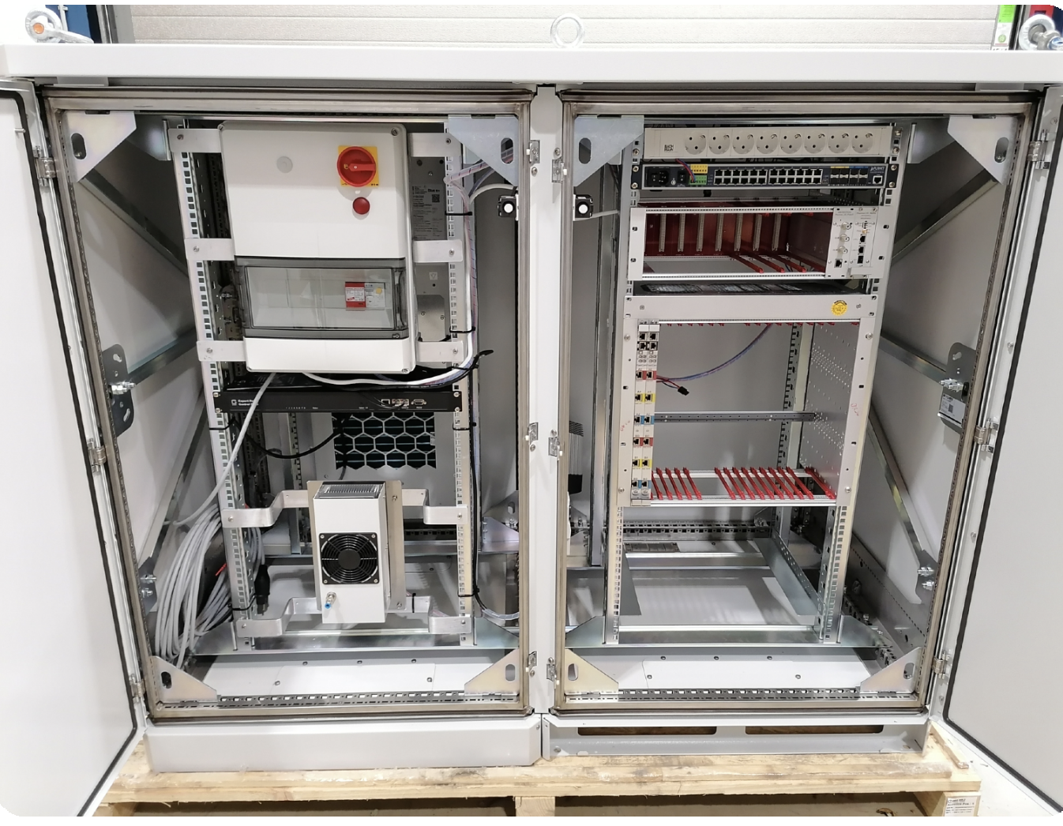
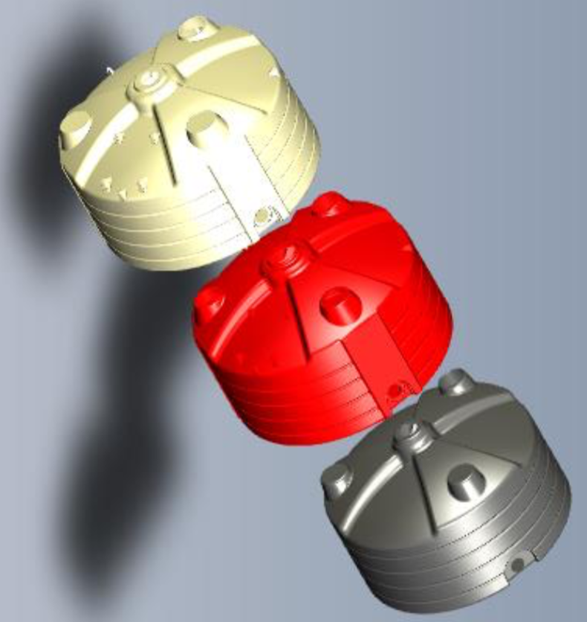
*cooperation with KM3NeT,
MoU in prep.

Slide 12
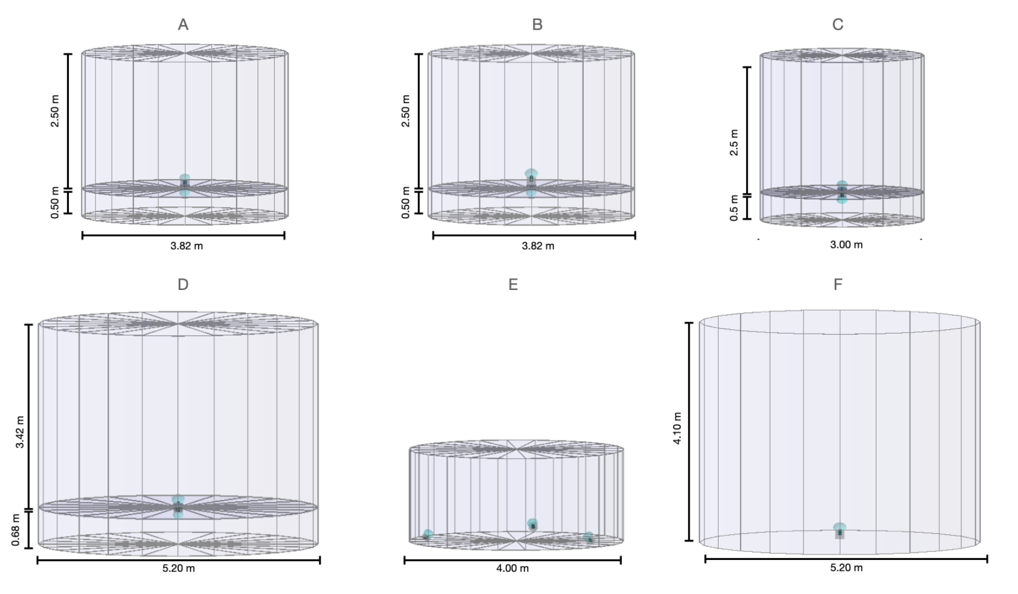
1.7 m

Slide 13
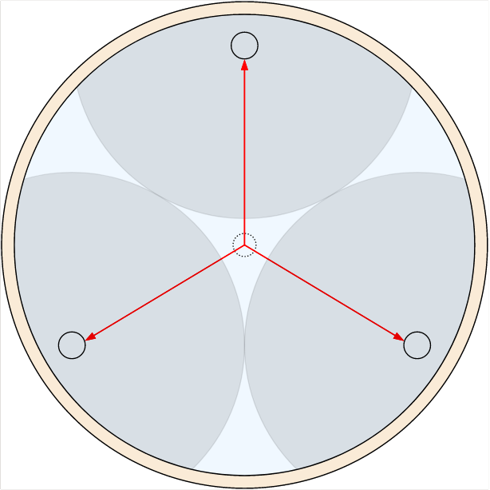
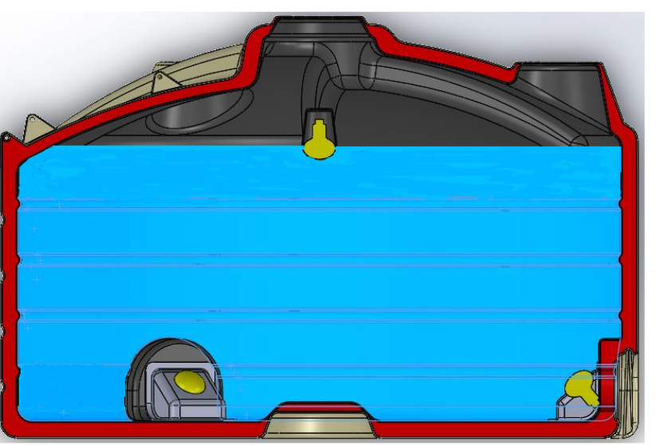
Muon identification a key element of background rejection –
two approaches under evaluation
E
1.7 m

Slide 14
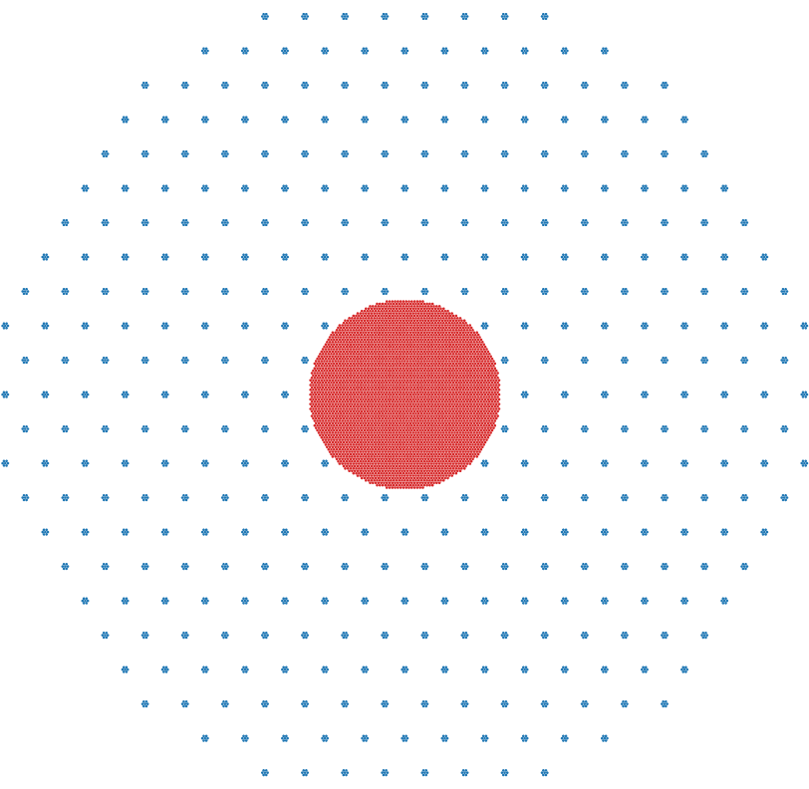
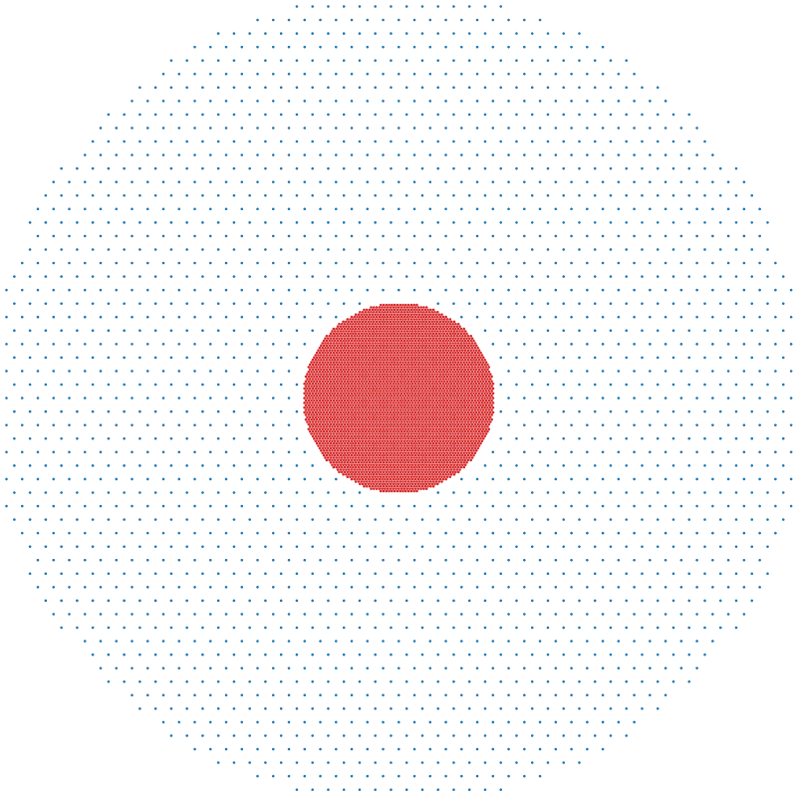
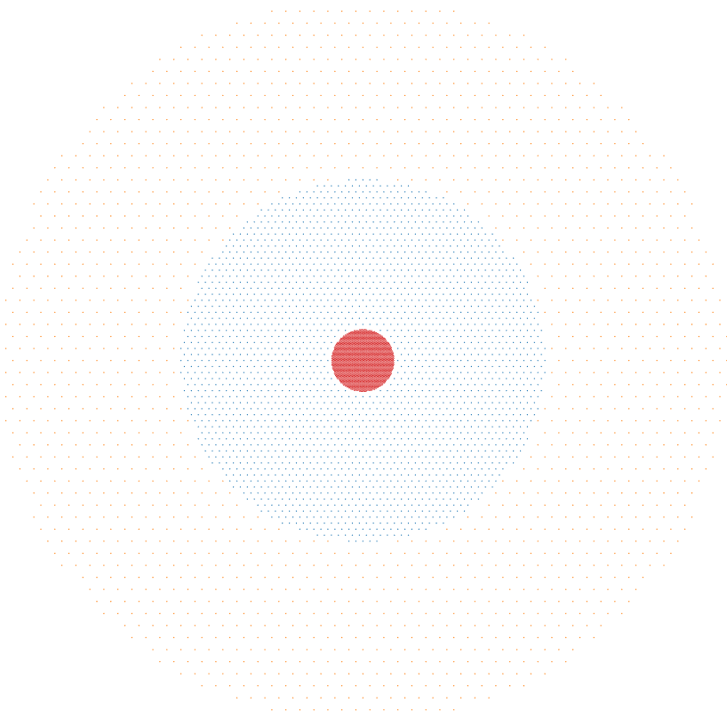
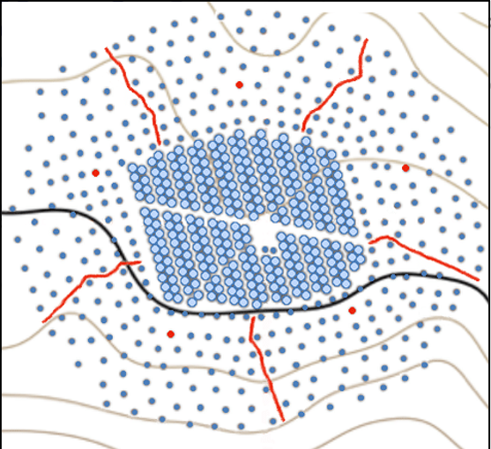
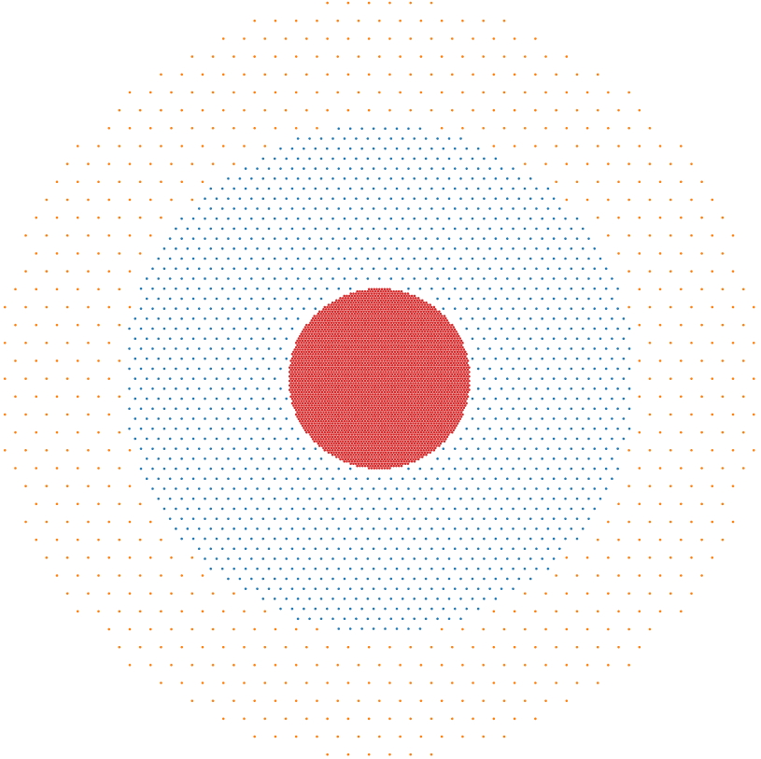
80% FF, 80,000 m²
A3
A5
A2
A1
A7
LHAASO
HAWC
A4
2.5% FF
A6
0.6% FF
Equal nominal cost arrays, similarly B1, C1, D1, …, E4 (13 total)

Slide 15
A1
600 GeV
14 TeV
500 m
35 degree zenith angle
Colour = time
Larger detector array and increased altitude w.r.t. HAWC
Very precise measurements possible even below 1 TeV

Slide 16
SWGO ‘Strawman’
(scaled HAWC)
1 year
CTA South 50 h
LHAASO 1 y

Slide 17
SWGO ‘Strawman’
(scaled HAWC)
1 year
Low E enhancement
CTA South 50 h
LHAASO 1 y

Slide 18
SWGO ‘Strawman’
(scaled HAWC)
1 year
Improved PSF and BG rejection
CTA South 50 h
LHAASO 1 y

Slide 19
SWGO Phase Space Exploration
1 year*
km²+
outer array
CTA South 50 h
LHAASO 1 y
*planned operation time >=5 years

Slide 20
1908
CTA South 50 h
Crab
LHAASO 1 y

Slide 21
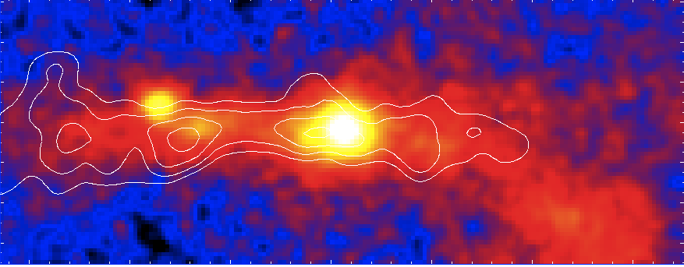
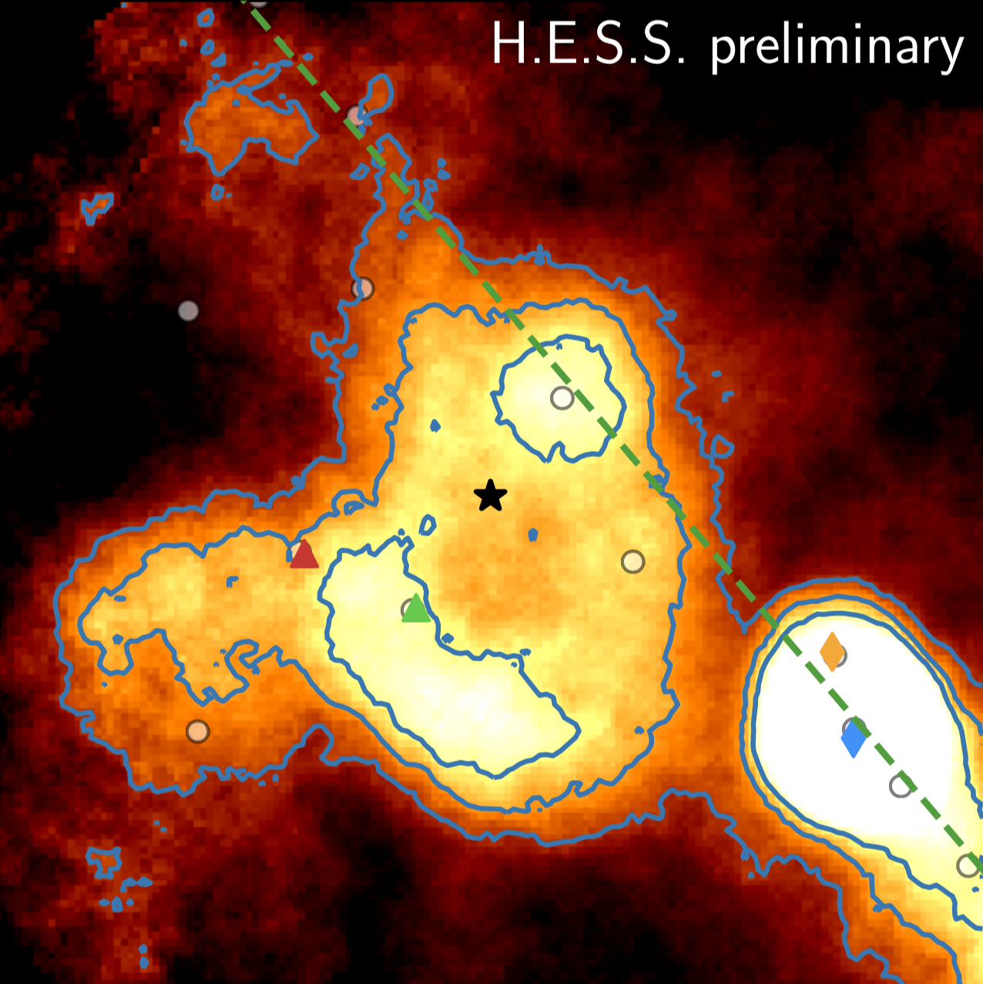
Central Molecular Zone
Westerlund I
CMZ (central)
Westerlund I
1908
CTA South 50 h
Crab
LHAASO 1 y

Slide 22
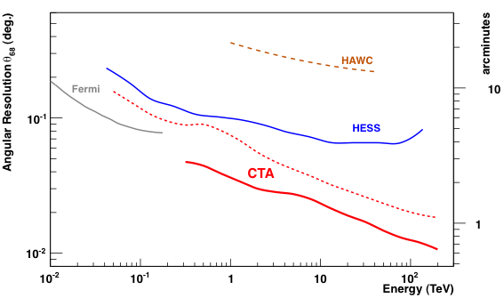
Resolution?
LHAASO KM2A
Current IACTs
o
Current WCDs
SWGO
Inner
Array
CTA
Goal → unprecedented resolution for a wide field VHE-UHE instrument

Slide 23
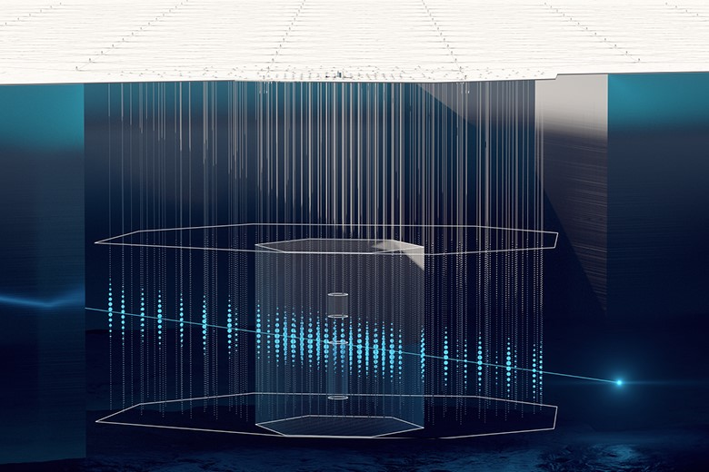
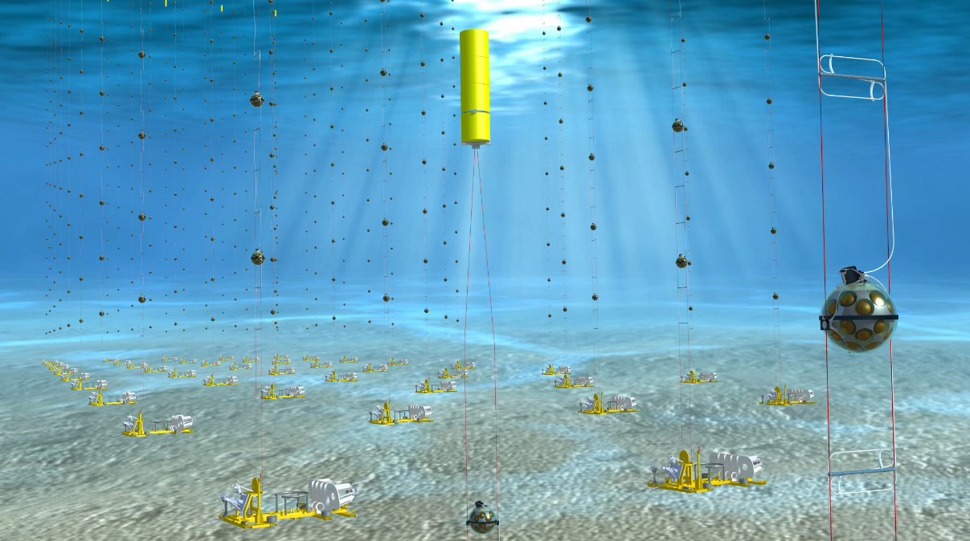
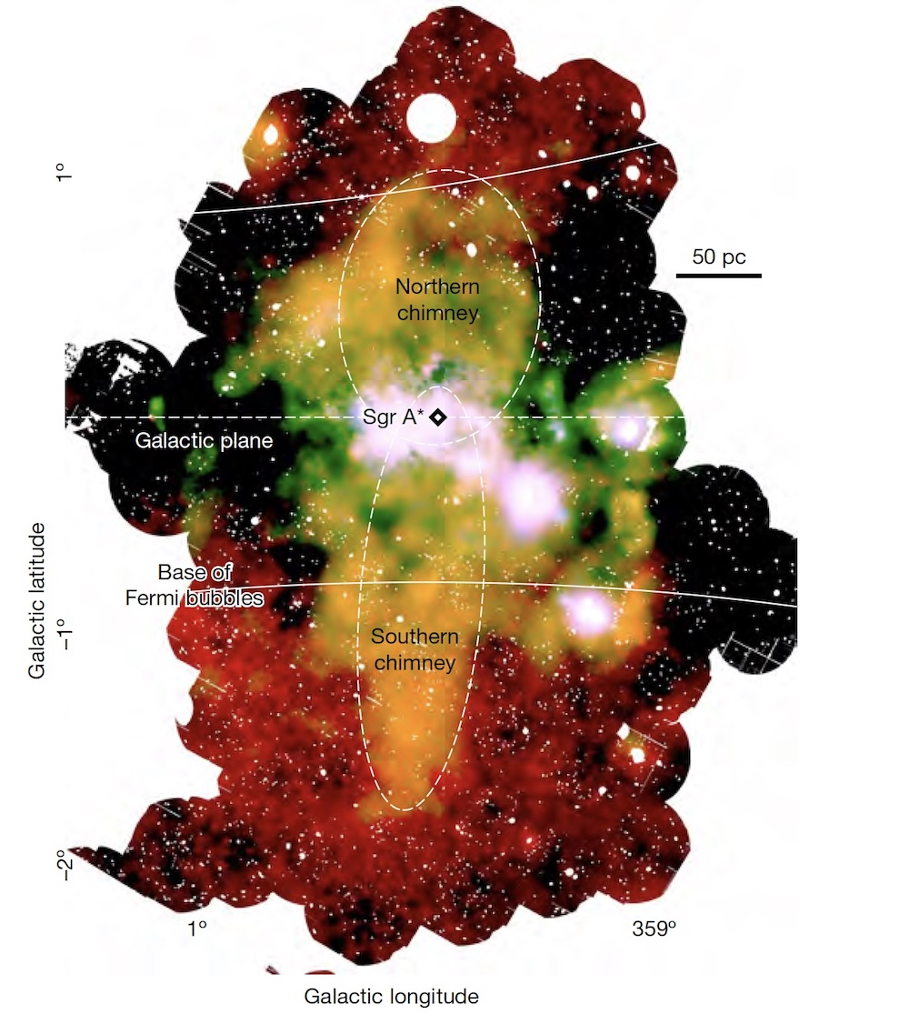
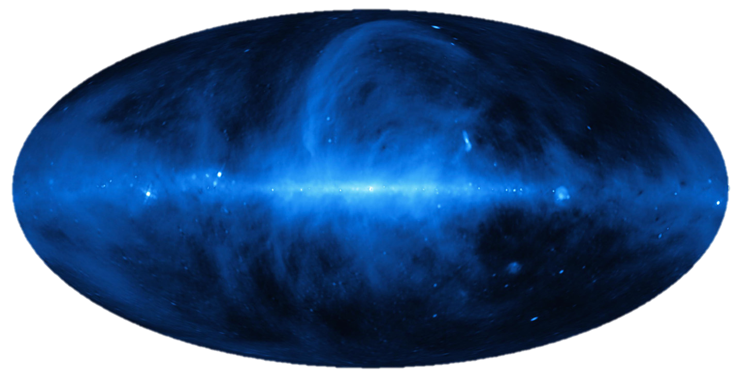
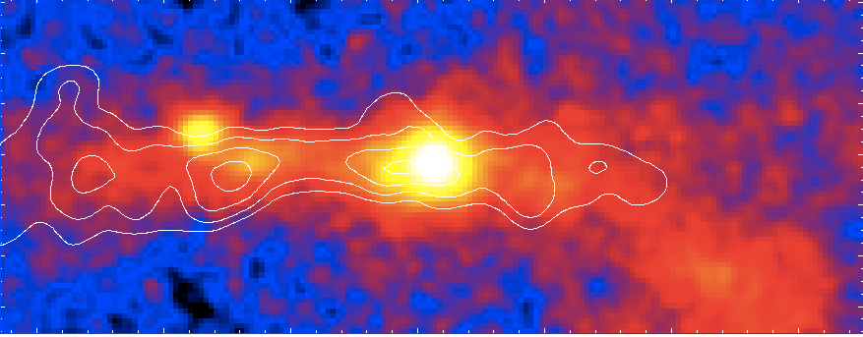
Neutrino Synergies
SWGO+LHAASO
Full sky map of TeV-PeV γ emission
Strongly complements new generation of neutrino instruments
Mapping out diffuse emission / separating IC from pion decay emission, Dark Matter search +++
Nearby transients/flares

Slide 24
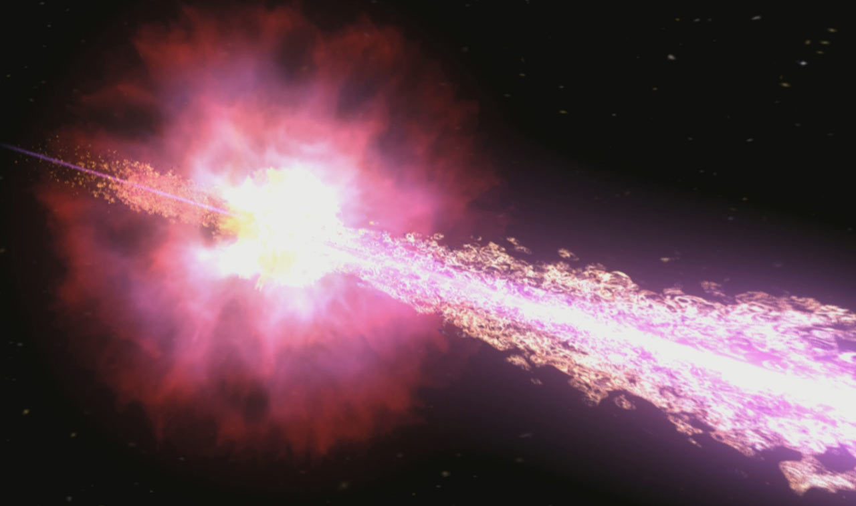
Transients
Credit: NASA
Instantaneous / short-timescale sensitivity of ground-particle detectors is much worse than IACTs! Especially at low E!!
So why are they still interesting for transients?
100% duty cycle → higher rate of high luminosity and/or nearby events (nearby bursts are very important → GWs, EBL systematics, ++)
Zero observation delay - can potentially catch events with fluxes many orders of magnitude higher
No need to trigger!
Blind searches and can check offline for ‘slow’ alerts
e.g. afterglow triggers from optical and radio → look back!
e.g. cubesats ++ many new / near future alert sources which can come hours late
Order of magnitude 1 minute sensitivity: Fermi-LAT: 10⁻⁷, SWGO: 10⁻⁹, CTA: 10⁻¹¹ erg/cm²/s
Fermi: 1 GeV
CTA/SWGO: few 100 GeV
SWGO can bring the 10s deg² error boxes (GBM, GW) down to ~arcmin size

Slide 25
SWGO
CTA
1️⃣
Follow up of SWGO detected Galactic Sources
year+
Gal. Extended
Extragal.
Extended
month
Gal.
Binaries
SWGO
Active
Galaxies
day
Timescale
CTA
hour
2️⃣
Follow up of SWGO detected Flares
Gamma-ray Bursts (2)
CTA
GRBs
minute
SWGO
second
3️⃣
Follow up of SWGO detected Transients
1 kpc
10 kpc
100 kpc
1 Mpc
10 Mpc
100 Mpc
1 Gpc
Distance
z ~
0.0001
0.001
0.01
0.1
1.0
Notes:
Three ways

Slide 26
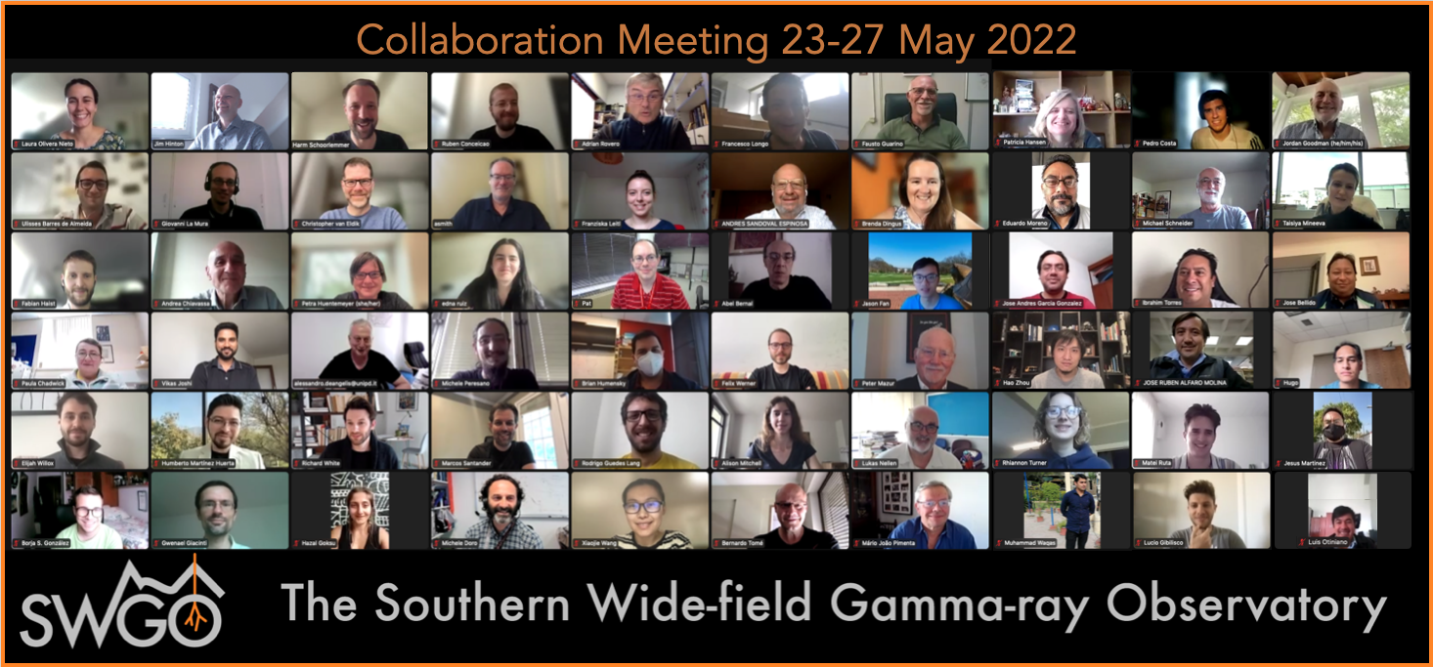
Thanks for listening!

