Slide 1



Cosmology, multi-messenger astrophysics and fundamental physics with GRBs
Lorenzo Amati
(INAF – OAS Bologna)
(7 July 2022)

Slide 2
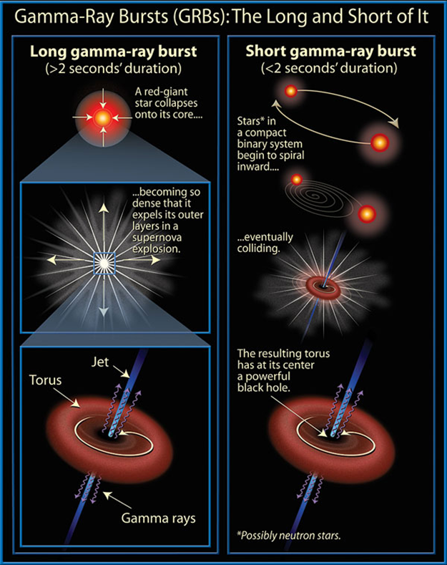
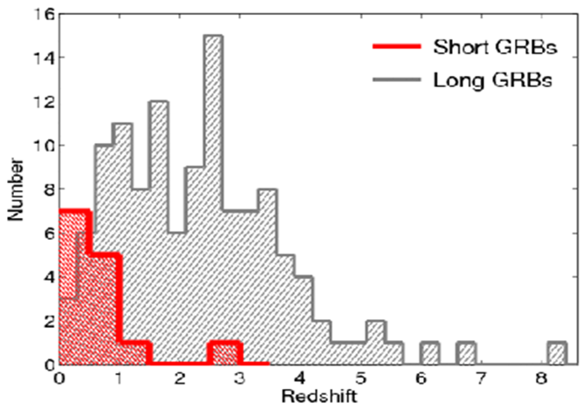
Gamma-Ray Bursts: the most extreme phenomena in the Universe
Long GRBs: core collapse of pecular massive stars, association with SN
Short GRBs: NS-NS or NS-BH mergers, association with GW sources

Slide 3
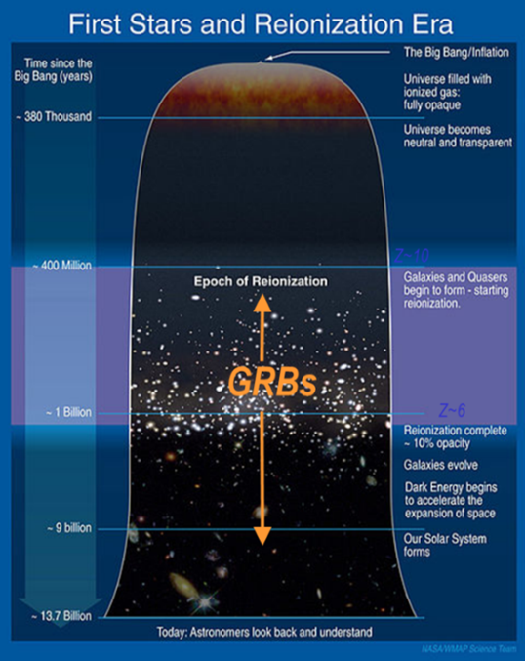
Shedding light on the early Universe with GRBs
Long GRBs: huge luminosities, mostly emitted in the X and gamma-rays
Redshift distribution extending at least to z ~9 and association with exploding massive stars
Powerful tools for cosmology: SFR evolution, physics of re-ionization, high-z low luminosity galaxies, pop III stars

Slide 4
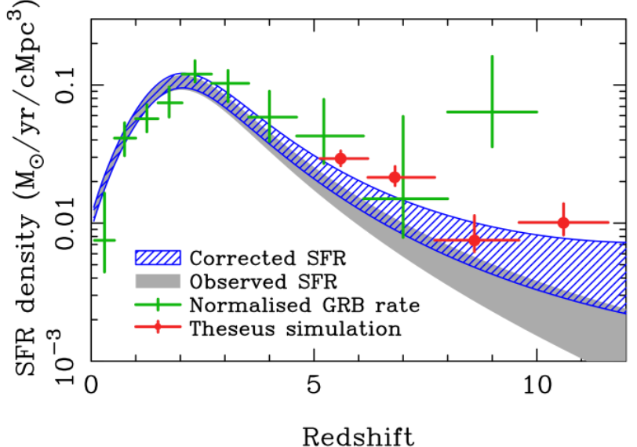
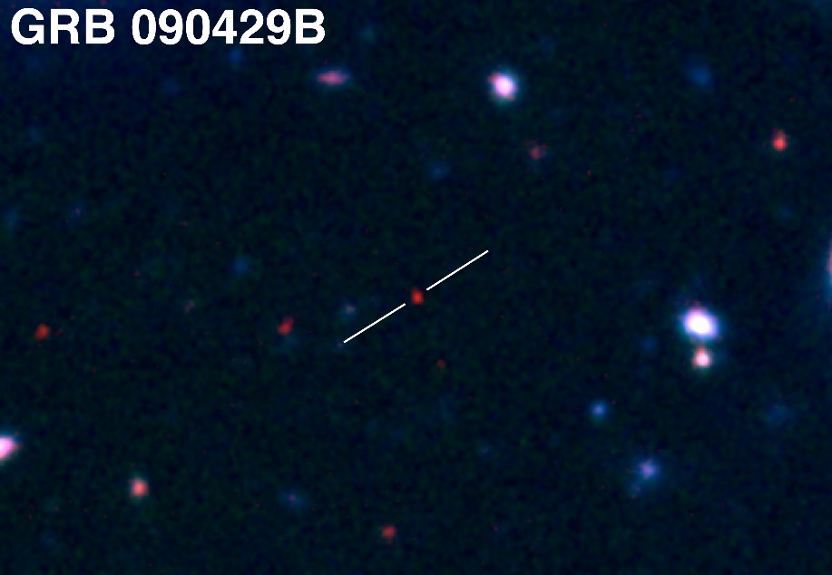
Shedding light on the early Universe with GRBs
A statistical sample of high–z GRBs can provide fundamental information:
measure independently the cosmic star–formation rate, even beyond the limits of current and future galaxy surveys
directly (or indirectly) detect the first population of stars (pop III)
Z = 9.2
Robertson&Ellis12

Slide 5
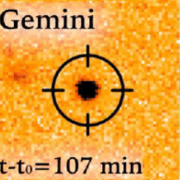
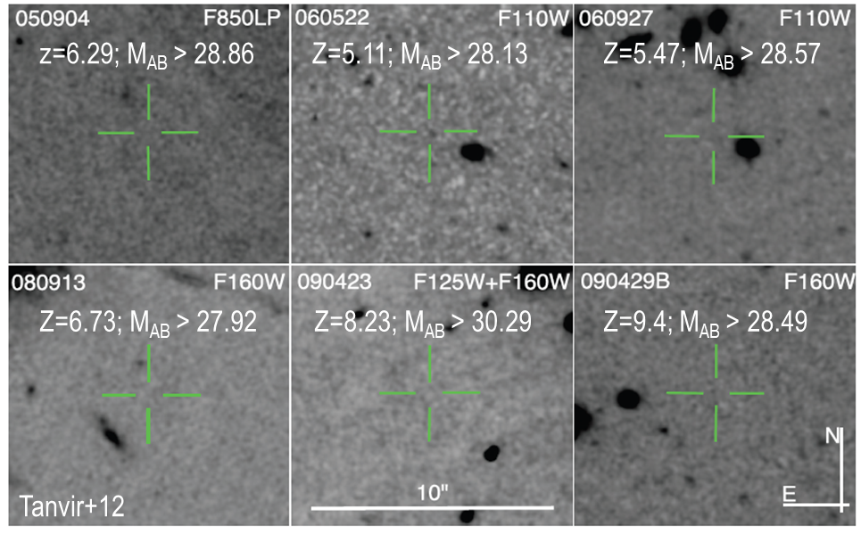
Detecting and studying primordial invisible galaxies
Robertson&Ellis12
Even JWST and ELTs surveys will be not able to probe the faint end of the galaxy Luminosity Function at high redshifts (z>6-8)

Slide 6
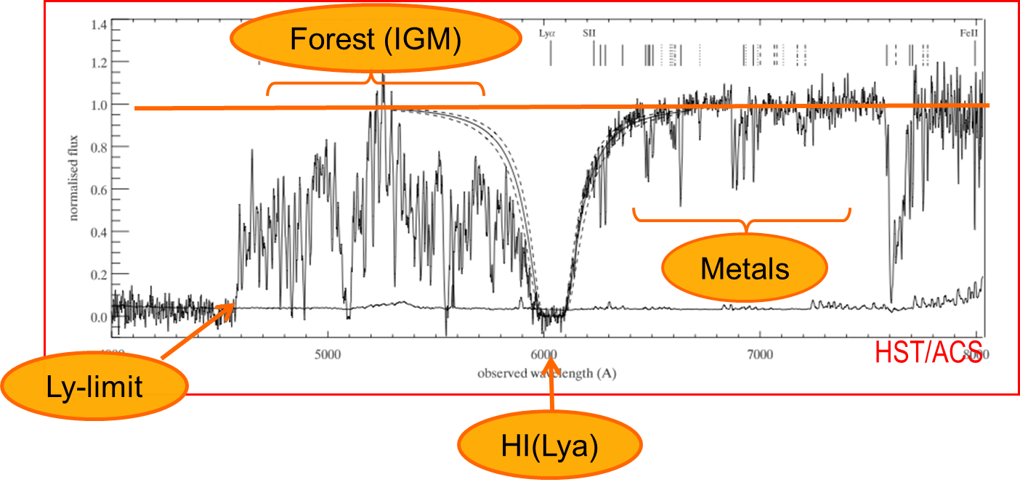
Detecting and studying primordial invisible galaxies
Robertson&Ellis12
Robertson&Ellis12

Slide 7
Detecting and studying primordial invisible galaxies
neutral hydrogen fraction
escape fraction of UV photons from high-z galaxies
early metallicity of the ISM and IGM and its evolution
Robertson&Ellis12
Robertson&Ellis12

Slide 8
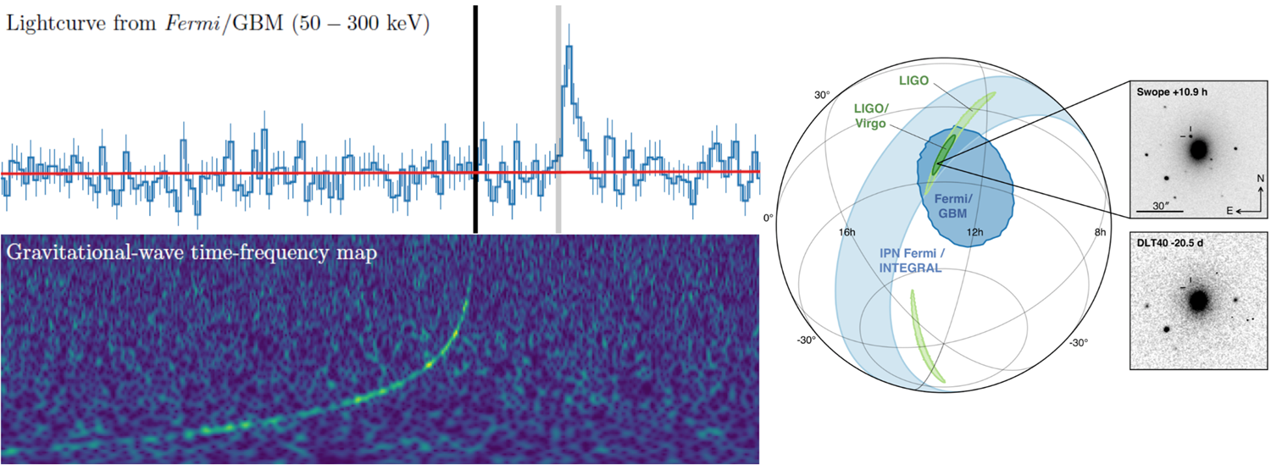
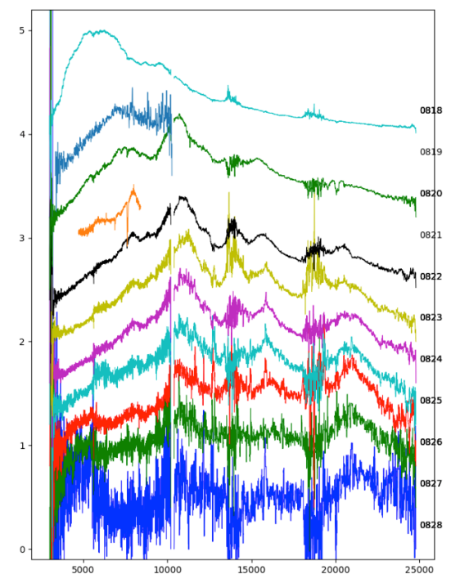
Short GRBs and multi-messenger astrophysics
GW170817 + SHORT GRB 170817A + KN AT2017GFO (~40 Mpc): the birth of multi-.messenger astrophysics
Notes:
Presenter’s note:

Slide 9
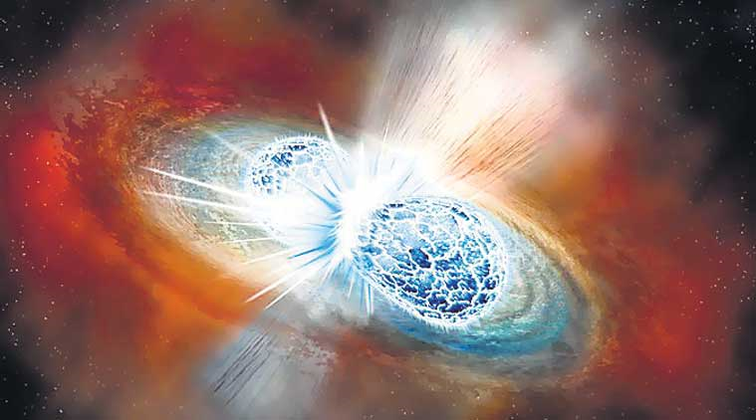
Short GRBs and multi-messenger astrophysics
GW170817 + SHORT GRB 170817A + KN AT2017GFO (~40 Mpc): the birth of multi-.messenger astrophysics
Notes:
Presenter’s note:

Slide 10
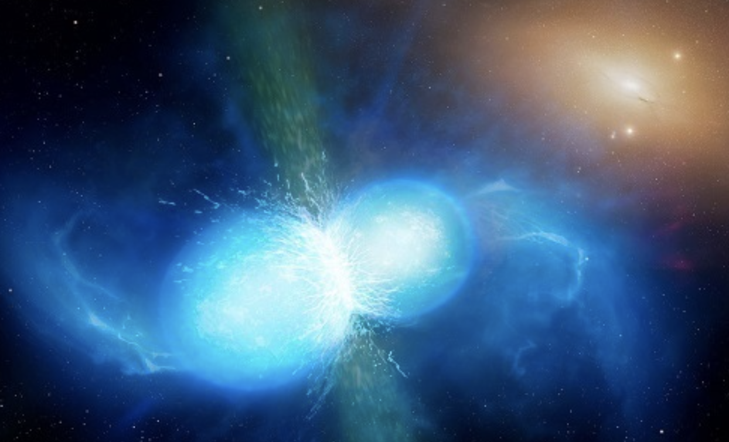
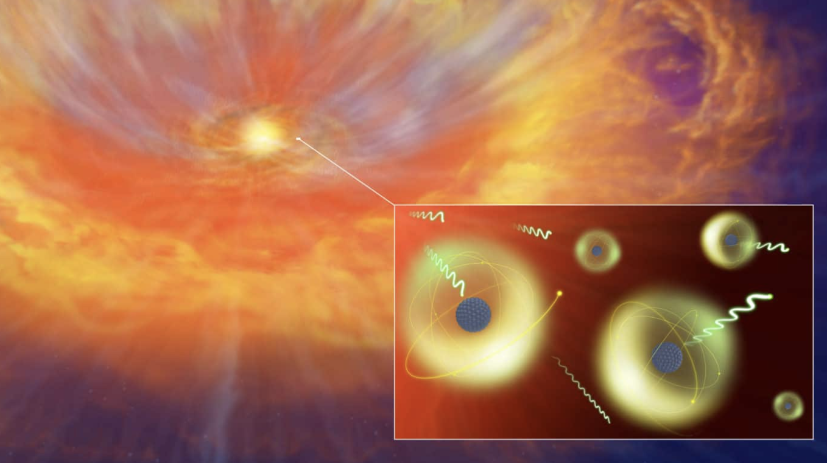
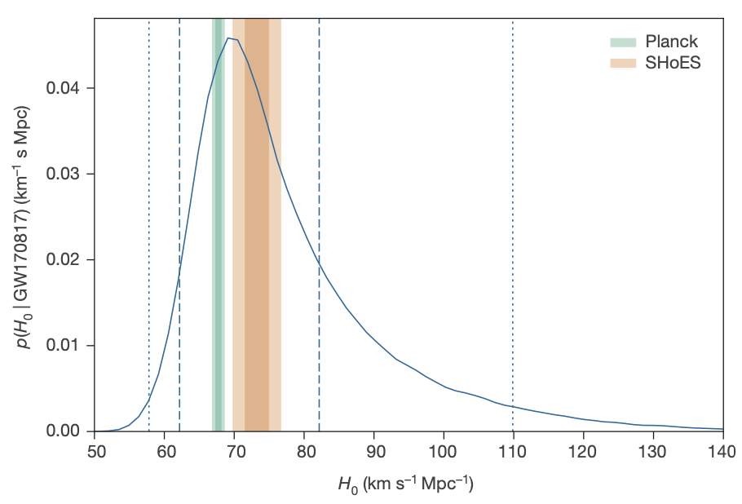
GRB: a key phenomenon for multi-messenger astrophysics (and cosmology)
GW170817 + SHORT GRB 170817A + KN AT2017GFO
THE BIRTH OF MULTI-MESSENGER ASTROPHYSICS
Relativistic jet formation, equation of state, fundamental physics
Cosmic sites of r-process nucleosynthesis
New independent route to measure cosmological parameters
Notes:
Presenter’s note:

Slide 11
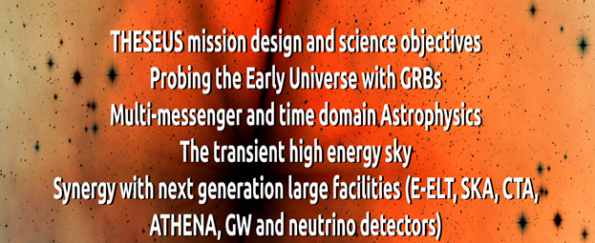
Future GRB missions (late‘20s and ‘30s)
THESEUS (studied for ESA Cosmic Vision / M5), HiZ-GUNDAM (JAXA, under study), TAP (idea for NASA probe-class mission), Gamow Explorer (proposal for NASA MIDEX): prompt emission down to soft X-rays, source location accuracy of few arcmin, prompt follow-up with NIR telescope, on-board REDSHIFT

Slide 12
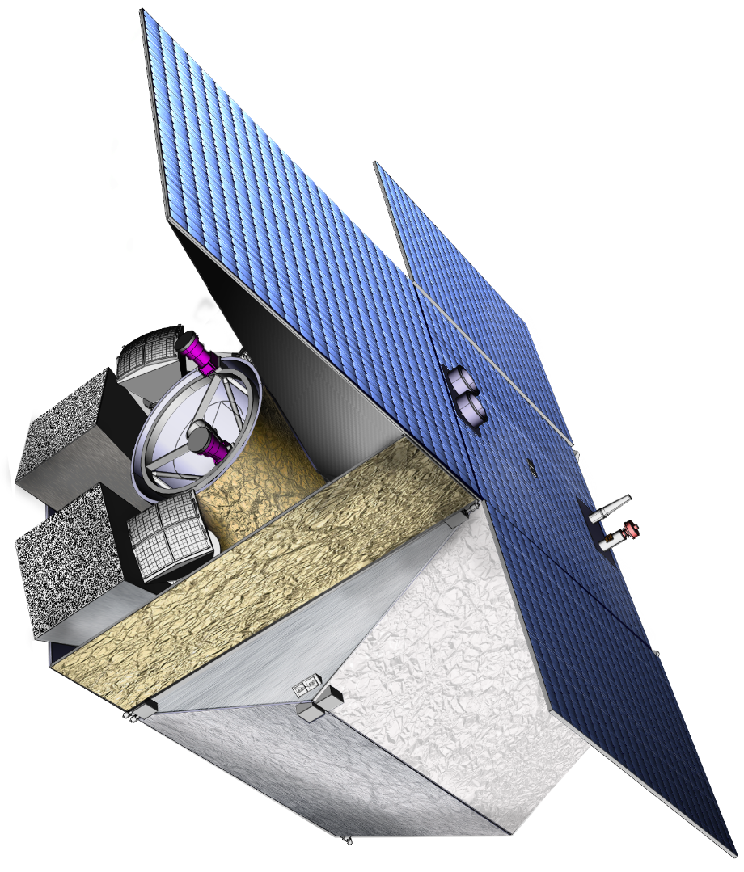
Future GRB missions: the case of THESEUS (led by Italy; ESA/M5 Phase-A study, re-proposed for M7)
THIS BREAKTHROUGH WILL BE ACHIEVED BY A MISSION CONCEPT OVERCOMING MAIN LIMITATIONS OF CURRENT FACILITIES
Set of innovative wide-field monitors with unprecedented combination of broad energy range, sensitivity, FOV and localization accuracy
On-board autonomous fast follow-up in optical/NIR, arcsec location and redshift measurement of detected GRB/transients
Notes:
Presenter’s note:

Slide 13
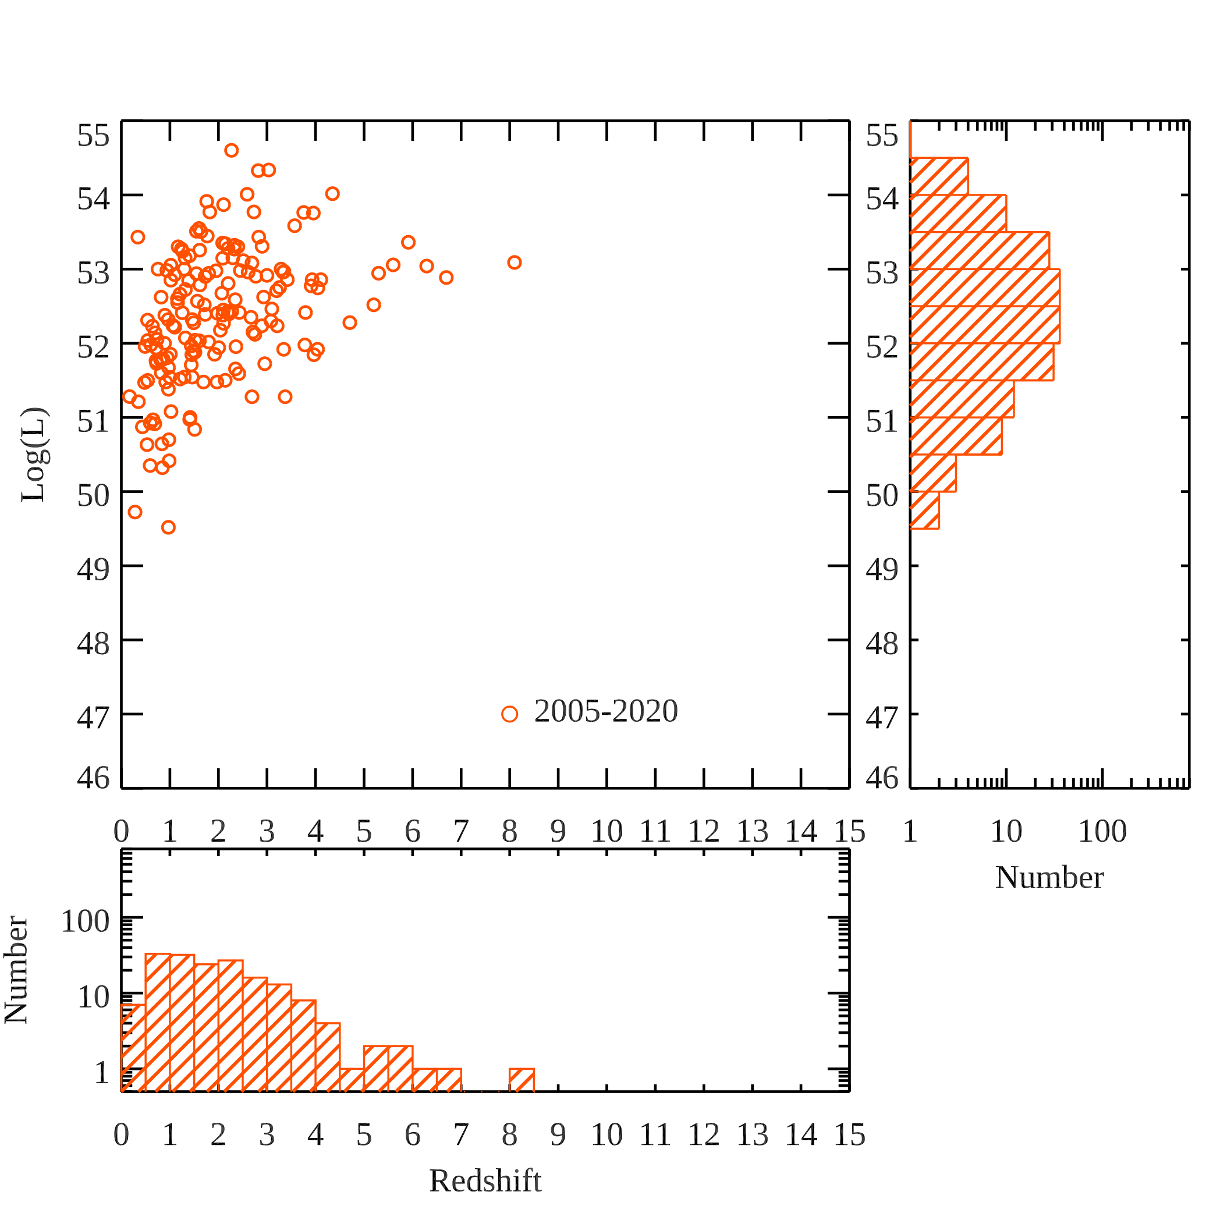
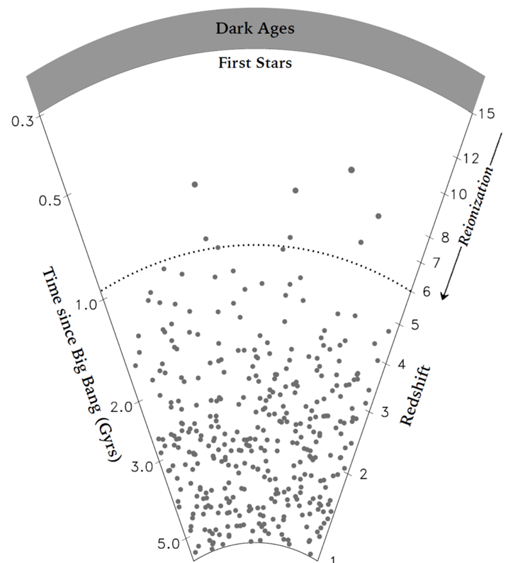
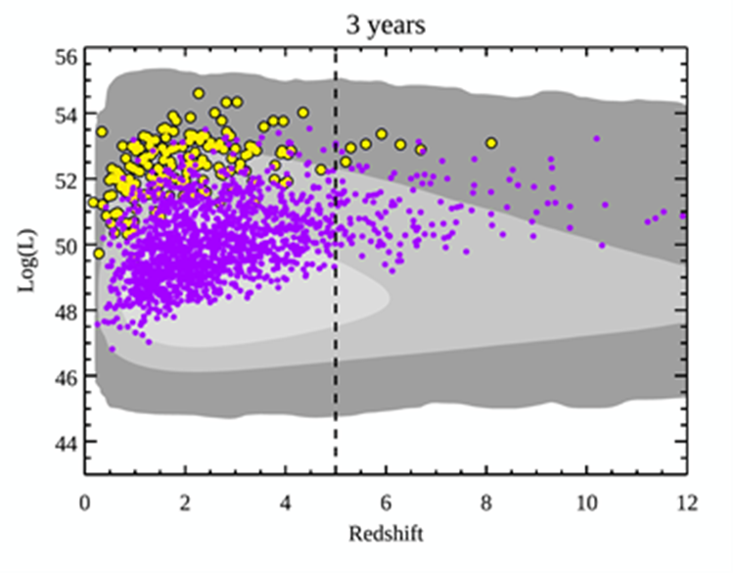
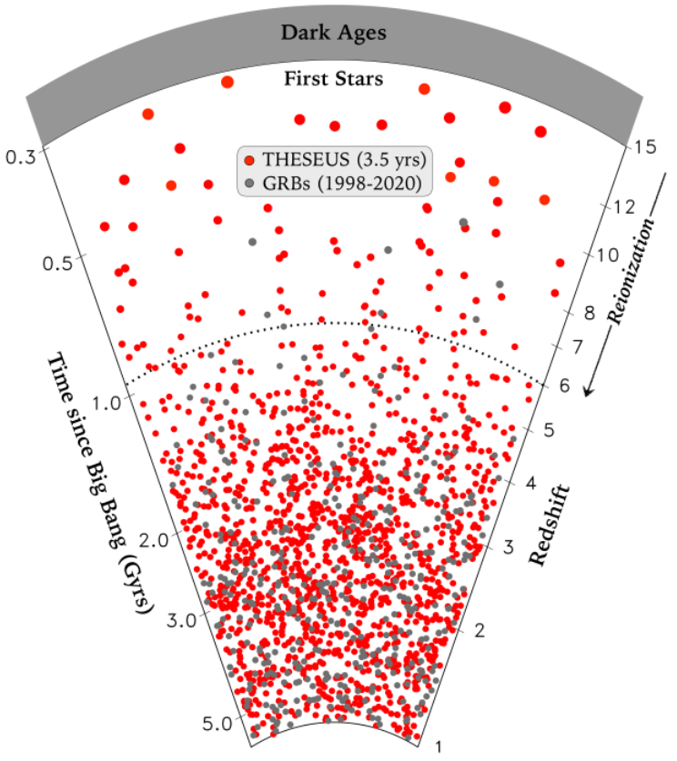
Shedding light on the early Universe with GRBs

Slide 14
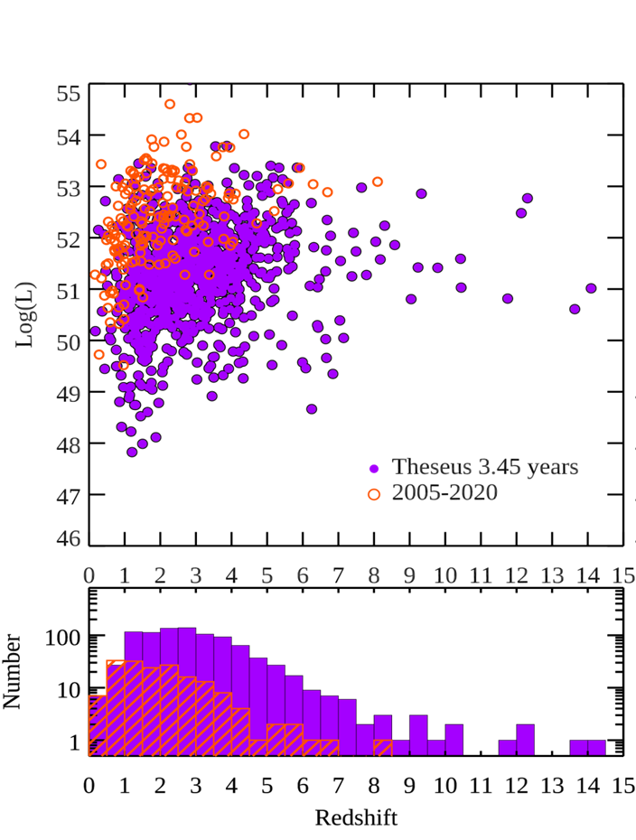
Shedding light on the early Universe with GRBs

Slide 15

THESEUS:
short GRB detection over large FOV with arcmin localization
Kilonova detection, arcsec localization and characterization
Possible detection of weaker isotropic X-ray emission

Slide 16
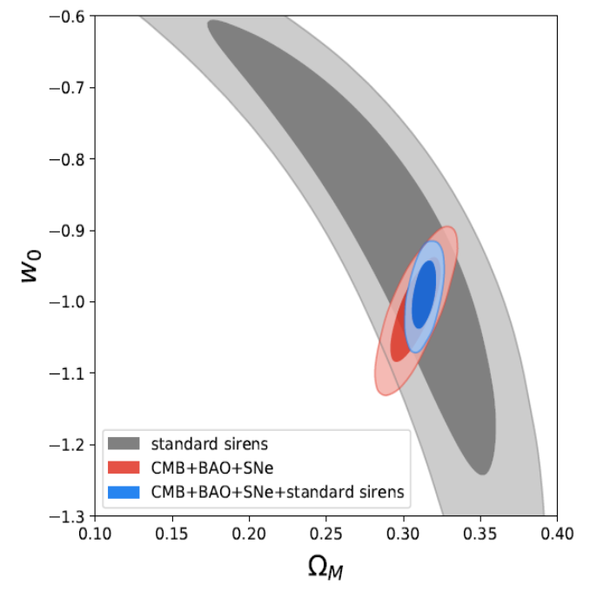
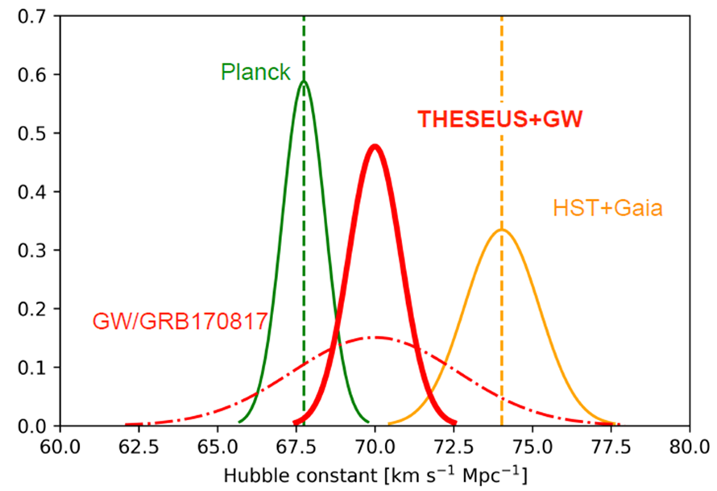
Multi-messenger cosmology through GRBs
MEASURING THE EXPANSION RATE AND GEOMETRY OF SPACE-TIME
~20 joint GRB + GW events
Notes:
Presenter’s note:

Slide 17

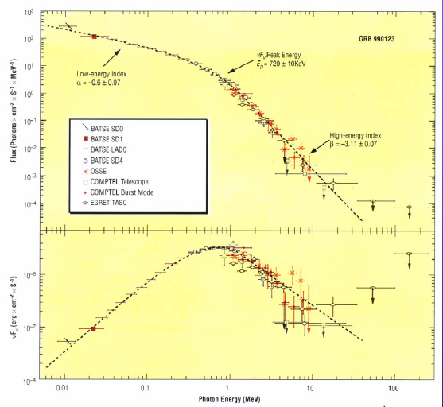
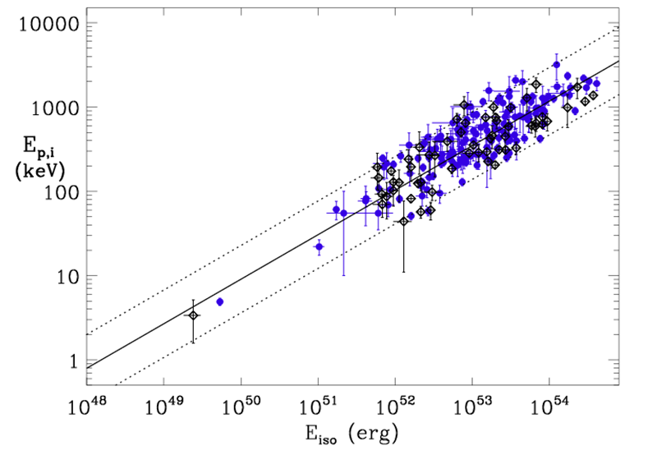
Measuring cosmological parameters with GRBs
GRB nFn spectra typically show a peak at a characteristic photon energy E_{p}
measured spectrum + measured redshift -> intrinsic peak enery and radiated energy
E_{p,i} = E_{p} x (1 + z)
Ep
Amati et al. (2002,2006,2008, 2013)

Slide 18
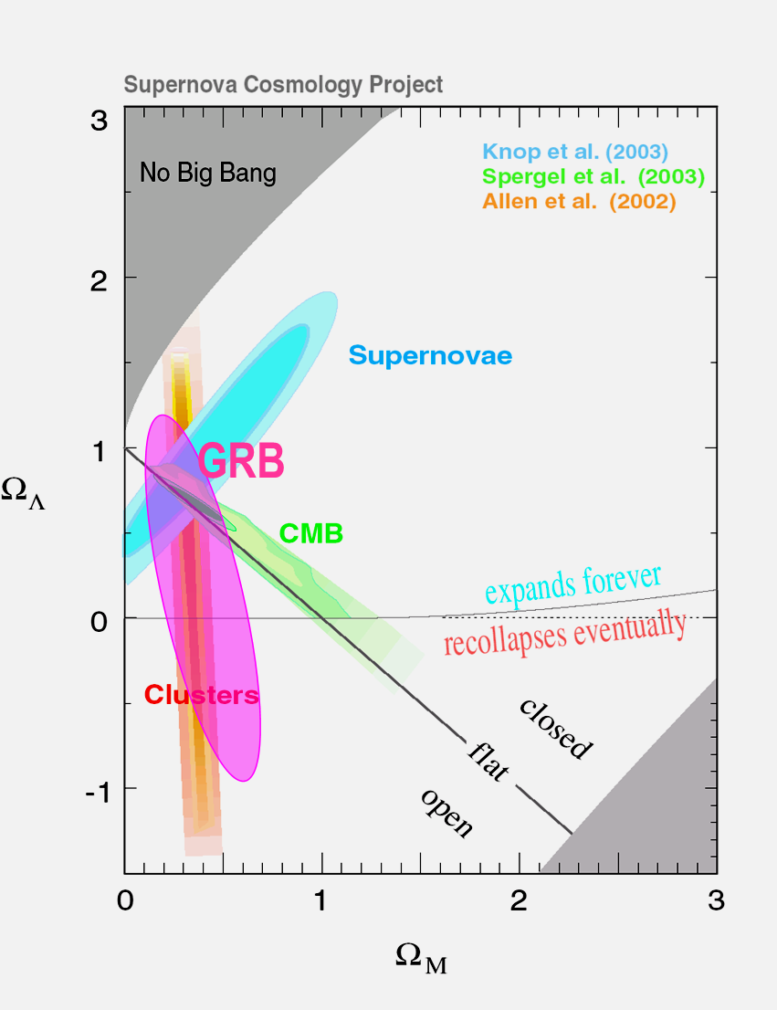
a fraction of the extrinsic scatter of the E_{p,i}-E_{iso} correlation is indeed due to the cosmological parameters used to compute E_{iso}
Evidence, independent on other cosmological probes, that, if we are in a flat ΛCDM universe , Ω_{M} is lower than 1 and around 0.3
Measuring cosmological parameters with GRBs
Amati et al. 2008, Amati & Della Valle 2013

Slide 19
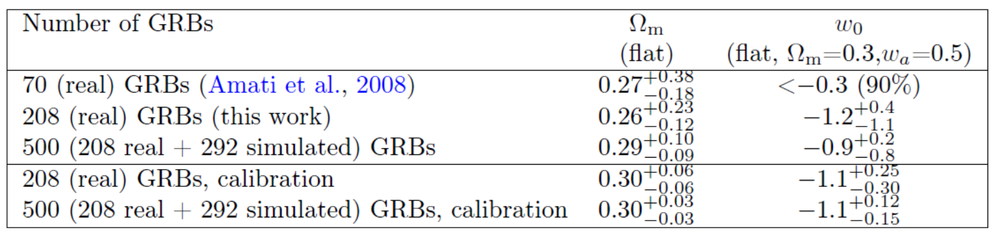
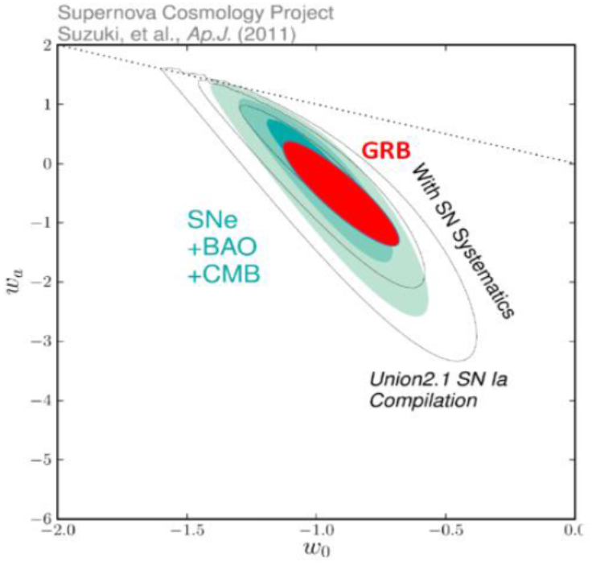
Future GRB experiments (e.g., SVOM, HERMES, THESEUS, …) and more investigations (in particular: reliable estimates of jet angles and self-calibration) will improve the significance and reliability of the results and allow to go beyond SN Ia cosmology (e.g. investigation of dark energy)

Slide 20
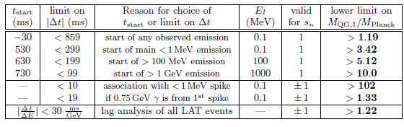
Fundamental physics with GRBs: testing LI / QG
Using time delay between low and high energy photons to put Limits on Lorentz Invariance Violation (allowed by unprecedent Fermi GBM + LAT broad energy band)
GRB 990510

Slide 21
In summary
GRBs are a key phenomenon for cosmology (ealry Universe, cosmological parameters), multi-messenger astrophysics (GW, neutrinos) and fundamental physics
Next generation GRB missions, like THESEUS, developed by a large European collaboration and already studied by ESA (M5 Phase A) will fully exploit these potentialities and will provide us with unprecedented clues to GRB physics and sub-classes.
THESEUS is a unique occasion for fully exploiting the European leadership in time-domain and multi-messenger astrophysics and in related key-enabling technologies
THESEUS observations will impact on several fields of astrophysics, cosmology and fundamental physics and will enhance importantly the scientific return of next generation multi messenger (aLIGO/aVirgo, LISA, ET, or Km3NET;) and e.m. facilities (e.g., LSST, E-ELT, SKA, CTA, ATHENA)
THESEUS ESA/M5 Phase A study successful -> reproposed for M7 (2037)
SPIE articles on instruments, Adv.Sp.Res. & Exp.Astr. articles on science
http://www.isdc.unige.ch/theseus/

Slide 22
Back-up slides

Slide 23
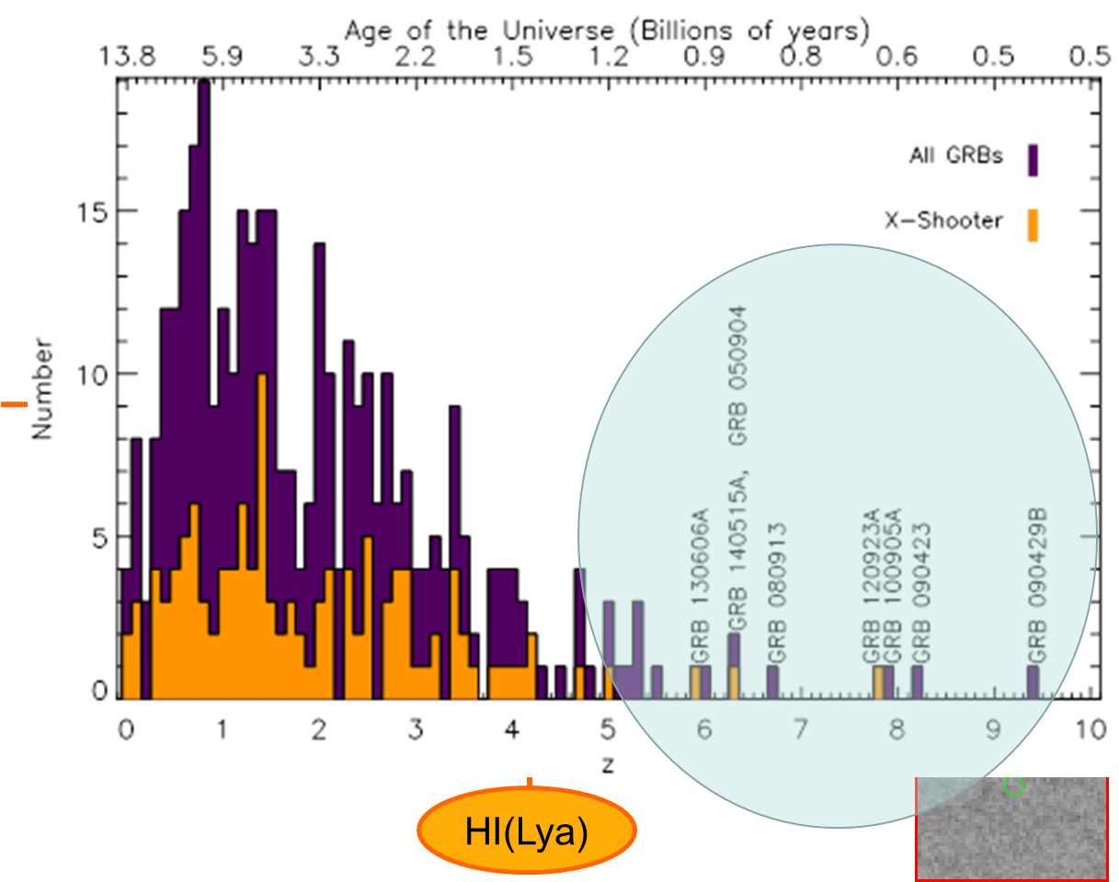
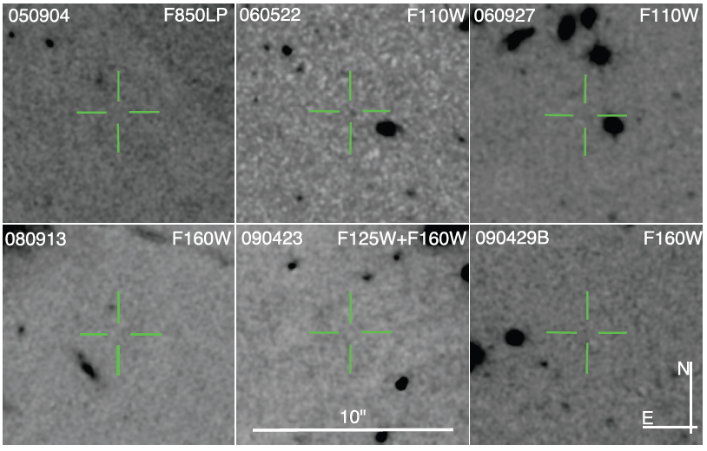
Detecting and studying primordial invisible galaxies
z=6.29; M_{AB} > 28.86
Z=5.11; M_{AB} > 28.13
Z=5.47; M_{AB} > 28.57
Z=6.73; M_{AB} > 27.92
Z=8.23; M_{AB} > 30.29
Z=9.4; M_{AB} > 28.49
Tanvir+12
Robertson&Ellis12

Slide 24
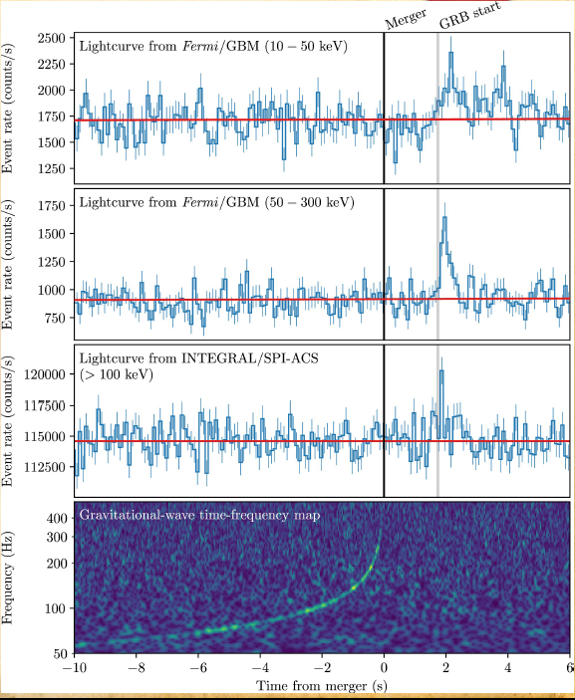
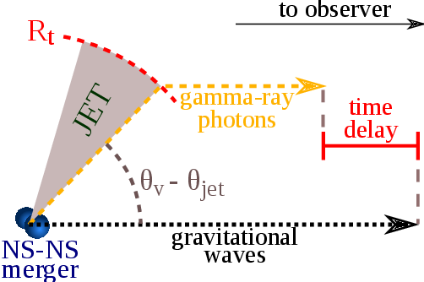


Fundamental physics with GRBs: GW vs. light speed
GW170817/GRB170817A, D ~ 40 Mpc
|V_{gw}-C| / C <10⁻¹⁶

Slide 25
Gamma-Ray Bursts: the most extreme phenomena in the Universe
Long GRBs: core collapse of pecular massive stars, association with SN
Short GRBs: NS-NS or NS-BH mergers, association with GW sources

Slide 26

Future missions: the case of THESEUS
Transient High Energy Sky and Early Universe Surveyor Lead Proposer (ESA/M5): Lorenzo Amati (INAF – OAS Bologna, Italy) Coordinators (ESA/M5): Lorenzo Amati, Paul O’Brien (Univ. Leicester, UK), Diego Gotz (CEA-Paris, France), A. Santangelo (Univ. Tuebingen, D), E. Bozzo (Univ. Genève, CH) Payload consortium: Italy, UK, France, Germany, Switzerland, Spain, Poland, Denmark, Belgium, Czech Republic, Slovenia, Ireland, NL, ESA

Slide 27
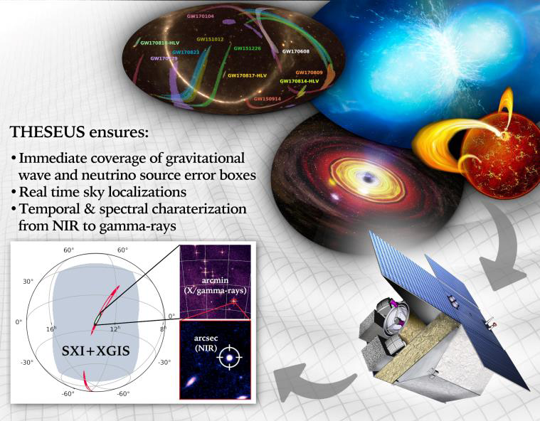
Exploring the multi-messenger transient sky

Slide 28

Future GRB missions: synergies
ENTERING THE GOLDEN ERA OF MULTI-MESSENGER ASTROPHYSICS
Synergy with future GW and neutrino facilities will enable transformational investigations of
multi-messenger
sources
Notes:
Presenter’s note:
One can mention here the very recent publication of the Roadmap 2020-2030 of the GW International Committee that
confirms the extension of 2G in the 2030s with some upgrades (e.g. A+, Virgo+, Voyager)
the 3G projects are officially inserted in the 2020-2030 roadmap
https://www.nature.com/articles/s42254-021-00303-8.pdf

Slide 29
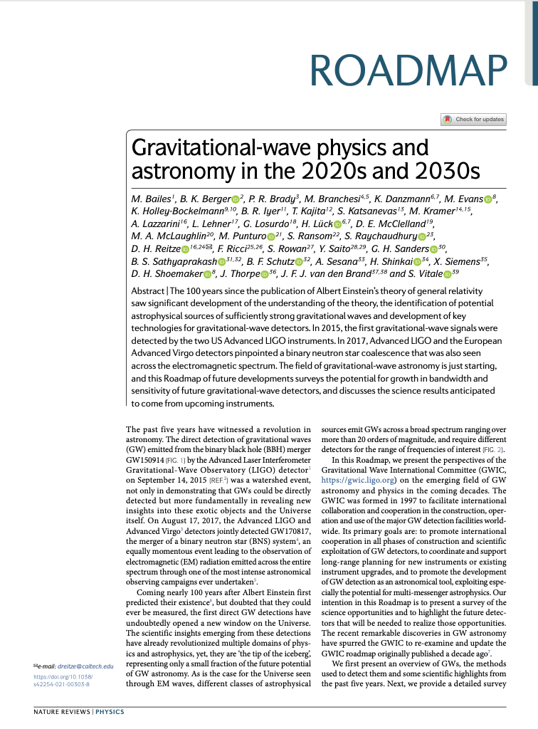
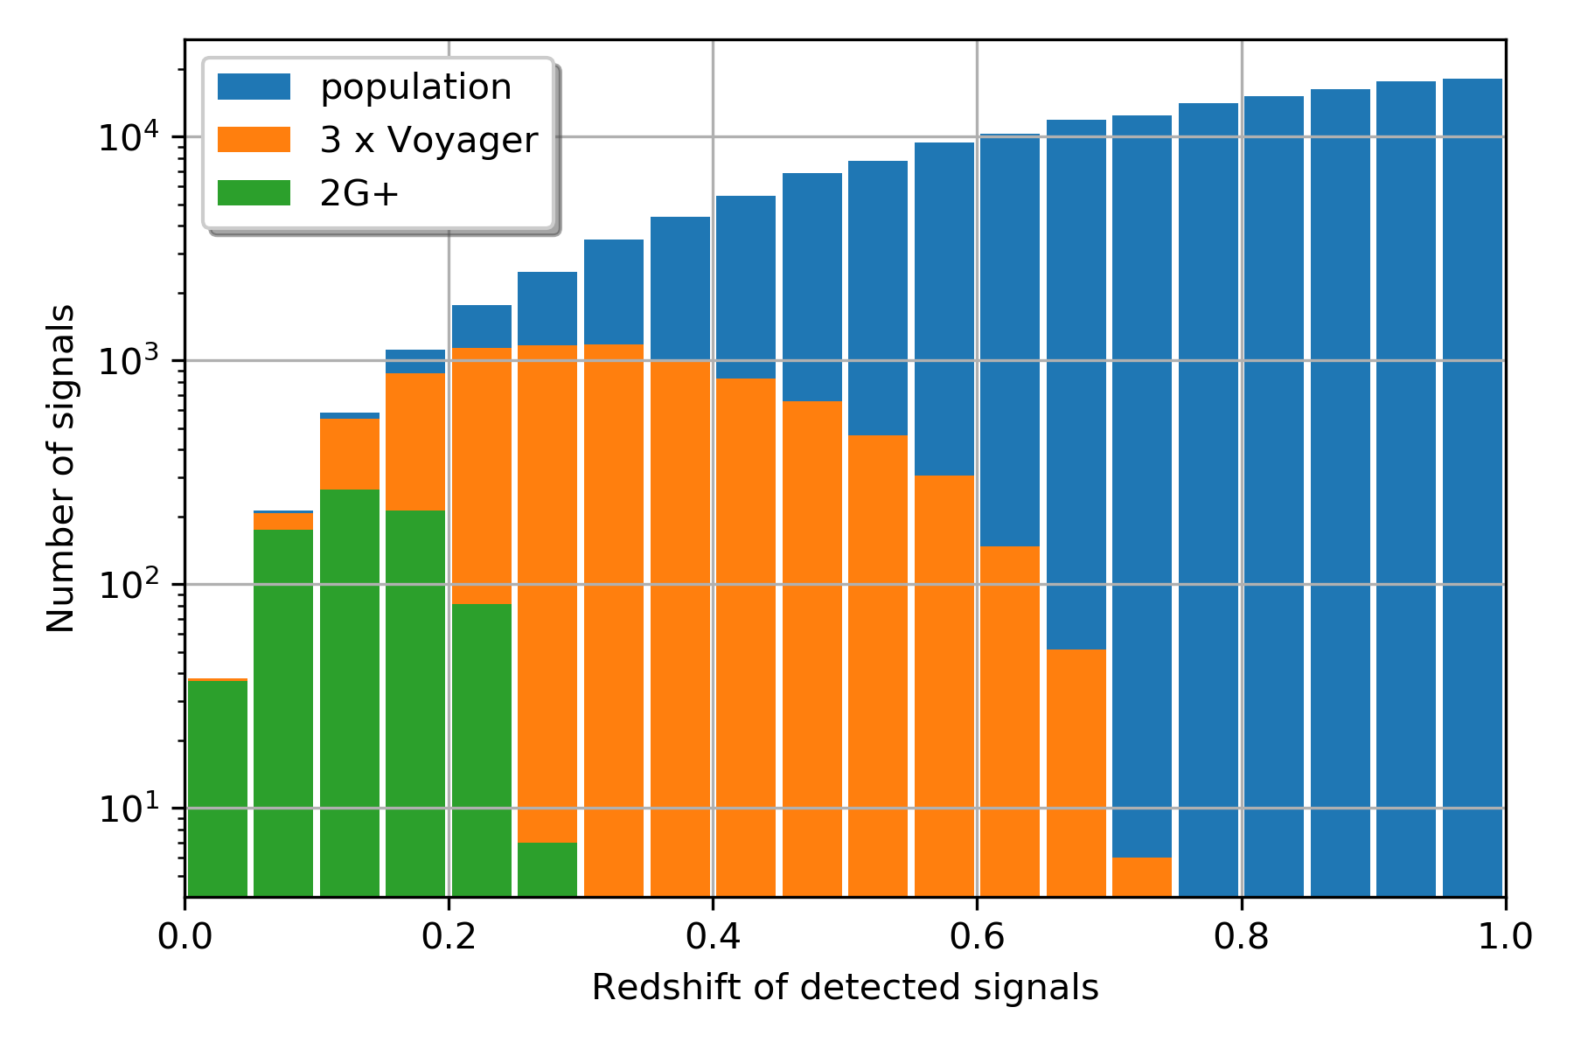
https://www.nature.com/articles/s42254-021-00303-8
GWIC Roadmap and Letter of Endorsement from EGO/virgo clearly mention further upgrades of 2G to bridge in the 3G era
April 2021
NS-NS merger detection efficiency with 2G and 2G++ will sensibly improve at z>0.1 with 2G++
Notes:
Presenter’s note:

Slide 30

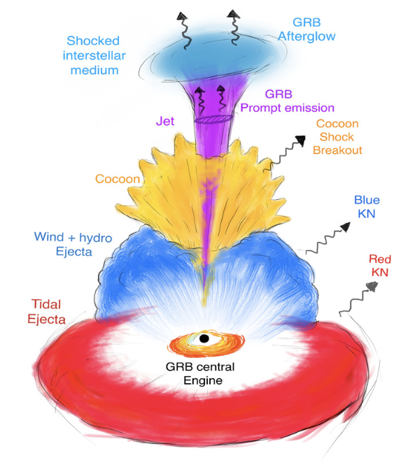
Multi-messenger science with THESEUS
INDEPENDENT DETECTION & CHARACTERISATION OF THE MULTI-MESSENGER SOURCES
Lessons from GRB170817A
Aligned GRBs
Misaligned GRBs
Expected rates:
THESEUS + 3G:
~50 aligned+misaligned short GRBs
~200 X-ray transients
Higher redshift events – X/𝛾 is likely only route to EM detection: larger statistical studies including source evolution, probe of dark energy and test modified gravity on cosmological scales
Notes:
Presenter’s note:
Very brief explanation of the red and blue KN (we can take in case another figure). Focus on explain 1) the “standard short GRB”-aligned and “soft short GRB”-misaligned issue 2) the synergy with upgraded 2G to study KN and jet structure with off-axis afterglow 3) the statistical studies possible with synergies with 3G

Slide 31
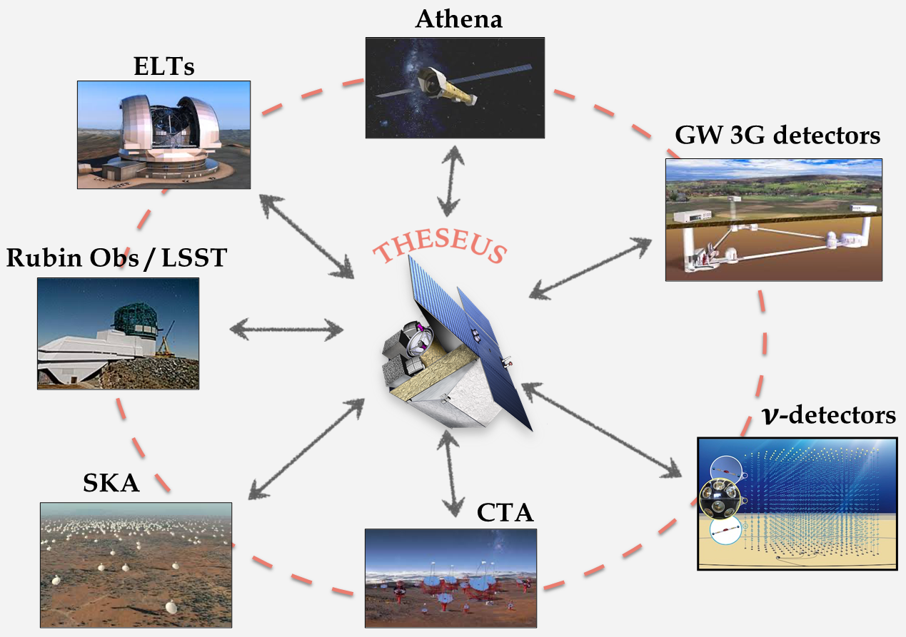
Multi-wavelength/messenger synergies
Amati+ 2021

Slide 32
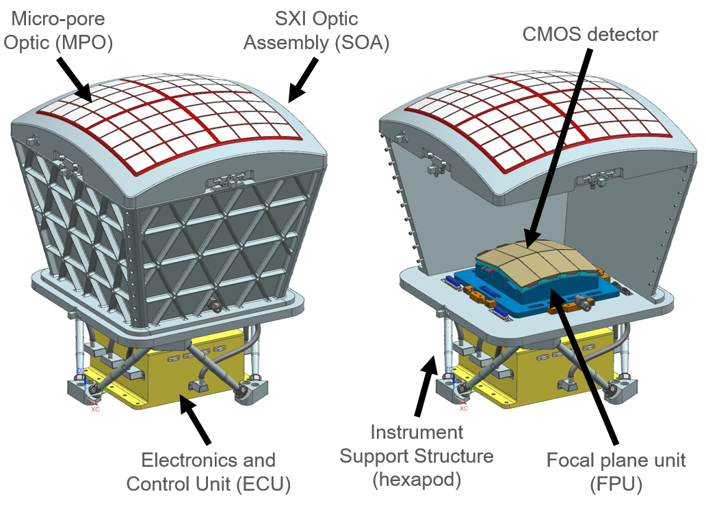
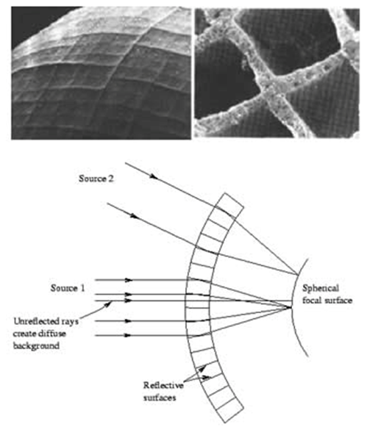

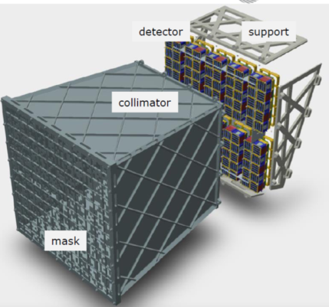
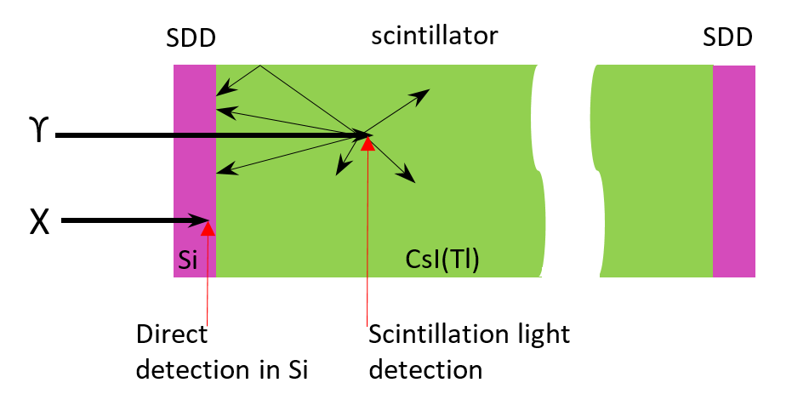

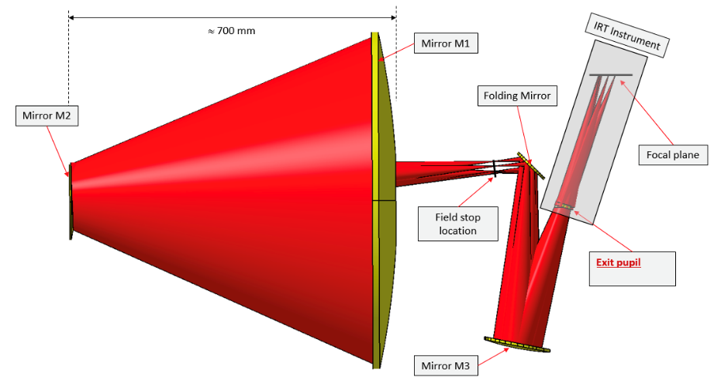

Future missions: the case of THESEUS
Soft X-ray Imager (SXI): a set of two sensitive lobster-eye telescopes observing in 0.3 - 5 keV band, total FOV of ~0.5sr with source location accuracy <2’
X-Gamma rays Imaging Spectrometer (XGIS): 2 coded-mask X-gamma ray cameras using Silicon drift detectors coupled with CsI crystal scintillator bars observing in 2 keV – 10 MeV band, a FOV of >2 sr, overlapping the SXI, with <15’ GRB location accuracy
InfraRed Telescope (IRT): a 0.7m class IR telescope observing in the 0.7 – 1.8 μm band, providing a 15’x15’ FOV, with both imaging and moderate resolution spectroscopy capabilities
Y_{IRTOR}
Z_{IRTOR}
Notes:
Presenter’s note:

Slide 33
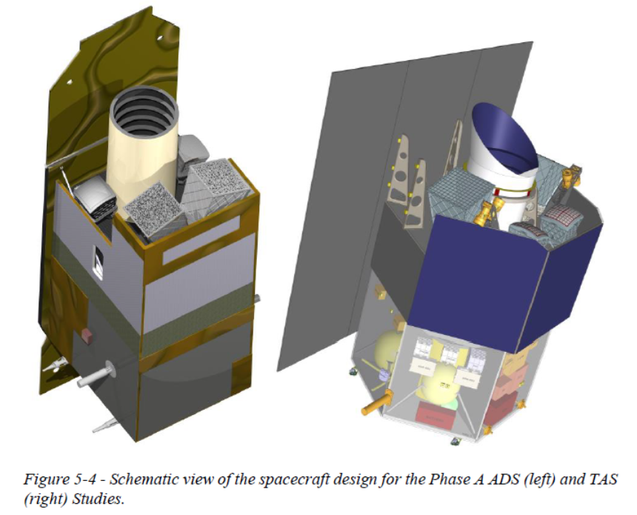
Future missions: the case of THESEUS
Soft X-ray Imager (SXI): a set of two sensitive lobster-eye telescopes observing in 0.3 - 5 keV band, total FOV of ~0.5sr with source location accuracy <2’
X-Gamma rays Imaging Spectrometer (XGIS): 2 coded-mask X-gamma ray cameras using Silicon drift detectors coupled with CsI crystal scintillator bars observing in 2 keV – 10 MeV band, a FOV of >2 sr, overlapping the SXI, with <15’ GRB location accuracy
InfraRed Telescope (IRT): a 0.7m class IR telescope observing in the 0.7 – 1.8 μm band, providing a 15’x15’ FOV, with both imaging and moderate resolution spectroscopy capabilities
Low Earth Orbit (< 5°, ~600 km)
Autonomously rapid slewing bus
4-years nominal
Amati+ 2021
Notes:
Presenter’s note:

Slide 34
Future missions (early / mid ‘20s)
SVOM (2022/23-): prompt emission down to 5 keV and up to MeVs, prompt follow-up with small X-ray and O/UV telescopes, dedicated on-ground telescopes
Einstein Probe (2022/23-): very good sensitivity, arcmin location accuracy, operating only in the very soft X-ray energy band (0.3 - 5 keV), 1.4 sr FOV, follow-up in X-rays
POLAR-2 (2025?): improved polarimetry of prompt emission;
HERMES and other nano-satellite programs (2022/23-): small detectors, energy band > 10 keV, potentially very good location accuracy for mid-bright GRBs, very good timing, depends on follow-up from ground
eXTP (2025?) China-Europe, monitoring in 2-50 keV on 4-5 sr, X-ray followp-up with deep spectroscopy and polarimetric sensitivity

Slide 35
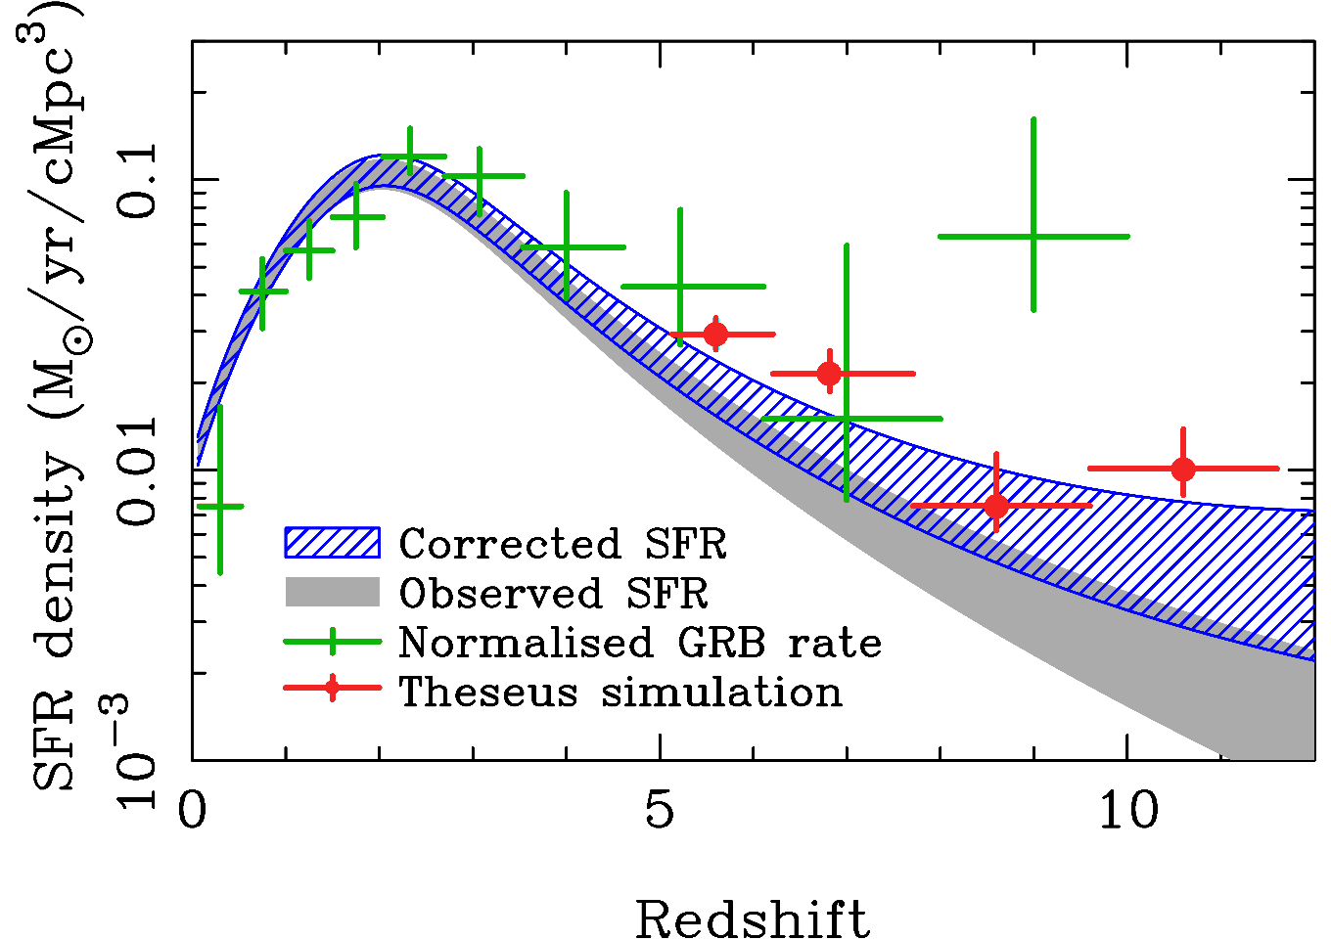
Independent measure of cosmic SFR at high-z (possibly including pop-III stars)
A statistical sample of high–z GRBs will give access to star formation in the faintest galaxies, overcoming limits of current and future galaxy surveys
THESEUS Consortium 2021
Notes:
Presenter’s note:

Slide 36
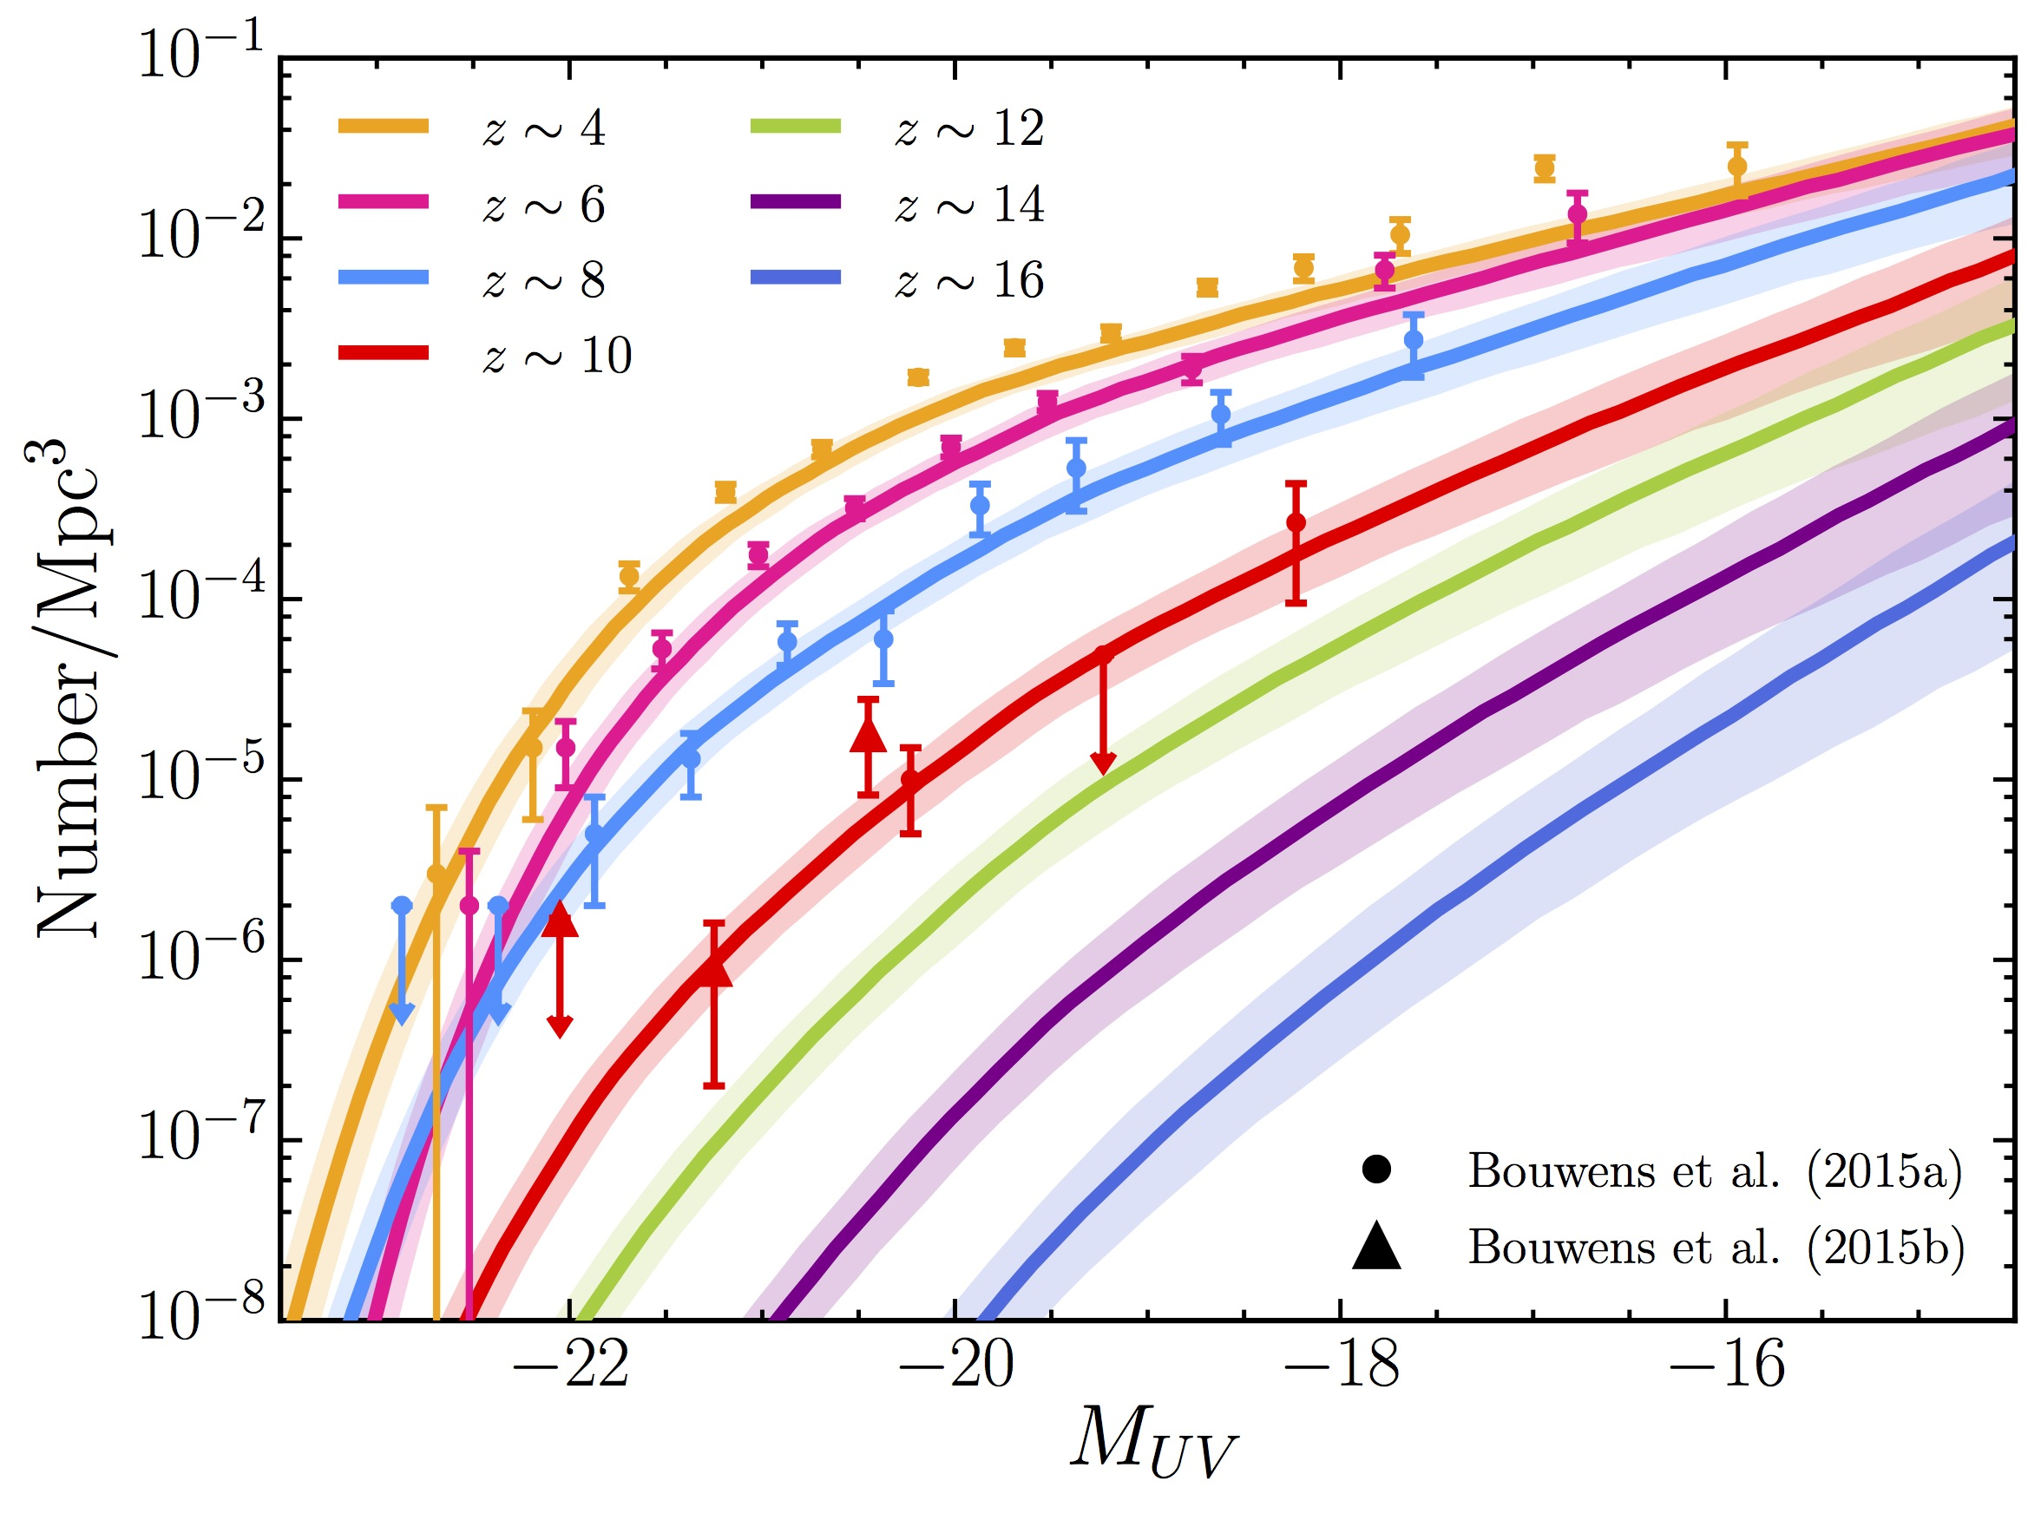
Detecting and studying primordial invisible galaxies
The proportion of GRB hosts below a given detection limit provides an estimate of the fraction of star formation “hidden” in such faint galaxies
m_{UV} ≈ 30
?
Bright
Faint
THESEUS Consortium 2021
Notes:
Presenter’s note:

Slide 37
Shedding light on cosmic reionization
Combination of massive star formation rate and ionizing escape fraction will establish whether stellar radiation was sufficient to reionize the universe, and indicate the galaxy populations responsible
THESEUS Consortium 2021
Notes:
Presenter’s note:

Slide 38
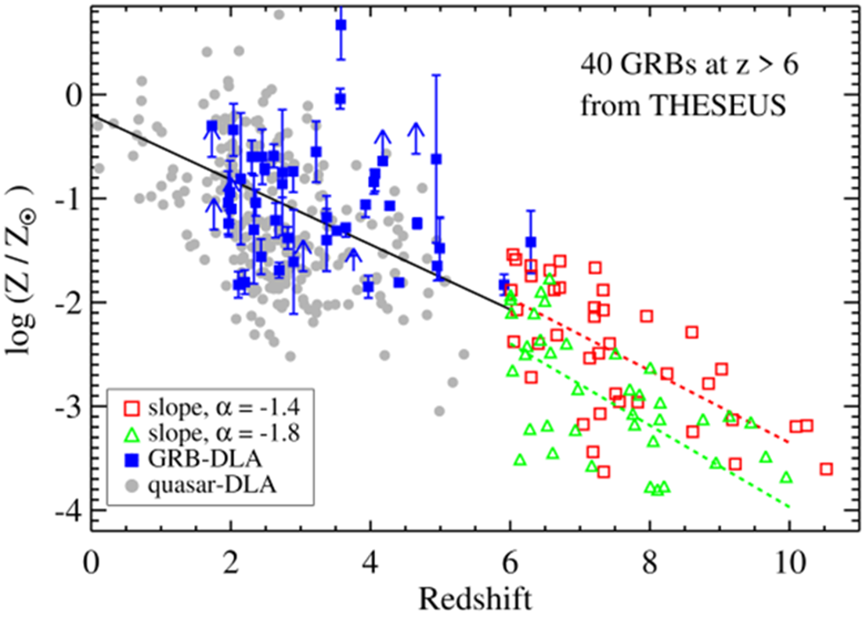
Cosmic chemical evolution at high-z
THESEUS Consortium 2021
Notes:
Presenter’s note:

Slide 39
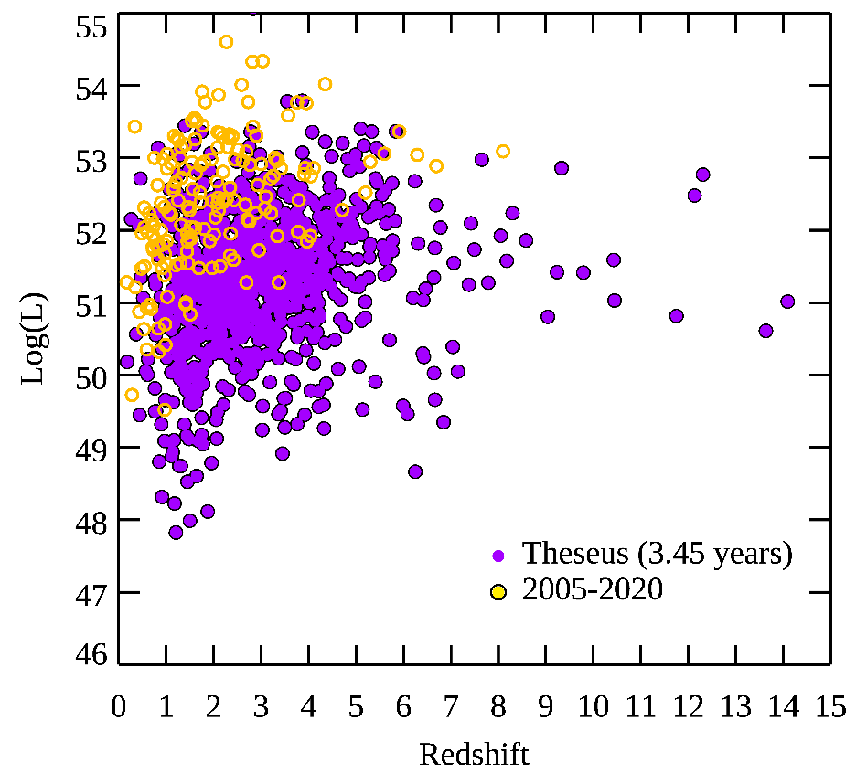
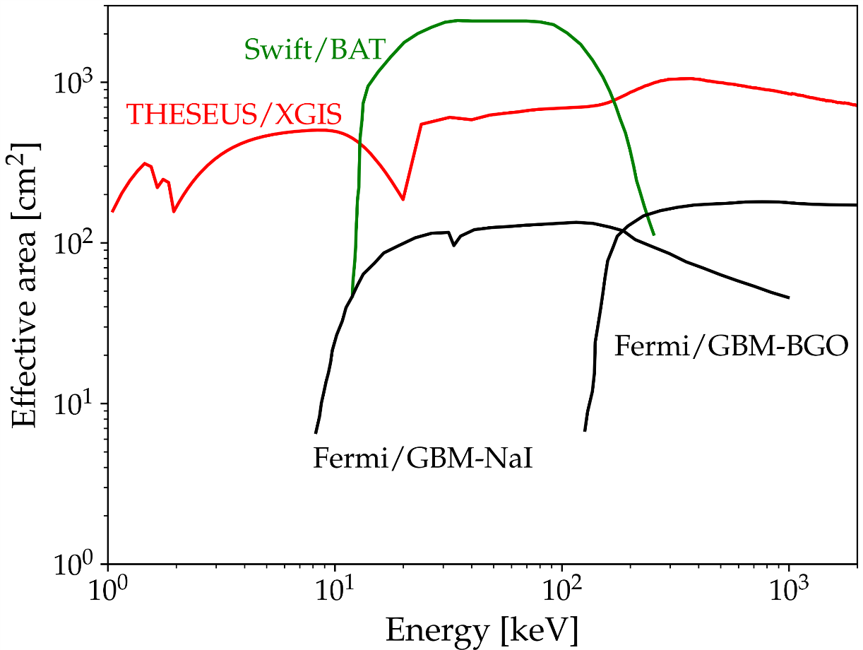
THESEUS: XGIS performances
THESEUS capabilities for GRB SCIENCE
THESEUS will provide an unprecedented sample of many hundreds of GRBs with redshift, wide band X/gamma-ray spectroscopic and few ms timing characterization, NIR
Notes:
Presenter’s note:
LOFT is being designed to address one of the key science themes of Cosmic Vision: matter under extreme conditions.
Two are the objectives at the core of the LOFT mission:
- First, to probe the state of matter at supra nuclear densities, the ones only reached in the interiors of Neutron Stars.
- Second, to probe the theory of gravity, general relativity, in the very strong environment of Black holes.
LOFT is therefore an observatory designed to probe two key questions of nature, through astrophysics.
But of course LOFT is an observatory and will explore, in addition to its core science, the physics of hundred of
galactic and extragalactic sources.

Slide 40
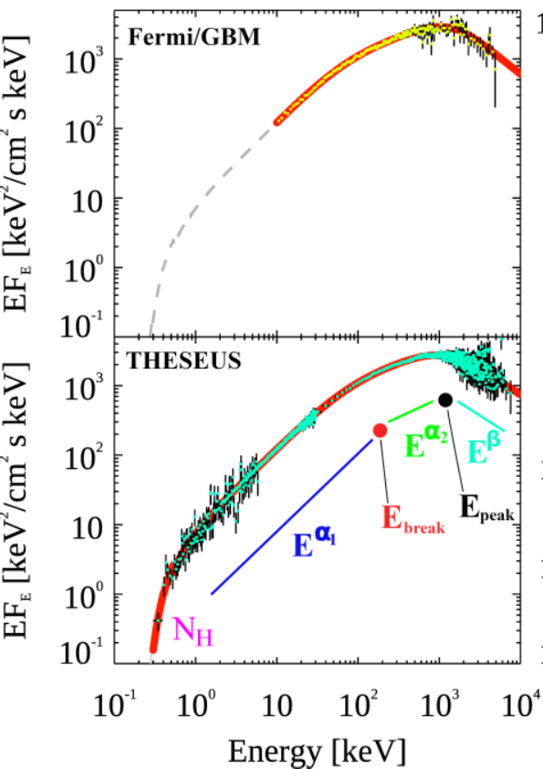

THESEUS: XGIS performances
THESESEUS capabilities for GRB SCIENCE
Extreme prompt emission physics, jet structure, central engine, circum-burst environment -> progenitors, weak/soft “local” GRBs, cosmological parameters, fundamental physics
Notes:
Presenter’s note:
LOFT is being designed to address one of the key science themes of Cosmic Vision: matter under extreme conditions.
Two are the objectives at the core of the LOFT mission:
- First, to probe the state of matter at supra nuclear densities, the ones only reached in the interiors of Neutron Stars.
- Second, to probe the theory of gravity, general relativity, in the very strong environment of Black holes.
LOFT is therefore an observatory designed to probe two key questions of nature, through astrophysics.
But of course LOFT is an observatory and will explore, in addition to its core science, the physics of hundred of
galactic and extragalactic sources.

Slide 41




THESEUS mission profile
The Soft X-Ray Imager (SXI)
Two sensitive “lobster-eye” X-ray telescopes (0.3 - 5 keV); total FOV of 0.5sr (>1000 $×$ conventional X-ray telescopes); 100ms photon timing; source location accuracy <2’
Mimic a lobster-eye using curved, square-pore MPOs
No single optical axis: get a wide field of view plus focusing with constant effective area
Spot (double reflection) Lines (single reflections)
Notes:
Presenter’s note:
LOFT is being designed to address one of the key science themes of Cosmic Vision: matter under extreme conditions.
Two are the objectives at the core of the LOFT mission:
- First, to probe the state of matter at supra nuclear densities, the ones only reached in the interiors of Neutron Stars.
- Second, to probe the theory of gravity, general relativity, in the very strong environment of Black holes.
LOFT is therefore an observatory designed to probe two key questions of nature, through astrophysics.
But of course LOFT is an observatory and will explore, in addition to its core science, the physics of hundred of
galactic and extragalactic sources.

Slide 42
THESEUS: mission profile
The Soft X-Ray Imager (SXI)
2 identical SXI modules:
Focal length: 300mm
Optic: 8x8 array of plates
Focal plane: 8 CMOS detectors
0.5sr total field of view
SXI will show a unique combination of FOV and effective area (GRASP), enabling simulatneous detection and localization of many transients in parallel.
Notes:
Presenter’s note:
LOFT is being designed to address one of the key science themes of Cosmic Vision: matter under extreme conditions.
Two are the objectives at the core of the LOFT mission:
- First, to probe the state of matter at supra nuclear densities, the ones only reached in the interiors of Neutron Stars.
- Second, to probe the theory of gravity, general relativity, in the very strong environment of Black holes.
LOFT is therefore an observatory designed to probe two key questions of nature, through astrophysics.
But of course LOFT is an observatory and will explore, in addition to its core science, the physics of hundred of
galactic and extragalactic sources.

Slide 43

THESEUS: mission profile
The X-Gamma Ray Imaging Spectrometer (XGIS)
Two coded-mask X-gamma ray cameras using innovative coupling between Silicon drift detectors (2-30 keV) and CsI crystal scintillator bars (20 keV–10 MeV)
Notes:
Presenter’s note:
LOFT is being designed to address one of the key science themes of Cosmic Vision: matter under extreme conditions.
Two are the objectives at the core of the LOFT mission:
- First, to probe the state of matter at supra nuclear densities, the ones only reached in the interiors of Neutron Stars.
- Second, to probe the theory of gravity, general relativity, in the very strong environment of Black holes.
LOFT is therefore an observatory designed to probe two key questions of nature, through astrophysics.
But of course LOFT is an observatory and will explore, in addition to its core science, the physics of hundred of
galactic and extragalactic sources.

Slide 44


THESEUS: mission profile
The X-Gamma Ray Imaging Spectrometer (XGIS)
Unprecedented energy band (2 keV – 10 MeV)
Large effective area down to 2 keV
FOV >2 sr overlapping the SXI one
GRB location accuracy <15’ in 2-150 keV
Excellent timing (< a few μs)
Notes:
Presenter’s note:
LOFT is being designed to address one of the key science themes of Cosmic Vision: matter under extreme conditions.
Two are the objectives at the core of the LOFT mission:
- First, to probe the state of matter at supra nuclear densities, the ones only reached in the interiors of Neutron Stars.
- Second, to probe the theory of gravity, general relativity, in the very strong environment of Black holes.
LOFT is therefore an observatory designed to probe two key questions of nature, through astrophysics.
But of course LOFT is an observatory and will explore, in addition to its core science, the physics of hundred of
galactic and extragalactic sources.

Slide 45



THESEUS: mission profile
The X-Gamma Ray Imaging Spectrometer (XGIS)
XGIS Phase A study: detection module prototype (ESA-OHB-ESA –INAF/OAS +ASI-INAF partners)
Notes:
Presenter’s note:
LOFT is being designed to address one of the key science themes of Cosmic Vision: matter under extreme conditions.
Two are the objectives at the core of the LOFT mission:
- First, to probe the state of matter at supra nuclear densities, the ones only reached in the interiors of Neutron Stars.
- Second, to probe the theory of gravity, general relativity, in the very strong environment of Black holes.
LOFT is therefore an observatory designed to probe two key questions of nature, through astrophysics.
But of course LOFT is an observatory and will explore, in addition to its core science, the physics of hundred of
galactic and extragalactic sources.

Slide 46
THESEUS: mission profile
The Infra-Red Telescope (IRT)
A 0.7 m class telescope with an off-axis Korsch optical design allowing for a large field of view (15’x15’) with imaging and moderate (R~400) spectroscopic capabilities
Mimic a lobster-eye using curved, square-pore MPOs
Teledyne H2RG sensitive in 0.7-1.8 microns
Expected sensitivity per filter (over 150 s): 20.9 (I), 20.7 (Z), 20.4 (Y), 21.1 (J), 21.1(H). Spectral sensitivity limit (over 1800 s), about 17.5 (H) over the 0.8-1.6 microns
Y_{IRTOR}
Z_{IRTOR}
Notes:
Presenter’s note:
LOFT is being designed to address one of the key science themes of Cosmic Vision: matter under extreme conditions.
Two are the objectives at the core of the LOFT mission:
- First, to probe the state of matter at supra nuclear densities, the ones only reached in the interiors of Neutron Stars.
- Second, to probe the theory of gravity, general relativity, in the very strong environment of Black holes.
LOFT is therefore an observatory designed to probe two key questions of nature, through astrophysics.
But of course LOFT is an observatory and will explore, in addition to its core science, the physics of hundred of
galactic and extragalactic sources.

Slide 47


THESEUS: mission profile
The Infra-Red Telescope (IRT)
On-board photometric redshift for >90% detected GRB afterglows
On-board sensitive absorption spectrosocpy for medium-bright events
Notes:
Presenter’s note:
LOFT is being designed to address one of the key science themes of Cosmic Vision: matter under extreme conditions.
Two are the objectives at the core of the LOFT mission:
- First, to probe the state of matter at supra nuclear densities, the ones only reached in the interiors of Neutron Stars.
- Second, to probe the theory of gravity, general relativity, in the very strong environment of Black holes.
LOFT is therefore an observatory designed to probe two key questions of nature, through astrophysics.
But of course LOFT is an observatory and will explore, in addition to its core science, the physics of hundred of
galactic and extragalactic sources.

Slide 48




Gamma-Ray Bursts: the most extreme phenomena in the Universe

