Slide 1
Neutral pion bumps in the TeV spectra of X-ray flaring blazars
Maria Petropoulou, Department of Physics (NKUA)
Collaborators: A. Mastichiadis (NKUA), D. Paneque (MPP), G. Vasilopoulos (ObAS)
4 July 2022

Slide 2
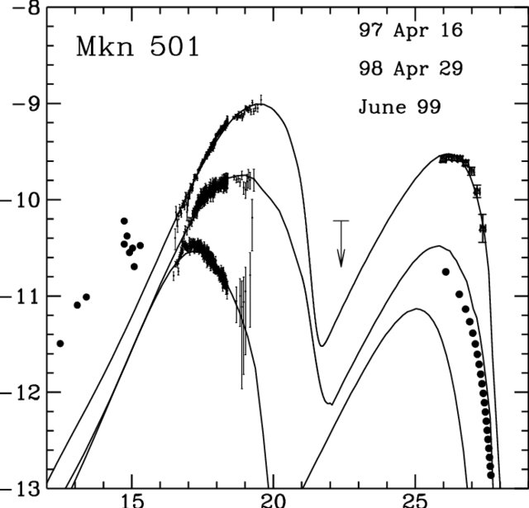
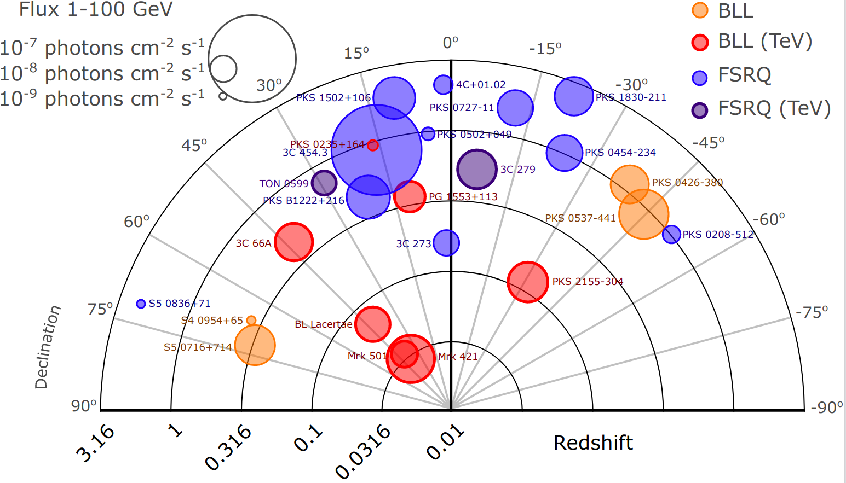
Introduction to Mrk 501
Tavecchio et al. 2008, ApJ
One of the nearest to Earth TeV blazars
Hard X-ray flares (E_{pk}> 10 keV)
Transient extreme blazar
Log(Flux)
Credit: S. Dimitrakoudis
Log(Frequency)

Slide 3
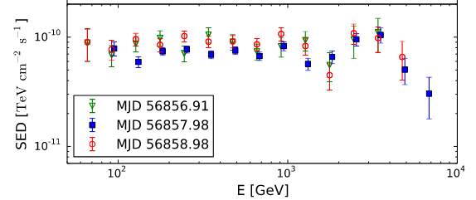
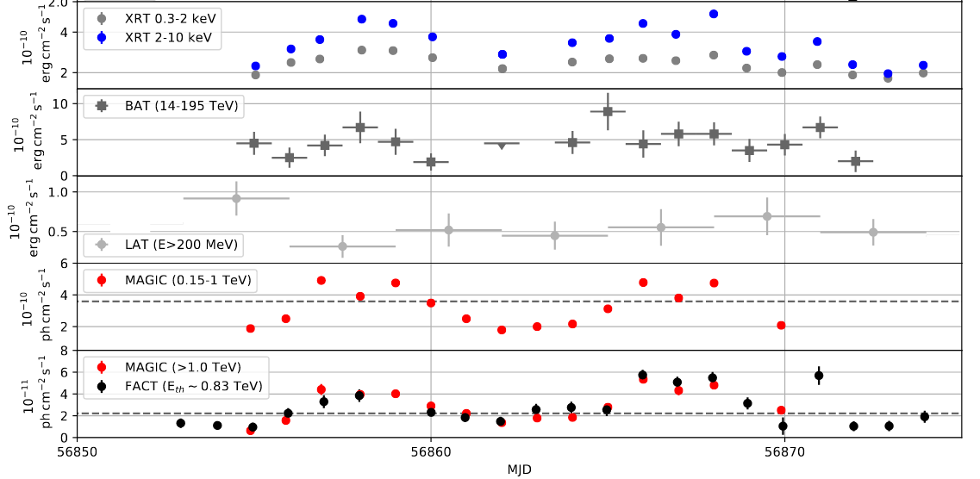
Motivation
X-ray & VHE flaring activity in July 2014
Narrow spectral feature at ~ 3 TeV
MAGIC Collaboration et al., 2020, A&A, 637, 86

Slide 4
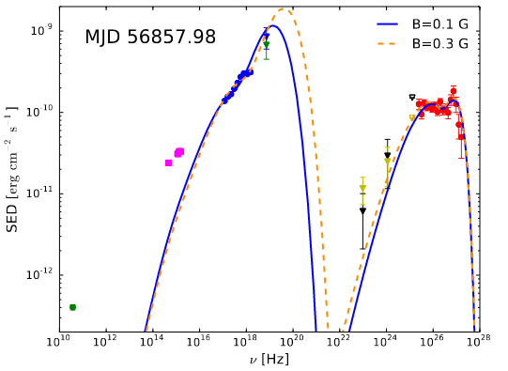
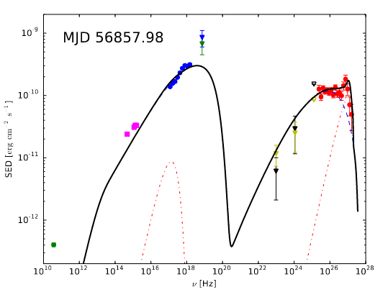
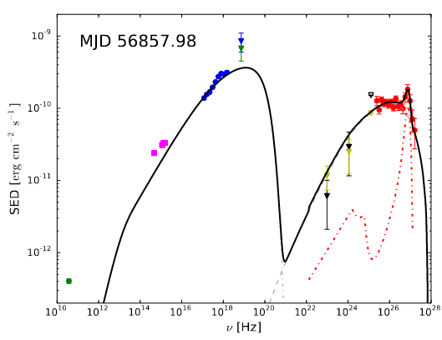
Various interpretations of TeV feature
SSC from piled-up EED
SSC from 2 emitting regions
SSC + IC cascade model
MAGIC Collaboration et al., 2020, A&A, 637, 86
(see also Wendel et al. 2021, A&A)

Slide 5
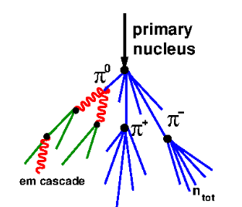
An alternative scenario
photon
proton
Narrow TeV spectral feature → monoenergetic protons with tens of TeV energy
Energetic target photons needed for pion production
Interaction with jet photons
Interaction with external photons

Slide 6
A simple model for high-energy flares
Multi-wavelength flare produced in the same region down the jet
TeV flare produced in the inner jet regions (within X-ray coronal field)
Photopion production on synchrotron jet photons
Photopion production on hard X-rays from corona

Slide 7
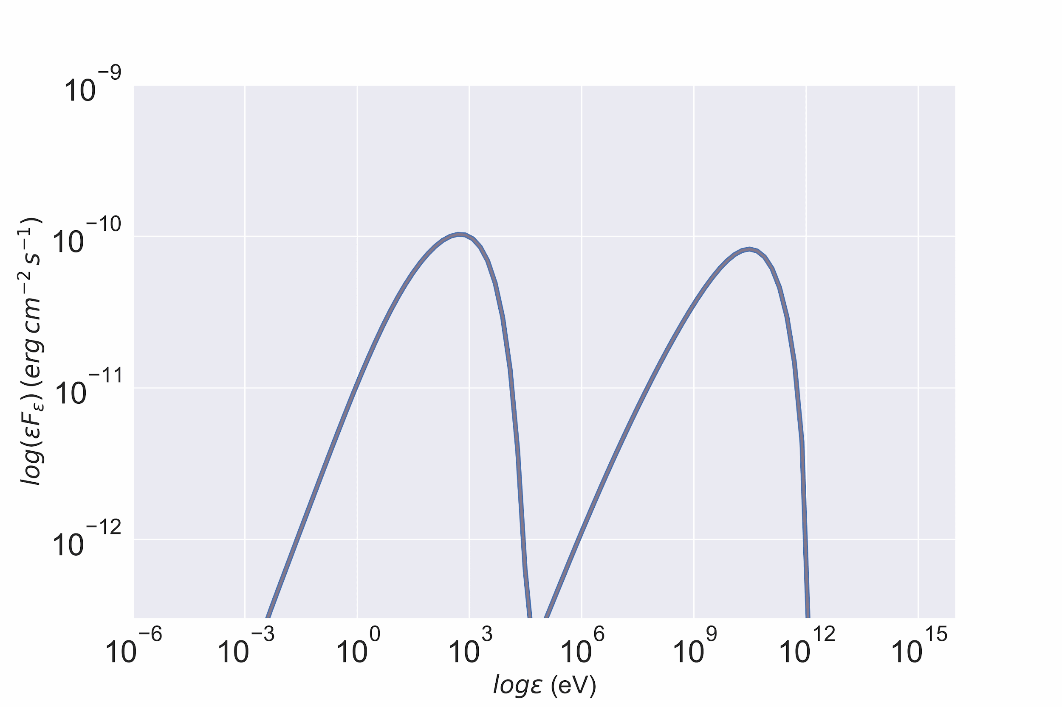
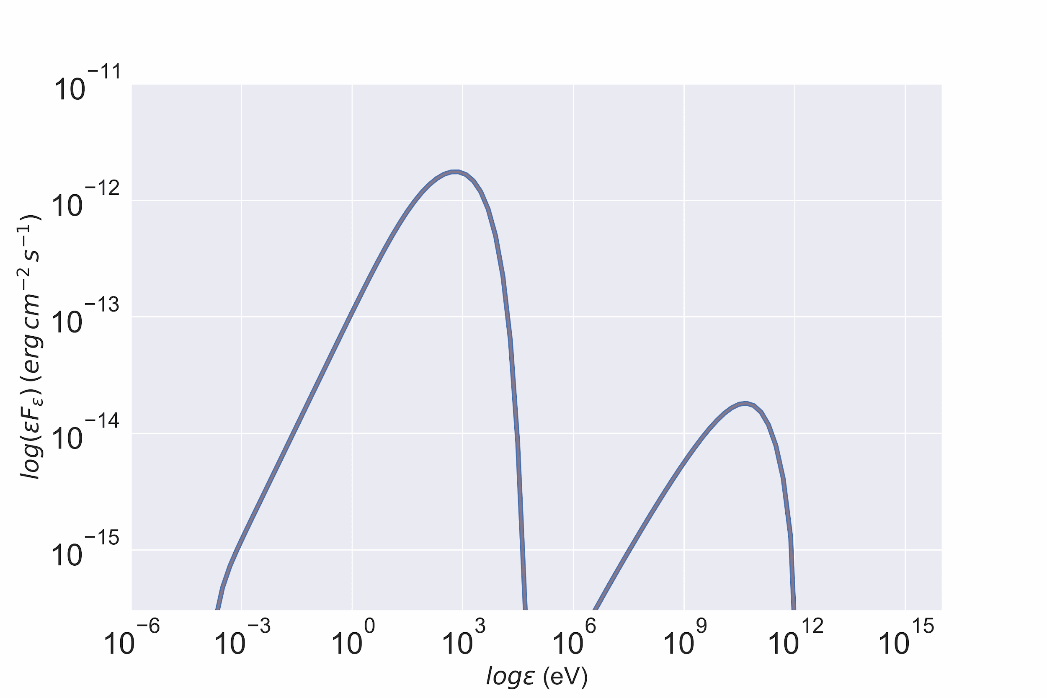
X-ray jet photons: SEDs
E_{e,max} = E_{p,max} = 32 TeV (Flare) and 1 TeV (Quiet) Other parameters: se = sp = 1.9, B=0.86 G, R=1e15 cm, δ=20
Hardening of TeV spectrum
Narrow TeV spectral feature

Slide 8
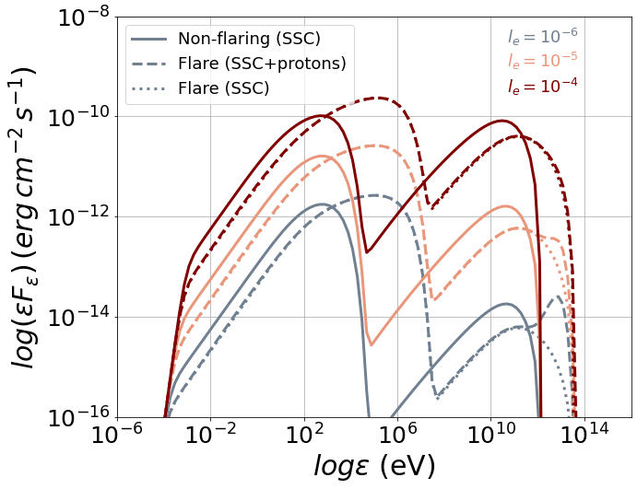
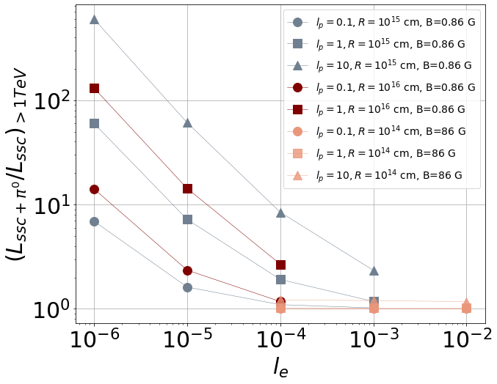
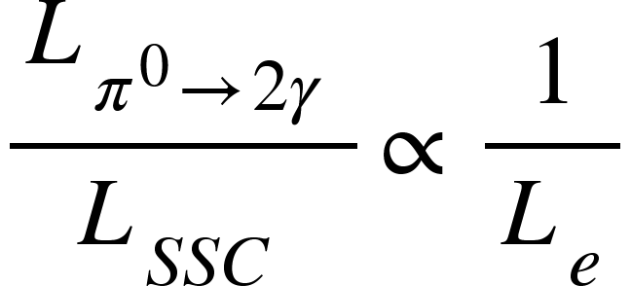
X-ray jet photons: SSC vs. π⁰ decay
As the electron luminosity increases, the SSC component hides the π⁰ bump:
Other parameters: B=0.86 G, R=1e15 cm, δ=20
Dimensionless electron luminosity

Slide 9
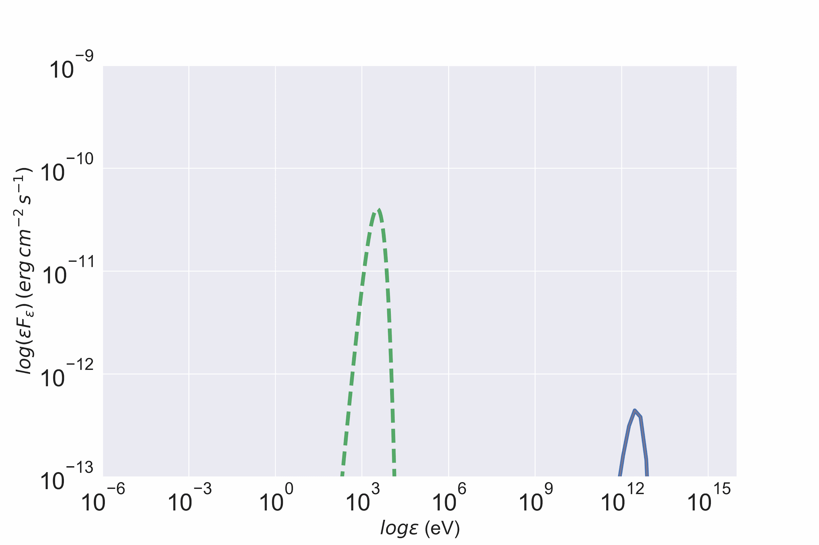
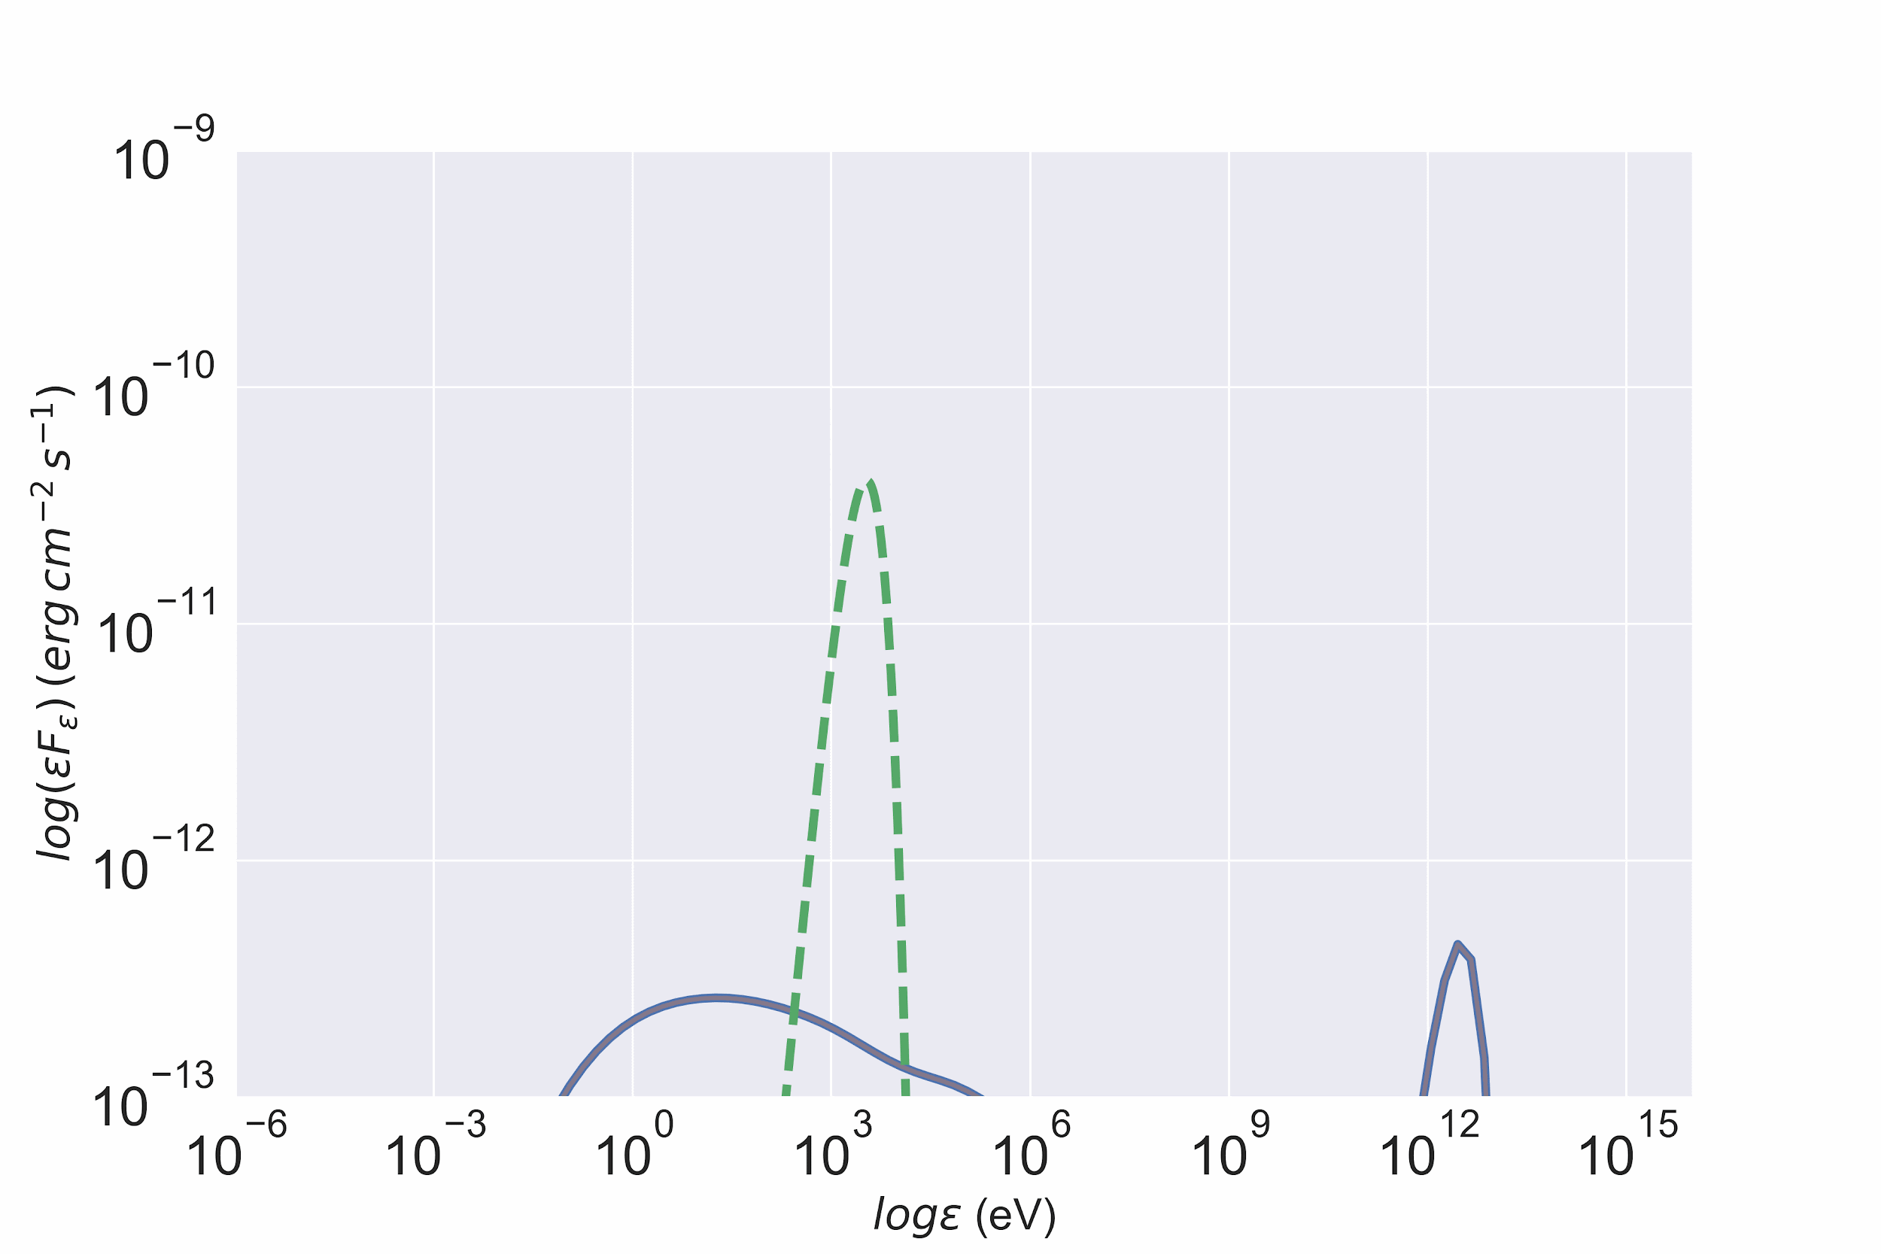
X-ray ambient photons: SEDs
Weak magnetic field (B=0.1 mG)
Strong magnetic field (B=0.1 kG)
Synchrotron of secondaries
Intrinsic γγ absorption
Greybody photon field
ICS of secondaries
Other parameters: δ=10, R=1e15 cm, Lp,j = 1e49 erg/s

Slide 10
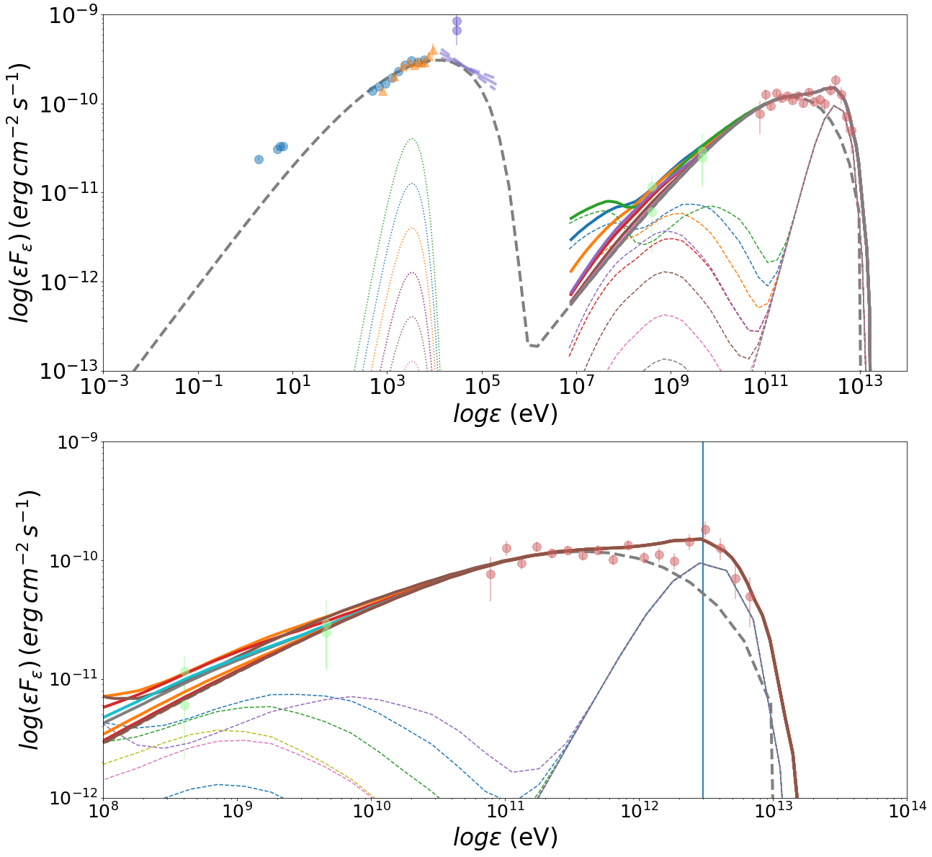
Application to Mrk 501
preliminary
MJD 56857.98
Different combinations of u_{ext} and L_{p} can lead to the same π⁰ γ-ray flux
Limits on u_{ext}/u_{B} can be placed using optical/UV + X-ray obs.
BAT
SSC
π⁰ - decay
ICS of secondaries
Data from MAGIC Collaboration et al., 2020, A&A

Slide 11
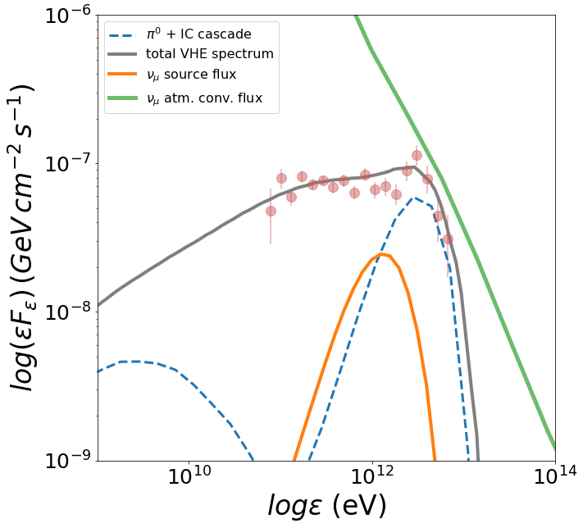
Neutrinos from flaring Mrk 501 ?
preliminary
Atmospheric muon neutrino flux from Honda et al. (HKKMS2007) plotted assuming ΔΩ= 1 deg
Source neutrino flux well hidden in the atmospheric background

Slide 12
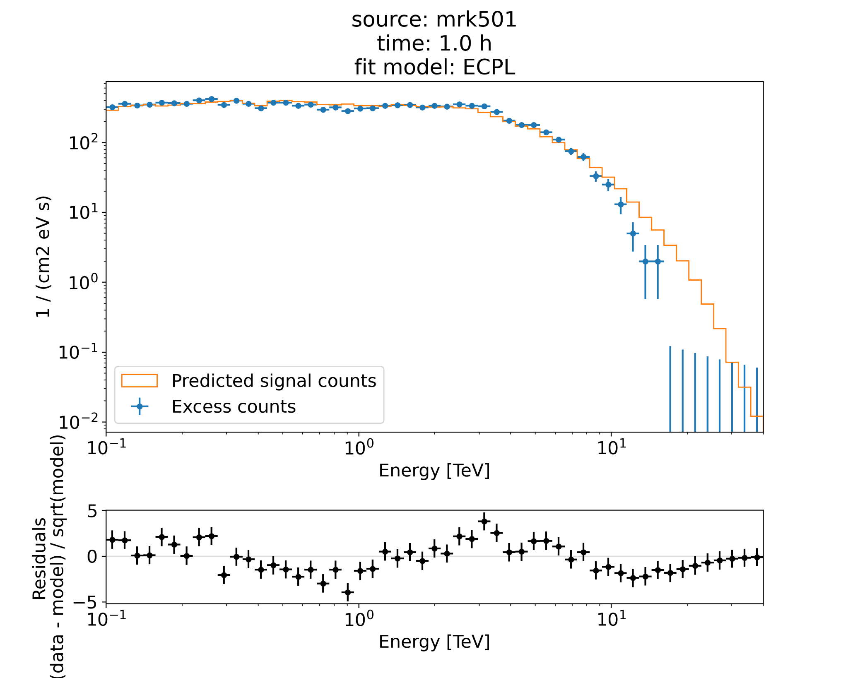
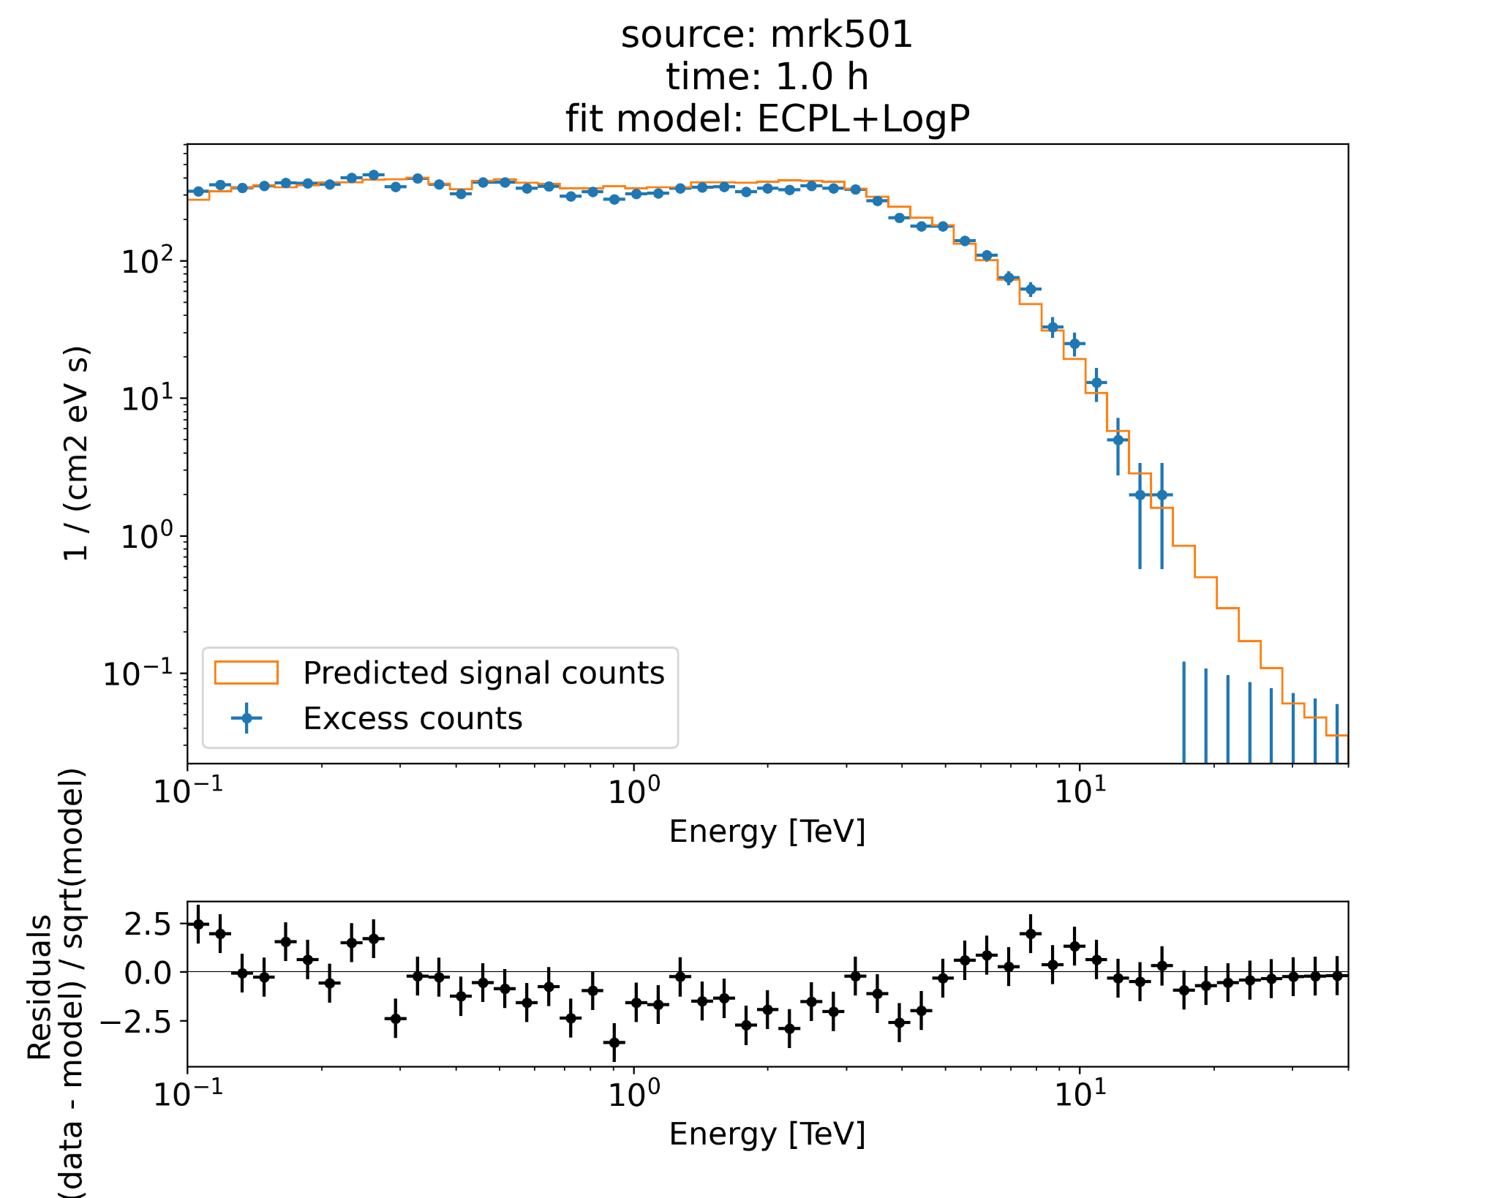
CTA: 1 hr exposure
Foivos Zanias
undergrad @ NKUA

Slide 13
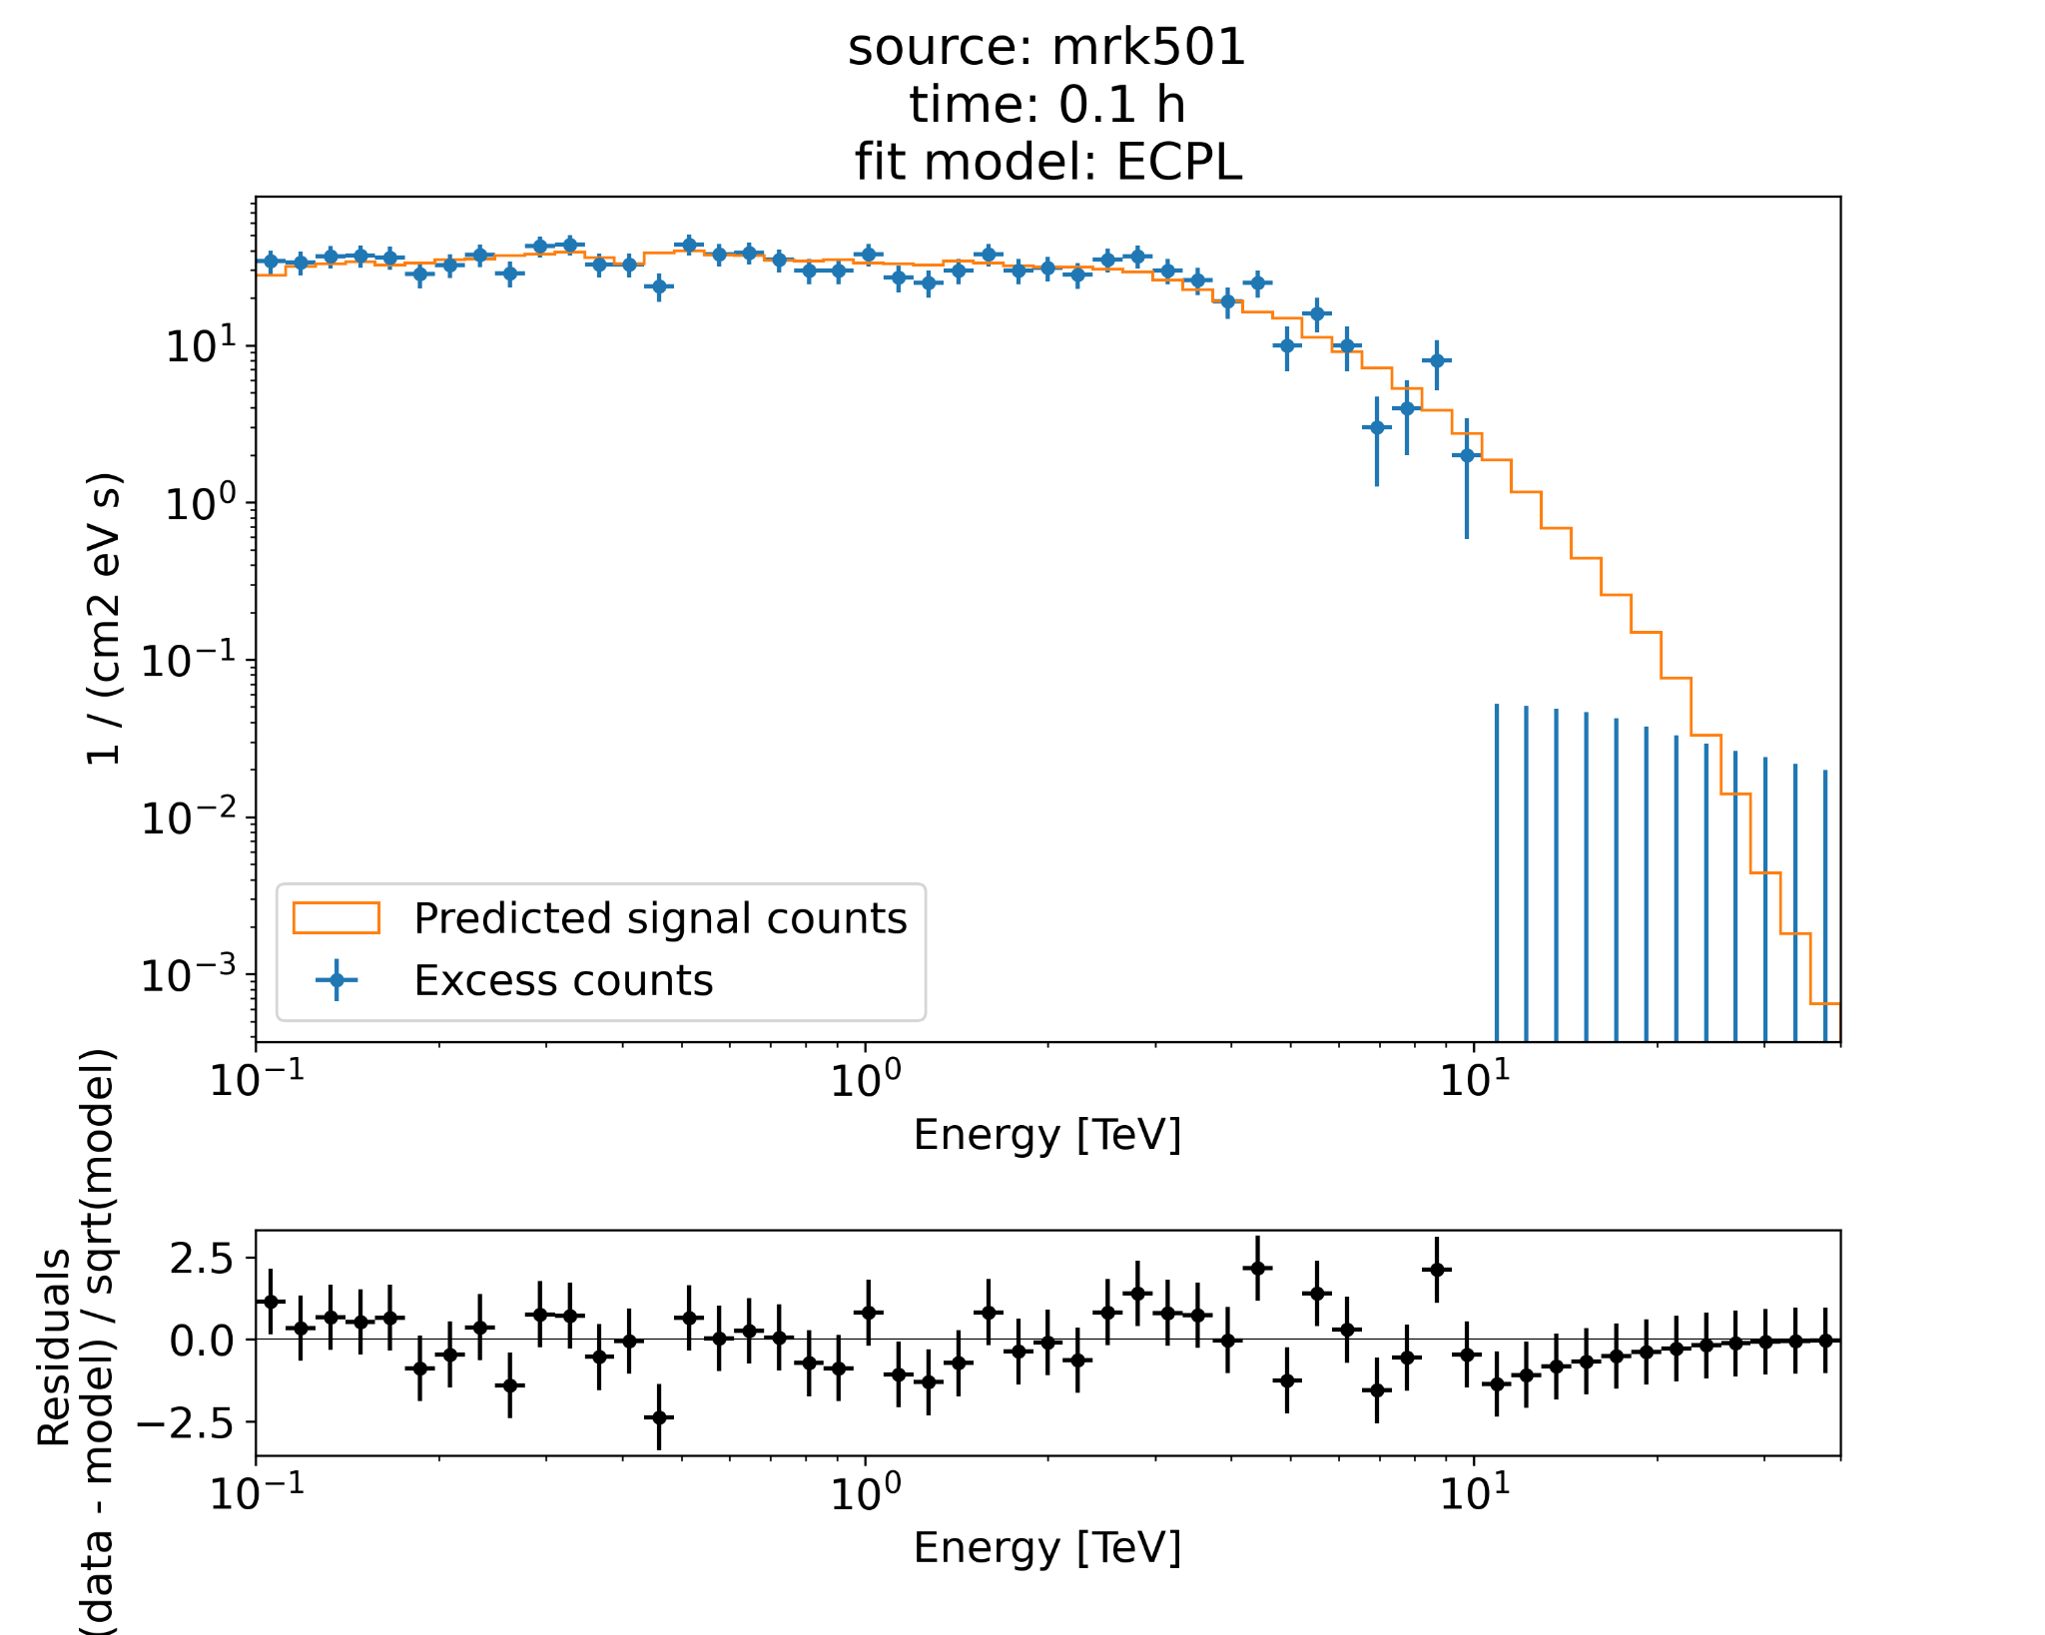
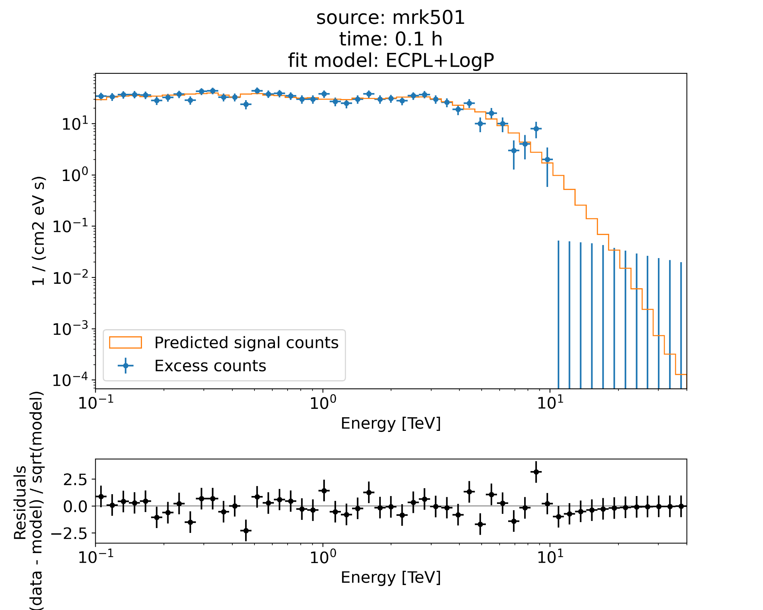
CTA: 0.1 hr exposure
Foivos Zanias
undergrad @ NKUA

Slide 14
Conclusions
Intermittent proton acceleration to tens of TeV in flaring blazars can lead to transient narrow TeV spectral features from π⁰ decay
Effectively mono-energetic proton distributions and hard X-ray / soft γ-ray photons are needed
TeV neutrinos with similar flux as the VHE feature are expected. Neutrino signal hidden in the atmospheric background, unless bumps at E > 30 TeV are discovered!
Preliminary application to the VHE data of Mrk 501 in July 2014 is promising
CTA will be able to better resolve such features with exposure times < 1 hr and allow searches for time variability
Thank you!
Contact email: mpetropo@phys.uoa.gr
Petropoulou, Mastichiadis, Paneque et al., in prep.

Slide 15
Back-up slides

Slide 16
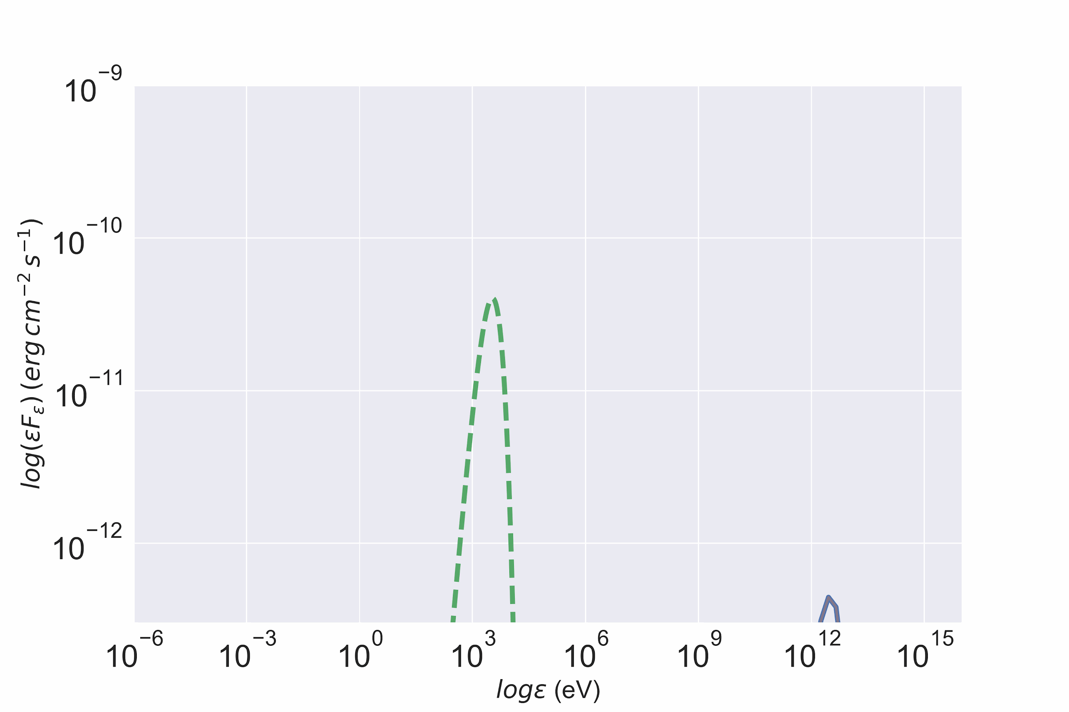
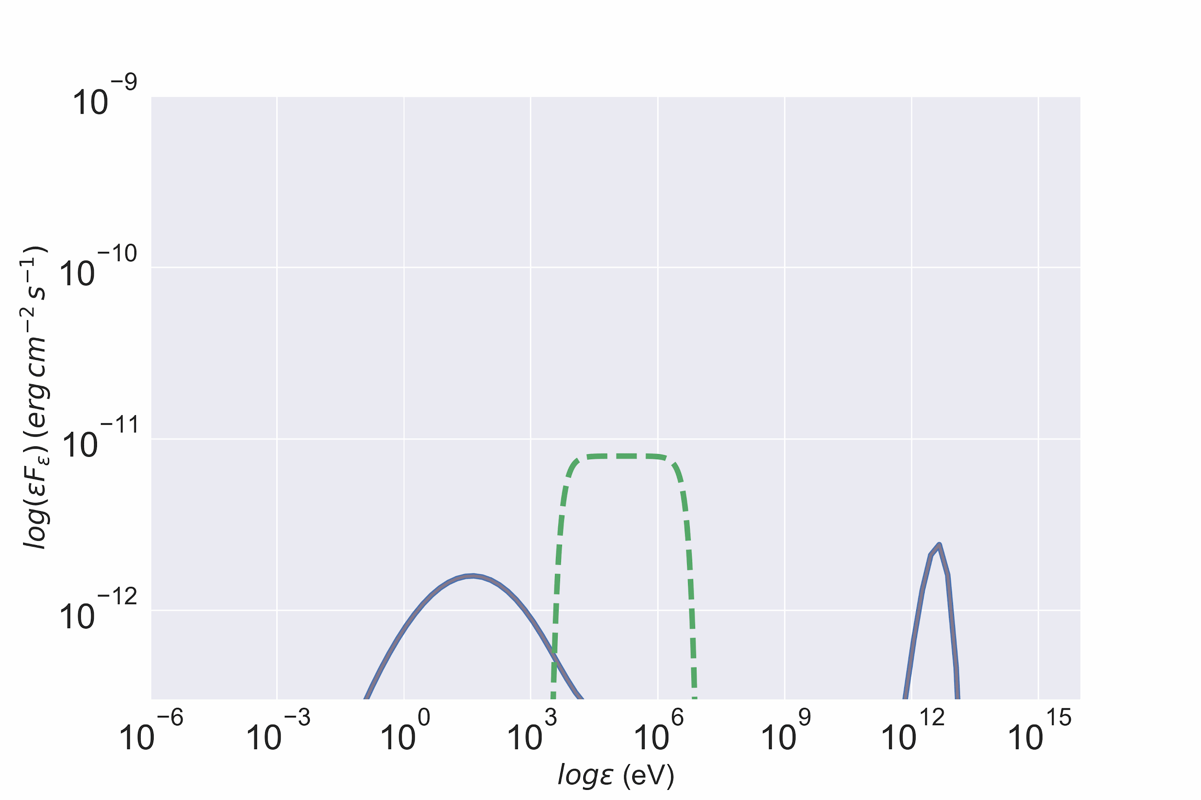
X-ray ambient photons: SEDs - 2
Strong magnetic field (B=0.1 kG)
Grey-body photon field
Power-law photon field
Other parameters: δ=10, R=1e15 cm, Lp,j = 1e49 erg/s

Slide 17
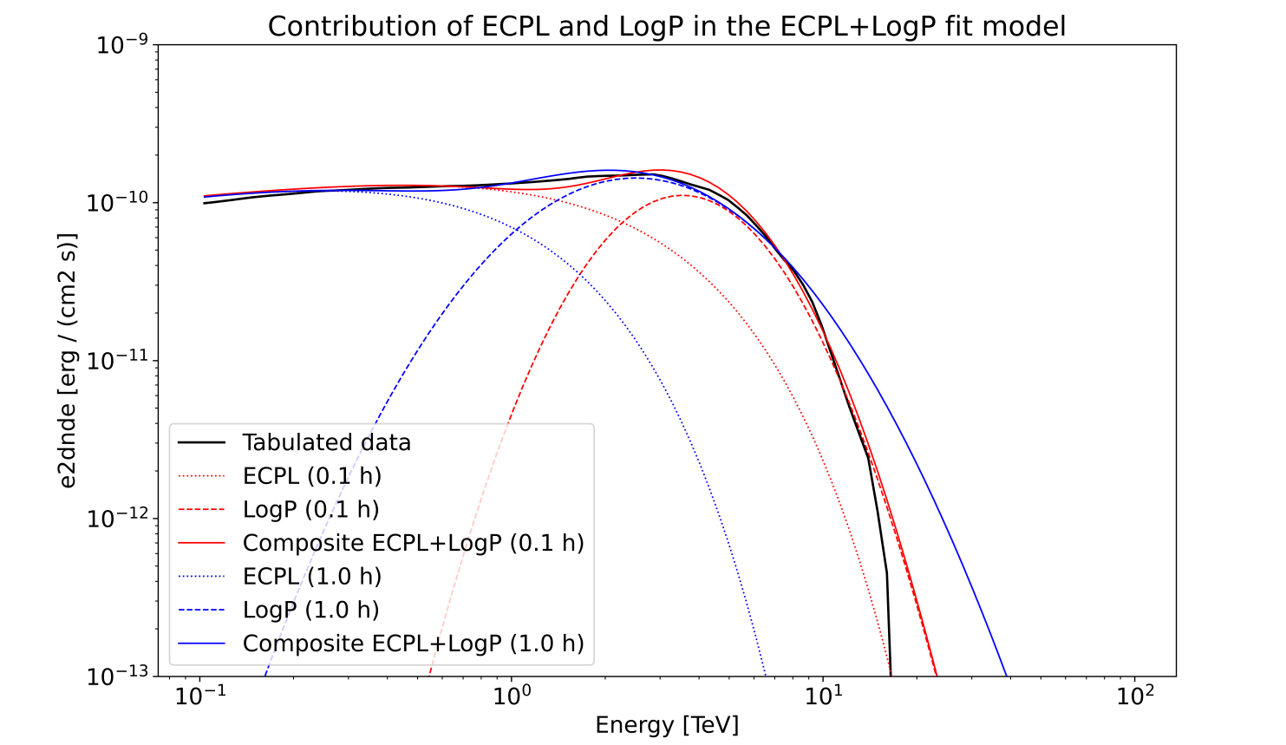
Comparison of composite models
Foivos Zanias
undergrad @ NKUA

Slide 18
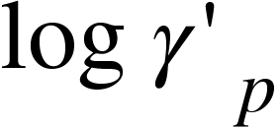
Energetics
Power in relativistic protons:
Effectively monoenergetic proton distribution
Extended proton distribution

