Slide 1
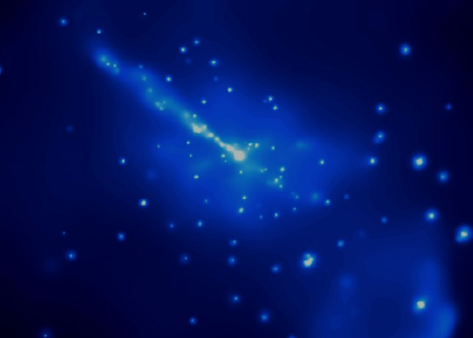



A Shock-in-Jet Synchrotron Mirror Model for Blazars
0
Markus Böttcher
North-West University
Potchefstroom, South Africa
In collaboration with Matthew Baring (Rice University, Houston, TX, USA)
Based on: Böttcher, M., 2021: Physics, vol. 3, Issue 4, p. 1112
Supported by the South African Research Chairs Initiative (SARChI) of the Department of Science and Innovation and the National Research Foundation of South Africa.

Slide 2
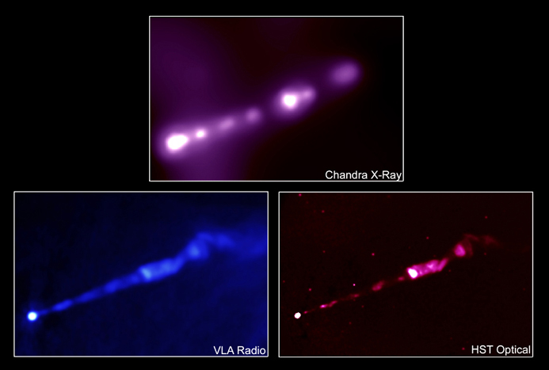
Relativistic Shocks in Jets
Internal Shocks: likely sites of relativistic particle acceleration.
Most likely mildly relativistic, βγ ~ 1
Efficient Diffusive Shock Acceleration at mildly relativistic, oblique shocks produces relativistic, non-thermal electron distributions which can be as hard as n_{e}(γ) ~ γ⁻¹, depending on B-field obliquity and efficiency of pitch-angle scattering.
Key parameter: Mean free
path for pitch-angle scattering:
λ_{pas} = η₁ r_{g}(p) p^{α−1}
Jet of M87 at different wavelengths

Slide 3
Example: FSRQ 3C279
Extended
flaring period
2013 – 2014
Variability time scale
~ 1 day
(Hayashida et al. 2015)

Slide 4
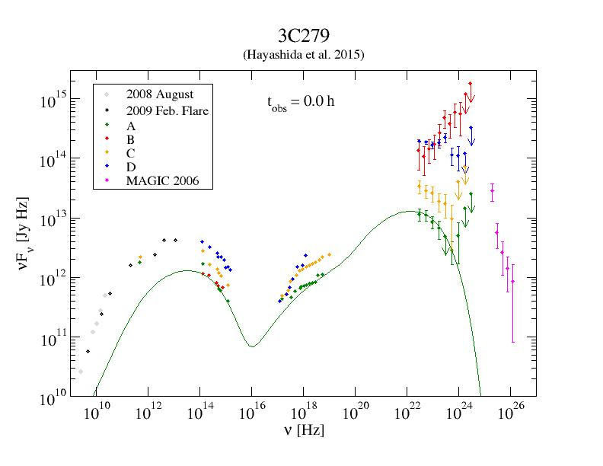
Example: FSRQ 3C279 (2013 – 2014)
λ_{pas} = 300 r_{g} γ²
η₁ = 300
α = 3
B = 0.65 G
δ = 15
R = 1.8*10¹⁶ cm
→ Δt’ ~ few*10⁵ s
→ Δt_{obs} ~ few hr
γ-rays EC (Dust Torus) dominated:
u = 4*10⁻⁴ erg/cm³
T_{BB} = 300 K
A = Low State
Flare C:
ΔF_{γ} / F_{γ} ~ ΔF_{opt} / F_{opt}
(Böttcher & Baring 2019)

Slide 5
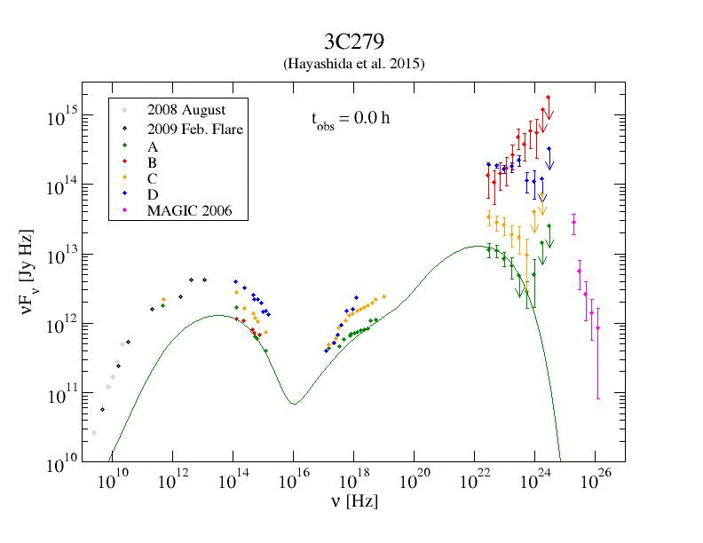
3C279 – Flare C
Flare modeled with
L_{inj} = 1.1x10⁴³
→ 5.0x10⁴³ erg/s
(Böttcher & Baring 2019)

Slide 6
Example: FSRQ 3C279
Flare B
(December 2013):
Orphan γ-ray flare
(Hayashida et al. 2015)

Slide 7
Example: FSRQ 3C279 (2013 – 2014)
λ_{pas} = 300 r_{g} γ²
η₁ = 300
α = 3
B = 0.65 G
δ = 15
R = 1.8*10¹⁶ cm
→ Δt’ ~ few*10⁵ s
→ Δt_{obs} ~ few hr
γ-rays EC (Dust Torus) dominated:
u = 4*10⁻⁴ erg/cm³
T_{BB} = 300 K
A = Low State
Flare B: ΔF_{γ} / F_{γ} >> ΔF_{opt} / F_{opt}
(Böttcher & Baring 2019)

Slide 8
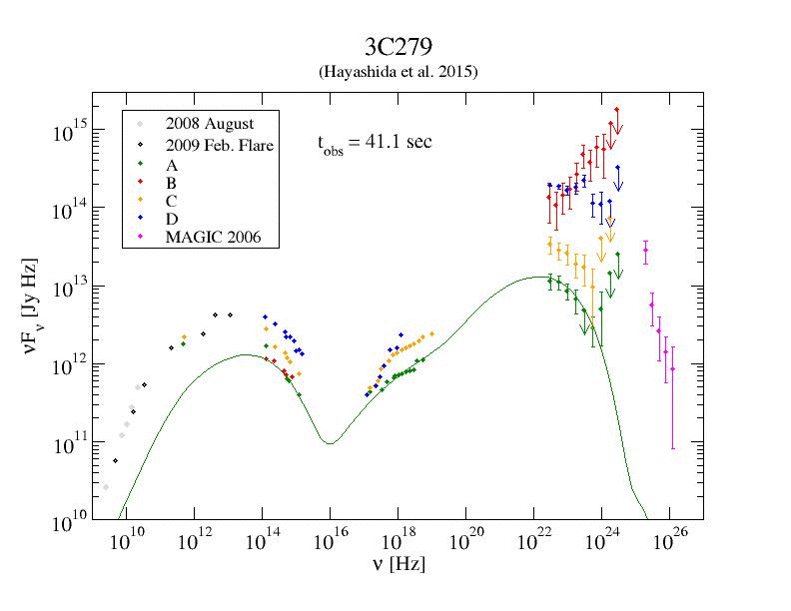
3C279 – Flare B
Flare modeled with
L_{inj} = 1.1x10⁴³
→ 4.0x10⁴⁴ erg/s
η₁ = 100 → 10
= 3.0 → 2.3
Harder electron spectrum
B = 0.65 → 0.075
with gradual recovery after shock passage:
(Böttcher & Baring 2019)

Slide 9
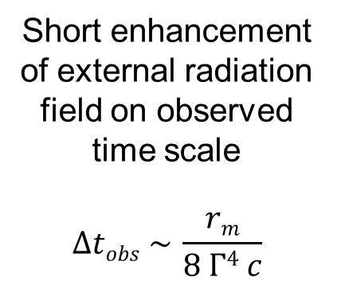
Alternative Idea: Synchrotron Mirror
Originally proposed by Ghisellini & Madau (1996); Böttcher & Dermer (1998); Bednarek (1998);
further developed by Vittorini et al. (2014); Tavani et al. (2015)
r_{m}
Short enhancement of external radiation field on observed time scale
$$∆tobs \sim \frac{rm}{8 Γ4 c}$$
(Böttcher & Dermer 1998)

Slide 10
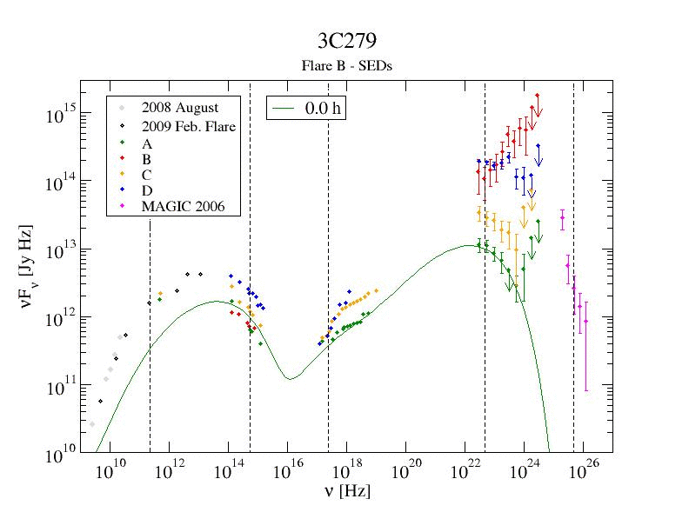
3C279 Flare B with the Synchrotron Mirror Model?
Keeping all shock parameters constant:
Only moderate orphan flare, irrespective of mirror parameters, due to limited energy budget.
Impossible to reproduce large orphan flare (Flare B)
Suppression of synchrotron emission due to increased radiative cooling.

Slide 11
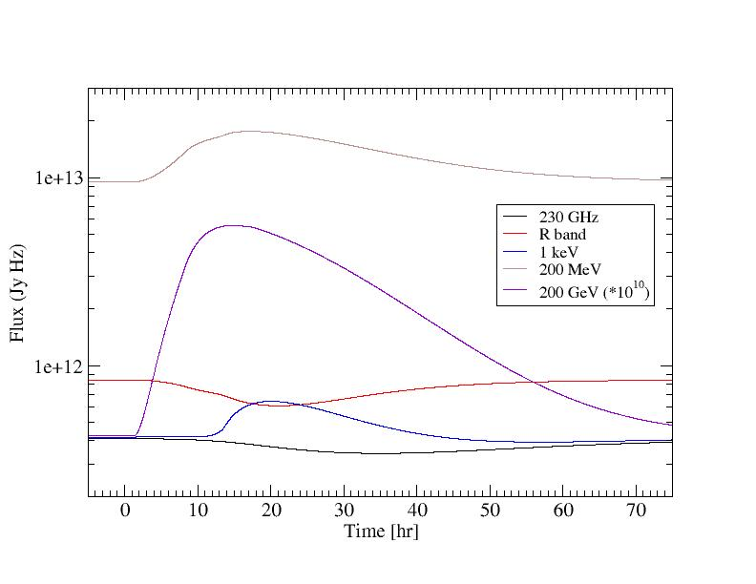
Spectral Variability Features of the Shock-in-Jet Synchrotron Mirror Model
Multi-wavelength lightcurves

Slide 12
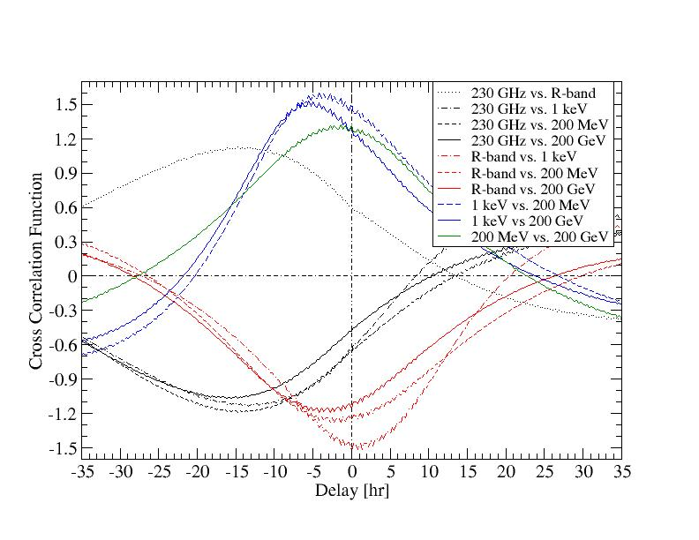
Spectral Variability Features of the Shock-in-Jet Synchrotron Mirror Model
Cross-Correlations
Radio and optical anti-correlated with X-ray and γ-ray emission.
Radio dip delayed by ~ 10 – 20 hr behind flares / dips in other wavebands.

Slide 13
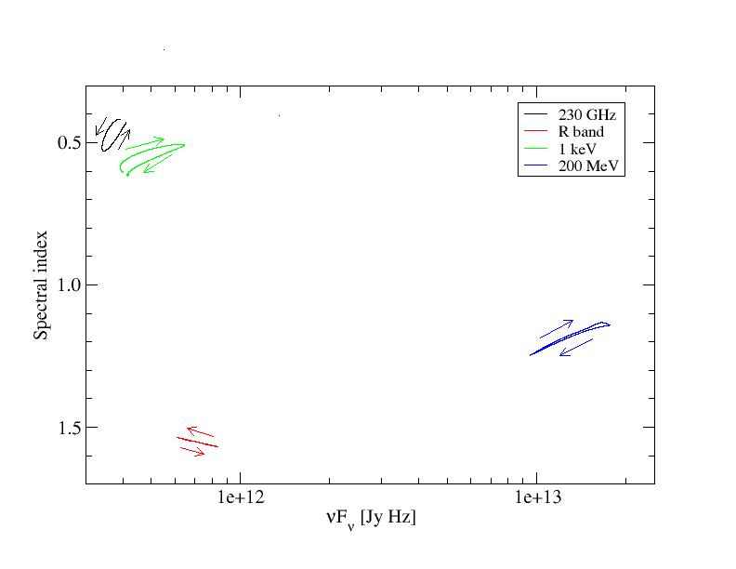
Spectral Variability Features of the Shock-in-Jet Synchrotron Mirror Model
Hardness-Intensity Diagrams
No significant spectral hysteresis in any waveband.
Harder-when-brighter trend in all wavebands, except optical (synchrotron).

Slide 14
Summary
0
Time-dependent, coupled MC Simulations of Diffusive Shock Acceleration and radiation transport: Naturally capable of reproducing MWL flares with roughly equal flare amplitude in synchrotron and Compton SED components (e.g., flare C of 3C279 in 2013).
Flares with strongly increased Compton dominance (incl. orphan γ-ray flares, e.g. flare B of 3C279 in 2013) require fine-tuned B-field evolution to avoid simultaneous synchrotron flares.
Alternative interpretation through synchrotron mirror scenario plausible, but without increased energy input into electrons, only moderate orphan flares can be produced.
Significant anti-correlations between synchrotron (radio – optical) and Compton (X-rays – γ-rays) with radio time lags of ~ 10 – 20 hours.
No significant spectral hysteresis, with harder-when brighter trend in most wavebands, except optical.
Supported by the South African Research Chairs Initiative (SARChI) of the Department of Science and Technology and the National Research Foundation of South Africa.

Slide 15
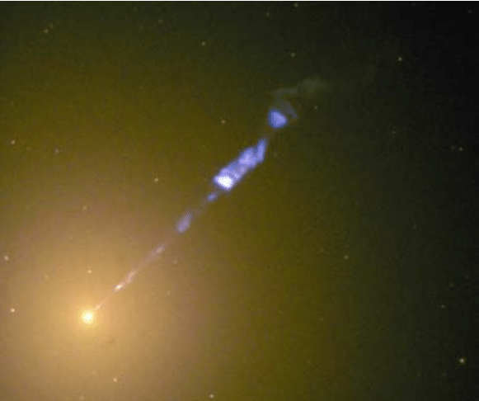
Thank you!
Any opinion, finding and conclusion or recommendation expressed in this material is that of the authors and the NRF does not accept any liability in this regard.

Slide 16
Backup Slides

Slide 17
Monte-Carlo Simulations of Diffusive Shock Acceleration (DSA)
Gyration in B-fields and diffusive transport (pitch-angle diffusion) modeled by a Monte Carlo technique.
Shock crossings produce net energy gains → first-order Fermi.
(Summerlin & Baring 2012)
Pitch-angle diffusion parameterized through a mean-free-path (λ_{pas}) parameter η (p):
λ_{pas} = η(p)*r_{g} ~ p^{α} (α ≥ 1)

Slide 18
Shock Acceleration Spectra
Particle spectra as hard as n(γ) ~ γ⁻¹ possible!
Baring et al. (2017)
Non-thermal particle spectral index and thermal-to-non-thermal normalization are strongly dependent on η₀, α, and B-field obliquity!

Slide 19
Time-Dependent Electron Evolution with Radiative Energy Losses
Acceleration time scale:
for almost all electrons
Use shock-accelerated electron spectrum (MC simulations of DSA by Summerlin & Baring 2012) as instantaneous injection Q_{e}(γ);
Solve Fokker-Planck Equation for electrons:
∂n_{e} (γ,t)
.
______
∂
__
n_{e} (γ,t)
______
= - (γ n_{e}) + Q_{e} (γ,t) -
∂t
∂γ
t_{esc,e}

Slide 20
Numerical Scheme
Injection spectra from turbulence characteristics + MC simulations of DSA
Injection from small acceleration zone (shock) into larger radiation zone
Time-dependent leptonic code based on Böttcher & Chiang (2002)
Radiative processes:
  Synchrotron
  Synchrotron self-Compton (SSC)
  External Compton (EC: dust torus + BLR + direct accretion disk)
L’
Shock injection “on” for
0 < Δt’ < L’/v’_{s}
Γ
β_{s}
Q_{e,s}(γ,t’) = Q_{e,s}(γ) H(t’; 0, Δt’)

Slide 21
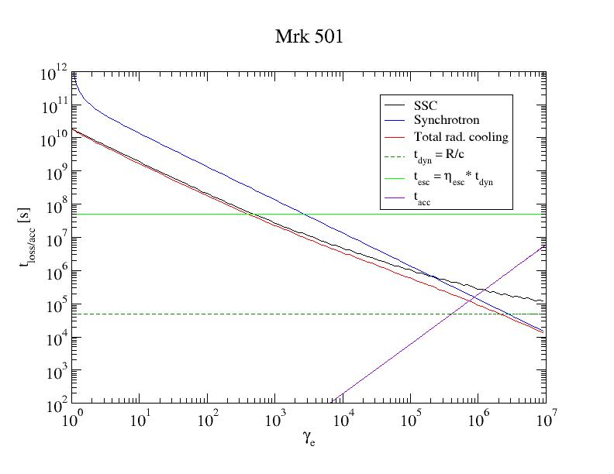
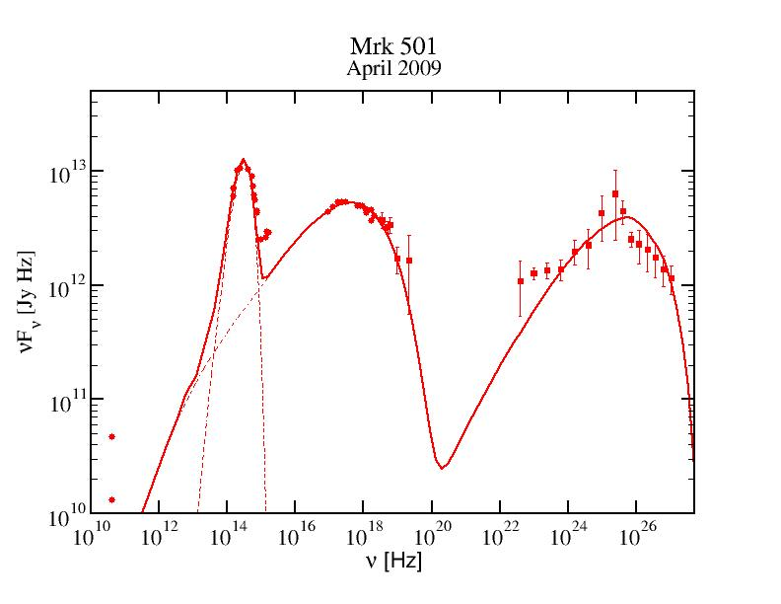
Electron Evolution Time Scales

Slide 22
Acceleration Indices for Oblique Shocks
(Summerlin & Baring 2012)
Non-thermal spectra as hard as n(p) ~ p⁻¹ achievable for moderately sub-luminal shocks.

Slide 23
Constraints from Blazar SEDs
Synchrotron peak ↔ γ_{max}
Balance t_{acc} ~ η(γ) ω_{gyr}(γ)⁻¹
with radiative cooling time scale
If synchrotron cooling dominates:
γ_{max} ~ B^{-1/2} [η(γ_{max})]^{-1/2}
hν_{sy} ~ 100 δ [η(γ_{max})]⁻¹ MeV (independent of B-field!)

Slide 24
Constraints from Blazar SEDs
hν_{sy} ~ 100 δ [η(γ_{max})]⁻¹ MeV (independent of B-field!)
Need large η(γ_{max}) to obtain synchrotron peak in optical/UV/X-rays
But: Need moderate η(γ ~ 1) for efficient injection of particles into the non-thermal accelerations scheme
Need strongly energy dependent pitch-angle scattering m.f.p., with α > 1 (Baring et al. 2017)

Slide 25
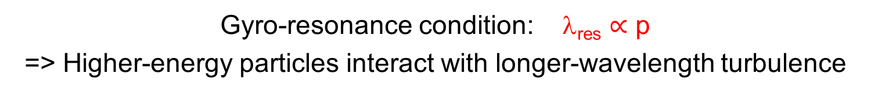
Implications for Shock-Induced Turbulence
Gyro-resonance condition: λ_{res} $∝$ p
=> Higher-energy particles interact with longer-wavelength turbulence
Stirring Scale ~ R
Inertial Range
Energy density W(k)
Dissipation Scale
k_{stir} ~ 2π/R
k = 2π/λ
Turbulence level decreasing with increasing distance from the shock
High-energy (large r_{g}) particles “see” reduced turbulence
Large λ_{pas}

Slide 26
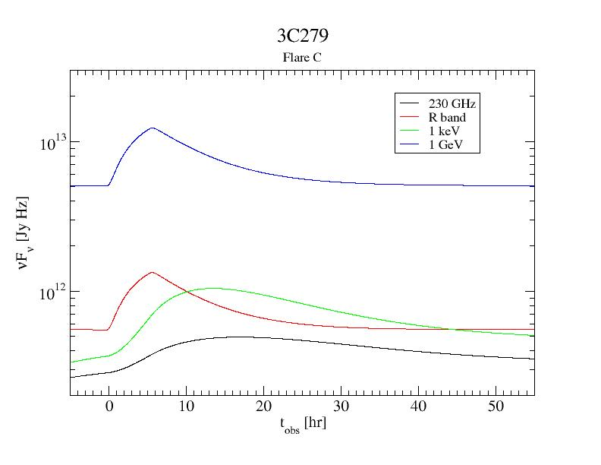
3C279 – Flare C
Model Light Curves

Slide 27
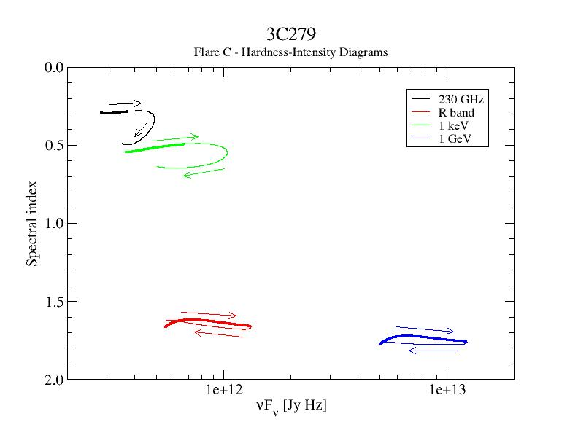
3C279 – Flare C
Hardness-Intensity Diagrams
Sy. (LE)
SSC (LE)
Sy. (HE)
EC (HE)

Slide 28
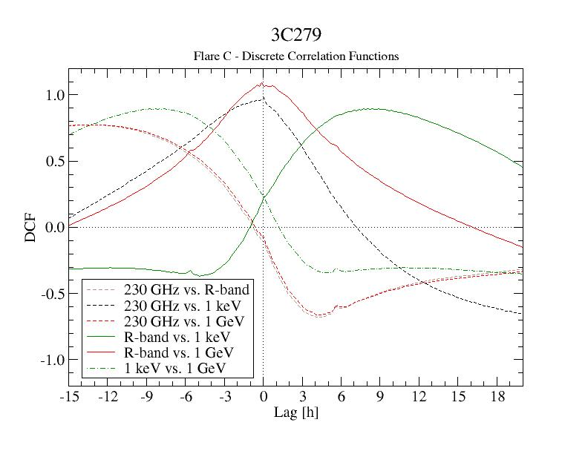
3C279 – Flare C
Discrete Correlation Functions
Optical and γ-rays well correlated
(0 lag)
X-rays and radio well correlated (0 lag)
X-rays and radio lag optical + γ-rays by
~ 7 - 9 hr)

