Slide 1
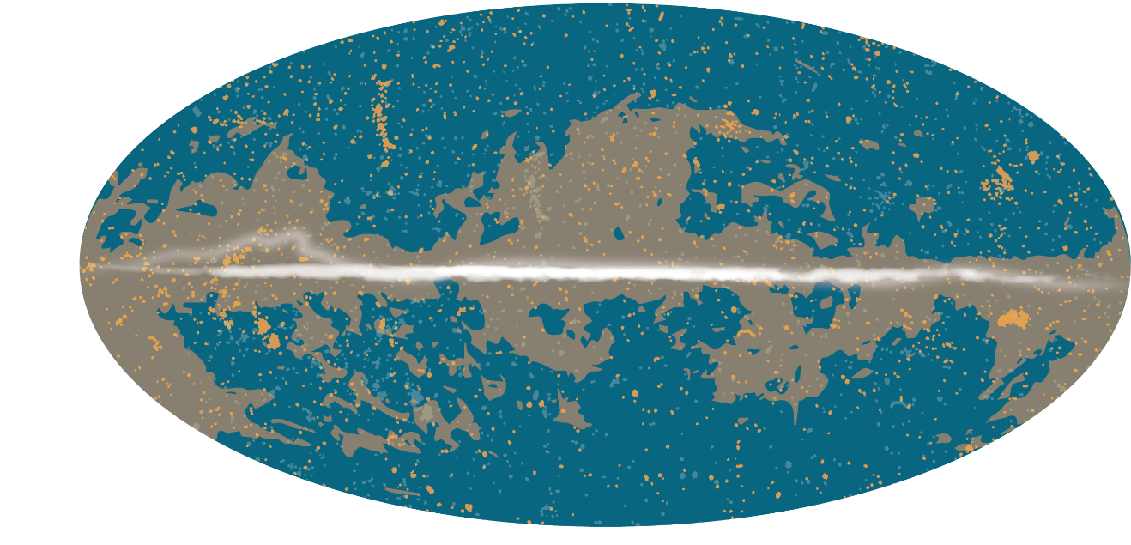
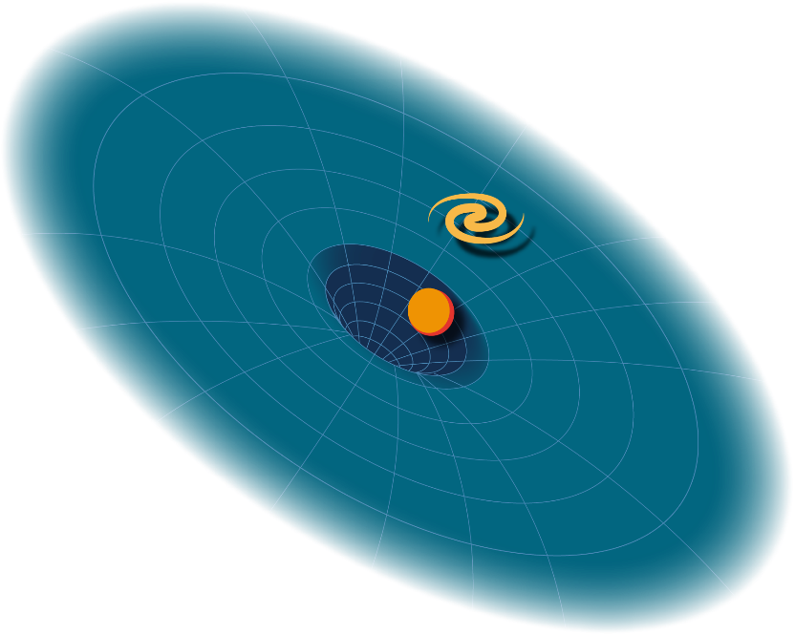
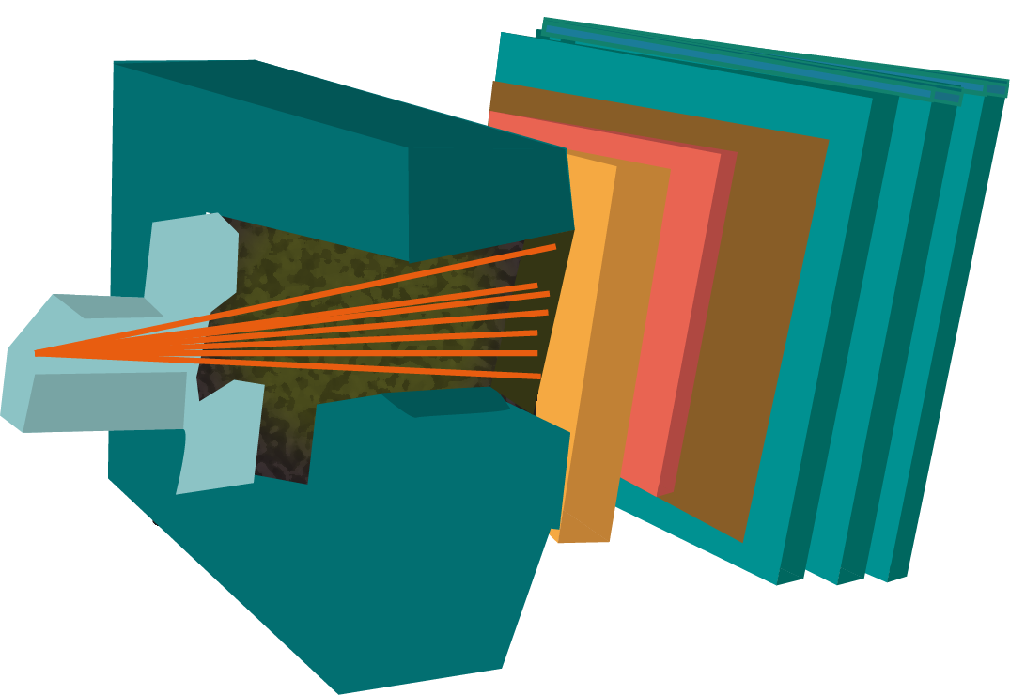
How can we help?
Esther Pallares Guimera
Institute of Cosmos Sciences
Notes:
Welcome! My name is Esther Pallarés, the ICCUB’s manager, and today I would like to explain to our newest membres, but also remind to our senior researchers, how can we help you.

Slide 2
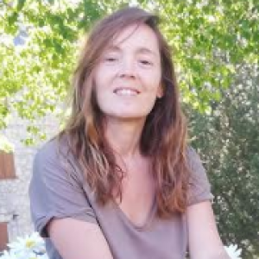
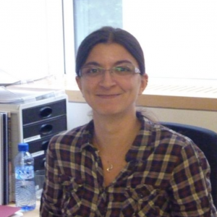
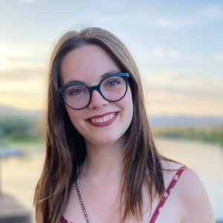
First of all, who are we?
Anna Argudo Míriam Gutiérrez Kayla MacDuff Esther Pallarés
Scientific office - V504 Administrative office - V504 Scientific office - V504
Notes:
First of all, let me introduce you our staff: Anna Argudo, Míriam Gutiérrez, Kayla MacDuff and me. Anna and me are in the V504 office and Miriam and Kayla at the V500 office, next to the elevators. At the scientific office, we are focused on communication, outreach and reports mainly. However, at the administrative office they welcome our new membres and

Slide 3
Administrative support
Esther Pallarès
Defines roles and assigns tasks according to the priorities established by the Executive Board, the council, and the different committes and comissions
Defines roles and assigns tasks according to the priorities established by the Executive Board, the council, and the different committes and comissions
ICCUB Scientific Office
ICCUB Scientific Office
ICCUB Administrative Office
ICCUB Administrative Office
Esther Pallarès, Anna Argudo
[secretariacientifica@icc.ub.edu]
Miriam Gutiérrez, Kayla Macduff [secretaria@icc.ub.edu]
New member registration
Control of ICCUB budget and contracts
Assistance to MdM visitors and new members
Office assignment and maintenance (ICCUB-IEEC and ICCUB-Tech)
Administrative support to EU grants
Control of scientific production & Scientific reports
ICCUB web page & Intranet
Organization of ICCUB activities
News & Press releases (in coordination with UB Press)
Support to competitive calls such as MdM
Registration of new ICCUB members
New member registration
Control of ICCUB budget and contracts
Assistance to MdM visitors and new members
Office assignment and maintenance (ICCUB-IEEC and ICCUB-Tech)
Administrative support to EU grants
Control of scientific production & Scientific reports
ICCUB web page & Intranet
Organization of ICCUB activities
News & Press releases (in coordination with UB Press)
Support to competitive calls such as MdM
Registration of new ICCUB members
Dep. Secretaries
FQA-ICCUB IT Outreach
Dep. Secretaries
ICCUB Outreach
FQA-ICCUB IT Support
FQA-ICCUB IT Support
Anna Argudo
Esther Pallarés
[divulgacio@fqa.ub.edu]
Dani Molina, Jordi Vidal, Joan Puigdueta, Miquel Mateos
[support@icc.ub.edu]
J.R. Rodríguez and his team
Economic management of projects
For MdM, the ICCUB Administrative Office will act as intermediary to help visitors and members, and to control the budget.
Itinerant exhibitions
Outreach webpages
Volunteers for media requests
Support to the organization of outreach activities
Corporative image
Economic management of projects
For MdM, the ICCUB Administrative Office will act as intermediary to help visitors and members, and to control the budget.
Itinerant exhibitions
Outreach webpages
Volunteers for media requests
Support to the organization of outreach activities
Corporative image
Servers maintenance
email maintenance
Printers maintenance
Assistance to users
Video registration (ICCUB Colloquia)
Members
Members

Slide 4
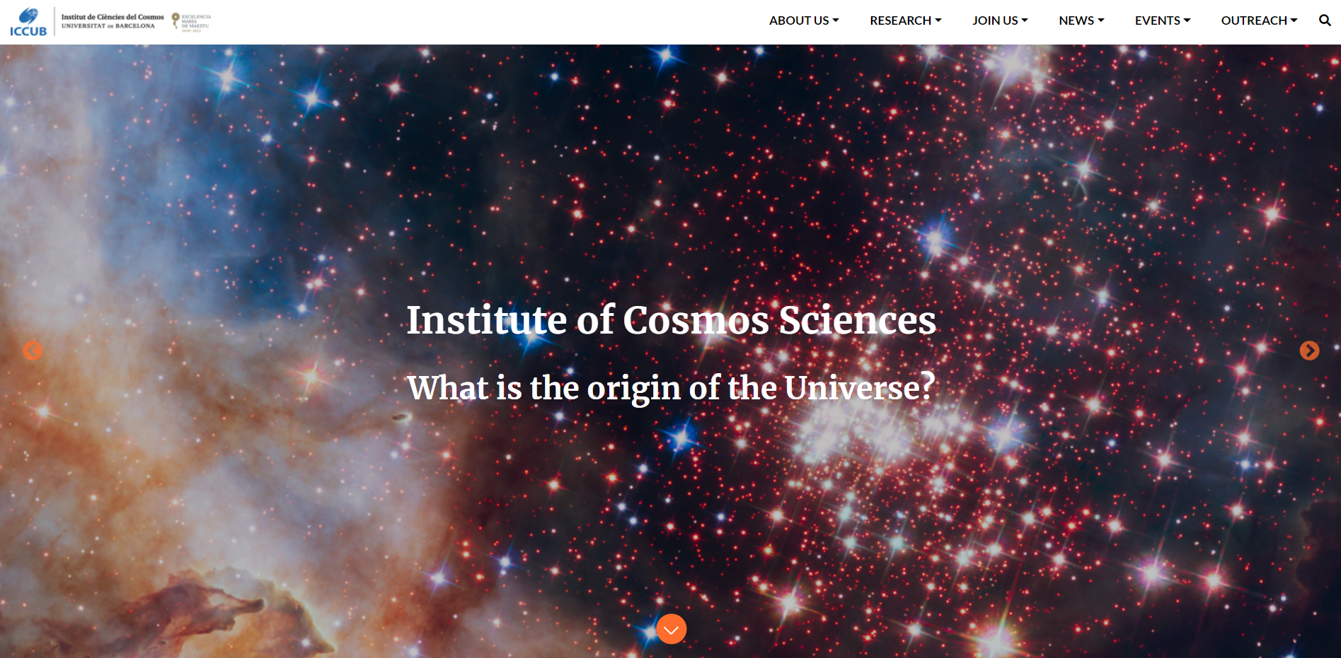
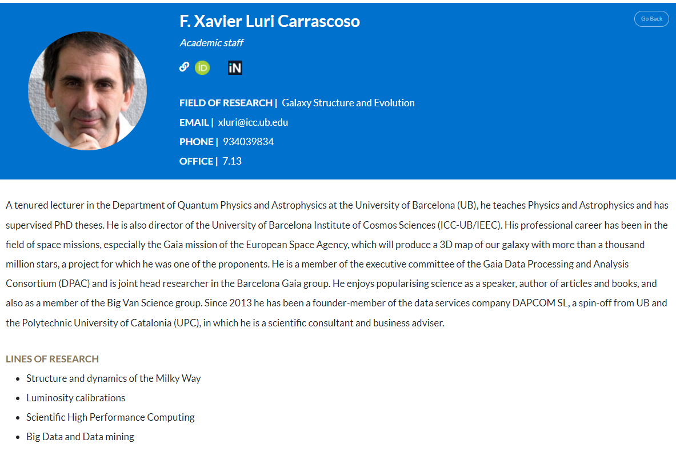
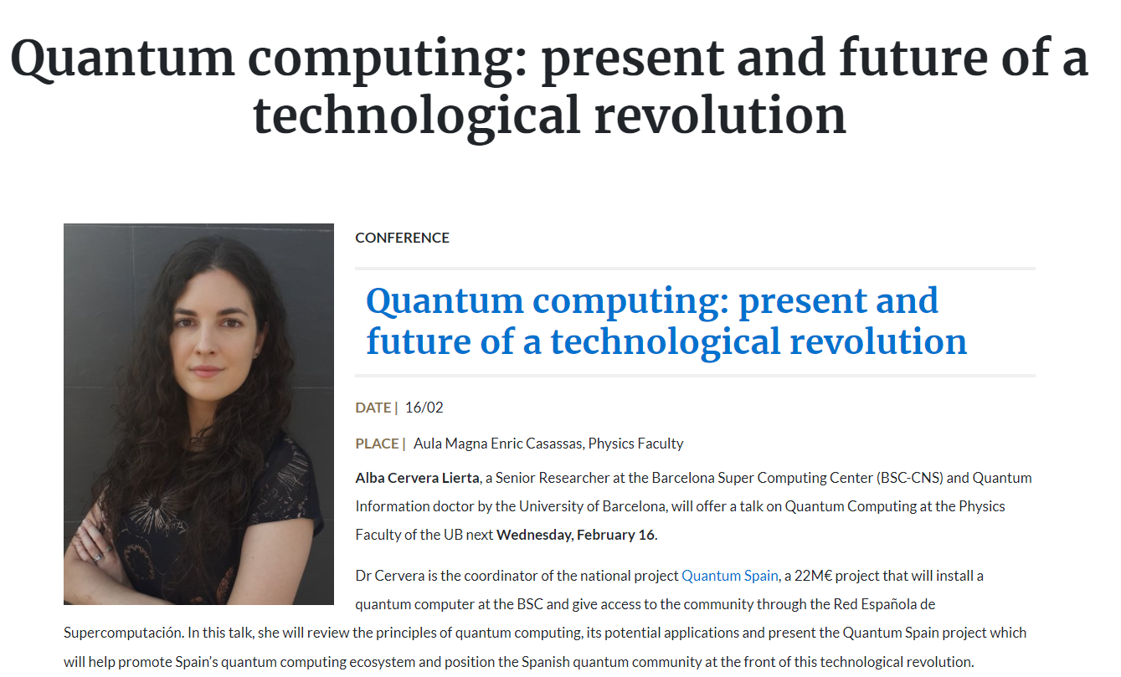
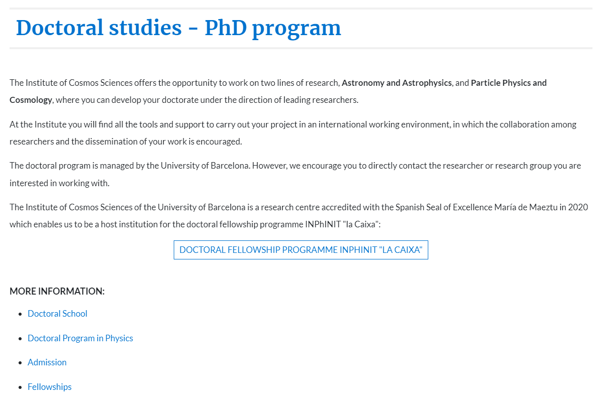
Our webpage and intranet
Notes:
One of the main events last year was the Update of our webpage and intranet. I suppose all of you have navigated on it. Our main aim was to present a cleaner and more modern design. On the website, all the content was updated last year. However, there are some details to work on. But in general, I really hope that you like it and find it useful!
This are just some examples of content on our website. I would like to stress that the website is always in maintanance and being updated, so, if you think there’s something missing or you would like to add a page, suggestions are always welcome.

Slide 5
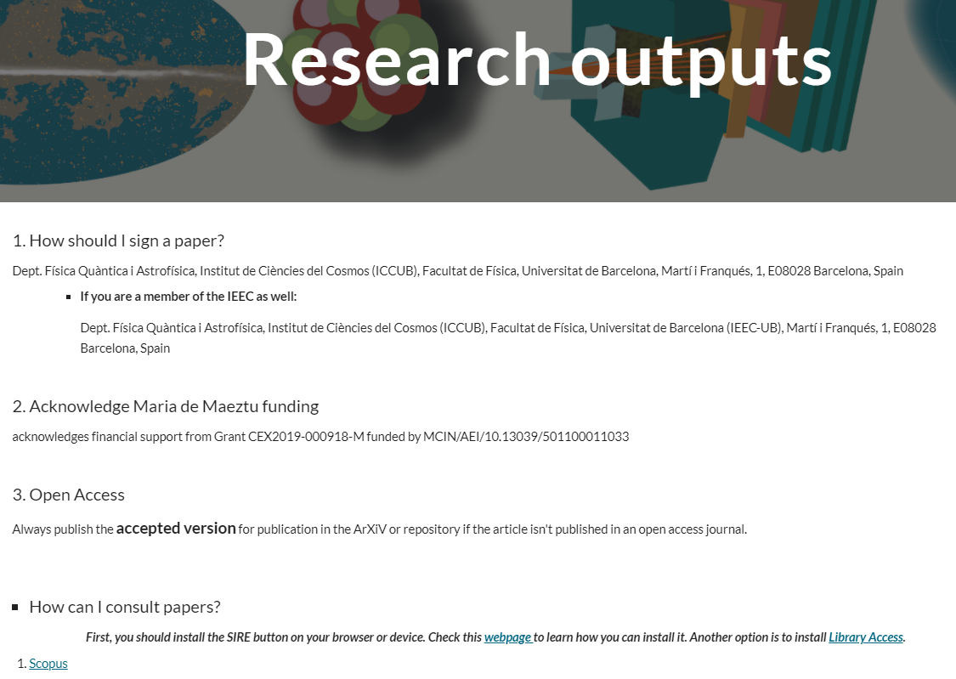
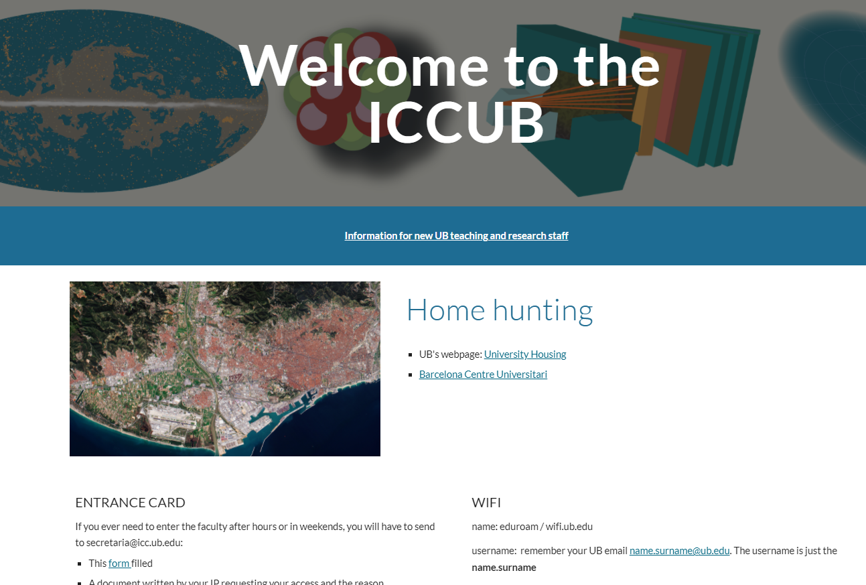
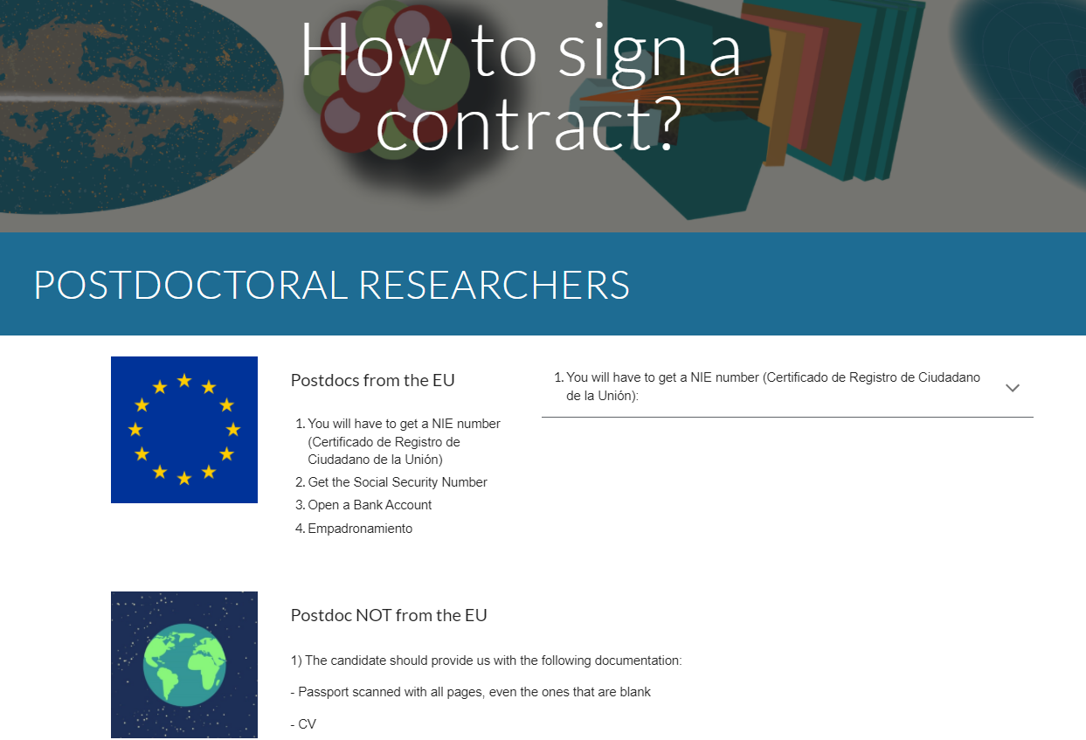
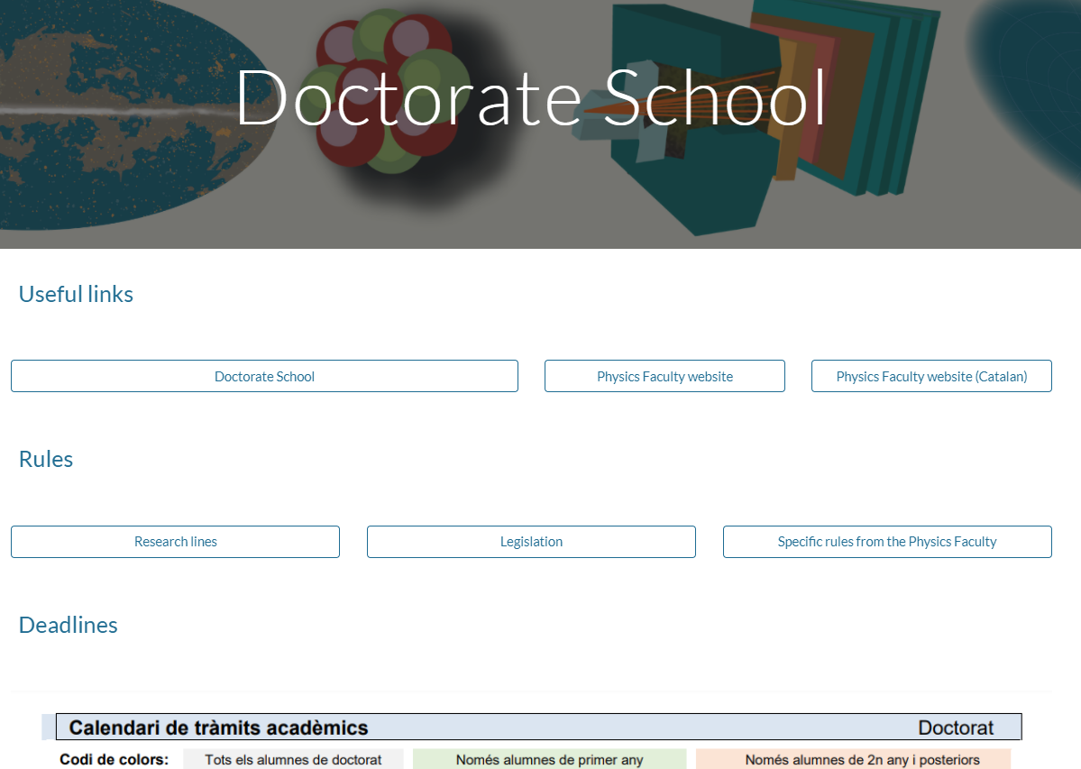
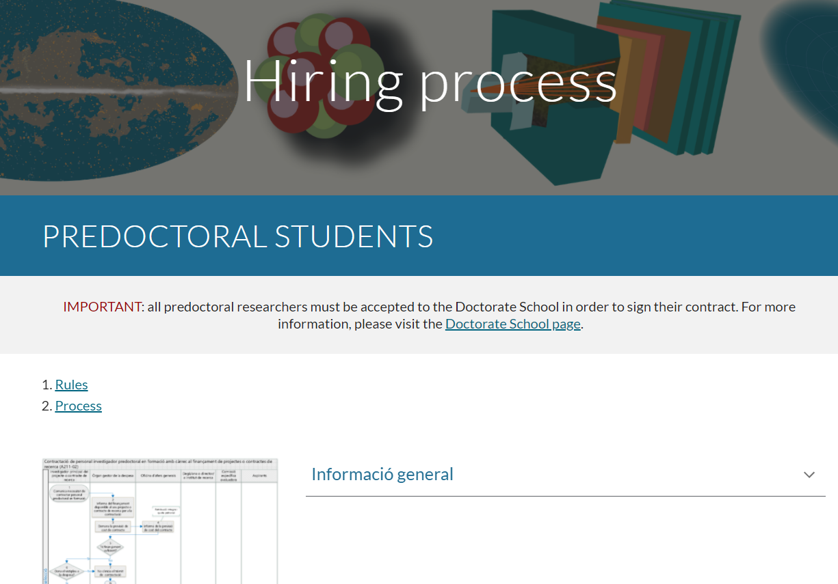
Notes:
Moreover, we also launched the intranet. I am happy that we managed to gather all this information in one place. I hope you consult it frequently looking for information related to the ICCUB or the UB. And, if you miss information, let us know, so we can add it for anyone who might need the information as well.
This site is even more flexible than the ICCUB webpage. You can see that it covers a very broad range of topics. I would like to stress two tabs:
How to sign a contract? And Welcome to the ICCUB. We , all, are aware of how difficult it is to be hired in Spain, where you need to get a NIE or a visa, etc. So, I would like to stress the importance of getting the predoctoral or postdoctoral researchers in contact with the secretariat. So, we can send them information and help them through the beuorocratic procedures.
Doctorate School. There is the basic information on how to get the admission and access to the Doctorate program. Moreover, recently has been added a document on how to deposit a thesis thanks to Ali and XXX. I would like to address the students and ask them to send us any difficulty they might have encountered with their thesis. So, we can collect all the information and make it available for other students at the ICCUB, like a FAQ.
Hiring process. You will find who to hire a postdoc or student according with the UB procedures. Anyhow, you can always contact the secretariat to give your offers as much publicity as possible and support you throughout the process.

Slide 6
Notes:
As you probably know, the Maria de Maeztu project has two calls per year to grant funding on the Organization of conferences, meetings, etc. and visitors. In this page, you will find all the information related to this calls: when they open, previous calls and to who they have been granted, ********* in of transparency.

Slide 7
Events and news
EVENTS:
Organization of seminars, conferences, ICCUB Colloquia, etc.
Indico webpage
Data protection
NEWS:
Press releases and coordination with other institutions (UB, IEEC)
Media appearances

Slide 8
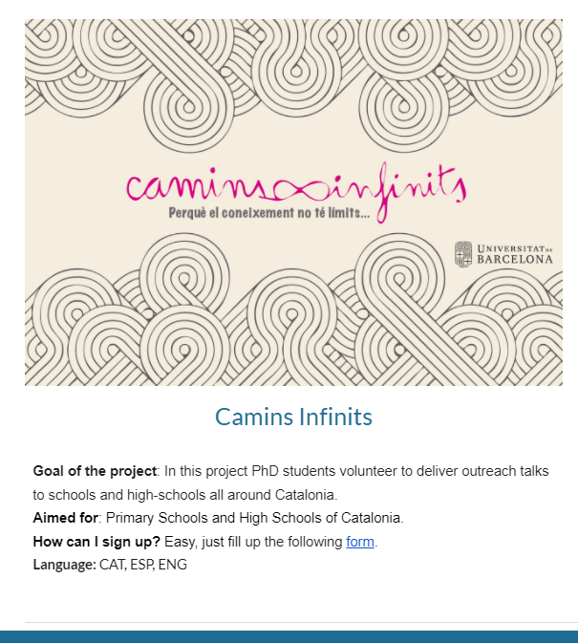
Outreach
and much more...!
Notes:
There is another tab with information on the different outreach program/s the UB has and that you might be part of. Remember that if you have a project or an idea of your own, you can always come to talk to us.

Slide 9
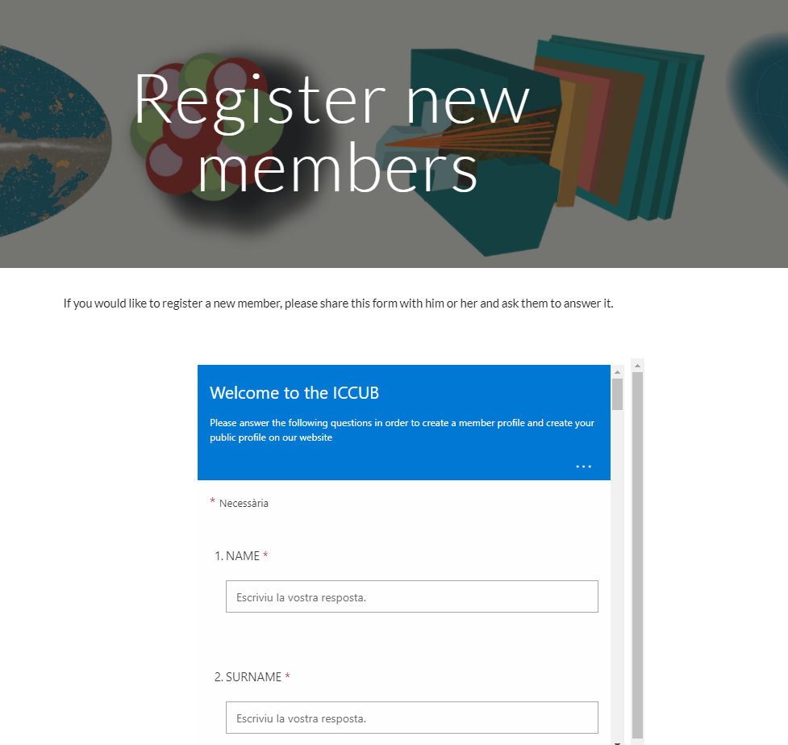
Registration of new members and emails
To registre a new membre, they have to fill the
form you will find on the intranet or contact
Secretaria, so we can contact them.
Along with this form, secretaria will ask for an
ICC and/or FQA email. ONLY secretaria can ask to
create an ICC and/or FQA email.

Slide 10
Emails for visiting researchers
If you have invited a fellow researcher to the ICCUB and they need to connect to the eduroam and/or print, you will just have to fill a form (link available at the intranet) (new procedure!)
When the credentials are activated, they will have an UB email account, thus an ICC/FQA email account won’t be provided.

Slide 11
Finally, what can you do for us?
Fill in your profile
Inform us about posible news
Report on errors and help us update the content
You are welcome to make suggestions!

