Slide 1





Fourth Barcelona TechnoWeek
Course on Nanosatellites
Institute of Cosmos Sciences, Barcelona, 17-21 June 2019
Thermal Aspects
Ignacio Torralbo Gimeno
Universidad Politécnica de Madrid
Instituto ‘Ignacio da Riva’

Slide 2
Contents
Introduction
Basic concepts
Thermal control methods
Thermal design
Thermal analysis
Testing
Some examples
Conclusion
References

Slide 3
Introduction
Why do spacecraft need a dedicated thermal control system (TCS)?
  To maintain all the components onboard the S/C within the allowable temperature range along each mission phase. This has to be achieved using the minimum S/C resources.
  To guarantee the optimal performance of a component in operational conditions.
  To avoid damage in non-operational conditions.

Slide 4
Introduction
Why do spacecraft need a dedicated thermal control system (TCS)?
  Requirements of components:
    Temperature ranges :
      Operational conditions
      Non-operational / survival conditions
    Temperature gradients (spatial): structural distortions, mispointing.
    Temperature stability (temporal).
  Hostile environment
    Vacuum (no convection).
    Outer space temperature ~ 3 K.
    Extreme environmental conditions. Quick changes. rapidly changing illumination conditions

Slide 5
Introduction
Why do spacecraft need a dedicated thermal control system (TCS)?
  To guarantee temperature stability for optics, optomechanical devices or any component sensitive to temperature.
    most materials have non-zero CTEs and hence temperature changes imply thermal distortion
  To minimize the temperature gradients according to the specified limits.
  To guarantee that the interface (e.g. S/C-instrument IF) requirements (temperatures and heat fluxes) are met
    Radiators are sized to evacuate the internal heat.
  To identify the relevant parameters as those with high influence on the thermal behaviour of the S/C and manage them with the existing constraints given by the environmental conditions and the S/C resources.

Slide 6
Introduction
Typical requirements
Component | Minimum Temperature [ºC] | Maximum Temperature [ºC]
Electronics | -10 | +50
Batteries | 0 | +20
Solar panels | -150 | +70
IR detectors | -220 | -170
Temperature
Component | Stability
Electronics | < 5 ºC/h
CCD | < 0.1 ºC/min
Cryo telescope | < 100 μºC/min
Temporal
Component | Stability
Optical bench | < 2 ºC/m
Mirror | < 0.5 ºC (all the surface)
Spatial

Slide 7
Introduction
Typical requirements
  Electronic cards and mechanical equipment:
    Around room temperature (originally designed for terrestrial use, ease of testing,…)
  Detectors
    Signal noise -> usually coldest part
  The critical equipment (usually)
    optics
    detectors
    Batteries
  De-rating:
    Lower the maximum operational temperature to increase the life.

Slide 8
Introduction
Parameters driving the TCS
  the S/C environment
    External loads
  the heat dissipated onboard the S/C
    Electronic dissipation, heaters, ..
  the distribution of the thermal dissipation within the spacecraft
  the temperature requirements of the S/C components
  the configuration of the spacecraft: geometry, materials, etc.

Slide 9
Introduction
TCS Design
  Based on:
    Previous experience
    Basic semi-analytical calculations
    Complex numerical simulations (GMM, TMM)
    Steady cases: hottest and coldest
    Transient cases
    Laboratory tests on engineering models
    Tests on vacuum chambers
  Limitations:
    Subjected to many uncertainties.
    Testing is needed to validate numerical models.
    A realistic design requires interaction with other S/C subsystems: mechanical design, attitude control, power management, etc.

Slide 10
Thermal Environment
Ground operations:
  Including: AIV, testing, storage and shipping.
  Convection, conduction and radiation heat exchange.
  Power dissipation.
  Temperature and humidity control to avoid condensations.
Orbit:
  Main feature: vacuum environment
  All the dissipation has to be dumped into space just by radiation.
  Different thermal behavior in maneuver orbits and definite orbits.
  Highly varying conditions in planetary missions.
The thermal system is usually designed for the nominal orbit, making it compatible with ground operations and ascent phase.

Slide 11
Introduction
TCS Design. Example
Effect of the convection, conduction and radiation
Temperature vs power for a E-Unit inside a 25 ºC cavity.

Slide 12
Thermal Environment
Orbit
Thermal Loads
  Solar radiation
  Planetary albedo
  Planetary IR radiation
  Internal dissipation
  Radiation to outer space

Slide 13
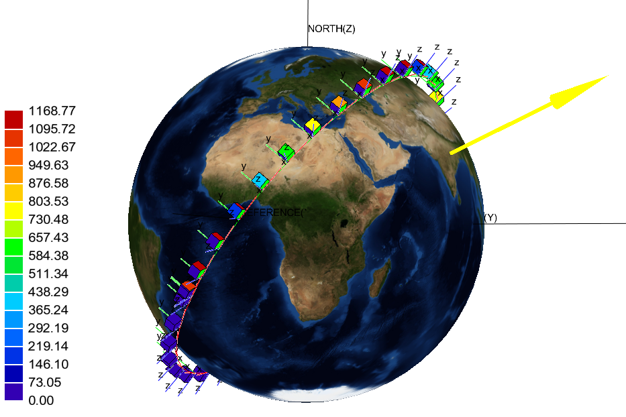
Introduction
TCS Design. Example
Solar Heat Flux. From 1168 W/m² to 0 W/m² in 93 min
ISS orbit (400 km, 51,6 º)

Slide 14
Basic concepts
Conduction
Fourier’s law
The time rate of heat transfer through a material is proportional to the negative gradient in the temperature and to the area.
Normal area to the direction of heat transfer.
Thermal conductivity [W·m⁻¹·K⁻¹]
Temperature gradient in the direction of the flow.
l
_{T}
T₁
T₂
x
T₁
T₂

Slide 15
Basic concepts
Conduction
Thermal conductivity

Slide 16
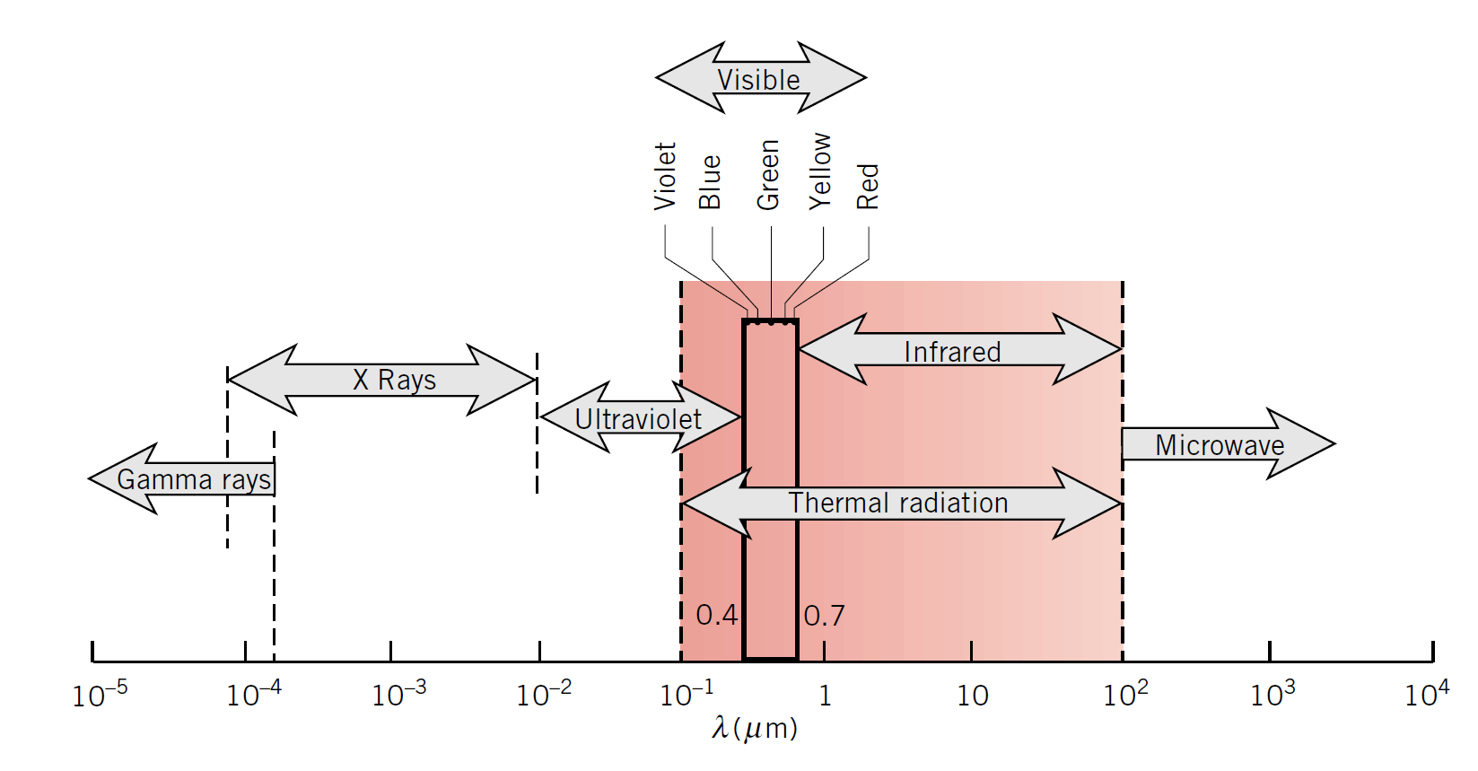
Basic concepts
Thermal radiation
Electromagnetic spectrum

Slide 17
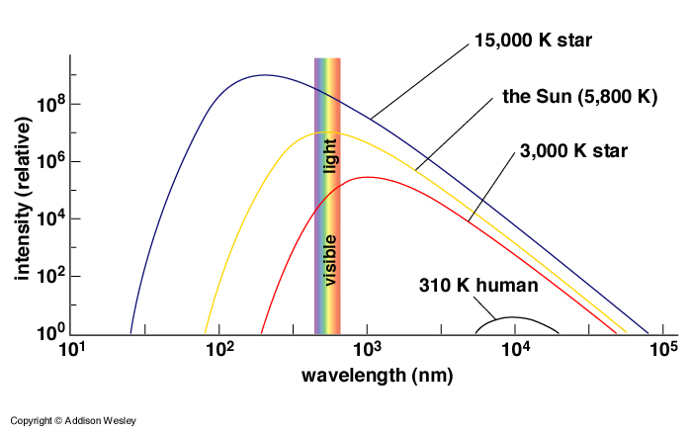
Basic concepts
Thermal radiation
Electromagnetic spectrum
Planck law (black body radiation)

Slide 18
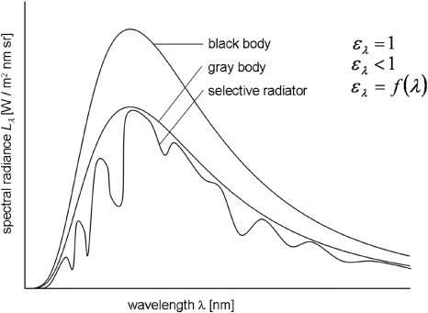
Basic concepts
Thermal radiation
Emissivity

Slide 19
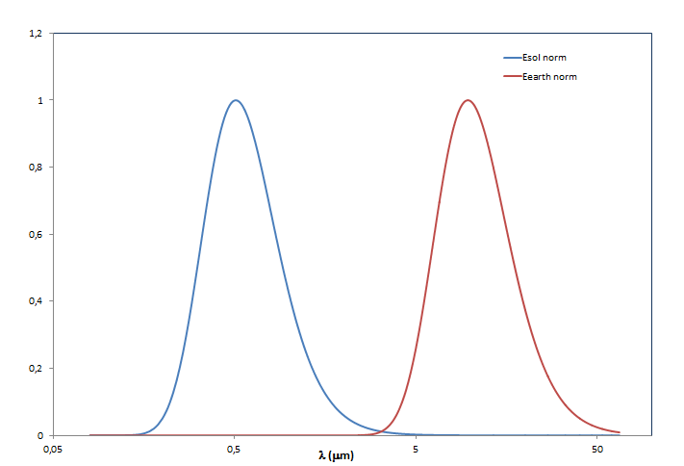
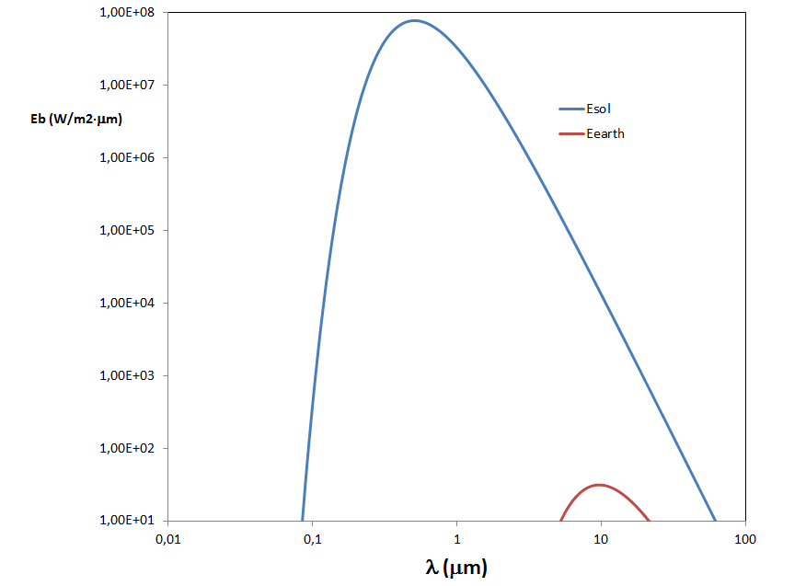
Basic concepts
Thermal radiation
Infrared emissivity and solar absorptivity
T = 5700 K
T = 5700 K
T = 300 K
T = 300 K

Slide 20
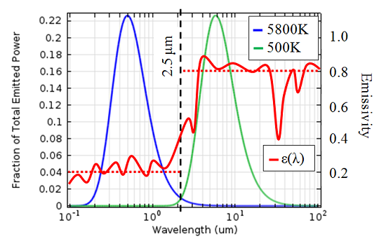
Basic concepts
Thermal radiation
Infrared emissivity and solar absorptivity
^{Two bands of interest}
^{Wavelengths up to 2 mm:}
^{solar radiation}
^{absorptivity, α}
^{Wavelengths from 2 to 100 mm:}
^{IR radiation}
^{emissivity, ε}

Slide 21
Thermal control methods
Two main categories
  Passive methods
  Simplest, reliable, low mass, low power, low costs,…
    Radiation
    Conduction
  Active methods
  Allowable temperature range, precise, evacuate large power, cryogenics
    Heaters
    TECs
    Heat Pipes

Slide 22
Thermal control methods
Coatings
  Sphere in a vacuum environment under solar radiación
Influence of α/ε ratio
  α/ε = 0.09 → T =150 K
  α/ε = 40 → T =700 K

Slide 23
Thermal control methods
Coatings
Coefficients (diffuse surfaces):
  Absorptance:
  Reflectance:
  Transmittance:
  Kirchhoff’s Law:

Slide 24
Thermal control methods
Coatings
Types:
  Flat absorber ↑ α_{s} ↑ ε
    Black paints (flat absorber)
  Solar reflector ↓ α_{s} ↑ ε
    White paints
    Second surface mirrors (SSM) ↓ ↓ α_{s} ↑ ε
    Optical solar reflectors (OSR) ↓ ↓ α_{s} ↑ ε
  Flat reflector ↓ α_{s} ↓ ε
    Polished metals
  Solar absorbers ↑ α_{s} ↓ ε

Slide 25
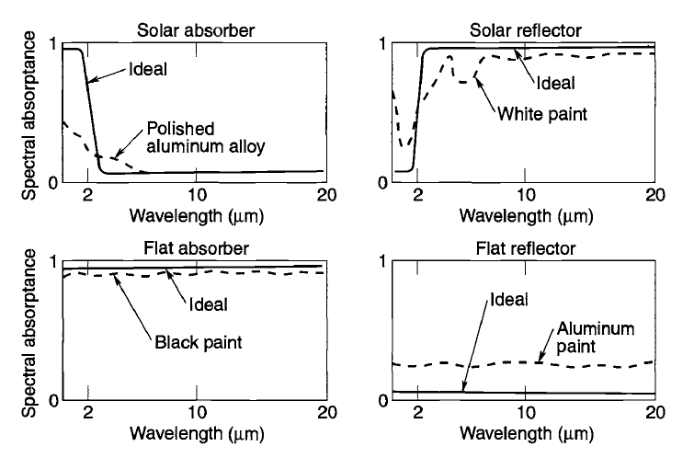
Thermal control methods
Coatings

Slide 26
Thermal control methods
Coatings
Selection of coatings is mainly driven by α / ε ratio, degradation, ease of application, mass, electrical conductivity, cost
Paints are most commonly used. Paints have high-ε, the choice is rather driven by α
Electronic boxes inside SC and structural panels to which they are attached usually painted to achieve a high ε (black paint is a conventional choice). Therefore one can dissipate heat from electronic or make uniform the temperatures inside the SC or payload
Internal temperature-sensitive components that do not dissipate much (propellant lines, tanks,…) often have low-ε finish (bare or polished Alu, Gold)
Radiator coatings have low-α and high-ε (second-surface mirrors, white paint, silvered Teflon, aluminized Teflon…)
Also if ESD can be a problem -> conductive coatings
EOL -> increase in solar absorptivity with little or no effect on IR emissivity

Slide 27
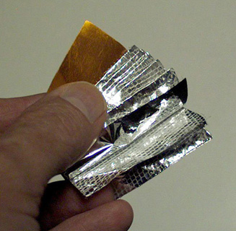
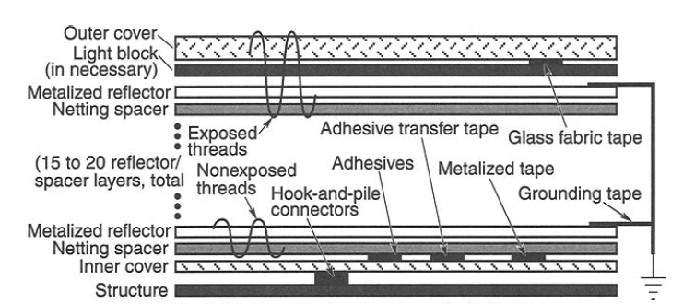
Thermal control methods
MLI
Multilayer Insulation - MLI blanquets:
  Conduction and radiation heat transfer
  Multiple highly reflective surfaces.
  Heat conduction is minimized by minimizing the contact between layers:
    Spacers
    Embossed

Slide 28
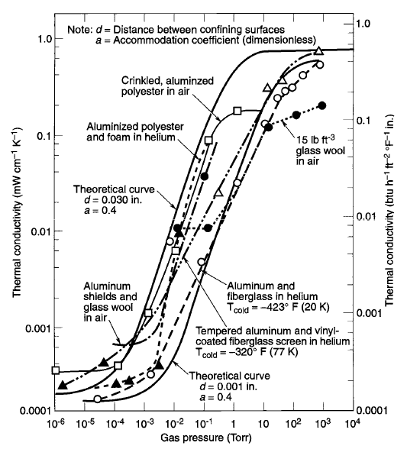
Thermal control methods
MLI
Highly efficient in vacuum

Slide 29
Thermal control methods
MLI
Properties depend on:
  Materials y thermal finishes:
    Outer cover
    Inner cover
    Inner layers
  Number of layers
  Size
  Vent paths: size and separation of perforations
  Ground connections
  Geometry, inserts, etc
  Attachments: hook and pile (Velcro) fasteners, stand-offs

Slide 30
Thermal control methods
Radiators
Radiators are the surfaces through which energy is dumped into space.
They radiate to space in the IR, regardless of their configuration.
They have to be sized to radiate the internal dissipation plus the external thermal loads (solar, albedo planetary IR).
They usually have low values of α_{s} (α_{s} < 0.2) and high values of ε (ε > 0.8).
Different configurations:
  Structural panels
  Flat plate mounted on a S/C surface
  Deployable panels

Slide 31
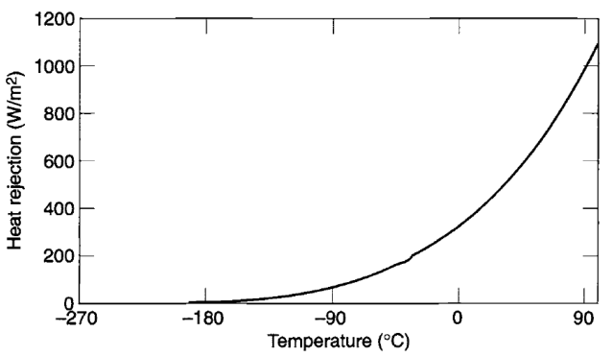

Thermal control methods
Radiators
They reject heat by IR radiation which strongly depends on the temperature
Sizing considering operating T°, worst-case waste heat, environmental heating, radiative and conductive interactions with other SC surfaces

Slide 32
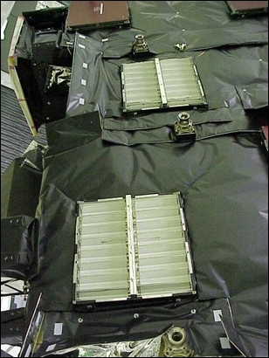
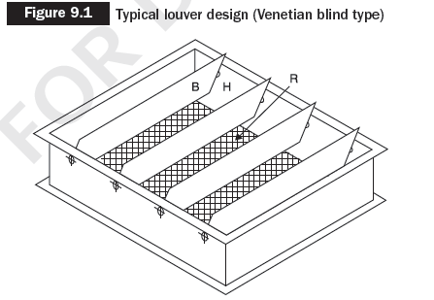
Thermal control methods
Louvers
Used to block the view of outer space
  low-ε parallel blades can rotate and uncover a high-ε radiator

Slide 33
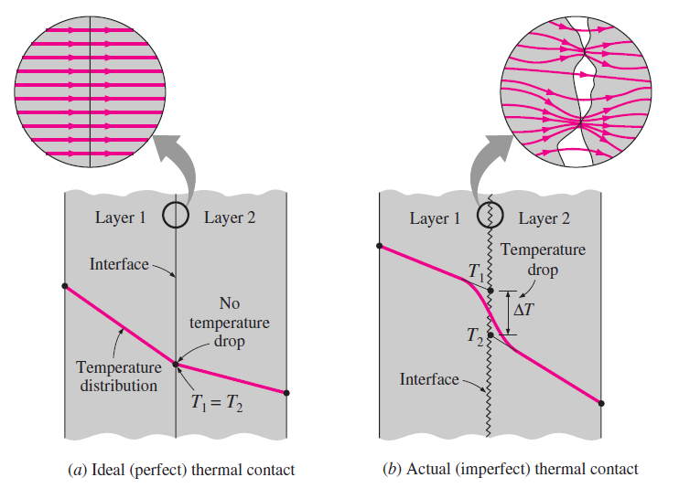
Thermal control methods
Mechanical interfaces
Thermal contact resistance has to be taken into account. The modeling is quite complex.
The real contact area is only a small fraction of the apparent contact area.
The contact is formed by a number of microcontacts through which heat is conducted, causing a constriction in heat flux.

Slide 34
Thermal control methods
Mechanical interfaces
Parameters
  Geometry of the contacting solids (surface roughness and waviness).
  Gap thickness.
  Type of interstitial fluid or material (vacuum, grease, foil, etc.).
  Thermal conductivities of the contacting solids and the interstitial substance.
  Hardness or yield pressure of the contacting asperities (plastic deformation of the highest peaks of the softer solid).
  Modulus of elasticity of the contacting solids (elastic deformation of the wavy parts).
  Average temperature of the interface (material physical properties).

Slide 35
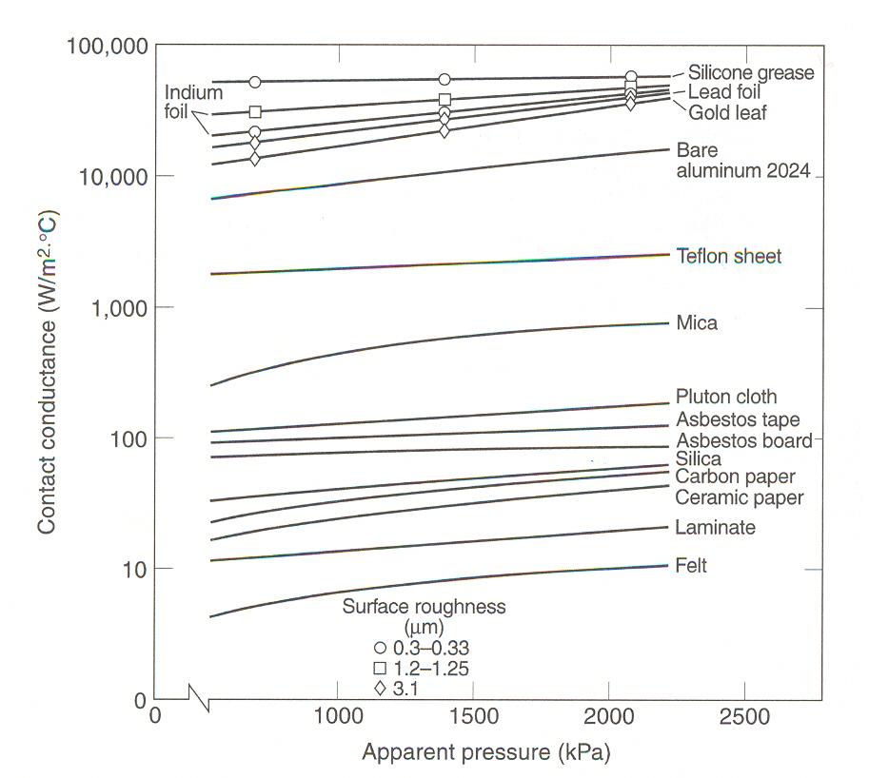
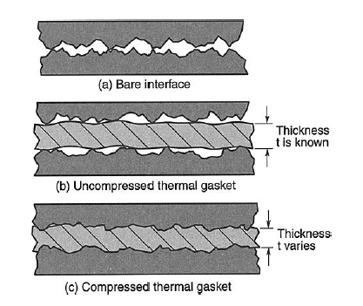
Thermal control methods
Thermal fillers

Slide 36
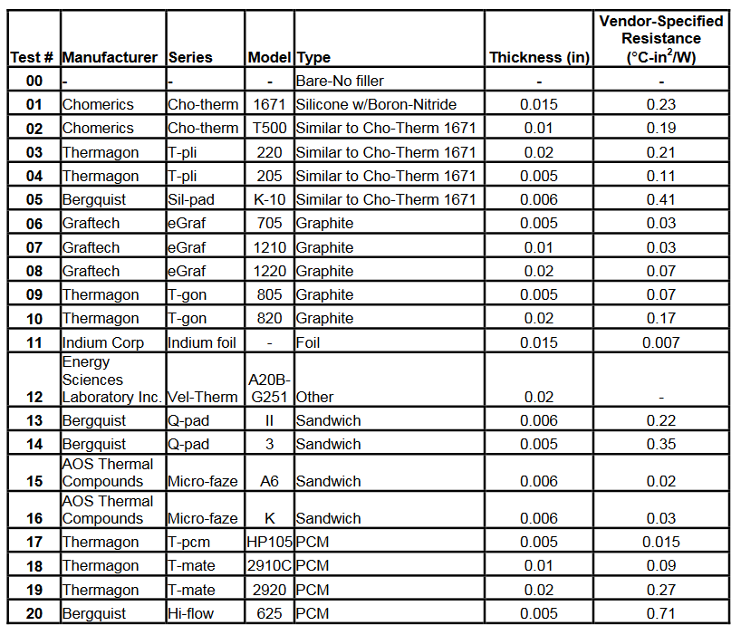
Thermal control methods
Thermal fillers

Slide 37
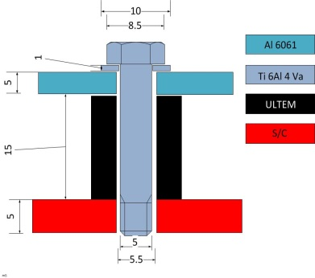
Thermal control methods
Insulating washers

Slide 38
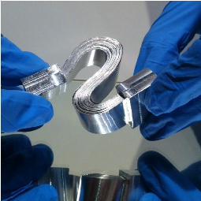
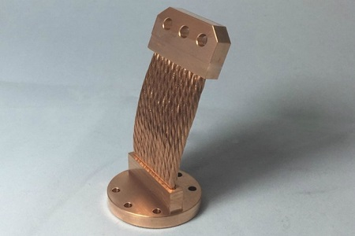
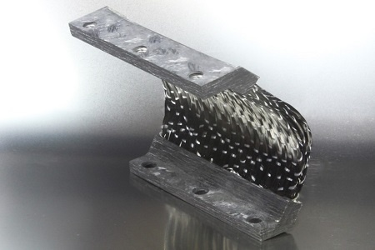
Thermal control methods
Thermal straps
Used to transport heat
Made of a material with high thermal conductivity.
Main disadvantage: mass

Slide 39
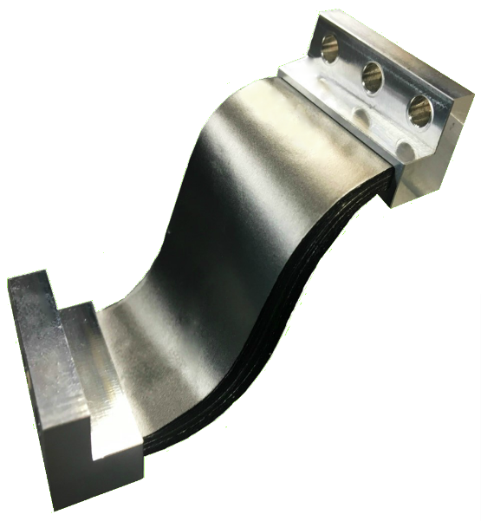
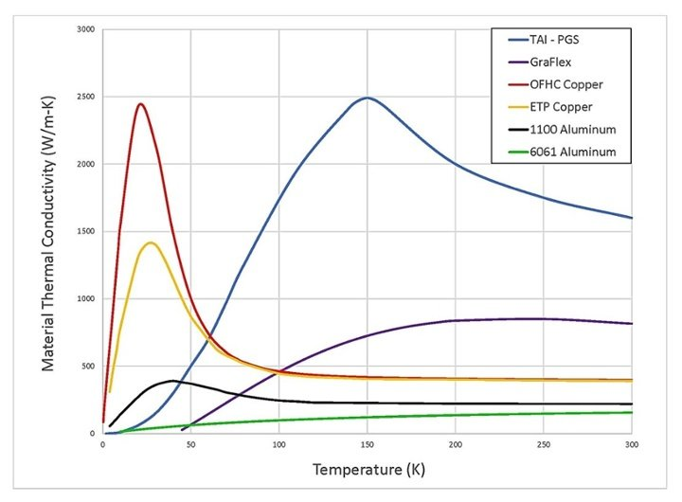
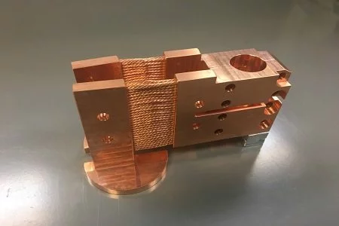
Thermal control methods
Thermal straps

Slide 40
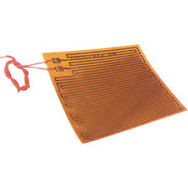
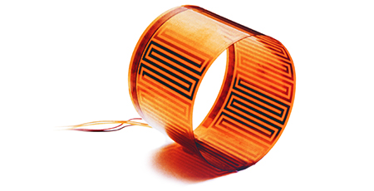
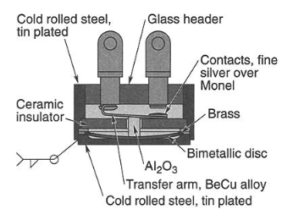
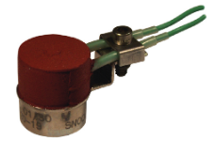
Thermal control methods
Heaters
Used to protect component during cold phases: cold op and non-op, survival.
Common type is patch heater: electrical resistance between kapton foil (max. temp 250 ºC).
Can dissipate up to about 10 W/cm².
Usually controlled by mechanical o electronic thermostat
  bi-metal with fixed set points
  Dead-band < 4 ºC not recommended

Slide 41
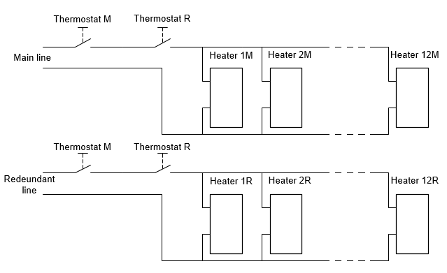
Thermal control methods
Heaters
Redundancy
Two thermostat in series
  Avoid always ON
Two heaters in parallel
  Avoid always OFF
Double routing heater

Slide 42
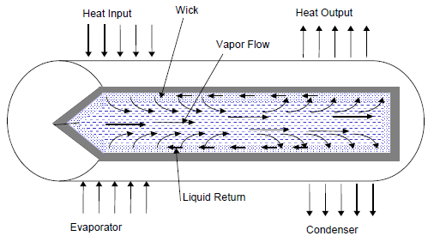
Thermal control methods
Heat Pipes
Used to transport heat from one place to another, based on the vaporization and condensation of a fluid which maintains its circulation by means of capillarity forces.
It is a sealed device designed to work in saturation.
Basic components:
  - Sealed pipe.
  - Porous material line: wick.
  - Condenser.
  - Evaporator

Slide 43
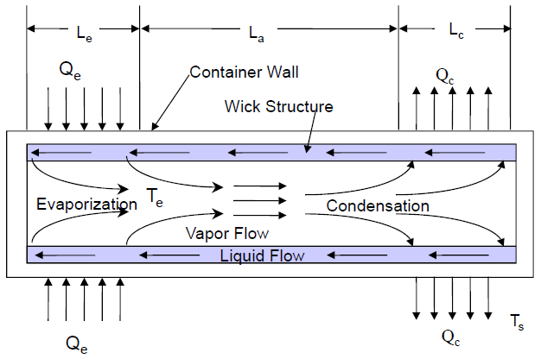
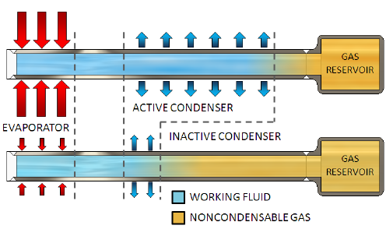
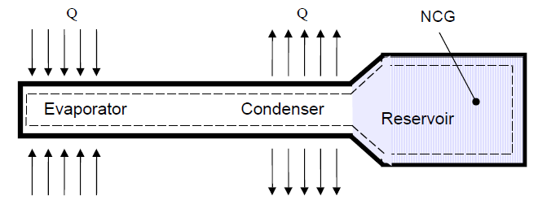
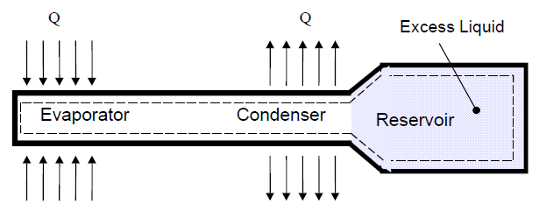
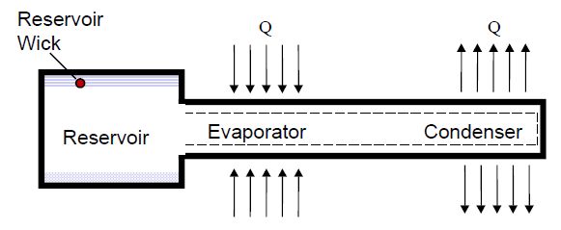
Thermal control methods
Heat Pipes
Types
  CCHP: Constant Conductance Heat Pipe
    To transport more heat needs more ΔT
  VCHP: Variable Conductance Heat Pipe
    Can transport different amount of heat with the same ΔT
  DHP: Diode Heat Pipe
    Only works in one direction

Slide 44
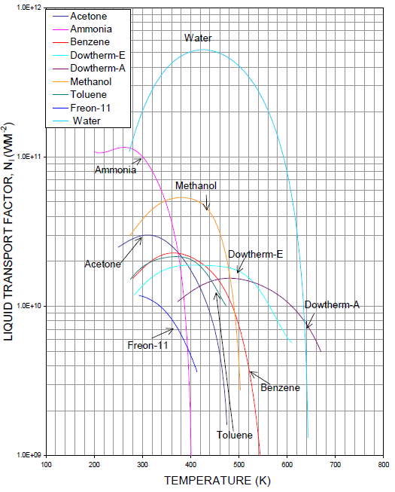

Thermal control methods
Heat Pipes
Liquid transfer factor
$$N_{1}=\frac{σλρ}{υ}$$
σ Surface tension
λ Latent heat
ρ Density
υ Viscosity

Slide 45
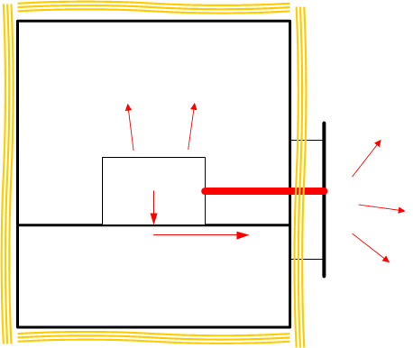
Thermal design
Classical approach
S/C insulated form the environment
Radiators to reject heat into space
Heaters for cold phases

Slide 46
Thermal design
Nanosats
    Unknown attitude. Extreme cases to be studied (3-axis stabilised – rotating S/C).
    Limited mass and volume for thermal hardware.
    Solar panels on the body. Limited space for radiators.
    Limited power for heaters.
    Very compact electronics (hotspots and difficulties to transport heat to the outer surfaces).
    Low mass and thermal inertia.

Slide 47
Thermal analysis
Lumped parameters method
Discretization of the model in nodes that condensate the properties of the corresponding volume
Conservation of energy

Slide 48
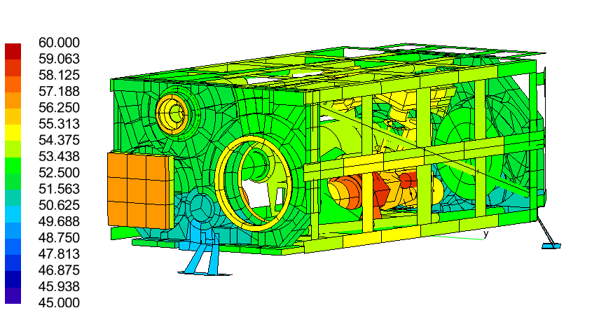
Thermal analysis
GMM (Geometrical Mathematical Model)
Geometry
Thermo-optical properties (α, ε)
External loads
Radiative exchange factors (GR)

Slide 49
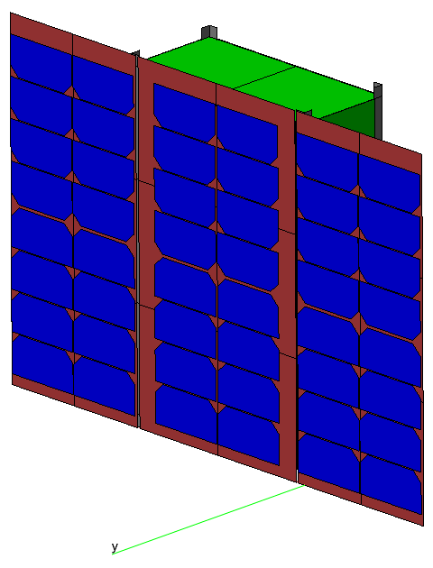
Thermal analysis
TMM (Thermal Mathematical Model)
Inputs:
  Vectors of external loads on the nodes:
    Solar, albedo, planetary IR from GMM
    Equipment dissipation
    Heaters
  Nodes couplings matrices
    Radiative couplings (from GMM)
    Conductive coupling (partially from GMM)
  Boundary and initial conditions
Process:
  Solve the system of equations. Selection of the algorithm
    Differential equations for transient analysis
    Algebraic equations for steady-state solutions
Outputs:
  Temperatures
  Heat fluxes

Slide 50
Thermal analysis
TMM (Thermal Mathematical Model)
Solve for the different cases
  “Hot Operational”. Steady-state. Equipment ON.
  “Cold Operational”. Steady-state. Equipment ON.
  “Hot Non-operational”. Steady-state. Equipment OFF.
  “Cold Non-operational”. Steady-state. Equipment OFF.
  Cold survival. Survival heaters ON.
  Transient
    Orbital variation. (in LEO cold steady-state usually leads to too low temperatures.
    Manoeuvres.

Slide 51
Testing
Why?
  Space missions are very costly, and we have only one SC that will flight
  Thermal modeling involves many assumptions and uncertainties and the design relies on a worst-case approach
    > Over-engineering TCS
  Tests are thus essential for the verification and to ensure the satellite achieves all the requirements so
  that the mission

Slide 52
Testing
How?
  Development Test
    Validate new designs
  Qualification Test
    Demonstrate that the design implementation and the manufacturing process meets the requirement with sufficient margins
  Flight Acceptance Test
    Detect workmanship deficiencies, manufacturing errors or
    any latent defect.
    Less severe than qualification testing.

Slide 53
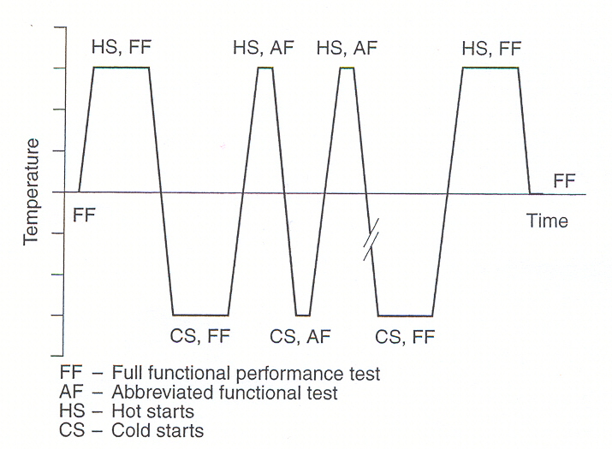
Testing
Thermal Vacuum Test (TV)
  Cycling under vacuum conditions to wort hot and cold temperatures.
  Verification through functional testing
Thermal Cycling Test (TC)
  Ambient pressure. Fast and cost friendly
  Reveal defects due environmental stress
Thermal Balance Test (TBT)
  Part of the TV (usually), mainly two purposes:
    Demonstrate the ability of the TCS
    Provide data for TMM correlation

Slide 54
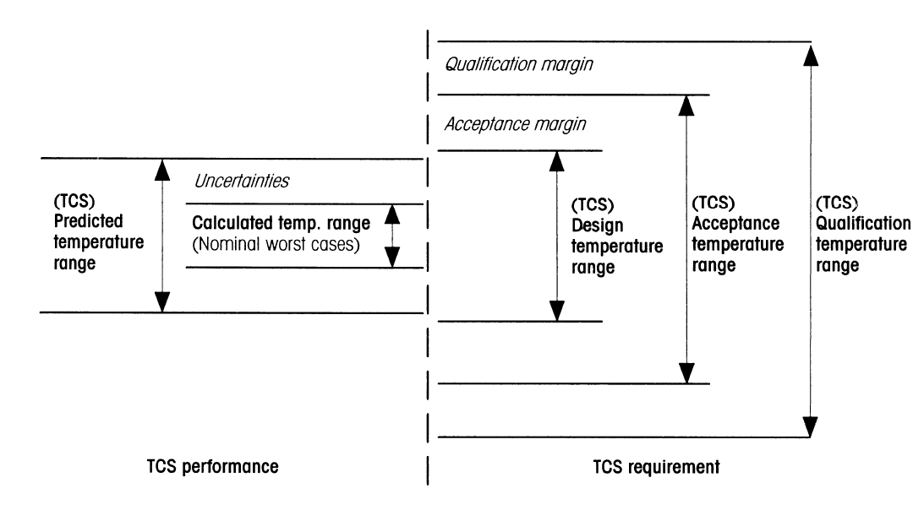
Testing
Margins
  Different margins applied in the different phases of the mission:

Slide 55
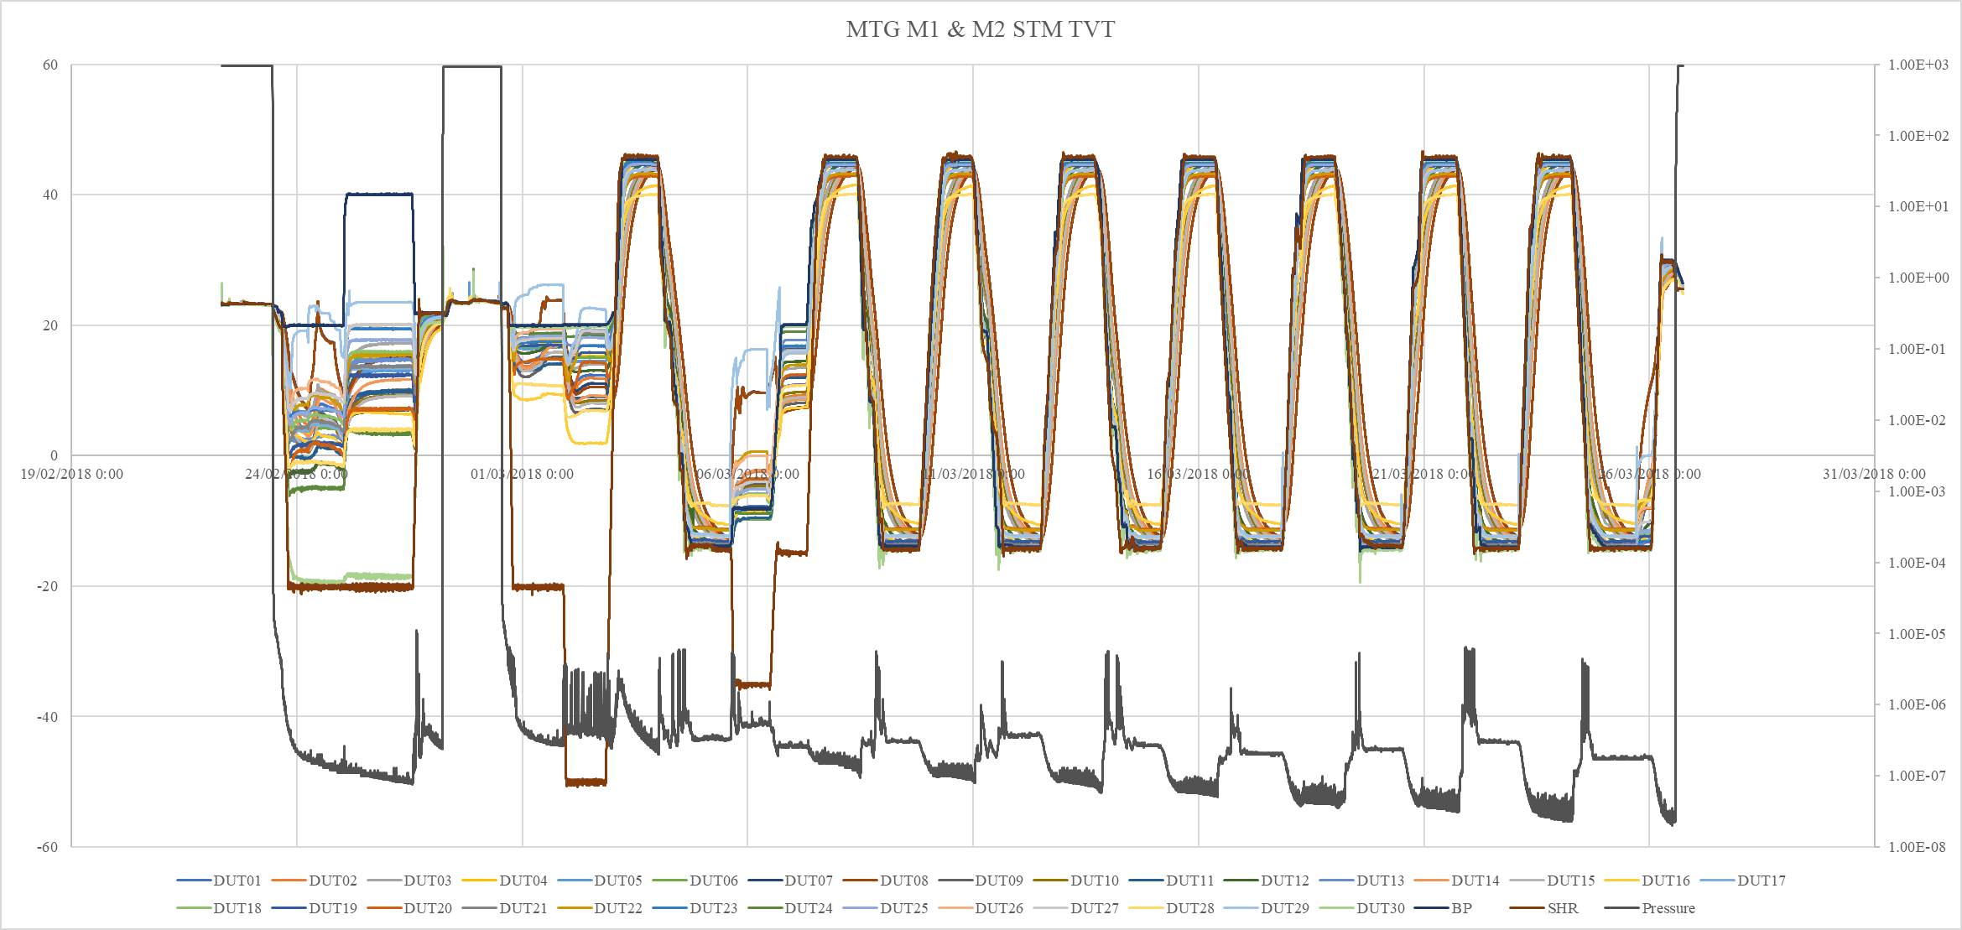
Testing
Example

Slide 56
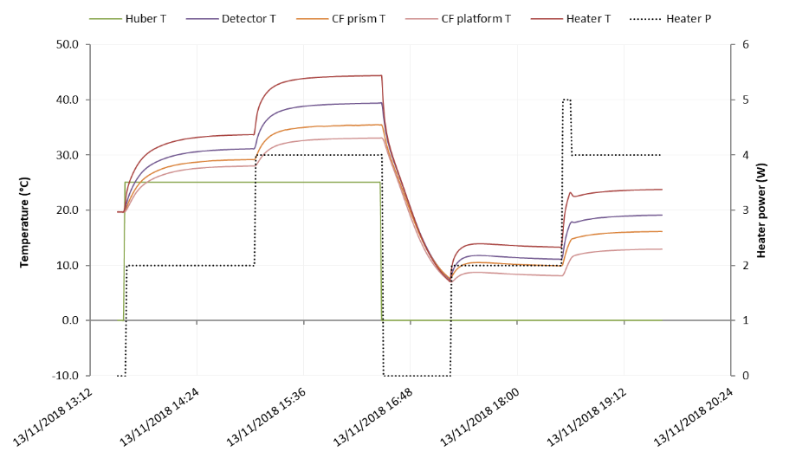
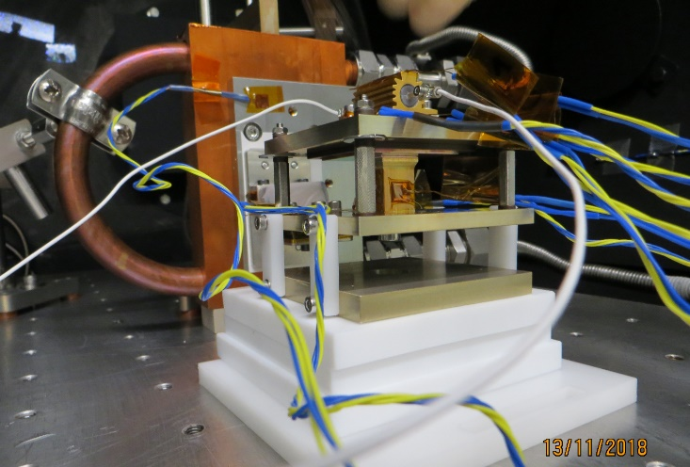
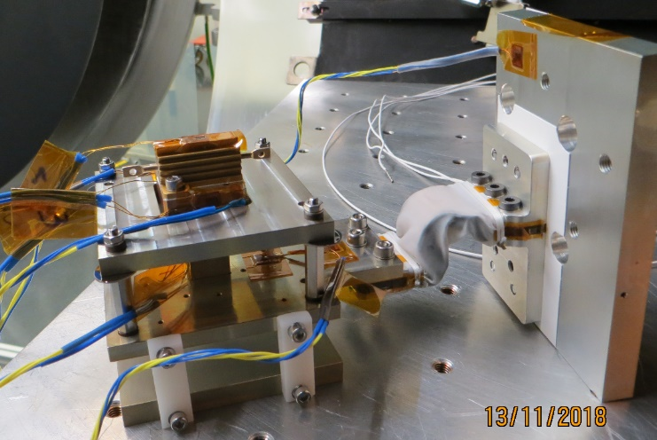
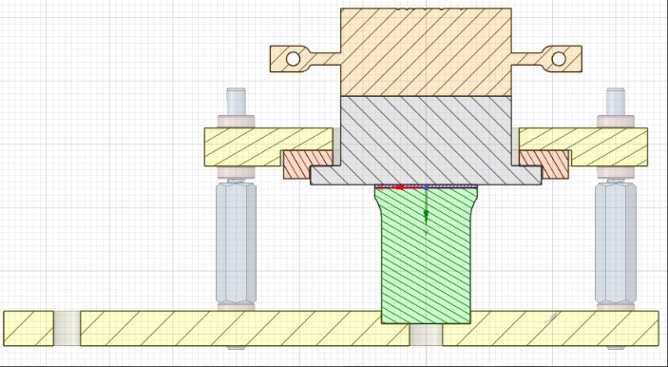
Examples
Development test

Slide 57
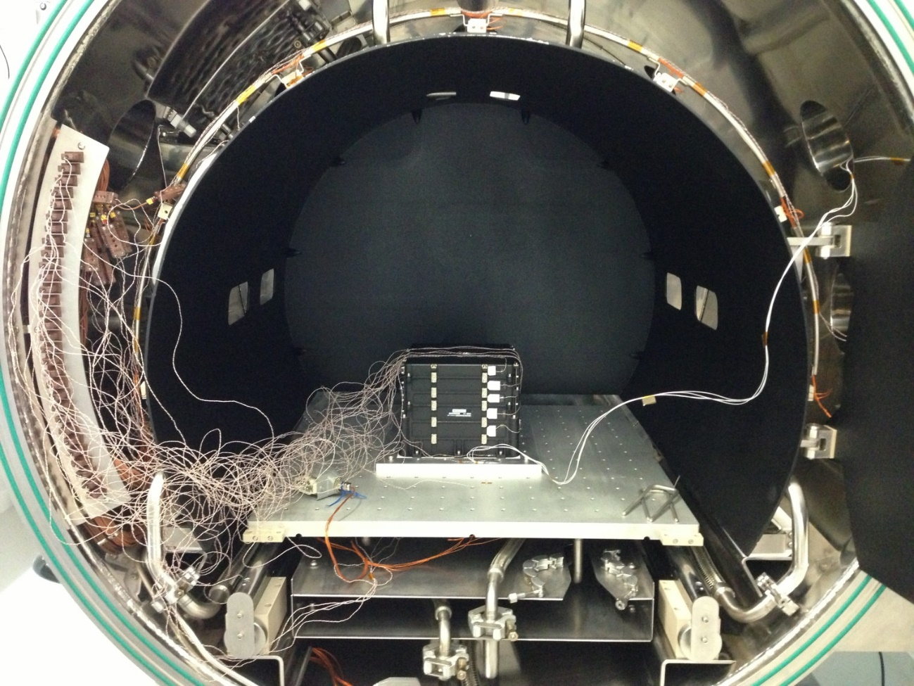
Examples
TVT

Slide 58
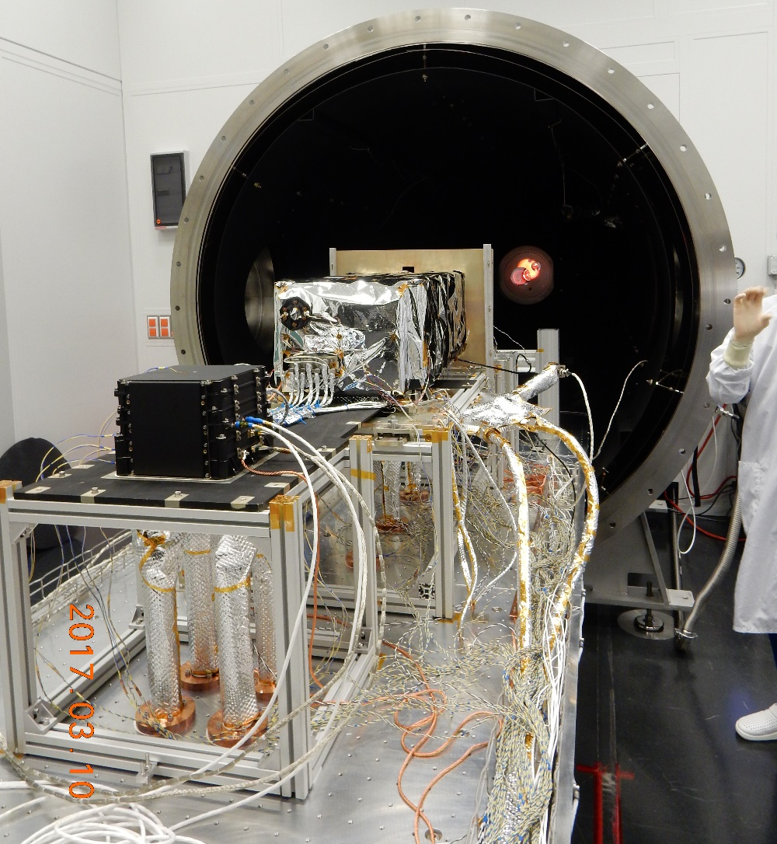
Examples
TVT

Slide 59
Examples
Louvers (Rosetta mission)

Slide 60
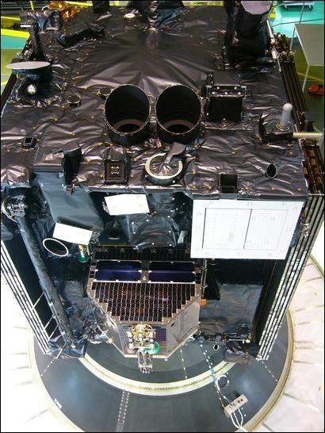

Examples
MLI Rosetta mission – black Kapton ISO - Betacloth

Slide 61


Examples
Heat Pipes
Swift BAT System

Slide 62
Conclusions
TCS has an import role in the S/C and instruments design.
The space is hostile. Fast environment variation.
No convection, only radiation and conduction which are less effective.
Thermal analysis: Hand and numerical calculations
Design philosophy
  Decouple from the environment
  Passive or active
  Use the worst-case approach
  Margins!
  Testing if possible

Slide 63
Conclusions

Slide 64
References
Spacecraft thermal control. CSL Université de Liege. Prof. P.Rochus, Ass. L.Salvador (November 2011)
J. Meseguer, I. Perez-Grande, A. Sanz-Andrés, Woodhead Publishing, 2012.
D. G. Gilmore, Spacecraft Thermal Control Handbook, 2003
TFAWS03. Performance Testing of Thermal Interface Filler Materials in a Bolted Aluminum Interface Under Thermal/Vacuum Conditions
http://thermotive.com/thermalstraps.html
https://www.techapps.com/gfts
https://www.techapps.com/copper-thermal-strap-assemblies
Holman, J. P., “Heat Transfer (8ª ed.)”, McGraw-Hill, 1997.
Cengel, Y.A., “Heat Transfer. A practical approach”.

