Slide 2
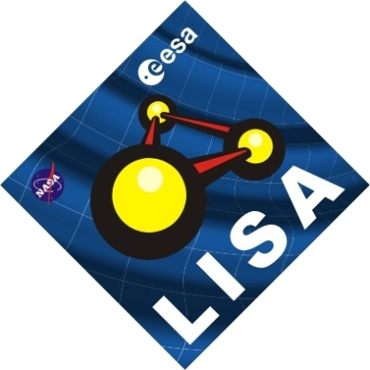
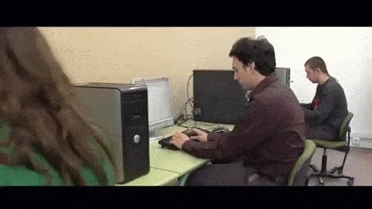
About me.
Working as Software Engineer in the Gravitational Wave Research at group at IEEC since 2006.
Since last 1st Jan, Software Engineering Manager at ICE/CSIC-IEEC

Slide 3
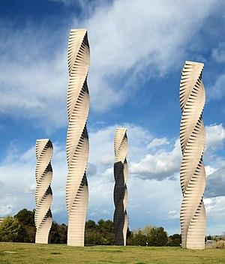
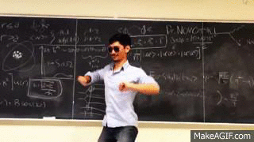
About me.
Working as Lecturer in Software Engineering topics in Universitat Autònoma de Barcelona (UAB) School of international Studies of UPF (ESCFI-UPF)

Slide 4
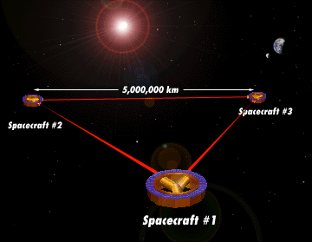
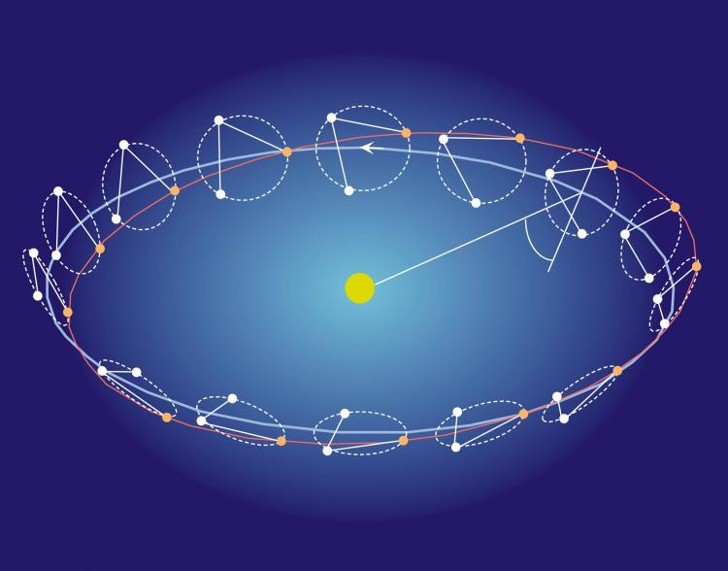
About me.mainProject();
LISA - Laser Interferometer Space Antenna

Slide 5
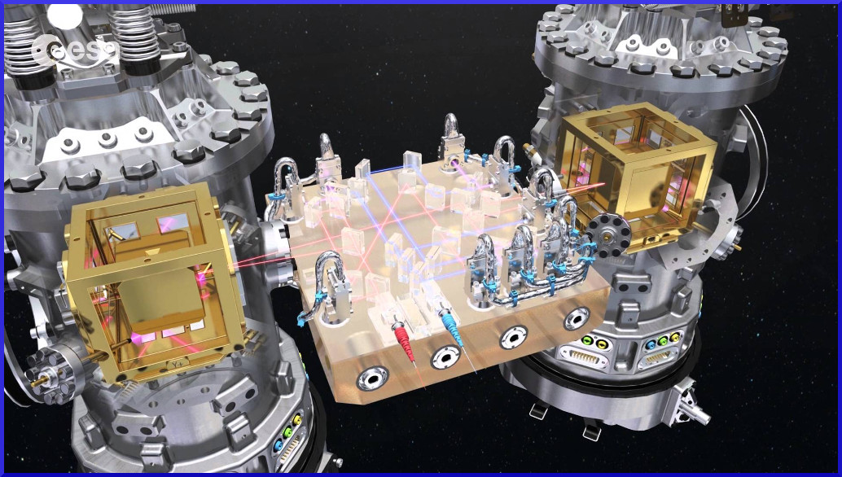
Prototyping : LISA PathFinder

Slide 6
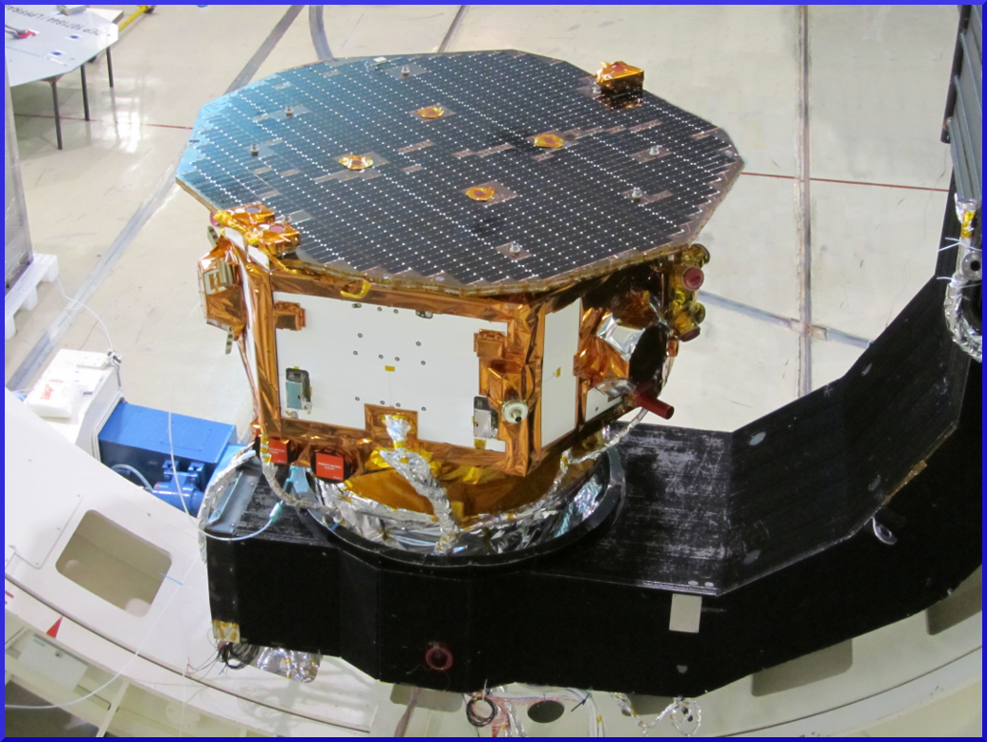
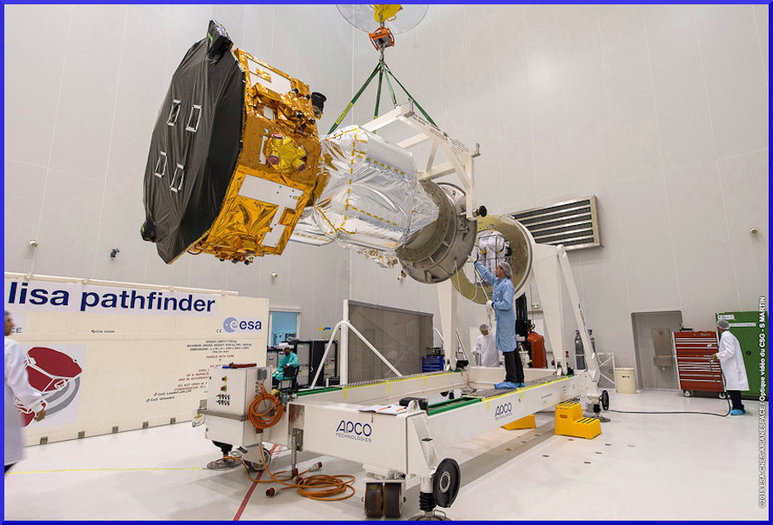
LISA PathFinder

Slide 7
Let's talk about software, and how/what some of us do it

Slide 8
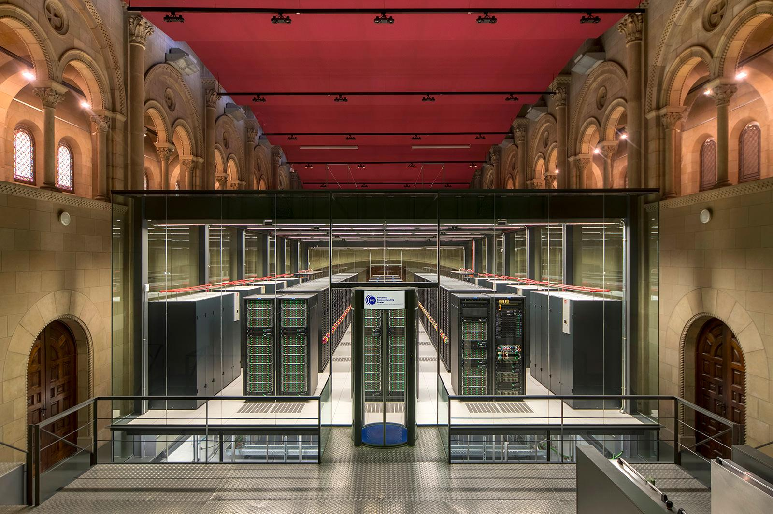
Software for space science? Where ?
MareNostrum
165888 CPU Cores
390 TB Memory Ram
14 PB Hard Disk Storage
+ 38976 GPUs Cores

Slide 9
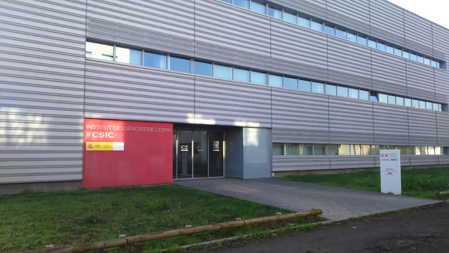
Computing at Institut de Ciències del Espai
Computing at Institut de Ciències del Espai:
192 CPU Cores
284 GB Memory Ram
22 TB Hard Disk Storage
+ 8830 GPU Cores

Slide 10
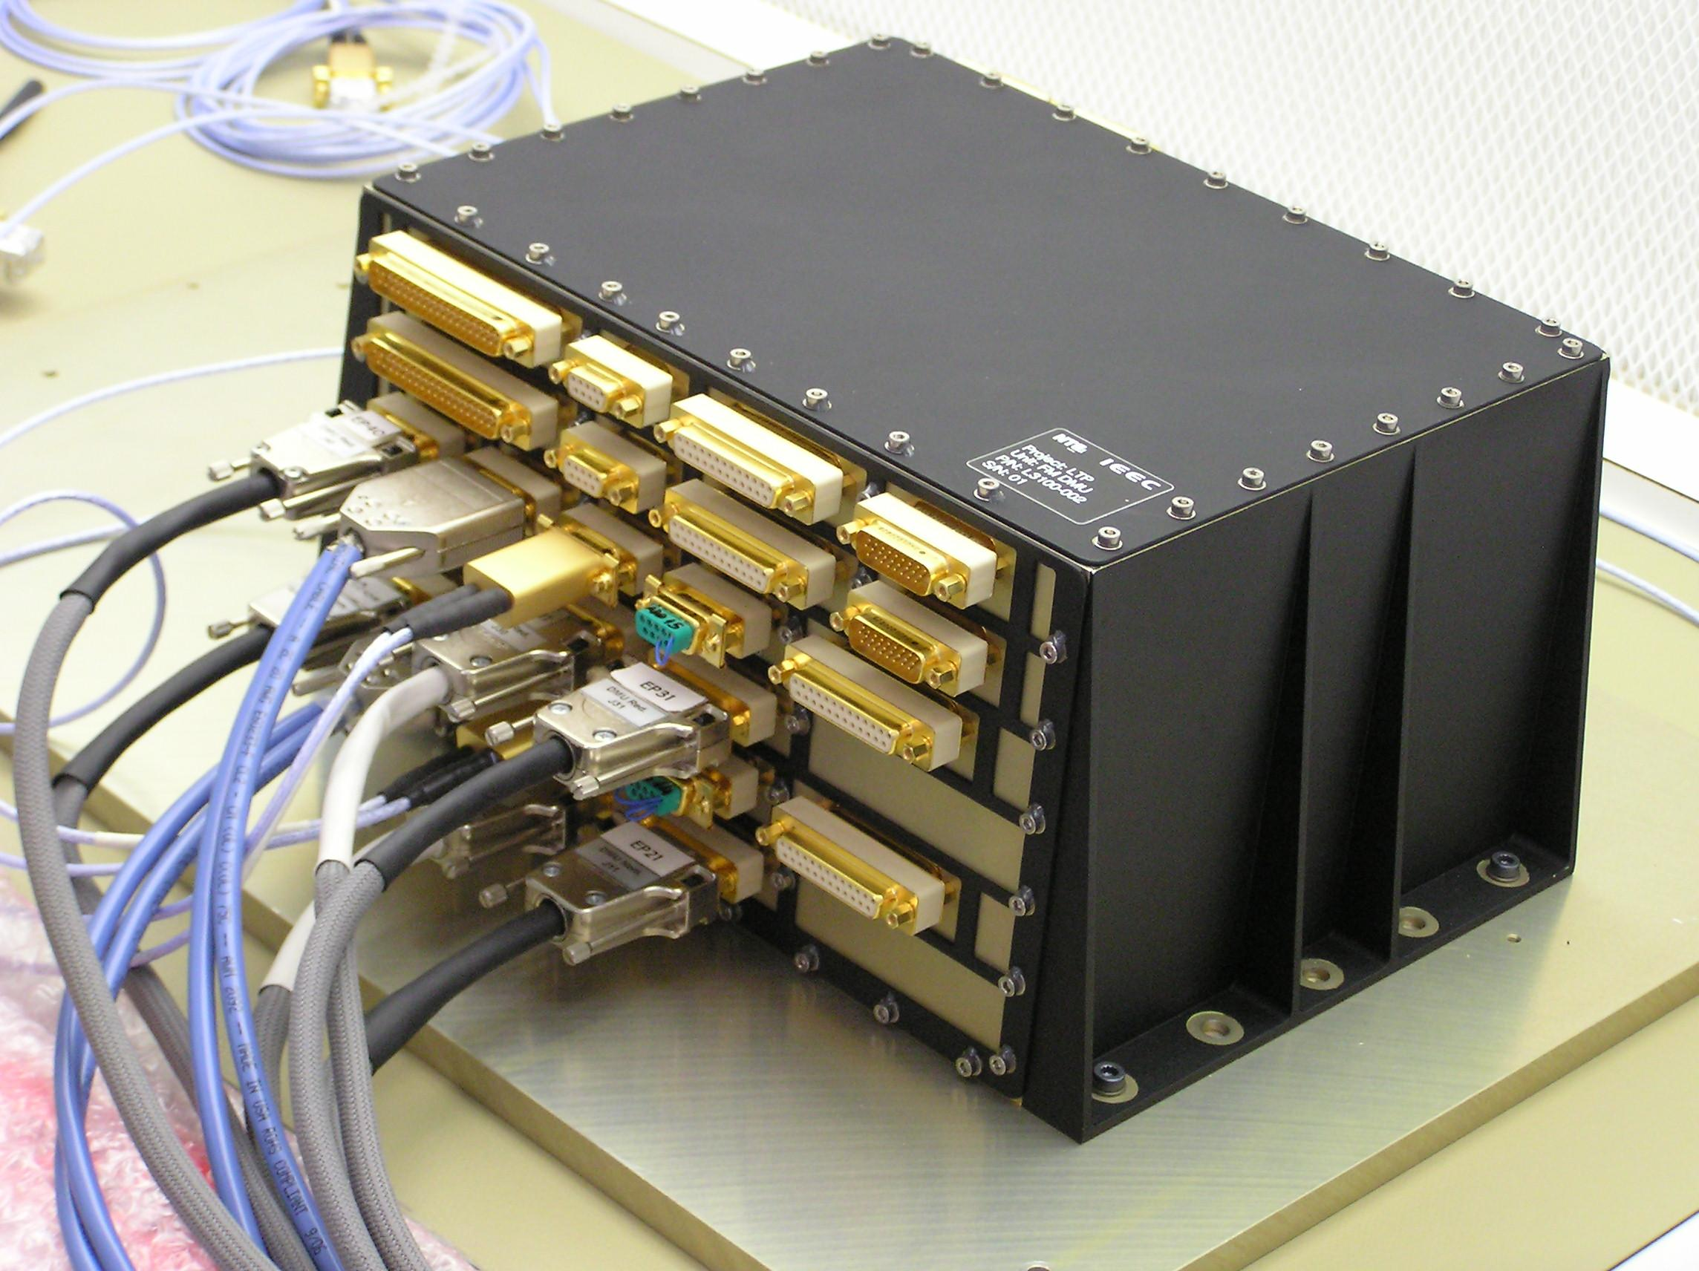
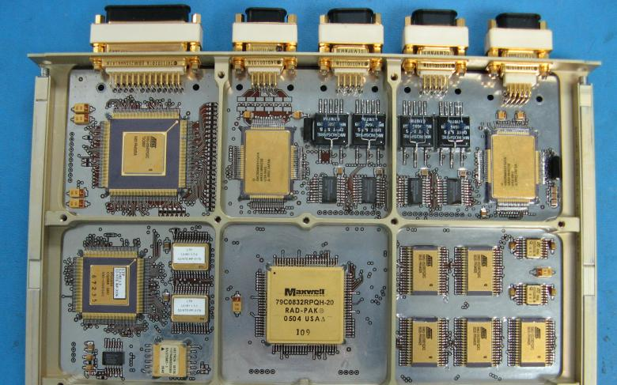
LISA PathFinder: Data Management Unit

Slide 11
Data Management Unit : Computing Resources
CPU: 12 Mhz (TSC695F, ERC32 architecture (Sparc V7))
Memory: 2MB RAM, 256K Persistent memory
Software: 79K code lines

Slide 12
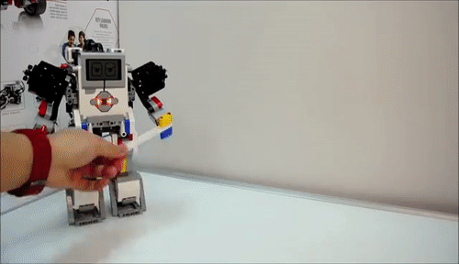
DMU vs Lego Mindstorms EV3
300Mhz & 64Mb of memory

Slide 13
Do software, but critical?
A critical system is a system whose failure or malfunction may result in one (or more) of the following outcomes:
death or serious injury to people
loss or severe damage to equipment/property
environmental harm
If those system implies software, we the peopl.. err... the software engineers enter in scene!

Slide 14
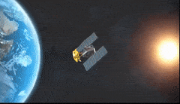
In space?

Slide 15
How we did it?
Engineering process under ESA Standards
Strict engineering process with hard requirements:
75 % CPU ---> 9 MHz
Top limit of 80 % Memory used.
Also with high quality assurance:
Testing -> In LISA Pathfinder 5 lines of tests per line of functional code.

Slide 16
The processTM
Phase A / TRL: 2-3:
Preliminary Requirement Review (PRR)
Phase B / TRL: 4-5:
Preliminary Definition phase.
System Requirements Review (SRR)
Preliminary Design Review (PDR)
Phase C / TRL: 6-7:
Detailed Definition /
Implementation
System Requirements Review (SRR)
Critical Design Review (CDR)
Phase D / TRL: 8:
Qualification Review (QR)
Phase E1 / TRL: 9:
Flight Qualification / Acceptance review (AR)
Phase E2:
Operational Readiness Review (ORR)
Flight Readiness Review (FRR)
Launch Readiness Review (LRR)
Flight Qualification Review (FQR)
End of Life Review (EOLR)
Phase F:
Disposal of spacecraft

Slide 17
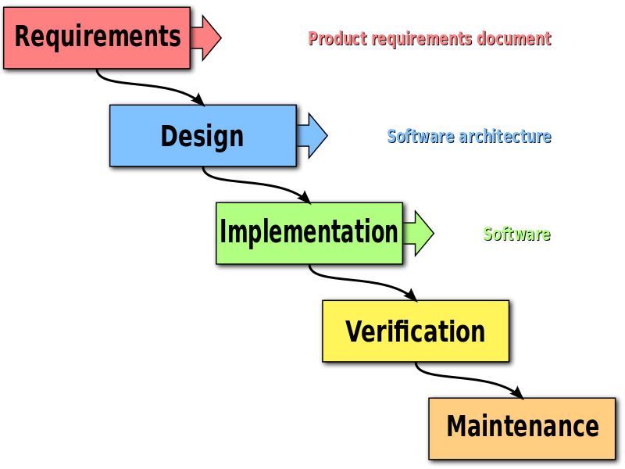
Software Engineering waterfall model

Slide 18
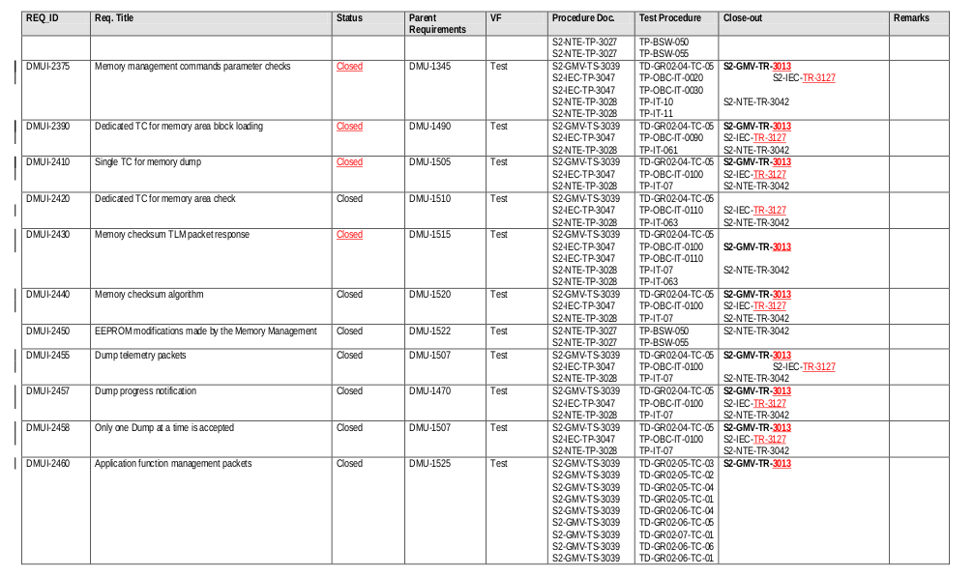
The processTM ->PhaseA/B
Software Requirements:
138 Pages,
120 Reqs for Basis Software,
1050 Reqs for main Application.
300 Reqs For Interface.
722 pages for Traceability document.

Slide 19
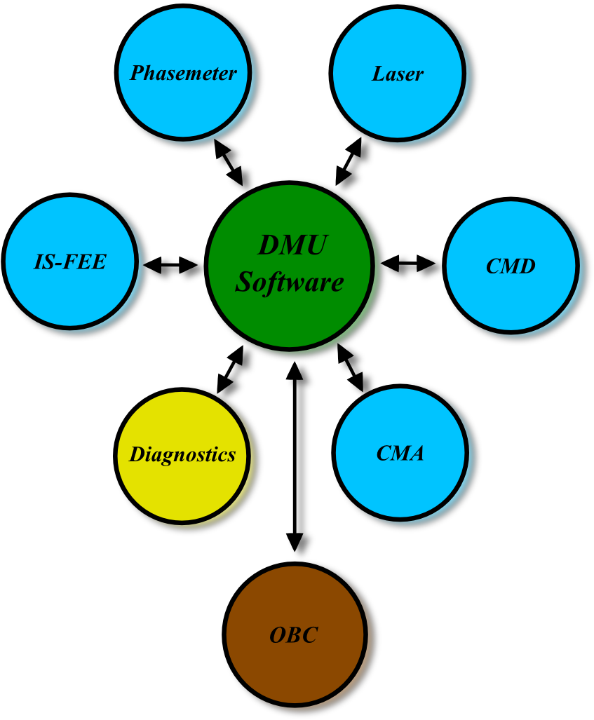
The processTM ->Phase A/B
Conceptual Block Diagram

Slide 20
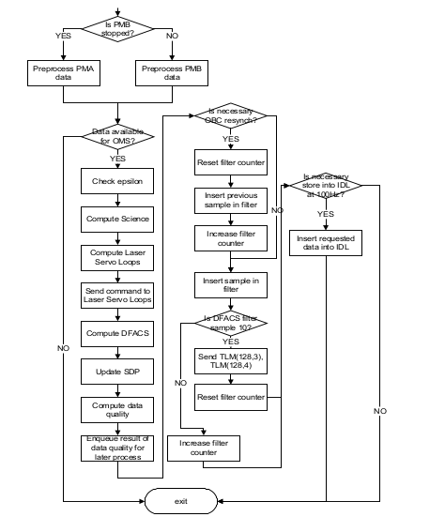
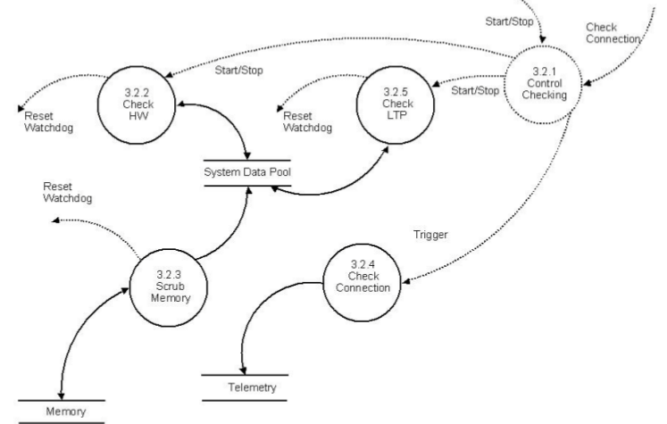
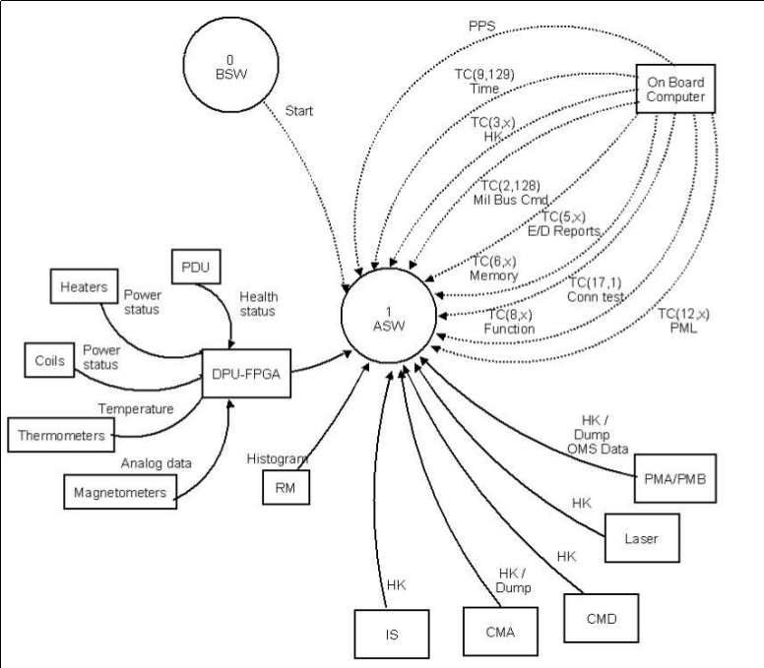
The processTM ->PhaseA/B
Designing

Slide 21
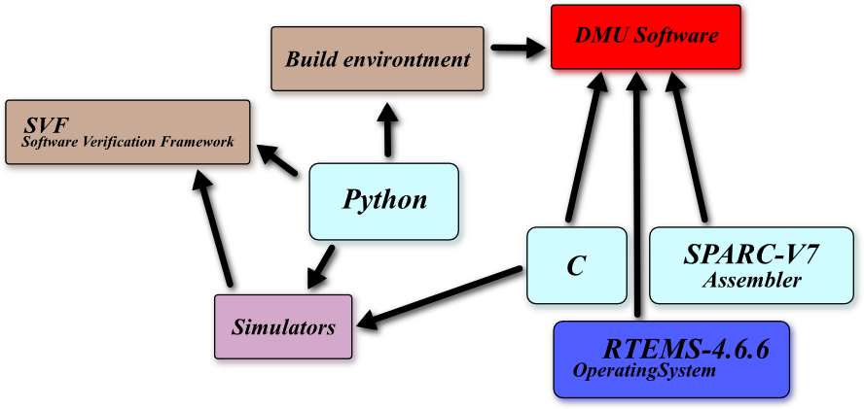
The processTM ->Phase A/B
Technology Mind-Map

Slide 22
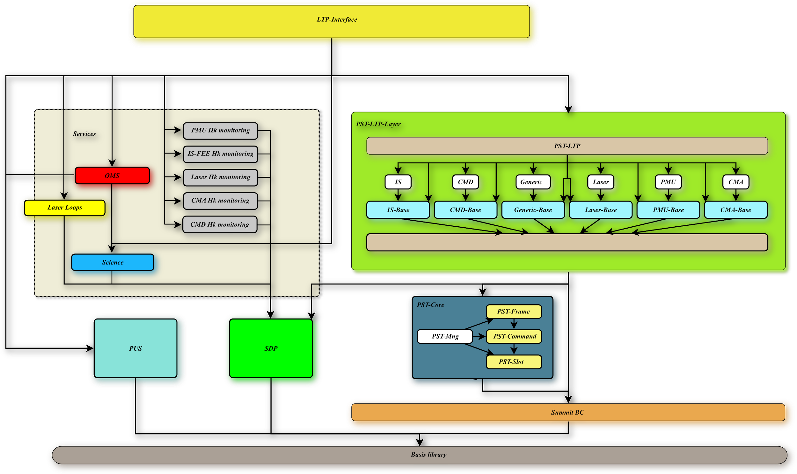
The processTM ->Phase A/B
Designing

Slide 23
The processTM ->Phase C
Developing
Boot:
Custom micro-OS from scratch
23k Code lines
130k Code lines for test
Main SW:
RTEMS OS
56k Code lines
260k Code lines for test
Programming language:
Sparc V7 assembler for boot and CPU register access
C99 for applications
Python for tools

Slide 24
The processTM ->Phase D
Test and quality process

Slide 25
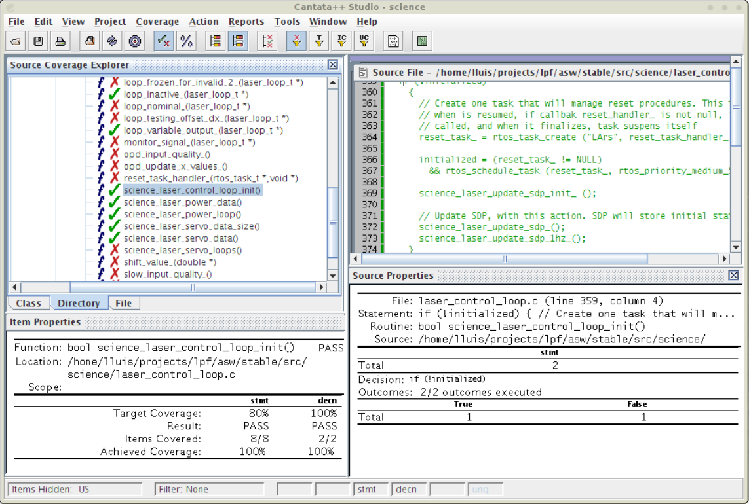

Slide 26
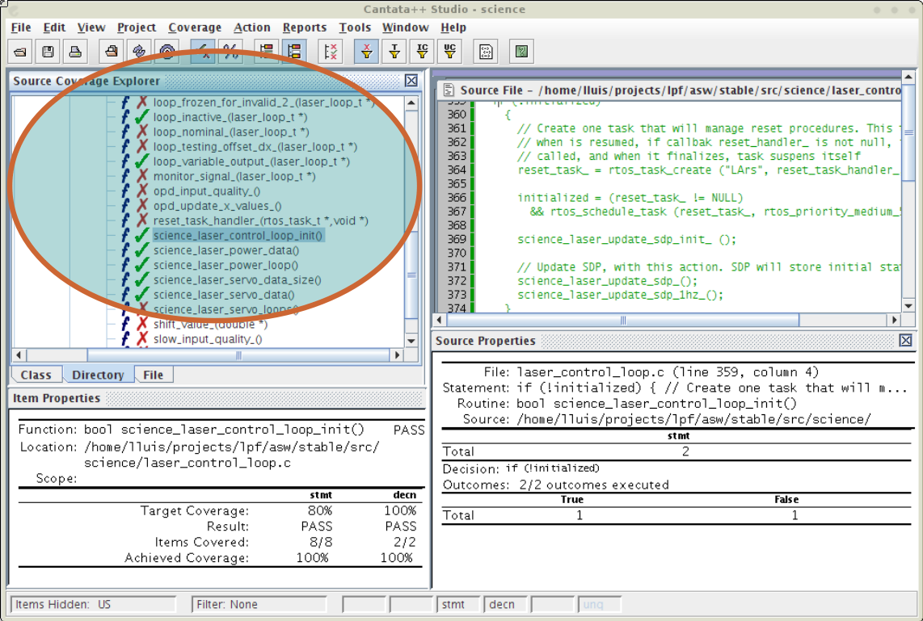

Slide 27
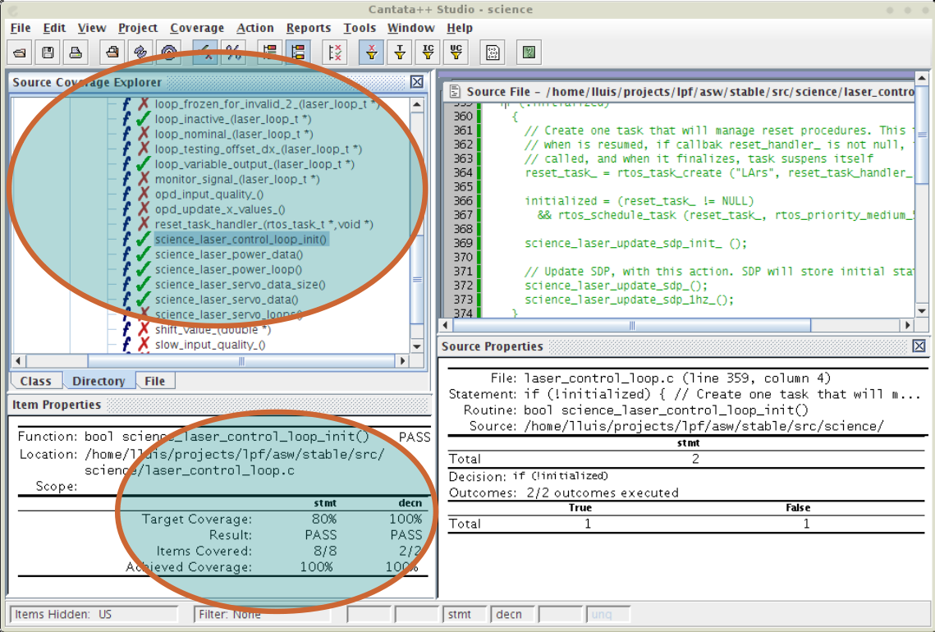

Slide 28
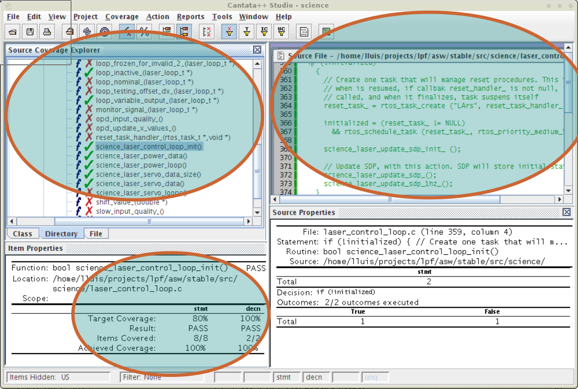

Slide 29
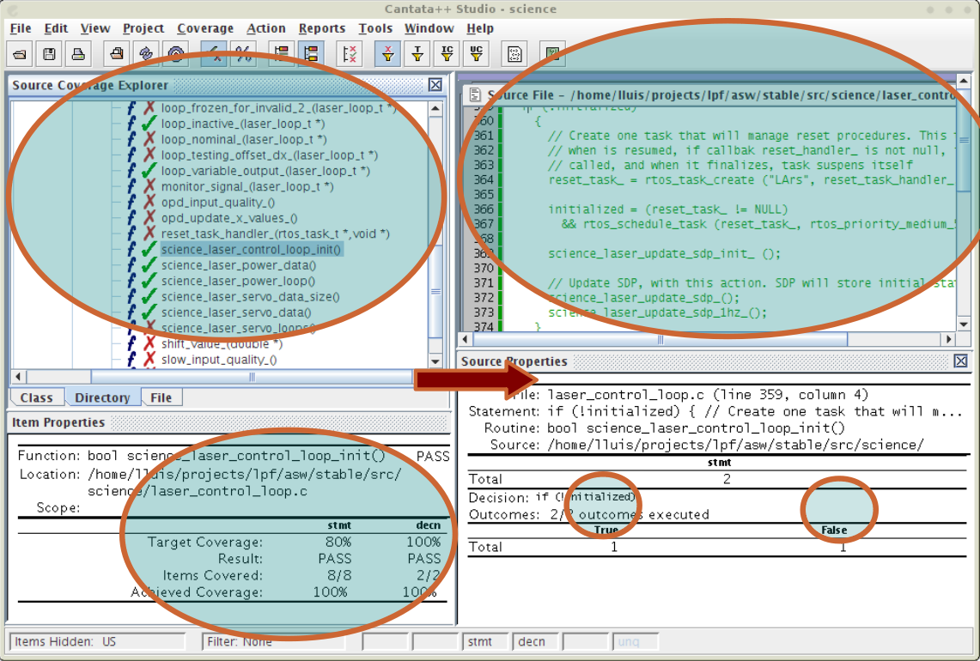

Slide 30
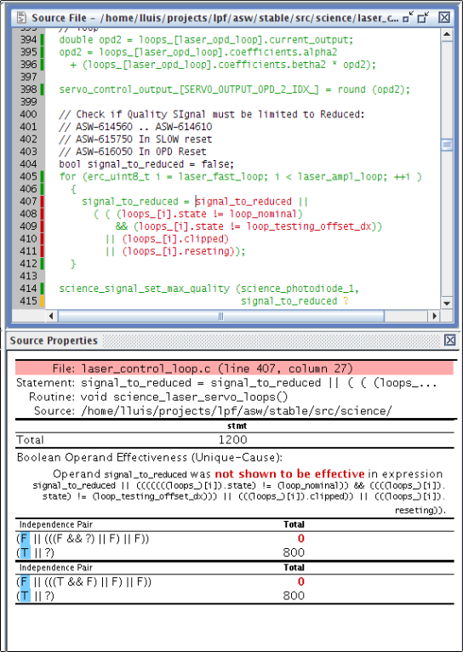

Slide 31
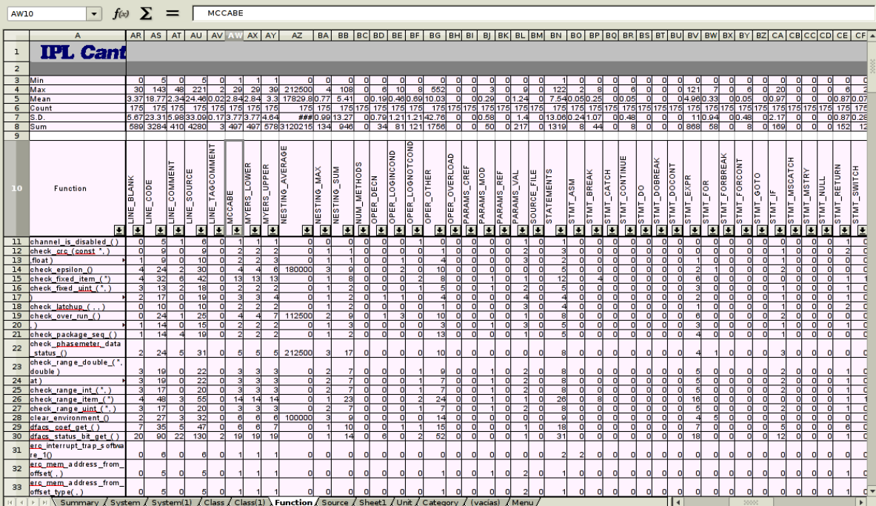

Slide 32
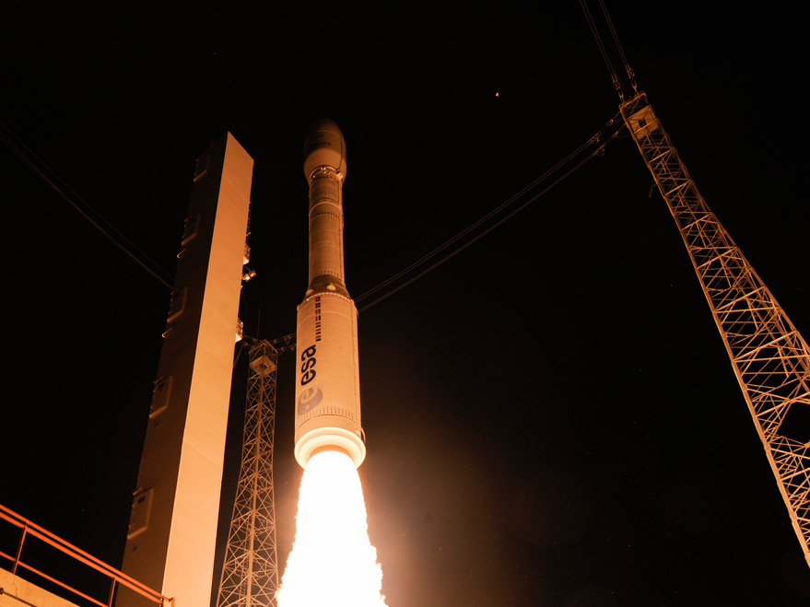
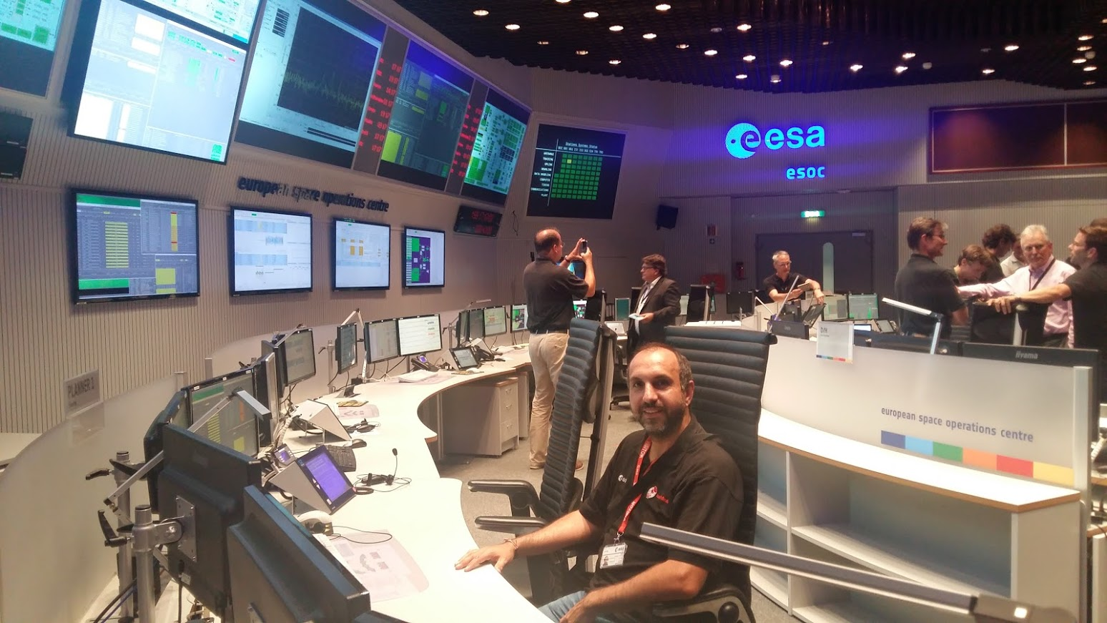
And finally 10 years after …. Phase E!!

Slide 33
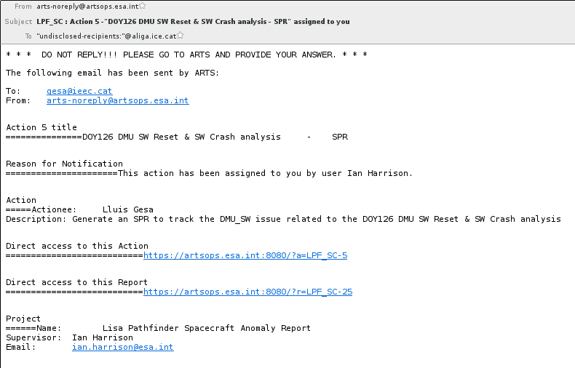
But after all the effort, an email is received..

Slide 34
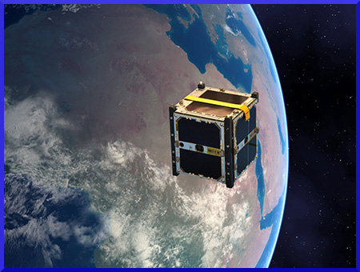
After LPF, C3SatP

Slide 35
After LPF, C3SatP
Custom platform made from scratch by IEEC:
Robust OBC with ESA Mission heritage in software.
Optionally with High computing capability in a Hybrid Computer (FPGA + MSoC)
Optionally with SDR

Slide 36
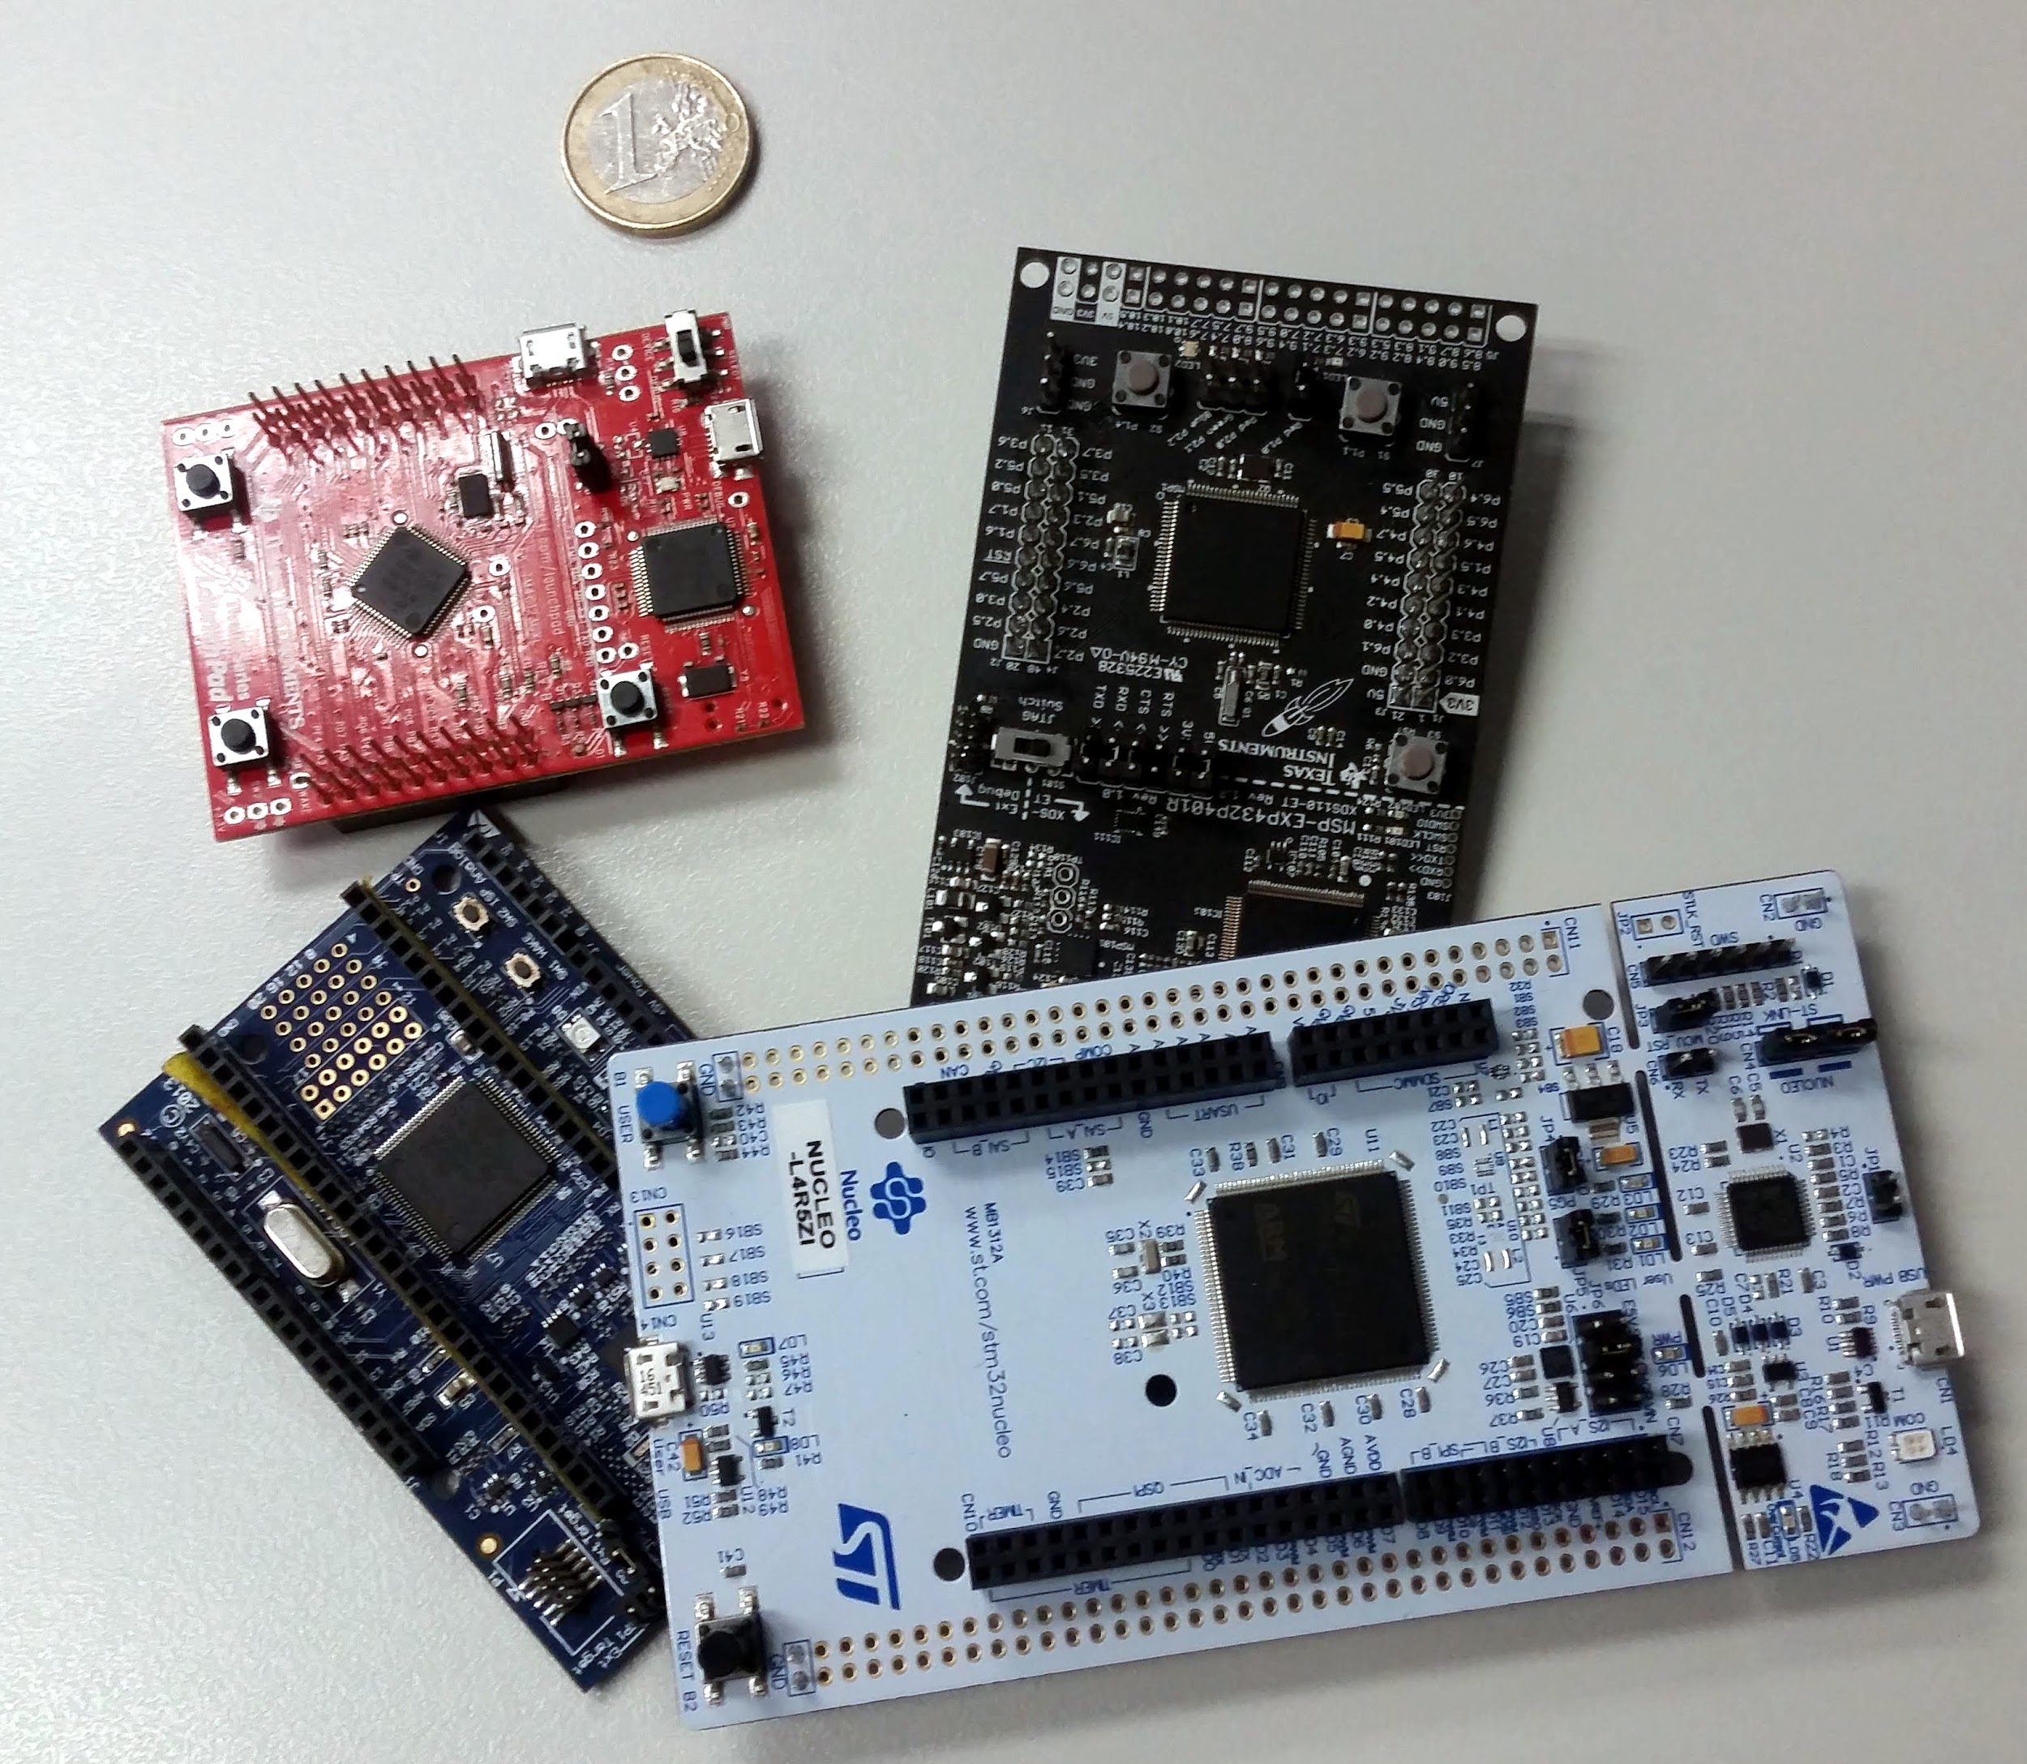
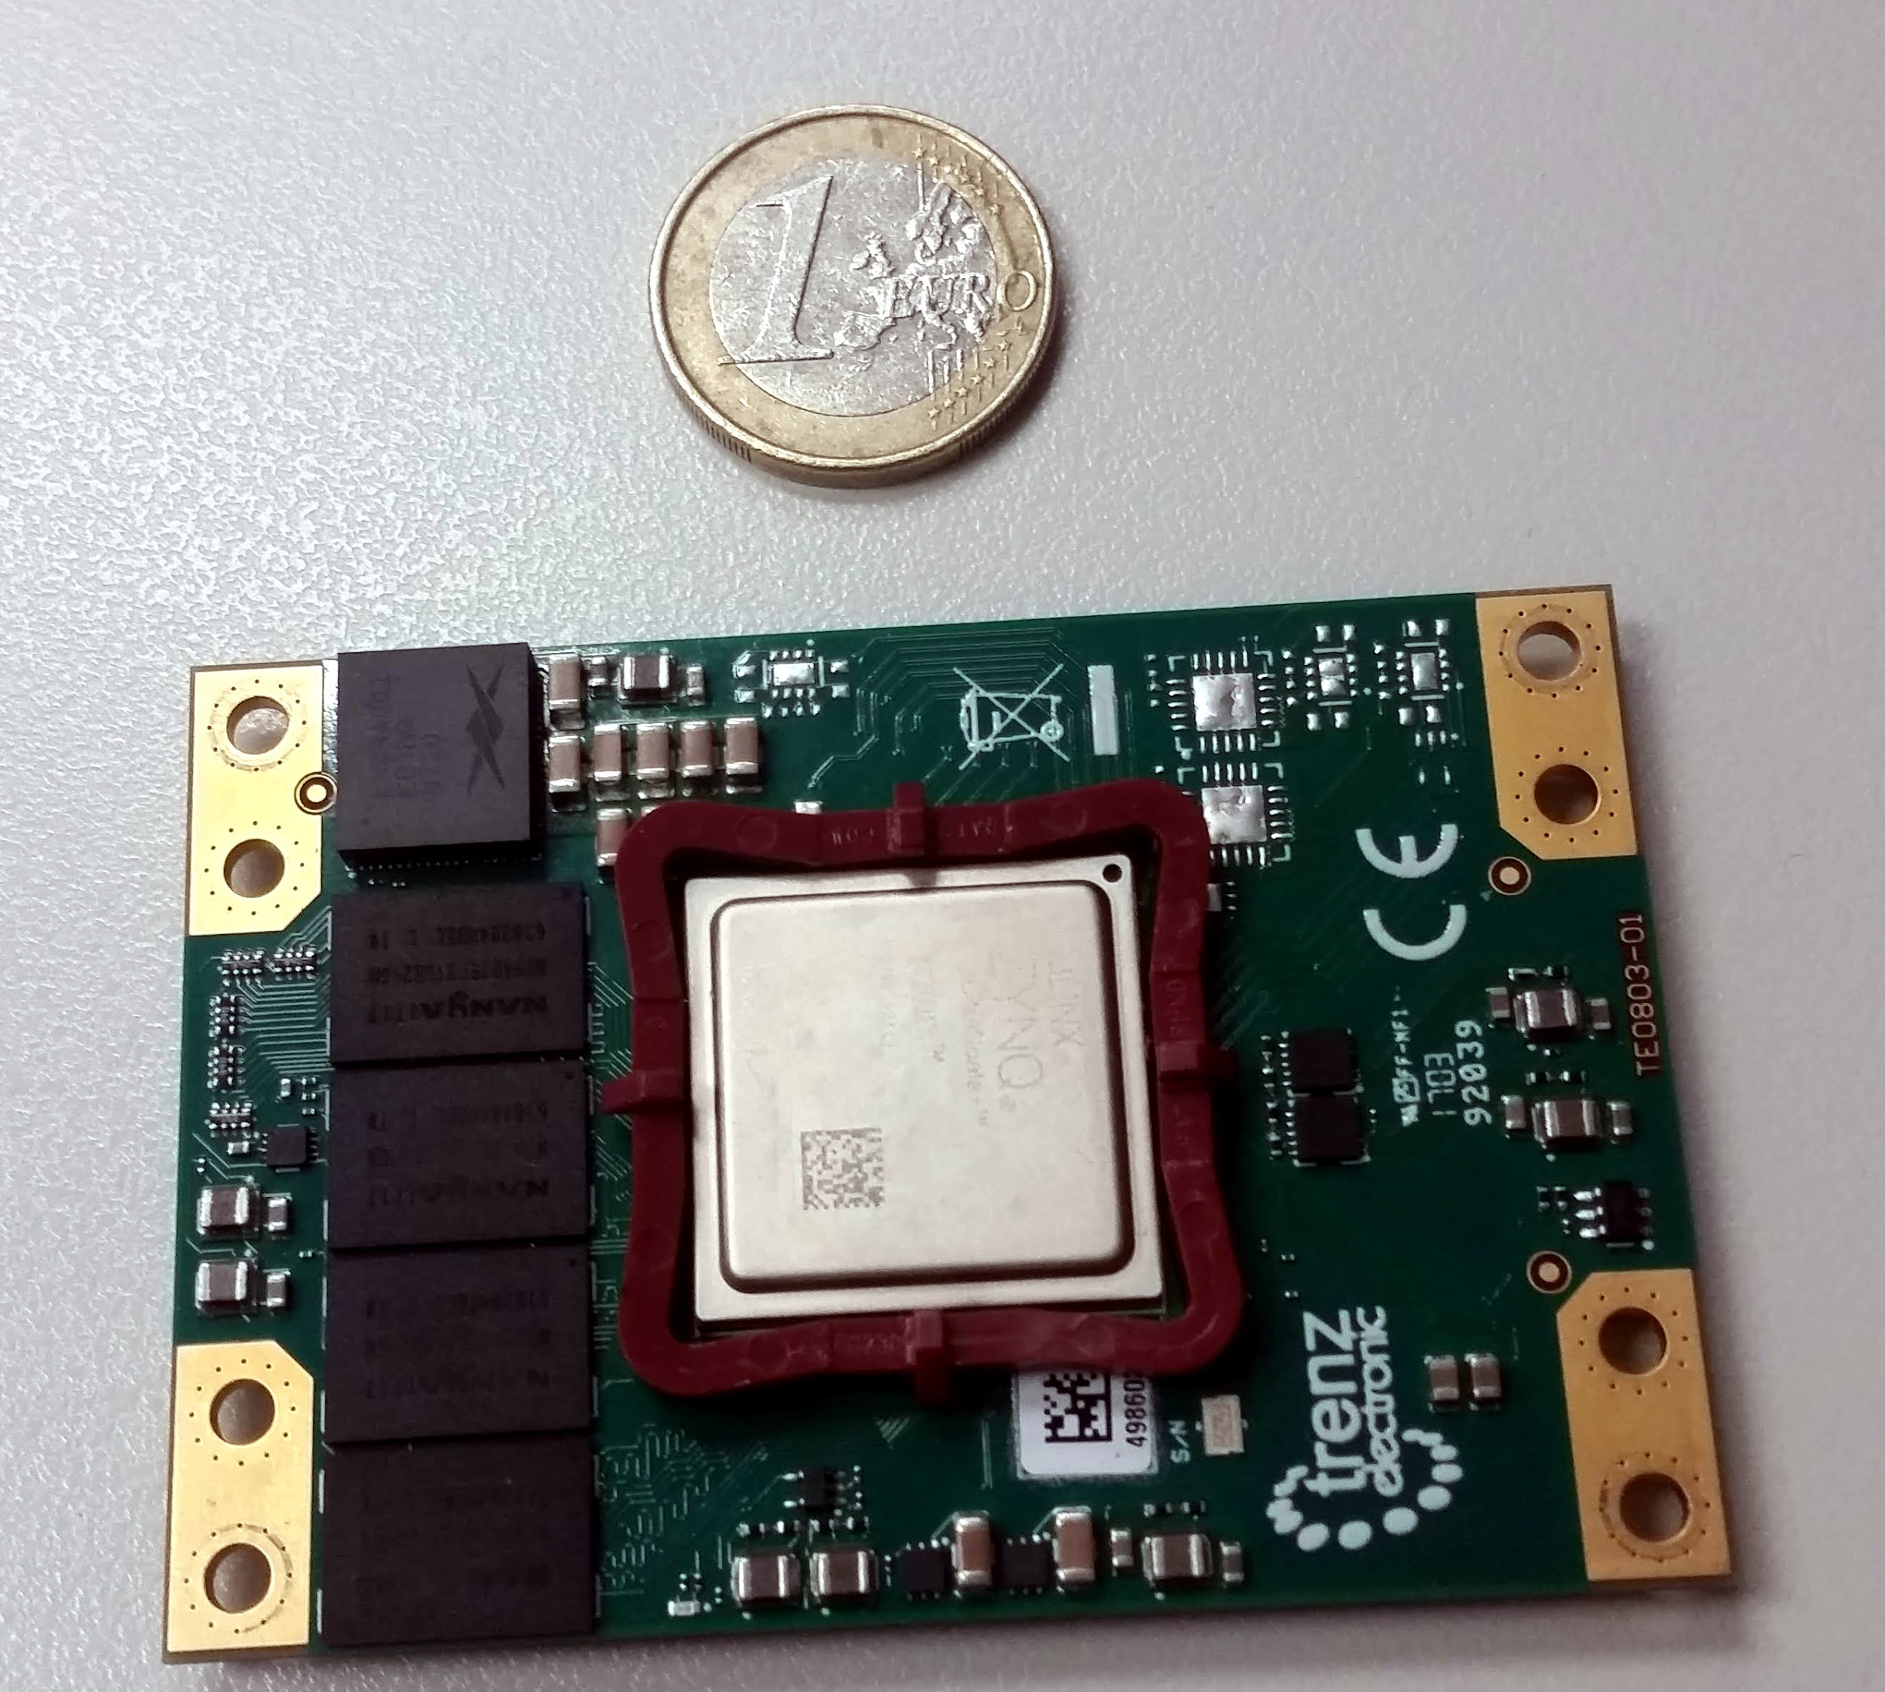
New project, new toys..
CPU 180 Mhz
128 Kb RAM / 256 Kb Flash
4 Cores 1.5 Ghz + 2 Cores 400Mhz. 2GB RAM

Slide 37
New project, new toys.. Also for software
New options for operating systems:
GNU/Linux
FreeRTOS
MBed
Contiki
...
New options for communications:
TCP/IP
Cubesat Space Protocol (CSP)

Slide 38
New project, new toys.. Also for software
New platforms
KubOS
Taste from ESA
Commercials: ISIS, GomSpace, …..
Resources from Libre Space Foundation
...
New Languages:
Python ---> uPython
Java

Slide 39
New development approaches
And program watchdogs!
Is needed the development rigidity of the standard software development for space missions?
Maybe not.. But don’t forget:
Software should run fine! How many missions had severe failures due software issue?
Don’t relax!
And program watchdogs!

Slide 40
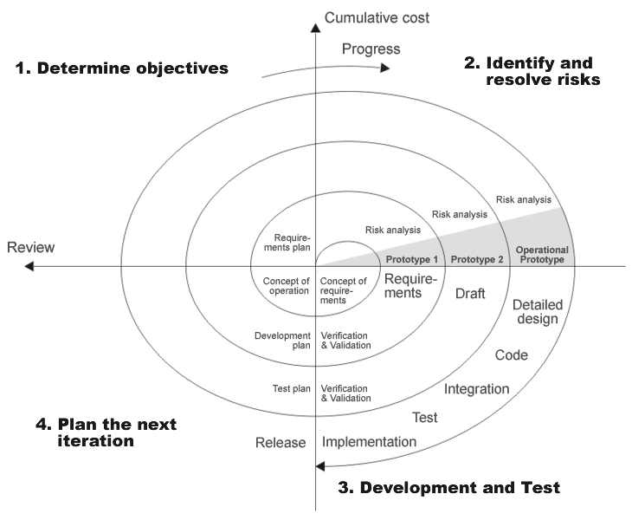
New development approaches
Prototyping
Agile Development

Slide 41
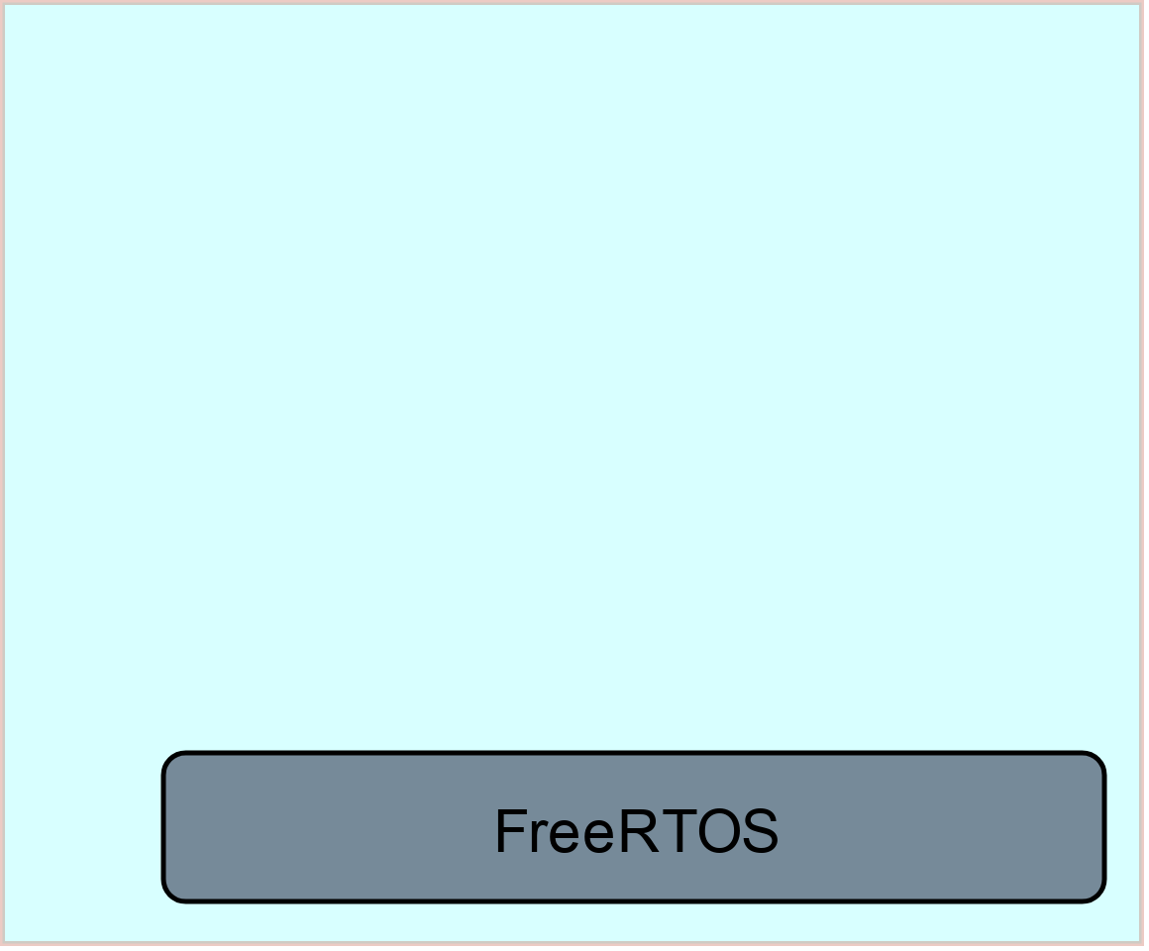
Our Software Solution

Slide 42
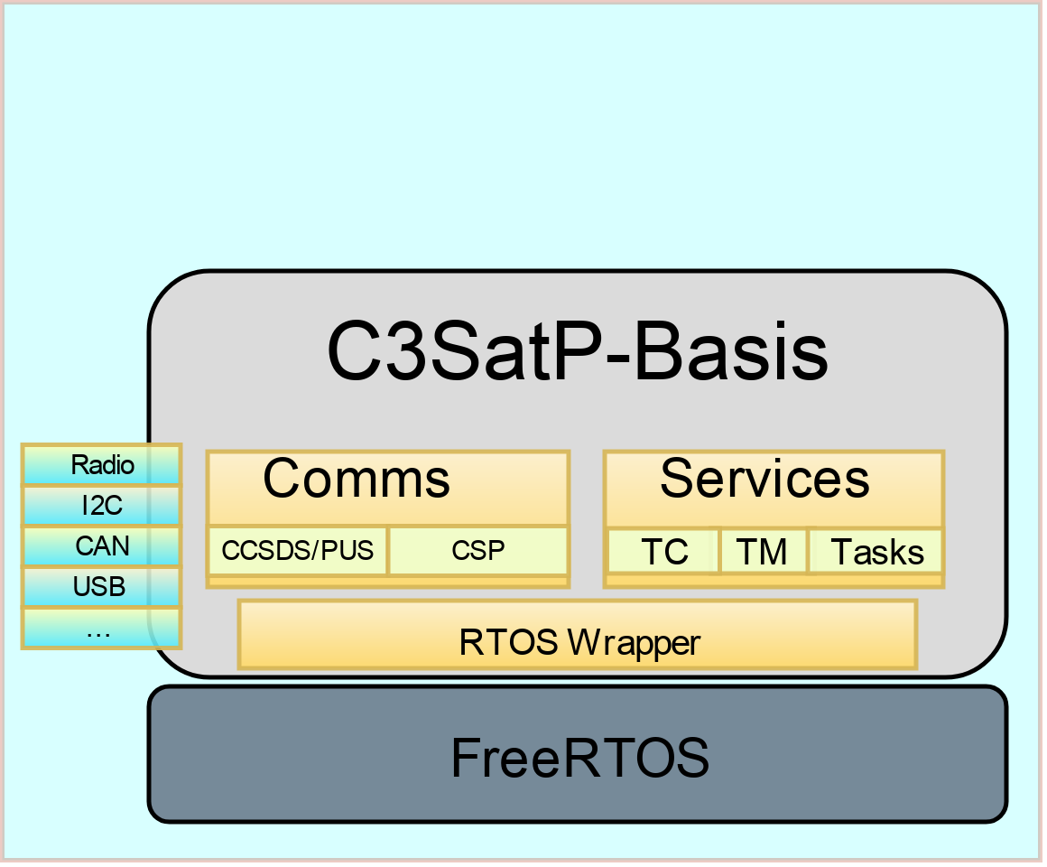
Our Software Solution

Slide 43
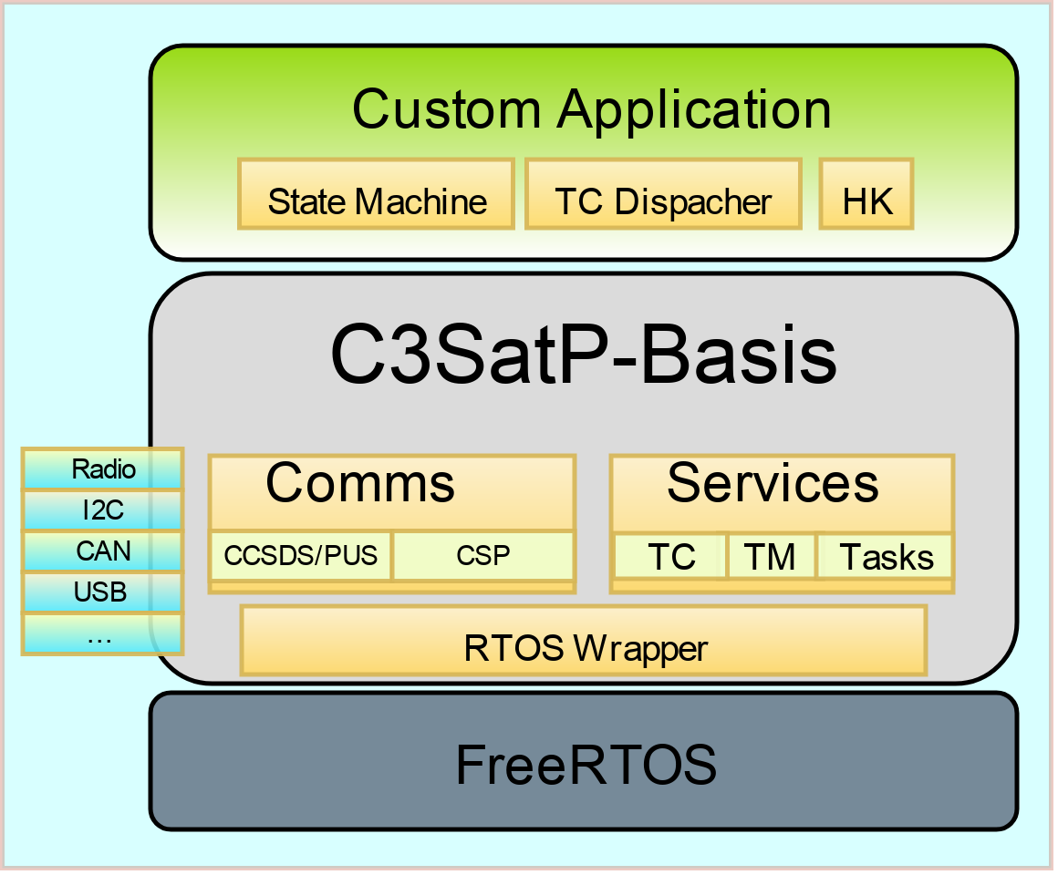
Our Software Solution

Slide 44
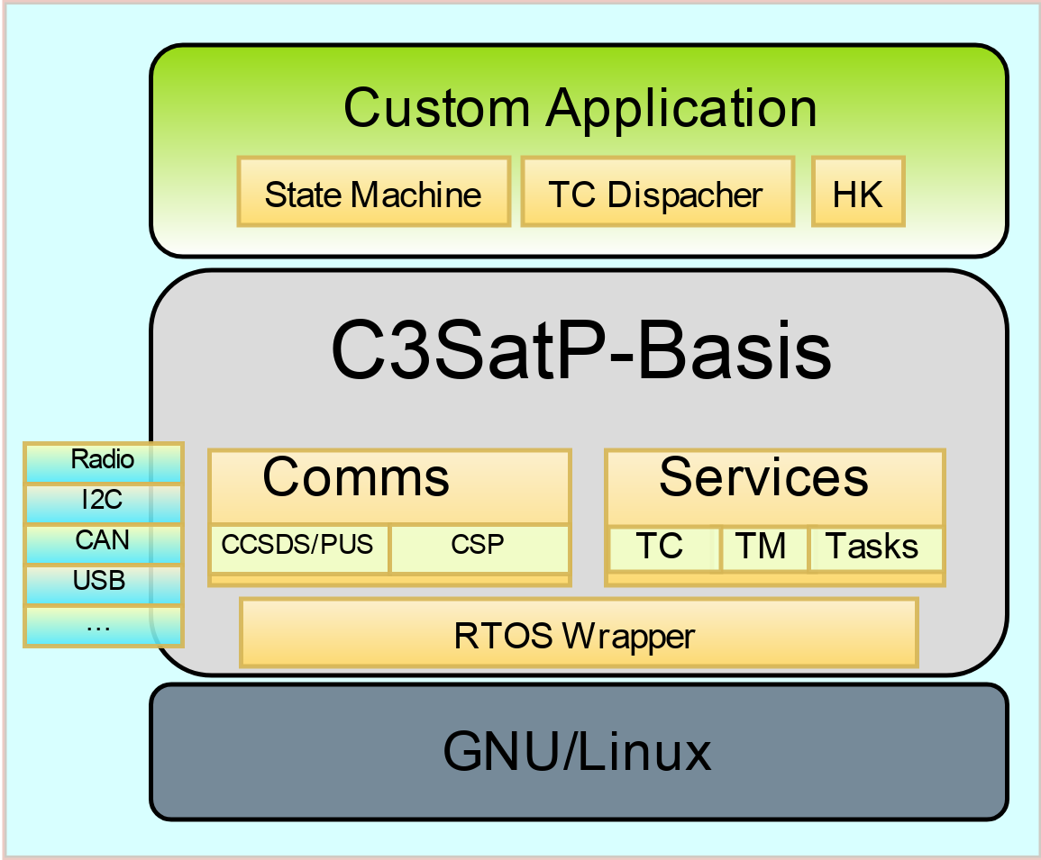
Our Software Solution

Slide 45
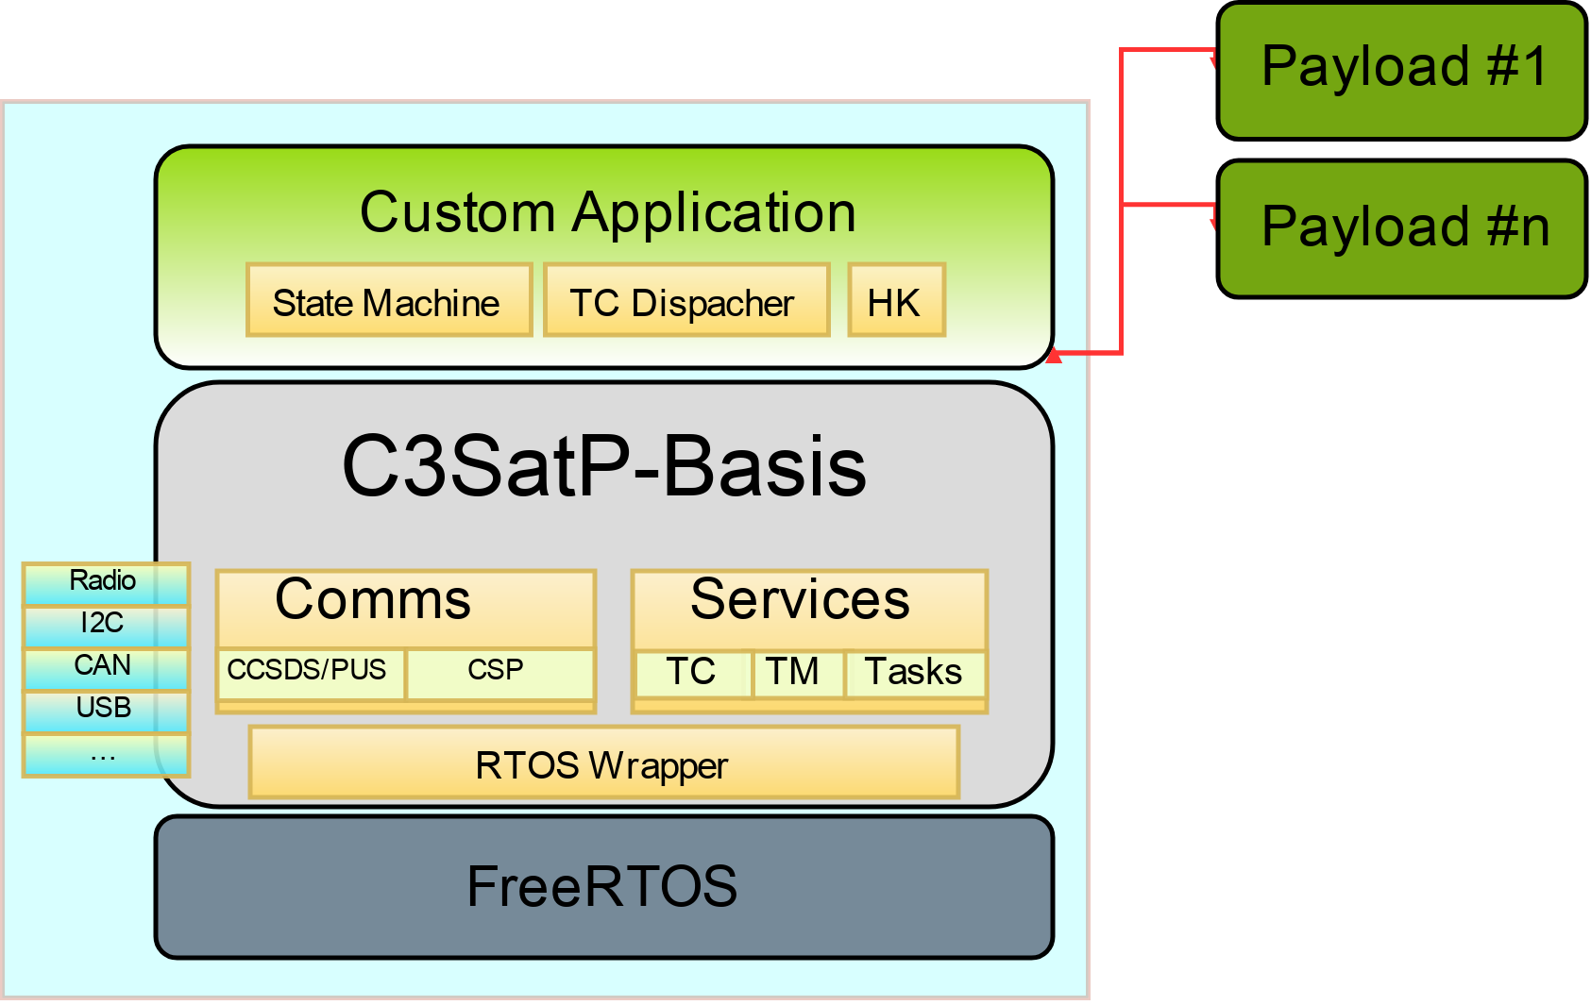
Our Software Solution

Slide 46
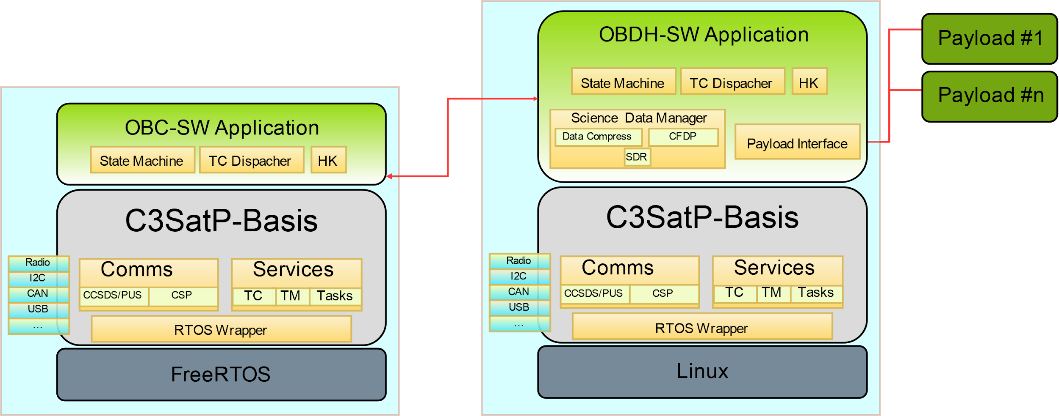
Reuse & Reuse !!

Slide 47
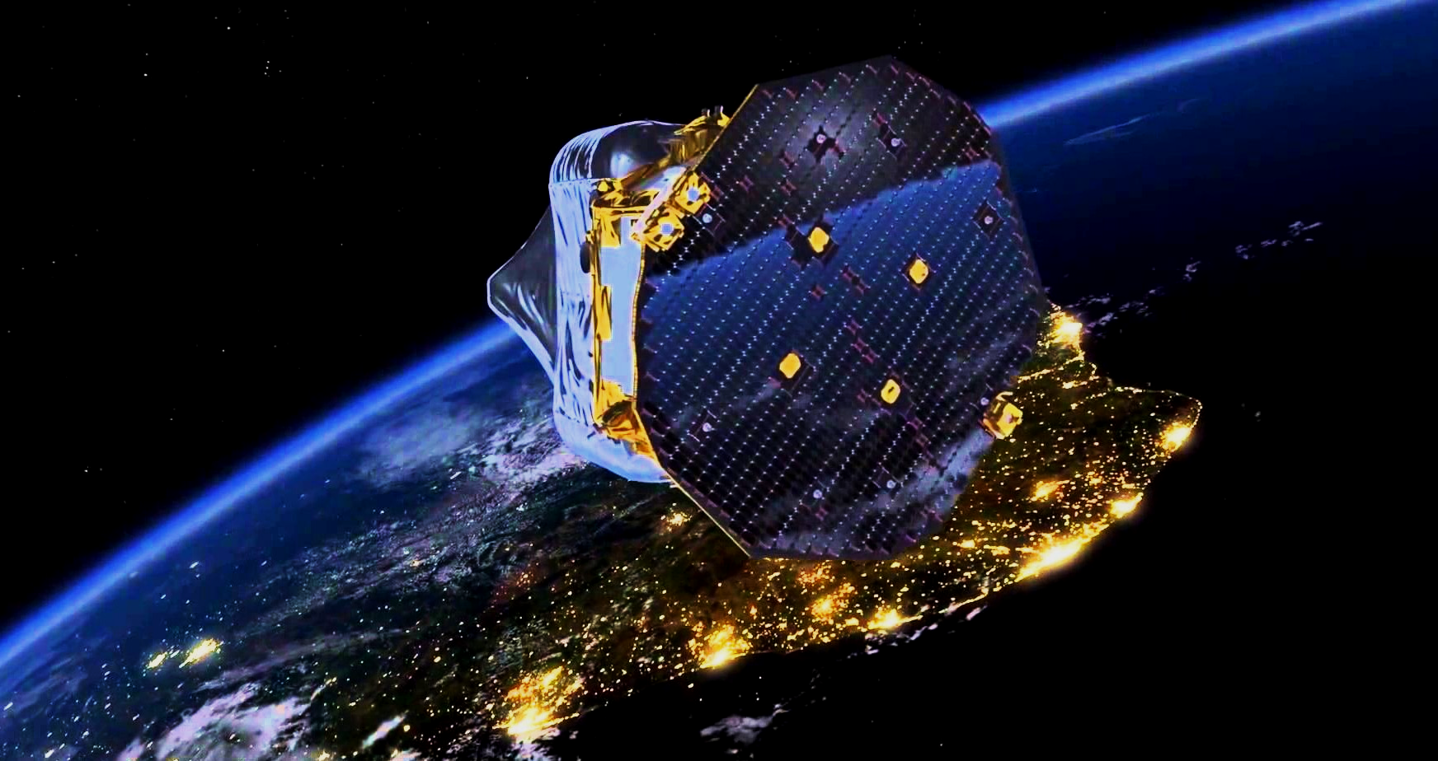
Thanks for your attention
gesa@ieec.cat
@lluisgesa

