Slide 1
Fourth Barcelona TechnoWeek Course on Nanosatellites
Institute of Cosmos Sciences, Barcelona, 17-21 June 2019
Attitude Determination & Control
Norman Fitz-Coy
University of Florida

Slide 2
Attitude Determination & Control
Objectives
This segment of the course provides an introduction to spacecraft attitude determination and control (ADC) with emphasis on nanosat applications. Topics include:
Terminology & Definitions
ADC System Requirements
ADC System Components
Sensors (external / internal)
Actuators (passive / active)
Attitude Representations/Kinematics/Dynamics
Attitude Determination Approaches
Attitude Control Approaches (2-axis/3-axis)
ADC Mission Assurance Approaches (i.e., V&V)
Example

Slide 3
Terminology & Definitions: ADC
Attitude (noun)
the position of a craft (such as an aircraft or spacecraft) determined by the relationship between its axes and a reference datum (such as the horizon or a particular star)
https://www.merriam-webster.com/dictionary/attitude
Attitude is relative!
Determination (noun)
a fixing or finding of the position, magnitude, value, or character of something: such as (a) the act, process, or result of an accurate measurement • more precise determination of the size of the tumor
https://www.merriam-webster.com/dictionary/determination
Control (noun)
(b) a device or mechanism used to regulate or guide the operation of a machine, apparatus, or system • the controls of the aircraft
https://www.merriam-webster.com/dictionary/control

Slide 4
Terminology & Definitions: GNC
Navigation (noun)
the science of getting ships, aircraft, or spacecraft from place to place; especially: the method of determining position, course, and distance traveled
[NB. Definition extended to include attitude (position) and attitude rate (angular velocity)]
https://www.merriam-webster.com/dictionary/navigation
Guidance (noun)
the process of controlling the course of a projectile by a built-in mechanism • problems with the missile's guidance
[NB. Technically only develops the maneuver required to transition from one state to another – the action required to achieve this maneuver is performed by the control system]
https://www.merriam-webster.com/dictionary/guidance

Slide 5
Terminology & Definitions (cntd)
Attitude Error
Low frequency component of misalignment between the desired attitude of the spacecraft and its actual attitude (aka pointing accuracy)
Knowledge Error
Low frequency component of misalignment between the measured attitude of the spacecraft and actual attitude
Control Error
Low frequency component of misalignment between the desired attitude of the spacecraft and the current knowledge of its attitude (i.e., its “determined” attitude)
Attitude Jitter
High frequency component of spacecraft attitude misalignment; typically ignored by the control system and reduced by good control design and/or fine pointing control (aka attitude stability)

Slide 6
Terminology & Definitions (cntd)
Pictorial Representation
Desired
Determined (i.e., Estimate)
Actual

Slide 7
Terminology & Definitions (cntd)
ADC Block Diagram
Control
Disturbances
Desired Attitude
Attitude Controller
Actuator Controller
Actuator Dynamics
Spacecraft Dynamics
Estimation Algorithms
Attitude Sensors
Determination
Component | Tasks
Attitude Controller | Computes torques required to reduce pointing error
Actuator Controller | Computes the actuator commands to realize the required torques
Actuator Dynamics | Generates actual torques based on actuator commands
Disturbances | External torques due to external (space) and/or internal (spacecraft) environments
Spacecraft Dynamics | The dynamical system that is the spacecraft and all of its components
Attitude Sensors | The components of the spacecraft that measure its behavior and the celestial phenomena
Estimation Algorithms | Computes the attitude of the spacecraft (relative to some frame of reference) based on celestial phenomena models and observed measurements

Slide 8
ADC System Requirements
Design requirements and constraints
Pointing requirements (knowledge / control)
Knowledge drives sensor choices
Control drives actuator choices
Rate requirements (e.g., slew/retargeting)
Station keeping requirements
Environmental disturbance (LEO, MEO, GEO)
Constraints (volume, mass, power – a.k.a. SWaP)
Reliability
Cost and schedule
Notes:
LEO: < 2,000 km alt
MEO: >2,000 and <36,000 km
GEO: ~ 36,000 km

Slide 9
ADC System Requirements
ADC Requirements vs. Mission Requirements
Attitude determination requirements
Real-time attitude determination
Know attitude within certain accuracy
Implications: payload, C&DH, EPS, and propulsion subsystems
Post-processed attitude determination
Mission objectives (payload)
More precise (better models/prediction and discriminate bad measurements)
Implications: payload, C&DH (e.g., data storage), TT&C, EPS
Attitude control requirements
Passive vs. active; 2-axis vs. 3-axis
Pointing precision (station keeping); rate constraints (slewing/retargeting)
Implications: Payload, C&DH, TT&C, EPS, Propulsion
Solution strategy
Identify components (multiple options/vendors may exist)
Perform trade studies with cost/schedule/risk constraints
Utilize the “KIS” principle

Slide 10
ADC System Requirements (cntd)
Overall ADC system must satisfy the requirements
Requirements must be “shared” between the subsystems/components
Requirements need to be assigned to each of the components
Does a component exist that satisfies the requirements?
Is it feasible to use the component?
Is the component affordable?
Is the component reliable?
Level x.1 (SubSystem)
Pointing Requirement
Level x.2 (Sub-SubSystem)
Knowledge
Control
Level x.3 (Component)
Calibration
Sensor Errors
Sensor Alignment
Control Bandwidth
Actuator Alignment
Disturbances

Slide 11
ADC System Components: Sensors
External sensors
Sun sensor
Course sun sensors (CSS)
Digital sun sensors (DSS)
Fine sun sensors (FSS)
Earth horizon sensor (HS)
Magnetometer (TAM)
Star camera, star tracker
Internal sensors
Gyros
Mechanical / optical
Accelerometers
Inertial measurement units (integrated gyro and accelerometer)
Integrated Inertial Navigation Units (IINU) – typically IMU+GPS

Slide 12
ADC System Components: Sensors (External)
 | Accuracy | Performance | Mass (kg) | Power (W) | Cost ($)
Star Camera (Star Tracker) | 0.0003°- 0.02° | Slew rate: 2-3°/s 2 -10 Hz | 0.05 - 5 | 0.22 - 20 | Moderate-High
Analog Sun Sensor (CSS) | 0.01° - 5° | FOV: 10°- 120° | 0.004 - 0.025 | 0 - 0.05 | Low
Digital Sun Sensor (DSS) | 0.01° - 0.5° | FOV: 30°- 140° | 0.015 - 1.3 | 0.05 - 0.3 | Moderate-High
Horizon Sensor (Fixed Head or Scanning) | <0.05°- 3° | FOV: 60° | 0.5 - 4 | 0.3 - 10 | Low-High
Magnetometer (TAM) | 0.5°- 5° | 4 Hz | 0.2 - 1.2 | <0.7 - 1 | Low
GPS | 1° (fine) >5° (course) |  | 0.02 - 1.6 | ~2 | Moderate/ Low
Summary
Star Camera: most accurate type of attitude sensors
Horizon Sensor: fixed head sensor can be used on a spinning spacecraft; scanning sensor utilizes a rotating lens and can be used on a non-spinning spacecraft
Magnetometer: typically used for altitudes below 1000 km
GPS: accurate position determination; course attitude from antenna gain pattern and fine attitude from multi-antennae interferometry
Notes:
Star camera consists of the detector, sunshade, and thermal control
Star tracker consists of the above plus the avionics (image processing, star catalog, and algorithm)
GPS uses antenna gain pattern for course attitude and multi-antennae interferometry for fine attitude

Slide 13
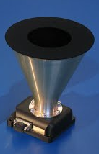
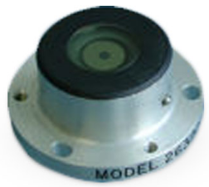
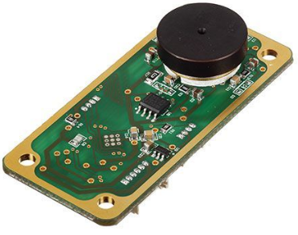
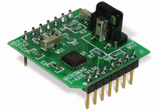
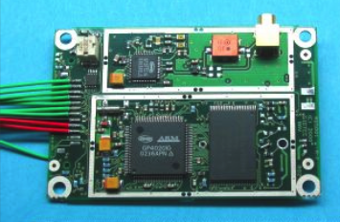
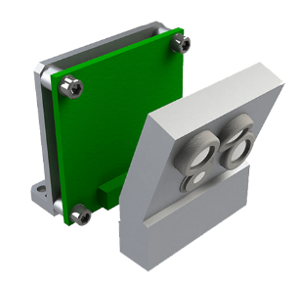
ADC System Components: Sensors (External)
Adcole Corporation CSS
Nano Avionics DSS
Sinclair Star Tracker
http://www.adcole.com/aerospace/analog-sun-sensors/coarse-sun-sensor-detector/
http://n-avionics.com/cubesat-components/attitude-control-systems/cubesat-digital-sun-sensor-dss/
http://www.sinclairinterplanetary.com/startrackers
PNI MicroMag3 3-axis magnetometer
Surrey SGR-05U GPS
Nano Avionics DSS
https://www.sparkfun.com/datasheets/Sensors/MicroMag3%20Data%20Sheet.pdf
https://www.sst-us.com/shop/satellite-subsystems/global-positioning-systems-gps-receivers/sgr-05u-space-gps-receiver
https://www.cubesatshop.com/product/mai-ses-ir-earth-sensor/

Slide 14
ADC System Components: Sensors (Internal)
 | Performance | Performance (Bandwidth) | Mass (kg) | Power (W) | Cost ($)
Mechanical Gyros | Drift: <0.01°/h |  |  |  | Moderate-High
Optical Gyros | Drift: <0.01°/h | Sampling 2000 – 5000 Hz | 0.45 | 0.37 - 1.6 | Moderate
MEMS Gyros | Drift: <1-10°/h | >10 -262 Hz | 0.035 | 0.18 – 0.5 | Low
Accelerometers | <1µg | >300 MHz | 0.071 | 0.4 | Low
Inertial Measuring Units (IMU) | Gyro drift: 0.005 – 5°/h | Guidance 100 – 300 Hz Control 600 – 800Hz | 0.054 – 0.14 | 0.14- 2 | Low-Moderate
Integrated Inertial Navigation Units (IINU) | Gyro stability bias 1°/h | GPS/Inertial 0.02°-0.05° | 0.004-11.79 | 0.35-47 | Low-High
Summary
Mechanical Gyro: accurate but typically heavy
Ring Laser Gyro: vibration insensitive and reliable lifetime
MEMS Gyro: slow time response
IMU: integrated gyros, accelerometers, and avionics; typically used in conjunction with external sensors (sun or star) and filter techniques
IINU: Typically an IMU integrated with GPS

Slide 15
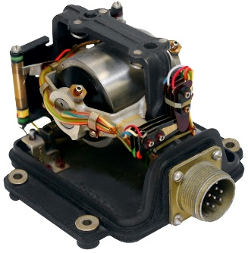
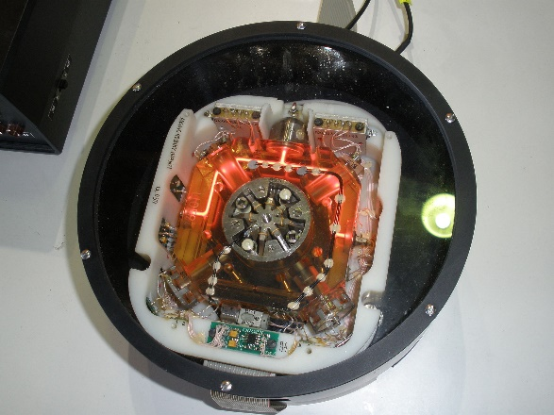
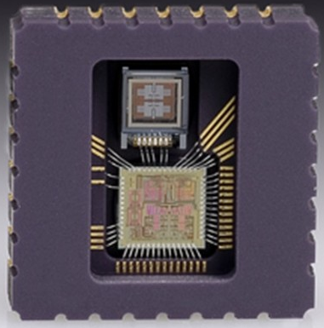
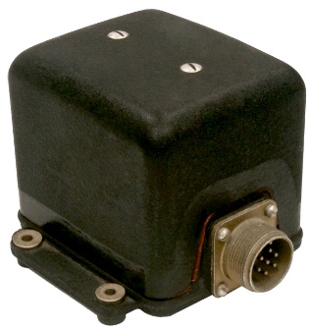
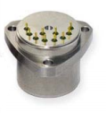
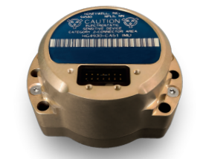
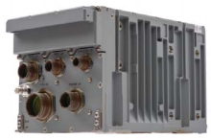
ADC System Components: Sensors (Internal)
Mechanical Gyro
Ring Laser Gyro
IBG20 Butterfly MEMS Gyro
https://www.ion.org/museum/item_view.cfm?cid=1&scid=16&iid=40
https://en.wikipedia.org/wiki/Ring_laser_gyroscope#/media/File:Ring_laser_gyroscope_at_MAKS-2011_airshow.jpg
https://www.acreo.se/our-offer-0/ibg20-butterfly-mems-gyroscope-20
Honeywell Accelerometer
Honeywell IMU
http://pdf-file.ic37.com/pdf6/HONEYWELL-ACC/QA3000-010_datasheet_1071540/174819/QA3000_datasheet.pdf
https://aerospace.honeywell.com/en/~/media/aerospace/files/brochures/n61-1523-000-001-hg4930-mems-inertial-measurement-unit-bro.pdf
Honeywell GPS/IMU
https://aerospace.honeywell.com/en/~/media/aerospace/files/brochures/n61-0411-000-002-embeddedgpsinsegi-bro.pdf

Slide 16
ADC System Components: Actuators (Passive)
Gravity Gradient
Provide 2-axis control (nadir-pointing)
Essentially a “ballast” that can be integrated into the design of the structure – typically a deployed boom
Sensitive instrumentation (e.g. magnetometer) can be attached to boom to reduce interference
Gyroscopic precession possible (i.e., “coning motion”)
Heavier/longer boom ⇒ Smaller cone angle/frequency of oscillation
Gravity-Gradient (GG) torque
Note:
Restoring torque is proportional to the angular displacement
No torque about the nadir direction

Slide 17
ADC System Components: Actuators
Aerodynamic (Drag)/Solar Sail
“Weather vane” effect on S/C’s attitude
Can be a positive attribute (e.g., point a S/C surface in the ram direction) or a negative attribute (i.e., a disturbance)
Provides minimal controllability since “drag” results from linear momentum exchange due to collisions
Control depends on
S/C ballistic coefficient (ratio of inertial to aerodynamic forces)
Coefficient of drag or coefficient of reflectivity/absorption/diffusion
Orbit altitude (drag only)
“Drag” torque

Slide 18
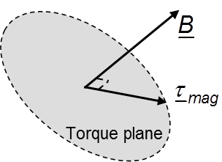
ADC System Components: Actuators
Magnetic Torque
Provides 2-axis control
Magnetic coils use current loops to generate a dipole moment which interacts with the surrounding (Earth) magnetic field to produce a torque perpendicular to both
Other names: magnetorquers, magnetic rods, torque rods (long helical coils with ferromagnetic core), Helmholtz coil
Commonly used for momentum desaturation (i.e., momentum management)
Less effective at altitude since Earth’s magnetic field varies as r⁻³
Magnetic torque

Slide 19
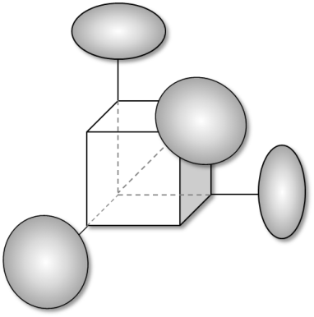
ADC System Components: Actuators
Angular Momentum Exchange Devices (AMEDs)
Uses principles of conservation of angular momentum to yield 3-axis control; typically a redundant system design
Will saturate thus requires a momentum management system (i.e., a system to dump angular momentum)
Different types
Reaction wheel assemblies (RWA)
Single-gimbal control moment gyros (SGCMG)
Variable speed control moment gyros (VSCMG)
Double-gimbal control moment gyros (DGCMG)
AMED torque
Redundant RW Configuration

Slide 20
ADC System Components: Actuators
Reaction Jets (Thrusters)
System of thrusters to impart moments on the spacecraft
Requires consumables (fuel)
Cold gas
Monopropellant
Bipropellant
Concerns
Finite amount of fuel
Misalignment
Propellant management (valves/leakages/mass flow rates)
Contamination (e.g., payload optical sensors)
Uses: rapid slew maneuvers, momentum management, orbit maneuvers (typically in pairs)
Reaction Control torque

Slide 21
ADC System Components: Actuators
 | # of axes | Torque (N-m) | Mass (kg) | Power (W) | Cost ($)
Gravity Gradient Booms | 2 | 10⁻⁸ | 3 - 10 |  | Low-Moderate
Magnets/Hysteresis Rods | 1 - 3 | 0.13 | 0.018 - 0.03 | 0.017 -0.5 | Low
Magnetic Coils | 1 - 3 |  | 0.04 | 0.018 | Low
Aerodynamic | 2
Reaction Jets | 1 - 3 | (93-312 N-sec) | 0.68-1.42 | 0.25 - 15
Reaction Wheel (RW) | 1 - 3 | <4x10⁻⁶ - 0.2 Jitter 73 – 480 Hz | 0.06 – 3.6 | 0.18 - 10 | Moderate-High
Control Moment Gyro (CMG) | 1 - 3 | <0.075 – 75 Jitter 100 - 467 Hz | 0.5-28 | 3 - 113 | Moderate-High
Summary
Gravity gradient boom: passive; used in Earth pointing applications
Permanent magnets/hysteresis rods: passive; used in low Earth applications
Magnetic coils: active; used in low Earth applications
Reaction Jets: active; used for slewing, momentum dumping, orbit adjusts
Reaction wheels: active; reaction torque generated on S/C with changes in wheel speed
CMG: active; used for slewing maneuvers; constant wheel speed; gyroscopic coupling amplifies small gimbal input torque producing large output torques on S/C

Slide 22
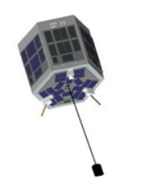
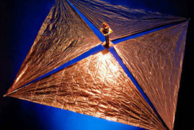
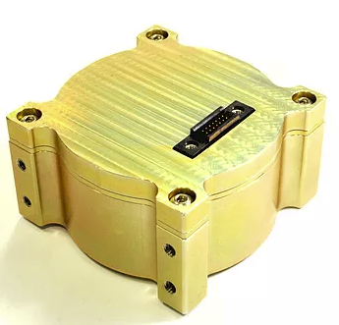
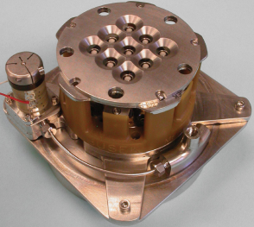
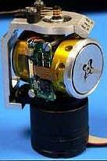
ADC System Components: Actuators
NSS Magnetic Torquer
Gravity Gradient Boom
https://www.cubesatshop.com/product/nss-magnetorquer-rod/
Gossamer Deorbit Sail
http://slideplayer.com/slide/7440345/
http://www.esa.int/Our_Activities/Telecommunications_Integrated_Applications/Sailing_satellites_into_safe_retirement
BET-1mN Electrospray Thruster
Stellenbosch RW
SwampSat CMG
http://www.busek.com/index_htm_files/70008500%20BET-1mN%20Data%20Sheet%20RevH.pdf
https://www.cubespace.co.za/cubewheel
https://directory.eoportal.org/web/eoportal/satellite-missions/s/swampsat

Slide 23
Attitude Representations
Coordinate Systems
Inertial
J2000: Fixed on January 1, 2000 at 12:00:00 TT (~64s before UTC)
Earth-Centered Inertial (ECI)/True-of-Date (TOD): Account for precession, nutation, etc.
Rotating
Earth-centered Earth-fixed (ECEF): Rotate J2000 by Greenwich mean sidereal time (GMST) angle
Perifocal (PQW): Rotate J2000 by RAAN, inclination, and argument of perigee (3-1-3 Euler sequence)
Local
Local Vertical Local Horizontal (LVLH): “Forward, out-the-window, down”
Radial, In-track, Cross-track (RIC): Rotate perifocal by true anomaly
Body
User-defined: origin and basis specified
Principal: Aligned with the principal directions of the spacecraft inertia tensor (i.e., product of inertias are zero); origin is at the S/C’s c.m.
Sensor/Payload: Fixed to the sensor/payload; origin is offset from S/C’s c.m.

Slide 24
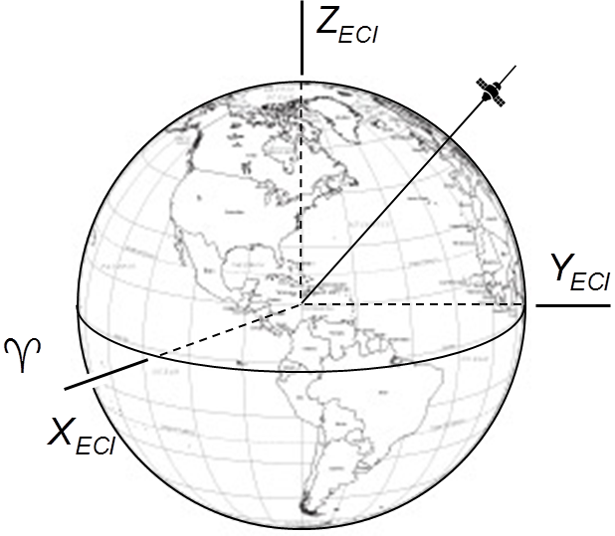
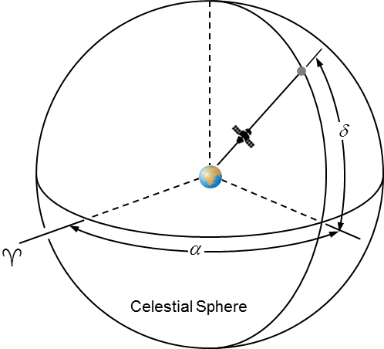
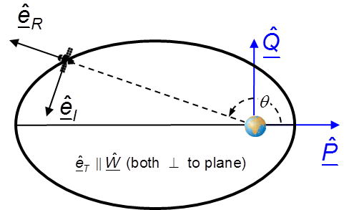
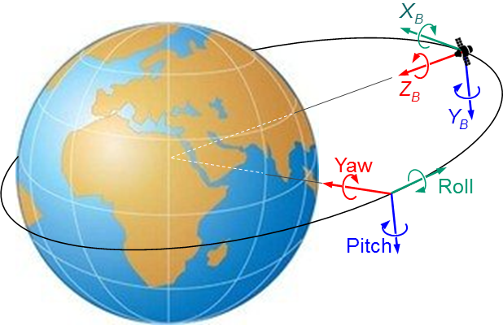
Attitude Representations
Right Ascension-Declination
ECI and LVLH (SEZ)
Perifocal (PQW) and Radial, In-Track, Cross-Track (RIC)
S/C Yaw-Pitch-Roll

Slide 25
Attitude Representations
UTC (Coordinates Universal Time): yr-mon-day-hr-min-sec
Introduced in January 1972 as approximation to UT1
Offset from TAI by +35 leap seconds
Local time (what we’re used to): offset from UTC (depending on where you are on Earth)
JD/MJD (Julian date/Modified Julian Date): used by reference models
Epoch is January 1, 4713 BC 12:00
MJD = JD – 2400000.5
UT (Universal Time)
UT0: mean solar time at Greenwich
UT1: corrections for polar motion
UT2: corrections for seasonal variations (obsolete)
TAI (International Atomic Time): Standard for accurate time-keeping
GPS time
Epoch is Jan 6, 1980 00:00:00 UTC
Offset from TAI by +19 seconds (not updated for leap seconds)

Slide 26
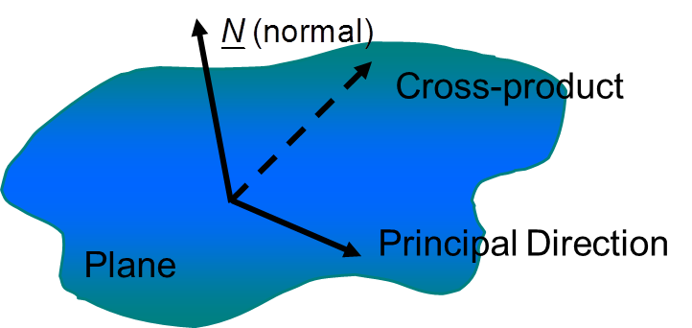
Attitude Representations
Attitude is the relative orientation between two coordinate frames; e.g. the orientation of a body-fixed frame w.r.t. an Earth-fixed frame (it is all RELATIVE!)
Coordinate frames consist of three dextral orthonormal basis directions
Dextral ⇒ right-handed
Orthonormal ⇒ orthogonal (perpendicular) and unit lengths
cf. A reference frame is similarly defined but includes references for distance and time measures
Definition of coordinate frames requires the following:
A fundamental plane (defined by its normal)
A principal direction in the fundamental plane
(NB. Could also be defined in terms of three non-collinear points and a direction between two of the three points since three non-collinear points define a plane!)
Notes:
By defining a fundamental plane, a direction is defined; i.e., the plane’s normal defines a unique direction (aka vector). Combining that direction with the principal direction in the plane (another direction), along with the condition that the a vector product is defined, yields a unique dextral orthogonal coordinate system!

Slide 27
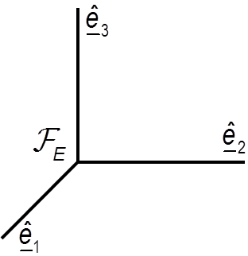
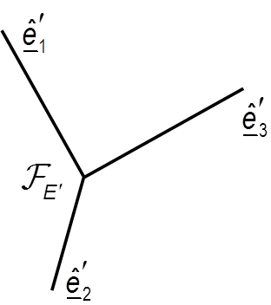
Attitude Representations (cntd)
Several attitude representations exist
Direction cosines, Euler angles (Bryant, Cardan, Tait), axis/angle, quaternions (Euler symmetric parameters), classical Rodrigues parameters (Gibbs), modified Rodrigues, …
Attitude can be described by a rotation about an axis (Euler’s Theorem)
"Any displacement of a rigid body such that a point on the rigid body remains fixed is equivalent to a rotation about an axis passing through the fixed point. "
Attitude errors are multiplicative; they are NOT additive!

Slide 28
Attitude Representations (cntd)
Parameterization | Notation | Pros | Cons | Common Applications
Direction Cosine Matrix (DCM) |  | No singularities; no trigonometric functions, convenient composition rule | Six redundant parameters | Analytical studies; transformation of from one frame to the other
Euler Angles |  | No redundant parameters; physical interpretation is clear in some cases | Trigonometric functions; singularities at some θ; no convenient composition rule | Analytical studies; input/output; onboard attitude control of 3-axis stabilized s/c
Euler Axis/Angle |  | Clear physical interpretation | One redundant parameter; axis undefined when sinθ=0; trigonometric functions | Commanding slew maneuvers
Euler Symmetric Parameters (aka quaternions) |  | No singularities; no trigonometric functions; convenient composition rule | One redundant parameter; no obvious physical interpretation | Onboard inertial navigation
Classical Rodrigues Parameters (p) Modified Rodrigues Parameters (σ) |  | No redundant parameters; no trigonometric functions; convenient composition rule | Classical: Infinite for 180° rotation Modified: Infinite for 360° rotation | Analytical studies;

Slide 29
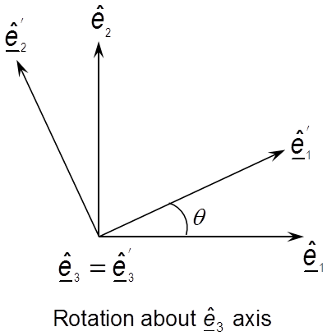
Attitude Representations (cntd)
Fundamental Rotation Matrices (DCM)
Consider a rotation of bases about the third axis, then
Rewriting terms in a matrix form yields
Fundamental DCM for rotations about the other two axes are
Properties of DCM
Orthonormal; i.e., and

Slide 30
Attitude Representations (cntd)
Euler Angles/Euler Sequences
A sequence of three successive principal rotations, each about the “new” coordinate basis results in a generic attitude
Classically a 3-1-3 rotation was referred to as a Euler sequence and a 3-2-1 sequence as a Tait or Cardan or Bryant sequence (later all asymmetric sequence became know as Cardan or Bryant-Tait sequences). Any sequence is now referred to as an Euler sequence!
Gimbal locked (aka singularity): There are attitude configurations in which the 1st and 3rd rotations cannot be uniquely determined, hence the moniker “gimbal-locked”. This occurs for all 12 sequences (6 symmetric and 6 asymmetric)
Symmetric | Asymmetric
(1-2-1), (2-3-2), (3-1-3), (1-3-1) (2-1-2), (3-2-3) | (1-2-3), (2-3-1) (3-1-2), (1-3-2), 2-1-3, (3-2-1)
Gimbal-lock: π | Gimbal-lock: π/2

Slide 31
Attitude Representations (cntd)
3-1-3 Euler Sequence

Slide 32
Attitude Representations (cntd)
Axis/Angle
Quaternions

Slide 33
Attitude Representations: Kinematics
Angular rates from inertial sensors can be integrated to propagate attitude change
Used to propagate attitude between observations
Very dependent on attitude representation (two examples below)
Euler Angles:
Quaternions:
or
Preferred

Slide 34
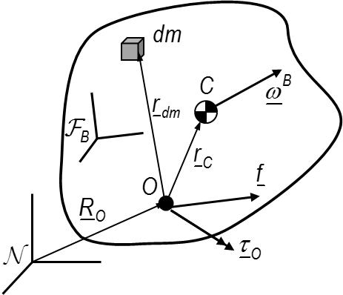
Attitude Representations: Dynamics
Preliminaries
Notation
First moment of inertia (c.m. definition)
Second moment of inertia (aka mass moment of inertia)
Linear momentum: quantifies the translational motion
Angular momentum: quantifies the rotational motion
Only this term remains when “O” is chosen to be “C” !

Slide 35
Attitude Representations: Dynamics (cntd)
Choosing the body’s c.m. as its reference point, then
Typically J_{o} is constant (rigid body coordinatized in body frame)
This is the generalized form of Euler’s equation
Assuming principal axes (i.e., products of inertia are zero) yields
Closed form solution of this 1st order differential equation exists only in some special cases. However, can be numerically integrated to obtain angular velocity

Slide 36
Attitude Determination Approaches
Information need
At least two independent vectors measured in each coordinate basis (e.g., body and inertial frames)
Two approaches
Batch: collect measurements and obtain a solution
TRIAD
Q-Method
QUEST (most common)
Others (OLAE, ESOQ, ESOQ2)
Recursive: continuously take measurements to improve previous solution (from Batch or good guess) through filtering technique
Recursive least square
Continuous or discrete
Extended Kalman Filter (EKF) – most common
Continuous or discrete, or Murrell’s
Unscented Kalman Filter (UKF) – computationally intensive
Both EKF and UKF refines the uncertainty (covariance)

Slide 37
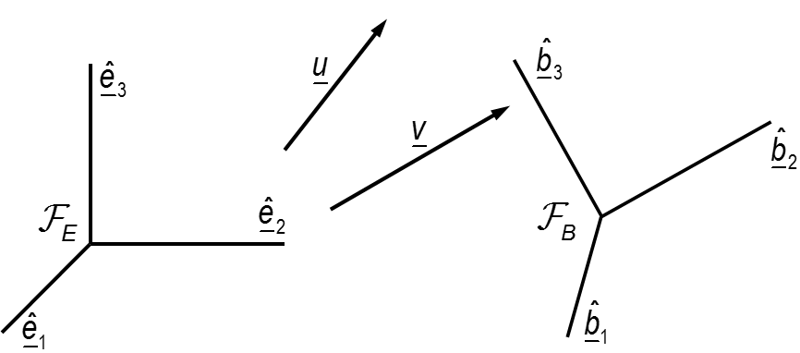
Attitude Determination Approaches (cntd)
Basic concept (TRIAD)
Basic concept (QUEST)
Solve constrained nonlinear least squares problem

Slide 38
Attitude Control Approaches
Need for attitude control: science, thermal management, communications, power generation, maneuvering, etc.
Implications of attitude control: S/C design/complexity (attitude determination sub-system, power, processing), cost, success (additional failure mode), mission life
Considerations: Is attitude control necessary? If so, what is the minimum amount of control necessary for mission success? Approach strategies:
Passive: S/C dynamics inherently yield desired attitude motion
Active: S/C actively performs action to achieve desired attitude
“If all you have is a hammer, everything looks like a nail.” – Abraham Maslow
“Better is the enemy of good.” – Voltaire

Slide 39
Attitude Control Approaches (cntd)
Spin Stabilized (passive)
Uses gyroscopic stability principles; i.e., entire S/C is spun to provide gyroscopic stiffness (needs mechanism to damp nutation)
S/C uses body mounted solar panels (to facilitate solar charging and mechanically advantageous)
Dual Spin aka De-Spun (passive/active)
Similar to above except provides a de-spun stage for some components (e.g., antennae, sensors) that have specific pointing requirements (i.e., a momentum biased system)
Permanent Magnet (passive)
Passive approach which results in zero power “detumble” maneuver
Causes vehicle to rotate twice per orbit
Magnetic Coils (active)
Torque rods etc.
Notes:
Spin stabilized: early communication satellites; typically used during initial orbit change maneuvuers
Dual-spin: Galileo instrument platform; 2nd gen communication satellites
Gravity-gradient: Many examples including Shuttle during operations to minimize ACS firing
3-Axis: most modern satellites

Slide 40
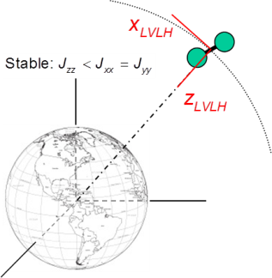
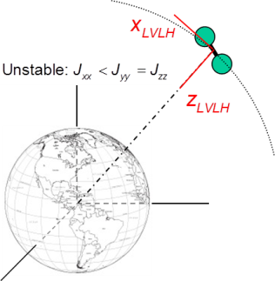
Attitude Control Approaches (cntd)
Gravity-Gradient (passive)
Passive approach which uses “pendulum” behavior to align S/C “long” axis with nadir; good for Earth pointing missions
2 stable orientations (may require actuation to reorient S/C)
Torques are small so environmental disturbances may dominate (e.g., drag at low altitude)
Small displacement motion is neutrally stable (i.e., no damping) and thus require mechanism to damp librational motion
Pitch momentum-biased GG
Adds momentum wheel on pitch axis (aka Y-Thompson)
Provides directional stability about the yaw axis

Slide 41
Attitude Control Approaches (cntd)
Three-axis (active)
Angular momentum exchange devices (AMEDS)
Momentum wheels (MWs) – wheel’s spin axis fixed in the S/C body and the wheel spins at a constant rate to provide a momentum bias for gyroscopic stiffness. Typically aligned with the S/C pitch axis
Reaction wheels (RWs) – wheel’s spin axis fixed in the S/C body and the wheel speed varies; a reaction torque is applied to the S/C when the wheel speed changes
Control Moment Gyroscopes (CMGs) – wheel’s speed is fixed and the wheel’s spin axis is gimballed (single or double gimballed) w.r.t. the S/C body; a reaction torque is applied to the S/C when the orientation of the wheel’s spin axis changes
RWs and CMGs are typically in cluster configurations
All require mechanism for angular momentum dumping
Thrusters
Cold gas, monopropellant, bipropellant
Limited life due to consumable; contamination of optics

Slide 42
Attitude Control Approaches (cntd)
 | # of Axes | Pointing Options | Accuracy
Spinner | 2 | Inertially fixed | ±0.1° - ±1° (spin rate dependent)
Dual Spin | 3 | Inertially fixed | ±0.1° - ±1° (3rd axis payload dependent)
Permanent Magnet | 2 | North/South | ±5°
Magnet Coil | 2 | Nadir pointing | ±5°
Gravity Gradient | 2 | Nadir pointing | ±5°
Gravity Gradient + Momentum Bias | 3 | Nadir pointing | ±5°
AMEDs | 3 | None | ±0.001° - ±1° (high slew rates w/ CMG)
Reaction Control | 3 | None | ±0.1° - ±5° (high slew rates possible)

Slide 43
Attitude Control Approaches (cntd)
Active Control
Pointing objective (requires 2 vectors):
Constraint:
Construct tracking basis:
Define matrix which transforms representations in inertial basis to representation in tracking basis:
Compute attitude parameters from rotation matrix (representation dependent; see “Survey of Attitude Representations” by Schuster)
Define angular velocity and angular acceleration:

Slide 44
Attitude Control Approaches (cntd)
Form attitude error (representation dependent); e.g.,
SO(3):
Euler parameters:
Other parameterizations: Somewhat more complicated!
Form angular velocity error and angular acceleration:
Both coordinatized in the body frame
Control objective:
Drive error rates to zero and error attitude to identity
Notes:
SO(3) – special operator (3)

Slide 45
Attitude Control Approaches (cntd)
2-axis control (i.e., magnetic coils)
Pointing objective not guaranteed
Used primarily to detumble/dump momentum e.g., B-dot controller
3-axis control
Pointing objectives achievable (orientation and rates)
Feedback controller (most common); e.g., eigen-axis controller
Momentum management
AMEDs will saturate (due to disturbance)
Must balance attitude objectives and momentum management
Stop attitude objective and dump momentum

Slide 46
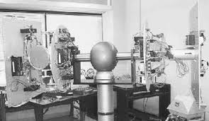
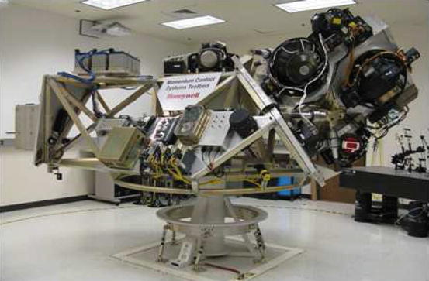
ADC Mission Assurance Approaches
Assembly, Integration & Test (Verification & Validation)
Difficult to perform end-to-end ground validation tests
Typically hardware-in-the-loop testing
Mix of hardware and simulations
Most utilize air bearing configurations
Limited motion in two axes
Limited environmental test (no vacuum)
Gravity bias unloading needed
Torque inferred from motion
University of Michigan
York University
Honeywell MCS/LOS Testbed
Georgia Institute of Technology

Slide 47
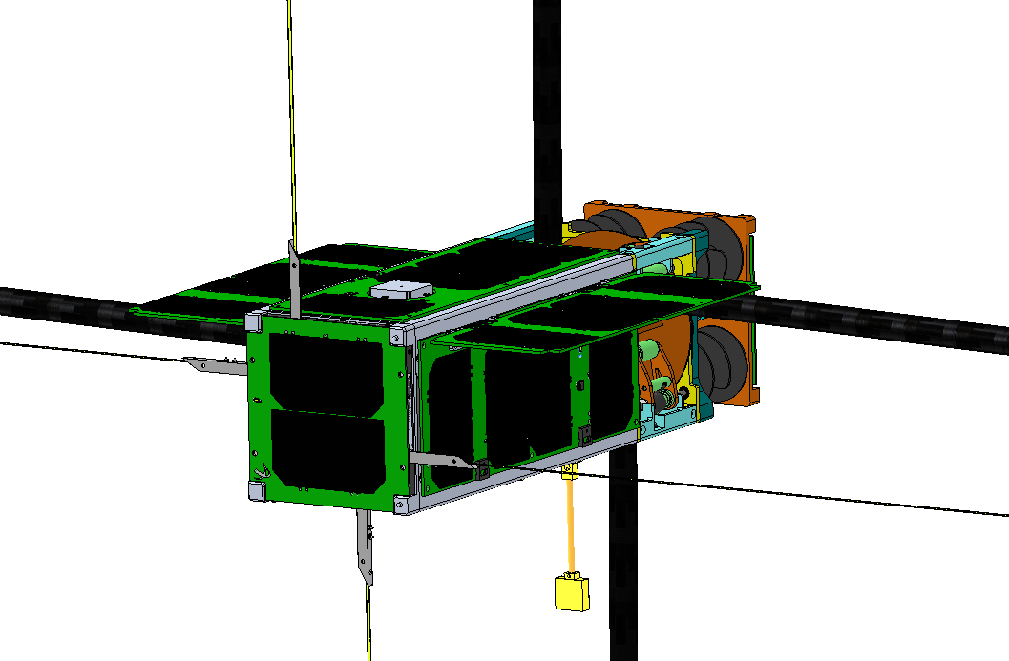
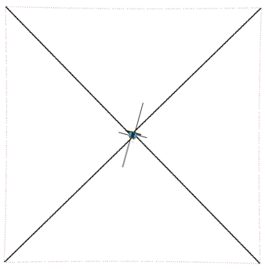
Example: SwampSat II
Mission Objectives:
Characterize very low frequency (VLF) waves in LEO using a 16 m square loop antenna to collect
Control requirements:
Detumble S/C
Orient antenna plane $⊥$ to ram direction (+/-10 deg)
SwampSat II during mission
Payload antenna deployed

Slide 48
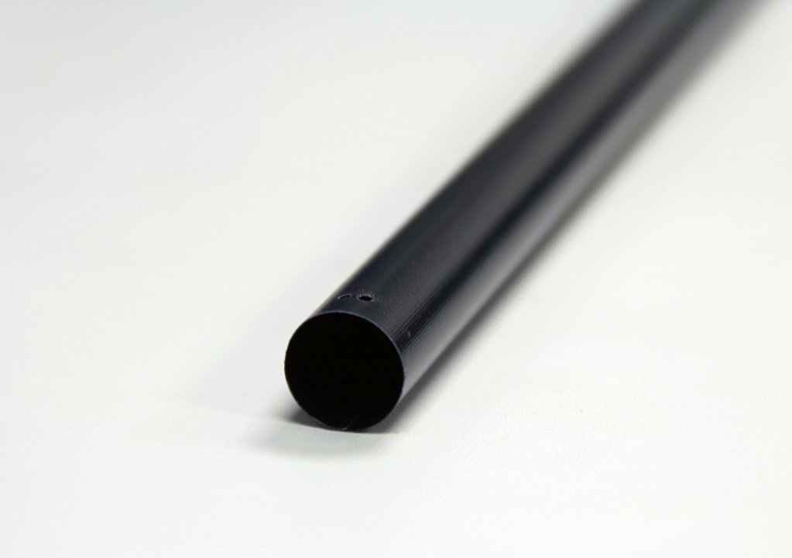
Example: SwampSat II Boom Characteristics
Four booms are used to support the 16 meter square loop antenna
Each boom is 2.8 meters long
Conductors embedded in one boom
Parameter | Value | Units
Flattened height | 50 | mm
Deployed diameter(2r) | 12.7 | mm
Thickness | 0.168 | mm
Internal angle (θ ) | 450 | deg
Max axial load | 5.7 | N
Bending stiffness (EIx) | 20.9 | Nm²
Bending stiffness (EIy) | 17.1 | Nm²
Mass of boom | 42.4 | g

Slide 49
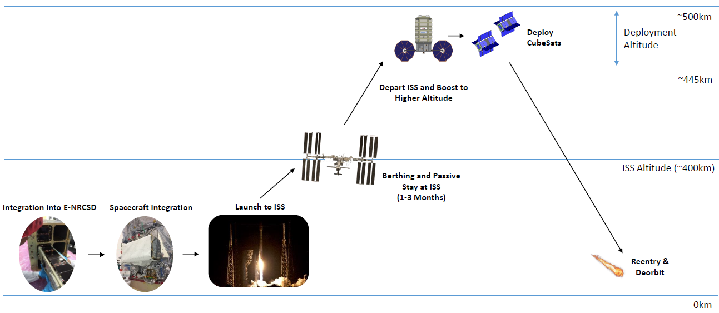
Example: SwampSat II ConOps
Manifested on Cygnus NG-12 NanoRacks deployment October 2019
Cygnus departs ISS ~3 months later
SwampSat II deployed at an altitude ~500 km

Slide 50
Example: SwampSat II ConOps
Deploy Payload
5
Conduct Science
4
Deploy
Panels
6
Receive Uplink
3
7
Detumble
Spacecraft
Transmit Downlink
2
8
Retirement
Launch
1

Slide 51
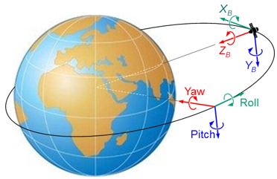
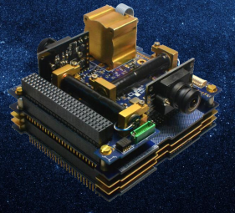
Example: Simulation Parameters
 | Parameter | Value
Orbital | Altitude | 500 km
 | Inclination | 51.46 deg
 | Eccentricity | 0
 | Disturbances | Aero, GG, Mag
Spacecraft | Mass | 4 kg
 | Stowed dimensions | [30,10, 10] cm
ADCS Package | Magnetic moment | [0.13; 0.2; 0.2] Am²
 | RW max speed | 8000 rpm
 | RW max torque | 0.23 mNm
https://cubespace.co.za/y-momentum/

Slide 52
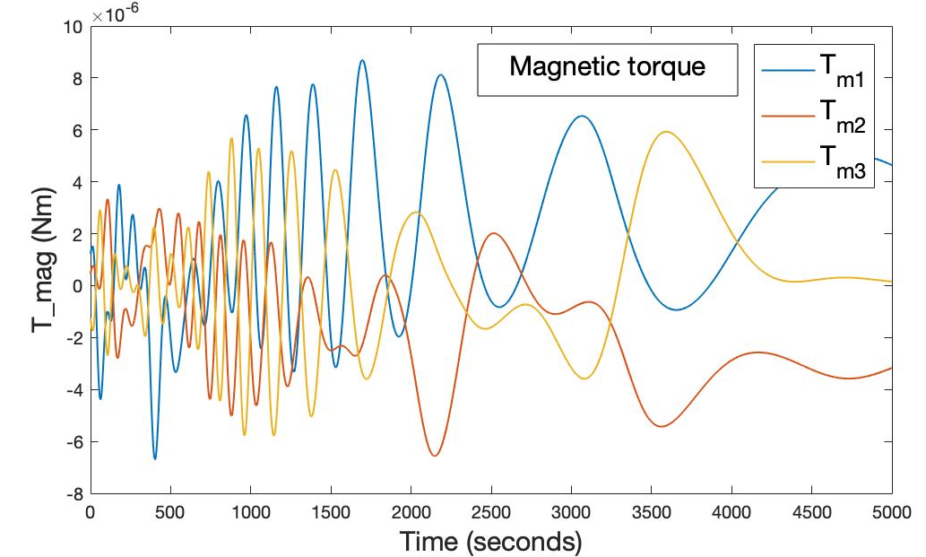
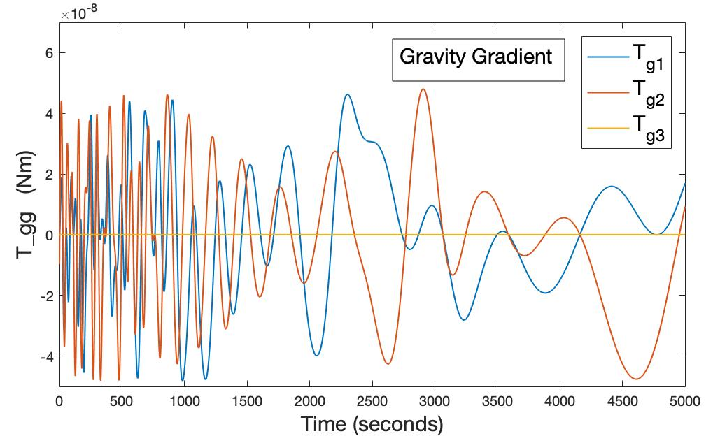
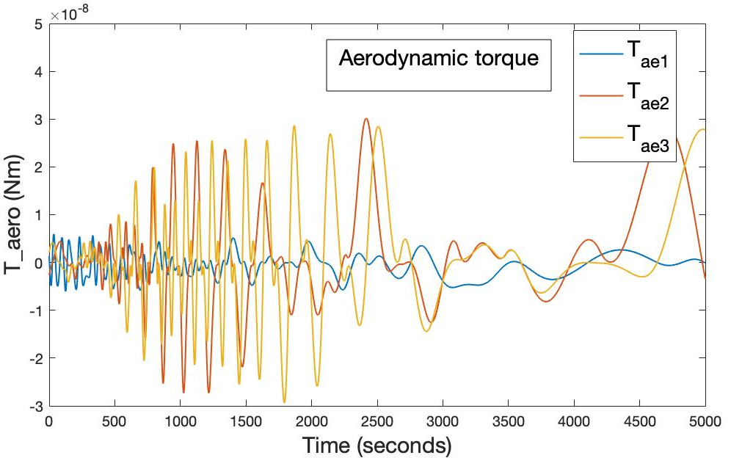
Example: Disturbance Torques

Slide 53
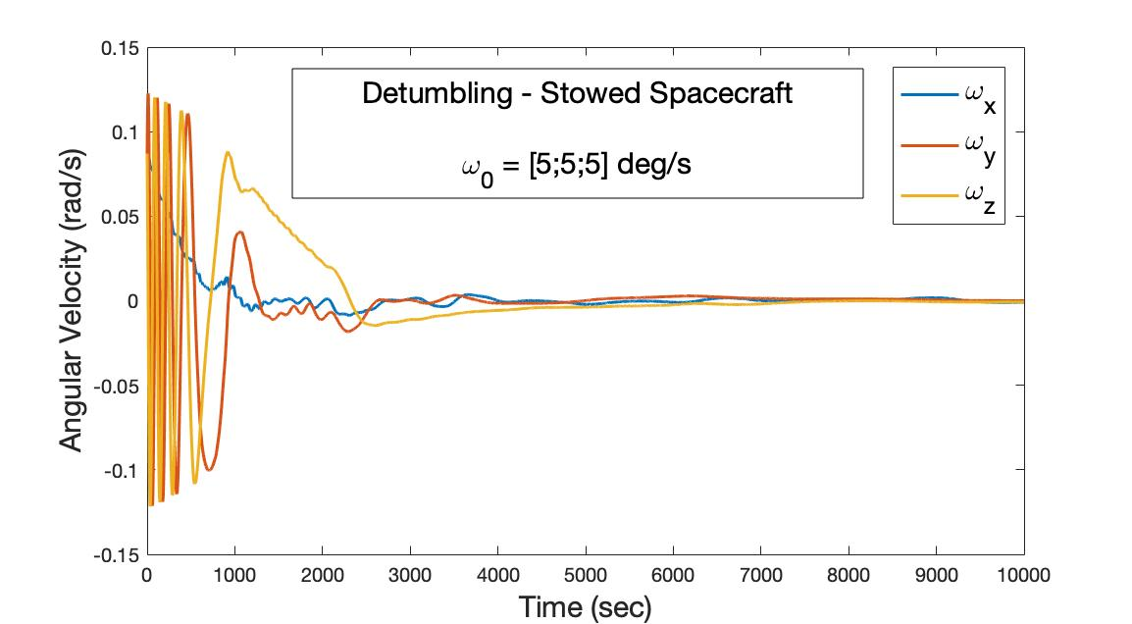
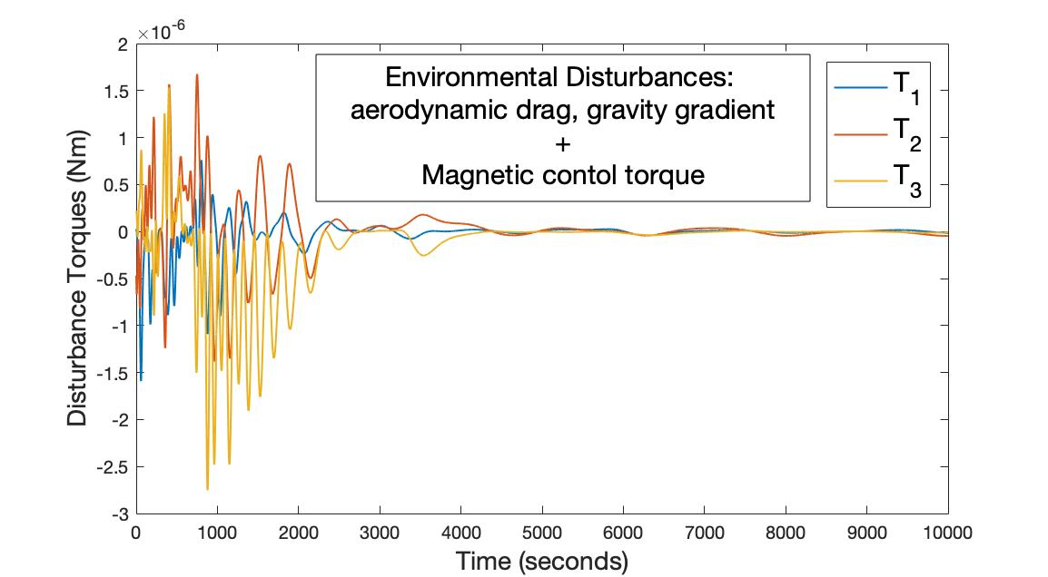
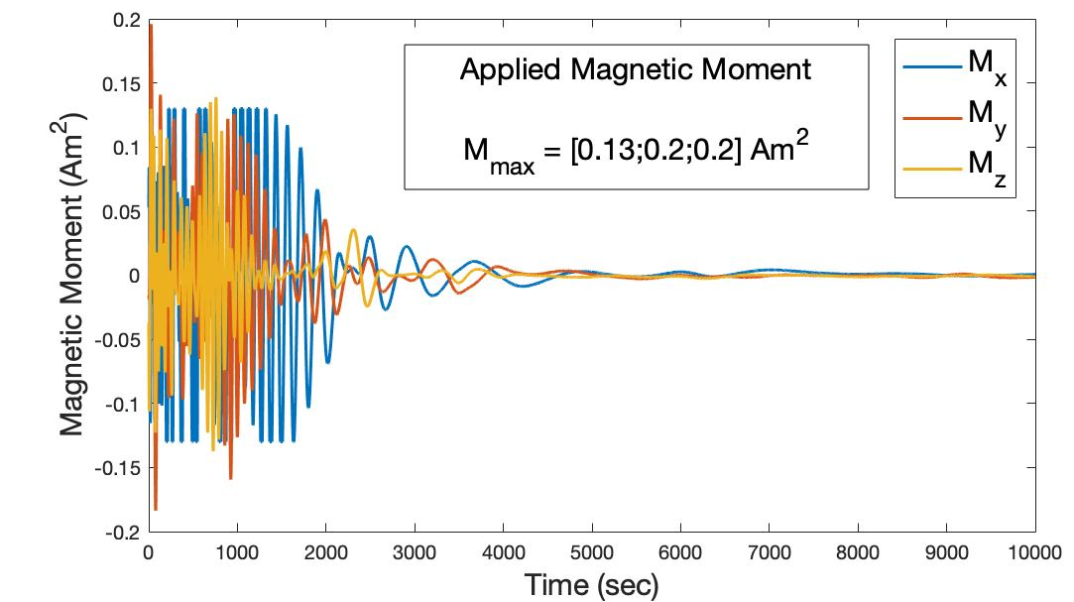
Example: Detumbling
Assumptions
Rigid homogeneous symmetric body
Inertia axes aligned with body axes
Magnetic torque actuators
Target rate: 0.001 rad/sec per axis
Detumbling time = 2.07 hrs
Controller: B-dot Proportional

Slide 54
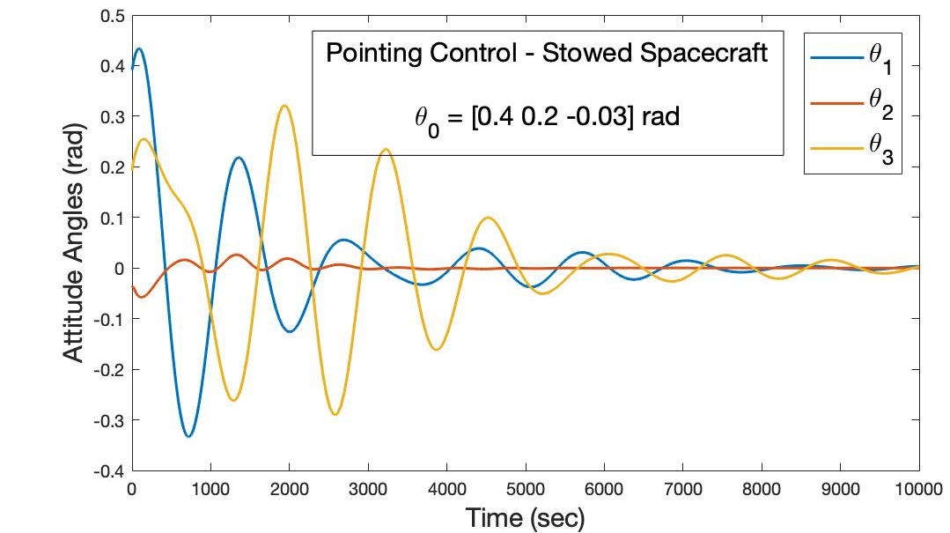
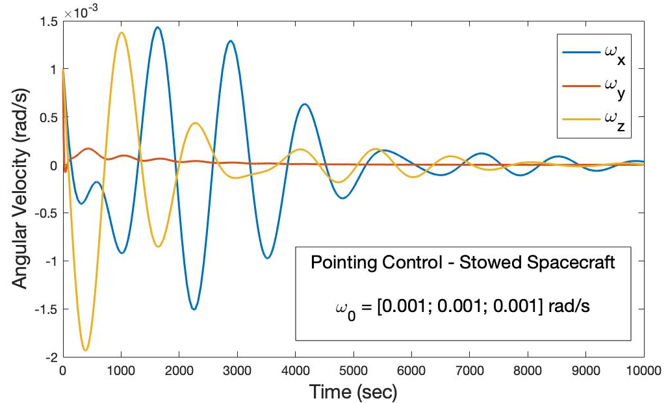
Example: Pointing (Stowed)
Assumptions
Rigid homogeneous symmetric body
Inertia axes aligned with body axes
Actuators: Magnetic torquers
Target rate < 0.001 rad/sec per axis
Target attitude < 0.17 rad per axis
Target attitude met
Controller: Proportional Derivative
Available Torque:

Slide 55
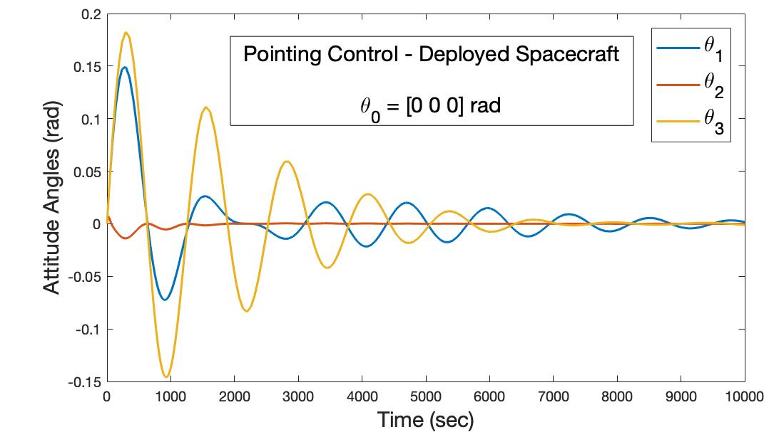
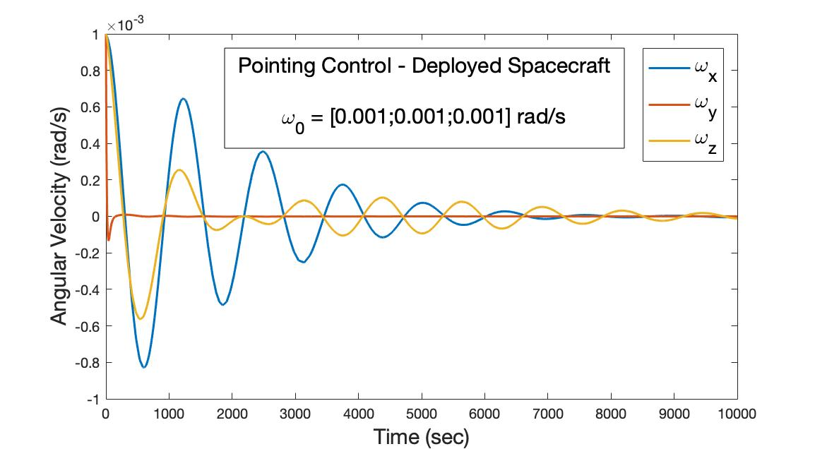
Example: Pointing (Deployed)
Assumptions
Rigid homogeneous symmetric body
Inertia axes aligned with body axes
Actuators: Y-wheel, magnetic torquers
Controller: Proportional-Derivative
Target rate < 0.001 rad/sec per axis
Target attitude < 0.17 rad per axis
Target rates and attitude achieved

Slide 56
Useful Reference Sources
W. J. Larson and J. R. Wertz, Space Mission Analysis and Design – 3rd Edition,” Microcosm Inc., 1999.
J. R. Wertz, Spacecraft Attitude Determination and Control, Kluwer Academic Publishers, 1978.
P. C. Hughes, Spacecraft Attitude Dynamics, John Wiley & Sons Inc, 1986.
M. J. Sidi, Spacecraft Dynamics and Control, A Practical Engineering Approach, Cambridge University Press, 1997.
V. A. Chobotov, Spacecraft Attitude Dynamics and Control, Krieger Publishing Co., 1991.
B. Wie, Space Vehicle Dynamics and Control, AIAA, 2008.
J. B. Kuipers, Quaternions and Rotations: A Primer with Applications to Orbits, Aerospace, and Virtual Reality, Princeton University Press, 2002.
J. L. Crassidis and J. L. Junkins, Optimal Estimation of Dynamic Systems, Chapman & Hall, 2011.
H. Schaub and J. L. Junkins, Analytical Mechanics of Space Systems, AIAA, 2003.
D. A. Vallado and W. D. McClain, Fundamentals of Astrodynamics and Applications, Microcosm Inc., 2001.
M. D. Shuster, “Survey of Attitude Representations,” Journal of the Astronautical Sciences, Vol. 41, 1993, pp. 439–517.
M. D. Schuster and S. D. Oh, “Three-Axis Attitude Determination from Vector Observations,” AIAA Journal of Guidance and Control, 1981, Vol. 4, No. 1, pp. 70-77.
B. Wie, H. Weiss, and A. Arapostathis, “Quaternion Feedback regulator for Spacecraft Eigenaxis Rotations,” AIAA Journal of Guidance, Control, and Dynamics, 1989, Vol. 12, No. 3, pp. 375-380.

Slide 57
Acknowledgements
Thanks to Dr. Josue Munoz and Ms. Hasnaa Khalifi for their generous inputs/contributions
Norman Fitz-Coy
nfc@ufl.edu

