Slide 1
PicoCal Electronics
Patrick Robbe, IJCLab Orsay, 30 March 2023

Slide 2
Introduction
Readout chain for LS4
FEB
Backend/PCIe400
ECAL
PMT
12-20 m coax cable
Energy ASIC (ICECAL65)
Time ASIC (SPIDER)
lpGBT
Long distance
optical fibers
Signal conditioning chip
Requirements for electronics for LS4:
  Energy measurement on 12 bits, on a large dynamic range, E_{T}=0 to O(100 GeV)
  Time measurement with 15ps rms resolution at large energies (E_{T}~1 GeV), for the entire chain (Detector, PMT, cable and electronics)
  FEBs located on the ECAL platform: modest radiation environment (~40 kRad)
  Keep flexibility to include a timing layer in the readout, re-using most of the chain
  Perform data reduction or pre-processing in the electronics when possible

Slide 3
Run 3 electronics
FEB
Backend/PCIe40
ECAL
PMT
15 m coax cable
Energy ASIC (ICECALv3)
GBT
Long distance
optical fibers
No time measurement, smaller dynamic range (E_{T} = 0 to 20 GeV)
6016 channels, 32 channels per board: 188 boards in 14 crates
No data processing (in FEB or PCIe40), all data sent offline: 12 bit ADC per channel + 40 bits LLT per board
Institutes:
  ICECAL ASIC: Barcelona/Valencia
  FEB: IJCLab Orsay
  PCIe40 firmware: LAPP Annecy

Slide 4
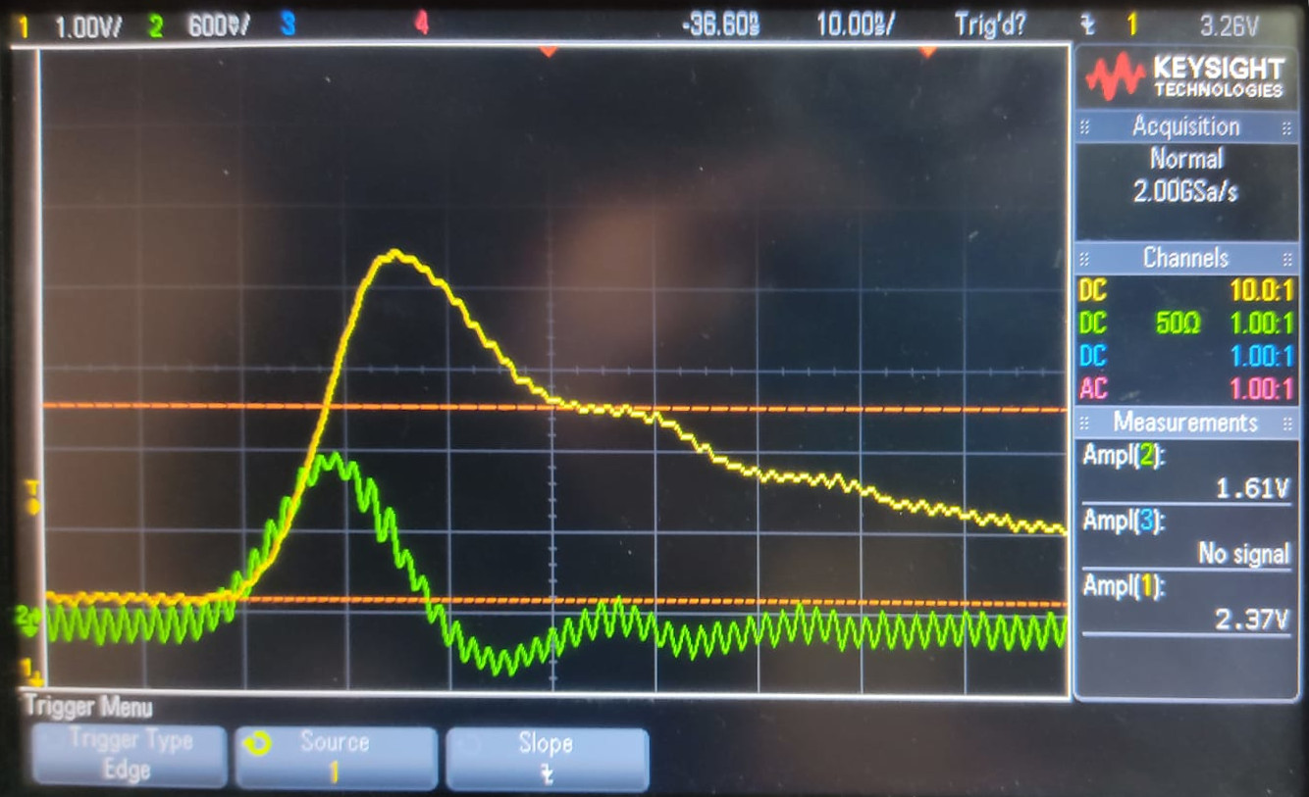
COTS PMT conditioning circuit
Barcelona/Valencia
COTS based signal conditioning circuit, placed either at the base of the PMT (if radiation hardness allows) or at the input of the FEB, to compensate signal losses in the coaxial cable
Goal: deliver voltage signal with range of ~2V to facilitate signal distribution to each path (E/t)
First prototype produced and tested
  Source AWG with GFAG signal shape
  Pole Zero cancellation reduces the signal width
  Amplification modified during tests
  Stability has to be reviewed
Second version under design
  Market search for different options of op-amps
  Flexible design for interchangeable op-amps
  Aiming for test beam evaluation this year

Slide 5
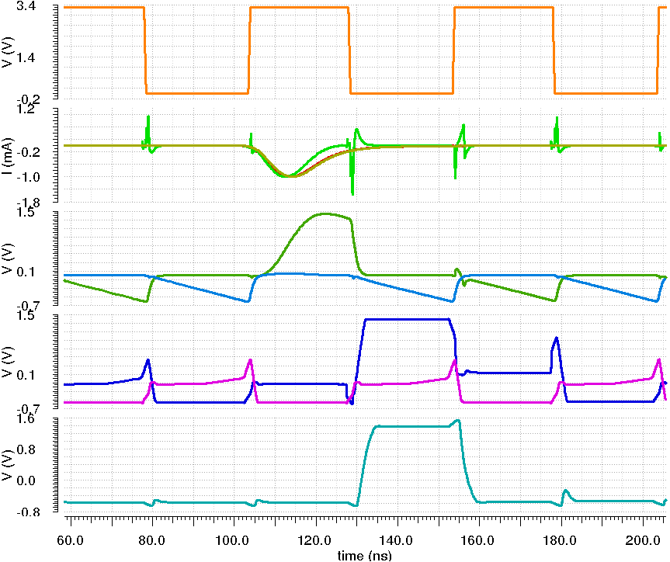
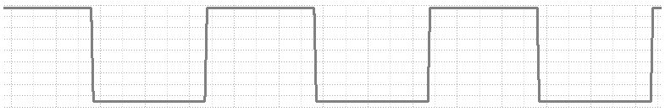
ICECAL65
Barcelona/Valencia + Univ. Politecnica de Barcelona
PMT
amp’d
signal
Pre-
amplifier
Track-
and-Hold
CHANNEL
OUTPUT
Filter
Integrator
Multiplexer
Two separate processing paths (energy – ICECAL65 and time – SPIDER) with dedicated ASICs in CMOS 65nm TSMC technology (most lasting technology)
Energy measurement with 2 gains to cover the large dynamic range
Analog processing chain:
  Input Stage:
    low noise + high bandwidth
    four independent signal outputs
    extra discriminator output
  Pole Zero cancellation Shaper:
    minimize spillover
    tunable pole and zero
  Integrator:
    tunable feedback capacitor
  Track & Hold:
    high slew rate
Digital sampling synchronization
  Dedicated DLL per channel.
  Three independent phases
  for integrator, T&H and ADC.
  Predictable subchannel after reset
Status:
  Channel design at behavior level ready
  Library ready with the most essential blocks
  OTA (for most blocks) being designed
  DLL with 32 phase steps under design
PZ
ʃ
TH
ADC
driver
V
Drv
12b
ADC
12b ADC
12b ADC
12b ADC
PZ
ʃ
TH
x8
MEM
Integrator clock
Track-and-Hold clock
ADC
clock
Clock Input
DLL
Clock input
PZ output
Current Amp
output
input
PMT signal
Main
signal
TH output
Tail
Main
signal
Channel output
Tail

Slide 6
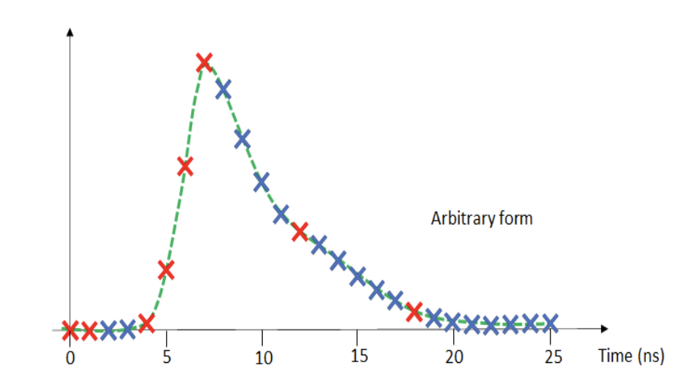
SPIDER
Clermont/Orsay + Caen/Lyon
Tests at Syracuse of other chips
15ps rms resolution:
  In range E_{T} = 50 MeV to 5 GeV, factor of 100
  With maximal possible channel occupancy: the version of LS3 will aim at 10% occupancy per channel (E_{T}>50 MeV), improved for LS4 version
  Based on waveform TDC (Time to Digital Convertors)
Waveform digitization in analog memories avoids degradation of time resolution due to time walk effects when working with traditional TDC and discriminators and large dynamic ranges, but with the drawback of large readout dead-time
Use 8 samples of the digitized wave form and extract time information in a companion FPGA
  Adapt easily to evolution of signal shape due to ageing
  Compatible with timer layer option
More details in Dominique Breton’s talk at DRD7 ECFA workshop

Slide 7
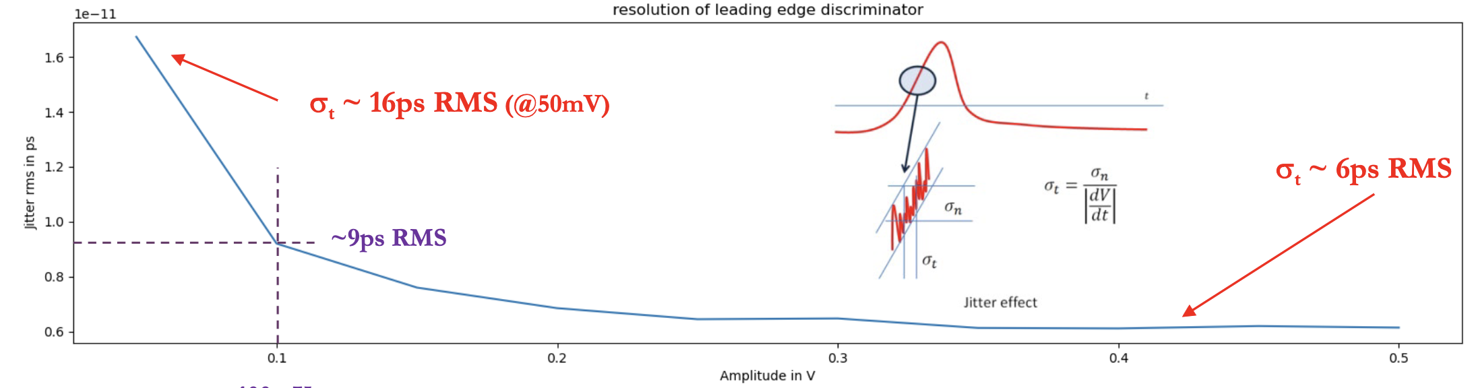
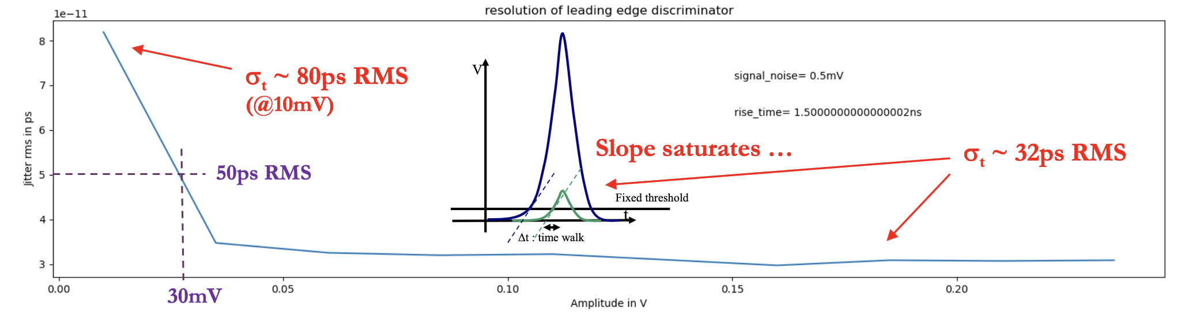
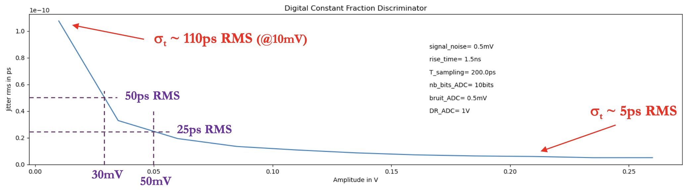
SPIDER
Simulations of electronics timing jitter vs. signal amplitude with realistic SPACAL signal caracteristics: rise time 1.5ns, σ_{noise} = 500μV RMS
Dynamic range of 20 and TDC/single-edge discriminator
Dynamic range of 100 and TDC/single-edge discriminator
Dynamic range of 100 and SPIDER technology
E_{T}=50 MeV for 50 mV

Slide 8
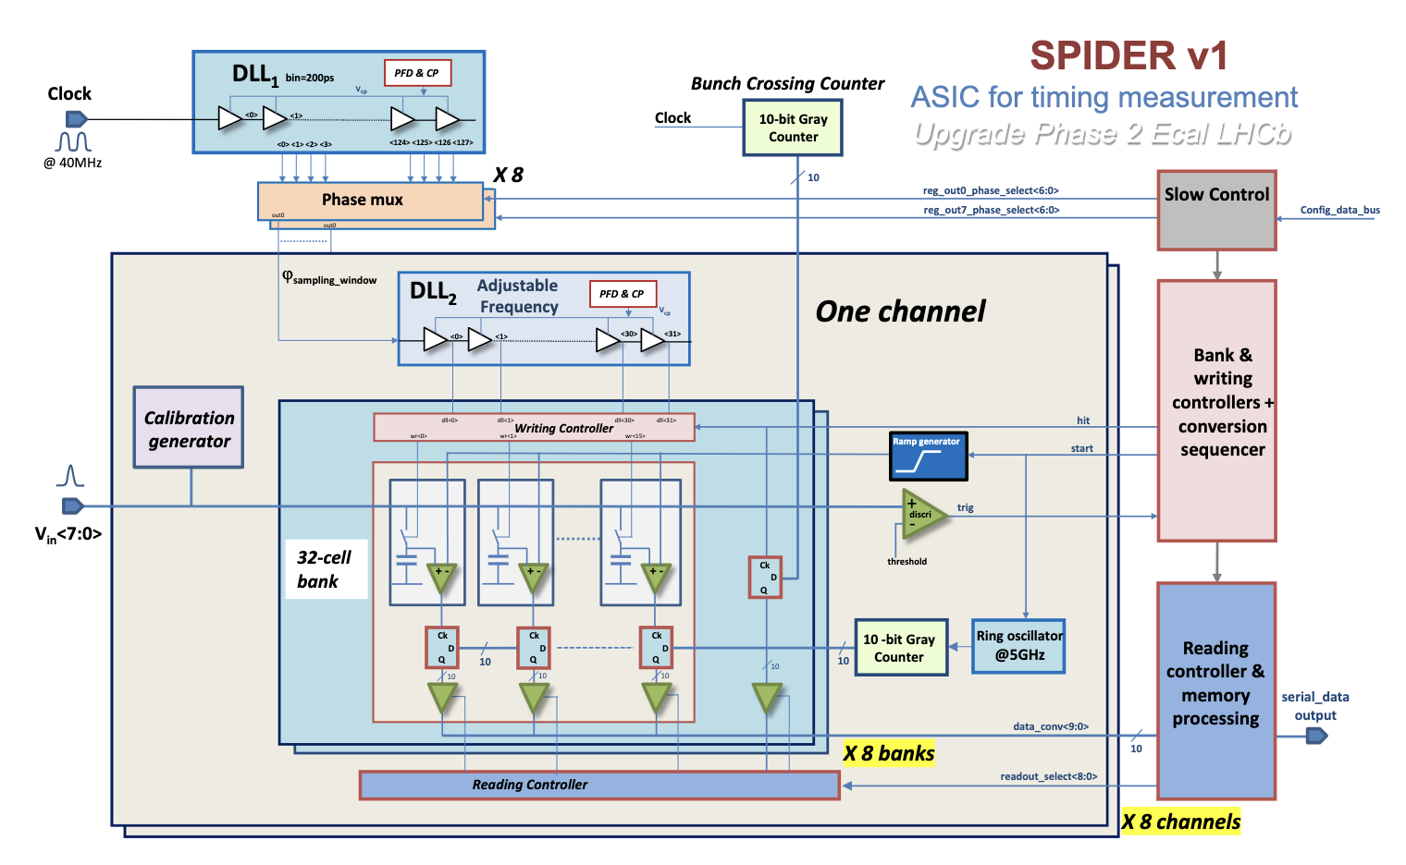
SPIDER
Fix start and width of sampling window (to adapt to different detectors)
Adjust sampling frequency
LS3 version:
  8 channels per ASIC for LS3 version
  8 memory banks in parallel to reduce dead-time for 10% occupancy
  Development started in 2022
LS4 version:
  Add on-chip data compression
  Get closer to 100% occupancy
  Work with Barcelona/Valencia to try to include ICECAL in a common chip

Slide 9
FEBs
Orsay
Front-End board to
  Host the two ASICs and the optical interfaces (lpGBT)
  Perform digital processing in several FPGAs on the board (Microchip PolarFire chip)
    time extraction,
    pedestal subtraction,
    Associate time and energy informations
    Data formatting
    Likely that more sophisticated data processing is needed in order to reduce data flow: would require communications between boards via backplane or cables
To be largely based on previous versions produced in Orsay (9U boards, placed on the calo platform): 32 channels, 3 FEBs/PCIe40
  Unavoidable that during Run 4 we have two different systems running in parallel
  Because of limited space on the calo platform, need to have boards handling 64 channels for LS4, with connectors on the front and back sides
    Need also to redesign the backplane
Start development mid 2023

Slide 10
Steps for LS4
LS3: 9344 channels in total, i.e. ~3500 extra channels (20 crates in total)
  For 6016 channels, keep the current Run 3 electronics entire chain
  Two options for the 3500 extra channels (x extra PCIe40/400 for both):
    Produce 110 new FEBs (timing FEBs) with the new ASICs (ICECAL65 and SPIDER), with 32 channels per board, and interface to PCIe400:
      Important to test precise time measurement during Run 4, even if not required for physics
    Produce 110 FEBs (backup FEBs) almost identical to the Run 3 FEBs, using the Run 3 ICECAL ASIC but without time measurement:
      Some components for the Run 3 FEB are not available anymore so cannot produce them identical
      lpGBT Interface with PCIe400 (and compatible also with future PCIe40 firmwares)
LS4: 30208 channels (24 crates in total)
  New FEB developed for all channels, with 64 channels per board: 470 boards in total
  With final versions of ICECAL65 and SPIDER ASICs

Slide 11
First planning: Chips and FEBs for LS3
PMT conditioning chip: produced and tested end of 2025
ICECAL65: v0 (8 channels) mid 2025, v1 (16 channels) end of 2027
SPIDER: v0 (2 channels) mid 2024, v1 (8 channels) mid 2026, v2 (LS3) end of 2027
FEBs:
  R&D of the timing and backup FEBs in parallel until 2026
  Decide beginning of 2026 which one to produce for Run 4:
    To produce timing FEB, we need to wait for the production of the ASICs: FEBs would be produced and tested end of 2028
    For the backup FEBs, they would be ready mid 2027. Possibility to install still a smaller number of timing FEBs during on YETS of Run 4 to test the timing

Slide 12
PCIe400
Annecy, …
For LS3, keep data processing similar to Run 3, i.e. send all energy measurement offline + 10% of the time measurement (removing LLT):
  Requires extra 20 PCIe40 or 10 PCIe400
  440 extra optical links
For LS4, some data processing to reduce the data flow will be necessary, which can be done partly in the PCIe400 FPGAs
  Some ideas for FPGA assisted co-processing presented by Riley Henderson (Monash University) in December
LAPP Annecy agrees to take care of the basic data processing firmware (similar to the Run 3 one), help needed for the development of the more complex options for LS4

Slide 13
Open tasks
Second test bench for SPIDER (Syracuse potentially interested)
Backplanes of Front-End crates and the associated connectics for LS4
Analog cables (signal, interconnections)
Optical connections
Power-supplies for Front-End crates
Electronics for calibration system (LEDs, Cincinnati potentially interested)
Software for slow control of the electronics
Firmware for advanced data processing in PCIe400 (or FEB)

Slide 14
Conclusions
Architecture defined for the electronics chain, for energy and time measurement
R&D for 2 ASICs to measure energy and time started last year, R&D for FEB starting now
Planning to have these 2 ASICs already in Run 4 (which would allow to test timing with the Calo) is tight, but the associated developments are required also for LS4
Realistic back-up plan also in place with contingency to be ready and commissioned for the start of Run 4

Slide 15
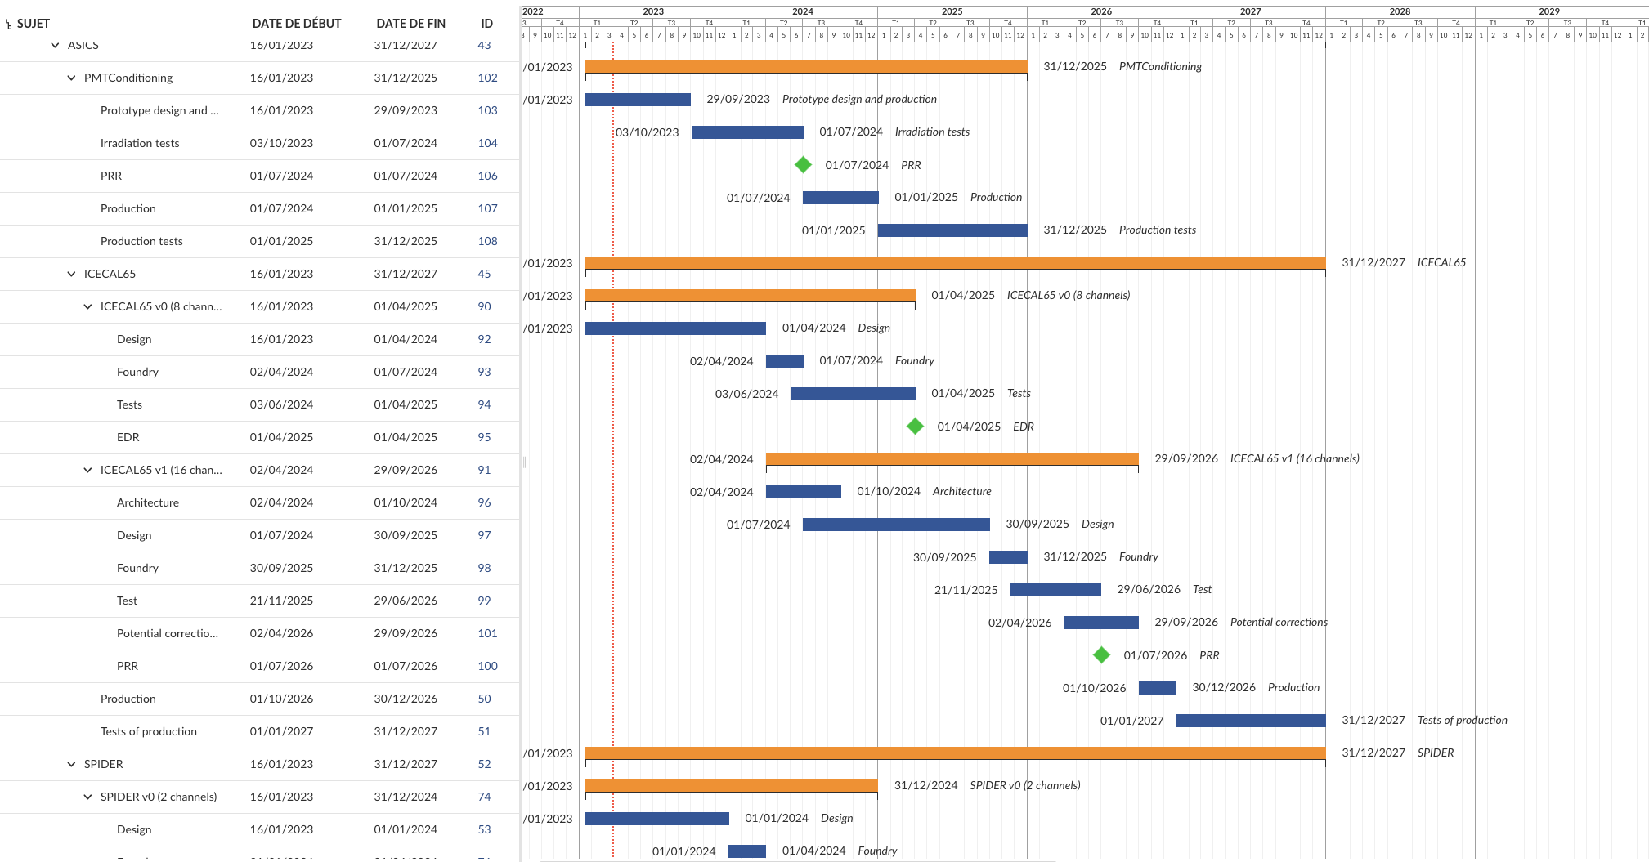
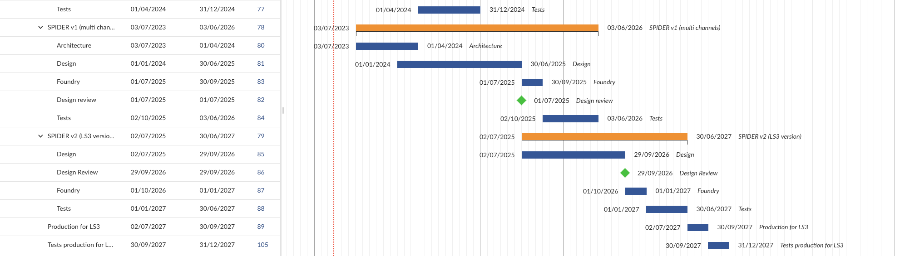
Chip planning
PMT chip
End of production + tests = End of 2027
ICECAL65 (LS3 version is final one)
SPIDER

Slide 16
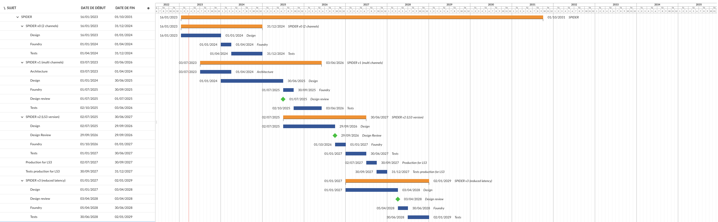
SPIDER: Planning for LS4
SPIDER v0
SPIDER v1
SPIDER v2 (LS3)
SPIDER v3
SPIDER v4 (LS4)

Slide 17
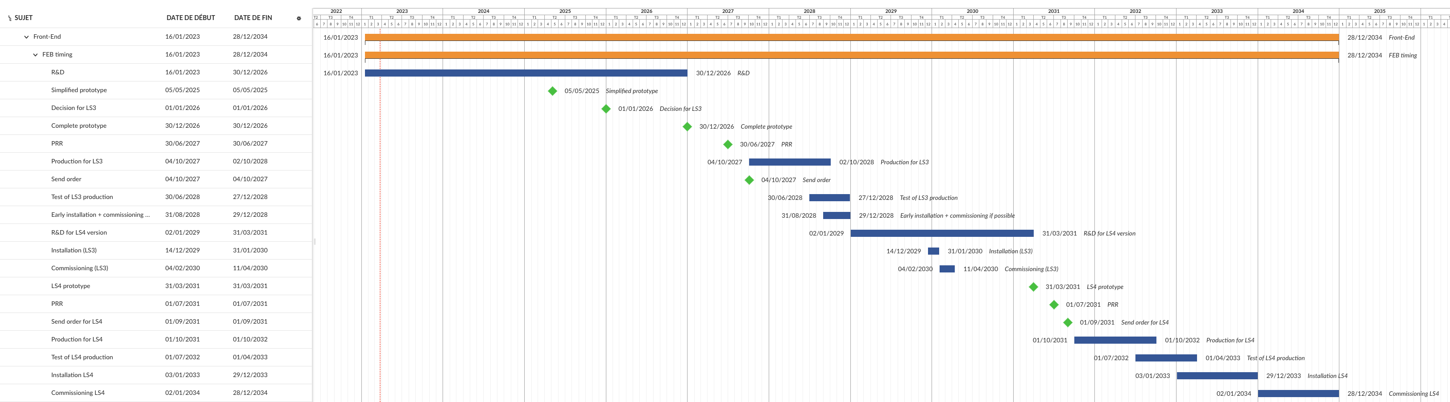
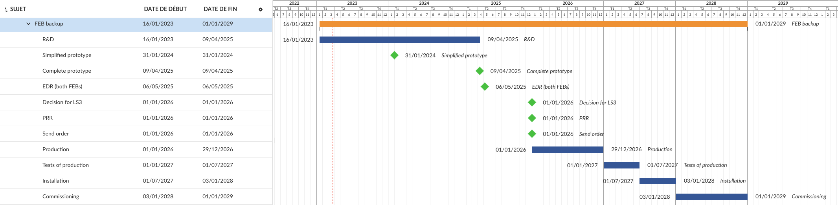
FEB planning: timing FEB (LS4) and backup FEB (LS3)

