Slide 1
Mighty Tracker project overview
and plans
6th Workshop on LHCb upgrade II Barcelona
30 March 2023
Pascal Perret
On behalf the Mighty Tracker Project

Slide 2
Overview
Scoping TDR
TDR
Ib?
TDR
U2
A lot in front of us:
  Up to 3 TDR to prepare
    Run 4: «Opportunities for the detector at LS3»
      LHCb Tracker TDR: early 2024?
    Run 5:
      Descoping TDR: 2024
      U2 TDRs: 2025-2026
  1st Mighty tracker workshop organised at CERN March 7-8 https://indico.cern.ch/event/1251283/

Slide 3
Run 4: which tracking detector?
SciFi is the baseline solution. It was designed to run efficiently up to 50 fb⁻¹
  ~<3% loss expected in pattern recognition performance
    Some studies on-going (cf talk from Lennart)
    But possibility to increase SiPM HV to compensate (partially?) this aging (cf Guido)
  Is it valid?
    SiPM aging?
      DCR comparison between expectation and measurements after 1 fb⁻¹ agrees very well
      (talk SciFi meeting: Federico)
    Fibers aging
      Oxidation ?
        Test samples: continuing monitoring of 29 samples (5 year): average aging rate < 1%
        (talk SciFi meeting: Jan, Sonia)
      Radiation?
        To be checked, need of additional data (running at nominal lumi …)
  Replacement of SciFi central modules is a first option in case of needs (aging).
  Replacement of SiPM inner modules with new SiPM development (cf Blake) ?
Not in time for a TDR early 2024

Slide 4
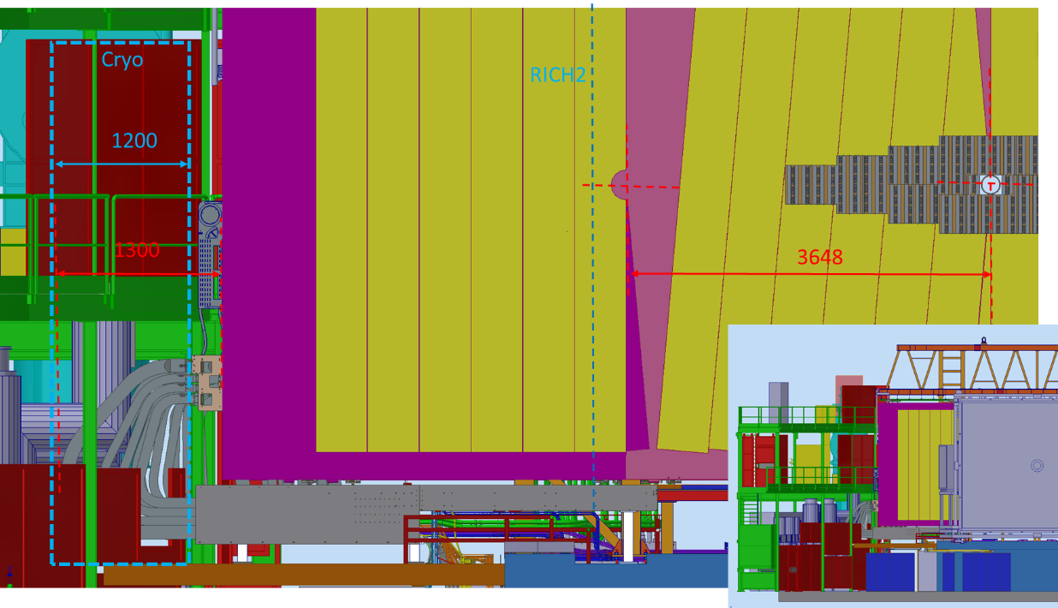
Run 4: which tracking detector?
SciFi consolidation?
  Critical points:
    SiPM cooling liquid (using of C₆F₁₄): in case of leak?
    Heating wires and CPS
    Electronics: VTRx, Cluster FPGA reprogramming after radiation
    Detector access is an issue:
      Pilars
      RICH2

Slide 5
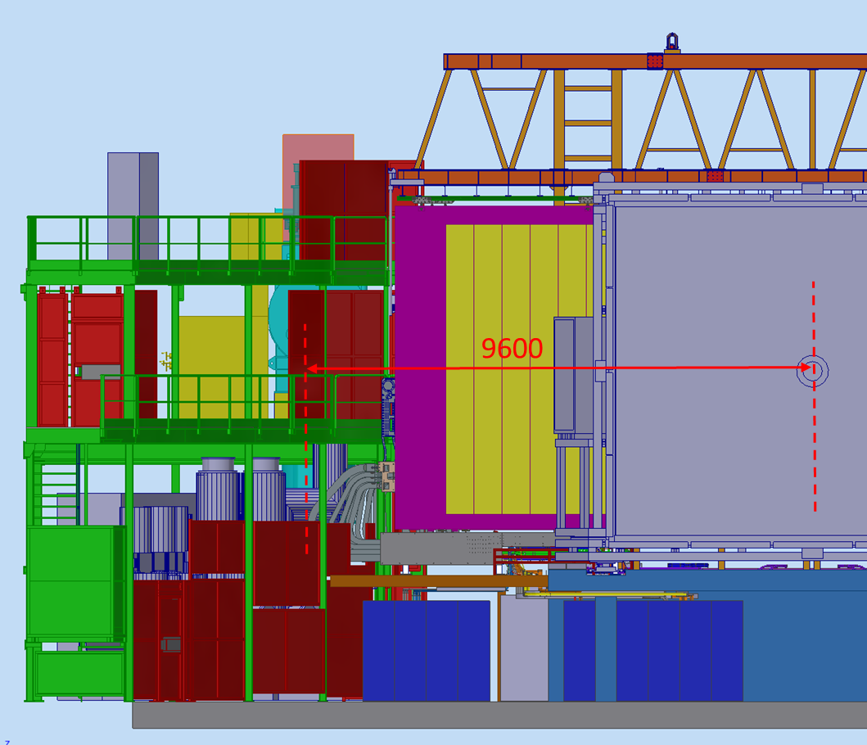
Run 4: which tracking detector?
Alessandro
SciFi consolidation?
  Critical points:
    Detector access is an issue
      Pilars
      RICH2
    We need some extra space on cryo side in order to open completely C-side, going out of RICH2

Slide 6
Run 4: which tracking detector?
SciFi consolidation?
  Critical points:
    Detector access is an issue
    We need some extra space on cryo side in order to open completely C-side going out of RICH2
    Others?
  Need more running experience to identify possible point of failures that will have to be fixed

Slide 7
Run 4: which tracking detector?
Do we want/need to go above the baseline?
  Some boundary conditions
    Any additional part should not affect the reliability of the SciFi
      SciFi detector access for maintenance has to be granted
    Additional material budget should not degrade the tracking (and LHCb) performances
    Should not compromise U2
      Resources dispersion/availabilities
        Manpower, budget
  Mpix is an option
    What could be available?
      Inner part (6 modules)
      2 layers (after T2, front of T3)?
    Is the time scale realistic?
    What could be re-used for Run 5?
      Installation of complete cooling system?
    Financial agency support? (~10% - 20% of U2?)

Slide 8
Run 4: which tracking detector?
What are the motivations to go above the baseline?
  Do we plan to collect more than 50 fb⁻¹ before LS4?
  Physics performance enhancement?
    Heavy ion run program in Run 4
      How many pixel layers needed, which area? → What will bring 2 Si layers?
    Other physics channel?
      Is SciFi enhancement needed/ enough?
  We need some guidelines
Installation of new infrastructure during LS3 for LS4/Run 5?
  Or for a “pilot detector” that could be installed during 1 EYETS in ~2031?
Internal review Q4 2023 to preparing a decision on LS3/Run 4

Slide 9
U2: descoping options
How to decrease the cost (impact on performances?)?
  Descoping: FTDR ~ 175 MCHF ; MEDIUM ~ 150 MCHF ; LOW ~ 120 MCHF
      -14% -32%

Slide 10
U2: descoping options
How to decrease the cost (impact on performances?)?
  Descoping: FTDR ~ 175 MCHF ; MEDIUM ~ 150 MCHF ; LOW ~ 120 MCHF
      -14% -32%
FTDR:
Reducing the number of fiber layers from 6 to 4 will have a small impact (~3%)
22,350
19,500
Reducing the number of Si layers from 6 to 5 will have a small impact (<6%)

Slide 11
U2: descoping options
How to decrease the cost (impact on performances?)?
  Descoping: FTDR ~ 175 MCHF ; MEDIUM ~ 150 MCHF ; LOW ~ 120 MCHF
      -14% -32%
FTDR:
Reducing the number of fiber layers from 6 to 4 will have a small impact (~3%)
22,350
42%!
19,500
Reducing the number of Si layers from 6 to 5 will have a small impact (<6%)
24%
Infrastructure is a large part
Bridge modification/replacement not costed
Uncertainty on cost estimate
Currency exchange rate: €/$/£/¥/ CHF: large fluctuations

Slide 12
U2: descoping options
How to decrease the cost (impact on performances?)?
  Descoping: FTDR ~ 175 MCHF ; MEDIUM ~ 150 MCHF ; LOW ~ 120 MCHF
      -14% -32%
  Mighty Tracker
    Reduce the number of channels
      Reduce the acceptance
        Change of B field (magnet)
      Increase the granularity (fibre diameter, pixel size or combine electronics/readout channel)
    Reduce the number of layers/station
    New technologies
    Revisit the cost estimate

Slide 13
U2: descoping options
How to decrease the cost (impact on performances?)?
  Descoping: FTDR ~ 175 MCHF ; MEDIUM ~ 150 MCHF ; LOW ~ 120 MCHF
      -14% -32%
  SciFi tracker
    Reducing the number of fibre layers will have a small impact (3%)
      Remove outer part (24/128) (assuming same infrastructure) ⇒ - 6%
      Reduce the height of the modules?
    Increase radiation hardness of fibres and/or SiPM
      Alternative to cryogenic cooling?
    Infrastructure: 42%. How to reduce the cost?
  Pixel tracker
    Reduce the detector area (impact on SciFi (radiation?))
      Reducing the number of Si layers from 6 to 5 will have a small impact (<6%)
      Reducing by a factor 2 Pix + Electronics (assuming same infrastructure) ⇒ - 18% …

Slide 14
U2: descoping options
How to decrease the cost (impact on performances?)?
  Descoping: FTDR ~ 175 MCHF ; MEDIUM ~ 150 MCHF ; LOW ~ 120 MCHF
      -14% -32%
  SciFi tracker
    Reducing the number of fiber layers will have a small impact (3%)
      Remove outer part (24/128) (assuming same infrastructure) ⇒ - 6%
      Reduce the height of the modules?
    Increase radiation hardness of fibres and/or SiPM
      Alternative to cryogenic cooling?
    Infrastructure: 42%. How to reduce the cost?
  Pixel tracker
    Reduce the detector area (impact on SciFi (radiation?))
      Reducing the number of Si layers from 6 to 5 will have a small impact (<6%)
      Reducing by a factor 2 Pix + Electronics (assuming same infrastructure) ⇒ - 18% …
-12%

Slide 15
U2: descoping options
How to decrease the cost (impact on performances?)?
  Descoping: FTDR ~ 175 MCHF ; MEDIUM ~ 150 MCHF ; LOW ~ 120 MCHF
      -14% -32%
  SciFi tracker
    Reducing the number of fiber layers will have a small impact (3%)
      Remove outer part (24/128) (assuming same infrastructure) ⇒ - 6%
      Reduce the height of the modules?
    Increase radiation hardness of fibres and/or SiPM
      Alternative to cryogenic cooling?
    Infrastructure: 42%. How to reduce the cost?
  Pixel tracker
    Reduce the detector area (impact on SciFi (radiation?))
      Reducing the number of Si layers from 6 to 5 will have a small impact (<6%)
      Reducing by a factor 2 Pix + Electronics (assuming same infrastructure) ⇒ - 18% …
-24%

Slide 16
U2: descoping options
How to decrease the cost (impact on performances?)?
  Descoping: FTDR ~ 175 MCHF ; MEDIUM ~ 150 MCHF ; LOW ~ 120 MCHF
      -14% -32%
  SciFi tracker
    Reducing the number of fiber layers will have a small impact (3%)
      Remove outer part (24/128) (assuming same infrastructure) ⇒ - 6%
      Reduce the height of the modules?
    Increase radiation hardness of fibres and/or SiPM
      Alternative to cryogenic cooling?
    Infrastructure: 42%. How to reduce the cost?
  Pixel tracker
    Reduce the detector area (impact on SciFi (radiation?))
      Reducing the number of Si layers from 6 to 5 will have a small impact (<6%)
      Reducing by a factor 2 Pix + Electronics (assuming same infrastructure) ⇒ - 18% …
-33%

Slide 17
Organisation
Work Package breakdown structure under discussion
2 coordinators for each WP
Institute interests
Institutes have to be involved in the decision process: extended IB
Some work packages exist already and are very active!
To help to answer all these questions, each WP will have to provide
A roadmap
Milestones
Estimated (needed/available) FTE
SciFi is a new project!
New collaborators welcome: plenty of tasks not covered

Slide 18
Open questions
  R&D detector choices
    HV-CMOS
      Radiation damage
      Low material budget
      Operating temperature
    SciFi: this is a new detector
      Radiation damage (Impact of new ECAL on radiation?)
        Improvement in fibre radiation tolerance
        Neutron shielding
      Cryogenic cooling, vacuum insulation
      Fibre mirroring
      Could timing information be useful?
      FE electronics architecture
    Detector integration
  Tracking algorithm improvements (Retina, Graphical Neural Network, etc.)

Slide 19
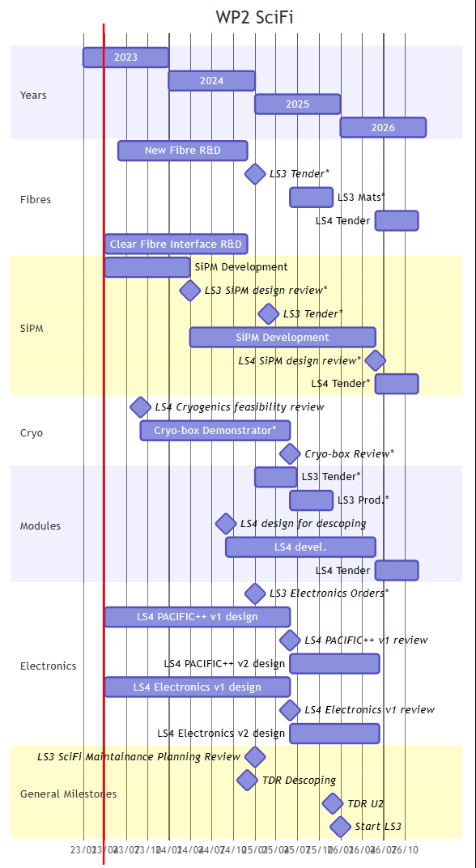
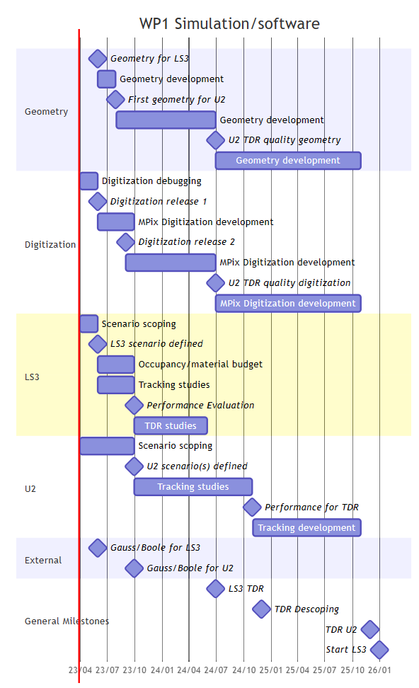
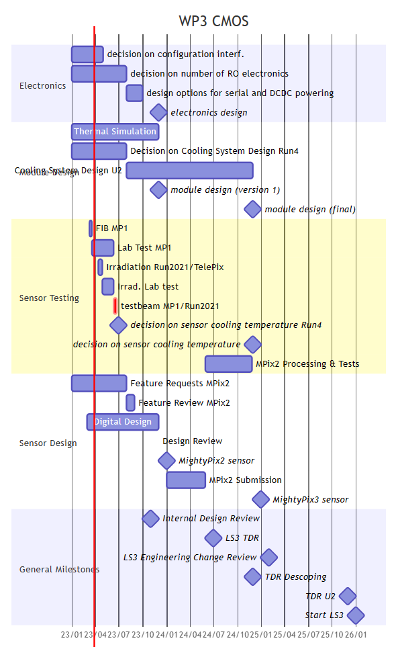
First step: Project Timeline
Preliminary
Simulation (Matt)
Fibre (Blake)
Pixel (Klaas)
To be reviewed.
Next steps:
Manpower estimation (needed/available)
Define priorities
Internal review Q4 2023
To preparing a decision on LS3

Slide 20
What next
We have to identify commonalities with other projects
  Pixel: UT
    Common meetings to present our progress and to identify possible common R&D
      Pre-meeting next week
    cooling
  SiPM/cooling : RICH?
  Fibres: ECAL ?
      Meeting mid-April
  Others?
Workshop in Bonn 31/05 – 02/06: https://indico.cern.ch/event/1266905/
  Wider audience
  Attract new collaborators
    Every one is welcome to join and participate
  Prepare our roadmap

Slide 21
Summary
Run 4
  SciFi is the baseline
    Detector access is an issue
      Benefit of LHC cryo displacement to extend a bit available space
  Internal review Q4 2023: to prepare a decision (needs, Mpix readiness, resources, impact, etc.)
Run 5 & Descoping
  Revisit the cost
  New technologies (fibres, cooling, etc.)
  Decrease of the number of channels ⇒ Reduce detector acceptance
We need new collaborators: you are welcome
Mighty Tracker Workshop in Bonn 31/05 – 02/06 https://indico.cern.ch/event/1266905/
More information: Simulation (Matt), Fibre (Blake), Pixel (Klaas)
We need some guidelines
+ Global optimisation

Slide 22
Backup

Slide 23
SciFi view from C-side
Blake

Slide 24
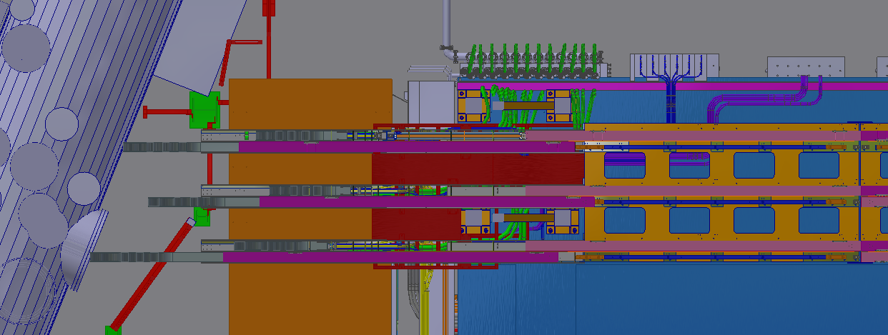
SciFi top view C-side
Alessandro

Slide 25
Descoping roadmap
Descoping
  Revisit the cost estimate
  Global detector optimisation process needed:
    Reduce peak luminosity (integrated luminosity?), reduce detector futures
    Reduce detector acceptance ⇒ Impact on physics performances
  Reduce Si size
    6 → 5 layers: impact on tracking performances?
    Reduce Si area:
      SciFi radiation hardness?
      Could timing information be useful?
  SciFi
    Reduce the number of layers?
    Remove outer modules (flexibility: no design changes, decision could be take at the construction time)
    Have shorter modules?

Slide 26
Downscoping: A modest tracker
Matt
In FTDR main descope option discussed is reducing
the silicon area: assume we gain from cryo cooling on
the SciFi side.
Also reduce to 5 silicon layers
Silicon area reduces to 11 m²
Reduces cost of Silicon by 40 %
With 4 fiber layers for SciFi total system
cost also reduces

Slide 27
Acceptance
Tim

