Slide 1
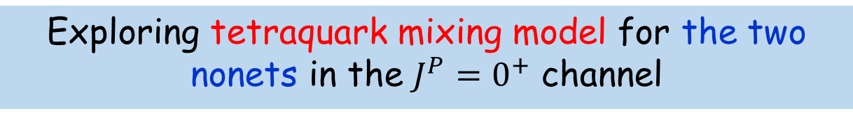
Exploring tetraquark mixing model for the two nonets in the $J^{P}=0^{+}$ channel
Hungchong Kim (Korea University)
This talk is based on :
arXiv:2403.18411 (to be published in EPJC)
PRD(2023) 108, 074016
EPJC(2022) 82, 1113
PRD(2019) 99, 014005
PRD(2019) 100, 034021
PRD(2018) 97, 094005
EPJC(2017) 77, 435
EPJC(2017) 77, 173
QNP 2024 7/8-7/12 at Universitat de Barcelona, Spain

Slide 2
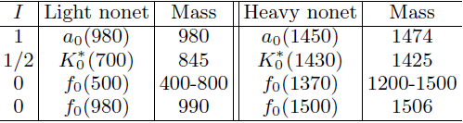
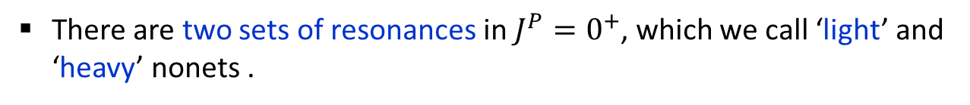

Overview
There are two sets of resonances in $J^{P}=0^{+}$, which we call ‘light’ and ‘heavy’ nonets .
$∆M≳500$ MeV
In this talk, we introduce a tetraquark mixing model for them.
Present various signatures supporting this model.

Slide 3






Introduction
Multiquarks are hadrons composed of four or more constituent quarks,
$$qq\overline{q}\overline{q}$$
$$qqqq\overline{q}$$
$$qqqqqq$$
$$∙∙∙∙$$
tetraquark
pentaquark
hexaquark
Multiquarks are different from normal hadrons that are composed of two or three quarks,
$$q\overline{q}$$
$$qqq$$
meson
baryon
The important issue is that multiquarks have not been confirmed for a long time.
Since there is no reason for multiquarks not to exist, they have been long anticipated.

Slide 4
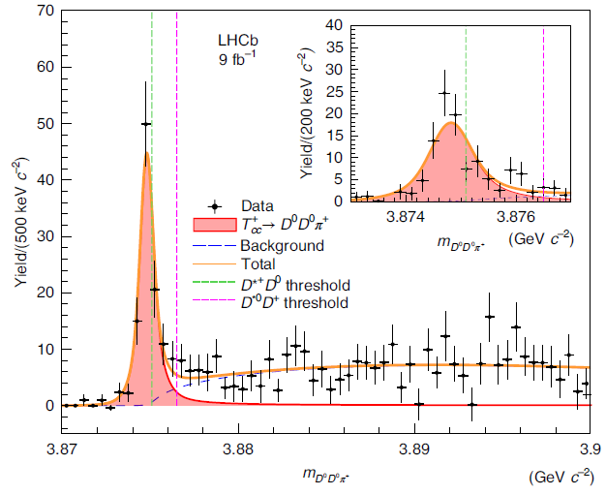
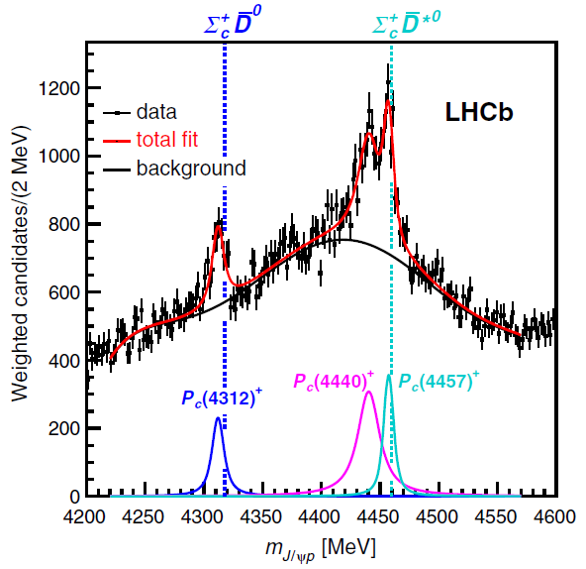


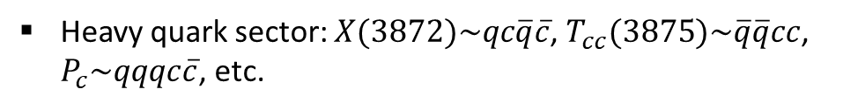




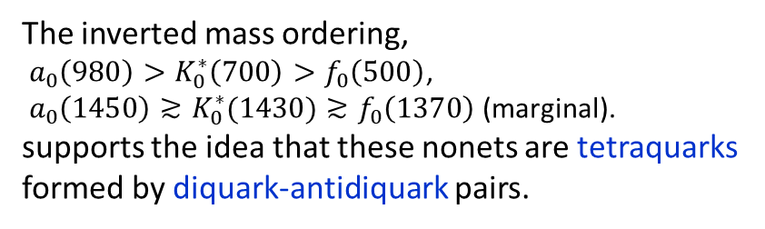
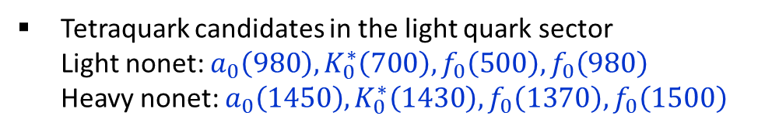

Introduction
There are various candidates for multiquarks in literatures.
Heavy quark sector: $X(3872)\sim qc\overline{q}\overline{c}$, $T_{cc}(3875)\sim \overline{q}\overline{q}cc$, $P_{c}\sim qqqc\overline{c}$, etc.
Hexaquark candidate: $d^{∗}\left(2380\right)$
Tetraquark candidates in the light quark sector
Light nonet: $a_{0}\left(980\right),K_{0}^{∗}\left(700\right),f_{0}\left(500\right), f_{0}\left(980\right)$
Heavy nonet: $a_{0}\left(1450\right),K_{0}^{∗}\left(1430\right), f_{0}\left(1370\right),f_{0}\left(1500\right)$
$T_{cc}^{+}\left(3875\right)⟹D^{0}D^{0}π^{+}$
The inverted mass ordering,
$a_{0}\left(980\right)>K_{0}^{∗}\left(700\right)>f_{0}\left(500\right)$,
${a_{0}\left(1450\right)≳K}_{0}^{∗}(1430)≳f_{0}\left(1370\right)$ (marginal).
supports the idea that these nonets are tetraquarks formed by diquark-antidiquark pairs.
[LHCb, NP 18, 751 (2022)]
$$qq$$
$$\overline{q}\overline{q}$$
($q=u,d,s)$
$${\overline{3}}_{f}⨂3_{f}=8_{f}⨁1_{f}$$
$P_{c}\left(4312\right)$, $P_{c}\left(4440\right)$, $P_{c}\left(4457\right)$
LHCb, PRL 122, 222001 (2019)

Slide 5







Introduction
These candidates are not confirmed as multiquarks because they can be interpreted as different states, such as hadronic molecules.
$X\left(3872\right)\sim D^{0}{\overline{D}}^{0}$, $T_{cc}≈DD^{∗}$
$P_{c}\left(4312\right)\sim Σ_{c}\overline{D}$, $P_{c}\left(4440\right)$, $P_{c}\left(4457\right)\sim Σ_{c}{\overline{D}}^{∗}$
$$d^{∗}\left(2380\right)\sim ∆∆$$
$a_{0}\left(980\right), f_{0}\left(980\right)\sim K\overline{K}$, $f_{0}\left(500\right)\sim ππ$, $f_{0}\left(1370\right)\sim ρρ$
However, hadronic molecules and multiquarks are quite different.
Hadronic molecules are composed of two colorless hadrons,
$$1_{c}$$
$$1_{c}$$
whereas multiquarks are composed of colored objects like diquarks and antidiquarks,
$$qq$$
$$\overline{q}\overline{q}$$

Slide 6




















Introduction
Therefore, a reasonable approach is required to exclusively identify multiquarks in this context.
Recently, we proposed a tetraquark mixing model that describes both light and heavy nonets as tetraquarks.
Light nonet
$${ a}_{0}\left(980\right),K_{0}^{∗}\left(800\right),f_{0}\left(500\right), f_{0}\left(980\right)$$
Heavy nonet
$${ a}_{0}\left(1450\right),K_{0}^{∗}\left(1430\right), f_{0}\left(1370\right),f_{0}\left(1500\right)$$
$$K_{0}^{∗0}\left(800\right)$$
$$K_{0}^{∗+}\left(700\right)$$
$$K_{0}^{∗0}\left(1430\right)$$
$$K_{0}^{∗+}\left(1430\right)$$
$$a_{0}^{−}\left(980\right)$$
$$a_{0}^{0}\left(980\right)$$
$$a_{0}^{+}\left(980\right)$$
$$a_{0}^{−}\left(1450\right)$$
$$a_{0}^{0}\left(1450\right)$$
$$a_{0}^{+}\left(1450\right)$$
$$f_{0}\left(1500\right)$$
$$f_{0}\left(980\right)$$
$$f_{0}\left(500\right)$$
$$f_{0}\left(1370\right)$$
$${\overline{K}}_{0}^{∗−}\left(800\right)$$
$${\overline{K}}_{0}^{∗0}\left(800\right)$$
$${\overline{K}}_{0}^{∗−}\left(1430\right)$$
$${\overline{K}}_{0}^{∗0}\left(1430\right)$$
This mixing model has successful features that cannot be reproduced by models other than tetraquarks.

Slide 7
Tetraquark mixing model

Slide 8


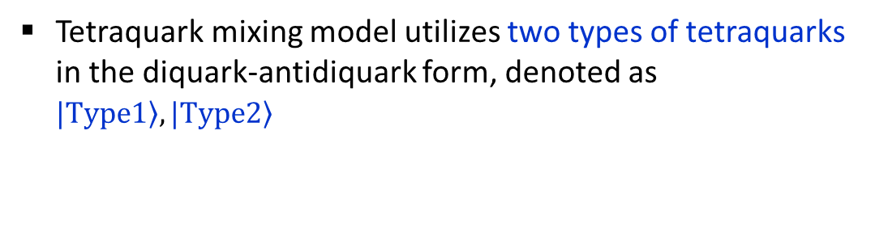

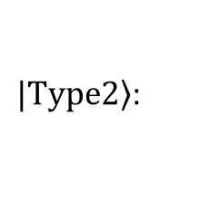


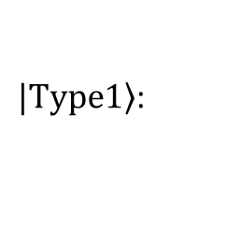
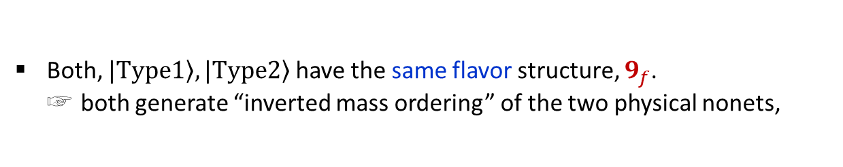
Tetraquark mixing model
Tetraquark mixing model utilizes two types of tetraquarks in the diquark-antidiquark form, denoted as $\left.|Type1\right\rangle ,\left.|Type2\right\rangle$
$$qq$$
$$\overline{q}\overline{q}$$
($q=u,d,s)$
$\left.|Type1\right\rangle$:
Well-known tetraquark type, originally proposed for the light nonet (Jaffe).
$\left.|Type2\right\rangle$:
Another type proposed in 2017 [EPJC 77, 3 (2017)].
Both, $\left.|Type1\right\rangle ,\left.|Type2\right\rangle$ have the same flavor structure, $9_{f}$.
☞ both generate “inverted mass ordering” of the two physical nonets,
$a_{0}\left(980\right)>K_{0}^{∗}\left(700\right)>f_{0}\left(500\right)$, ${a_{0}\left(1450\right)≳K}_{0}^{∗}(1430)≳f_{0}\left(1370\right)$ (marginal)
Note, the two types have different color and spin configurations.

Slide 9

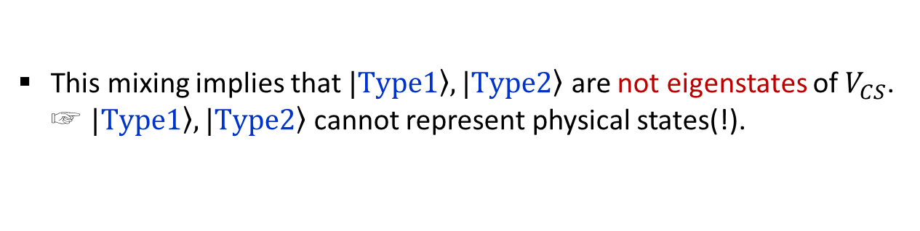

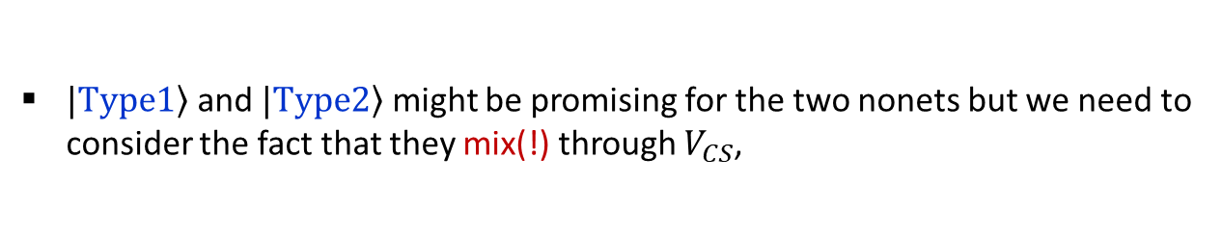



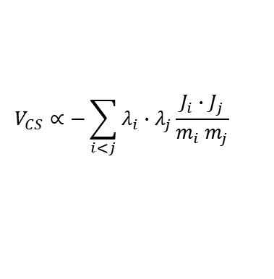
Tetraquark mixing model
$\left.|Type1\right\rangle$ and $\left.|Type2\right\rangle$ might be promising for the two nonets but we need to consider the fact that they mix(!) through $V_{CS}$,
$$V_{CS}∝−\sum_{i<j}{λ_{i}∙λ_{j}\frac{J_{i}∙J_{j}}{m_{i} m_{j}}}$$
$\left\langle Type2 | V_{CS} | Type1\right\rangle ≠0$
⇒ $V_{CS}$ forms a 2x2 matrix in this basis.
Color-spin interaction
$λ_{i}$: Gell-Mann matrix for color
$J_{i}$: quark spin
ex) For the $I=1$ channel,
This mixing implies that $\left.|Type1\right\rangle ,\left.|Type2\right\rangle$ are not eigenstates of $V_{CS}$. ☞ $\left.|Type1\right\rangle ,\left.|Type2\right\rangle$ cannot represent physical states(!).

Slide 10
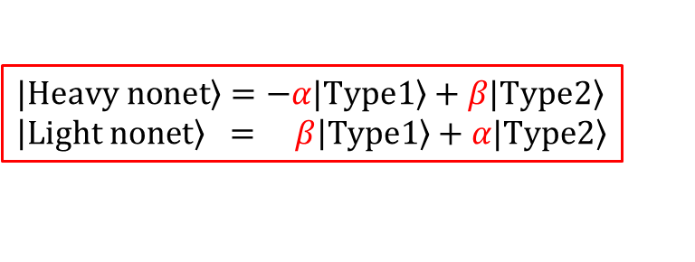
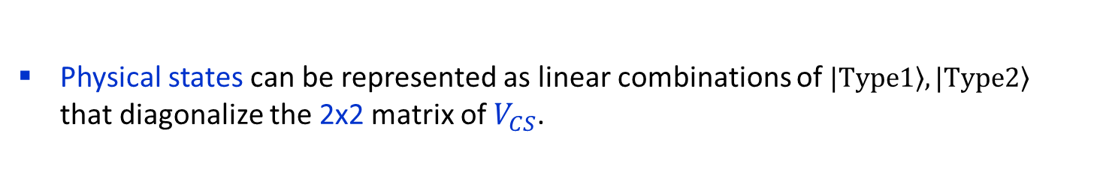
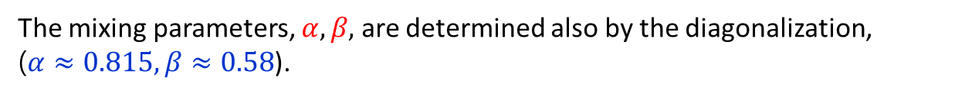


Tetraquark mixing model
Physical states can be represented as linear combinations of $\left.|Type1\right\rangle ,\left.|Type2\right\rangle$ that diagonalize the 2x2 matrix of $V_{CS}$.
The diagonalization produces two sets of “physical” states collectively represented by the two equations,
$$\left.|Heavy nonet\right\rangle =−α\left.|Type1\right\rangle +β\left.|Type2\right\rangle \\ \left|\left.Light nonet\right\rangle = β\right|\left.Type1\right\rangle +α\left.|Type2\right\rangle$$
⇒${ a}_{0}\left(1450\right),K_{0}^{∗}\left(1430\right), f_{0}\left(1370\right),f_{0}\left(1500\right)$
⇒${ a}_{0}\left(980\right),K_{0}^{∗}\left(800\right),f_{0}\left(500\right), f_{0}\left(980\right)$
The mixing parameters, $α,β,$ are determined also by the diagonalization,
($α≈0.815, β≈0.58$).
We called this the tetraquark mixing model for the two nonets.

Slide 11
Evidence supporting tetraquark mixing model

Slide 12
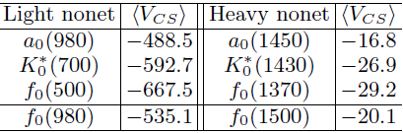
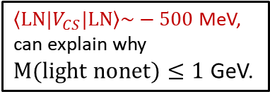
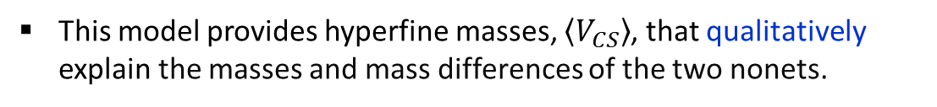

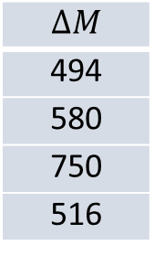

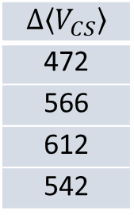

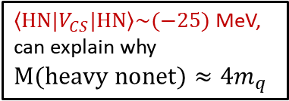
Hyperfine mass
This model provides hyperfine masses, $\left\langle V_{CS}\right\rangle$, that qualitatively explain the masses and mass differences of the two nonets.
[EPJC(2017) 77, 173, PRD(2018) 97, 094005]
$\left\langle LN|V_{CS}|LN\right\rangle \sim −500$ MeV, can explain why
$M(light nonet)≤1$ GeV.
$\left\langle HN|V_{CS}|HN\right\rangle \sim (−25)$ MeV, can explain why
$$M(heavy nonet)≈4m_{q}$$
$$\left\langle LN|V_{CS}|LN\right\rangle$$
$$\left\langle HN|V_{CS}|HN\right\rangle$$
$$ΔM$$
494
580
750
516
$$Δ\left\langle V_{CS}\right\rangle$$
472
566
612
542
SU(3)
$$ΔM≈Δ\left\langle V_{CS}\right\rangle$$
Note, the same formula works for the mass difference between vector mesons –pseudoscalar mesons, baryon octet- baryon decuplet.
This mixing model is also supported by the QCD sum rule calculation [PRD(2019) 100, 034021].

Slide 13
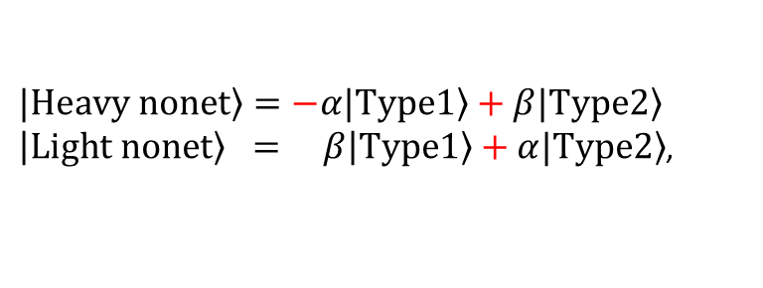



Additional evidence for the tetraquark mixing model
can be seen by decomposing the tetraquark wave functions,
$\left.|Heavy nonet\right\rangle =−α\left.|Type1\right\rangle +β\left.|Type2\right\rangle$
$\left|\left.Light nonet\right\rangle = β\right|\left.Type1\right\rangle +α\left.|Type2\right\rangle$,
into two-meson comp. and hidden-color comp.
(24)
$$q_{1}q_{2}{\overline{q}}_{3}{\overline{q}}_{4}$$
$$[$$
$$]_{1_{c}}$$
$⟹{\left(q_{1}{\overline{q}}_{3}\right)}_{1_{c}}⊗{\left(q_{2}{\overline{q}}_{4}\right)}_{1_{c}}+[{\left(q_{1}{\overline{q}}_{3}\right)}_{8_{c}}⊗{\left(q_{2}{\overline{q}}_{4}\right)}_{8_{c}}]_{1_{c}}$
(13)
two-meson comp.
hidden-color comp.
Both comps. can give supporting evidence.
First, the two-meson comp. provides the two-meson modes of the two nonets and their coupling strengths, which can reveal tetraquark characteristics distinct from meson molecules.

Slide 14











two-meson modes
Two-meson (PS) comp. of the light nonet in the mixing model
$$a_{0}^{+}\left(980\right)$$
[PRD(2023) 108, 074016]
($I=1$)
Overall factor from color-spin part
Two-meson modes from the flavor part
Only the modes below the mass threshold can be seen in the decay modes.
$$K_{0}^{∗+}\left(700\right)$$
($I=1/2$)
$$f_{0}\left(500\right)$$
($I=0$)
$a,b$ are flavor mixing parameters for isoscalar resonances
$$f_{0}\left(980\right)$$
($I=0$)

Slide 15


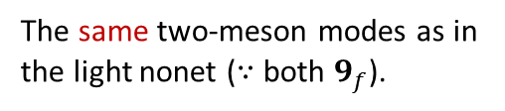








two-meson modes
Two-meson (PS) comp. of the heavy nonet in the mixing model
$$a_{0}^{+}\left(1450\right)$$
($I=1$)
Overall factor different from the light nonet
The same two-meson modes as in the light nonet ($∵$ both $9_{f}$).
$$K_{0}^{∗+}\left(1430\right)$$
($I=1/2$)
$$f_{0}\left(1370\right)$$
($I=0$)
$a,b$ are flavor mixing parameters for isoscalar resonances
$$f_{0}\left(1500\right)$$
($I=0$)
[PRD(2023) 108, 074016]

Slide 16
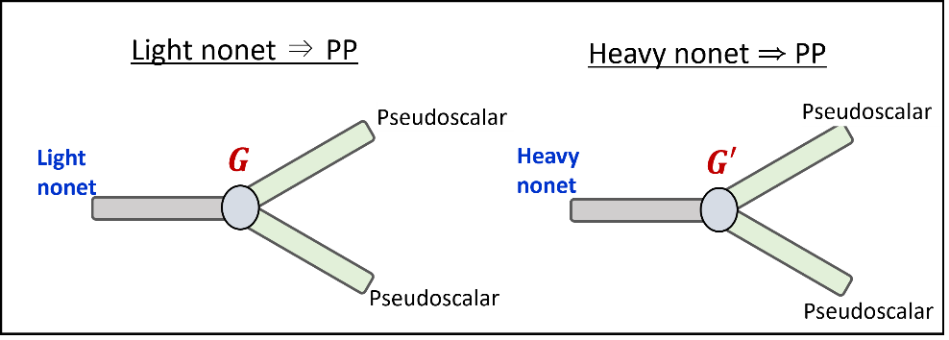




coupling strength
First thing to note from the two-meson comps is that
The different overall factors lead to different coupling strengths of the two nonets decaying into two pseudoscalar (PS) mesons.
Coupling strength of
Light nonet:
$$G=\left\langle PP | Light nonet\right\rangle ∝ \frac{β}{\sqrt{12}}+\frac{α}{\sqrt{2}}$$
different relative signs !
Heavy nonet:
$$G′=\left\langle PP | Heavy nonet\right\rangle ∝$$
$−$ $\frac{α}{\sqrt{12}}+\frac{β}{\sqrt{2}}$
Due to the difference in relative signs,
☞ the coupling strength into the PP mode is enhanced in the light nonet but suppressed in the heavy nonet.
$\left|G\right|$(light nonet) $≫\left|G′\right|$(heavy nonet)

Slide 17
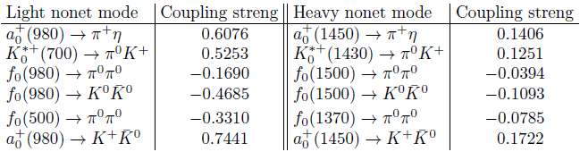


coupling strength
[EPJC(2022) 82, 1113]
Indeed, the coupling strengths can be directly calculated as:
$$G=\left\langle PP | Light nonet\right\rangle$$
$$G′=\left\langle PP | Heavy nonet\right\rangle$$
We can clearly see that, $\left|G\right|$(light nonet) $≫\left|G′\right|$(heavy nonet).

Slide 18
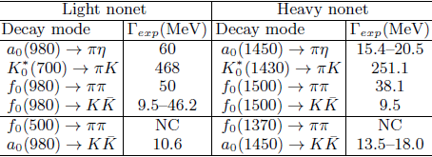

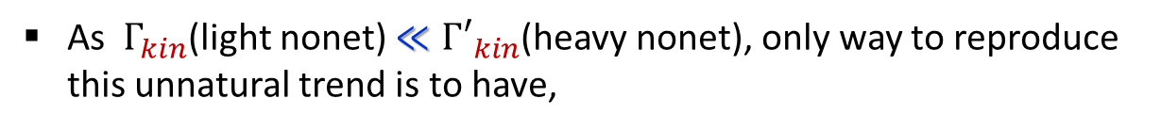




coupling strength
This prediction, $\left|G\right|$(light nonet) $≫\left|G′\right|$ (heavy nonet), can be experimentally verified by examining partial decay widths,
$$Γ_{partial}=G^{2} Γ_{kin}$$
We extracted experimental partial decay widths from PDG as:
[EPJC(2022) 82, 1113]
One exception comes from kinematical cutoff, so it does not undermine our discussion here.
The experimental partial decay widths have an unnatural trend,
$Γ_{exp}$(light nonet) $≳Γ_{exp}$(heavy nonet)
$$⟹$$
$G^{2}Γ_{kin}$ $≳G^{′2}{Γ′}_{kin}$
As $Γ_{kin}$(light nonet) $≪{Γ′}_{kin}$(heavy nonet), only way to reproduce this unnatural trend is to have,
$\left|G\right|$(light nonet) $≫\left|G′\right|$(heavy nonet)

Slide 19
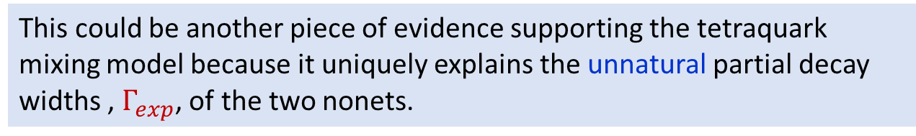
coupling strength
This could be another piece of evidence supporting the tetraquark mixing model because it uniquely explains the unnatural partial decay widths , $Γ_{exp}$, of the two nonets.

Slide 20
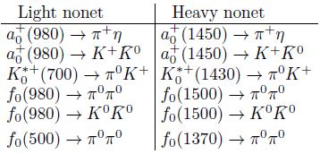
Another thing to note from the two-meson modes
Most of the modes below the mass threshold have also been observed experimentally.
⇒ The two-meson modes in the mixing model may be somewhat realistic.
But further verification is necessary by updating experimental data in the future.

Slide 21
Two nonets in a meson molecular approach
in order to compare the results from the tetraquark model with those from meson molecules.

Slide 22




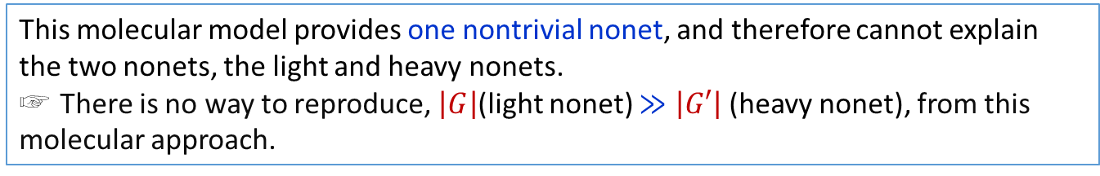


meson molecules
[PRD(2023) 108, 074016]
Specifically, we construct meson molecules by combining two PS nonets,
$PS⊗PS⇒$ two-meson molecules .
As $PS=1_{f}⊕8_{f}$, possible multiplets for two-meson molecules are
$$1_{f}⊗1_{f}= 1′$$
This trivial nonet cannot fit either of the two nonets under consideration.
$$8_{f}⊗1_{f}= 8"$$
$$8_{f}⊗8_{f}= 27⊕10 ⨁\overline{10}⊕8⊕8′⊕1$$
⇒ one nontrivial nonet ($∵8=8′$).
The two nonets under consideration can be derived from those marked by .
This molecular model provides one nontrivial nonet, and therefore cannot explain the two nonets, the light and heavy nonets.
☞ There is no way to reproduce, $\left|G\right|$(light nonet) $≫\left|G′\right|$ (heavy nonet), from this molecular approach.

Slide 23
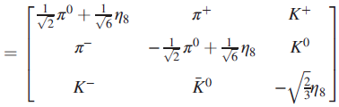




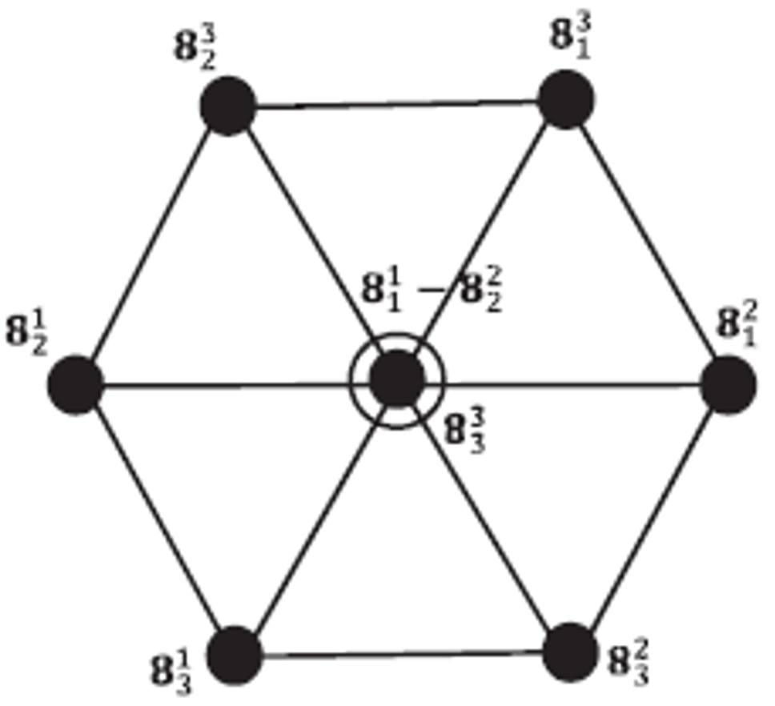













meson molecules
$$PS⊗PS$$
Nontrivial nonet in meson molecules
($8_{f}⊗8_{f}⇒8⊕1$)
$1=Tr\left(PP\right)$
$$=\vec{π}∙\vec{π}+\overline{K}K+(\overline{K}K)^{†}+η_{8}η_{8}$$
$8_{j}^{k}=(PP)_{j}^{k}−\frac{1}{3}δ_{j}^{k}Tr\left(PP\right)$
$$P_{j}^{i}$$
Only the modes below the mass threshold can decay.
$$I=1/2$$
short-hand notations
$$I=1$$
$$I=0$$
$$I=1/2$$

Slide 24

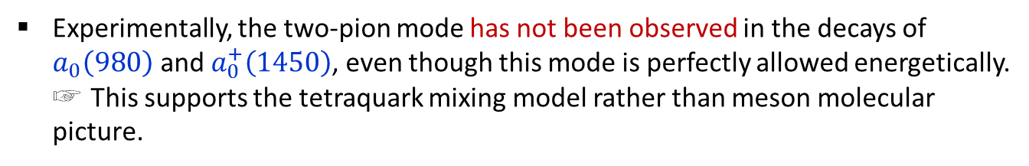
meson molecules
The two-meson modes in meson molecules differ from those in the tetraquark model in several ways.
It might be necessary to verify which picture is more realistic from future experimental data.
But, even at this stage, there is one clear distinction from the isovector channel.
For the isovector resonances, $a_{0}^{+}\left(980\right),a_{0}^{+}\left(1450\right)$,
Tetraquark model:
Meson molecules:
The two-pion mode appears in meson molecules but is absent in the tetraquark model.
Experimentally, the two-pion mode has not been observed in the decays of $a_{0}\left(980\right)$ and $a_{0}^{+}\left(1450\right)$, even though this mode is perfectly allowed energetically.
☞ This supports the tetraquark mixing model rather than meson molecular picture.

Slide 25







hidden-color
Hidden-color contribution to $\left\langle V_{CS}\right\rangle$
[arXiv:2403.18411]
The tetraquark nonets have hidden-color components through the decomposition
$$(q\overline{q})_{1_{c}}$$
$$(q\overline{q})_{1_{c}}$$
(24)
$$⇏$$
$$q_{1}q_{2}{\overline{q}}_{3}{\overline{q}}_{4}$$
$$]_{1_{c}}$$
$$[$$
$⟹{\left(q_{1}{\overline{q}}_{3}\right)}_{1_{c}}⊗{\left(q_{2}{\overline{q}}_{4}\right)}_{1_{c}}+[{\left(q_{1}{\overline{q}}_{3}\right)}_{8_{c}}⊗{\left(q_{2}{\overline{q}}_{4}\right)}_{8_{c}}]_{1_{c}}$
(13)
Two-meson comp. (TM)
Hidden-color comp. (HC)
This comp. is unique to tetraquarks, as it cannot be formed from meson molecules.
Its presence in physical quantities can provide additional evidence supporting the tetraquark nature of the two nonets.
To estimate the hidden-color contribution, we separate $\left\langle V_{CS}\right\rangle$ into three contributions, $\left\langle TM|V_{CS}|TM\right\rangle$, $\left\langle TM|V_{CS}|HC\right\rangle , \left\langle HC|V_{CS}|HC\right\rangle$ .

Slide 26
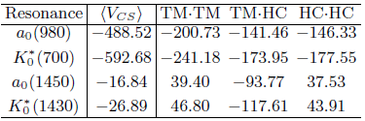
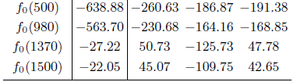




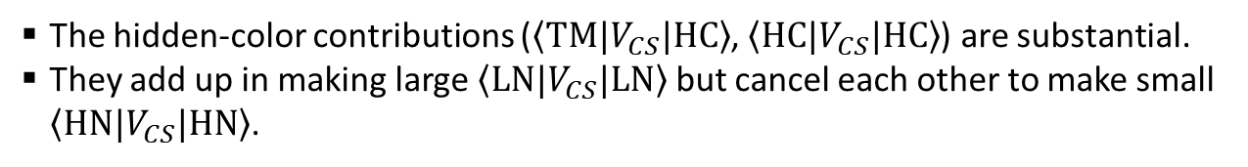

Hidden-color
$$\left\langle TM|V_{CS}|TM\right\rangle$$
$$\left\langle TM|V_{CS}|HC\right\rangle$$
$$\left\langle HC|V_{CS}|HC\right\rangle$$
$$I=\frac{1}{2}, 1$$
$$I=0$$
[The SU(3) sym case is presented here]
The hidden-color contributions ($\left\langle TM|V_{CS}|HC\right\rangle$, $\left\langle HC|V_{CS}|HC\right\rangle$) are substantial.
They add up in making large $\left\langle LN|V_{CS}|LN\right\rangle$ but cancel each other to make small $\left\langle HN|V_{CS}|HN\right\rangle$.

Slide 27
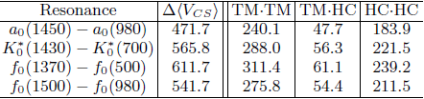
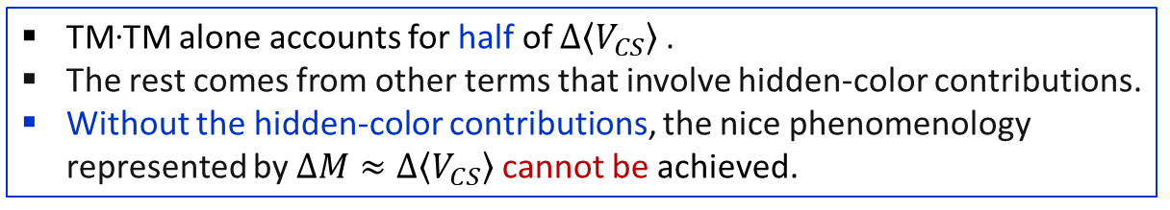

Hidden-color contributions to the mass splitting formula
[arXiv:2403.18411]
$ΔM≈Δ\left\langle V_{CS}\right\rangle$
TM·TM alone accounts for half of $Δ\left\langle V_{CS}\right\rangle$.
The rest comes from other terms that involve hidden-color contributions.
Without the hidden-color contributions, the nice phenomenology represented by $ΔM≈Δ\left\langle V_{CS}\right\rangle$ cannot be achieved.
Therefore, the hidden-color contributions significantly affect the physical hyperfine masses, further supporting the tetraquark nature of the two nonets.

Slide 28
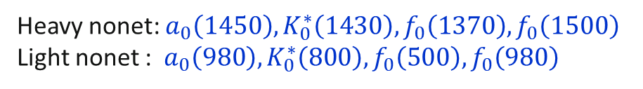
Summary
In this talk, we have demonstrated that the tetraquark mixing model can reasonably well explain the two nonets in $J^{P}=0^{+}$:
Heavy nonet: $a_{0}\left(1450\right),K_{0}^{∗}\left(1430\right), f_{0}\left(1370\right),f_{0}\left(1500\right)$
Light nonet : $a_{0}\left(980\right),K_{0}^{∗}\left(800\right),f_{0}\left(500\right), f_{0}\left(980\right)$
We have presented various pieces of evidence supporting this model.
It can qualitatively describe the masses and the mass differences between the two nonets.
This model predicts that $\left|G\right|$(light nonet) $≫\left|G′\right|$ (heavy nonet), which is supported by the experimental widths, $Γ_{exp}$(light nonet) $≳Γ_{exp}$(heavy nonet).
Hidden-color components, unique to tetraquarks, are found to contribute substantially to the hyperfine masses of the two nonets.
We also discussed a meson molecular approach to describe the two nonets.
We found that this molecular model is unable to produce the two nonets, making it unclear how the molecular model can otherwise explain the phenomenological aspects that support the existence of tetraquarks.
Additionally, the two-pion mode predicted in the isovector channel by the molecular model is not supported by experimental data.
All these collectively support that the two nonets are tetraquarks generated by the mixing of two tetraquark types.

Slide 29
Thank you for your attention !

Slide 30
Additional slides
to answer some questions that may arise in the talk.

Slide 31
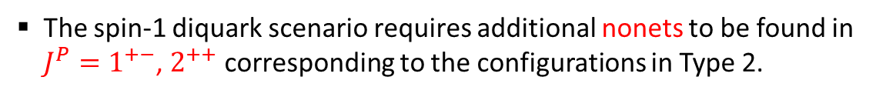

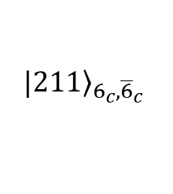
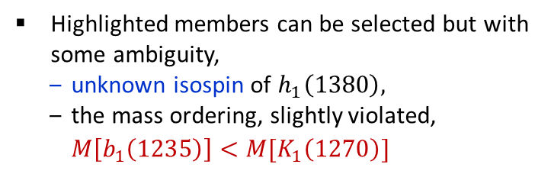
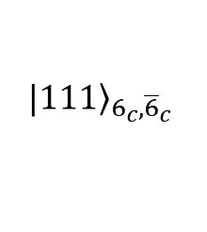


digression
additional nonets ?
The spin-1 diquark scenario requires additional nonets to be found in $J^{P}=1^{+−}$, $2^{++}$ corresponding to the configurations in Type 2.
$${\left.|111\right\rangle }_{{6_{c},\overline{6}}_{c}}$$
$${\left.|211\right\rangle }_{{6_{c},\overline{6}}_{c}}$$
※ One can prove that C-parity is negative for $J=1$, positive for $J=2$.
Are there such nonets in PDG ? My answer is ‘Maybe’.
There are lots of resonances to choose but the candidate selection is not definite.
$J^{P(C)}=1^{+(−)}$ resonances
Highlighted members can be selected but with some ambiguity,
  unknown isospin of $h_{1}\left(1380\right),$
  the mass ordering, slightly violated, $M\left[b_{1}\left(1235\right)\right]<M[K_{1}\left(1270\right)]$
$J^{P(C)}=2^{+(+)}$ resonances

Slide 32
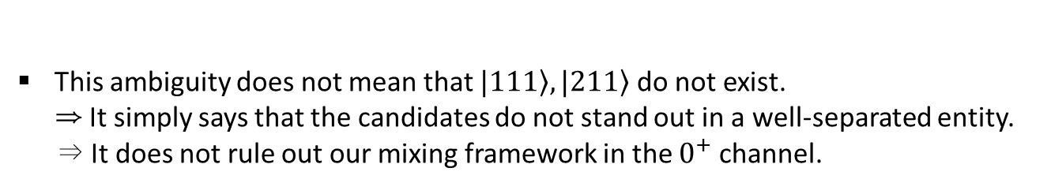
digression
The selection is ambiguous
maybe due to further mixings with additional tetraquarks constructed by other diquarks, and possible contamination from two-quark component with $ℓ=1$.
This ambiguity does not mean that $|\left.111\right\rangle , |\left.211\right\rangle$ do not exist.
⇒ It simply says that the candidates do not stand out in a well-separated entity.
⇒ It does not rule out our mixing framework in the $0^{+}$ channel.

Slide 33

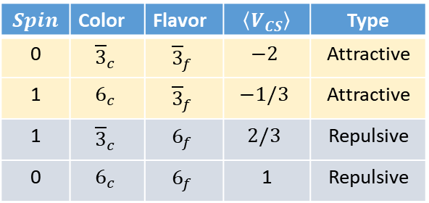
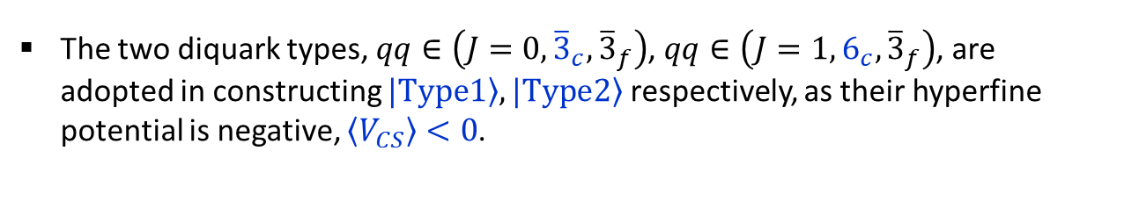


Why two diquark types ?
The two diquark types, $qq∈\left({J=0,{\overline{3}}_{c},\overline{3}}_{f}\right)$, $qq∈\left({J=1,6_{c},\overline{3}}_{f}\right)$, are adopted in constructing $\left.|Type1\right\rangle ,\left.|Type2\right\rangle$ respectively, as their hyperfine potential is negative, $\left\langle V_{CS}\right\rangle <0$.
〈Possible $qq$ structure〉
$$Spin$$ | Color | Flavor | $$\left\langle V_{CS}\right\rangle$$ | Type
0 | $${\overline{3}}_{c}$$ | $${\overline{3}}_{f}$$ | $$−2$$ | Attractive
1 | $$6_{c}$$ | $${\overline{3}}_{f}$$ | $$−1/3$$ | Attractive
1 | $${\overline{3}}_{c}$$ | $$6_{f}$$ | $$2/3$$ | Repulsive
0 | $$6_{c}$$ | $$6_{f}$$ | 1 | Repulsive
$$V_{CS}∝−\sum_{i<j}{λ_{i}∙λ_{j}\frac{J_{i}∙J_{j}}{m_{i} m_{j}}}$$
Hyperfine color-spin interaction
$λ_{i}$: Gell-Mann matrix for color
$J_{i}$: spin
$m_{i}$: constituent quark mass $\sim 330$ MeV

Slide 34
Other models to explain the two nonets
with some limitations.

Slide 35









$q\overline{q}$ ($ℓ=1$) [I]
Two-quark picture($q\overline{q}$) with $ℓ=1$
can make nonets also with ${J^{P}=0}^{+}.$
Does this picture explain the two nonets in PDG ? My answer is `No’
$$q\overline{q}:(S=0,1)⨂(ℓ=1)⟹J=0,1,2$$
Total $J$ | Configuration | # of confs.
$$J=0$$ | $$(S=1,ℓ=1)$$ | one
$$J=1$$ | $$\left(S=0,ℓ=1\right), (S=1,ℓ=1)$$ | two
$$J=2$$ | $$(S=1,ℓ=1)$$ | one
This picture has only one configuration in ${J^{P}=0}^{+}$, which is not enough to explain the two nonets in $J^{P}=0^{+}$.
$$ℓ=1$$
$$q$$
$$\overline{q}$$

Slide 36







$q\overline{q}$ ($ℓ=1$) [II]
Alternatively, one may consider that
the heavy nonet can be represented by $q\overline{q}$ ($ℓ=1$) and the light nonet by $qq\overline{q}\overline{q}$.
The heavy nonet must have the configuration
($S=1$, vector nonet) $⨂(ℓ=1)⟹J=0$
⇒ orbital excitations of the vector mesons, $ρ,ω,K^{∗},φ$.
In this picture, the spin-orbit (SO) coupling can make the heavy nonet ‘heavier’ than the vector nonet.
$≈$116 MeV
$≈−50$ MeV
$$⇒$$
$(ℓ=1)$
The mass ordering is reversed.
To reproduce the reversed gap ($≈−50$ MeV), SO must have strong isospin dependence, strong enough to flip the mass ordering established by the quark masses. ☞ not realistic !

Slide 37




Mixing model
Mixture of $q\overline{q}$, $qq\overline{q}\overline{q}$
One may view the two nonets as a mixture of $q\overline{q}$ $(ℓ=1)$ and $qq\overline{q}\overline{q}$ ?
Black et.al, PRD 59(1999)
Black et.al introduce the effective fields corresponding to $q\overline{q}$ and $qq\overline{q}\overline{q}$ nonets and make SU(3) invariant Lagrangian among them.
As pointed by Maiani et.al. EPJC50(2007), the required mixing seems too large given the fact that very different configurations are involved.
$q\overline{q}(ℓ=1)$, $qq\overline{q}\overline{q}$ do not mix under the color-spin interaction !
$\left\langle q\overline{q} | qq\overline{q}\overline{q}\right\rangle =0$, $\left\langle q\overline{q} | V_{CS}|qq\overline{q}\overline{q}\right\rangle =0$.
It is hard to establish such a mixing from well-known quark-quark interactions.

