Slide 1
Analyzing the D*D*D* system:
Hexaquark states and the Efimov effect
P. G. Ortega
Details in Arxiv: 2403.10344 [hep-ph]

Slide 2
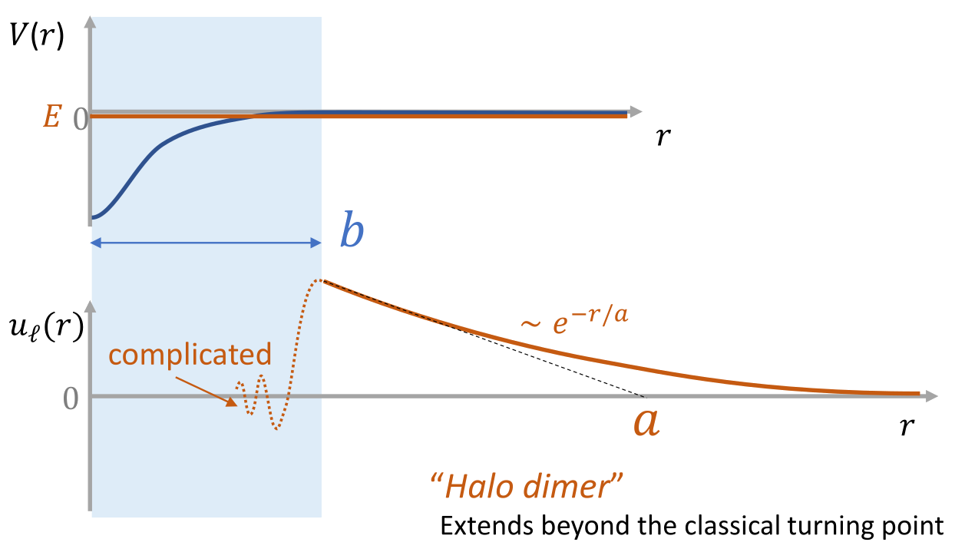
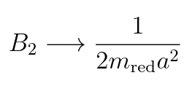
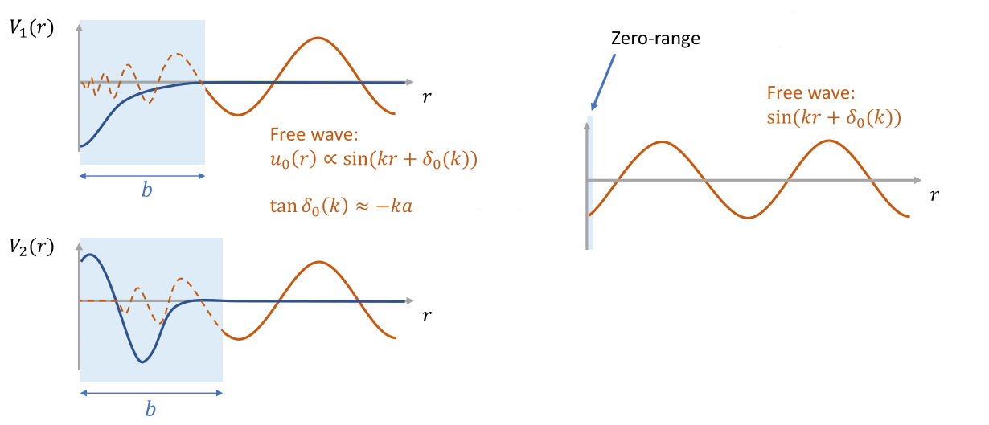
Two body universality
Nearly-resonant two-body state due to short-range attractive forces
Characterized by its scattering length
System becomes universal Insensitive to short-range details

Slide 3
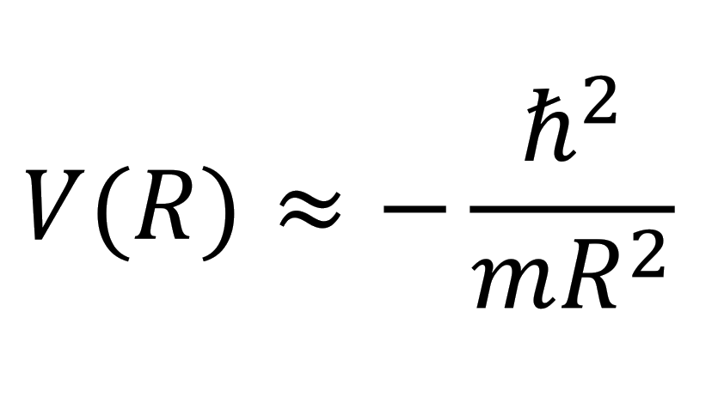
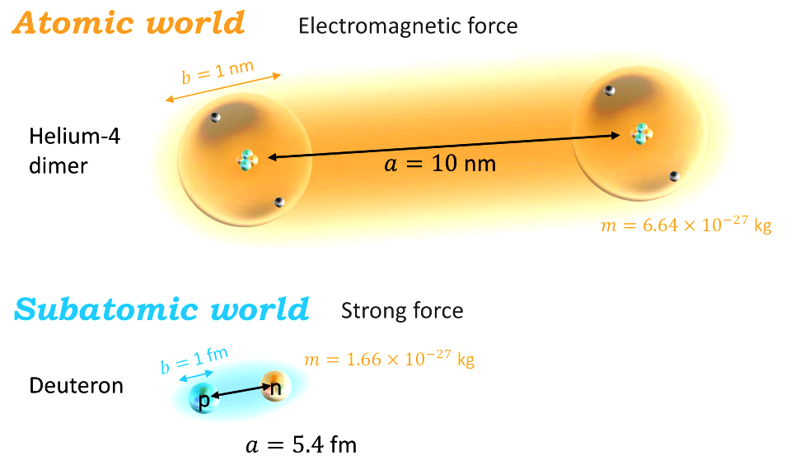
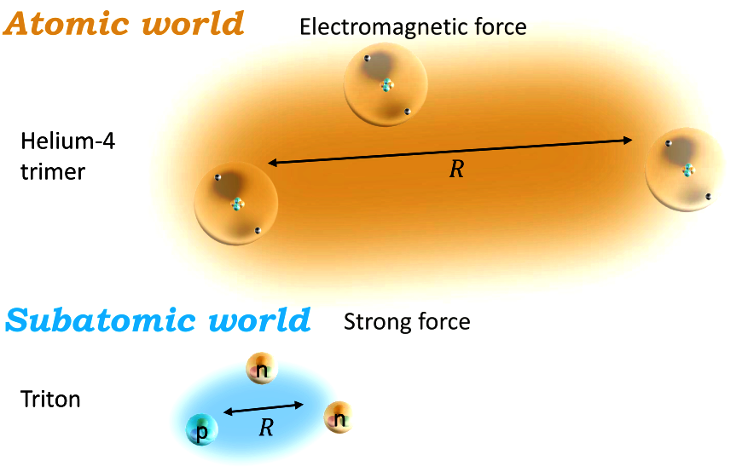
Two body universality
Nearly-resonant two-body state due to short-range attractive forces
Characterized by its scattering length
Effective long-range three-body force Efimov attraction

Slide 4
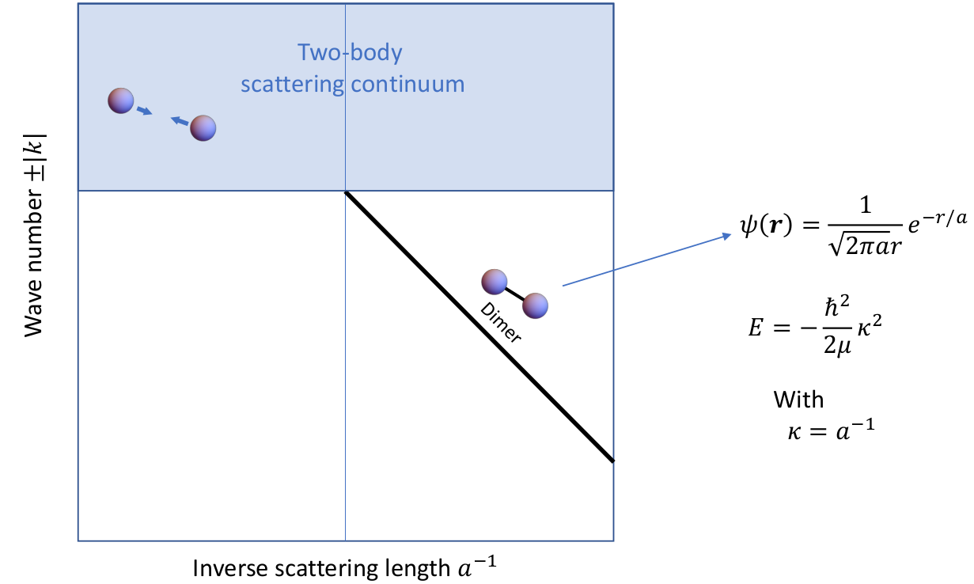
Efimov effect
Two-body spectrum in the zero-range theory
From P. Naidon, RIKEN

Slide 5
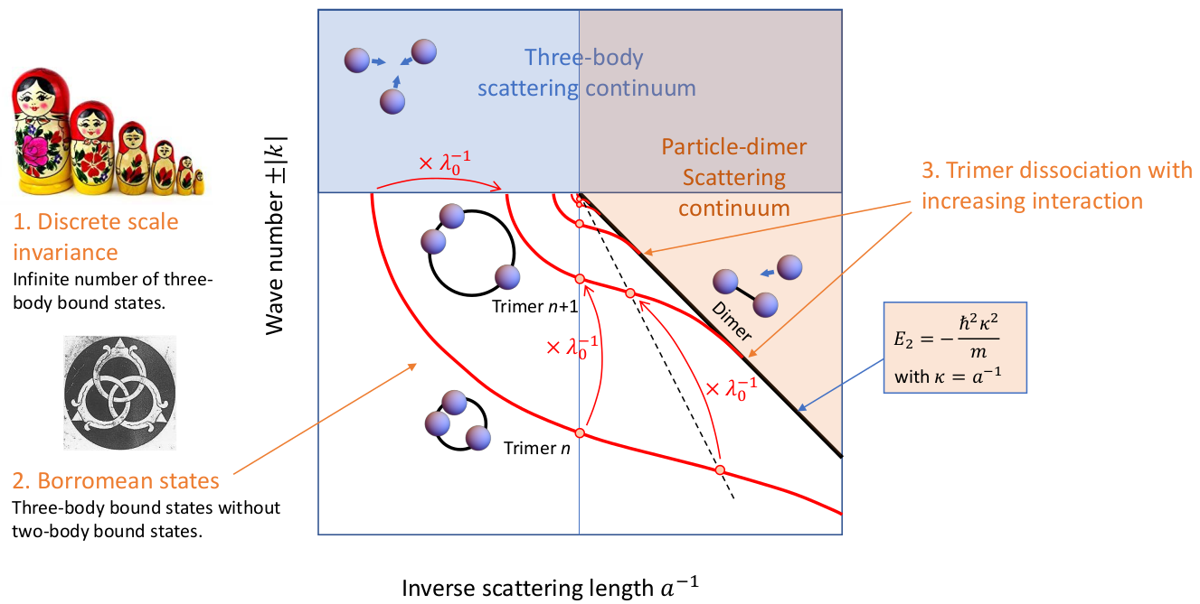
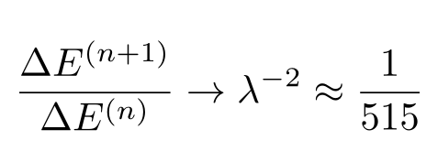
Efimov effect
Three-body spectrum in the zero-range theory
λ₀ ~ 22.7
From P. Naidon, RIKEN

Slide 6
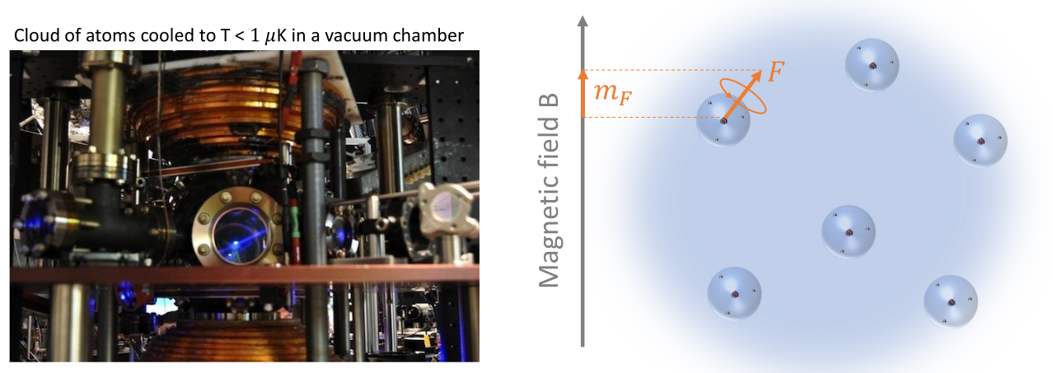
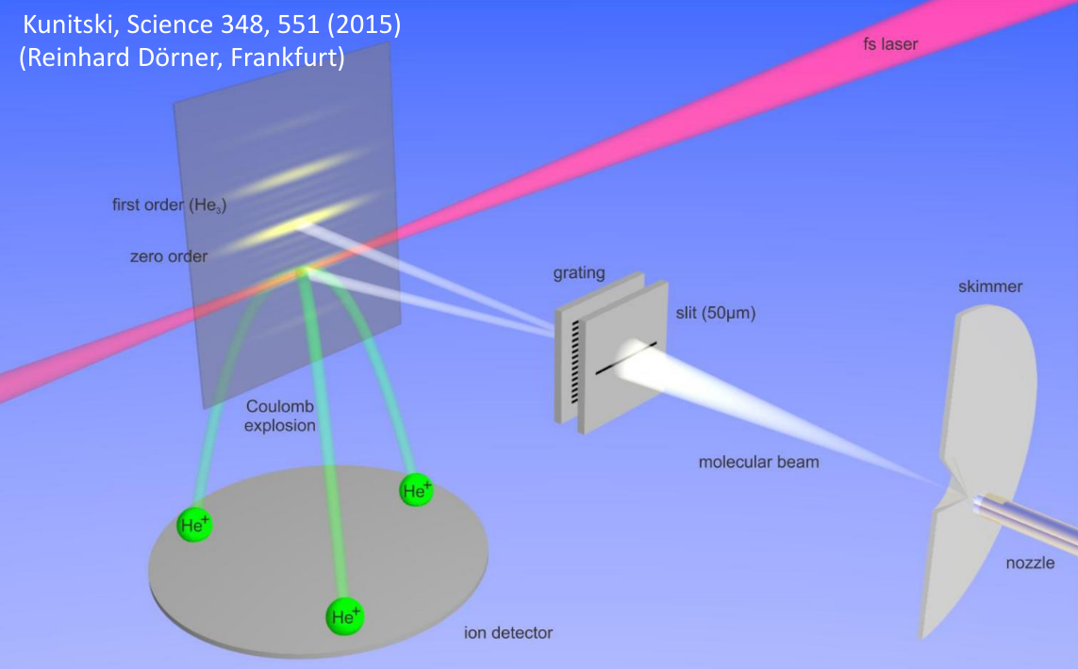
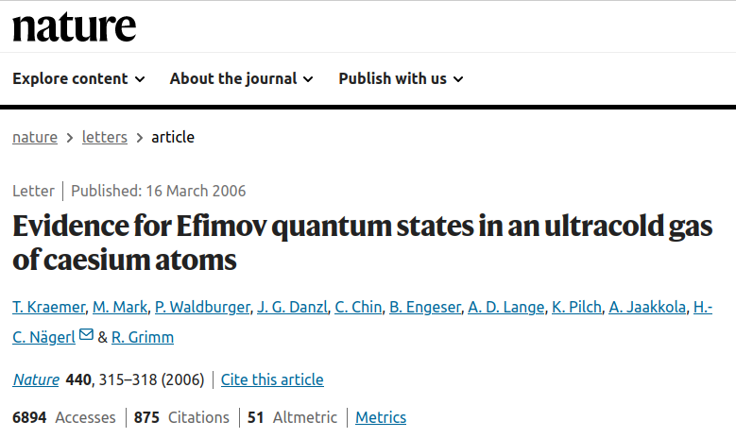
Evidence for Efimov states
Ultra-cold atomic gasses: Cesium, Helium,...

Slide 7
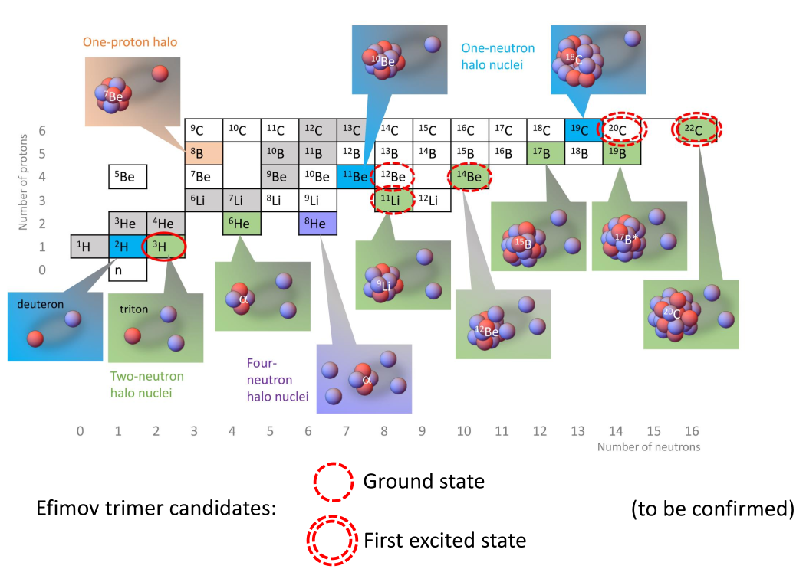
Evidence for Efimov states
Ultra-cold atomic gasses: Cesium, Helium,...
Halo nuclei: ¹⁴Be, ²²C, ²⁰C,...

Slide 8
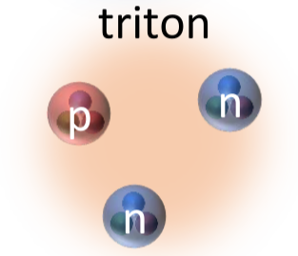
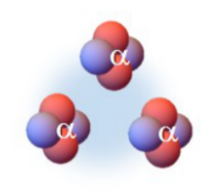
Evidence for Efimov states
Ultra-cold atomic gasses: Cesium, Helium,...
Halo nuclei: ¹⁴Be, ²²C, ²⁰C,...
Triton
3 α's Hoyle state of ¹²C

Slide 9
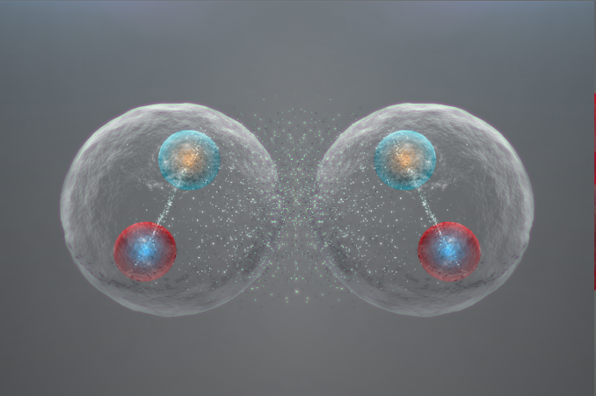
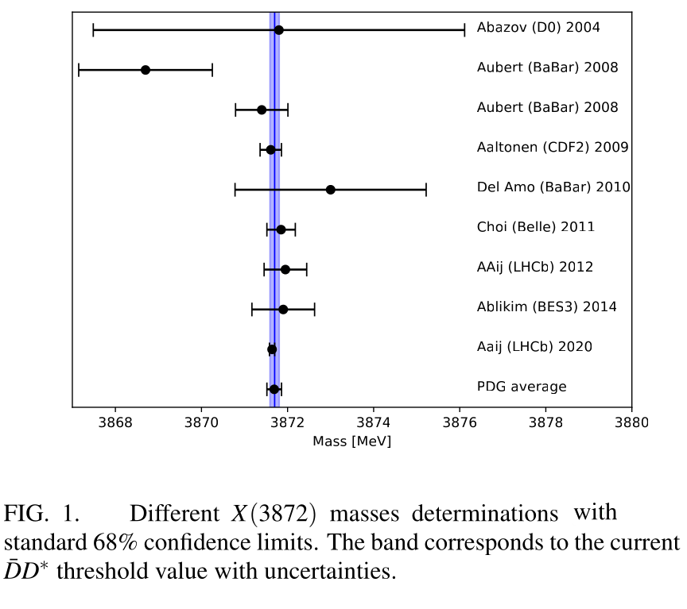
Evidence for Efimov states
Ultra-cold atomic gasses: Cesium, Helium,...
Halo nuclei: ¹⁴Be, ²²C, ²⁰C,...
Triton
3 α's Hoyle state of ¹²C
But, what about Hadronic Physics?
X(3872) best candidate up to now
J^{PC}=1⁺⁺ Shallow molecule B₂ ~ 0.05 MeV
interaction in S-wave
However, Efimov effect is excluded for the X(3872)
(E. Braaten, PRD69 (2004) 074005)

Slide 10
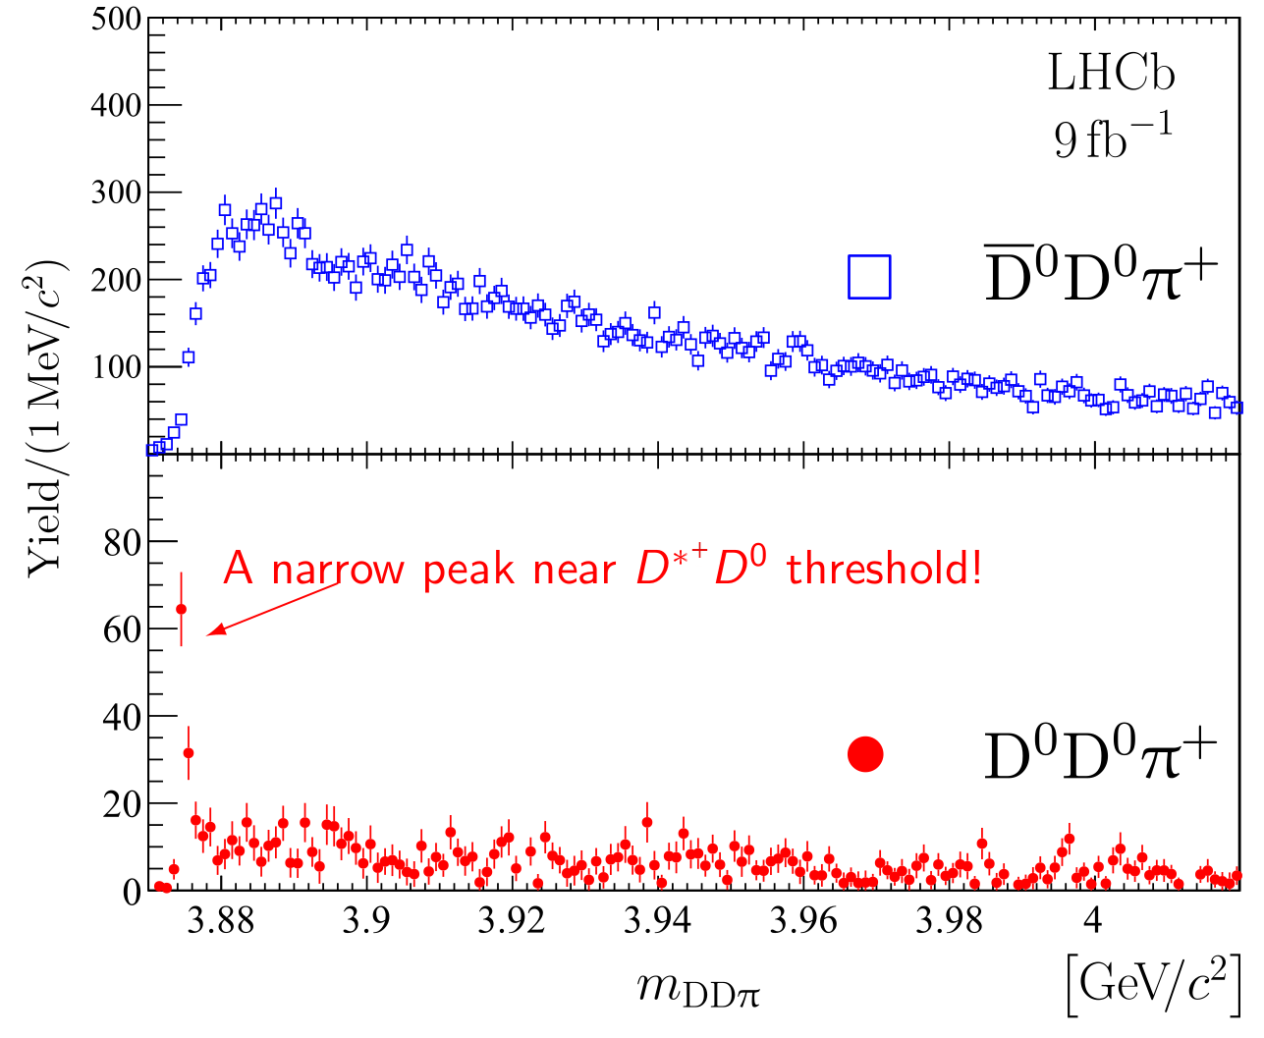
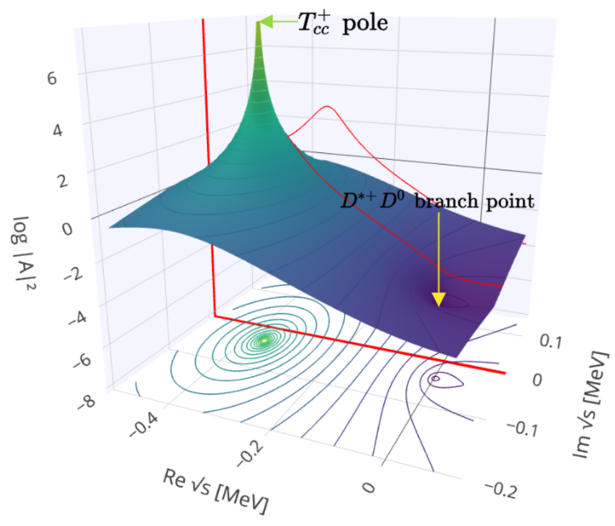
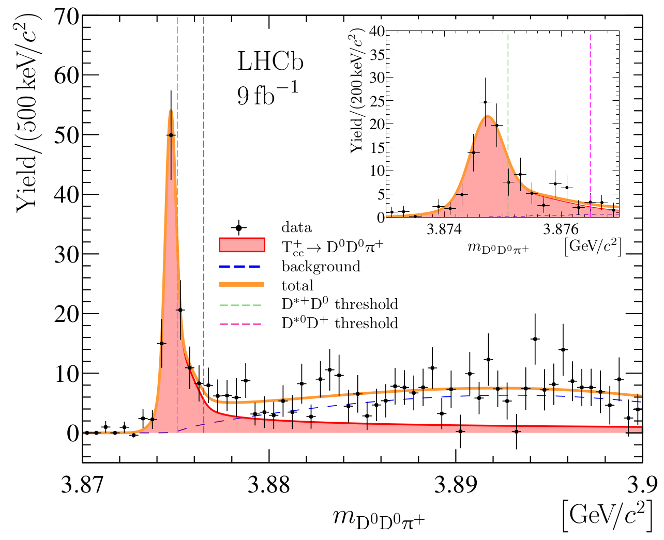
The landmark of 2021: Observation of T_{cc}⁺
J^{P}=1⁺ state decaying to DD* in S-wave
Isoscalar due to absence of signal in D⁰D⁺ and D⁺D⁰π⁺
No isospin violation in couplings to D*⁺D⁰ and D*⁰D⁺
​
Extremely narrow state, very close to threshold
Strong candidate for a pure DD* molecular state!
LHCb Coll, Nature Phys. 18 (2022), 751;
Nature Commun. 13 (2022) 3351.

Slide 11
Prediction of the T_{cc}* and D*D*D* system
Heavy-Quark Spin Symmetry predicts that the D*D* and DD* interactions in I(J^{P}) are related:
Then, if T_{cc} is a shallow DD* molecule, a heavy partner should exist in the D*D* system T_{cc}*
In this talk: Explore the universality of the D*D*D* systems in the J^{P}=0⁻ sector, with I=1/2
Identical bosons, simpler calculation
In J^{P}=0⁻ all D*D* pairs are in relative (I)J^{P}=(0)1⁺ Nearly-resonant attractive interactions
Conditions for the Efimov effect are met in this system!
Other works that have explored 3-body systems with charmed mesons:
DDD* state with ½(1⁻): T.-W. Wu et al, PRD105, L031505 (2022)
DD*D* and D*D*D* states: S.-Q. Luo et al, PRD105, 074033 (2022)
D*D*D* states: M. Bayar et al, Eur. Phys. J. C 83, 46 (2023)

Slide 12
Two-Body Interaction: The T_{cc}* state
Two-body amplitude from Bethe-Salpeter equation:
Two meson interaction:
(Montesinos:2023qbx)
Fixes the existence of a pole below the D*D* threshold, with variable composition:
For pure molecular state,
For pure compact state,
Relativistic two-meson loop function. Regularized via sharp cutoff Λ
B₂ : Two body binding energy
P : Molecular probability in the Tcc* state
Λ : Sharp cutoff for loop function
Parameters of the calculation:

Slide 13
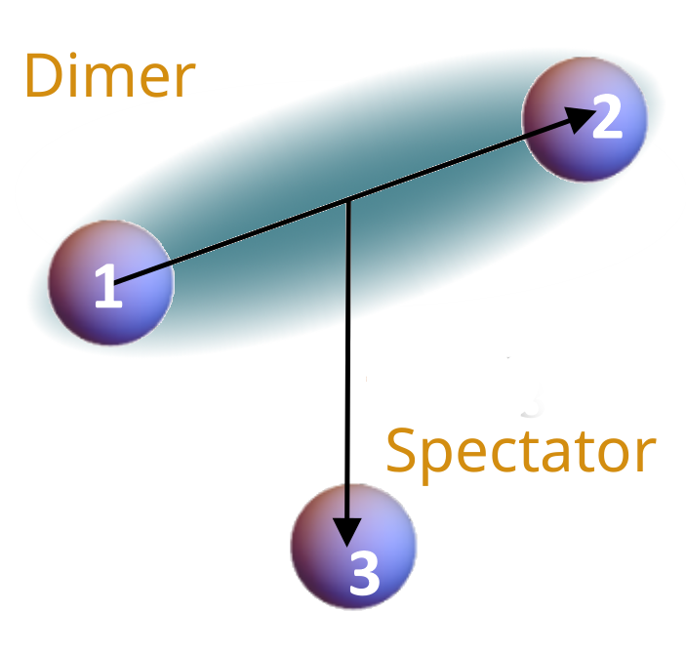
Three-Body Interaction: Ladder amplitude
0
Three-body amplitude from Ladder amplitude formalism:
K₃ contributions from short-range three-particle interactions
D ladder amplitude: Sum over all possible pairwise interactions connected through a sequence of one-particle exchanges
G long-range dimer-spectator interaction mediated by a particle exchange

Slide 14
Three-Body Interaction: Ladder amplitude
0
Three-body amplitude from Ladder amplitude formalism:
K₃ contributions from short-range three-particle interactions
D ladder amplitude: Sum over all possible pairwise interactions connected through a sequence of one-particle exchanges
G long-range dimer-spectator interaction mediated by a particle exchange
Long range despite short-range two-body interaction
Interaction of two particles mediated by a third one

Slide 15
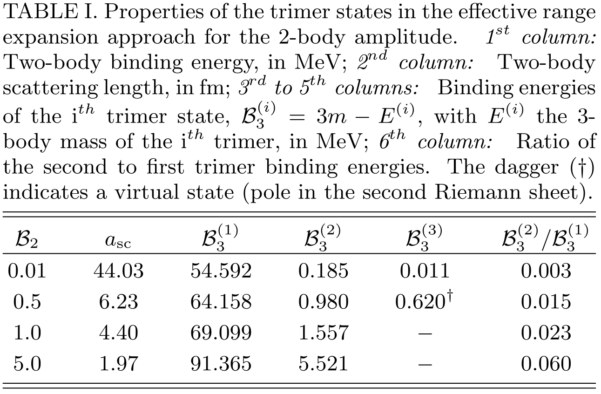
Results for effective range expansion
First simple study: Leading-order effective range expansion, that's it,
With
momentum of the particles in the dimer.
Phenomenology only depends on the D*D* scattering length
At least two trimers found for all B₂
Efimov effect can emerge in the D*D*D* system
Second to first trimer ratio approaches the resonant value of
for

Slide 16
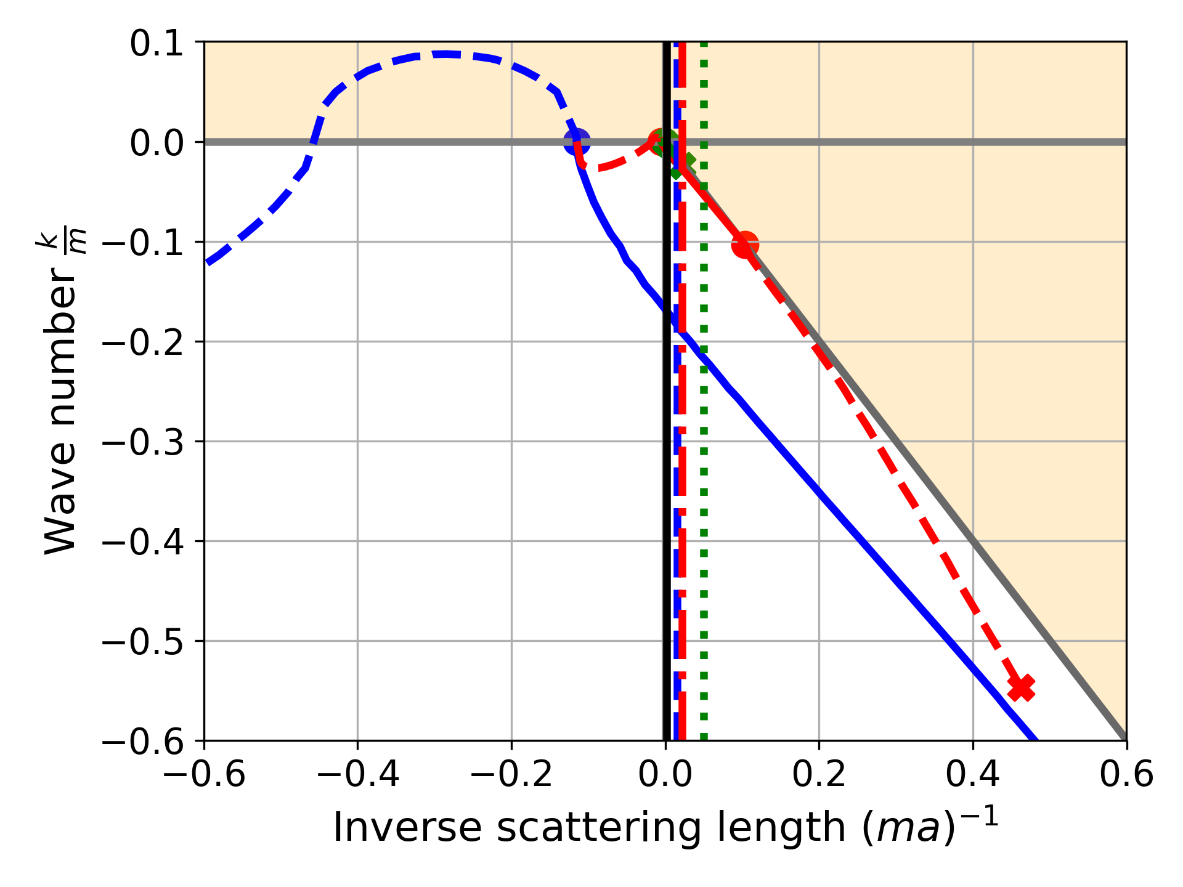
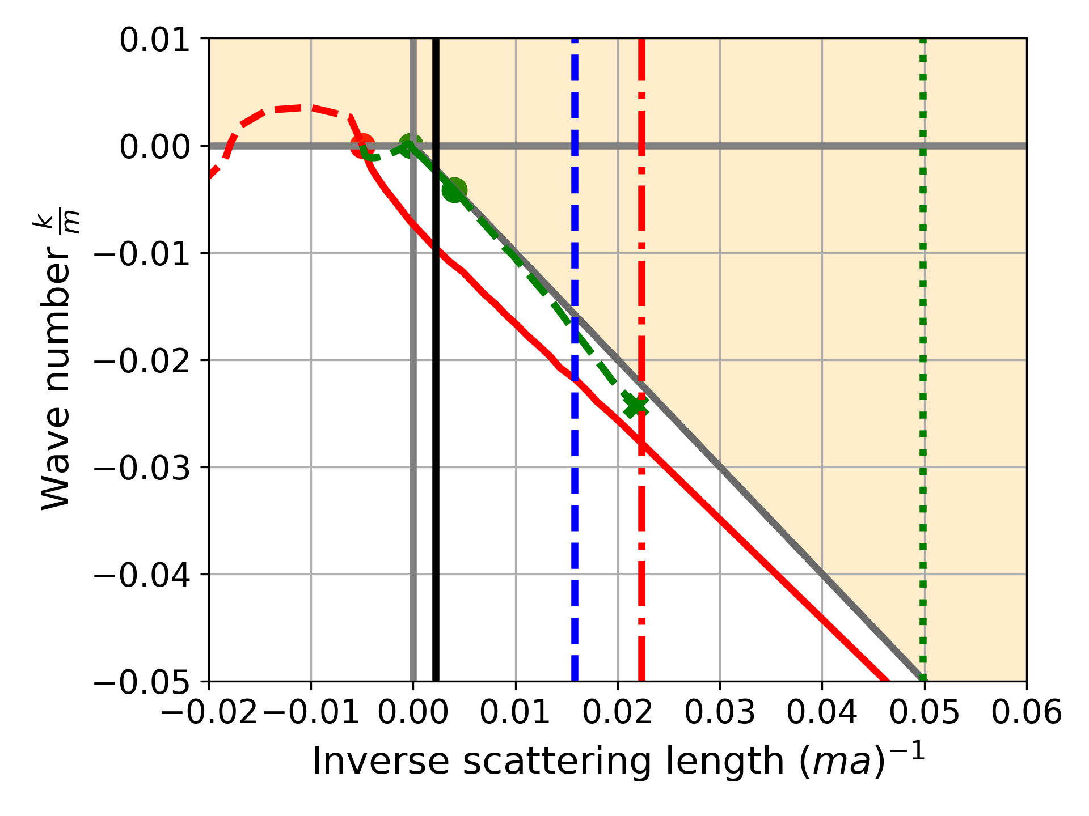
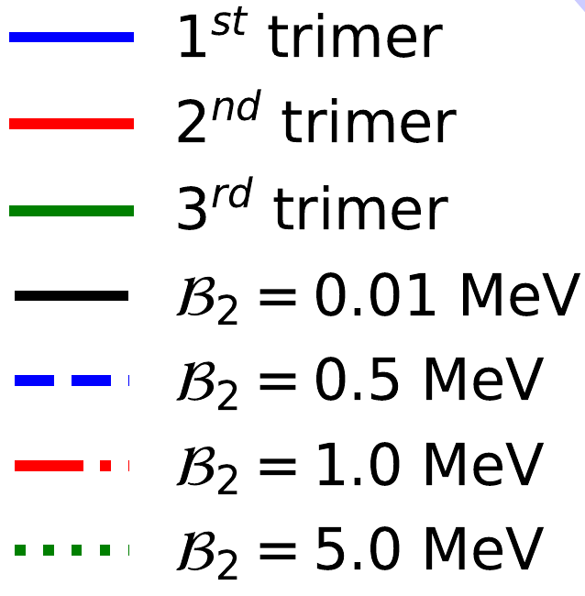
Results for effective range expansion
First simple study: Leading-order effective range expansion, that's it,
With momentum of the particles in the dimer.
Phenomenology only depends on the D*D* scattering length
At least two trimers found for all B₂
Efimov effect can emerge in the D*D*D* system
Second to first trimer ratio approaches the resonant value of
for

Slide 17
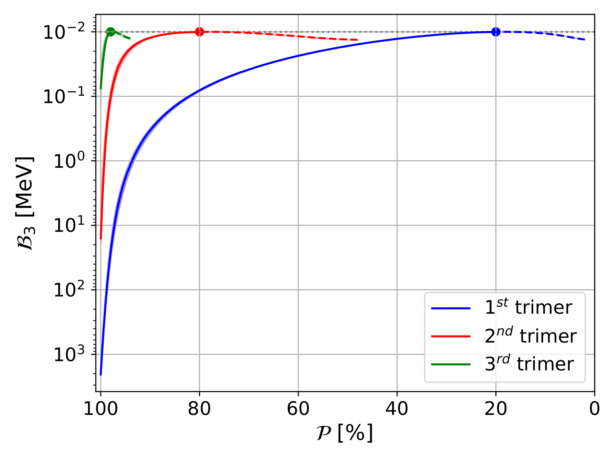
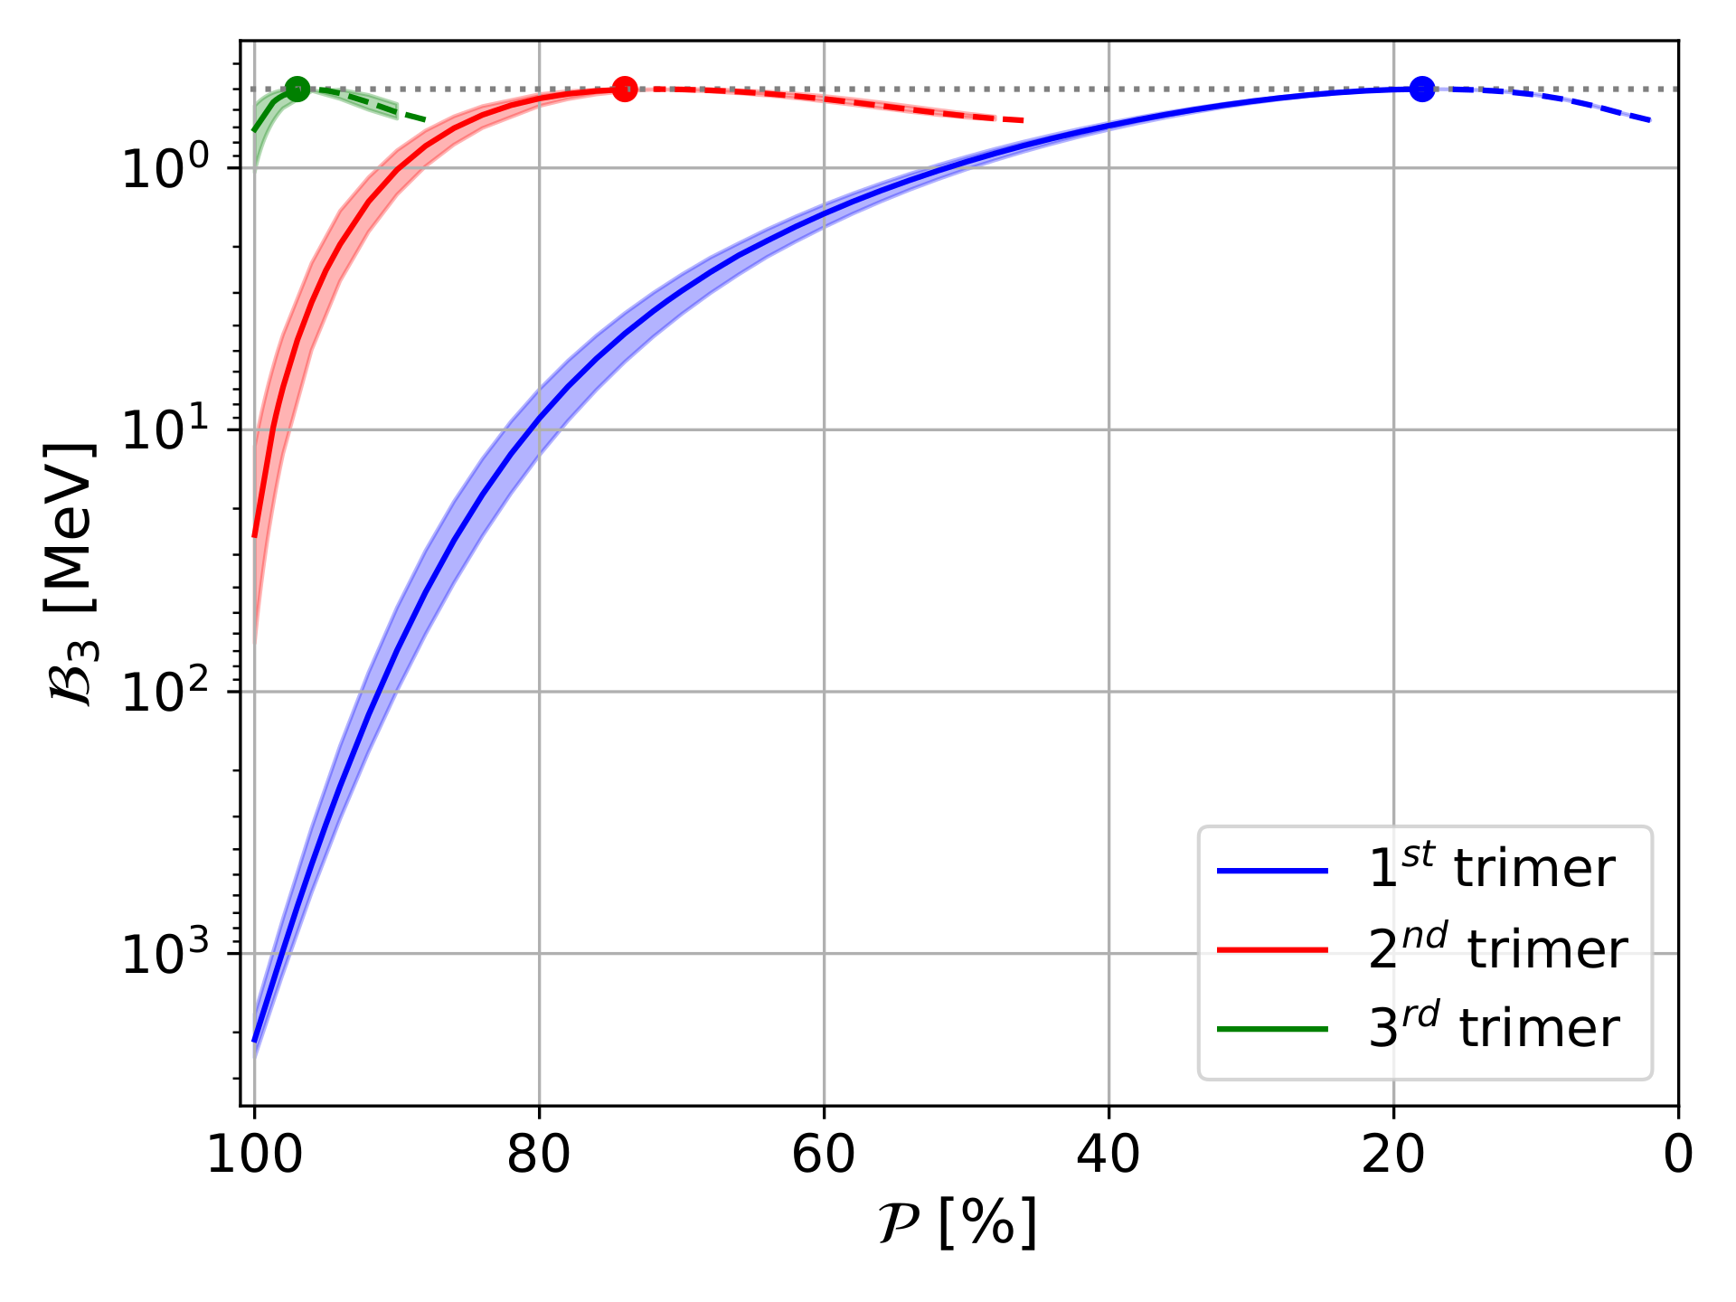
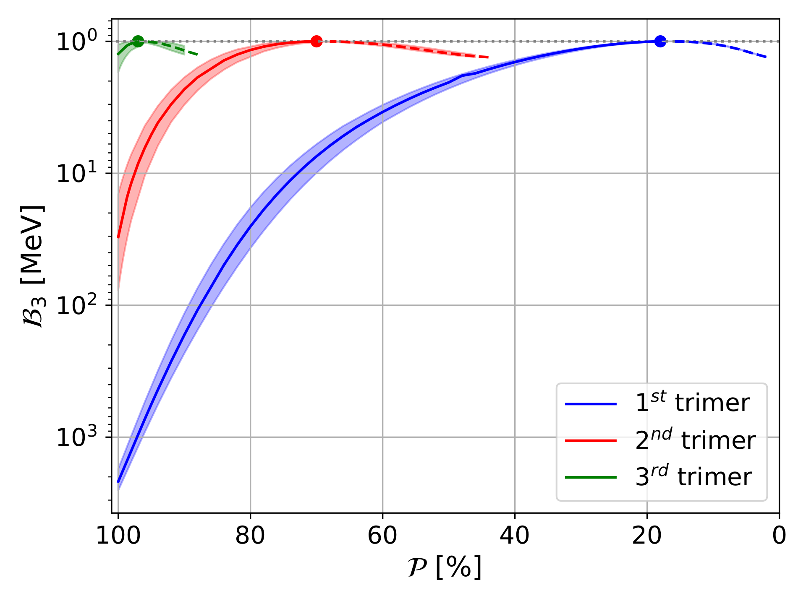
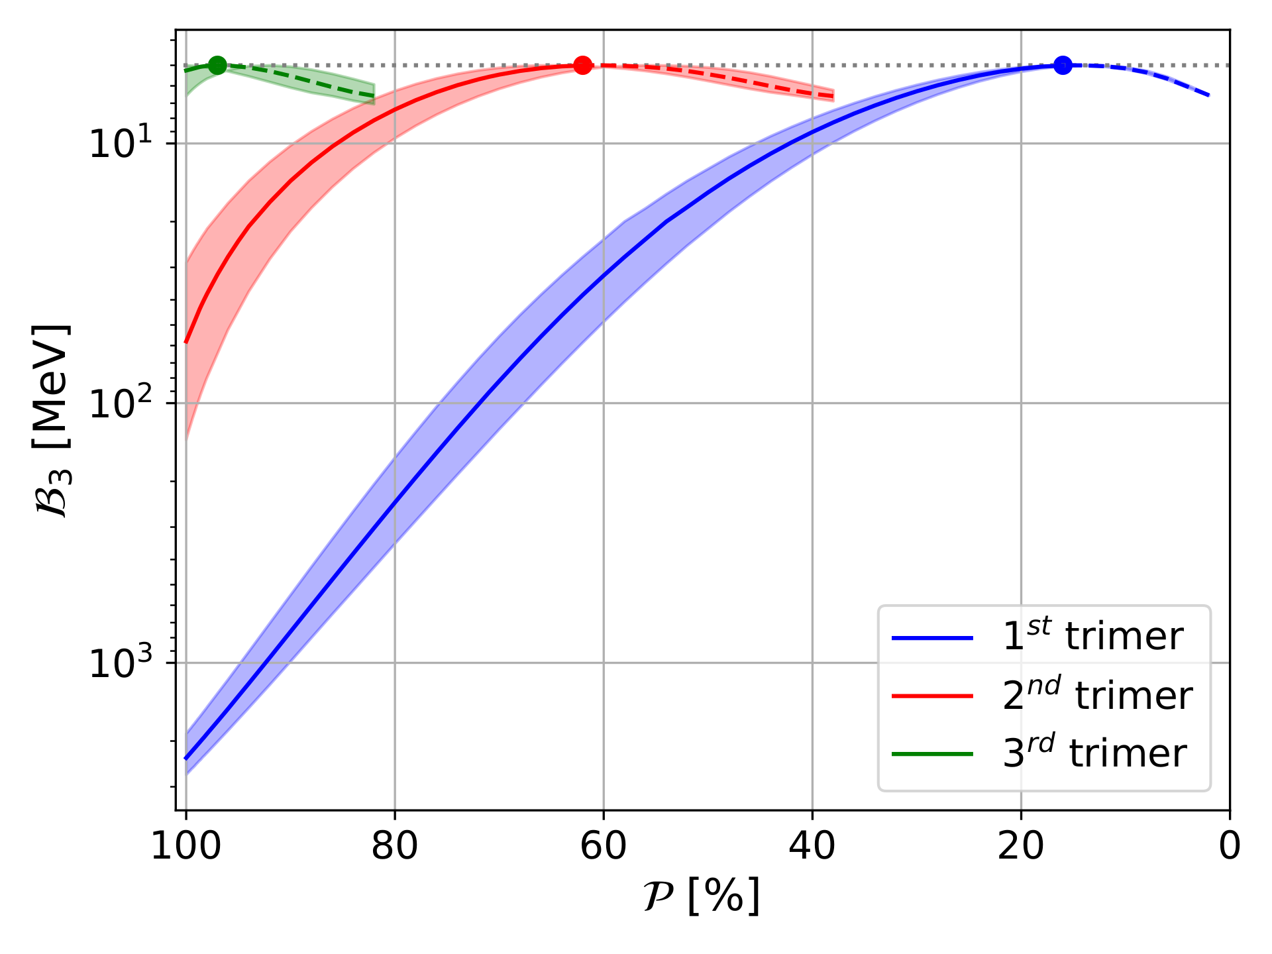
Trimer masses for full T₂
D*D*D* binding energies (B₃=3m-E₃) as a function of P.
P=100% : Pure molecular Tcc* state
P=0%: Pure compact Tcc* state
Central line: Λ = 0.7 GeV.
Shadow band: Λ = [0.5,1] GeV
Solid lines: Bound states.
Dashed lines: Virtual states
Dots: Riemann sheet change

Slide 18
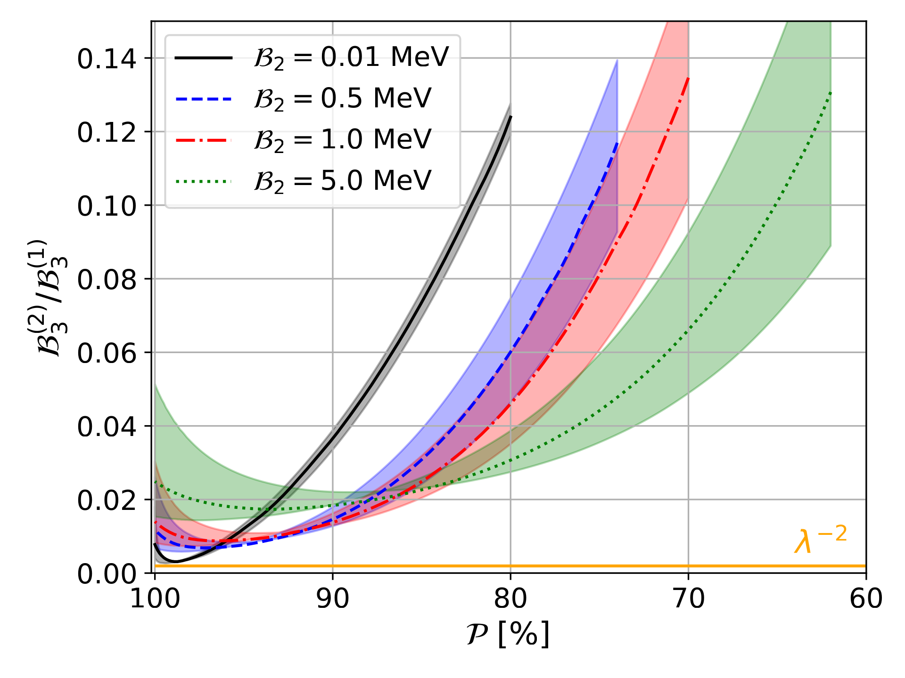
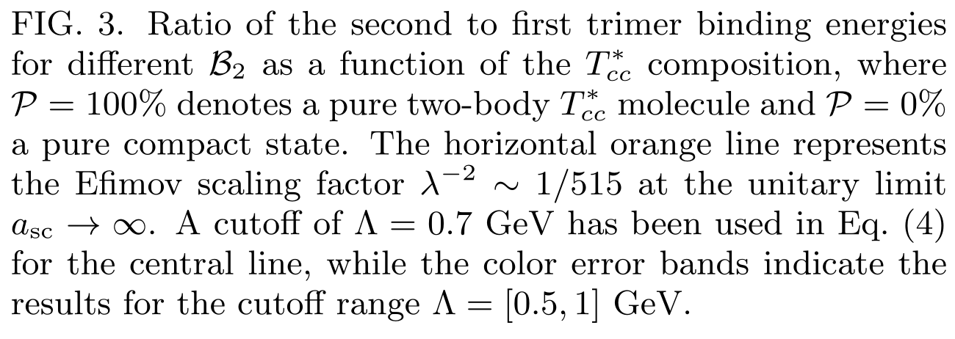
Second to first trimer ratio
The ratio increases as T_{cc}* becomes more compact.
It shows a small valley that gets shallower as B₂ increases.
The bottom of this valley approaches the Efimov scaling law the smaller B₂
for

Slide 19
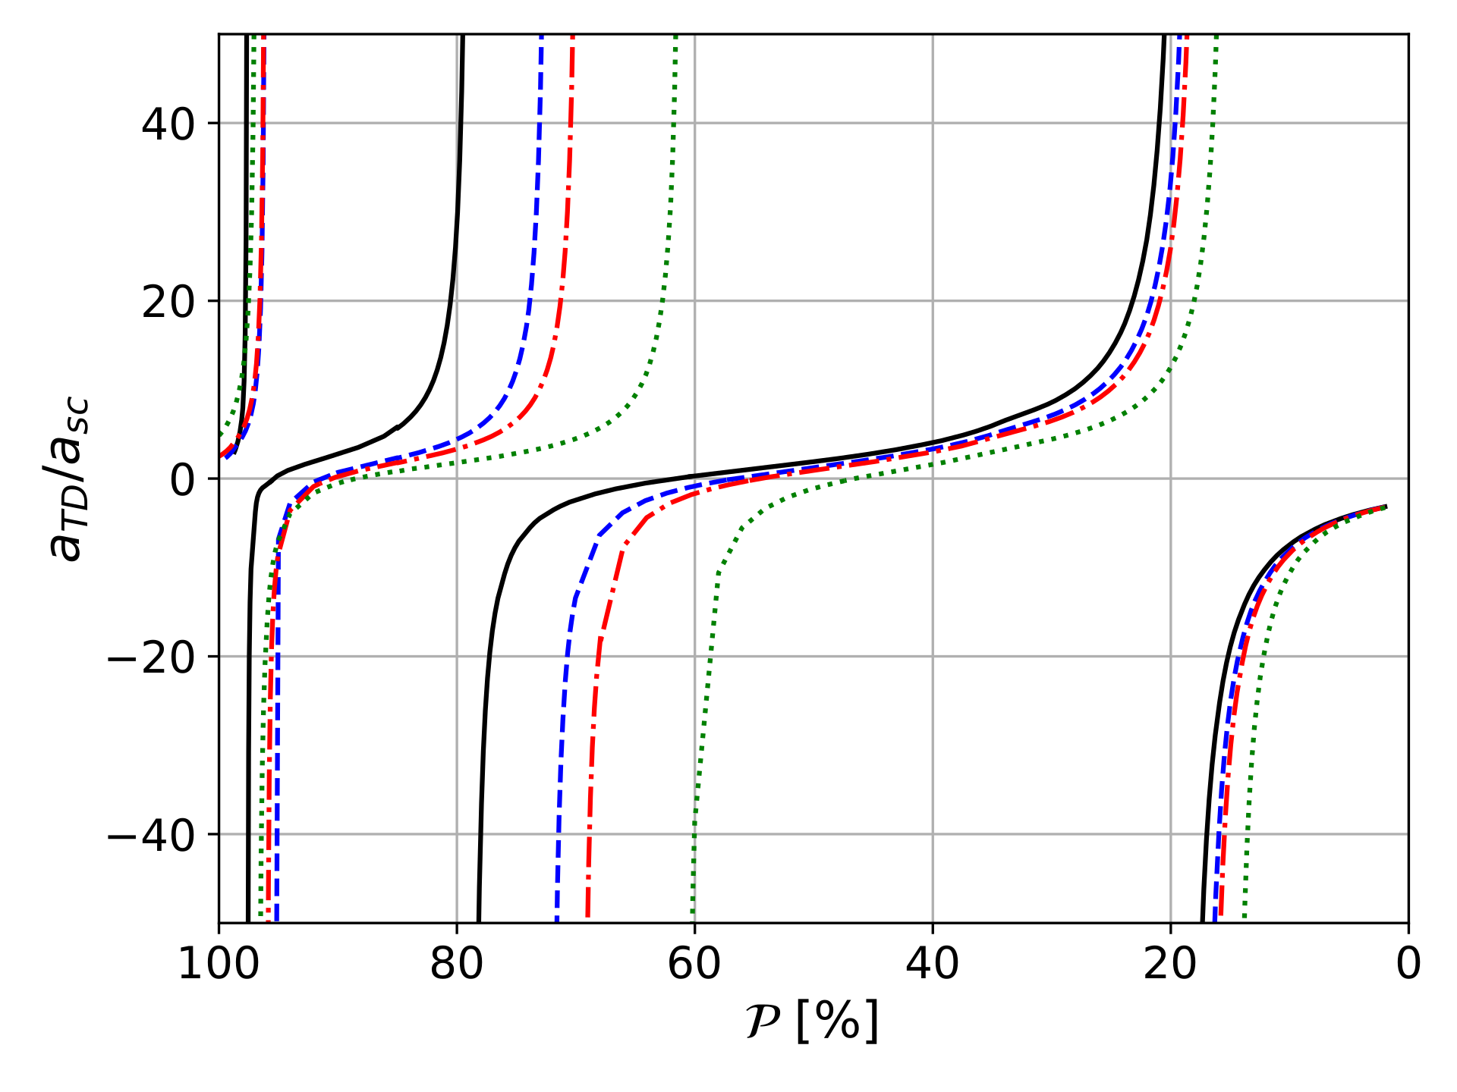
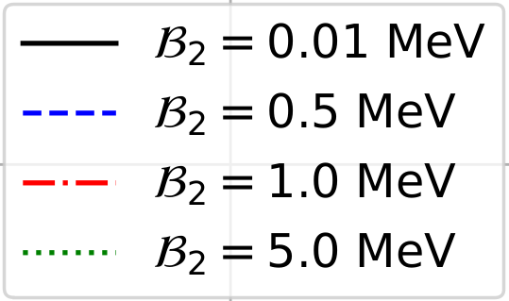
T_{cc}*-D* scattering
D has poles at the values of the dimer's energies equal to the T_{cc}* bound state.
The residue of the three-body amplitude is proportional to the dimer-spectator amplitude M_{TD}
The T_{cc}*-D* scattering length a_{TD} can help to discover the shallowest trimers

Slide 20
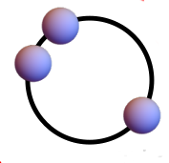
Summary
Analysis of the D*D*D* system in the (I)J^{P}=(½)0⁻ sector, assuming the T_{cc}* exists
Efimov effect can emerge Up to three trimers can be formed, depending on P and B₂
The shallowest state can be seen in the T_{cc}*D* scattering

Slide 21
THANKS FOR YOUR ATTENTION!

Slide 22
Backup slides

Slide 23
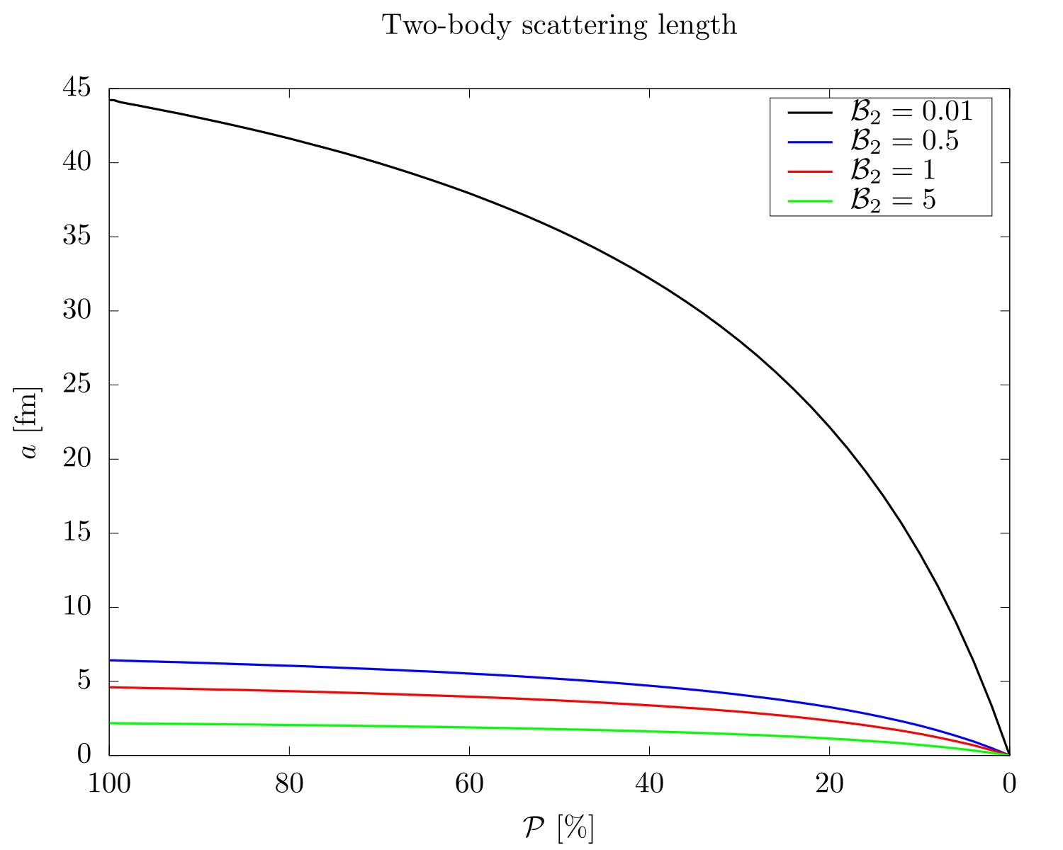
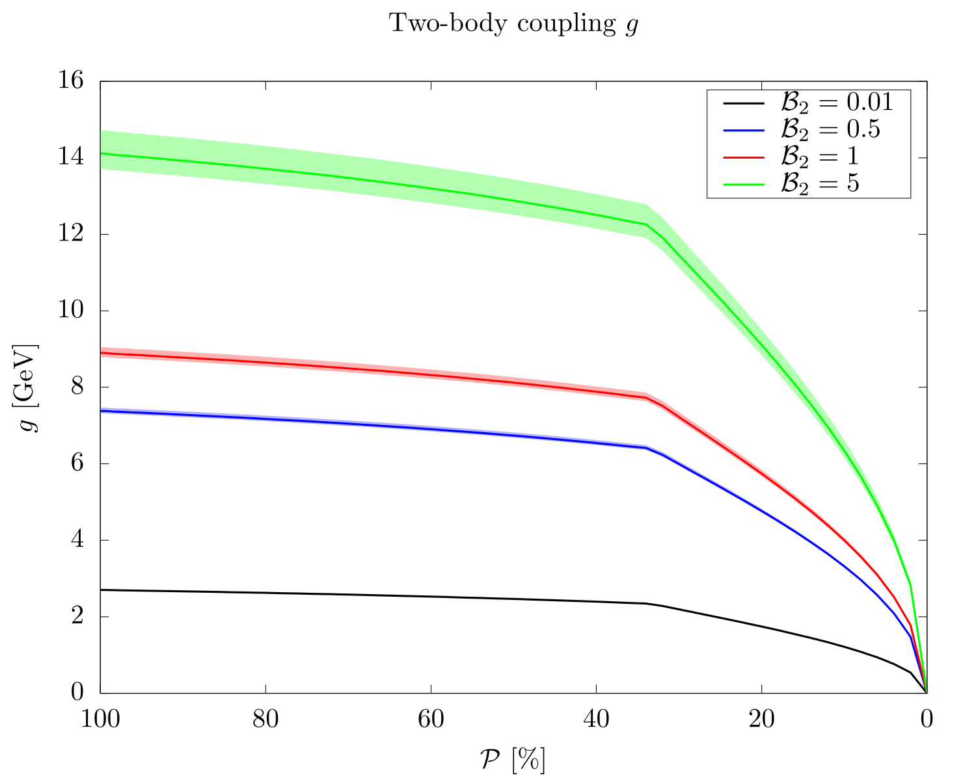
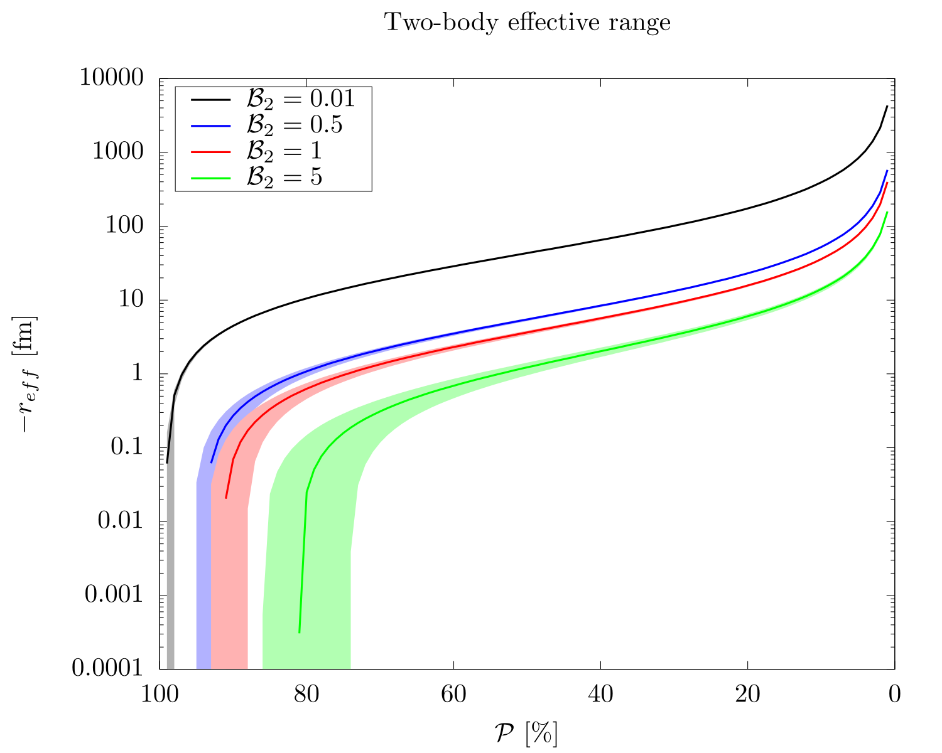
Two-body state properties
Weinberg’s compositeness:
Tcc* coupling to D*D* (g) and scattering length (a) drop to cero for P 0
Shallow bound states with purely attractive potential gives r_{eff} > 0
The effective range is mostly negative, but for P 1
Usual when a compact component is present
LHCb measured a non-positive r for Tcc with an upper limit (LHCb:2021auc):
And a Weinberg factor (Z=1-P) and coupling:

Slide 24
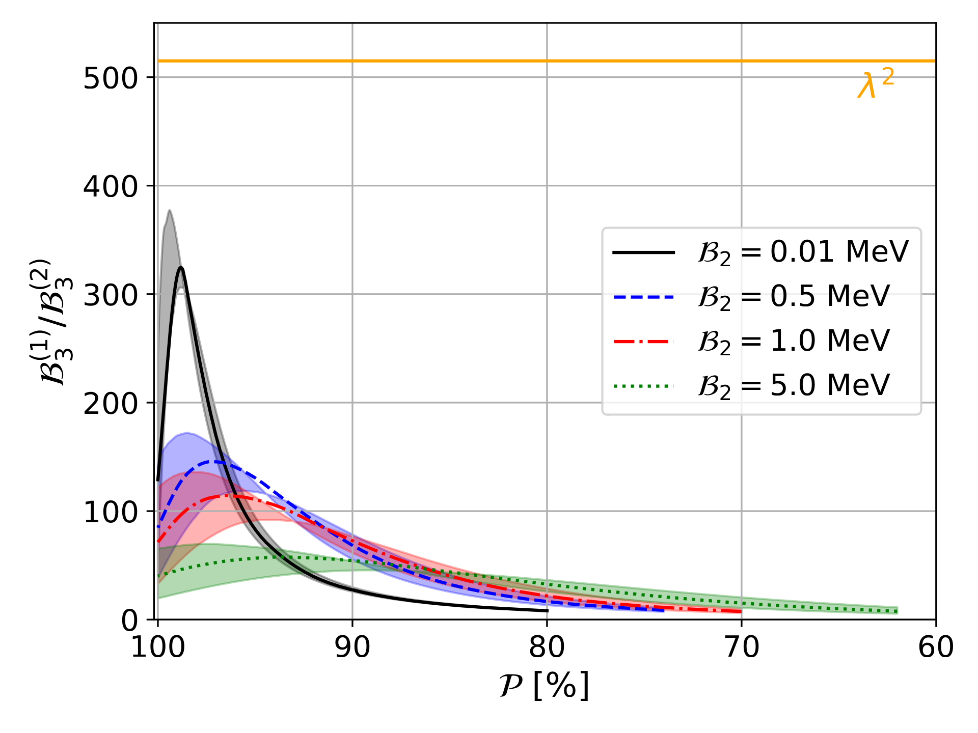
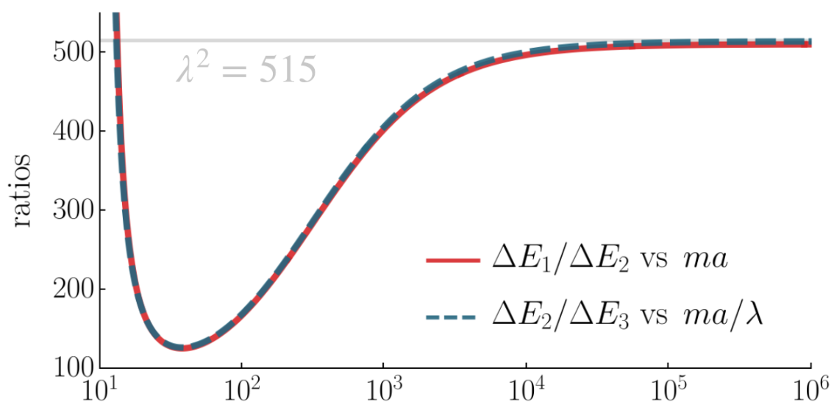
Discrete scale invariance
But only in the resonant limit
Scaling law predicts
For finite binding energies the scaling is reduced.
This also happens in the zero-range theory
Ratios of binding energies vs ma (x-axis). Dawid:2023kxu

Slide 25
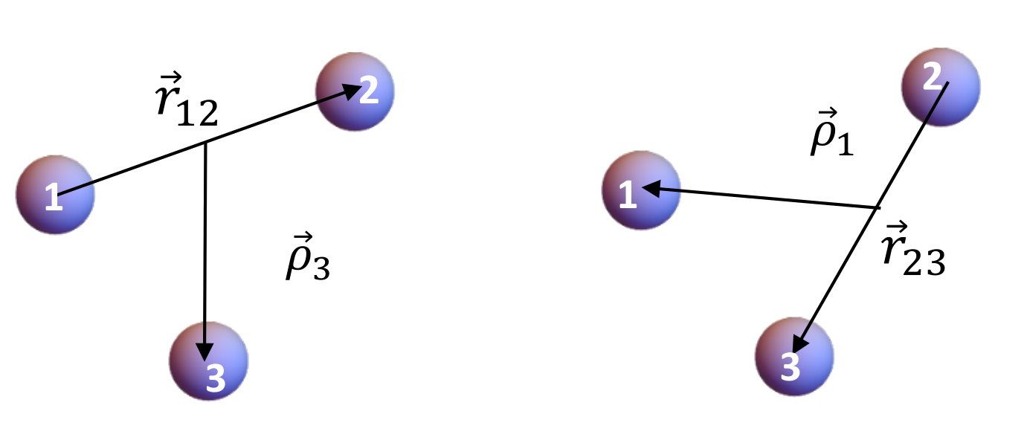
Why D*D*D* in (I)J^{P}=(½)0⁻ sector?
Three possible resonant pairs: Three identical bosons
D*D* wave function totally symmetric
J=0 implies s₁₂=1_{A} necessarily Needs t₁₂=0_{A} , so I=½.
If we rotate the coordinate system (12)3 (23)1 , then, the |I,J>₂₃ state is
0

Slide 26
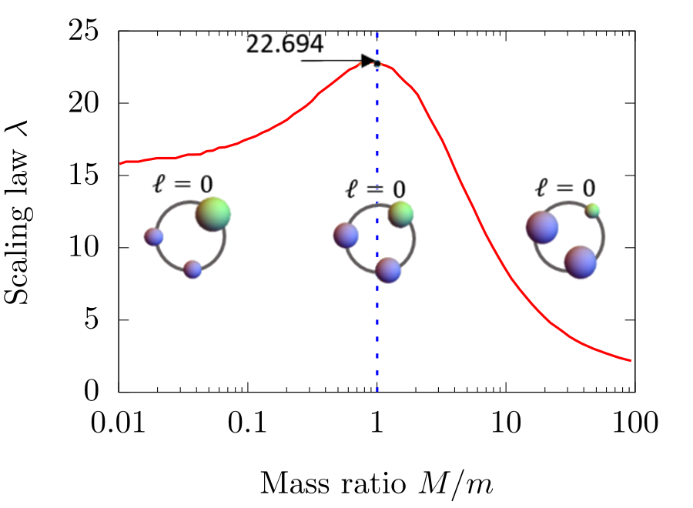
Possible in DD*D* in (I)J^{P}=(½)1⁻ sector?
Three possible resonant pairs: Two identical bosons plus one.
M/m ~1.08 Scaling law ~22.7 again
Possible Efimov states in T_{cc}D* - T_{cc}*D system?
J=1 implies s₁₂=1_{A} for D*D* Needs t₁₂=0_{A} , so I=½.
If we rotate the coordinate system (12)3 (23)1 , then, the |I,J>₂₃ state is
It can mix with a non-resonant repulsive pair... Similar to the triton case? Dependence on the scattering length of DD* for I=1

Slide 27
DD*-D*D* coupling
The DD*-D*D* coupling is ignored It can be modeled as a source of width for the T_{cc}* and
the D*D*D* trimers (Dai:2021vgf, Bayar:2022bnc, Luo:2021ggs)
This coupling reduces as B₂ tends to zero D*D* component dominates at threshold.
Small effect expected Estimated total T_{cc}* width including DD* and D*π rescatterings: (Jia:2022qwr)
For the same reason, the D* width is neglected Small contribution to T_{cc}* width and small correction to OPE

Slide 28
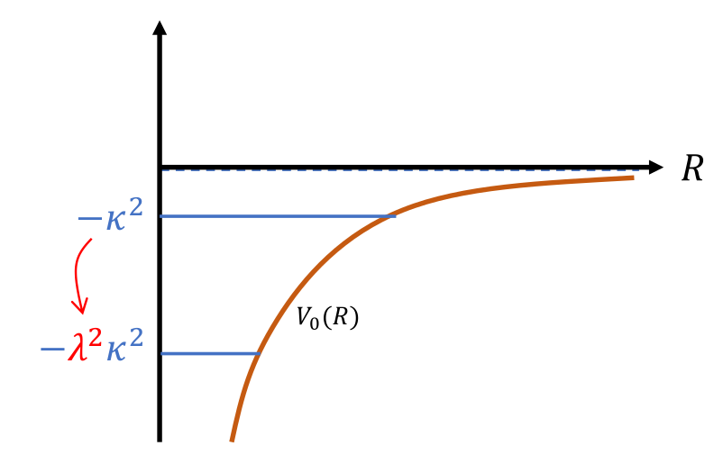
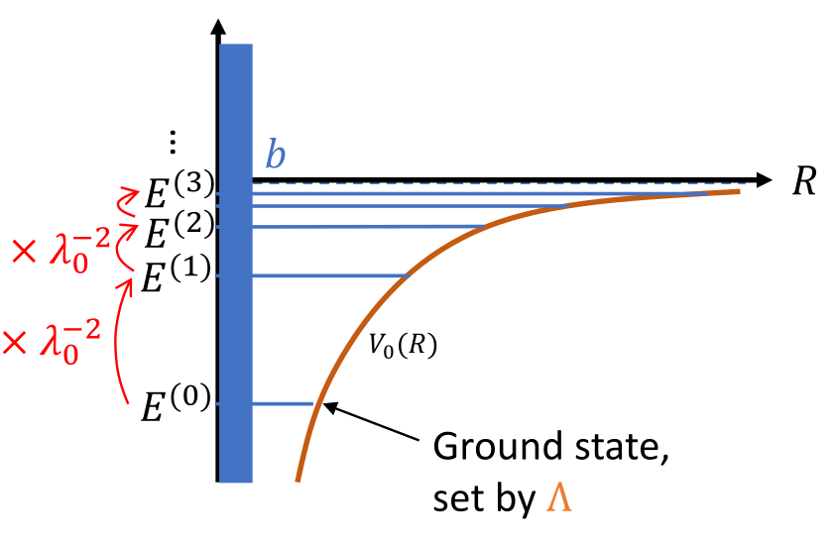
Three-body forces
We make explicit use of K₃=0
No fundamental short-range 3b forces included
Clean cancellation between the off-shell parts of the T₂ and three-body forces in chiral Lagrangians (MartinezTorres:2008gy,Khemchandani:2008rk)
But there is a three-body parameter induced from the two-body interaction Λ and P
Provides a non-zero range for the two-body interaction and modifies the energy of the first trimer.
Prevents the Thomas collapse Infinitely close 3 particles with infinite binding energy in zero-range theory

Slide 29
Higher partial waves
Only S-wave interactions are considered for the two-body and particle-dimer system
The proximity of the T_{cc}* to the D*D* threshold suppresses partial waves L>0 in the dimer.
The dominance of S-wave in the dimer also suppress higher partial waves in the particle-dimer system
Same approach taken in, e.g., Bayar:2022bnc and Luo:2021ggs for the study of D*D*D*
l₁₂ | L₃ | L | t₁₂ | s₁₂ | S
0 | 0 | 0 | 0 | 1 | 0
0 | 2 | 2 | 0 | 1 | 2
0 | 2 | 2 | 1 | 2 | 2
2 | 0 | 2 | 0 | 1 | 2
2 | 0 | 2 | 1 | 2 | 2
Luo:2021ggs studied D*D*D* for all L≤2 configurations
"Turning on the S-D mixing only has a small effect but, in general, slightly increases the binding energy of the system of interest (for the same cutoff)."

Slide 30
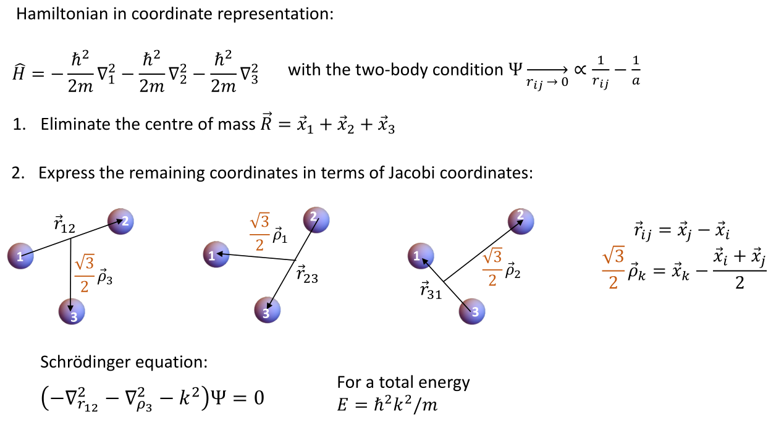
Derivation for three identical bosons
From P. Naidon, RIKEN

Slide 31
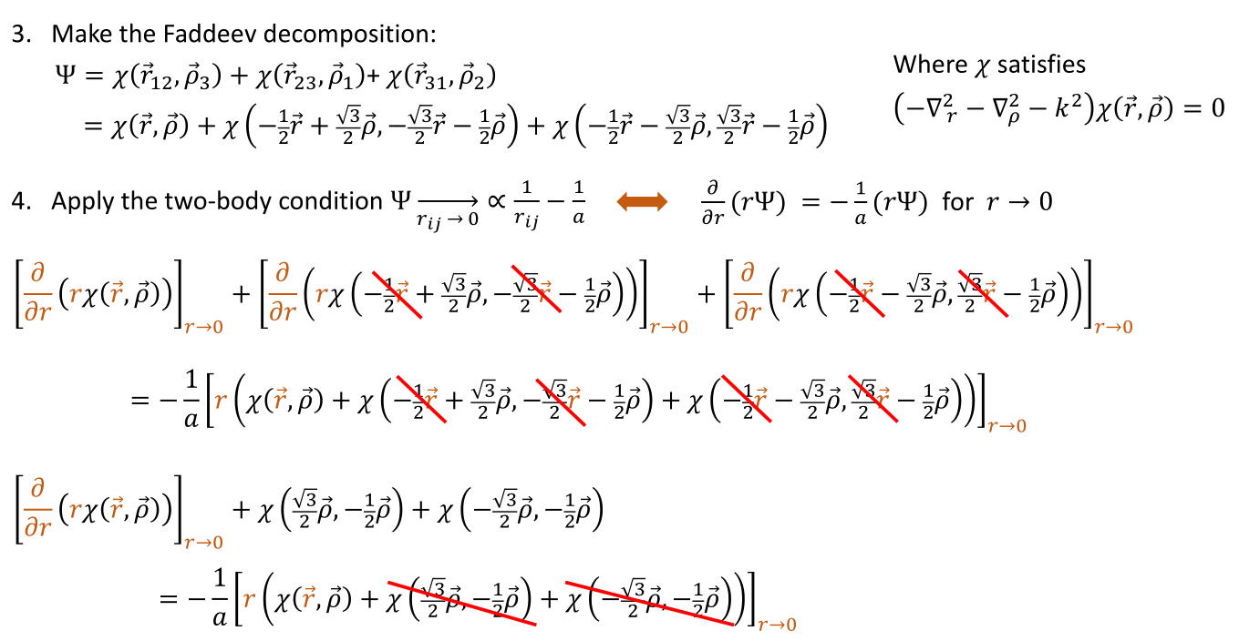
Derivation for three identical bosons

Slide 32
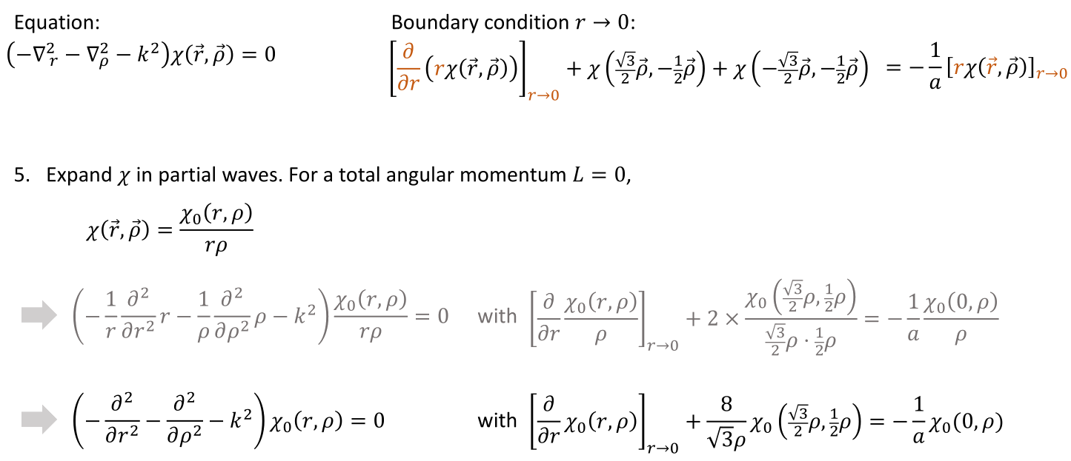
Derivation for three identical bosons

Slide 33
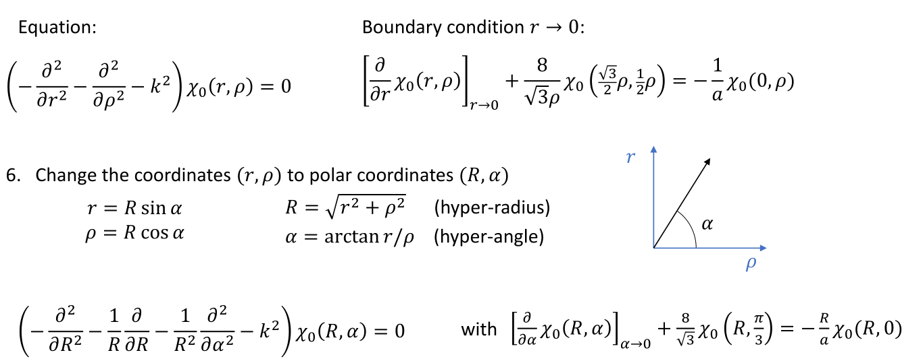
Derivation for three identical bosons

Slide 34
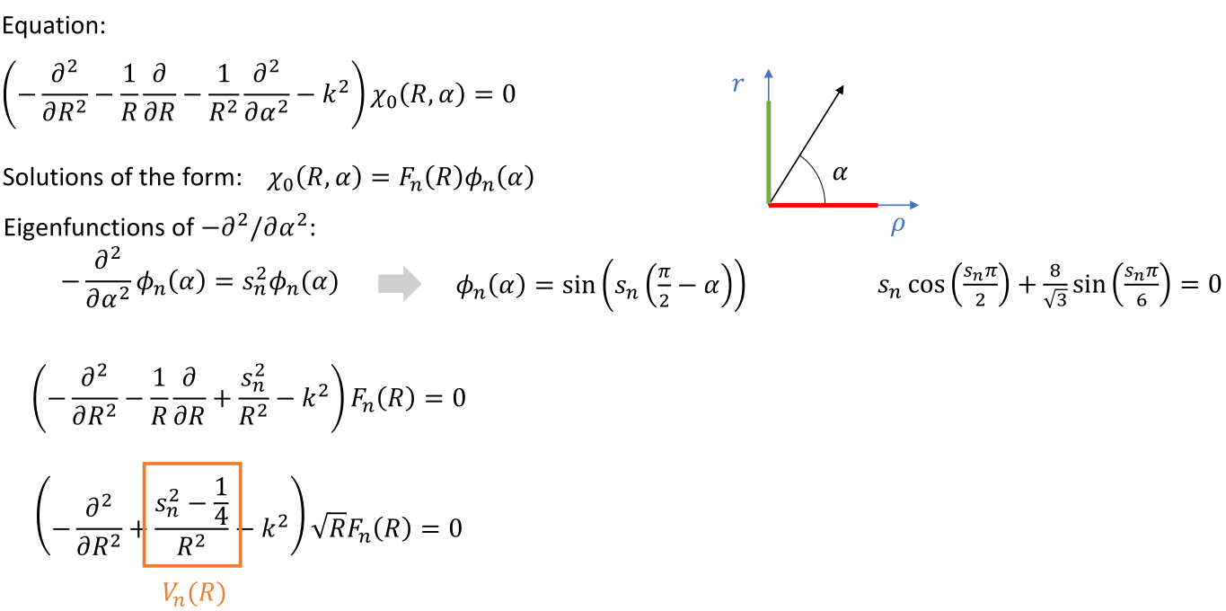
Derivation for three identical bosons

Slide 35
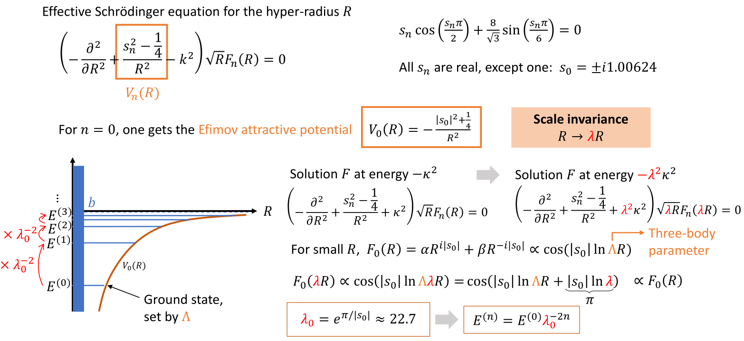
Derivation for three identical bosons

