Slide 1
Experimental Status of η Decays
Liping Gan
University of North Carolina Wilmington
Outline
Overview of η and ηꞌ Physics
JLab Eta Factory (JEF) experiment and status
Other new opportunities in the horizon
Summary

Slide 2
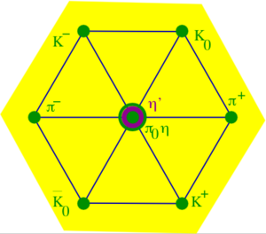

Why η is a unique probe for QCD and BSM physics?
A Goldstone boson due to spontaneous breaking of
QCD chiral symmetry
η is one of key mesons bridging our
understanding of low-energy hadron dynamics
and underlying QCD
All its possible strong and EM decays are forbidden in the lowest order so that η has narrow decay width (Γ_{η} =1.3KeV compared to Γ_{ω}=8.5 MeV)
    Enhance the higher order contributions (by a factor of ~7000
    compared to ω decays). Sensitive to weakly interacting forces.
Eigenstate of P, C, CP, and G:
tests for C, CP
Its quantum numbers are the same as Higgs or vacuum (except parity) and its decays are flavor-conserving
effectively free of SM backgrounds for new physics search.

Slide 3
Rich η (and ηꞌ) Physics
Standard Model Tests:
Chiral symmetry and anomalies
Extract η-ηꞌ mixing angle and quark mass ratio
Theory inputs to HLbL for (g-2)_{μ}
QCD scalar dynamics
Fundamental Symmetry Tests:
C, CP violations
P, CP violations
Lepton flavor violations
BSM Physics in Dark Sector:
Vector bosons (B boson, dark photon and X boson)
Dark scalars
Pseudoscalars (ALPs)
BSM weak decays
Phys. Rept. 945 (2022) 1-105

Slide 4
Low-Energy QCD Symmetries and Light Mesons
QCD Lagrangian in Chiral limit (m_{q}→0) is invariant under:
Chiral symmetry SU_{L}(3)xSU_{R}(3) spontaneously breaks to SU(3)
  8 Goldstone Bosons (GB)
U_{A}(1) is explicitly broken:
(Chiral anomalies)
  Γ(π⁰→γγ), Γ(η→γγ), Γ(η′→γγ)
  Non-zero mass of η₀
SU_{L}(3)xSU_{R}(3) and SU(3) are explicitly broken:
  GB are massive
  Mixing of π⁰, η, η′
  The π⁰, η, η′ system provides a rich laboratory to study the symmetry structure of QCD at low energies.

Slide 5
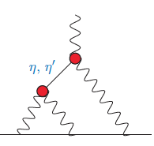

Transition Form Factor and ${(g−2)}_{μ}$
HLbL

Slide 6
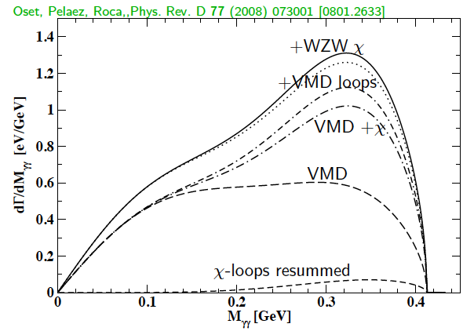
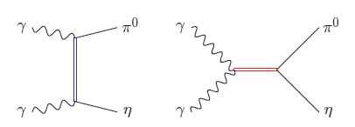
SM allowed η→π⁰γγ
A rare window to probe interplay of VMD & scalar resonances in ChPT to calculate O(p⁶) LEC’s in the chiral Lagrangian
The major contributions to η →π⁰γγ are two O(p⁶) counter-terms in the
chiral Lagrangian an unique probe for the high order ChPT.
L. Ametller, J, Bijnens, and F. Cornet, Phys. Lett., B276, 185 (1992)
Shape of Dalitz distribution is sensitive to the role of scalar resonances.
LEC’s are dominated by resonances
Gasser, Leutwyler 84; Ecler, Gasser, Pich, de Rafael1989; Donoghue, Ramirez, Valencia 1989
a₀, a₂
ρ, ω

Slide 7
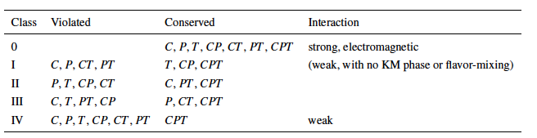
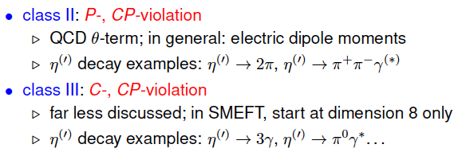
Discrete Symmetries
A new C- and T-violating, and P-conserving interaction was proposed by Bernstein, Feinberg and Lee Phys. Rev.,139, B1650 (1965) and Lee
Class III has much weaker experimental constraint, offer an opportunity for new physics search.

Slide 8
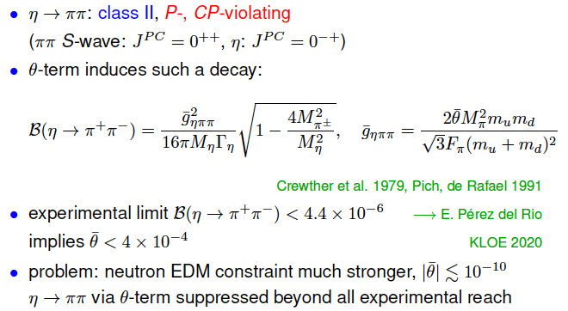
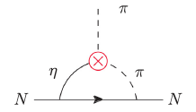

Class II: P-, CP-Violation in $η^{(′)}→ππ$

Slide 9


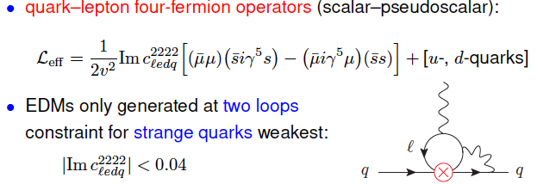
Class II: P-, CP-Violation via Strange-Quark-Muon Operators
Offer good opportunities for P-, CP-violation tests in the eta-sector.

Slide 10
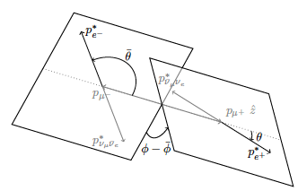

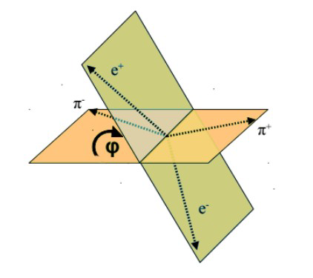
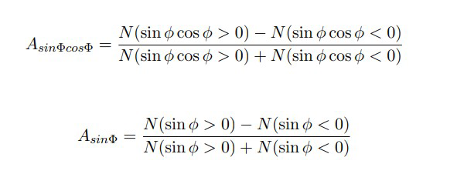



Class II: P-, CP-Violation via Scalar Operators (cont.)
$μ$-polarization asymmetry in $η^{(′)}→μ^{+}u^{−}$, $η^{(′)}→γμ^{+}u^{−}$, $η^{(′)}→π^{0}μ^{+}u^{−}$
JHEP 01, 031 (2019)
hep-ph/0202002
Angular asymmetry in decay planes:
$η^{(′)}→μ^{+}u^{−}e^{+}e^{−}$
$$η^{(′)}→π^{+}π^{−}e^{+}e^{−}$$

Slide 11
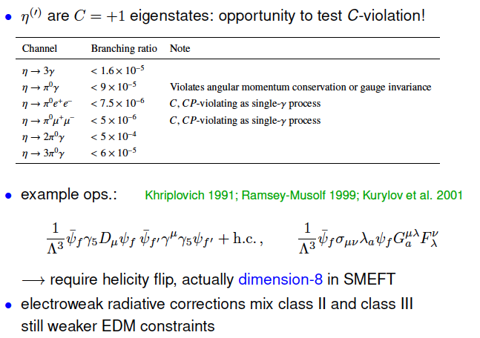
Class III: C- and CP-Violation

Slide 12

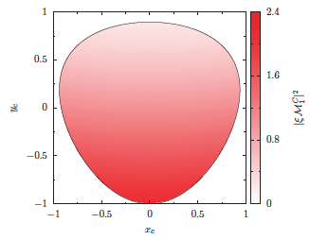
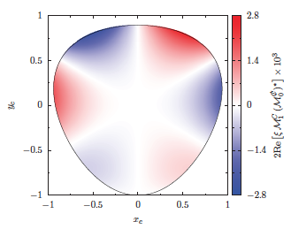
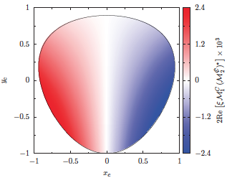
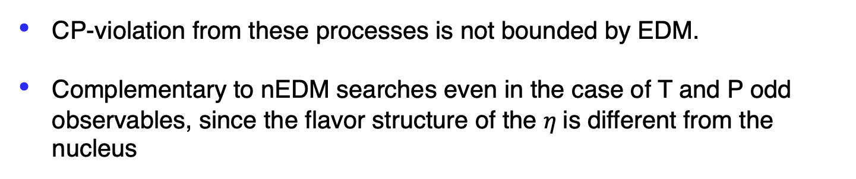
Class III: C- and CP-Violation in $η^{(′)}→π^{+}π^{−}π^{0}$, $η^{′}→π^{+}π^{−}η$
CP-violation from these processes is not bounded by EDM.
Complementary to nEDM searches even in the case of T and P odd observables, since the flavor structure of the $η$is different from the nucleus

Slide 13
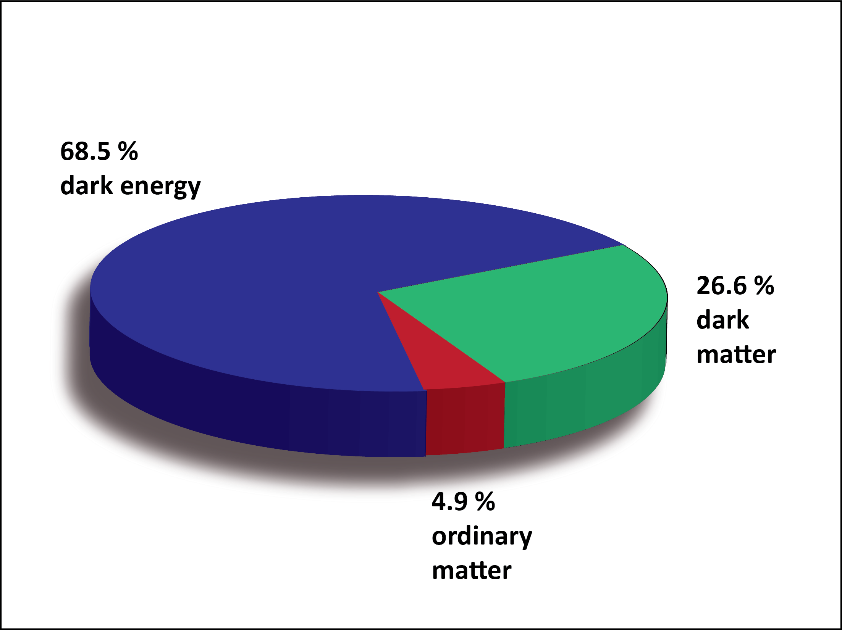
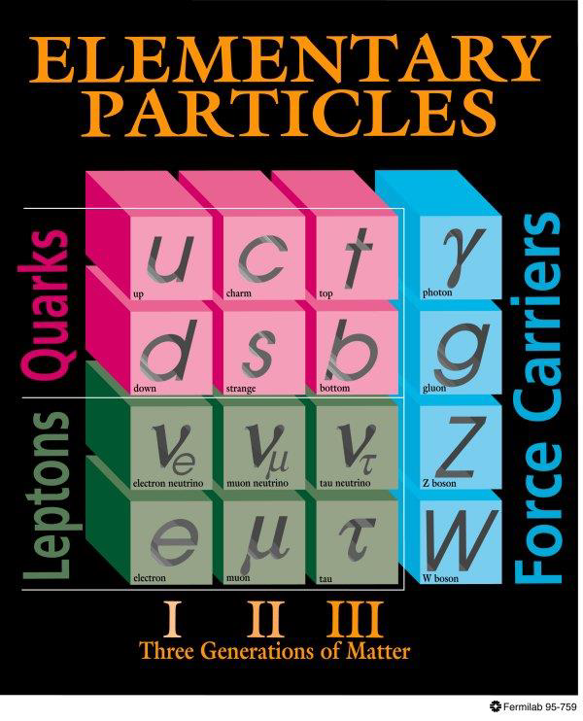
BSM Physics in Dark Sector
Dark Sector
New gauge forces, bosons and fermions beyond SM.
The stability of dark matter can be explained by the dark charge conservation.

Slide 14
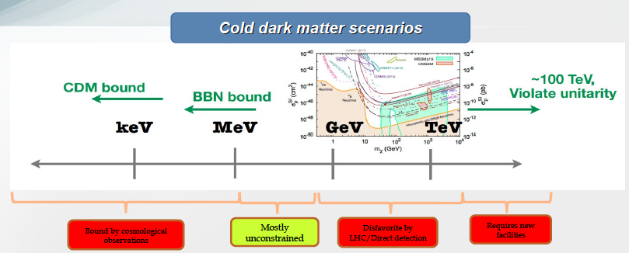
Where to Search for Dark Matter?
Sub-GeV region represents a good discovery opportunity

Slide 15
Landscape of BSM Physics Search
arXiv:1504.04855
η/ηꞌ
Complementary to other types of experiments, η/ηꞌ decays offer unique sensitivity for sub-GeV new physics that are flavor-conserving, light quark-coupling, PC-conserving.

Slide 16
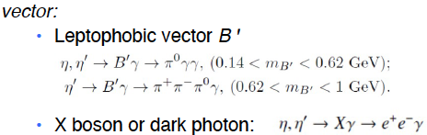


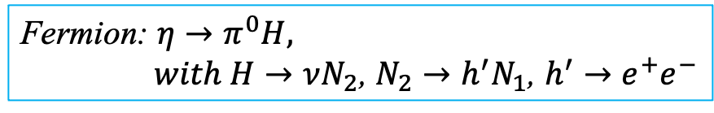
Portals Coupling SM and Dark Sector
Standard Model:
Dark Sector:
Gauge Interactions?
Dark matter?
Portals:
vector
Scalar
Fermion
ALP
Fermion: $η→π^{0}H,$
$with H→νN_{2}$, $N_{2}→h^{′}N_{1}$, $h^{′}→e^{+}e^{−}$
Phys. Rept. 945 (2022) 1-105, arXiv:2207.06905, arXiv:2203.07651

Slide 17
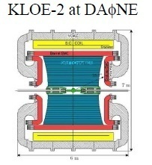
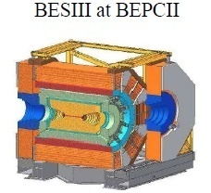
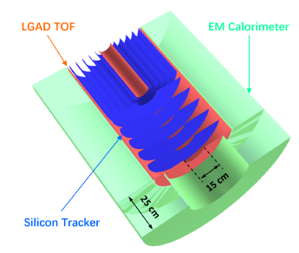
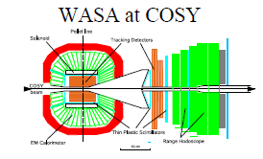
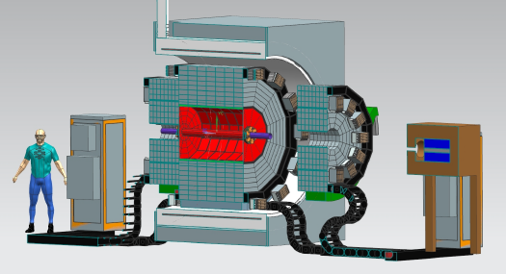
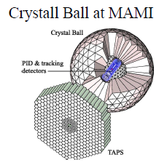
Global Experimental Efforts in η Decays
Low-energy
e⁺e⁻ Collider
Proposed eta@HIAF
Proposed REDTOP
Fixed-target
hadroproduction
High-energy
CBELSA/TAPS at ELSA
JEF at JLab
Photoproduction

Slide 18
JLab Eta Factory (JEF) Experiment
FCAL-II
Simultaneously produce η/ηꞌ on LH₂ target with 8.4-11.7 GeV tagged photon beam via γ+p → η/ηꞌ+p
Reduce non-coplanar backgrounds by detecting recoil protons with GlueX detector
Upgraded Forward Calorimeter with High resolution, high granularity
PbWO₄ insertion (FCAL-II) to detect multi-photons from the η/ηꞌ decays
The GlueX detector will detect the charged products from the η/ηꞌ decays
18

Slide 19
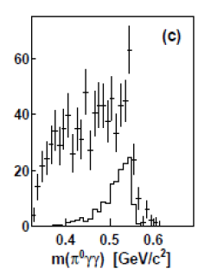
Uniqueness of JEF Experiment
Two-orders of magnitude background suppression comparing to the other experiments in rare neutral decays:
a) η/η’ energy boost; b) FCAL-II; c) recoil detections
A2 at MAMI: γp→ηp (E_{γ}=1.5 GeV)
(P.R. C90, 025206)
JEF: γp→ηp (E_{γ}=8.4-11.7 GeV)
Signal+backgrounds
η→π⁰γγ signal
η →π⁰π⁰π⁰ background
other backgrounds
η →π⁰π⁰π⁰
other backgrounds
1 day’s running
2. Capability of running in parallel with GlueX and other experiments in Hall D
potential for a high-statistics data set
3. Simultaneously produce tagged η and ηꞌ with similar rates
(~5x10⁵ per day)

Slide 20
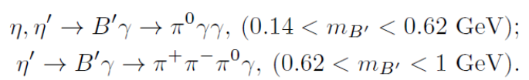

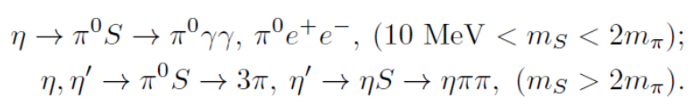





Main JEF Physics Objectives
1. Search for sub-GeV hidden bosons
vector:
    Leptophobic vector B ꞌ
    Hidden or dark photon:
scalar S:
Axion-Like Particles (ALP):
2. Directly constrain CVPC new physics:
3. Precision tests of low-energy QCD:
  Interplay of VMD & scalar dynamics in ChPT:
  Transition Form Factors of η⁽ꞌ⁾ :
4. Improve the light quark mass ratio via Dalitz distributions of η→3π
$$η^{(′)}→3γ,{ η}^{(′)}→2π^{0}γ,{ η}^{(′)}→π^{+}π^{−}π^{0}$$

Slide 21
Example of a Key Channel: η→π⁰γγ
New physics:
Search for sub-GeV gauge bosons
  A leptophobic vector B’:
  η→γB’, B’ →π⁰γ
  An electrophobic scalar Φ’:
  η→π⁰Φ’, Φ’→γγ
  PRL 117,101801 (2016); PL B740,61(2015)
Dark Sector:
Gauge Interactions?
Dark matter?
PR,D89,114008
Standard Model:
Portal:
vector
Scalar
fermion
Confinement QCD:
A rare window to probe interplay of VMD & scalar resonance in ChPT

Slide 22
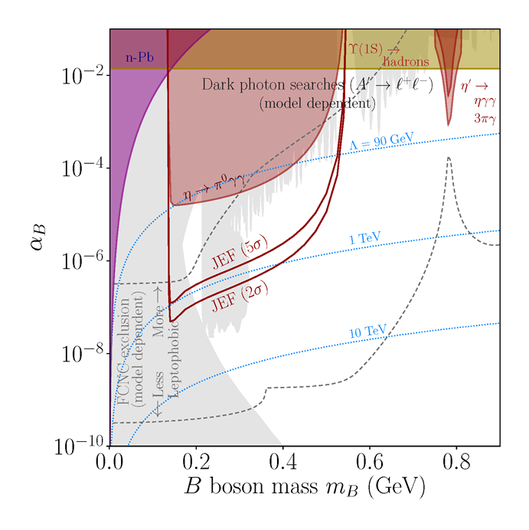
JEF Experimental Reach for B’
A search for a leptophobic dark B’ boson coupled to baryon number is complementary to ongoing searches for a dark photon
η→ B’γ →π⁰γγ
B’
γ
PL, B221, 80 (1989)
PR,D89,114008

Slide 23
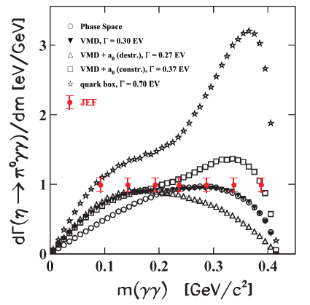
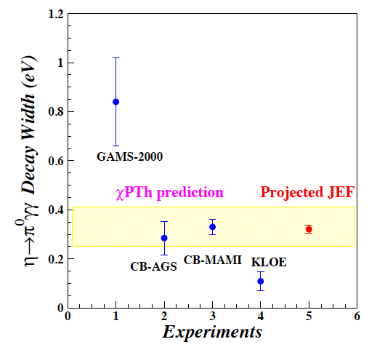
Projected JEF on SM Allowed η→π⁰γγ
J.N. Ng and D.J. Peters, Phys. Rev. D47, 4939
χPTh by Oset et al., Phys. Rev. D77, 073001
We measure both BR and Dalitz distribution
model-independent determination of two LEC’s of the O(p⁶) counter- terms
probe the role of scalar resonances to calculate other unknown O(p⁶) LEC’s
J. Bijnens, talk at AFCI workshop

Slide 24
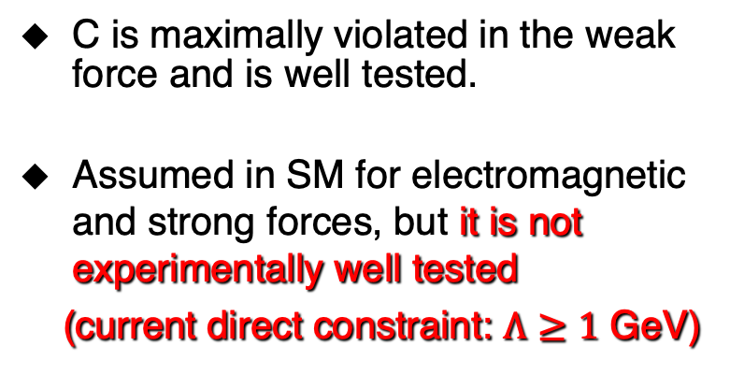
Test Charge Conjugation Invariance
C Violating η neutral decays
Mode | Branching Ratio (upper limit) | No. γ’s
3γ | < 1.6•10⁻⁵ | 3
π⁰γ | < 9•10⁻⁵
2π⁰γ | < 5•10⁻⁴ | 5
3γπ⁰ | Nothing published
3π⁰γ | < 6•10⁻⁵ | 7
3γ2π⁰ | Nothing published
C is maximally violated in the weak force and is well tested.
Assumed in SM for electromagnetic and strong forces, but it is not experimentally well tested
(current direct constraint: $Λ≥1$ GeV)

Slide 25
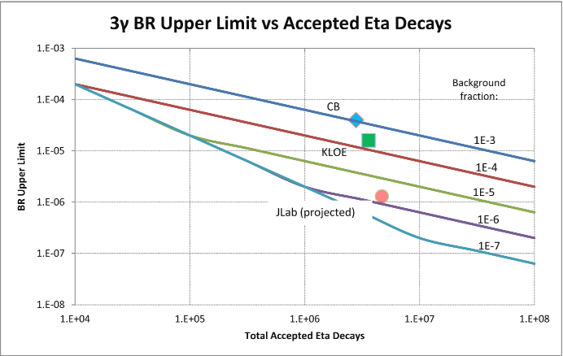
Experimental Improvement on C-violating η→3γ
SM contribution:
BR(η→3γ) <10⁻¹⁹ via P-violating
weak interaction.
A calculation due to new
physics by Tarasov suggests:
BR(η→3γ)< 10⁻²
Sov.J.Nucl.Phys.,5,445 (1967)
Proj. JEF
Improve BR upper limit by one order of magnitude to directly tighten the constraint on CVPC new physics

Slide 26
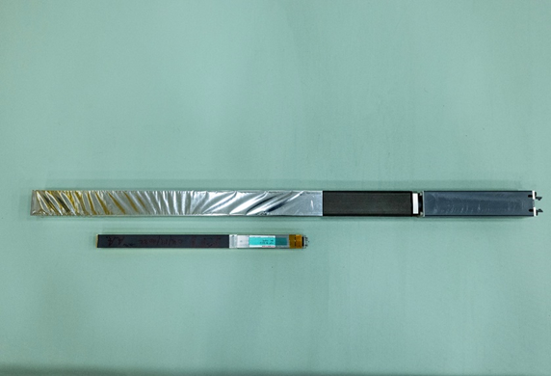
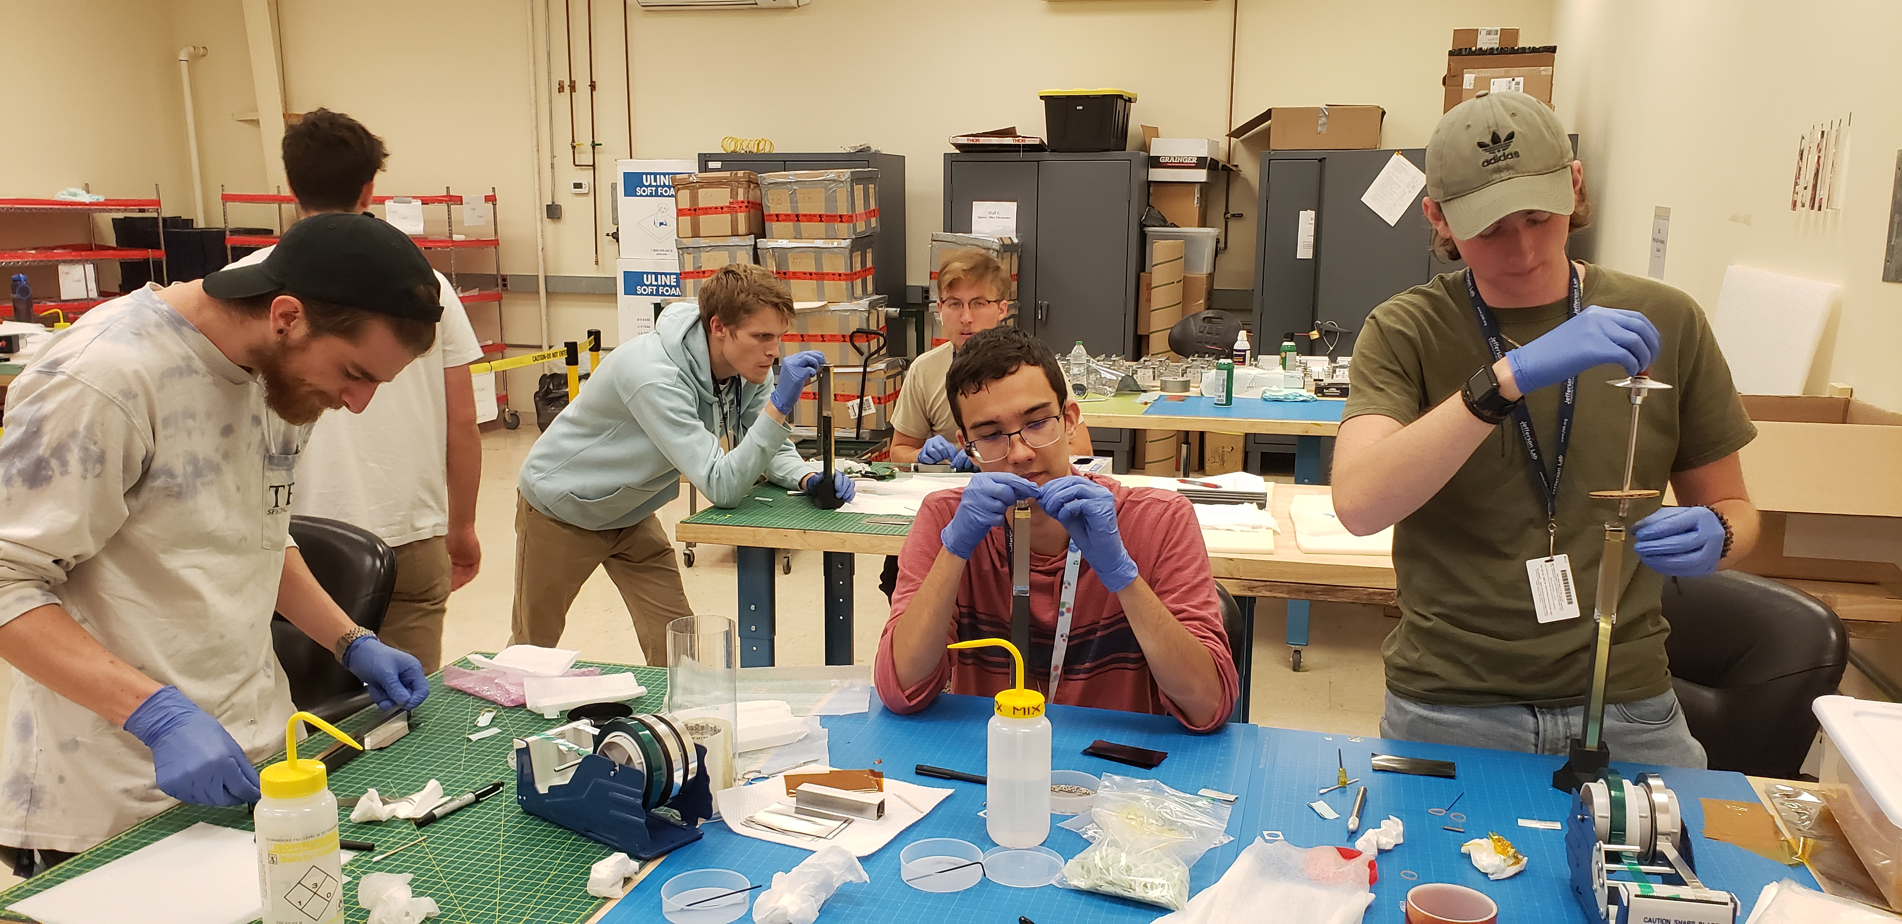
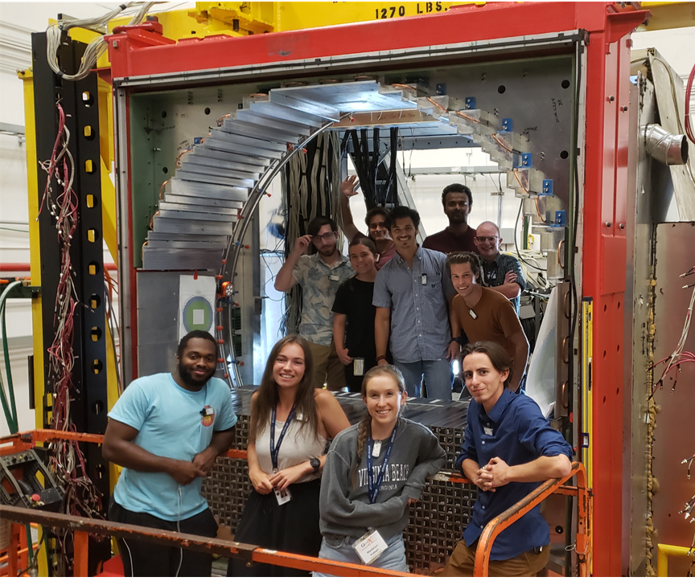
Status of the JEF Experiment
Development of an upgraded FCAL-II with a PbWO₄ insert.:
Undergraduate workforce
  1596 PbWO₄ modules are developed to replace ~400 Pb-glass modules.
  Installation of the upgraded FCAL-II has been on-going since Mar 2023 and will be completed by the end of 2024.
  Over 40 undergraduate students from 11 institutes were trained by involving in this project.
Pb-glass module (4x4x45 cm³)
PbWO₄ module (2x2x20 cm³)
Summer 2023
Oct 6, 2023
  Commissioning of FCAL-II and data taking with FCAL-II are scheduled to start in Jan 2025.

Slide 27
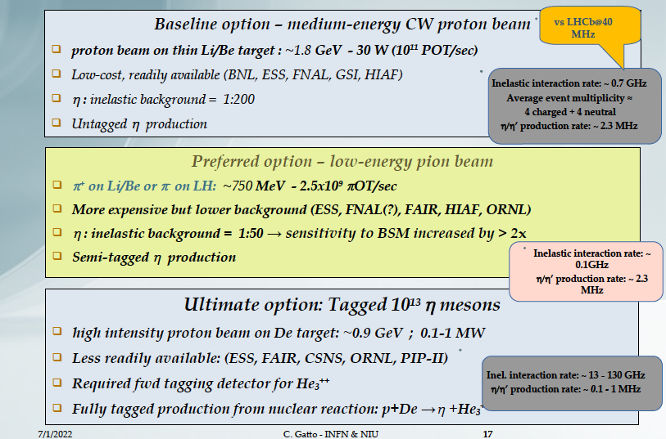
A New Proposal: REDTOP
arXiv:2203.07651
up to ~5x10¹³ η per year!

Slide 28
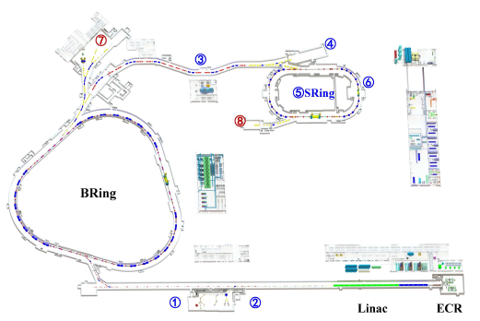
Another New Proposal: eta-Factory at HIAF
HIAF, Huizhou, China
arXiv:2407.00874v1
up to ~10¹³ η per year

Slide 29
Summary
Decays of η/η’ mesons provide a unique flavor-conserving laboratory to test low-energy QCD and to search for the BSM physics.
The JLab Eta Factory (JEF) experiment will start data collection in Jan 2025 using newly upgraded FCAL-II calorimeter with a PbWO₄ insert.
The global experimental efforts at different kinematics and via different production mechanisms will be important for controlling the experimental systematics.
Thanks for support by NSF PHY-1812396 and PHY-2111181

Slide 30
Production Rate
JEF for 100 days of beam:
 | η | η’
Tagged mesons | 6.5x10⁷ | 4.9x10⁷
Previous Experiments:
Experiment | Total η | Total η’
CB at AGS | 10⁷ | -
CB MAMI-B | 2x10⁷ | -
CB MAMI-C | 6x10⁷ | 10⁶
WASA-COSY | ~3x10⁷ (p+d), ~5x10⁸ (p+p) | -
KLOE-II | 3x10⁸ | 5x10⁵
BESIII | ~10⁷ | ~5x10⁷
JEF offers a competitive η/η’ production rate with much cleaner backgrounds

Slide 31
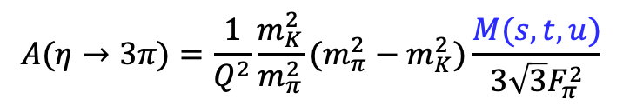
Improve Quark-Mass Ratio via 𝜂→3π Dalitz Distributions
  A clean probe for quark mass ratio:
    Decays through isospin violation:
    is small
    Amplitude:
  Uncertainties in quark mass ratio
$$A(η→3π)=\frac{1}{Q^{2}}\frac{m_{K}^{2}}{m_{π}^{2}}(m_{π}^{2}−m_{K}^{2})\frac{M(s,t,u)}{3\sqrt{3}F_{π}^{2}}$$
Phys. Rept. 945 (2022) 1-105

Slide 32
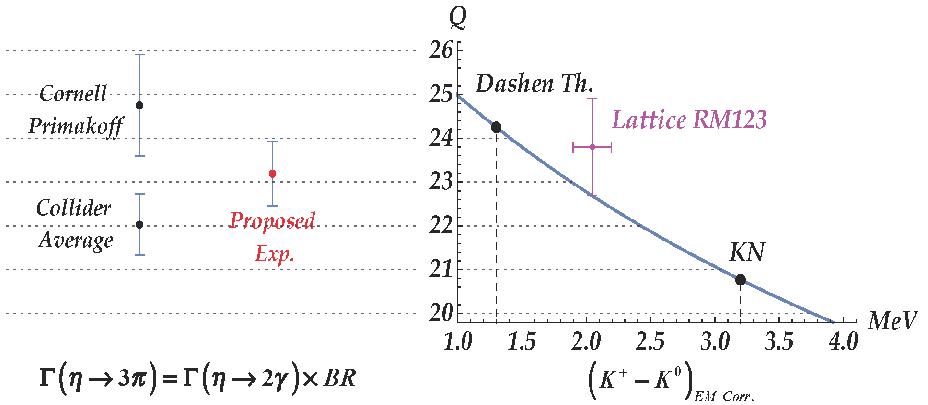
Precision Determination Light Quark Mass Ratio via PrimEx-eta
  A clean probe for quark mass ratio:
    decays through isospin violation:
    is small
    Amplitude:
$$A(η→3π)=\frac{1}{Q^{2}}\frac{m_{K}^{2}}{m_{π}^{2}}(m_{π}^{2}−m_{K}^{2})\frac{M(s,t,u)}{3\sqrt{3}F_{π}^{2}}$$

