Slide 1
Physics highlights and perspectives of FAIR
QNP 2024, July 8th – 12th, 2024, Barcelona
Yvonne Leifels (GSI/FAIR)

Slide 2
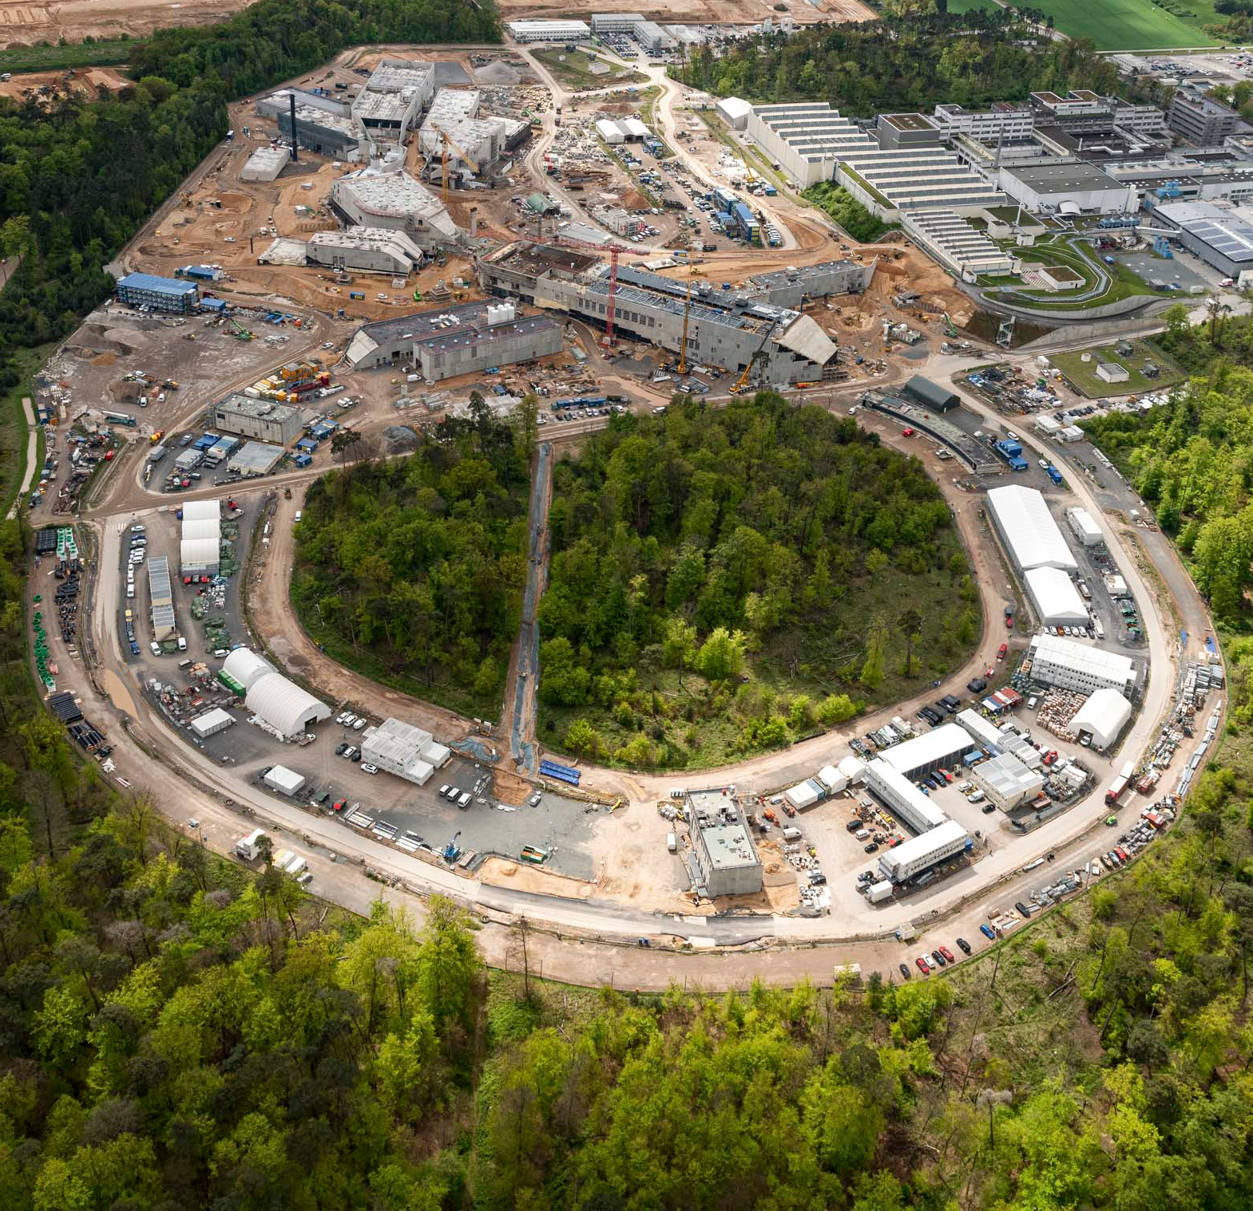
Overview
Introduction to FAIR
Status of FAIR construction
Scientific perspectives
  Primary beams
  Exotic beams
  Storage rings
Summary and Outlook
Notes:
Talk 12:10 Uhr; 30 + 10 Minuten

Slide 3
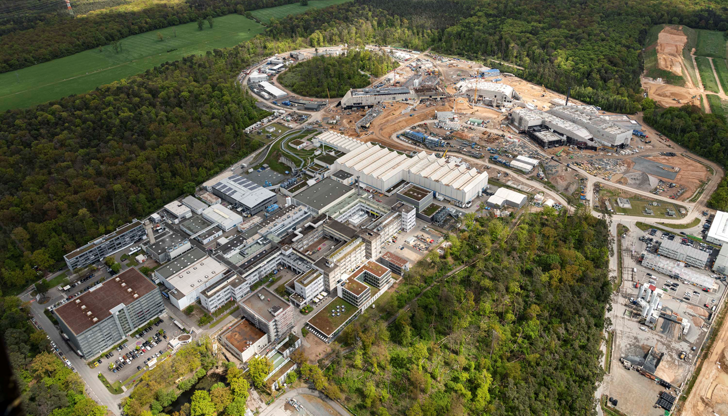
GSI Helmholtzzentrum für Schwerionenforschung
FAIR Facility for Antiproton and ion research
FAIR Facility for Antiproton and Ion research
GSI Helmholtzzentrum für Schwerionenforschung Darmstadt

Slide 4
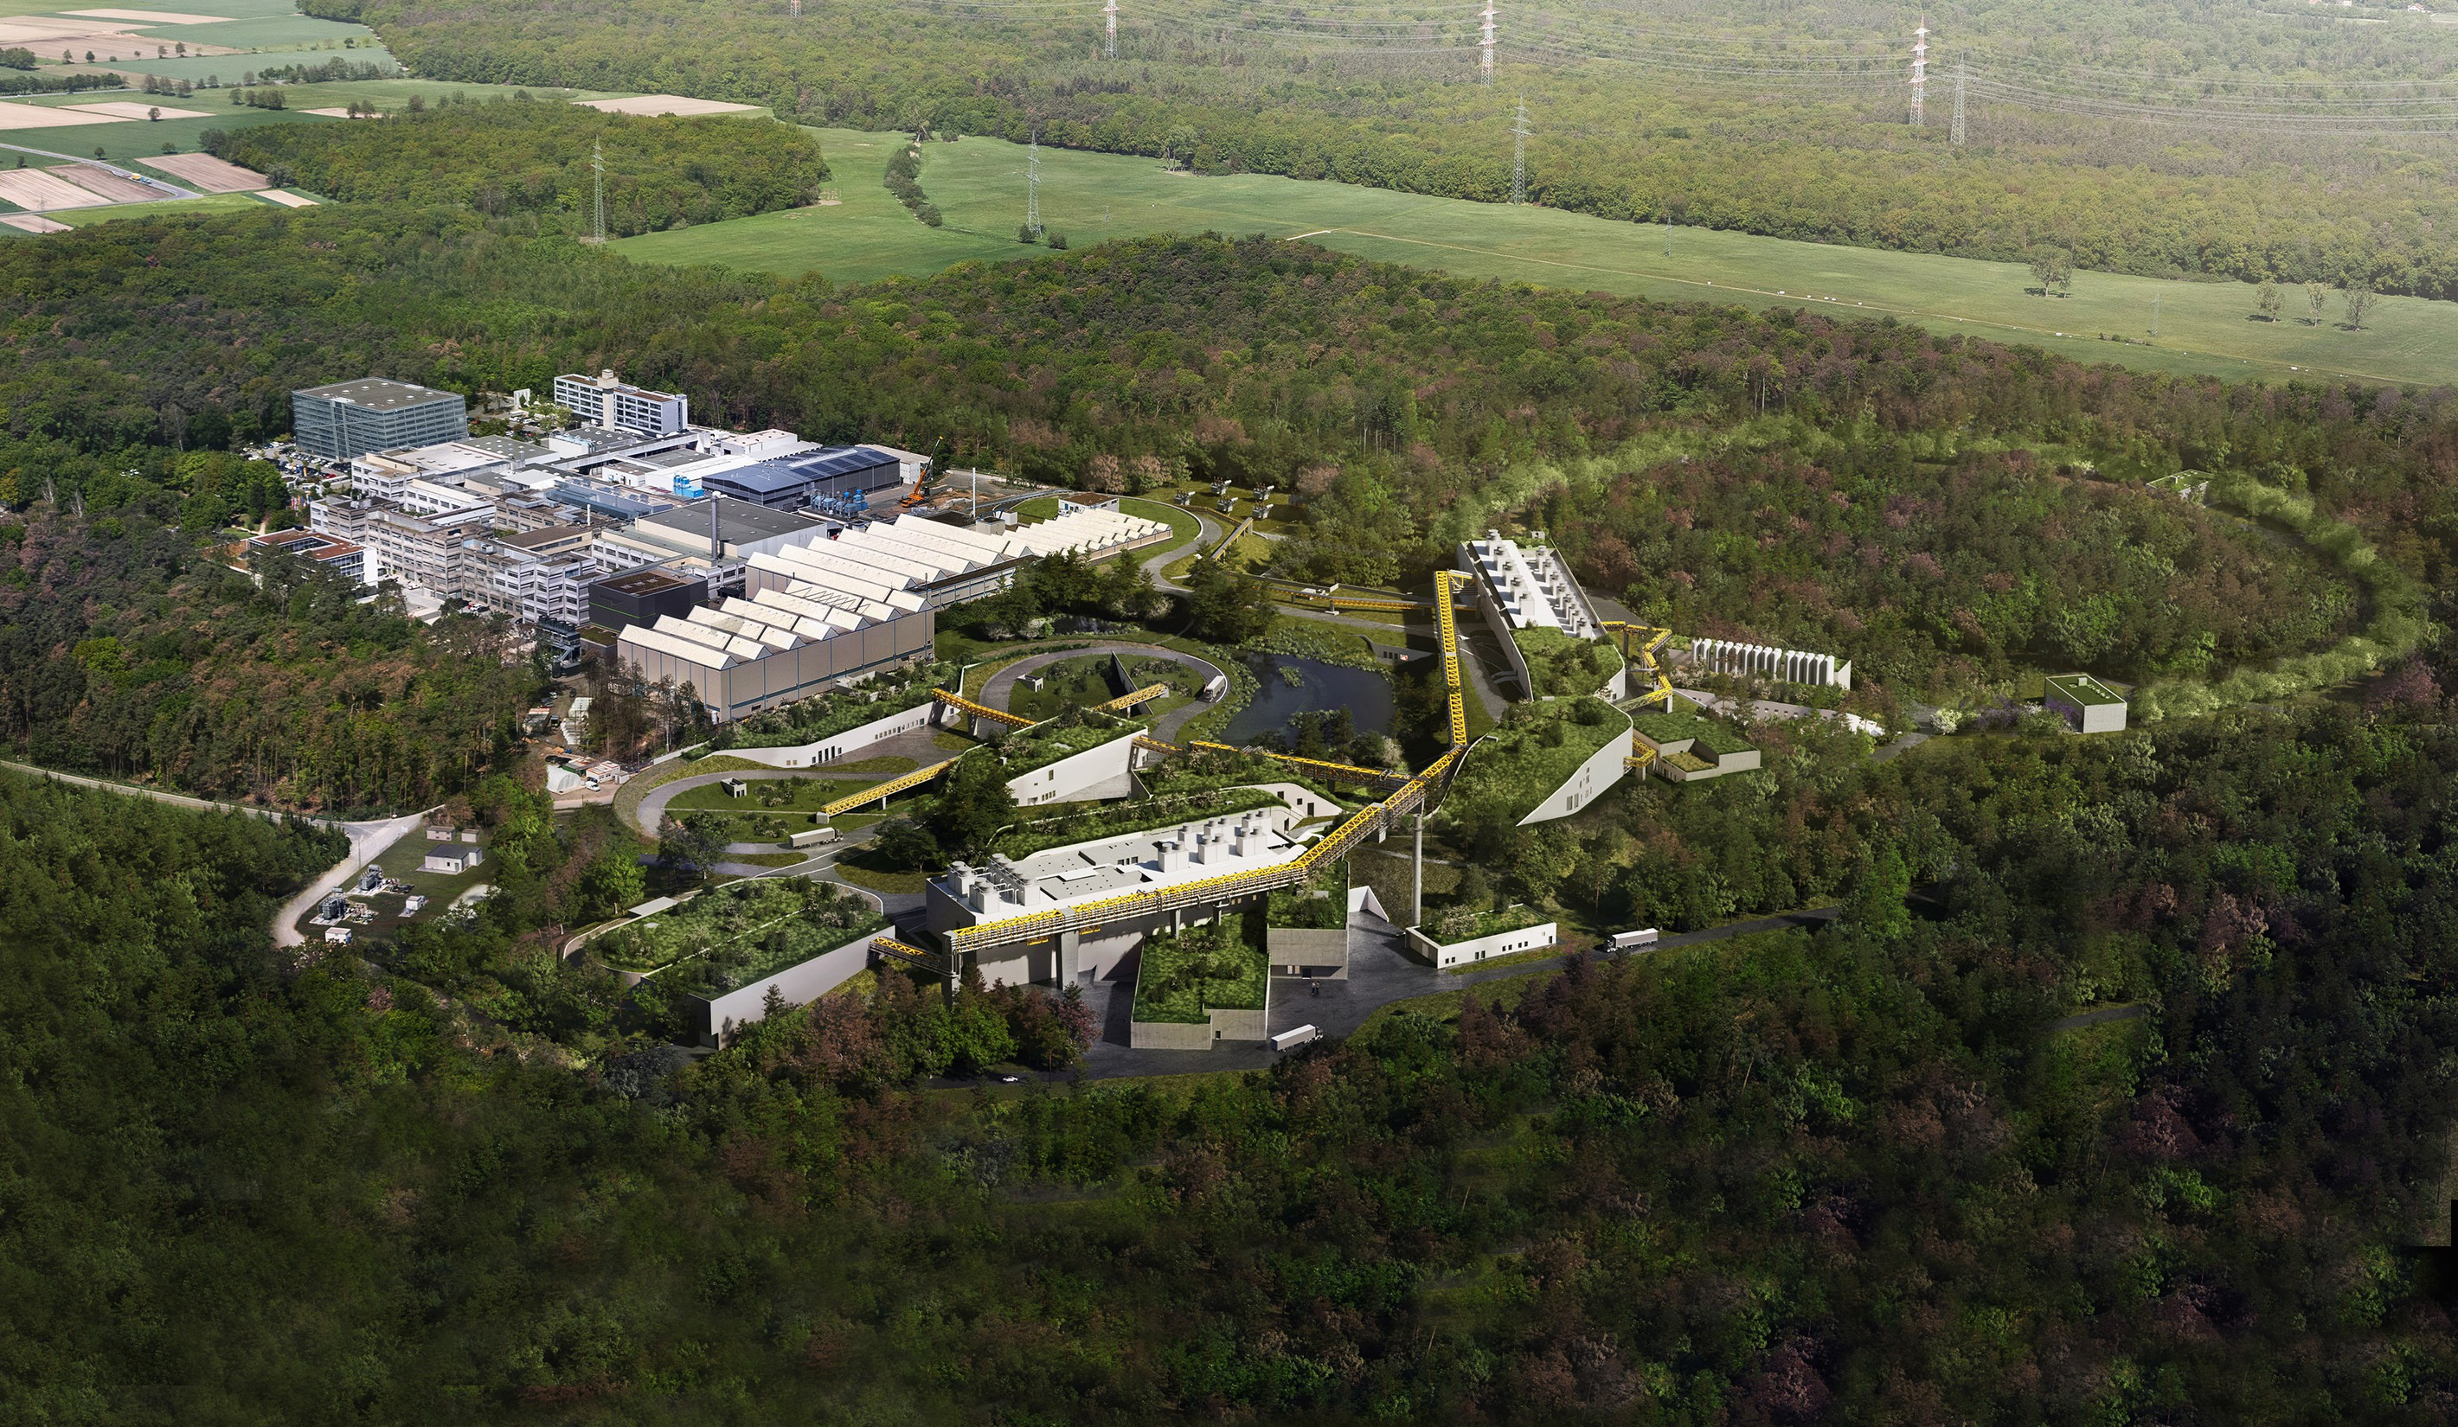











FAIR Facility for Antiproton and Ion Research
  Milestone of ESFRI Roadmap
  Top priority of nuclear physics community
  9 shareholders:
  + 1 associated partner:
  + 1 aspirant partner:
  Over 3000 scientists/engineers from 200 institutions out of 53 countries
Notes:
Germany, Slowenia, Romania, Poland, Russia, India, Finland, Sweden, UK, Czech

Slide 5
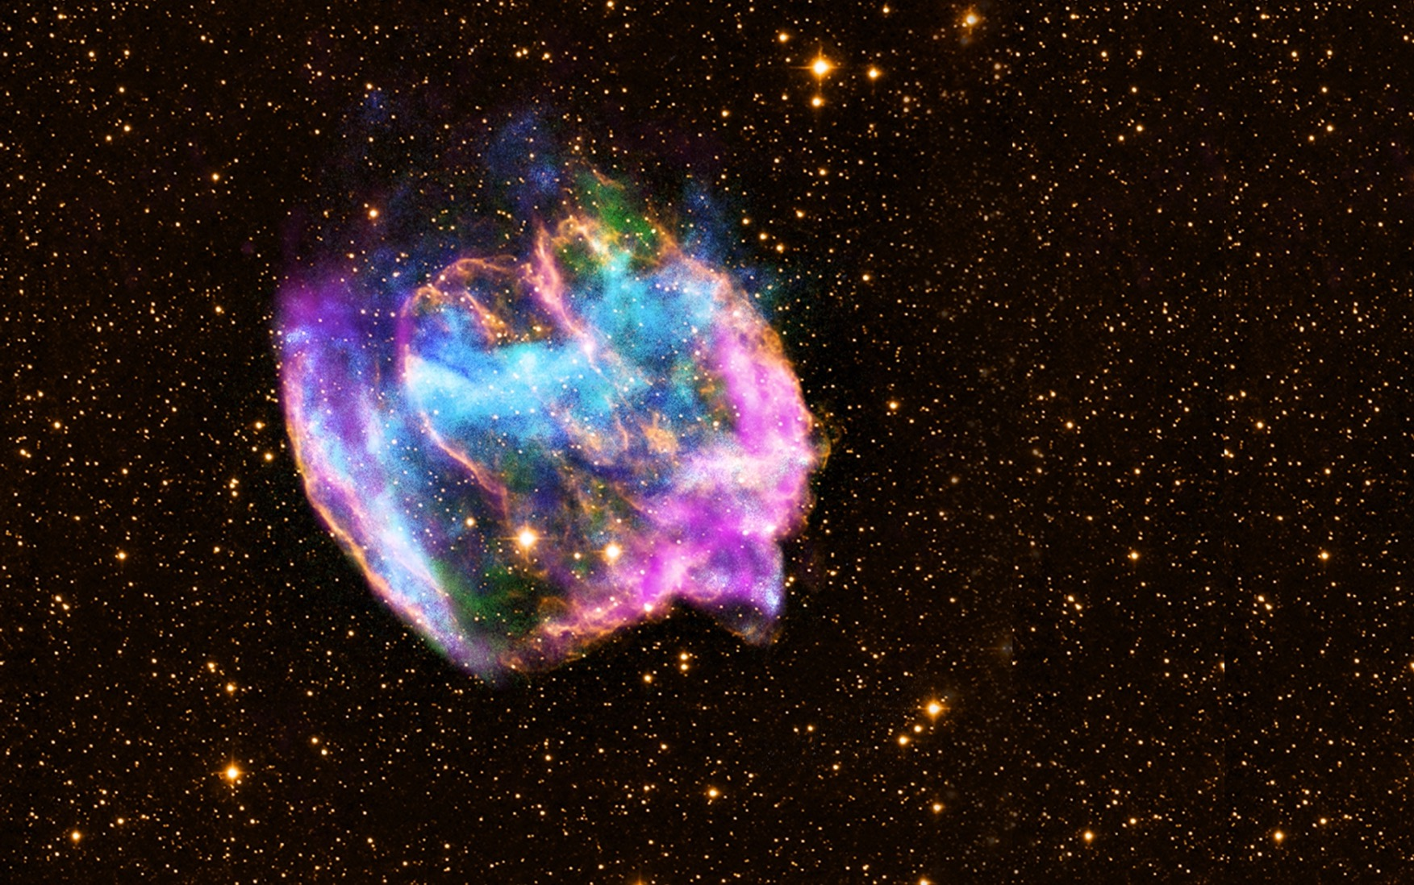
FAIR Objective:
Creating extreme conditions existing in universe with heavy-ion accelerators…

Slide 6
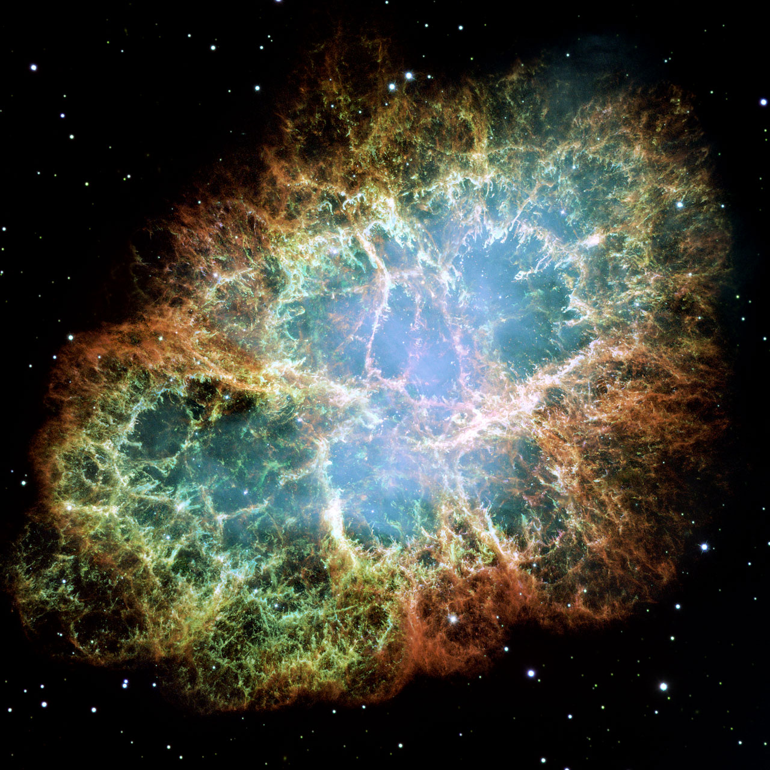
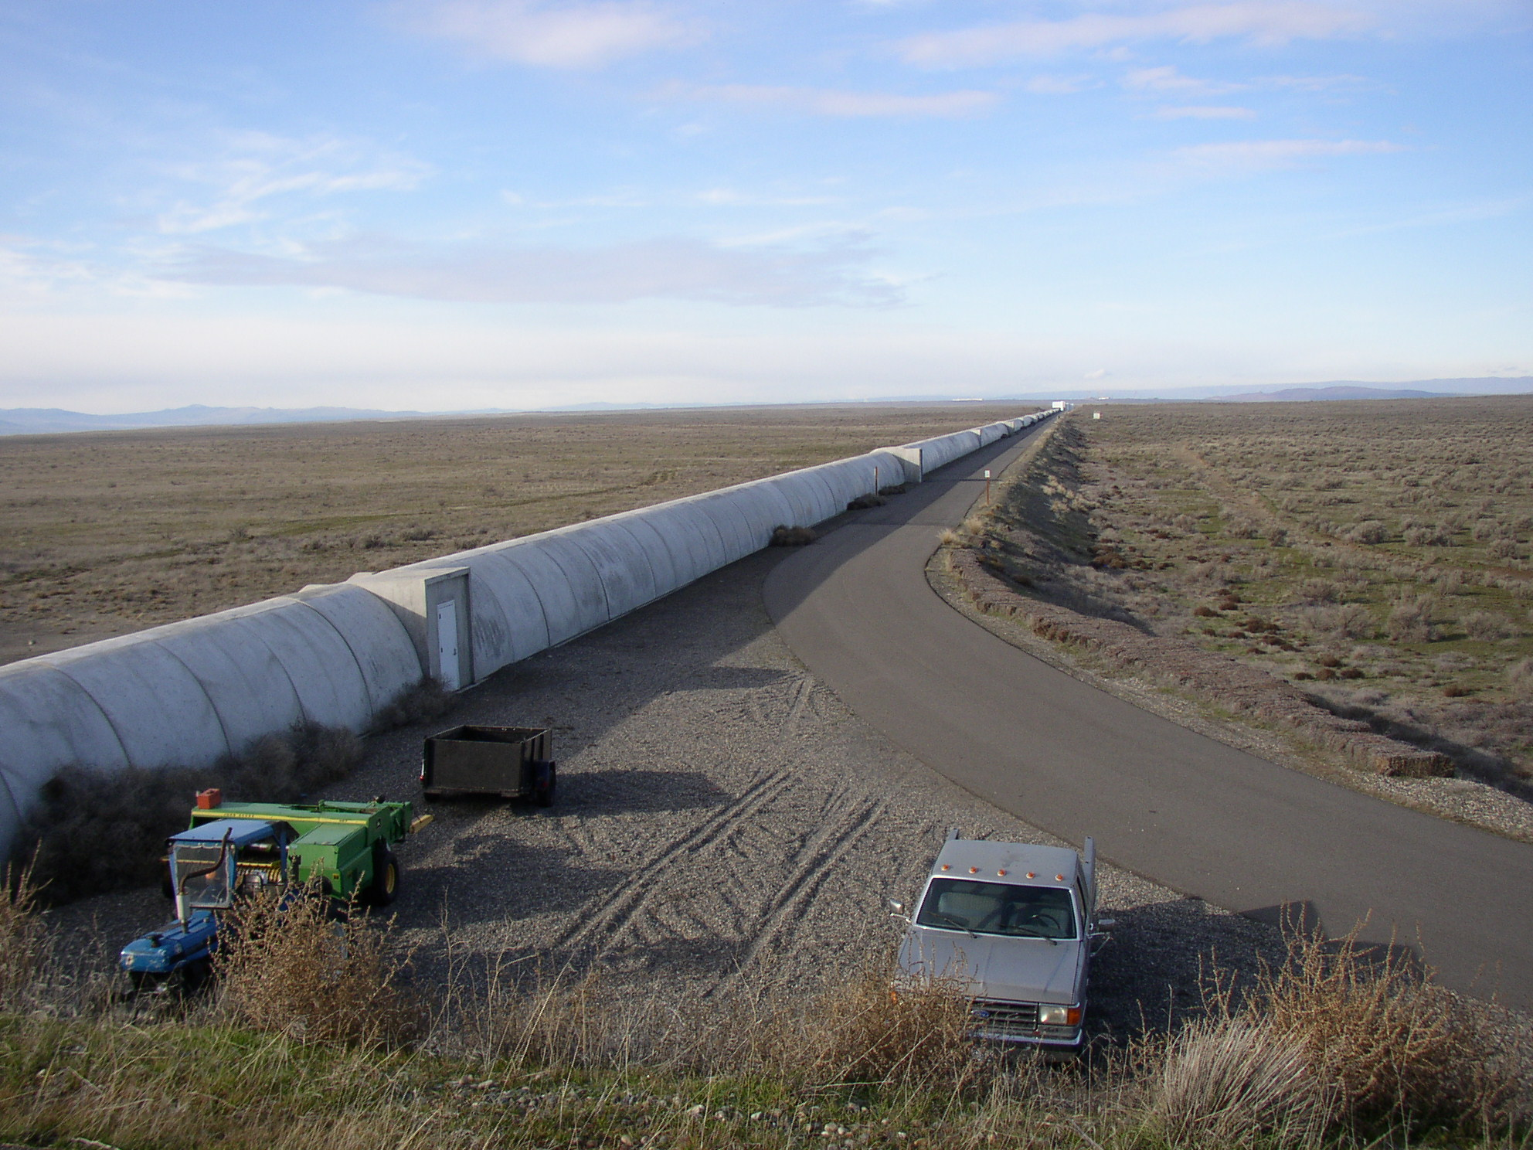
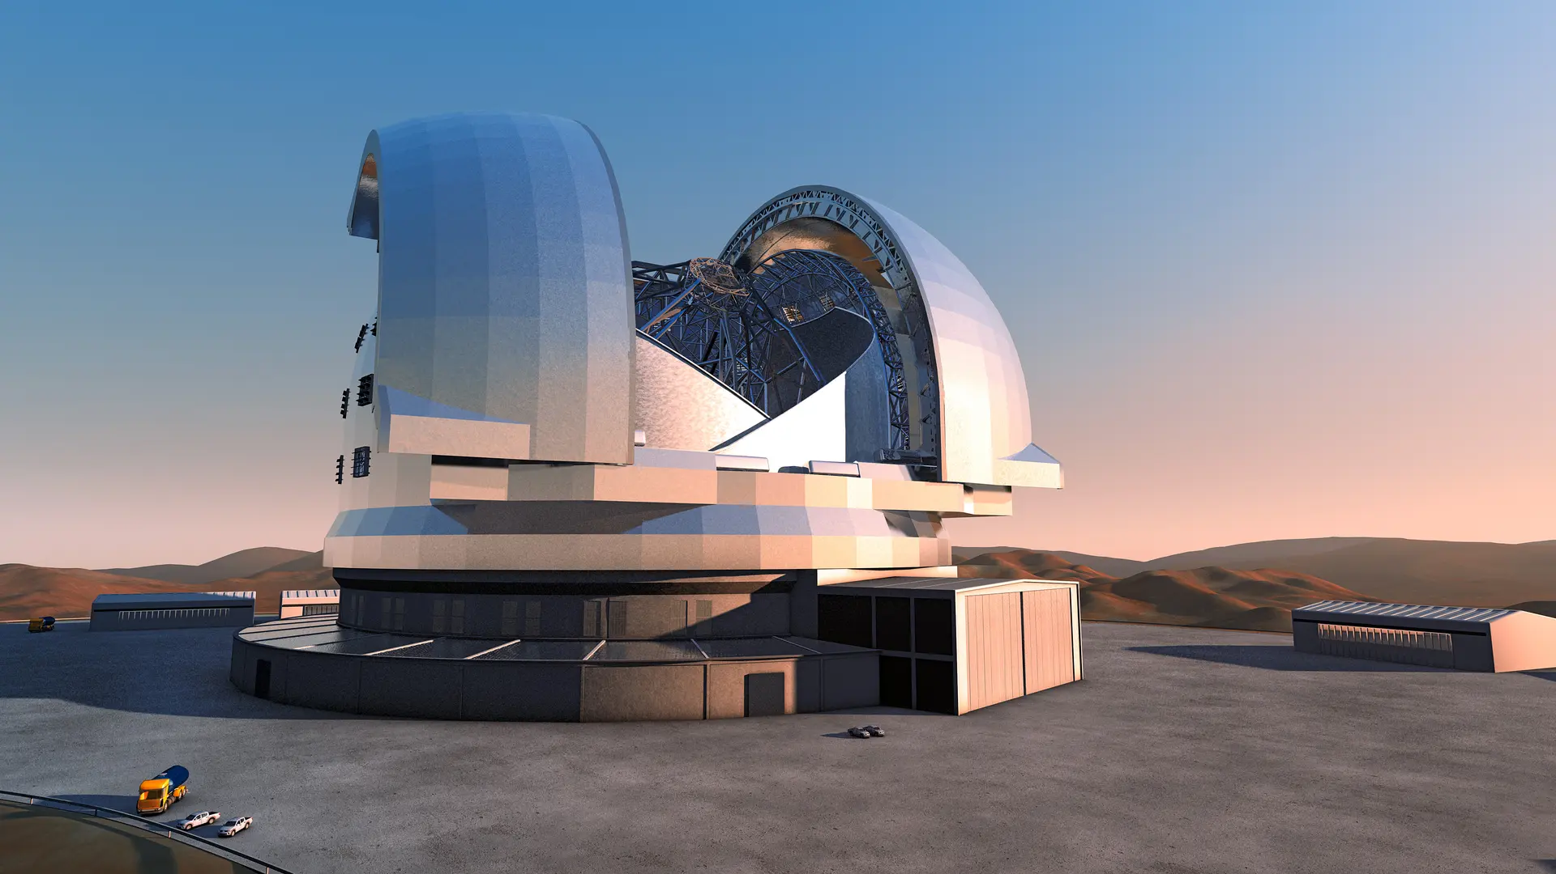
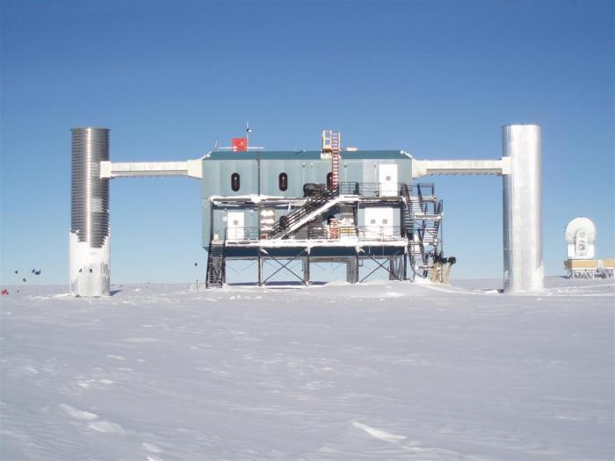
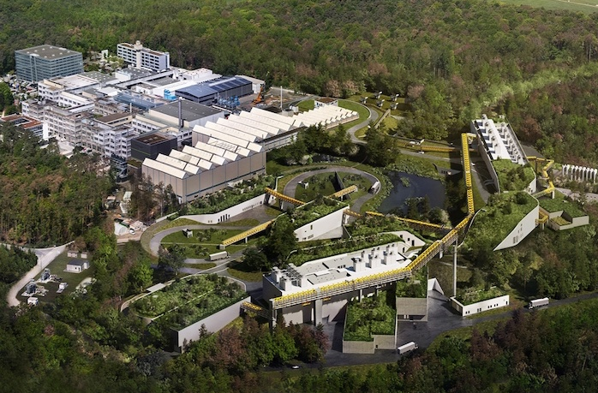
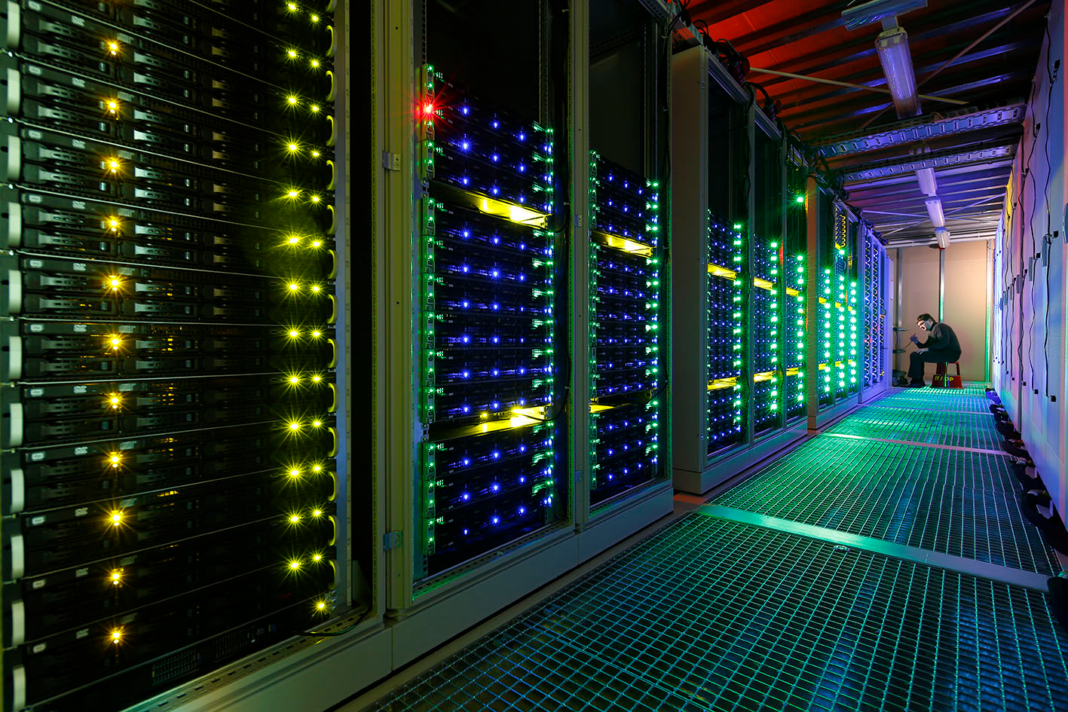
The begin
of a new era
Multimessenger astrophysics
Simulations
Nuclear physics

Slide 7
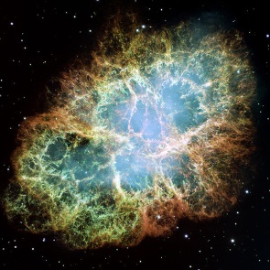
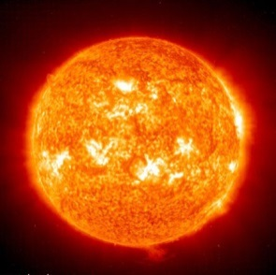
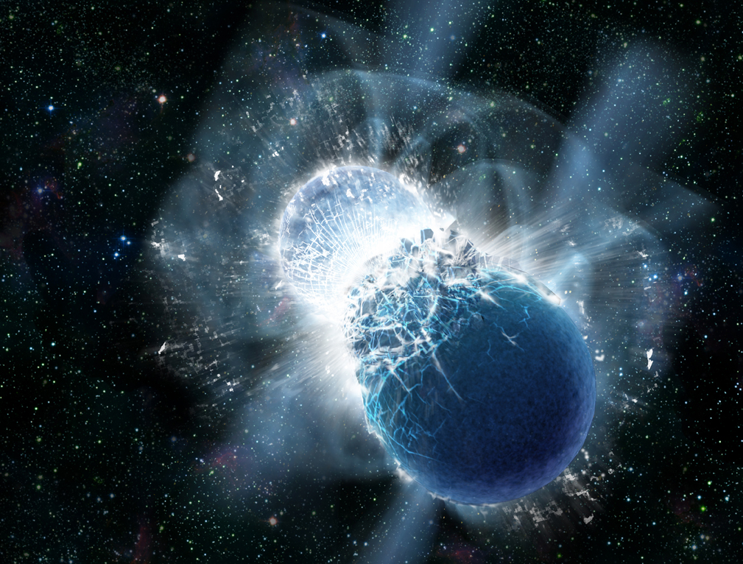
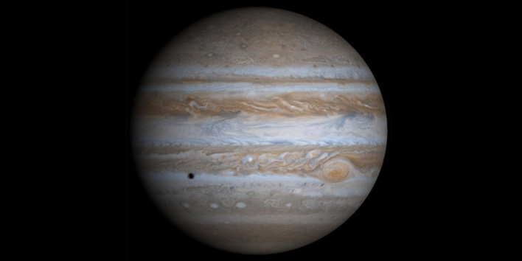
… to answer fundamental questions:
Synthesis of chemical elements in the cosmos
Building blocks of life: Production of carbon and oxygen in stars
Neutron star mergers: equation of state, strong force, neutron rich nuclei
Matter in the interior of Earth and of large planets

Slide 8
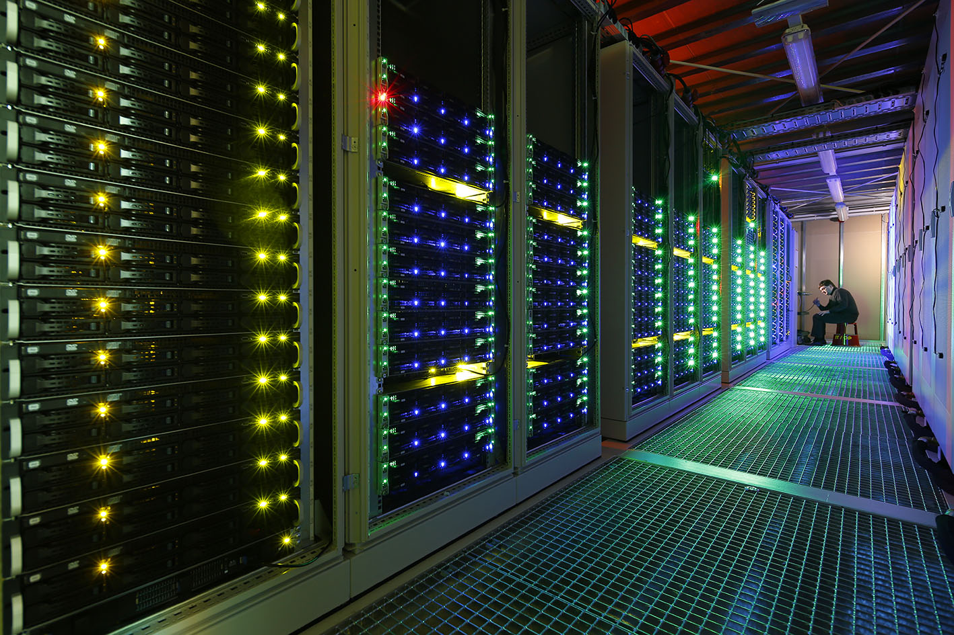
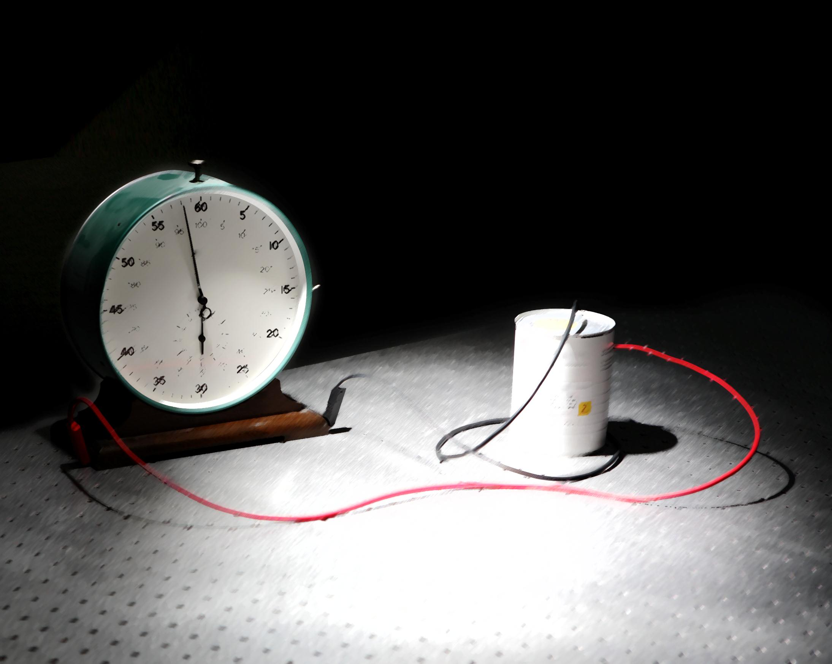
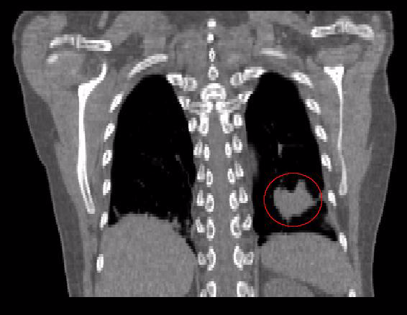
… with direct applications
High-performance and scientific computing, big data, green IT
Space radiation protection investigations in collaboration with ESA
Development of nuclear clock:
Promising candidate thorium-229
Novel applications for tumor and non-tumor diseases

Slide 9
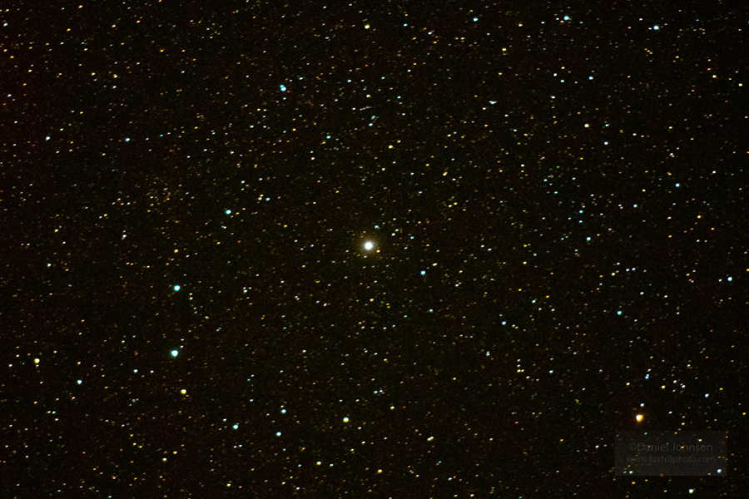

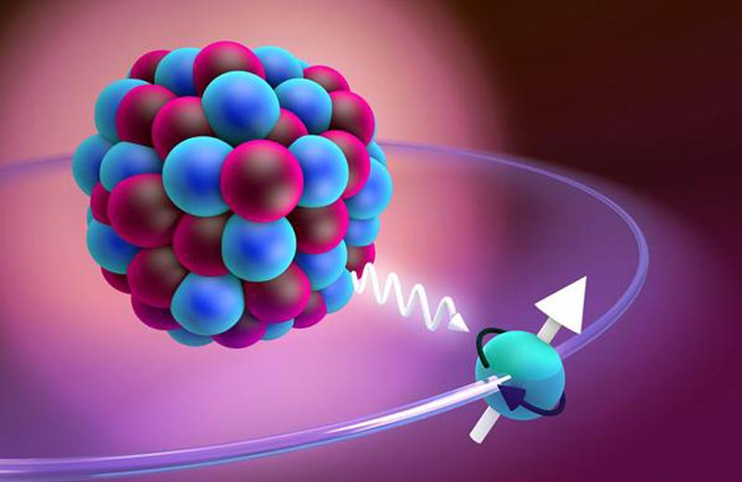
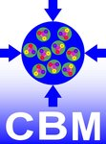

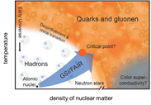

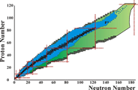
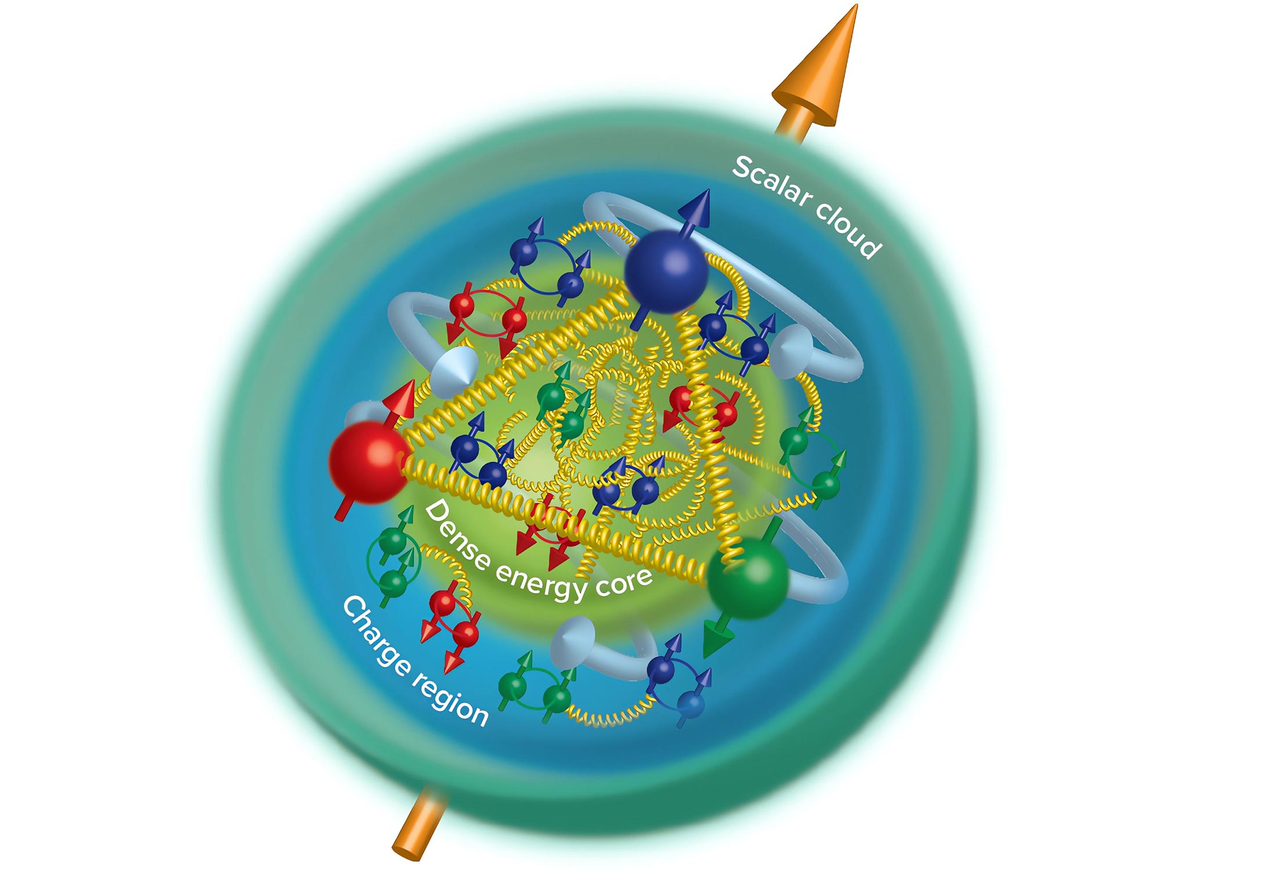

temperature
Precision tests
of QED
Cosmic ray simulator for irradiation studies
Materials under high pressure
QCD matter
at high baryon densities
Phase transition and critical point
Particles in dense medium
density
Nucleosynthesis
of heavy elements
Structure of exotic nuclei (e.g. hyper nuclei)
Neutron matter equaton of state
Gluonic excitations:
Hybrids, glueballs
Precision spectroscopy of charmonium states
Time-like form factors, nucleon structure

Slide 10
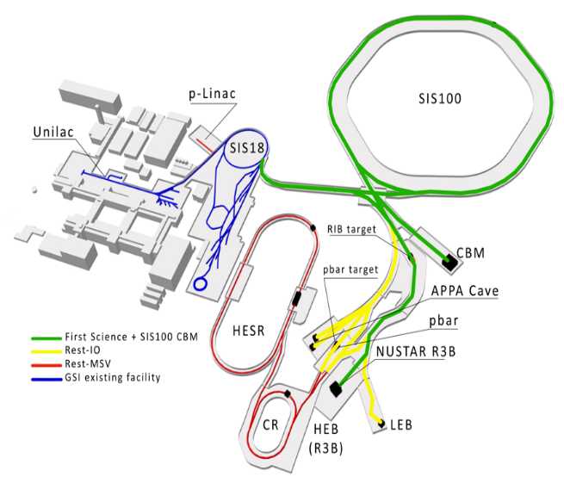
FAIR Accelerator facilities
First Science + SIS100 CBM
First Science ++
Rest FAIR Start Version
GSI existing facility
SIS100 primary beams:
10⁹/s Au up 11 GeV/u
10⁹/s C, Ca, … upto 14 GeV/u
10¹¹/s p up to 29 GeV/u
p-linac
SIS100
UNILAC
SIS18
RIB target
Timeline
2018 start of FAIR Phase-0 at upgraded GSI facilties
concrete construction completed
2024 start of accelerator installation
2027 first experiments with SIS18 beam
start of operation with SIS100
GSI facilities continue operation
PANDA
CBM
pbar target
APPA Cave
Secondary beams:
exotic nuclei via in-flight fragmentation and fission
highly charged nuclei
anti-protons
HESR
NUSTAR R3B
CR
HEB
LEB

Slide 11
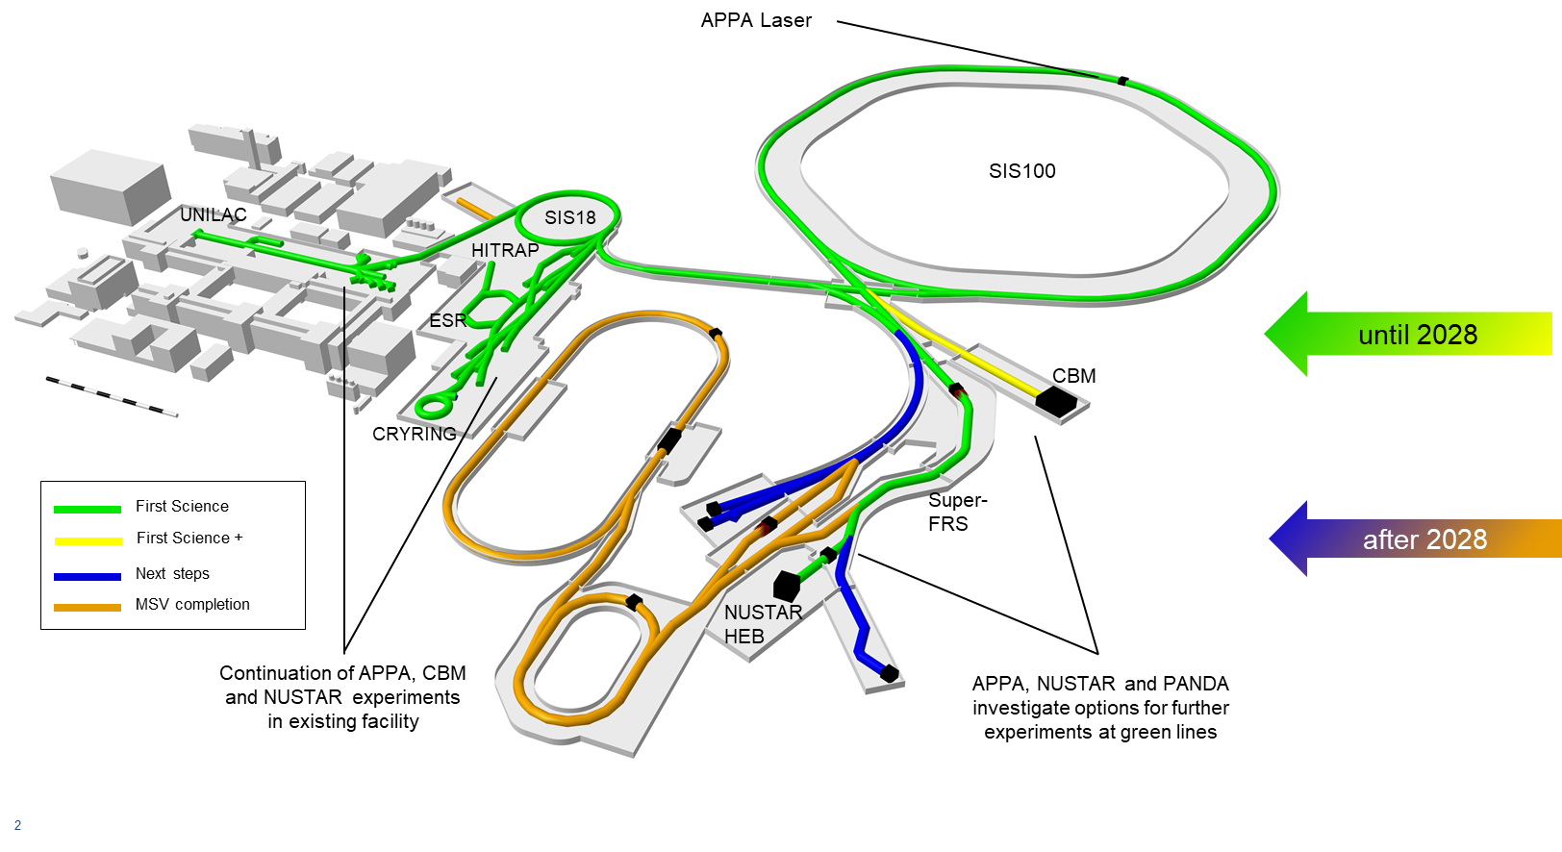
Current prospects

Slide 12
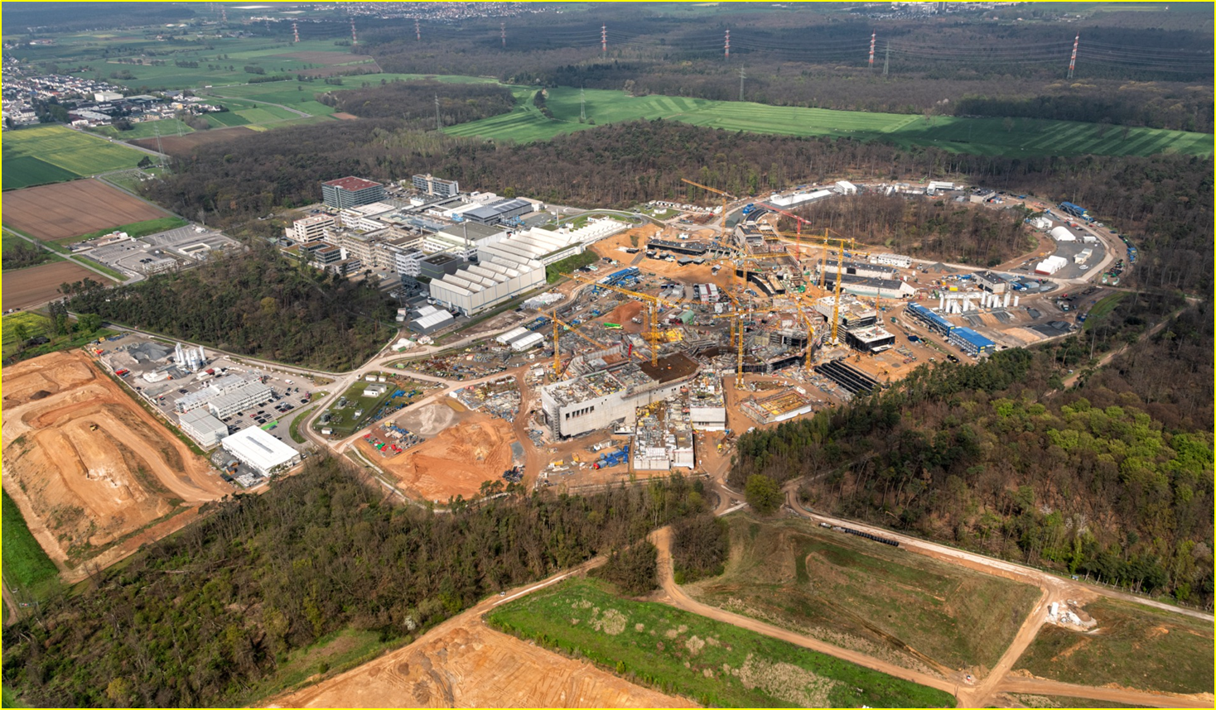
Concrete works finished in 2023
Concrete works finished Q4 2023
SIS100
CRYO 2
APPA
CBM
S-FRS
NUSTAR LEB
NUSTAR HEB
Drone video https://www.youtube.com/watch?v=wTCkZdeqI8I

Slide 13
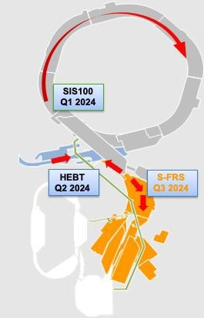
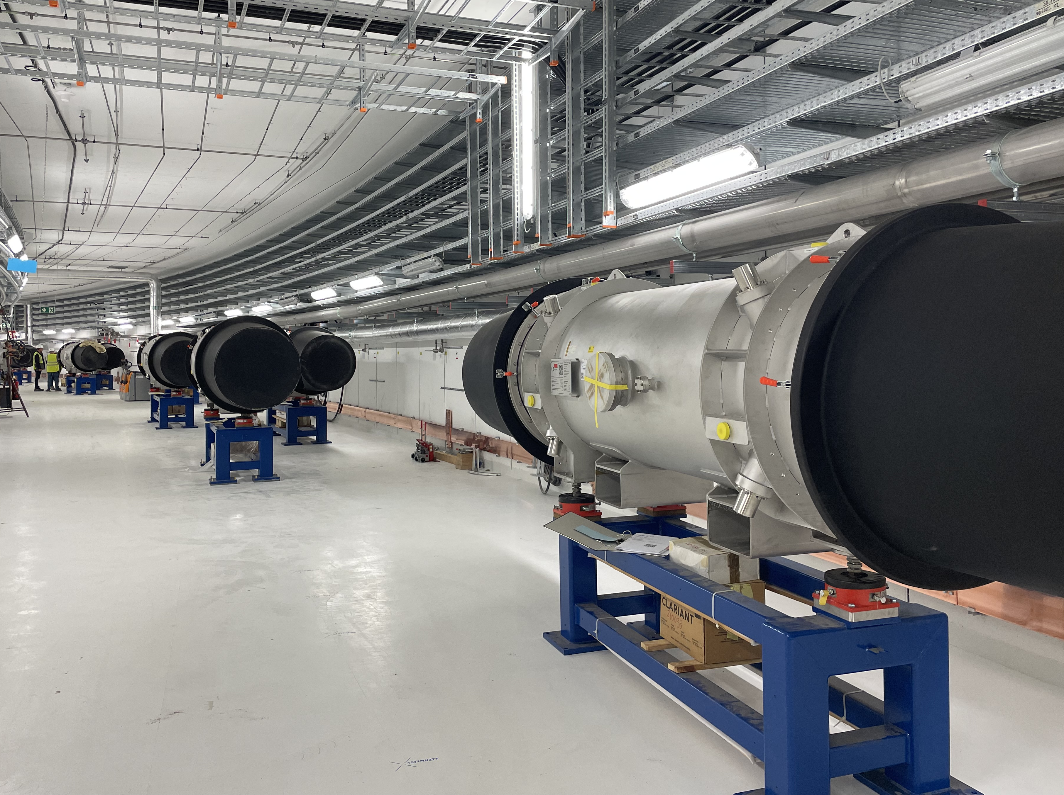
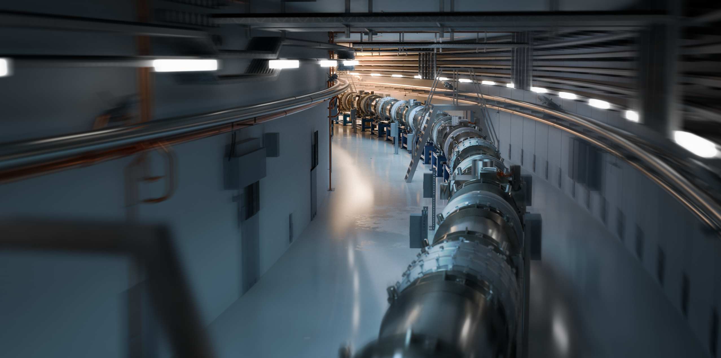
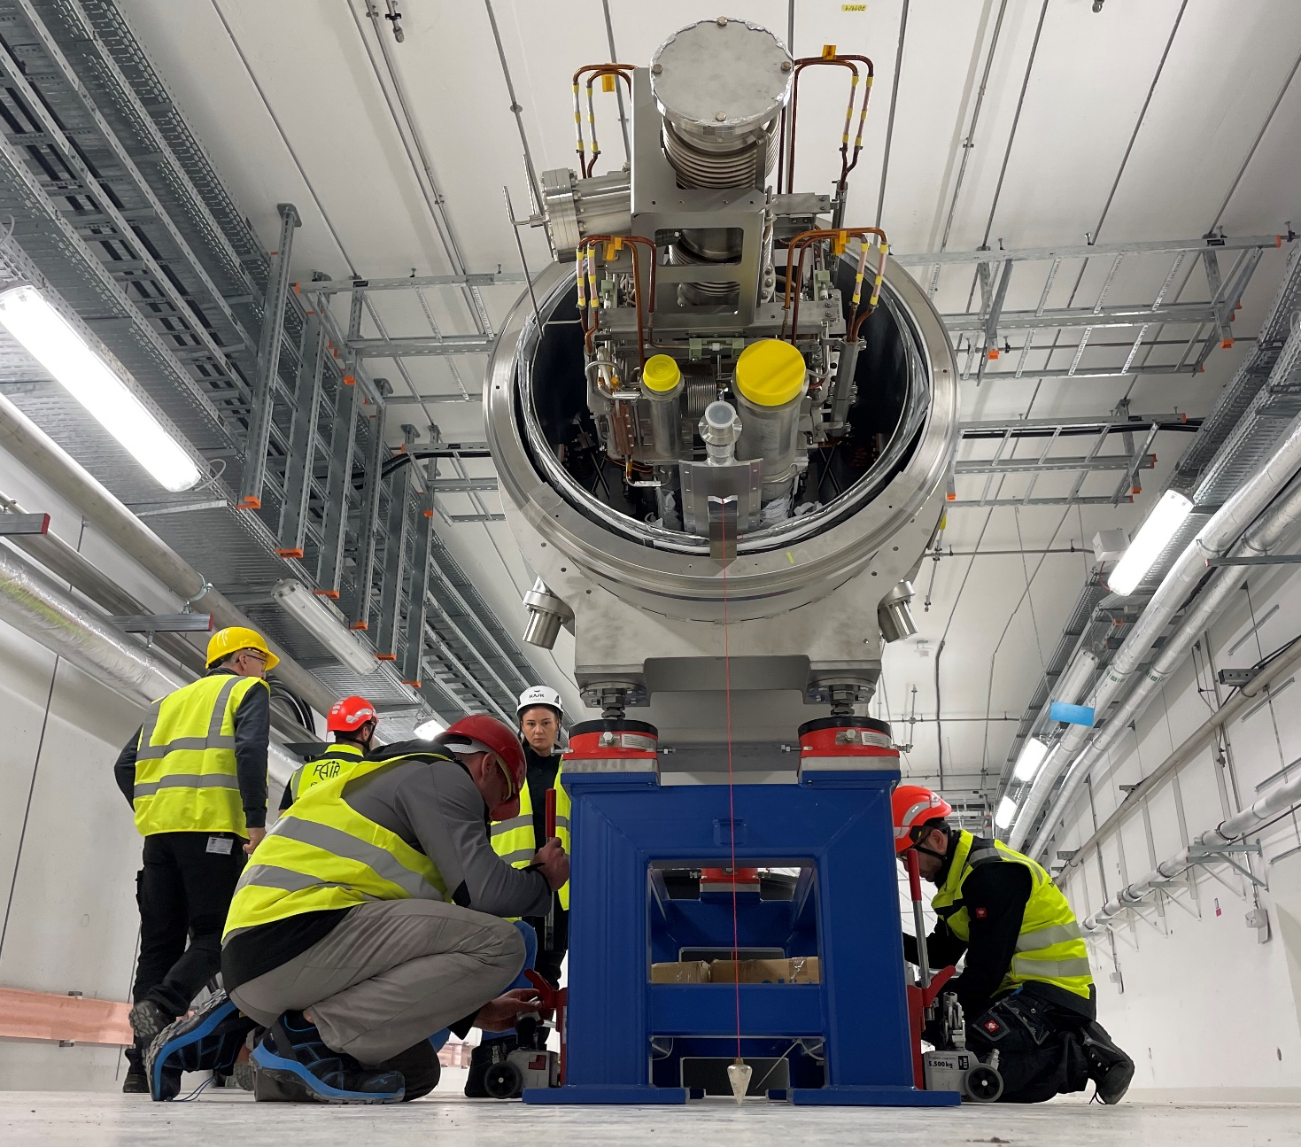
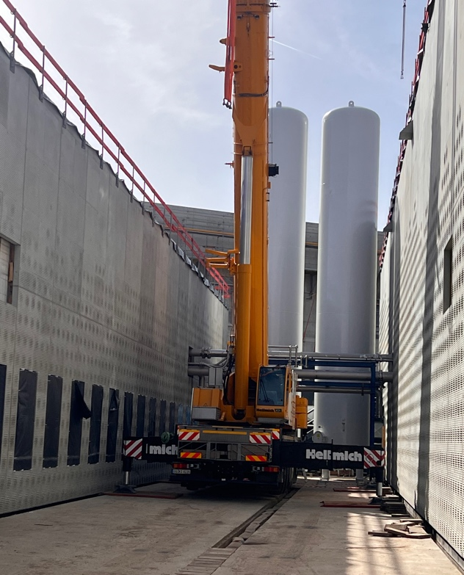
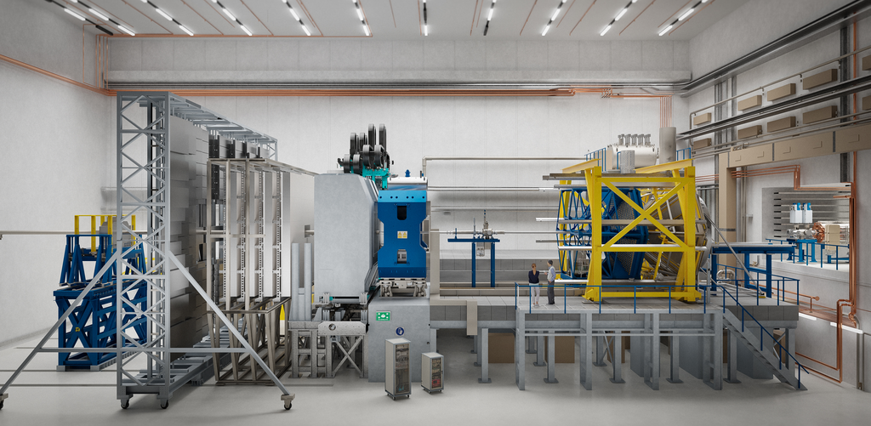
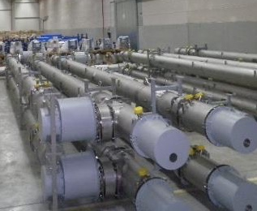
FAIR Start of installations
Ongoing installation work
Future
SIS100
CBM

Slide 14
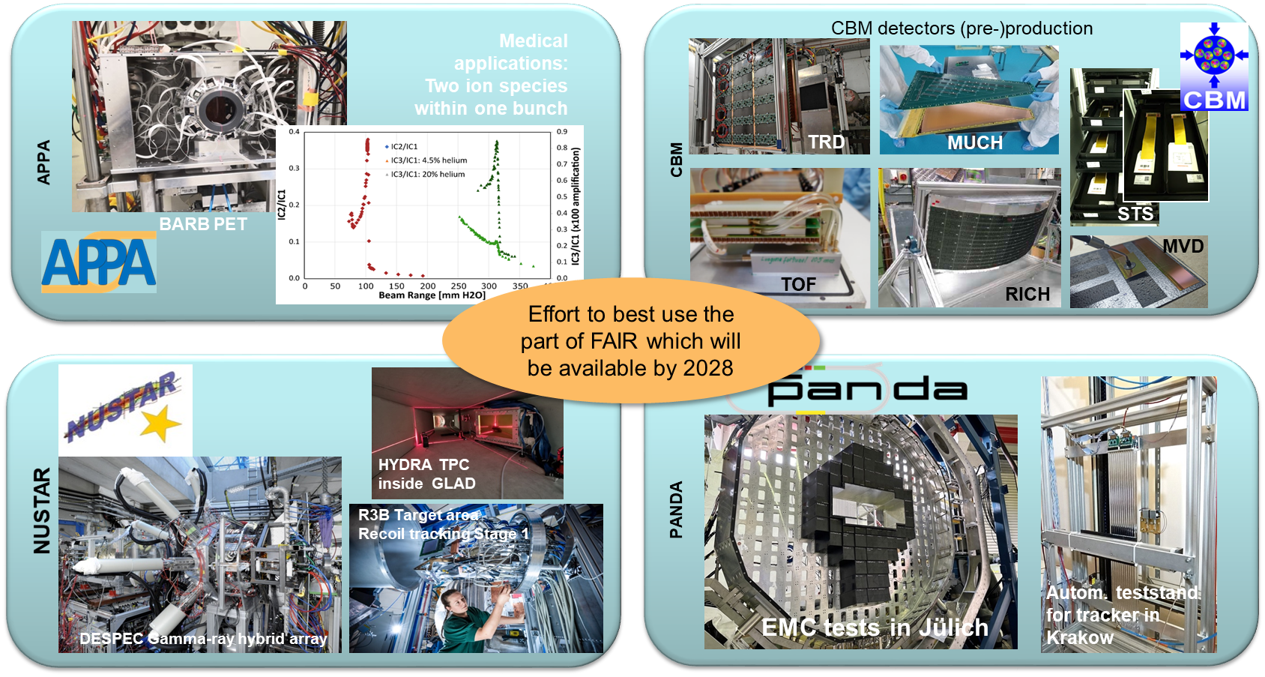
FAIR Detector R&D and construction

Slide 15
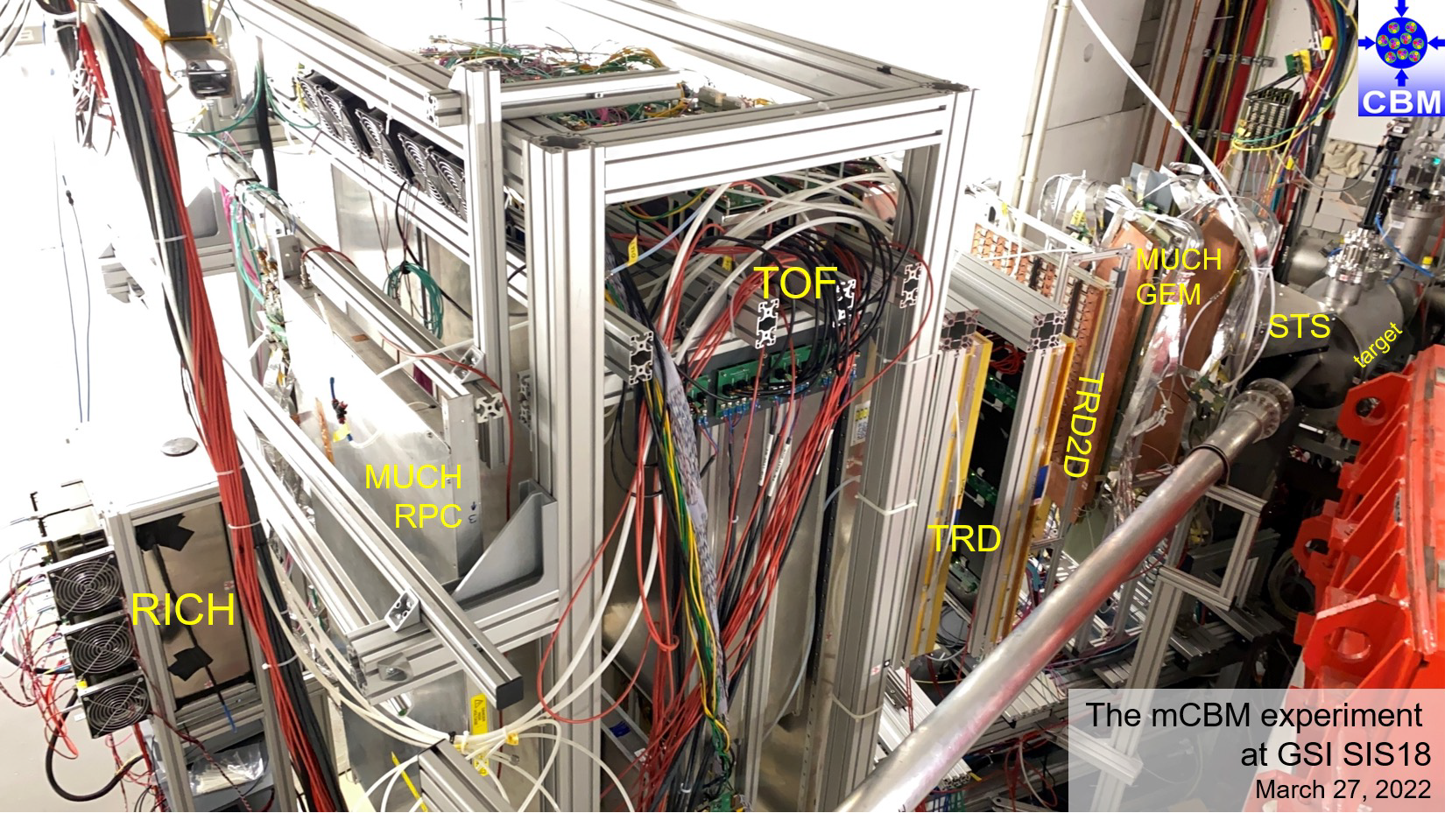
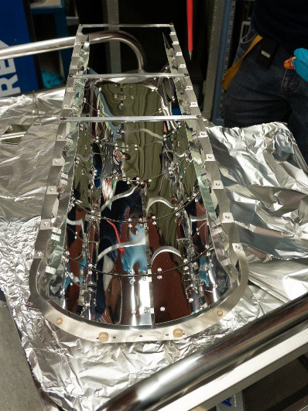
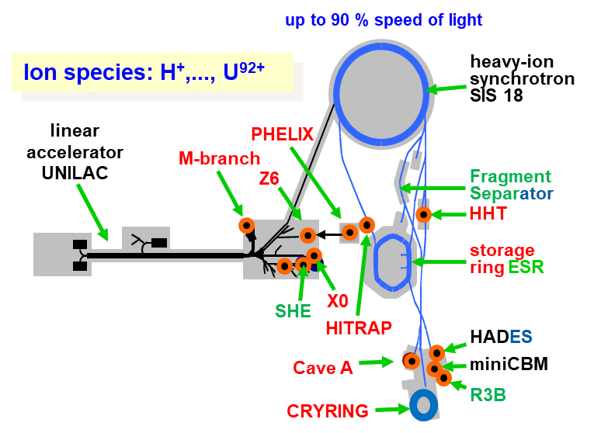
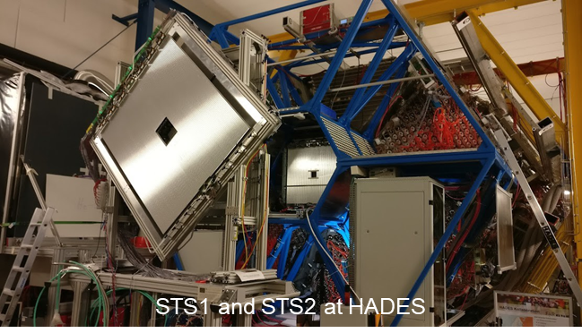
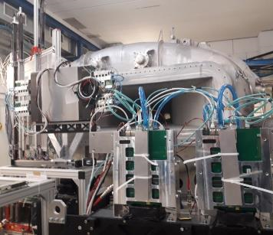
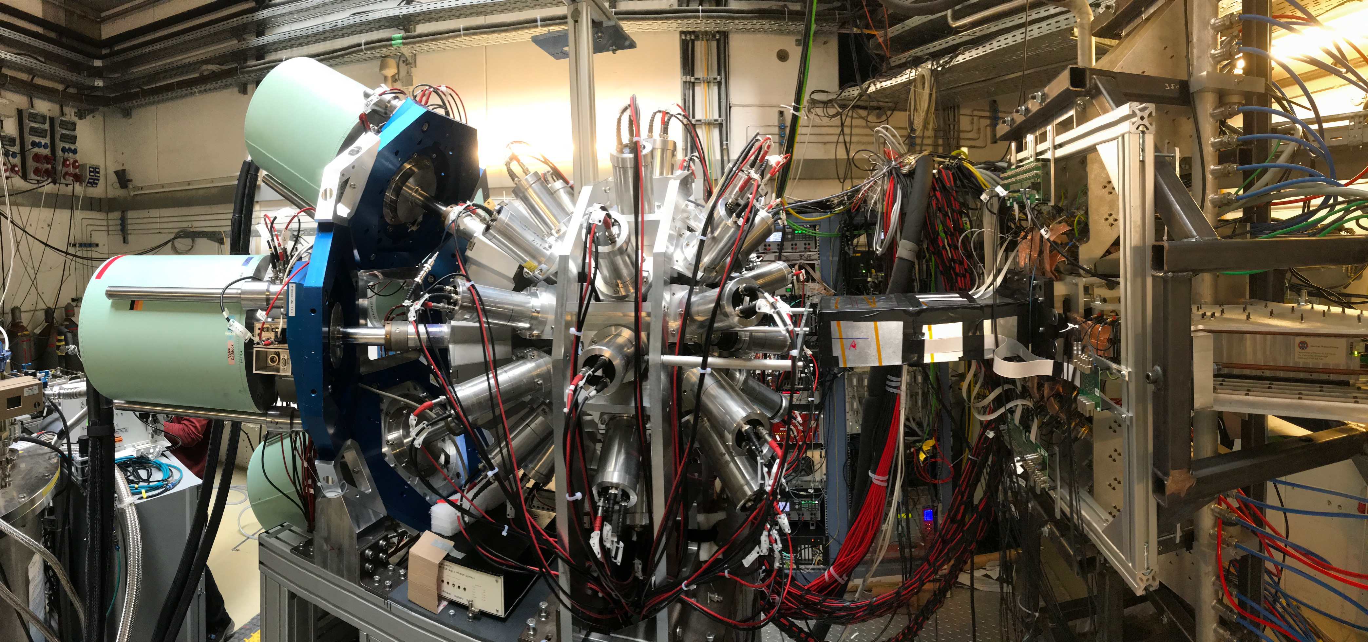
FAIR Phase-0
Research program at upgraded GSI accelerators using FAIR detectors
FAIR Phase-0 started in 2019
Stepwise approach to FAIR science: atomic-, plasma-, biophysics, materials reasearch, nuclear structure, hadron physics, dense matter physics
Commissioning and operation of upgraded GSI accelerators and newly built FAIR detectors
Education and training of early career researchers

Slide 16

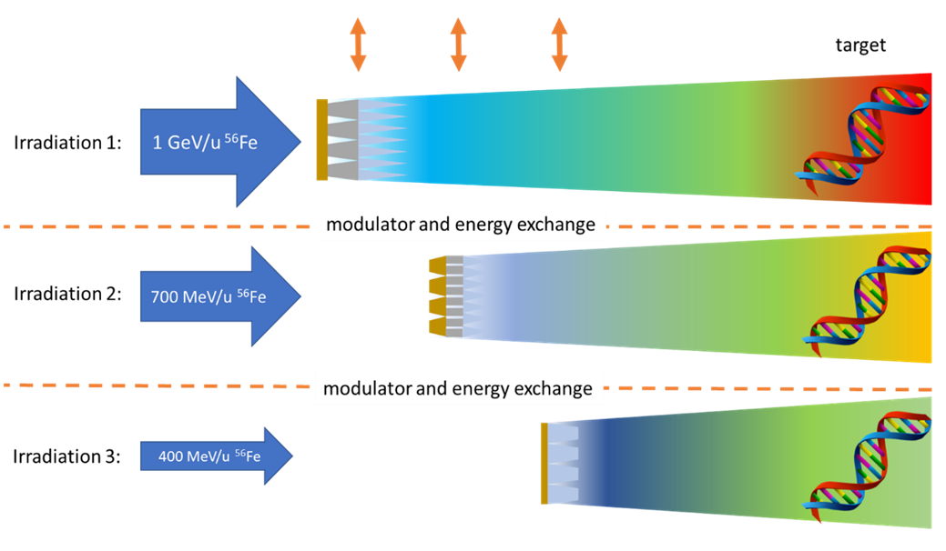
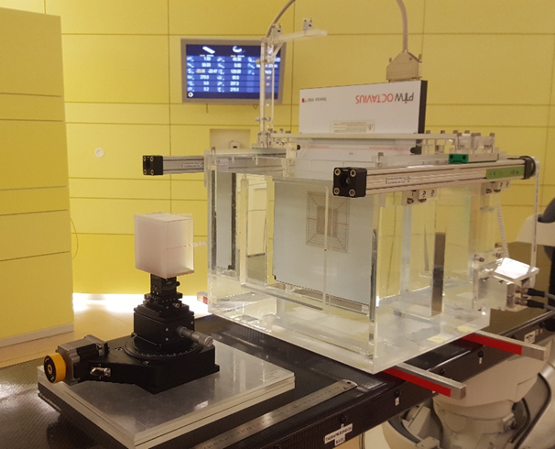
Primary beams
Biophysics: Cosmic ray simulator
At FAIR nearly the full space spectrum will be reproduced and used for experiments with biological tissues, shielding, and microelectronics
A hybrid active-passive method to produce a mixed radiation spectrum similar to the cosmic ray spectrum in deep space will be used
Schuy et al., Front. Phys. 2020
Funded by
superposition of radiation fields
3D ripple filter tested at HIT (Heidelberg) for producing
mixed fields in a water phantom

Slide 17
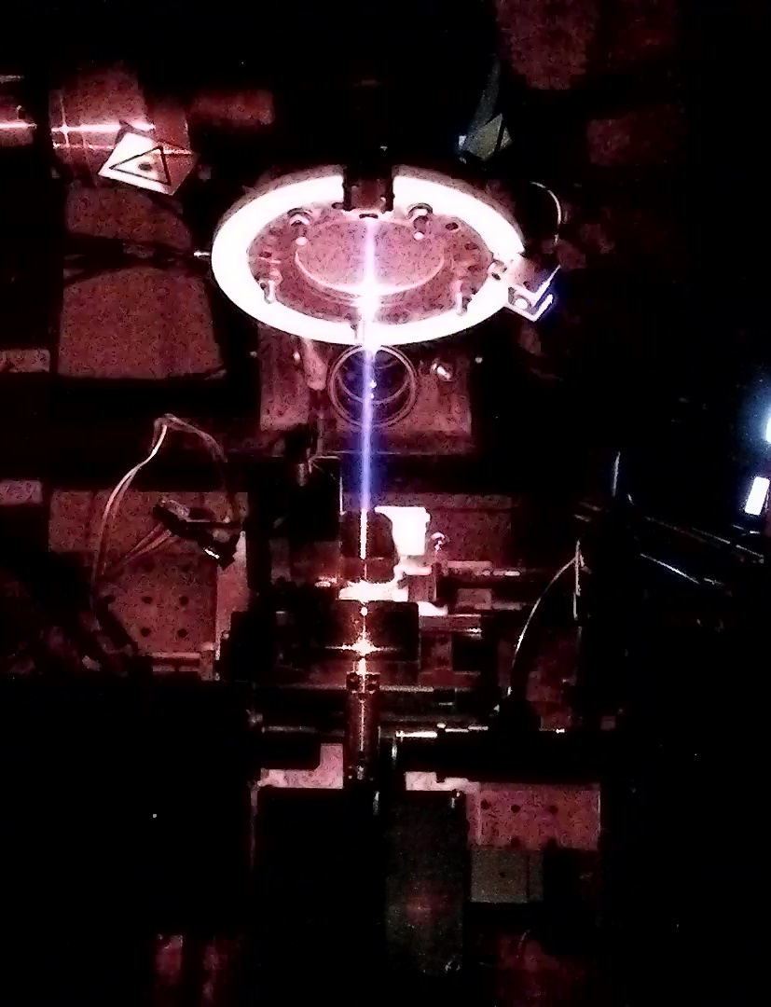
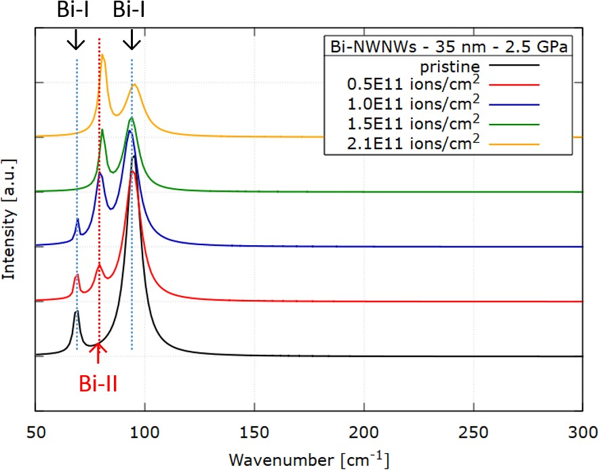

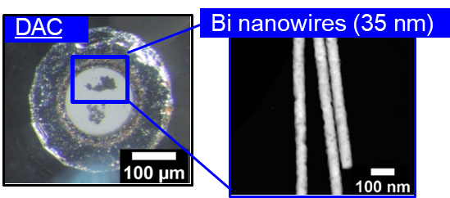
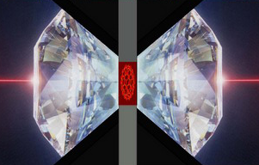
Materials Research
Irradiation under high pressure
Beam collimation
(200 µm)
Raman spectroscopy
increasing fluence
Samples Under
High Pressure
Optical Microscopy
Notes:
Bi(I) rhombohedral lattice; this Bi–I structure changes first to the monoclinic Bi-II at 2.55 Gpa; then to the tetragonal Bi-III at 2.7 GPa, and finally to the body-centered cubic Bi-V at 7.7 Gpa

Slide 18
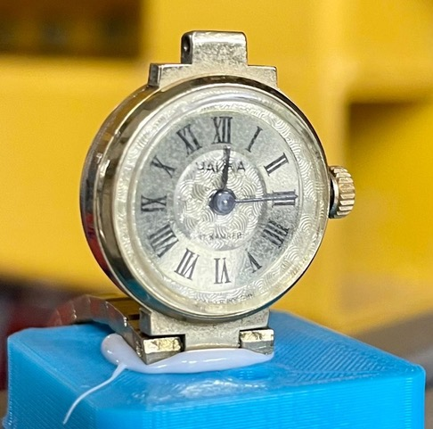
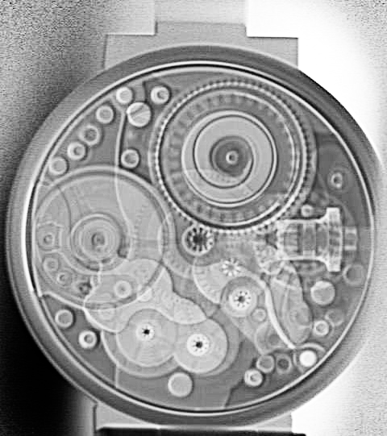
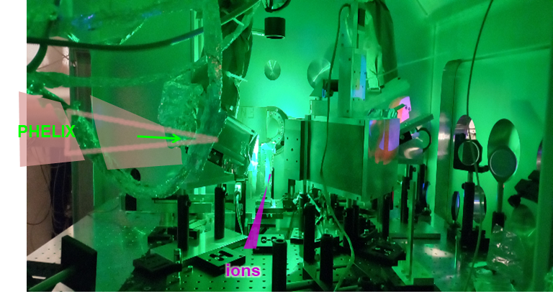
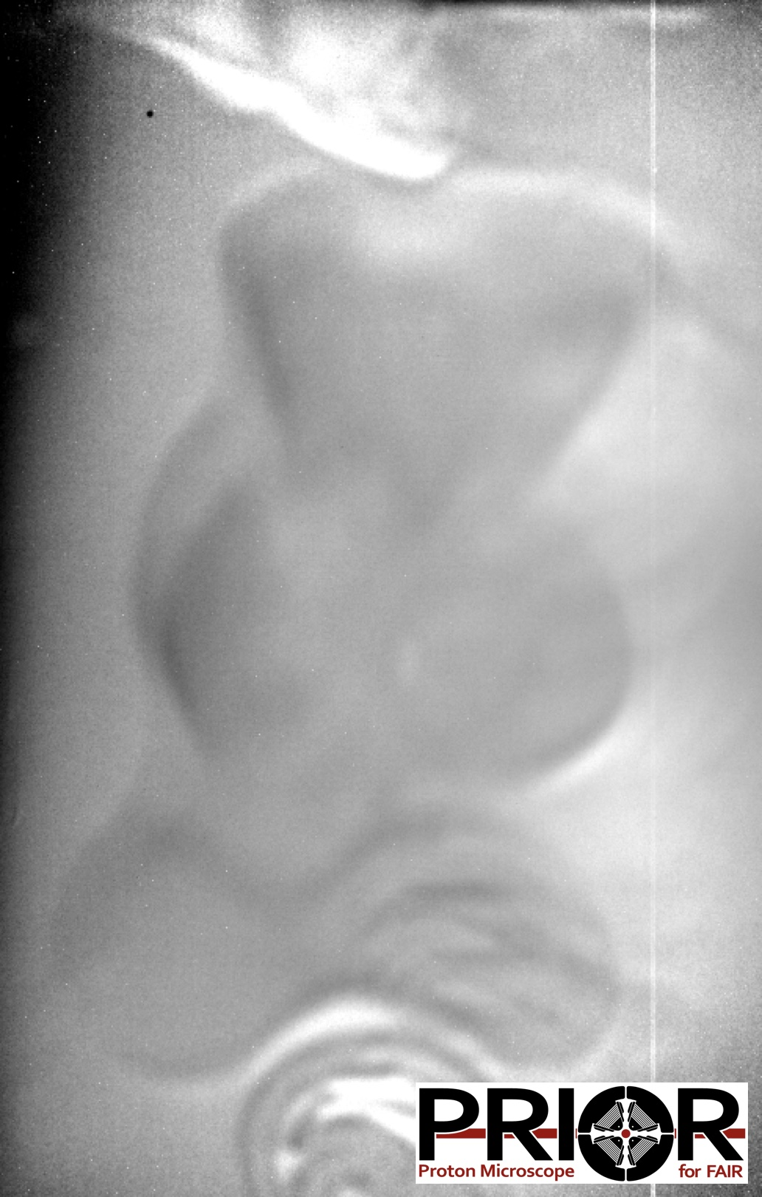
Plasma physics
High energy density studies
PRIOR – heavy ion radiography
Plasma diagnostics with lasers
▲ Small wrist watch (left) imaged with 975 MeV/u Carbon beam (right). (2mm mono CsI, PCO Edge 5.5 CLHS).
Spatial resolution performance of heavy-ions worse than protons but sufficient for physics experiments
Improved density contrast for 975 MeV/u Carbon for certain target areal densities
Contrast advantage depends on beam energy
Combination of PHELIX laser with heavy-ion beams
Volumetric heating by heavy-ion pulses
Diagnostics with laser-driven x-ray sources
Broadband x-ray spectrum, based on the enhancement of continuum emission by radiative recombination
broadband x-ray spectrum, based on the enhancement of continuum emission by radiative recombination, recently demonstrated at the Lawrence Livermore National Laboratory. Together with a newly developed dual-channel crystal spectrometer, highly resolved absorption spectra around the aluminium K-edge could be obtained, already in an experimental geometry that is suitable for heavy-ion heating in future experiments For experiments using heavy-ions from the SIS18 synchrotron, the high-energy laser beamline from PHELIX to the HHT-cave allows for experiments combining volumetric heating by the heavy-ion pulses with laser-driven x-ray sources for diagnostics. Project start: 2019, after review/approval of 6th JSC
HHT laser laboratory (HHTS) brought into operation (March 2021)
First light – May 2021
  Timing scheme PHELIX/SIS-18 demonstrated – jitter < 10 ns (measurement precision limited)
  Laser beam on target
Commissioning experiment (P214) currently going on

Slide 19

CBM/HADES – Scientific goals at FAIR
Location of chiral cross over
Mission:
Systematically explore QCD matter
at large baryon densities
with high accuracy and rare probes.
W. Fu, J. Pawlowski, F. Rennecke,
Phys.Rev.D 101 (2020) 5, 054032, arXiv:1909.02991
T. Galatyuk, https://github.com/
tgalatyuk/interaction_rate_facilities, 2022

Slide 20




HADES@FAIR Phase-0
Ξ⁻ production in Ag+Ag @ √s = 2.55 GeV
Original from: Phys.Lett.B 831 (2022) 137152
Over four weeks,
HADES collected
14 billion central Ag+Ag
events @ √s = 2.55 GeV
Ξ⁻ hyperons detected
via the decay chain:
Ξ⁻→Λπ⁻→p π⁻ π⁻
  excellent background
  suppression by using artificial
  neural networks
Significance slightly
below 5σ, yet clear signal
above background
Canonically extended SHM model predicts strong dependence of canonical radius R_{C} and Φ/Ξ⁻ ratio
reaction | $\sqrt{s}$ (GeV) | T_{lab} (GeV)
$$pp→K^{+}K^{+}Ξ^{−}p$$ | 3.247 | 3.7

Slide 21




Hypernuclei at HADES: Ag+Ag@√s = 2.55 GeV
Information on Λ(Λ)N(N) interactions important for understanding of neutron stars
Characteristics
  lifetime and binding energies
  size and deformation
  excitations
  super-halos
production mechanisms
  understanding clustering phenomena
HADES Ag+Ag@√s = 2.55 GeV:
multi-differential analysis
(4.61 ± 0.16 ± 0.39) × 10⁻⁴

Slide 22

Hypernuclei at FAIR
Information on Λ(Λ)N(N) interactions important for understanding of neutron stars
Characteristics
  lifetime and binding energies
  size and deformation
  excitations
  super-halos
Further experiments
  WASA@Super-FRS (binding energies, spectroscopy)
  HYDRA@R3B (binding energies, radius)
HADES Ag+Ag@√s = 2.55 GeV:
multi-differential analysis
HADES Ag+Ag@√s = 2.55 GeV:
Lifetime of (249 ± 21 ± 30) ps compatible with free Λ lifetime measured

Slide 23



Charm production
in pp/pA collisions at SIS100 with CBM
J/ψ production
Cross section ≈ 1 nb at 30 GeV/c (√$\overline{s}$=7.5 GeV)
Large and uniform reco eff. 5-30%
Strong background suppression (Kinematic-fit)
Scientific questions
Influence of internal charm of proton on cross section close to threshold?
J/ψ-N interaction with multiple gluon exchange with proton
  Forward (t=0) J/ψ dσ/dt related to J/ψ–N scattering
  amplitude, and nucleon mass via trace anomaly
  J/ψ-N interaction related to pentaquark searches
  J/ψ in-medium characteristics
comparing pp to pA/AA-reactions
J. Ritman et al.
FFN (GSI)
Notes:
t = four momentum transfer

Slide 24
Exotic beams
NUSTAR: Investigating properties of exotic nuclei
Production, identification and separation
Super-FRS
  in-flight fragmentation/fission
Properties being measured
masses
half lifes
mass/charge radii
single particle structure
collective behavior
equation of state of asymmetric nuclear matter
exotic systems (hyper nuclei)
R3B
WASA

Slide 25






Exotic beams
NUSTAR: Investigating properties of exotic nuclei
SHIP
Production, identification and separation
Super-FRS
  in-flight fragmentation/fission
Properties being measured
masses
half lifes
mass/charge radii
single particle structure
collective behavior
equation of state of asymmetric nuclear matter
exotic systems
12 m
CRYRING
DESPEC
ESR
ION Catcher
ILIMA@CR
R3B
WASA
GLAD Magnet@R3B
WASA

Slide 26


DESPEC set-ups prepared for
Phase-0 and ready for Early/First Science
wide AIDA
DTAS
DEGAS
DESPEC High-resolution set-up with
novel DEGAS Ge detectors
DESPEC High-efficiency set-up with
DTAS Total Absorption Spectrometer
Phase-0
Early Science
First Science
²⁰³Ir, ²⁰²Os, ²⁰³Pt, ²⁰²Ir | ^{203,204}Pt, ²⁰⁴Au, ²⁰⁶Au, ²⁰⁷Hg
Full β-γ spectros. | TAS & B(GT) measurement
 | Pt, Ir, Os chain up to N=127 | ²⁰⁷Au₁₂₈ ²⁰⁵Pt₁₂₇
 | T_{1/2} & β-delayed n emission | Full β-γ spectros.
 | Os, Re to N=129 ²⁰¹W₁₂₇ | ²⁰⁵Ir₁₂₈ ²⁰³Os₁₂₇
 | T_{1/2} & β-delayed n emission | Full β-γ spectros.

Slide 27





NUSTAR / R3B set-up for kinematically complete measurements of nuclear reactions
JLAB (e+A) conclusion: Protons more correlated in neutron-rich, stable nuclei
Open questions
effect of mass ratio or asymmetry?
development towards large N/Z
FAIR Phase-0 experiment at R3B
changing N/Z at similar mass
kinematically complete measurement using ¹²C, ¹⁶C beams
A. Corsi et al. R3B

Slide 28


NUSTAR
First R3B experiment
Neutron skin measurements constrain
symmetry energy at ρ₀
  parity violating electron scattering
Precise constraints on the neutron pressure around saturation density from measurements of neutron skins in Sn isotopes
  dipole polarizability
  neutron removal
PREX@JLAB Collaboration
Phys. Rev. Lett. 126, 172502
D. M. Rossi et al.
Phys. Rev. Lett. 111, 242503
⁶⁸Ni

Slide 29




Storage rings
Atomic Physics
SPARC Precision physics by trapping and storage of higly charged ions
hydrogen
Cooling a key to precision
Z=1
E_{b} = 13.6 eV
Z·α « 1
uranium ion
Radiative corrections in the non-perturbative regime
Correlated multi-body dynamics for atoms and ions
Precision determination of fundamental constants
Influence of atomic structure on nuclear decay properties
Astrophysics with stored highly charged ions
Z=92
E_{b} = 132 keV
Z·α ≈ 1

Slide 30












Precision measurement of intrashell transitions in He-like uranium in ESR
Validity check of QED in extremely strong electromagnetic fields
R. Loetzsch et al. Nature 625, 2024, 673, doi: s41586-023-06910-y
experimental and theoretical values for the intrashell transitions (absolute energy and energy differences between He- and Li-like ions of 1s_{1/2}2p_{3/2} J = 2 → 1s_{1/2}2s_{1/2} J = 1).
result is factor of 6 more precise compared to former study and probes 2nd order radiative corrections.
30
Notes:
Experimental setup (Bragg spectrometer for spectroscopy at the internal target (2021).

Slide 31





Mass measurements in storage rings
investigation of isomeric states
102 individual injections into ESR
decay of ^{72m}Ge³²⁺ is clearly observed
γ
γ
0⁺
691 keV
⁷²Ge³²⁺
0⁺
D. Freire-Fernández, W. Korten, R.J. Chen, et al. arXiv:2312.11313
Notes:
nacked nuclei

Slide 32








Reaction studies in storage rings
How did supernovae contribute to the element composition of the solar system?
  challenging nuclear cross section measurements are needed on radioactive nuclei
  a new experimental scheme for (p,γ) reactions established in the ESR storage ring
1st measurement of ¹²⁴Xe(p,n)
  new background-free detection method & maximized sensitivity
  (p,n) reaction now generally accessible for experiment
  stronger constraints for underlying nuclear physics models
1st radioactive beam measurement
  reliable data for ¹¹⁸Te(p,γ) and ¹¹⁸Te(p,n)
  analysis on-going
submitted to PRL
recoil detection in UHV at high efficiency

Slide 33
Summary and outlook
Primary and secondary beam capabilities at FAIR opens up a wealth of different physics opportunities
  strong interaction studies in pp and pA reactions
  QCD phase diagram at high densities
  equation of state of neutron-rich matter
  characteristics of exotic nuclei
  astrophysical relevant reactions
  high-precision tests of QED
  materials under extreme conditions
International FAIR community looks forward to continued explotation of the FAIR facilities on the GSI campus and…

Slide 34
Summary and outlook
Primary and secondary beam capabilities at FAIR opens up a wealth of different physics opportunities
  strong interaction studies in pp and pA reactions
  QCD phase diagram at high densities
  equation of state of neutron-rich matter
  characteristics of exotic nuclei
  astrophysical relevant reactions
  high-precision tests of QED
  materials under extreme conditions
…. looks forward to
2027 Start of experiments at
Super-FRS with SIS18 beams
2028 Start of experiments with SIS100
Thank you!

Slide 35
Current prospects

Slide 36

CBM – Scientific goal
Location of chiral cross over
Strange and charmed particle
production thresholds
in pp - collisions
W. Fu, J. Pawlowski, F. Rennecke,
Phys.Rev.D 101 (2020) 5, 054032, arXiv:1909.02991
reaction | $\sqrt{s}$ (GeV) | T_{lab} (GeV)
$$pp→K^{+}Λp$$ | 2.548 | 1.6
$$pp→K^{+}K^{−}pp$$ | 2.864 | 2.5
$$pp→K^{+}K^{+}Ξ^{−}p$$ | 3.247 | 3.7
$$pp→K^{+}K^{+}K^{+}Ω^{−}n$$ | 4.092 | 7.0
$$pp→Λ\overline{Λ}pp$$ | 4.108 | 7.1
$$pp→Ξ^{−}{\overline{Ξ}}^{+}pp$$ | 4.520 | 9.0
$$pp→Ω^{−}{\overline{Ω}}^{+}pp$$ | 5.222 | 12.7
$$pp→J/Ψpp$$ | 4.973 | 12.2

Slide 37


Hypernuclei at FAIR
Information on Λ(Λ)N(N) interactions important for understanding of neutron stars
Characteristics
  lifetime and binding energies
  size and deformation
  excitations
  super-halos
HADES Ag+Ag@√s = 2.55 GeV:
multi-differential analysis
Thermal model predictions

Slide 38
Charm production
in pp/pA collisions at SIS100 with CBM
J/ψ production
Cross section ≈ 1 nb at 30 GeV/c (√$\overline{s}$=7.5 GeV)
Large and uniform reco eff. 5-30%
Strong background suppression (Kinematic-fit)
Scientific questions
Influence of internal charm of proton on cross section close to threshold?
J/ψ-N interaction with multiple gluon exchange with proton
  Forward (t=0) J/ψ dσ/dt related to J/ψ–N scattering
  amplitude, and nucleon mass via trace anomaly
  J/ψ-N interaction related to pentaquark searches
  J/ψ in-medium characteristics
comparing pp to pA/AA-reactions
J. Ritman et al.
FFN (GSI)
Notes:
t = four momentum transfer

