Slide 1
Departamento de Física Teórica. Institute of Particle & Cosmos Physics (IPARCOS)
Universidad Complutense de Madrid
Description of femtoscopic correlations with realistic pion-kaon
interactions: the kappa case
Alejandro Canoa Monsalve
In collaboration with:
M. Albaladejo, J.M. Nieves, J.R. Peláez, E. Ruiz Arriola and J. Ruiz de Elvira
QNP2024, Barcelona, July 9th 2024
Supported by:

Slide 2
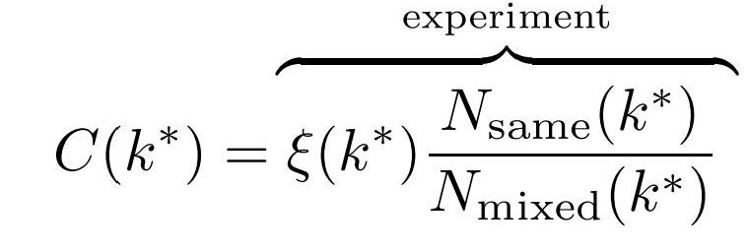
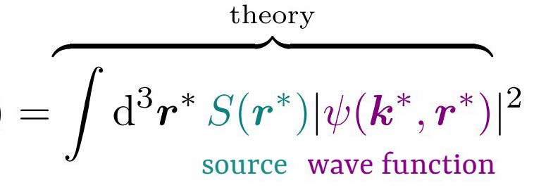
FEMTOSCOPIC CORRELATIONS:@ ALICE
Formalism originally devised to estimate the size of the source
In nucleus-nucleus
collisions
(pp,Pb-Pb…)
Observed correlations
$$N_{diff}$$
Experimental effects

Slide 3
Example:
arXiv:2312.12830v2 [hep-ex] 28 Dec 2023
BEAUTIFUL DATA and remarkable statistics !!
Fit 1
Fit 2
Fit 3
Three different sets (different cuts)
- P-wave and other effects removed with PYTHIA
- Basically S-wave.

Slide 4
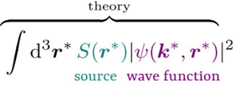
Usual (and ALICE) approach
Theoretical model: Lednicky et al. formalism
Assumptions
Only s-wave amplitude $f(k^{∗})$ is considered
NR Lippmann-Schwinger
approach for $Ψ$
Factorization
$α=\frac{1}{2}$symmetry factor
$ΔC$is a correction to the
free wavefunction
$F_{1},$ $F_{2}$ known analytical functions
$λ$correlation strength parameterizes other sources of the pair
$λ, R$ fit parameters

Slide 5
ALICE approach for the $πK$ interaction
Lednicky et al. formalism + an elastic Breit Wigner (BW) !!
I=3/2 wave is neglected
$M_{R}, γ$parameters of the interaction (fitted)
Fit 1
Fit 2
Fit 3
ALICE | $M_{R}($GeV$)$ | $γ($GeV$)$
Fit 1 | $$0.833±0.015$$ | $$0.890±0.025$$
Fit 2 | $$0.804±0.014$$ | $$0.801±0.033$$
Fit 3 | $$0.765±0.013$$ | $${0.714 }_{− 0.039}^{+ 0.044}$$
Imcompatible with each other!!

Slide 6
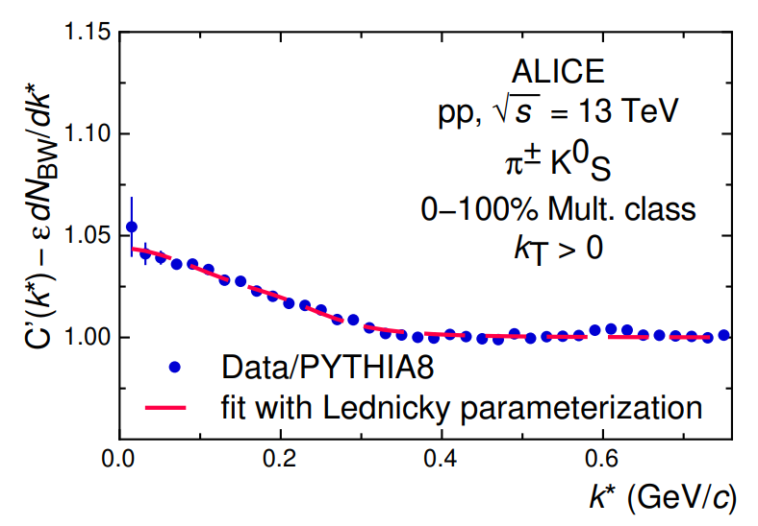
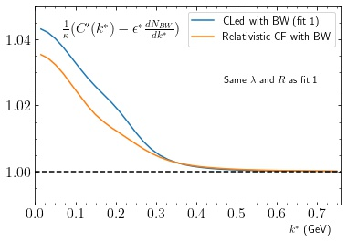
Our approach
Minimum relativistic
Fit 1
$M_{π}≈0.14$GeV, but
$k^{∗}$up to $0.76$ GeV
$$M_{π}$$
0.76
Need for relativistic corrections!!
Replace propagators
and the integral measure
(Relativistic CF)
$I_{1},I_{2}$ play the role of $F_{1},F_{2}$
ALICE approach
Supression due to
$I_{1},I_{2},F_{1},F_{2}$terms
10-15% difference!!

Slide 7
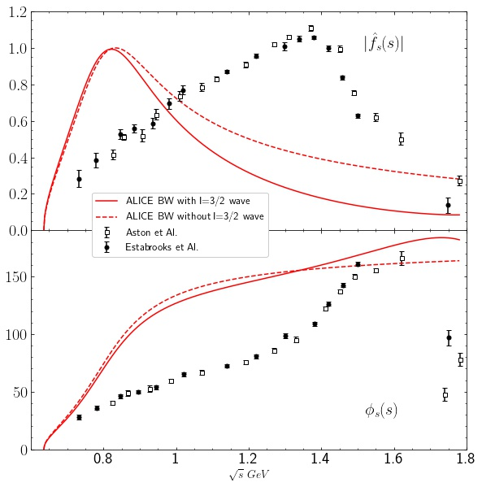
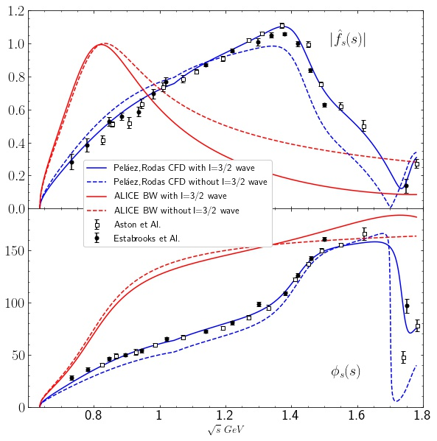
Our approach
BW vs. realistic interactions
$π^{+}K_{S}^{ }$combination of I=1/2 and I=3/2 isospin $πK$ states
ALICE uses an elastic BW,
neglecting I=3/2 wave
ALICE incapable of reproducing the $πK$scattering data
$f_{S}=f_{0}^{\frac{1}{2}}+\frac{1}{2}f_{0}^{\frac{3}{2}}=\left|f_{S}\right|e^{iφ}$
We use dispersive parametrizations of the s-wave isospin channels
(Constrained Fits to Data, CFD*)
Significant improvement!
Effect of the I=3/2 noticeable
x$4$bigger in $π^{+}K_{S}‼$
*Peláez, Rodas Phys. Rept. 969 (2022) 1-126

Slide 8
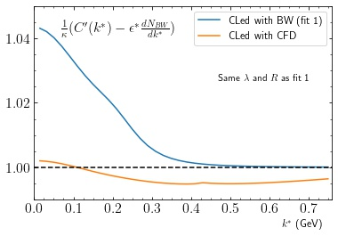
Our approach
Realistic interactions vs BW
ALICE approach
Realistic parametrization
The effect of the realistic interaction is even more relevant than the relativistic corrections

Slide 9
Our approach
Our complete formula
The normalization factor also appears in ALICE model implicitly ($κ)$
$I_{1}$and $I_{2}$come from the momentum integrals when we use the relativistic propagators.
$f_{el}$is the s-wave scattering amplitude of $π^{+}K_{S}→π^{+}K_{S}$
$f_{in}$ is the off-diagonal amplitude $π^{+}K_{S}→π^{0}K^{+}, π^{+}K_{L}$

Slide 10
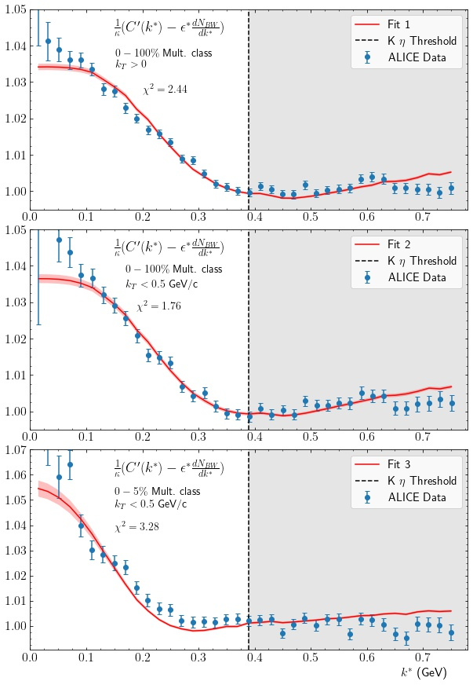
Our results
Just 3 parameters $(R,λ, κ)$ vs 6 fit parameters in ALICE
for each plot
The interaction is fixed and the same for the three fits
Inconsistent $\left(M_{R},γ\right)$ pairs from each fit in ALICE analysis

Slide 11
Our results
Our results | R(fm) | $$λ$$
Fit 1 | $$0.347±0.006$$ | $$0.23±0.01$$
Fit 2 | $$0.375±0.006$$ | $$0.29±0.03$$
Fit 3 | $$0.67±0.03$$ | $$0.89±0.09$$
ALICE | R(fm) | $$λ$$
Fit 1 | $$\text{0.912}±0.065$$ | $${\text{0.0783}}_{−0.0121}^{+0.0127}$$
Fit 2 | $$\text{1.063}±\text{0.088}$$ | $$\text{0.111}±\text{0.022}$$
Fit 3 | $${\text{1.618}}_{−0.142}^{+0.163}$$ | $${\text{0.274}}_{−0.059}^{+0.081}$$
Radius of the source smaller than ALICE (2-3 times smaller)
Bigger values of $λ$
Different dependence of $λ$
on R
Different nature of
the $κ$ resonance?

Slide 12
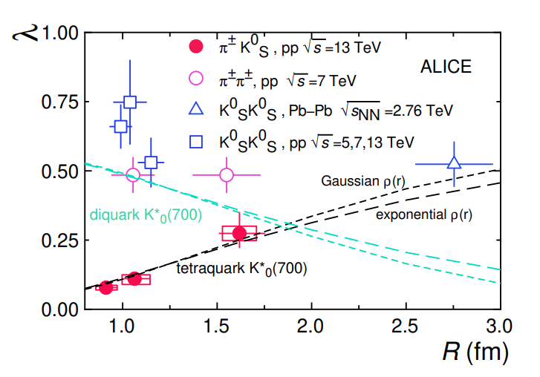
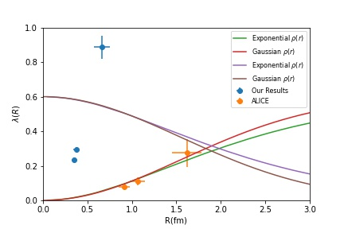
^{Preliminary}
Diquark
Tetraquark
Our $λs$

Slide 13
Summary
ALICE provide high quality data and their hint of interesting feature in their femtoscopic correlations is very encouraging.
We have improved their model taking into account relativistic corrections and realistic interactions
The values of the radius obtained are smaller than typically expected, but non- relativistic frameworks dominate the literature.
Lots of work ahead:
Could we extract information of the interaction if the source parameters are known?
Analysis of other cases (2 Kaons?)
Could the femtoscopic formalism clarify the nature of the kappa?

Slide 14
Departamento de Física Teórica. Institute of Particle & Cosmos Physics (IPARCOS)
Universidad Complutense de Madrid
Thanks for your time!
QNP2024, Barcelona, July 9th 2024
Supported by:

Slide 15
Spare slides

Slide 16
Lippmann-Schwinger equation

Slide 17
 | R(fm) | $$λ$$
Fit 1 | $$0.34703±0.00518\left(stat\right)±0.00074(sys)$$ | $$0.2347±0.0091\left(stat\right)±0.0022(syst)$$
Fit 2 | $$0.3749±0.059\left(stat\right)±0.0016(sys)$$ | $$0.2945±0.0139\left(stat\right)±0.0012(sys)$$
Fit 3 | $$0.6667±0.016\left(stat\right)±0.0015(sys)$$ | $$0.886±0.062\left(stat\right)±0.027(sys)$$

