Slide 1
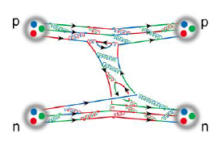
Density Functional Theory for atomic nuclei
Gianluca Colò

Slide 2
Glossary
According to Levy and Lieb, it is possible to define an exact functional that relates energy and particle density:
In the case of electron systems, the Coulomb interaction is known. The Hartree-Fock energy is known. There are also a few exact results. However, existing functionals usually include empirical parameters.
For nuclei, so far, there is still no accurate and unique Hamiltonian for the strong interaction at low energy.

Slide 3
Nuclear Density Functional Theory
The energy functional has a minimum at the ground-state density, where it assumes the ground-state E as a value.
Energy density =
E is called Energy Density Functional
Existence is guaranteed by Hohenberg-Kohn, Levy-Lieb.
It gives access, in principle, to all properties of the system.
The theorems do not tell what the EDF looks like.
Empirical input!

Slide 4
The Kohn-Sham scheme
We assume that the density can be expressed in terms of single-particle orbitals, and that the kinetic energy has the simple form:
We have said that the energy must be minimized, but we add a constraint associated with the fact that we want orbitals that form an orthonormal set (Lagrange multiplier):
The variation of this quantity, (𝛿/𝛿ϕ*)... = 0 produces a Schrödinger-like equation:
“DFT is an exactification of Hartree-Fock” (W. Kohn).

Slide 5
Skyrme Energy Density Functionals
They are local functionals depending on various densities.
Here, proton/neutron labels are omitted for the sake of simplicity.
This is a simplified formula.
J is for the spherical case. Only time-even densities included. Cf. P.D. Stevenson, M.C. Barton, Prog. Part. Nucl. Phys. (2018).
Parameters are determined by a fit to data (or pseudo-data).

Slide 6
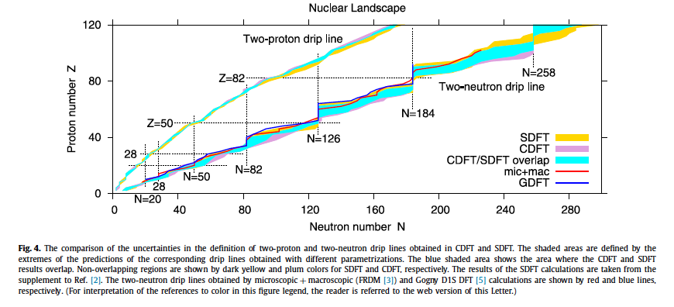
Skyrme, Gogny and covariant EDFs
Drip lines: loci where the (one- or two-nucleon) separation energy goes through 0. In other words, limits of the nuclear existence.
A.V. Afanasjev et al., Phys. Lett. B726, 680 (2013)

Slide 7
Ab initio nuclear structure
Techniques to solve the many-body problem that are exact, or systematically improvable, and can provide reliable estimates of the theoretical errors.
Results are sensitive to the choice of the Hamiltonian.
Quantum Monte Carlo (QMC)
Lattice EFT
In-medium similarity renormalization group (IMSRG)
Coupled cluster (CC)
Self-consistent Green’s function (SCGF)
No-core Shell Model (NCSM)
...
Image courtesy of A. Schwenk
Ab initio, depending on the specific implementation, has difficulties to handle heavy nuclei and highly excited states.

Slide 8
Status of nuclear DFT (very brief...)
Error on masses of the order of ≈ MeV. Drip lines shown in slide #6. How to do better?
Trends of charge radii and deformations fairly well reproduced. What about the accuracy?
Giant resonances. Underestimate of resonance widths.
β-decay. Overestimate of half-lives.
Interest in large amplitude motion
(fission etc.) (cf. talk by S. Giuliani)
n
⁹Li
n

Slide 9
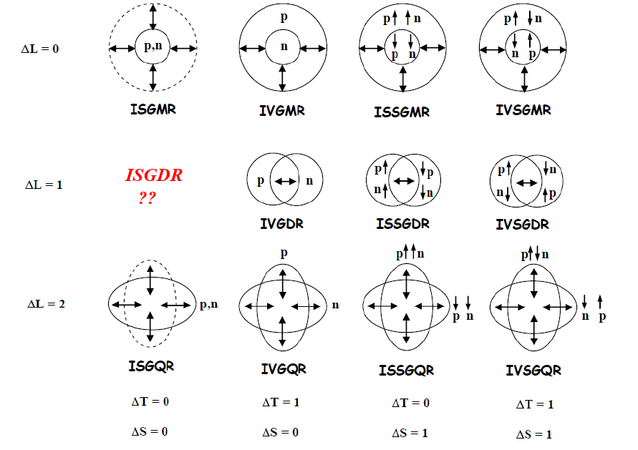
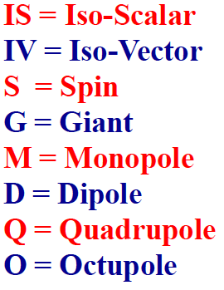

Collective giant resonances
Image courtesy of M. Harakeh
p, 𝛼
They are excited by photons or by particle inelastic scattering

Slide 10
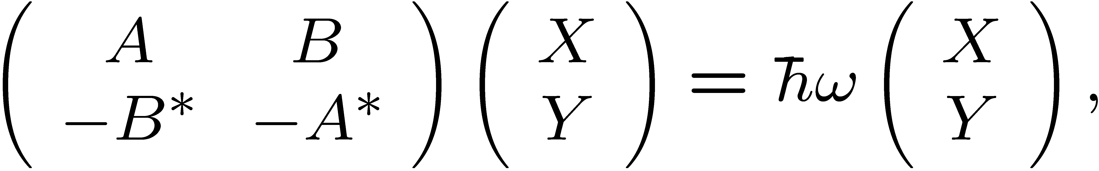
Time-dependent DFT and RPA
In the time-dependent case, one can solve the evolution equation for the density directly:
From: P. Stevenson (U. Surrey)
If the equation for the density is linearized and solved on a basis: Random Phase Approximation or RPA.
G.C. et al., Computer Physics Commun. 184, 142 (2013).
In RPA the excited states are 1p-1h superpositions

Slide 11
Possible improvements
Changing the form of the functional (more parameters, more terms, different form...)
Advanced statistical methods (Bayesian inference, ML...)
Adding specific many-body correlations
Building the EDFs from ab initio

Slide 12
Higher-order derivative terms
The UNEDF collaboration claimed that the standard Skyrme EDF has reached its limits [M. Kortelainen et al., Phys. Rev. C89, 054314 (2014)].
Derivative operators up to fourth order have been introduced later on.
There is no sign of a big improvement.

Slide 13
Possible improvements
Advanced statistical methods (Bayesian inference, ML...)

Slide 14
Recent results from PREX and CREX
Parity-violating asymmetry measured in electron scattering is a probe of the neutron distribution (in principle, a model-independent probe).
Neutron skin
D. Adhikari et al., Phys. Rev. Lett. 129, 042501 (2022)

Slide 15
EDF parameters and Equation of State (EoS)
When performing Bayesian analysis, it may be convenient to transform EDF parameters into more physically meaningful quantities.
Symmetric matter EOS
Symmetry energy S
Nuclear matter EOS
There are huge efforts to determine the density dependence of the neutron EoS, or of S
β=1
Neutron skin
β=0

Slide 16
Posterior distributions of parameters
T. Zhao et al., arXiv:2406.05267v1 [nucl-th]
Preliminary
Basic BE, radii
One should study carefully the effect of various inputs:
Only the monopole resonance determines the incompressibility
The symmetry energy parameters are affected by more than one observable
+ 𝛼_{D}
+ E(GRs)
+ CREX only
+ PREX only
all observables
Astrophysics comes in (cf. talk by A. Fantina)

Slide 17
Possible improvements
Adding specific many-body correlations

Slide 18
A class of further correlations: coupling single-particle with collective states
So far, Kohn-Sham eigenstates correspond to single-particle states and RPA eigenvalues correspond to vibrational states like Giant Resonances.
A further step consists in taking into account the coupling between them (Particle-Vibration Coupling or PVC, on top of DFT).
Odd nuclei: core + 1 particle + 1 particle plus phonon …

Slide 19
(cf. talk by D. Sharp)

Slide 20
RPA + PVC
Reminder: in RPA, the excited states were superpositions of 1p-1h states.
Now, we want to describe as superpositions of 1p-1h-1 phonon.
Cf. also the talk by Danilo Gambacurta.
The state α is 1p-1h plus one phonon.
The scheme is very effective to produce GR widths. It also produces a downward shift of the GRs.

Slide 21
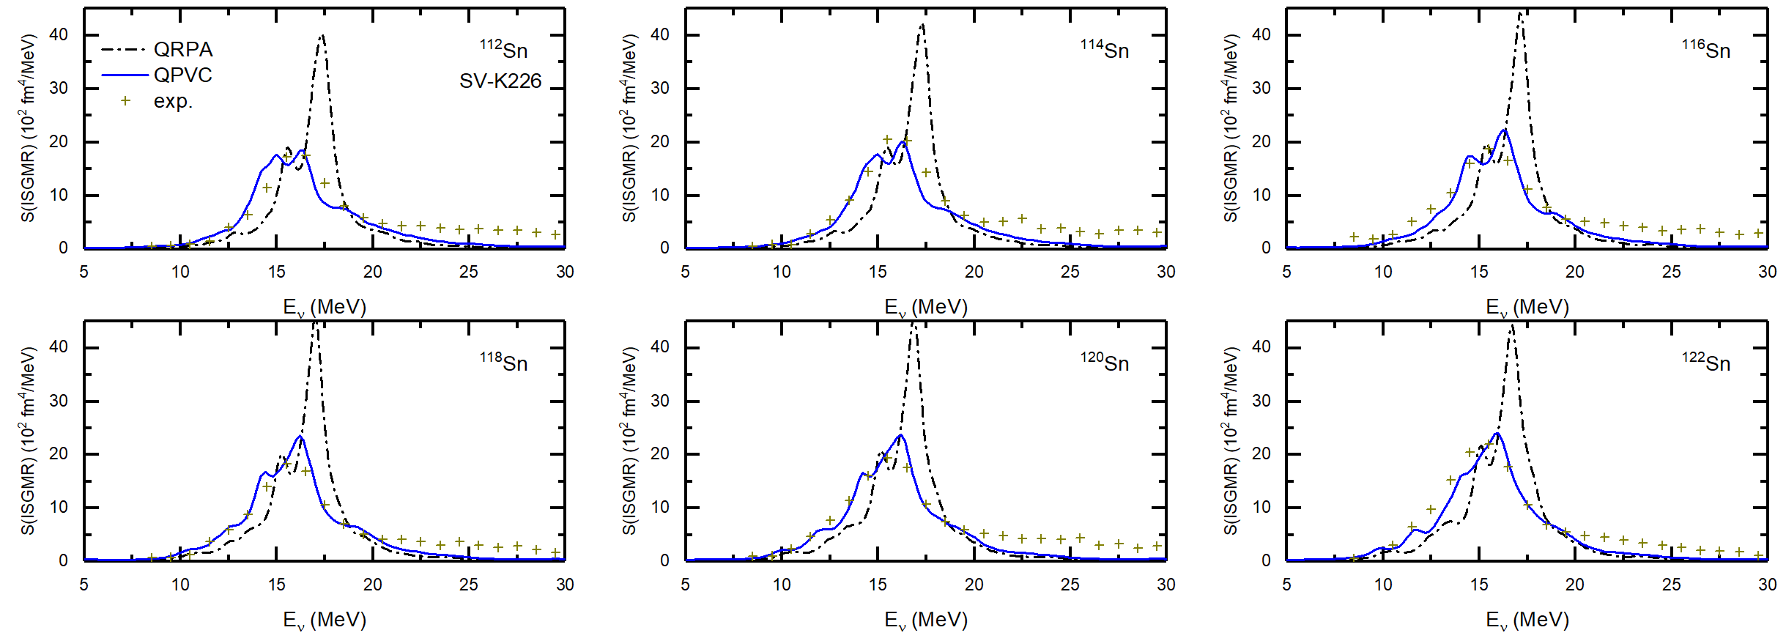
ISGMR in Sn isotopes
Exp. data from D. Patel et al., Phys. Lett. B726, 178 (2013)
QPVC reproduces the experimental data quite well.
The best description is obtained with the Skyrme EDF SV-K226.
Z.Z. Li, Y.F. Niu, GC, Phys. Rev. Lett. 131, 082501 (2023)

Slide 22
Isovector Giant Dipole Resonance in QPVC

Slide 23
More applications of QPVC: β-decay
While QRPA collects the simple two-quasiparticle excitation in a main peak, it does not account for spread and fragmentation of the strength. QPVC remedies to this shortcoming.
In the case of β-decay, this is particularly important because of the phase-space factor.
Y. F. Niu et al., Phys. Rev. Lett. 114, 142501

Slide 24
Possible improvements
Building the EDFs from ab initio
(cf. also talks by H. Sagawa/T. Naito)

Slide 25
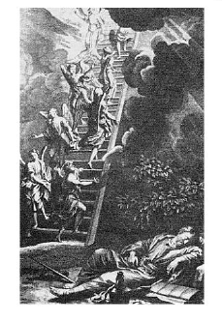
A systematic ladder of approximations
Our recently developed strategy is systematic and based on the Jacob’s ladder of electronic DFT.
Heaven of chemical accuracy
Perturbed nuclear matter
Homogeneous matter EOS
Follow a step-by-step approach
Use ab initio simulations of model systems as a constraint
Earth of Hartree
Accuracy in the atomization energies of 20 molecules [eV]
LSDA GGA mGGA
1.4 0.3 0.1. (average of these energies ≈ 8.21 eV)
J. Perdew, K. Schmidt, AIP Conf. Proc. 577, 1 (2001).

Slide 26
Auxiliary Field Diffusion
quantum Monte Carlo (AFDMC).
Self-consistent Green’s Function (SCGF) method.
ADC(n).

Slide 27
Local Density Approximation (LDA)
We start from the Equation of State (EoS) of nuclear matter.
Within LDA, the energy functional is the same as in uniform matter.
We apply it to finite systems as if their local density were uniform.
PNM
SNM

Slide 28
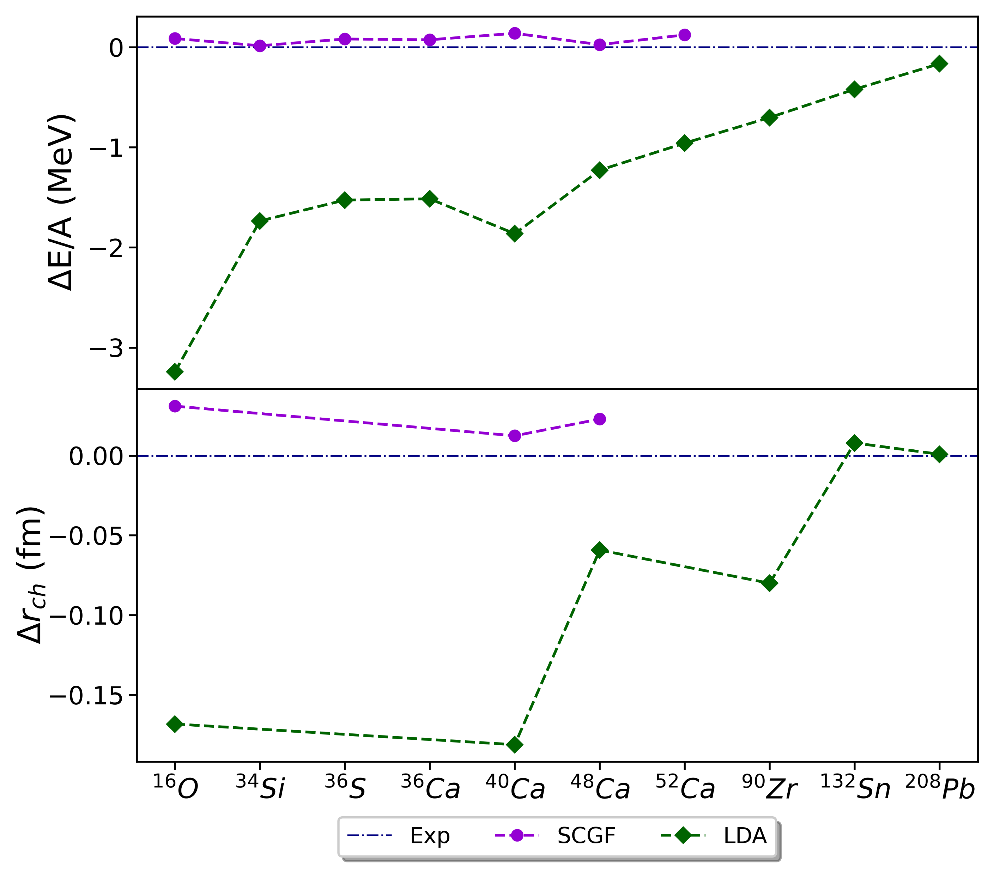
Results: NNLO_{sat}
Ab initio
Difference with respect to experiment for
E/A (upper panel)
r_{ch} (lower panel)
Encouraging results in heavy nuclei (¹³²Sn, ²⁰⁸Pb)
Something still missing
LDA

Slide 29
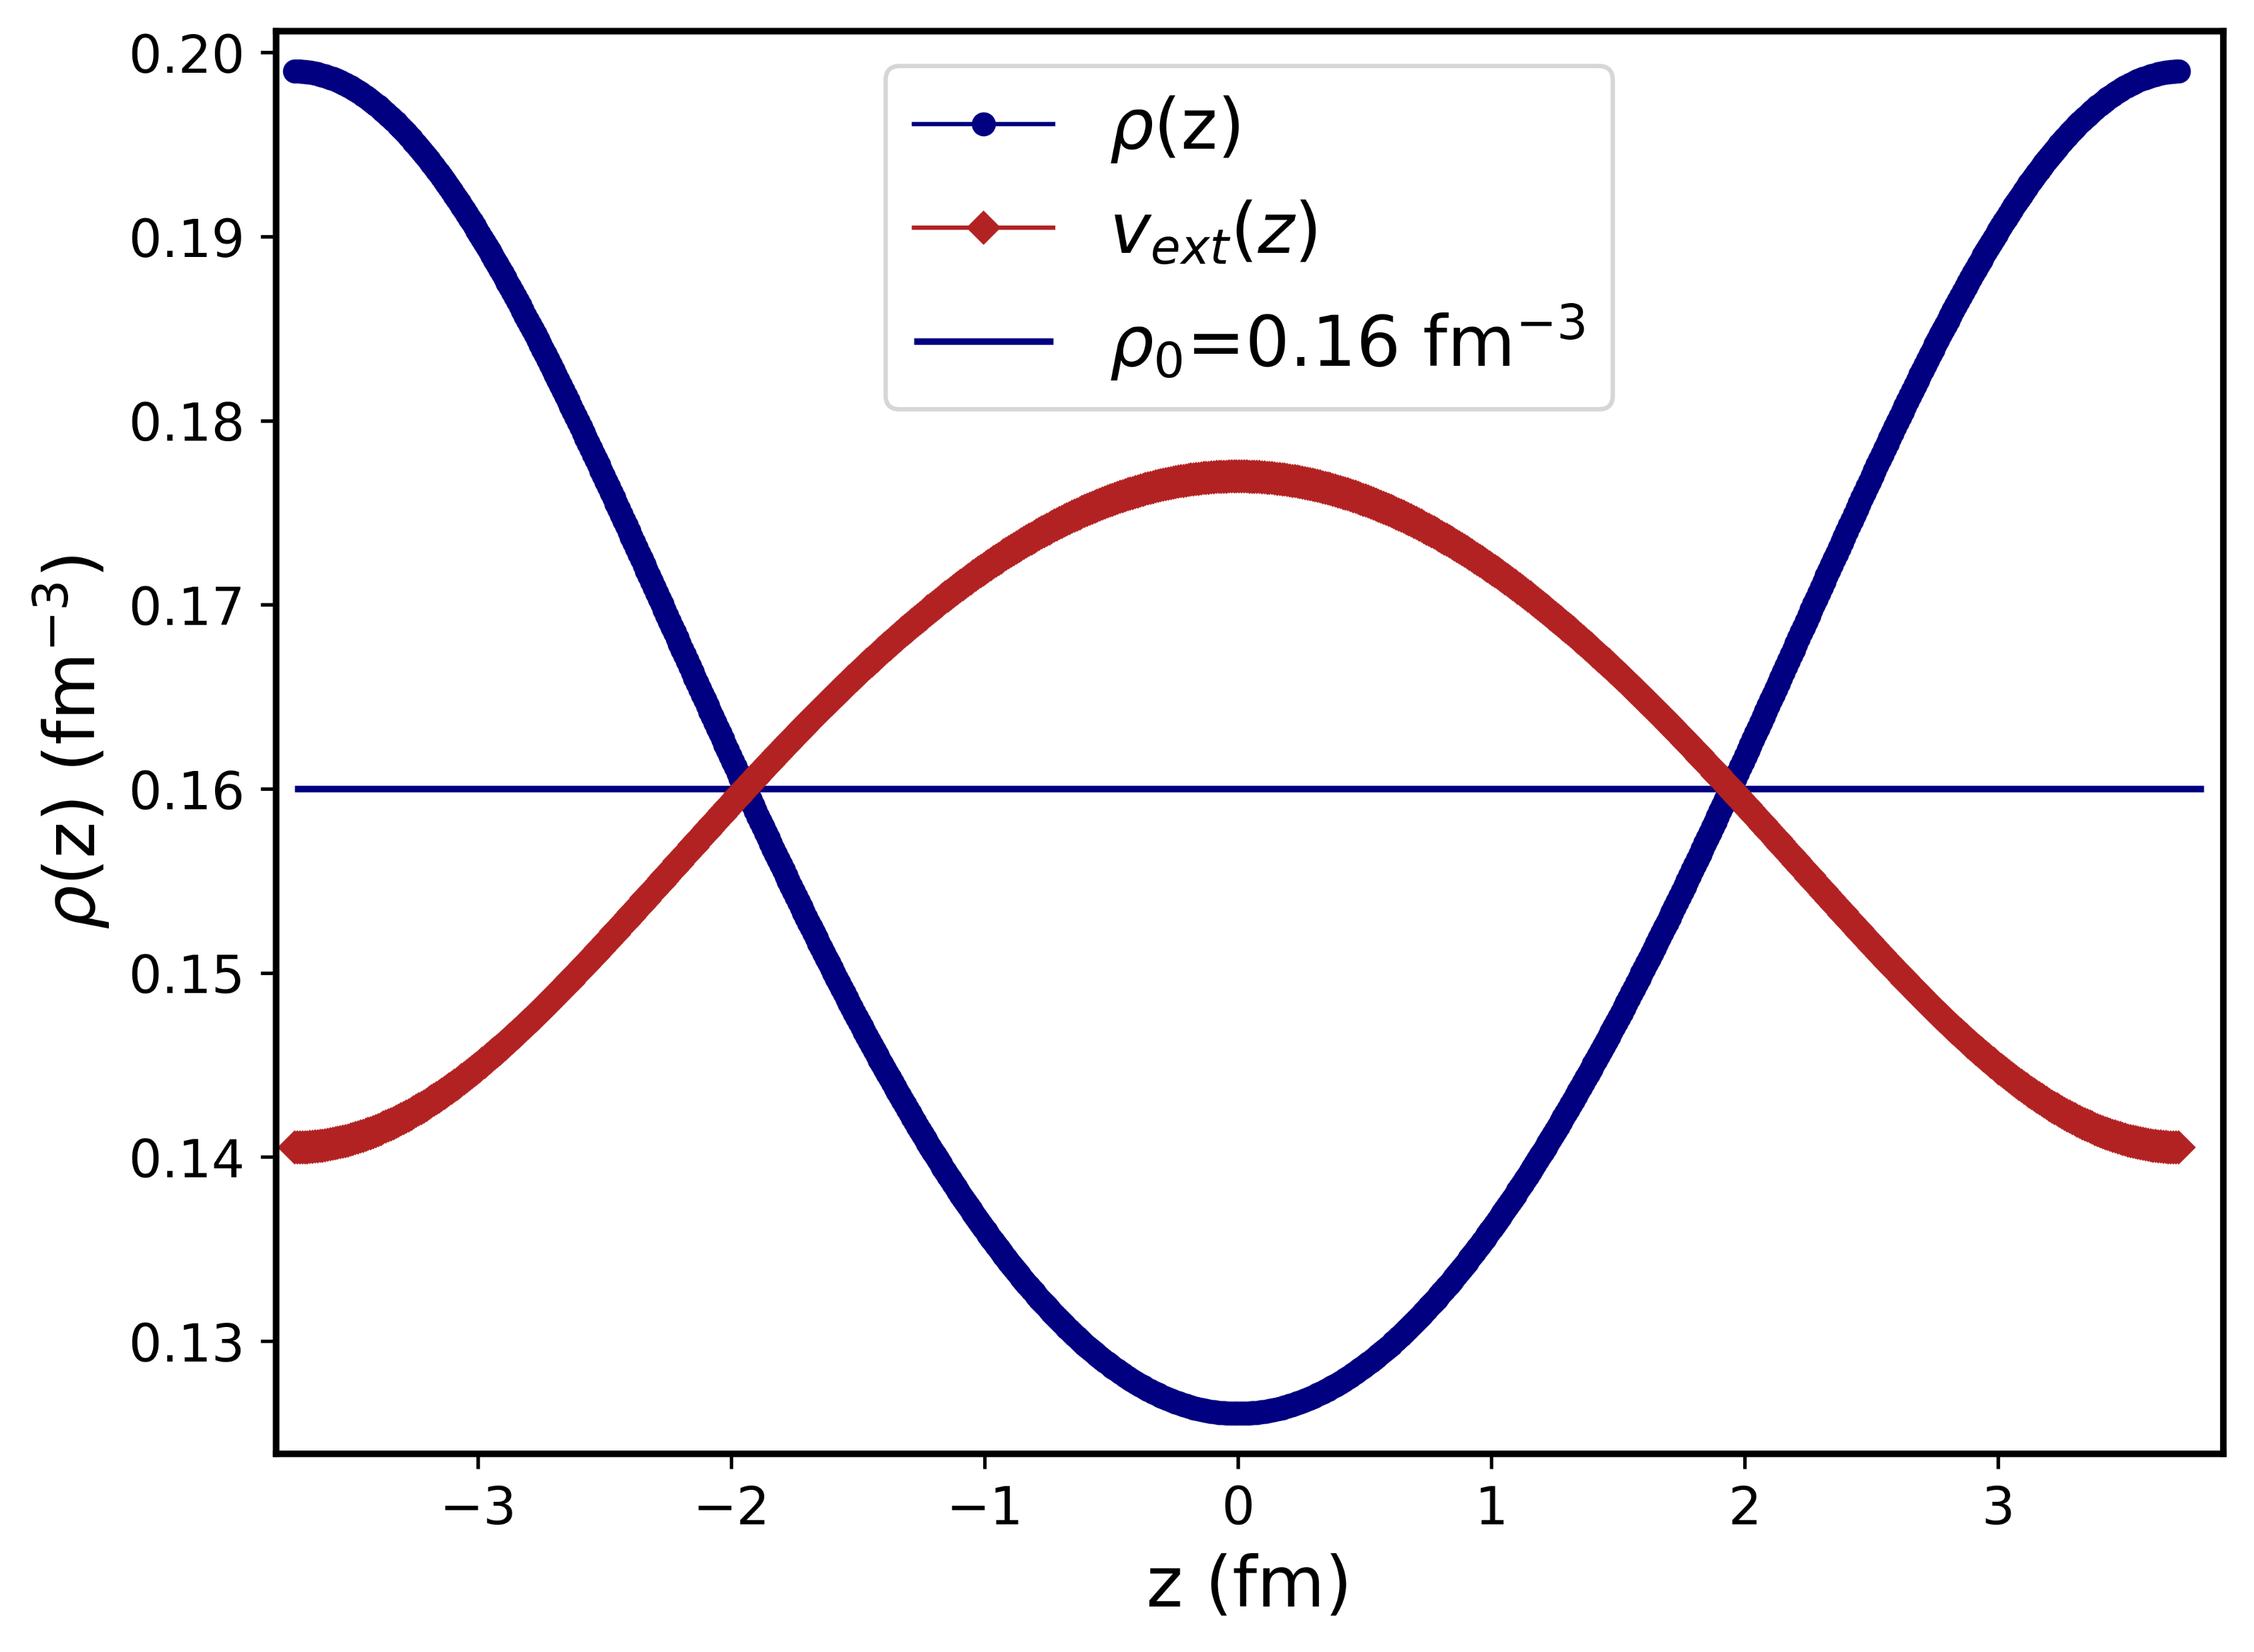
Towards the gradient approximation
LDA
Nuclei are finite systems and the dependence of the EDF on ∇ᵨ, 𝜏 and J is mandatory. These quantities vanish in uniform matter.
How can ab initio inform us about this dependence?
Uniform matter perturbed by a (weak) periodic potential

Slide 30
Benchmarking ab initio many-body methods
Before moving to SCGF for the response, we must check the agreement with other MB methods like CC or MBPT.
F. Marino et al.
(in preparation)
Cf. his talk.
Preliminary

Slide 31
Conclusion
DFT is an accurate method for many nuclear properties. There are many available EDFs, though.
In this talk, several avenues to possibly overcome the limitations of current DFT have been overviewed.
Merging nuclear ab initio and DFT should be definitely pursued.
The goal is to improve the predictive power of the theory, for basic nuclear observables like masses and drip lines – but also for problems that have not been discussed in this contribution (fusion/fission, reactions of astrophysical interest, weak interaction processes like single and double β-decay).

Slide 32
Collaborators:
C. Barbieri, X. Roca-Maza, E.Vigezzi (Univ. of Milano and INFN, Italy)
F. Pederiva (Univ. of Trento and INFN, Italy)
P. Klausner, M. Antonelli, F. Gulminelli (LPC Caen, France)
F. Marino (Mainz University, Germany)
A. Lovato (ANL, USA)
Z.Z. Li, Y. Niu (Lanzhou University)

Slide 33
Backup slides

Slide 34
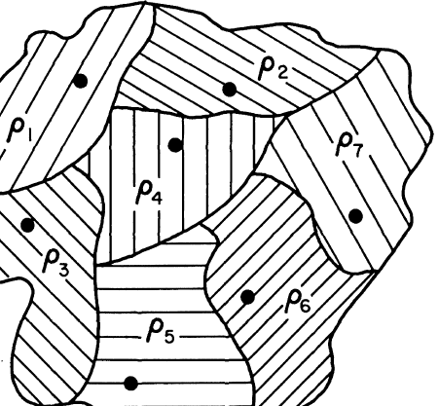
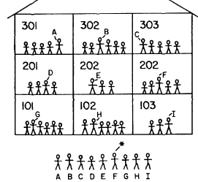
The constrained search approach by Lévy-Lieb
We consider all w.f. that correspond to a specific density with the symbol
“instead of finding the tallest child in the school by lining all of them in the yard, we just line in the yard the tallest pupils of each class...”

Slide 35
Skyrme forces and EDFs
From an effective force, and the kinetic energy, we can extract an EDF by means of the expectation value over a general Slater determinant:
In the standard Skyrme ansatz, there are central (momentum-independent and momentum-dependent terms) and spin-orbit terms.
Adding tensor terms is also possible.

Slide 36
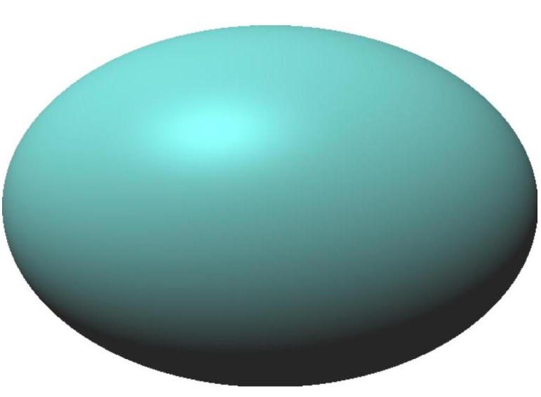
Giant Resonances and highly excited states
Spectroscopy of heavy and superheavy nuclei
Reactions (transfer, fusion, fission)
Neutron stars (cf. talk by T. Nakatsukasa)
E_{X}
DFT
Ab initio for ground states
A. Tichai , Phys. Lett. B851, 138571 (2024)
S.R. Stroberg et al., Phys. Rev. Lett. 126, 022501 (2021)

Slide 37
ISGMR in ⁴⁸Ca and ²⁰⁸Pb
Exp. data from T. Li et al., Phys. Rev. Lett. 99, 162503 (2007) and S.D. Olorunfunmi, Phys. Rev. C 105, 054319 (2022).
In these two cases there is no pairing.

Slide 38
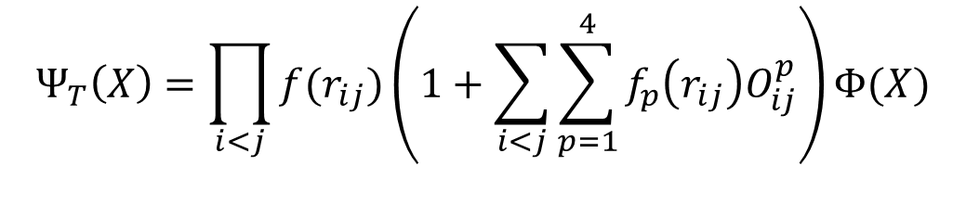
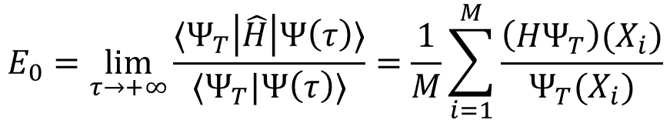
Quantum Monte Carlo (AFDMC)
$$Ψ_{0}(X)=\lim_{τ→+∞}{Ψ\left(X,τ\right)=\lim_{τ→+∞}e^{−\left(\hat{H}−E_{T}\right)τ}{ Ψ}_{T}(X)}$$
Imaginary-time
$$E_{0}=\lim_{τ→+∞}\frac{⟨Ψ_{T}\left|\hat{H}\right|Ψ\left(τ\right)⟩}{⟨Ψ_{T}|Ψ\left(τ\right)⟩}=\frac{1}{M}\sum_{i=1}^{M}{\frac{\left(HΨ_{T}\right)(X_{i})}{Ψ_{T}(X_{i})}}$$
Stochastic estimate of E
$$Ψ_{T}\left(X\right)=\prod_{i<j}{f(r_{ij})}\left(1+\sum_{i<j}{\sum_{p=1}^{4}{f_{p}\left(r_{ij}\right)O_{ij}^{p}}}\right)Φ(X)$$
Mean field state
Jastrow correlations
Computationally very demanding. Nuclear matter and light nuclei.
J. Carlson et al., Rev. Mod. Phys. 87, 1067 (2015)
S. Gandolfi, D. Lonardoni, A. Lovato, and M. Piarulli, Front. Phys. 8, 00117 (2020).
D. Lonardoni et al., PRC 97, 044318 (2018)

Slide 39
Self-consistent Green’s functions (SCGF) approach
The Green’s function represents the probability amplitude that a particle is found in state 𝛼 at time t after having been introduced in the system at time t’ in state 𝛽
It obeys the DYSON EQUATION:
The self-energy 𝛴 is approximated by a set of diagrams. From the solution for g, one calculates the observables.
W.H. Dickhoff and C. Barbieri, PPNP 52, 377 (2004)
V. Somà, Frontiers in Physics(2020)
C. Barbieri, PRL 103, 202502 (2009)

Slide 40
The Equation of State (EoS)
SCGF with NNLO_{sat}
QMC with AV4’
We parametrise the potential part of the EoS.
is quadratic in
is a polynomial in k_{F}
The optimal set of powers is chosen by model selection.

Slide 41
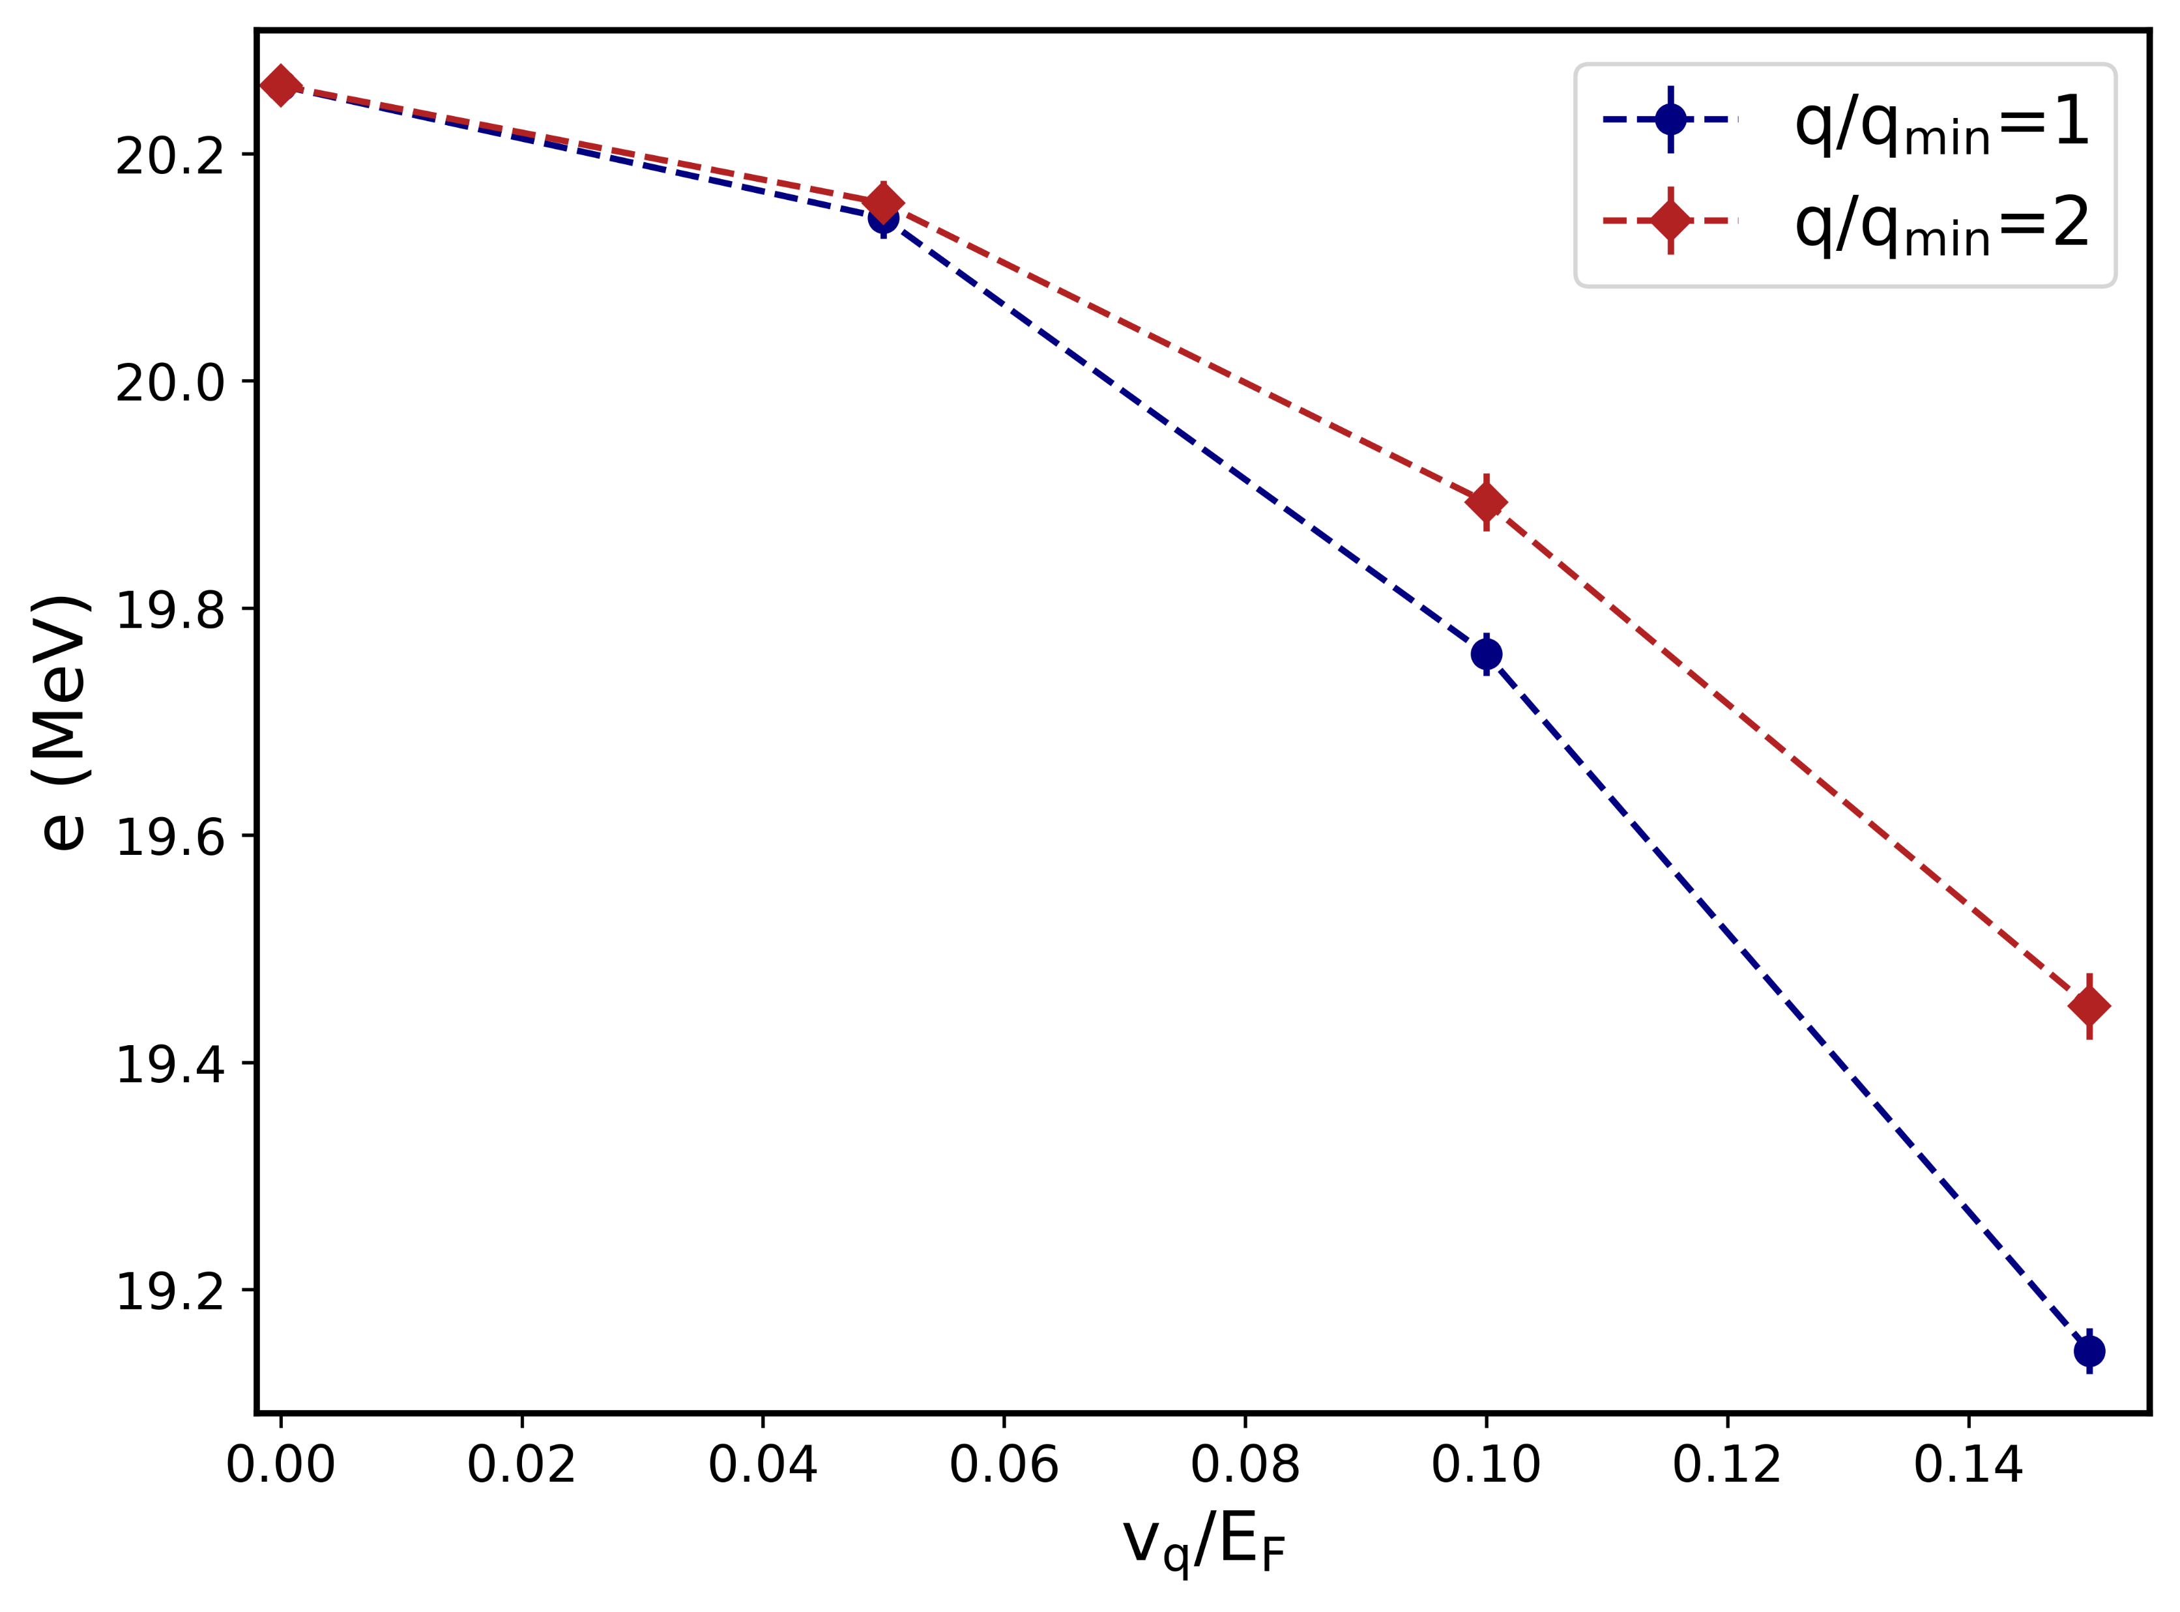

Perturbed nuclear matter
Add a weak external potential of the type:
In linear response:
One should check that one is in this lowest-order PT regime.
Then, one can try to optimise the parameters so that EDF matches these results.
PNM, N=66, $ρ_{0}=0.16 {fm}^{−3}$

Slide 42
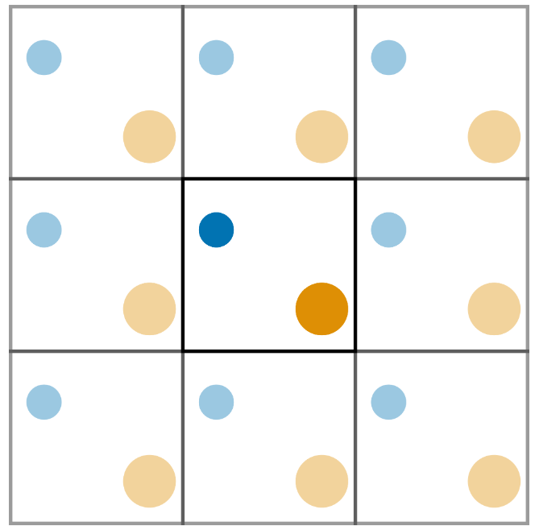
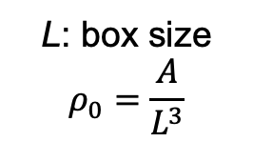


Finite size
Nuclear matter is simulated by using a finite number of nucleons A enclosed in a cubic box with periodic boundary conditions (PBCs)
L: box size
$$ρ_{0}=\frac{A}{L^{3}}$$
AFDMC, ADC-SCGF
$$k=\frac{2π}{L}n$$
$$n_{i}=0,±1,±2…$$
Discrepancy between the finite-A and the infinite system in the thermodynamic limit (TL)
Typically:
N=66 neutrons in PNM.
A=132 nucleons in SNM
Finite-size (FS) effects
Finite-A DFT approach
Buraczynski, Phys. Rev. C 105, 025807 (2022)

Slide 43
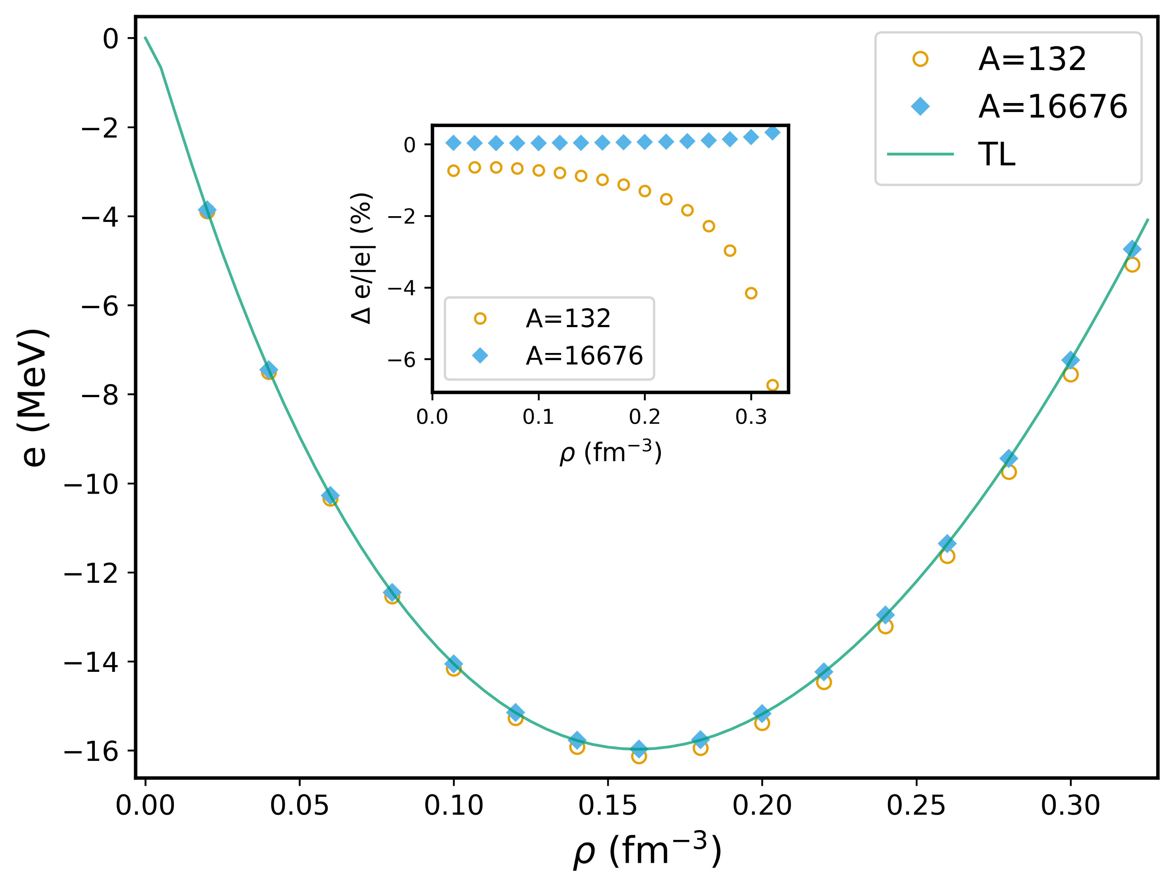
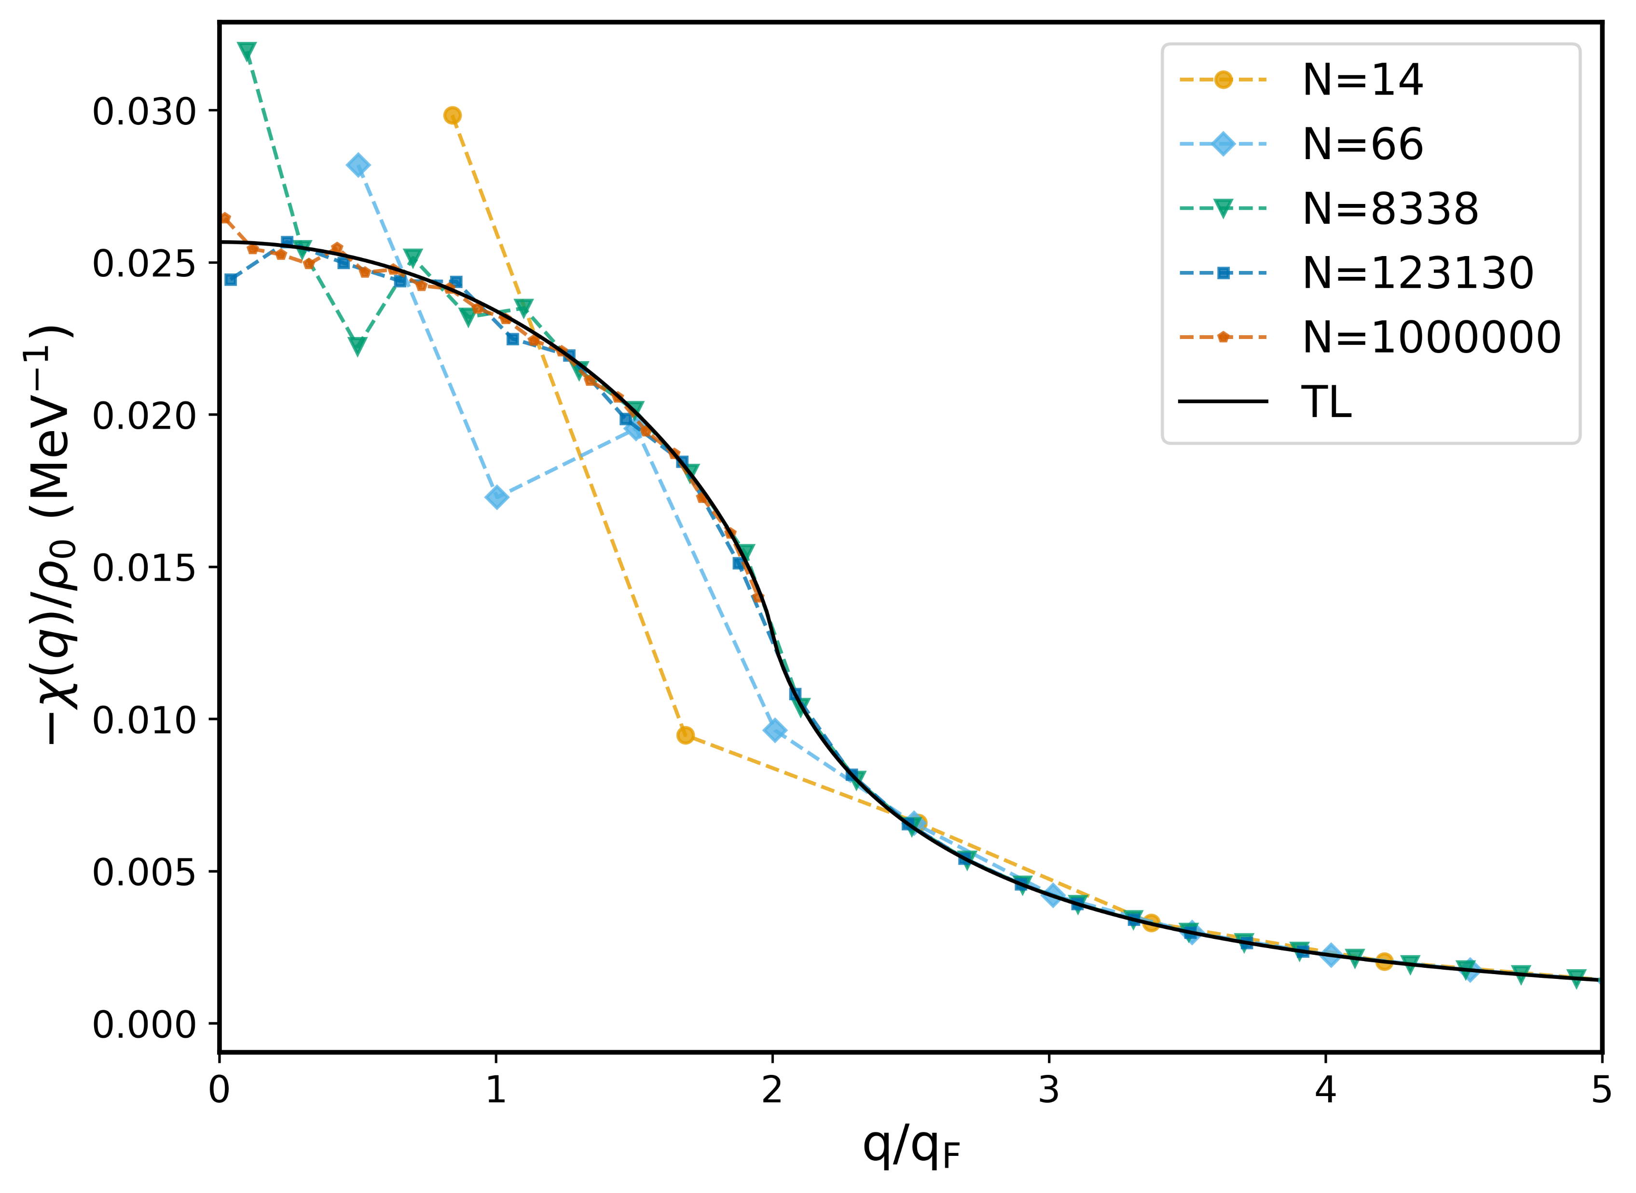
Finite size effects
SNM EOS in DFT
Free Fermi gas response
Finite size effects are weak on the EOS but strong on $χ(q)$

Slide 44
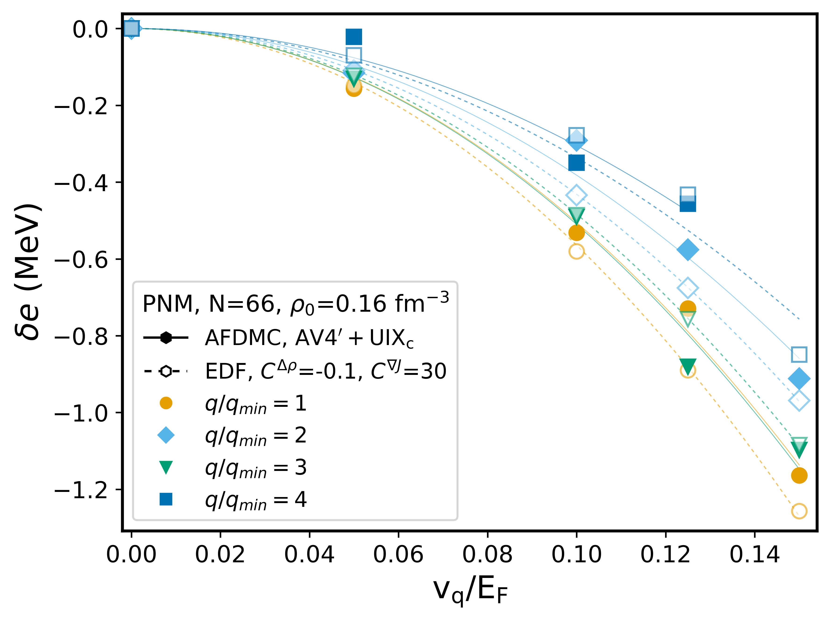
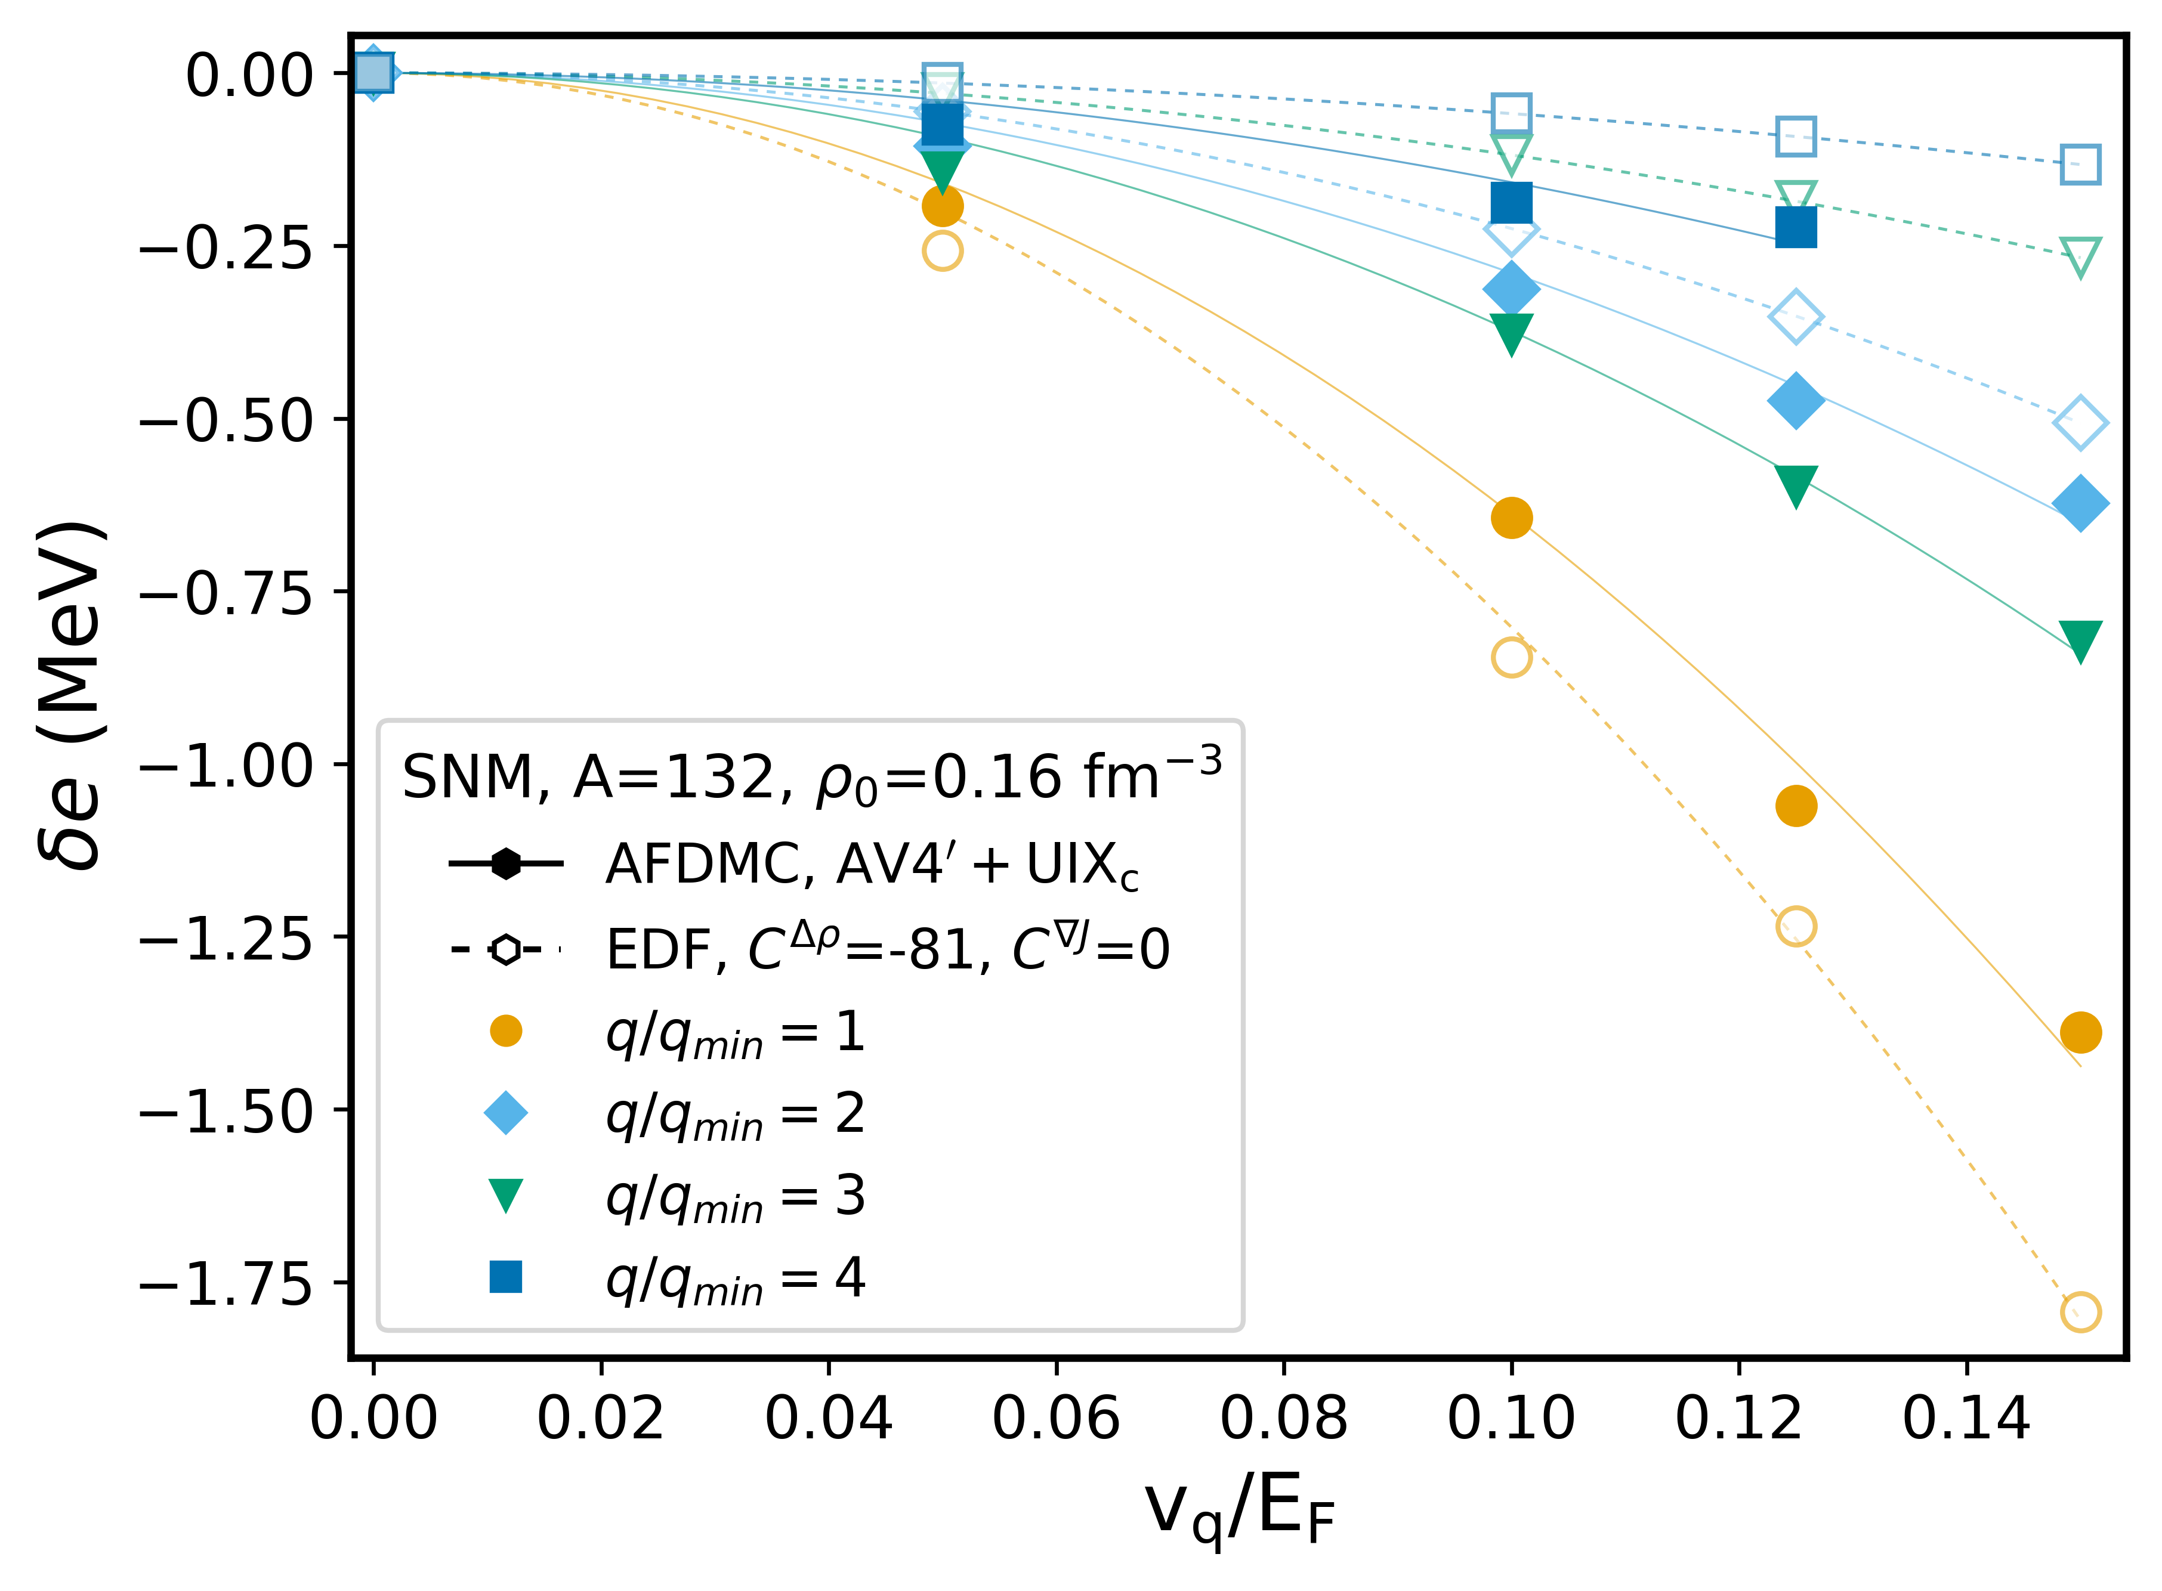
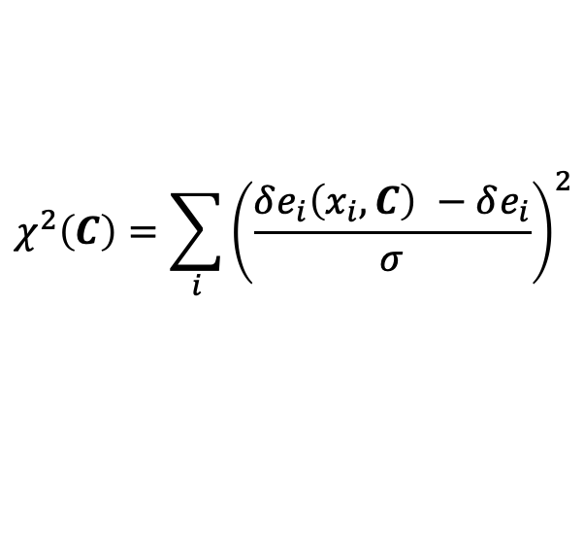
Ab initio gradient approximation
Pure neutron matter
Symmetric nuclear matter
$$χ^{2}\left(C\right)=\sum_{i}{{\left(\frac{δe_{i}\left(x_{i},C\right) −δe_{i}}{σ}\right)}^{2}}$$
The results are not realistic.

Slide 45
Uncertainties on AFDMC points are of the same order of the variations of the response function with q.
A value of C^{Δ𝞺} which is compatible with zero is confirmed by an independent Bayesian analysis.

