Slide 1





Quarkonium dynamics in the quantum Brownian regime with non-abelian quantum master equations
S.Delorme et al. JHEP 06 (2024) 060
Pol B Gossiaux, SUBATECH (NANTES)
QNP
7-12 July 2024
Barcelona (Spain)
With Aoumeur Daddi Hammou, Stéphane Delorme, Thierry Gousset, Jean-Paul Blaizot
and Pays de la Loire

Slide 2
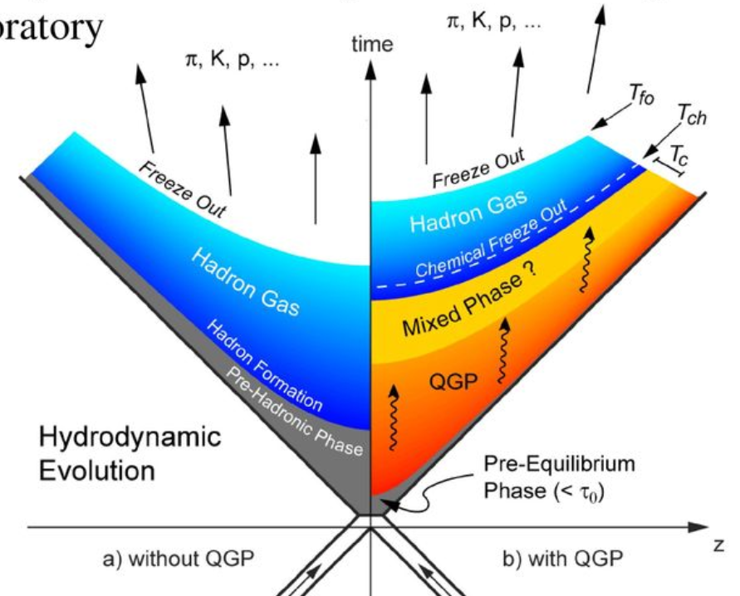
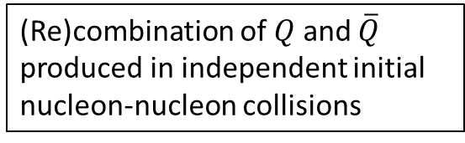
Probing URHIC with quarkonia production
2 typical contributions :
primordial
B
J/ψ
(Re)combination of $Q$ and $\overline{Q}$ produced in independent initial nucleon-nucleon collisions
A
Dominant for charmonia production at low p_{T}
Early « in-medium quarkonia » surviving up to the QGP freeze out

Slide 3
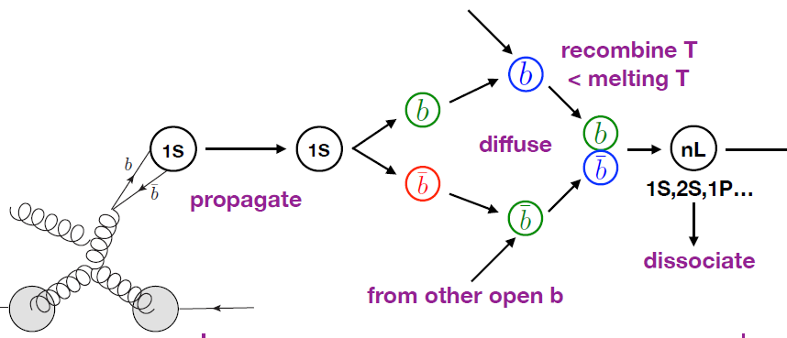
Regeneration: Dilute vs Dense
Bottomia (single pair)
Charmonia (many pairs)
No exogenous recombination : only the b-bbar pairs which are initially close together will emerge as bottomia states.
Full quantum treatment affordable
N.B.: In some SC formalisms : intermediate regeneration
Exogenous recombination : c & cbar initially far from each other may recombine and emerge as charmonia states
No full quantum treatment possible => semi-classical approximation (to be specified later)
Level of accuracy ?
Structure of the talk
Solve the quantum problem in a “simple” situation (single pair)
Use this solution to benchmark the semi-classical approximation
Yao, Mehen, Müller (2019)
3
Notes:
Interaction with partons : especially gluons

Slide 4
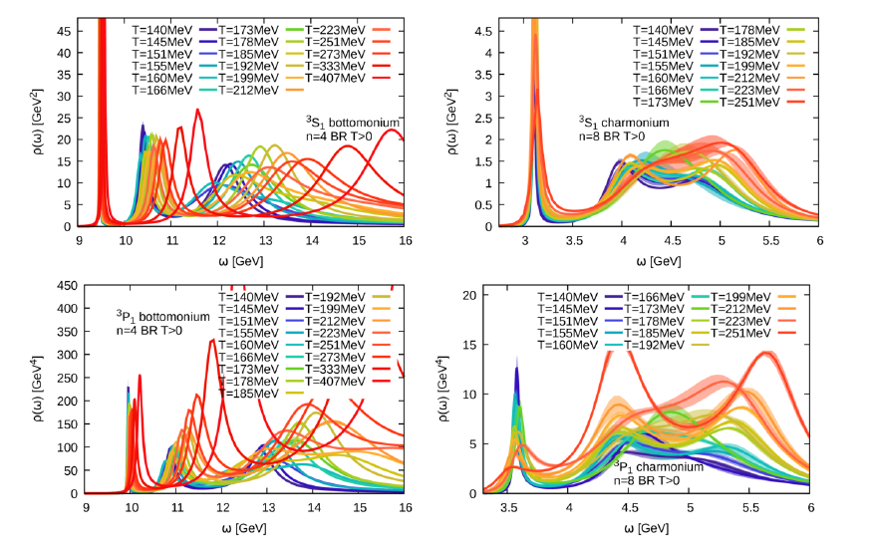
What is a quarkonia at finite T ?
Kim et al, JHEP11(2018)088
Rich structure : broadening and mass shift. What are the underlying “ingredients’” ?
4
Notes:
Interaction with partons : especially gluons

Slide 5
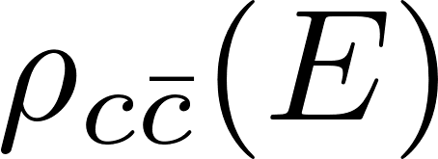
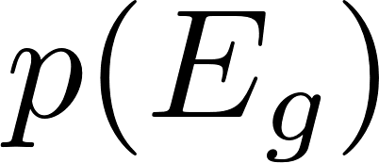
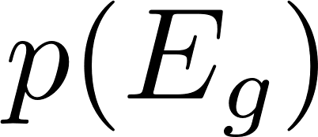

Two clear regimes
Spectral density
T
Time
High Temperature
Low Temperature
Dissociation of well identified bound states by scarce “high-energy” gluons (dilute medium => cross section ok)
Multiple scattering on quasi free states
Best d.o.f. : individual heavy quarks Best d.o.f. : quarkonia bound states
Quantum Brownian Regime Quantum Optical Regime
5

Slide 6
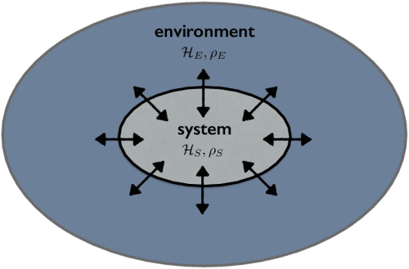
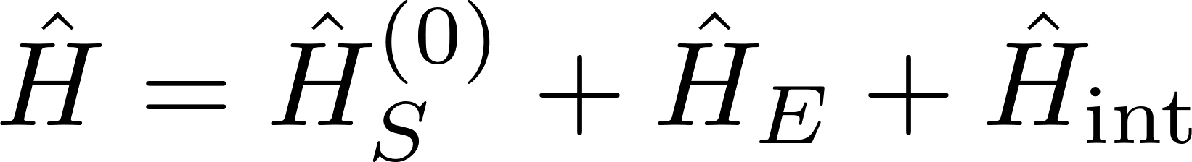

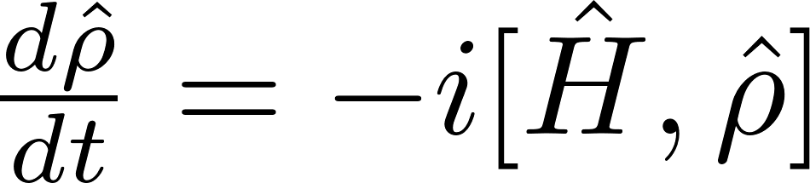

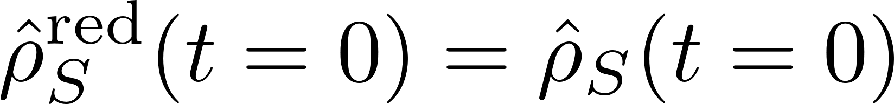
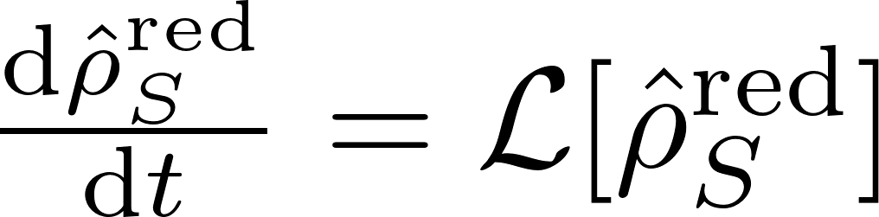
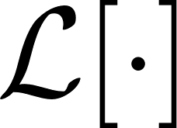
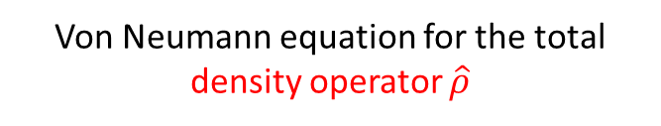
Quantum Master Equations
Quite generally, the system builds correlation with the environment thanks to the Hamiltonian
Von Neumann equation for the total density operator $\hat{ρ}$
System + environment
Evolution of the total system
Trace out environment degrees of freedom =>
Reduced density operator
System
Evolution of the system
Evol. eq. on the red. Density:
(linear mapping)
However, is generically a non local super-operator in time
6

Slide 7
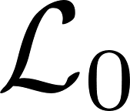
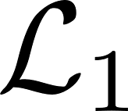
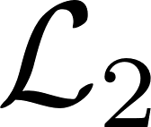
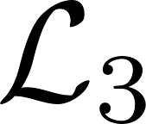
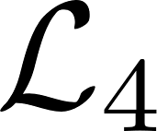

Non abelian Quantum Master Equation for a $Q\overline{Q}$ pair
2 coupled color representations (singlet octet)
The Linblad Operator contains various terms representing several aspects of HQ physics
: kinetic term
Unitary dynamics
: (screened) real potential term
: fluctuations => heating and decoherence
Imaginary potential W
Non-Unitary dynamics
: dissipation
: mandatory to preserve positivity (but sub-dominant)
J-P.Blaizot & M.A. Escobedo, JHEP 2018.6 (2018)
7
Notes:
Cite Blaizot Escobedo

Slide 8
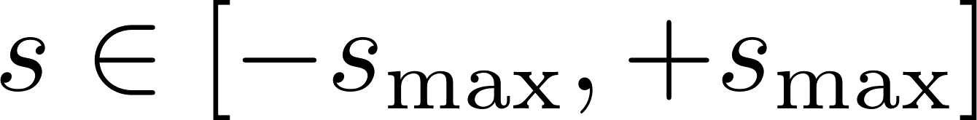
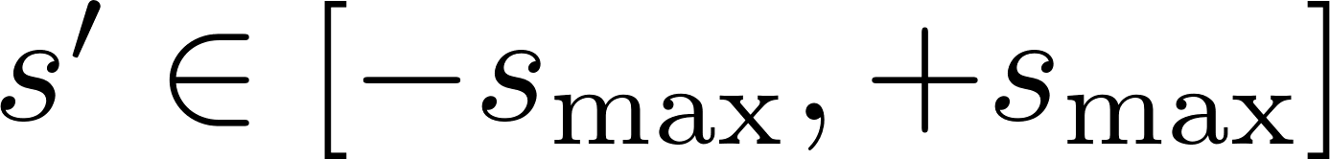
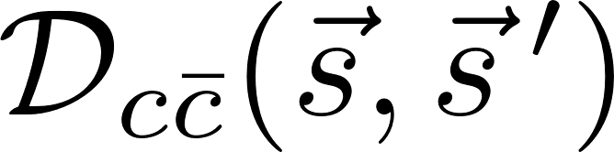
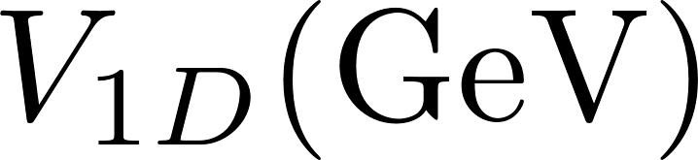
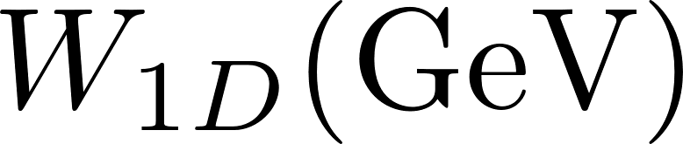
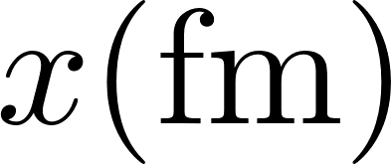
Further implementation features
1D grid for both and
Need to design a realistic 1D bona fide potential V + i W (based on 3D lQCD results, tuned to reproduce 3D mass spectra and decay widths)
!!! Not the radial decomposition of which is more cumbersome
Even states will be considered as « S like » while odd states will be considered as « P like » states
T=0.18
T=0.2
T=0.25
T=0.35
T=0.45
T=0.55
1D potential from R. Katz, S. Delorme & PBG, Eur. Phys. J. A (2022) 58:198
8

Slide 9
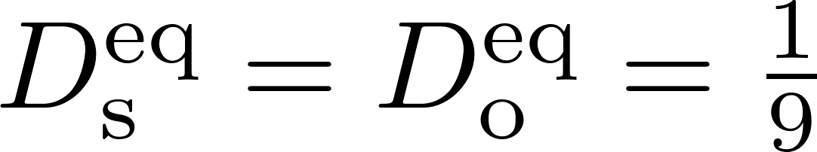
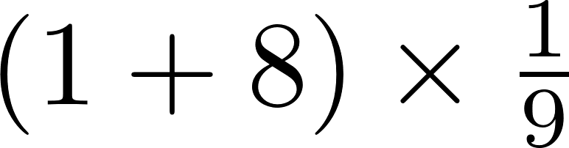
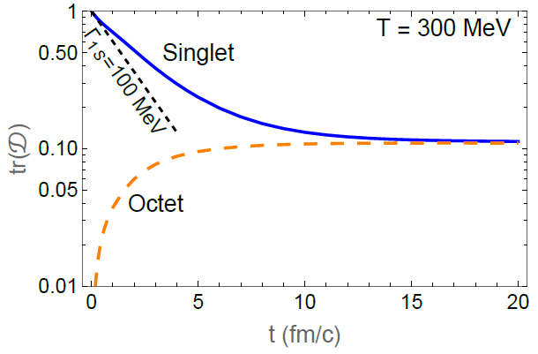

Some selected results for 1 $c\overline{c}$ pair
Color Dynamics : Singlet – octet probabilities:
Starting from a singlet 1S-like, one expects some equilibration / thermalisation -> asymptotic values :
At early times : Quasi exponential behaviour exp(-t/τ), with thermalisation time τ_{o}<τ_{s} ≈ 2 fm/c
Color appears to thermalize on time scales < QGP life time, but not instantaneoulsy.
C-cbar can interact with the surrounding QGP as an octet => energy loss
9

Slide 10

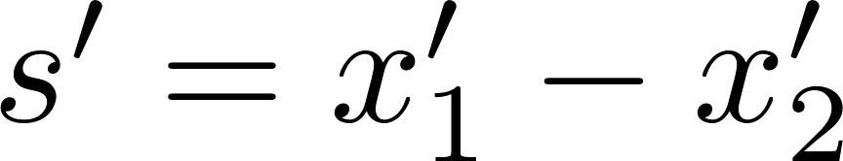

Evolution of the Density matrix
1S singlet initial state:
t=0 fm/c
t=5 fm/c
T=300 MeV
t=10 fm/c
t=20 fm/c
SC
Progressive loss of Q coherence, dissociated component
long-lived correlation
10

Slide 11
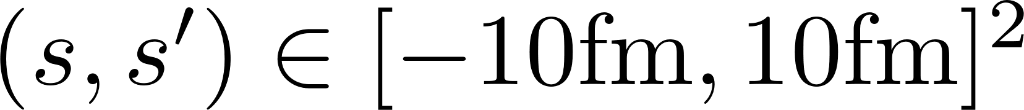

Evolution of the spatial density
1S singlet initial state:
Box :
t=0 fm/c
singlet
t=2 fm/c
octet
Surviving correlation
« open » HF
t=5 fm/c
t=10 fm/c
t=20 fm/c
Some c-cbar stay at intermediate distance (“recombination”) … remaining peak in the asymptotic distribution
11

Slide 12
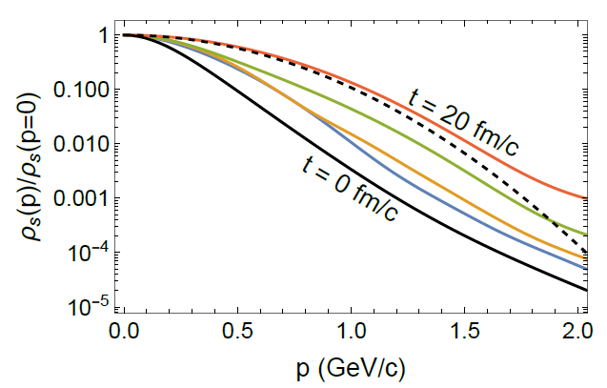
Evolution of the momentum density
Convergence -> ≈ Maxwellian distribution for p<M, as expected from SC expansion
Spurious region for p>M (coming from the mandatory regularization of the imaginary potential…room for improvement)
Mostly sensitive to the distribution at large relative distance (individual c quarks)
12

Slide 13
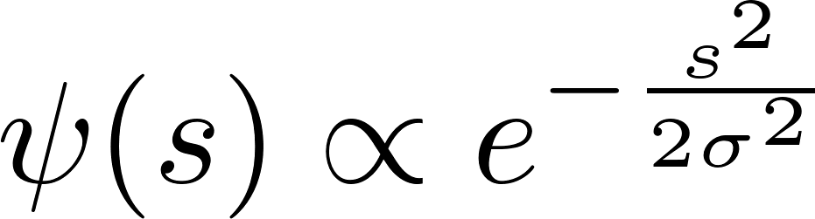
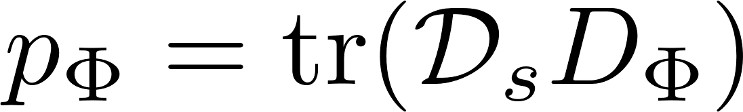
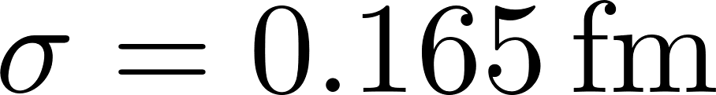
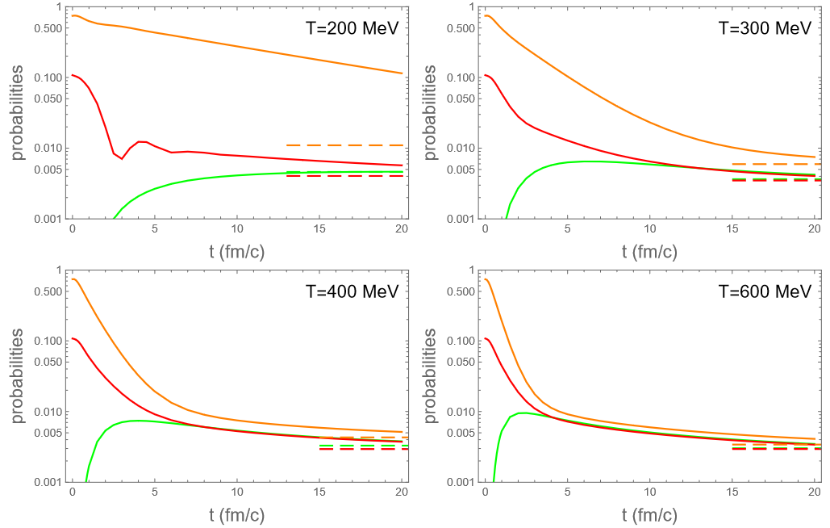
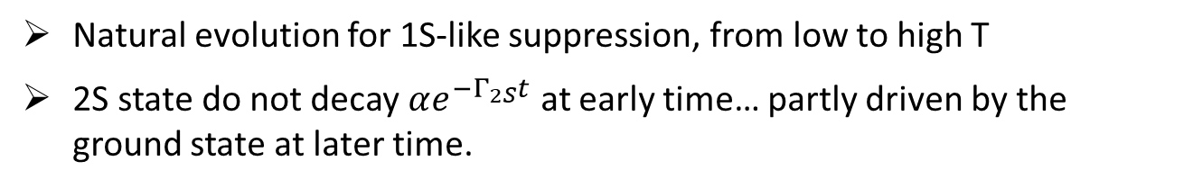
Results for projection on vacuum states
Starting from a compact S-like state :
1S-like
2S-like
1P-like
asympt. Prob.
Natural evolution for 1S-like suppression, from low to high T
2S state do not decay $αe^{−Γ_{2S}t}$ at early time… partly driven by the ground state at later time.
13

Slide 14
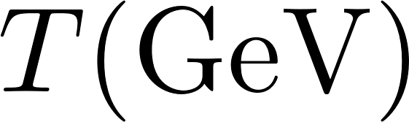
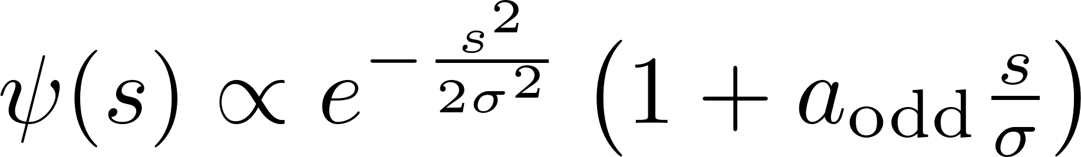
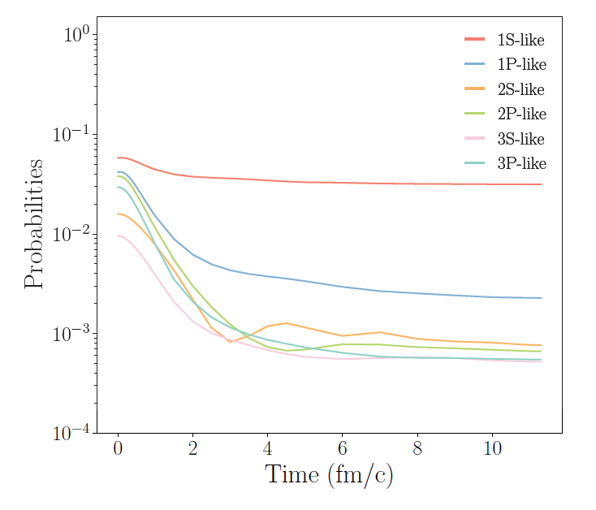
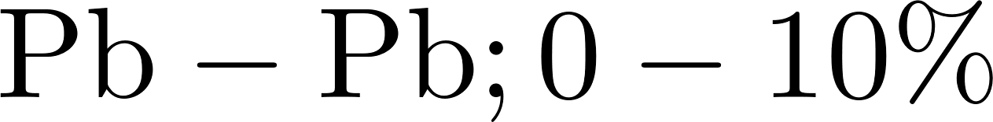
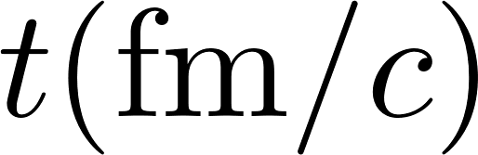
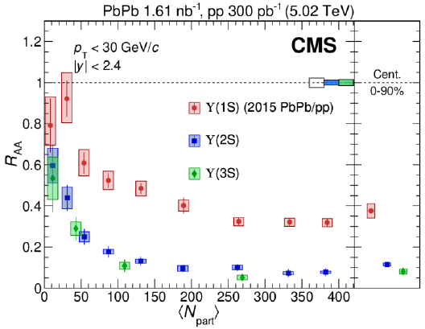


Contact with experiment ($b\overline{b}$)
Bottomonia yield using the QME with EPOS4 (T,v) profiles and starting from a compact $b\overline{b}$ state.
See Stephane Delorme’s talk at SQM24 for more details.
1S suppression : 50%
2S suppression: 95%
3S suppression: 95%
(direct production)
14

Slide 15
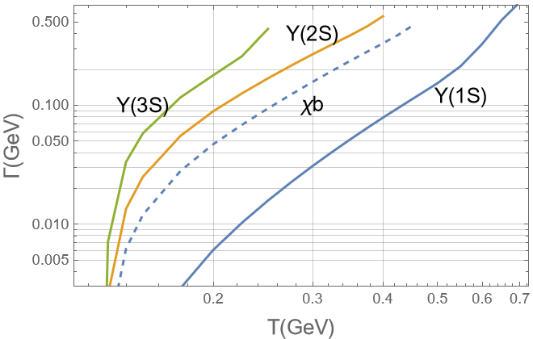

Contact with experiment ($b\overline{b}$)
Bottomonia yield using the QME with EPOS4 (T,v) profiles and starting from a compact $b\overline{b}$ state.
See Stephane Delorme’s talk at SQM24 for more details.
Similar R_{AA} for Y(3S) and Y(2S) although 3S decay rate Γ >> 2S decay rate Γ.
1S suppression : 50%
2S suppression: 95%
3S suppression: 95%
(direct production)
15

Slide 16
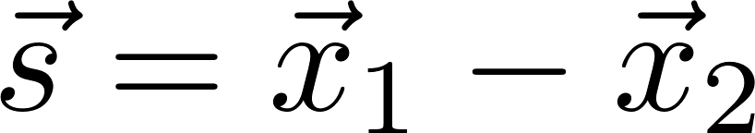
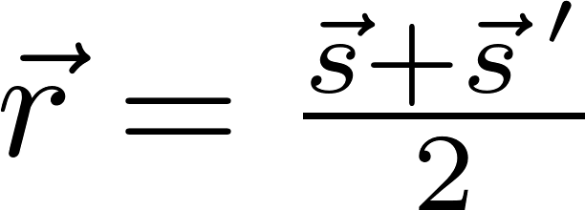
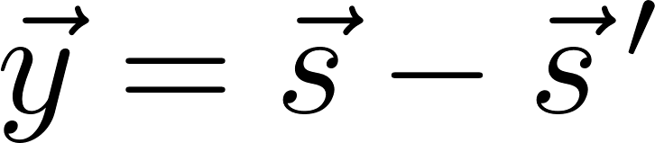
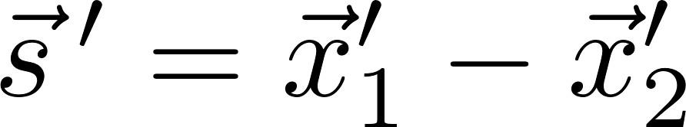
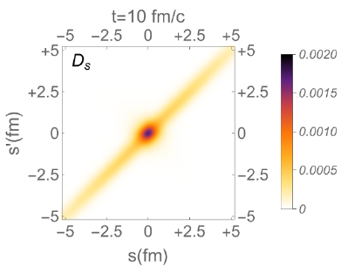




Semiclassical approximation
For the relative motion (2 body):
Wigner transform : and
=> Usual Fokker Planck equation :
Easy MC implementation + generalization for N body system (c-cbar @ LHC)
and
Near thermal equilibrium, Density operator is nearly diagonal => semi-classical expansion of the Linblad equation: power series in y up to 2nd order)
fluctuations
dissipation
16

Slide 17



Concrete implementation
1D (same as for the QME), 1 $c\overline{c}$ pair
Same real potential, W in the QME ⬄ η and γ in the FP
Abelian case (for the time, not clear how to deal with the singlet <-> octet transition in a semiclassical approach)
Yet, not trivial…
Initial state vacuum 1S state :
17

Slide 18






Unitary evolution
Unitary ⬄ no fluctuation and dissipation by coupling with the QGP
evolution of a vacuum 1S state in a screened V (T=200MeV) … still some evolution
W_{QME}(t=2fm/c)
W_{SC}(t=2fm/c)
Normalized to 1
Native potential
Reg. potential
(à la Kelbg) : std choice
18

Slide 19

Non-unitary evolution
Full coupling with the QGP
Some specific signs of genuine QM evolution at small time
Better agreement between the two descriptions at late times.
19

Slide 20


Non-unitary evolution
Full coupling with the QGP
III. Late stage evolution: the norm difference d₁ ceases to decrease and saturates ?!
I. Growth of the ≠ between QME and SC evolution : genuine QM features
II. Saturation and decrease of the ≠ between QME and SC evolution : classicalization
20

Slide 21


Non-unitary evolution
Full coupling with the QGP
Asymptotic
III. Late stage evolution: the norm difference d₁ ceases to decrease and saturates ?!
Small deviations of the asymptotic $\left\langle p^{2}\right\rangle$ from QME wrt Gibbs-Boltzmann
QME
I. Growth of the ≠ between QME and SC evolution : genuine QM features
II. Saturation and decrease of the ≠ between QME and SC evolution : classicalization
Gibbs-Boltzmann
21

Slide 22

Non-unitary evolution
Full coupling with the QGP
More concrete observable : Survival probability of the 1S initial state:
Good agreement of the SC calculation with the QME benchmark
Slight over suppression for the QME (overheating)
22

Slide 23

Non-unitary evolution
Full coupling with the QGP
More concrete observable : (Re)generate 2S state
Good agreement of the SC calculation with the QME benchmark, especially at large T
Most significant disagreement for low T, around t = 2.5 fm/c (beginning of the classicalization)
23

Slide 24


Non-unitary evolution
Full coupling with the QGP
More concrete observable : (Re)generate 2S state
Good agreement of the SC calculation with the QME benchmark, especially at large T
Higher effect of the genuine interference quantum effects due to the mixture of positive and negative regions in W_{2S}.
24

Slide 25
Conclusions
The Lindblad equation succeeds in producing the bottomonia sequential suppression observed in R_{AA}. As next step, we will compute this observable and have direct comparison with experimental data.
The semiclassical description reproduces very well the results of the exact
quantum description, especially, at high temperatures
The late time discrepancies are, mainly, due to the relaxation into different steady states. The steady sate of an open quantum system is still an active research topic !
To come : generalization of the comparison for the non-abelian case.
25

Slide 26
Back up

Slide 27



Two types of dynamical modelling
(and a 3rd class of its own: statistical hadronization)
Quantum Brownian Motion
Quantum Optical Regime
Correlations growing with cooling QGP
Best described in position-momentum space
Time short wrt quantum decoherence time ?
Well identified resonances
Time long enough wrt quantum decoherence time
?
Good description with transport models
(TAMU, Tsinghua, Duke)
Central quantities :
2->2 and 2->3 Cross sections,
decay rates
Equilibrium : exp(-E_{n}/T) (theorem)
Quantum Master Equations for microscopic dof (QS and Qbars)
Equilibrium / asympt* : some limiting cases
SC Approx: Fokker-Planck equations in position-momentum space
SC Approx: rate equations
* Since one is facing both dissociation and recombination, obtaining a correct equilibrium limit of these model is an important prerequisite !!!
27

Slide 28





Pictorial summary
Inspired from Yao Int. J. of Mod. Phys. A, Vol. 36, No. 20, 2130010 (2021)
τ_{E}: environment autocorrelation time
τ_{S}: system intrinsic time scale
τ_{R}: system relaxation time
Weak syst-environment coupling
+ Markovian limit
Smallest time scales wins it all !
Redfield equation
Quantum Optical Regime
Quantum Brownian Motion
Not the same basis !
Eigenstates of the HQ Hamiltonian
Phase space densities
Rate equations: ⬄ transport models
Semi-classical approx : density matrix ≈ diagonal
Good method for many $c\overline{c}$pairs
28
Notes:
Commenter la limite semi classique

Slide 29

Two types of dynamical modelling
T_{ov. damp}
QOR
QBM
Numbers extracted from potential described in Phys. Rev. D 101, 056010 (2020)
29

Slide 30





QED-like vs genuine QCD case
Genuine QCD
QED-like
Scattering from gluons change the color respresentation : o <-> s
No binding potential in the octet chanel => « large » energy gap
Scattering from photons do not change the Casimir : s <-> s
Usual 1S <-> 1P transitions between bound states.
30

Slide 31


Decay rates from QME
31

Slide 32


Decay rates from QME
32

Slide 33




Quantum vs SC dynamics
SCA : linear mapping
Several aspects :
  Temperature
  Initial state
  Property considered
First looking at global difference :
-
-
-
Fokker-Planck/Langevin
Always positive defined even if W_{in} and W_{fin} are not positive defined
In the following : only a limited set of results; manuscript to come soon
33

Slide 34

Quantum vs SC dynamics (QED-like)
34

Slide 35

Quantum vs SC dynamics (QED-like)
More local quantities: <p²> vs r (in the Wigner sense)
Nearly perfect agreement at large distance
More structure seen in the genuine QM calculation at close ccbar distance
35

Slide 36


Initial compact state
36

Slide 37



Asymptotic distributions / quarkonium weights
First, looking at the QED-like case.
60 fm/c
In the simulation, some peak survives in the density, at small distance
This peak is in direct correlation with the charmonium weight
The asymptotic states may not be reached in realistic AA collisions, but controlling/understanding them is important :
  Sanity check of the models
  Privileged link with lQCD spectral distribution (evaluated in this limit)

Slide 38

Asymptotic distribution: QED-like
First, looking at the QED-like case.
Even simpler case : Semi classical approximation :
(Wigner representation)
2 lines calculation :

Slide 39



Asymptotic distribution: QED-like
First, looking at the QED-like case.
Even simpler case : Semi classical approximation :
Peak, independently of box size
Pretty well described by SC relation (apart around the origin):
(Wigner representation)
ρ_{r}(fm₋₁)
T=0.2 GeV
QME
QME
SCA
r(fm)

Slide 40



Quarkonium-like weights
First, looking at the QED-like case.
Good agreement between QME & SC in the deep QBM regime (expected)
Good agreement between QME & Boltzmann Ansatz, even in the QOR !!! Not expected at all.
SCA : not succesfull for 1P-like state
SCA :
Boltzmann :
Local states
Boltzmann
QBM
QOR

Slide 41

Asymptotic distribution: QCD
Now the genuine QCD case
Solving
With thermalized Ansatz for D_{o}
The peak around origin is reduced in the case of QCD !
Quarks more deconfined than in QED-like case.
Reminder : discussion specific to the QBM regime (not the QOR)

Slide 42
Asymptotic distribution: QCD
A possible physical explanation
Loss
singlet
singlet
1S
P states
QED – like :
Gain
As the binding potential also acts on P-states (singlet), both densities can increase together when a real potential is applied (gain and loss terms keep α )
Loss
singlet
octet
1S
P states
QCD :
Gain <<
As there is no potential in the octet chanel, the Q and Qbar quarks have a tendancy to fly apart fast (the asymtotic octet density is found indeed flat).
Hence, the gain term does not increase α to the loss term and the equilibrium limit is displaced wrt QED-like

Slide 43

Quarkonium weights
And of course, a lot of questions…
Is this result correct or the sign of some illness in the QME ? (or the author’s mind)
Can this result be understood by rephrasing things with usual rate equation ?
Can we put some mathematical modelling on it ?

Slide 44

Quarkonium weights

