Slide 1
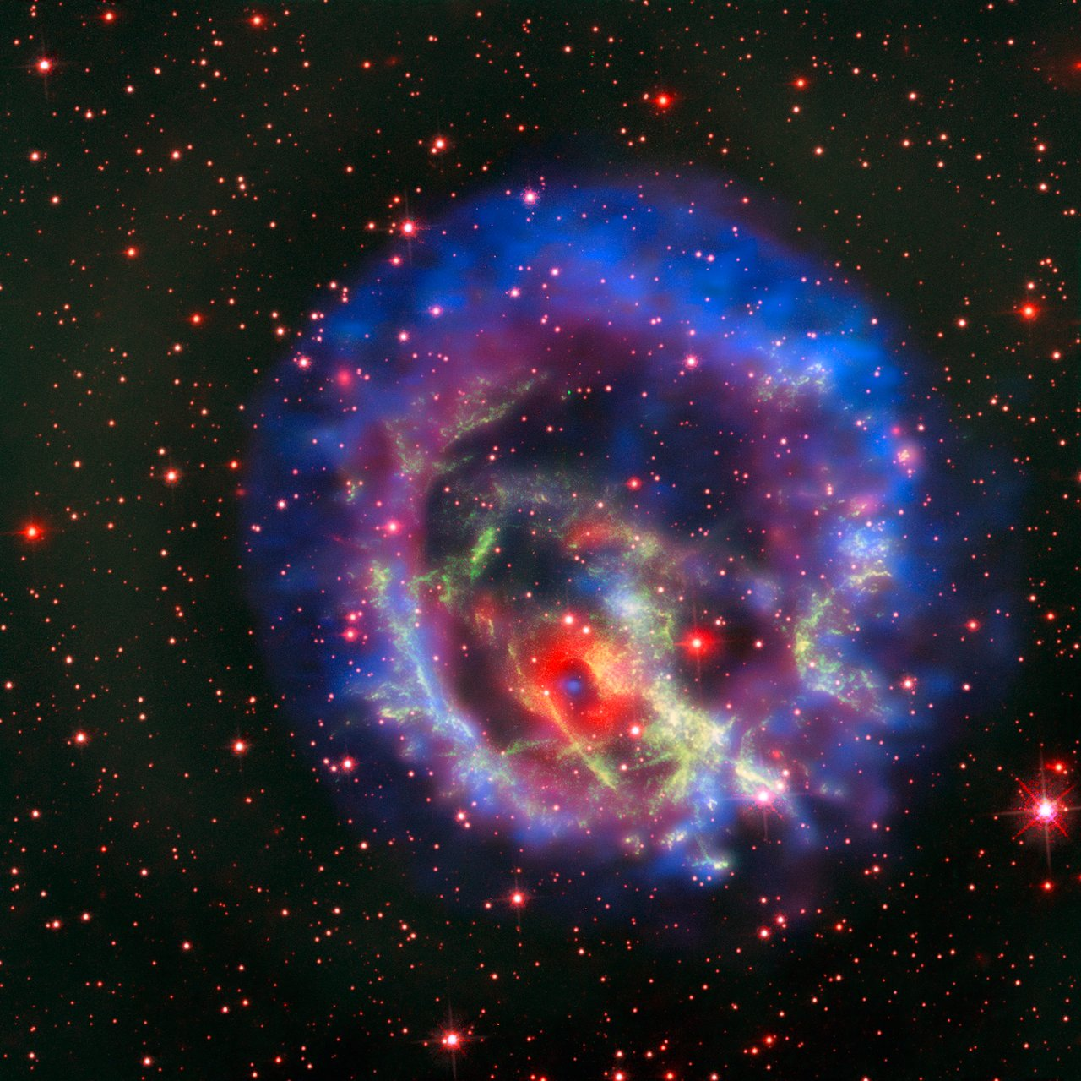

Neutron Star Equations of State
Eva Lope Oter
mariaevl@ucm.es
Theoretical Physics Department, Universidad Complutense de Madrid
QNP2024
Barcelona, July 9, Spain
Crédito:ESO/NASA, ESA and the Hubble Heritage Team (STScI/AURA)/F. Vogt et al

Slide 2

Motivation
We aim to study how gravity works at high energy density
  General Relativity (GR) requires further testing: Einstein’s equations have not been exhaustively constrained at such high ε:
Testing the theory of gravity in the presence of matter requires sizeable Tμν, so prior knowledge of EoS is needed.
Several constraints on current EoS coming from observables obtained within GR.
Our goal is to construct EoS from hadron inputs alone and to test GR and theories beyond GR

Slide 3
Motivations
We aim to study how gravity works at high energy density
  General Relativity (GR) requires further testing: Einstein’s equations have not been exhaustively constrained at such high ε:
Testing the theory of gravity in the presence of matter requires sizeable Tμν, so prior knowledge of EoS is needed.
Several constraints on current EoS coming from observables obtained within GR.
Our goal is to construct EoS from hadron inputs alone and to test GR and theories beyond GR
Another aim is to answer the question:
  How many first-order phase transitions can a NS EoS admit fulfilling constraints from astrophysical observables?

Slide 4
Motivations
We aim to study how gravity works at high energy density
  General Relativity (GR) requires further testing: Einstein’s equations have not been exhaustively constrained at such high ε:
Testing the theory of gravity in the presence of matter requires sizeable Tμν, so prior knowledge of EoS is needed.
Several constraints on current EoS coming from observables obtained within GR.
Our goal is to construct EoS from hadron inputs alone and to test GR and theories beyond GR
Another aim is to answer the question:
  How many first-order phase transitions can a NS EoS admit fulfilling constraints from astrophysical observables?
If we want to build exotic physics in General Relativity and beyond, we need to determine the systematic uncertainties at the employed EoS.

Slide 5
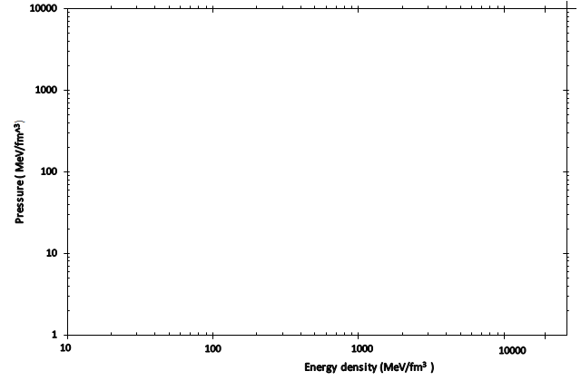
nEoS for cold matter
CRUST
P(ε)
n≃ 40 n_{s}
pQCD
OUTER
CORE
INNER
CORE
OUTER CORE
Uniform Neutron
Matter
?
?
INNER CORE
CRUST
n ≤ 2 n_{s}
R ≈ 1 Km
EFT
Maximum central density
R ≈ 11-13 Km
Generate EoS from hadronic theory and by fundamental principles

Slide 6
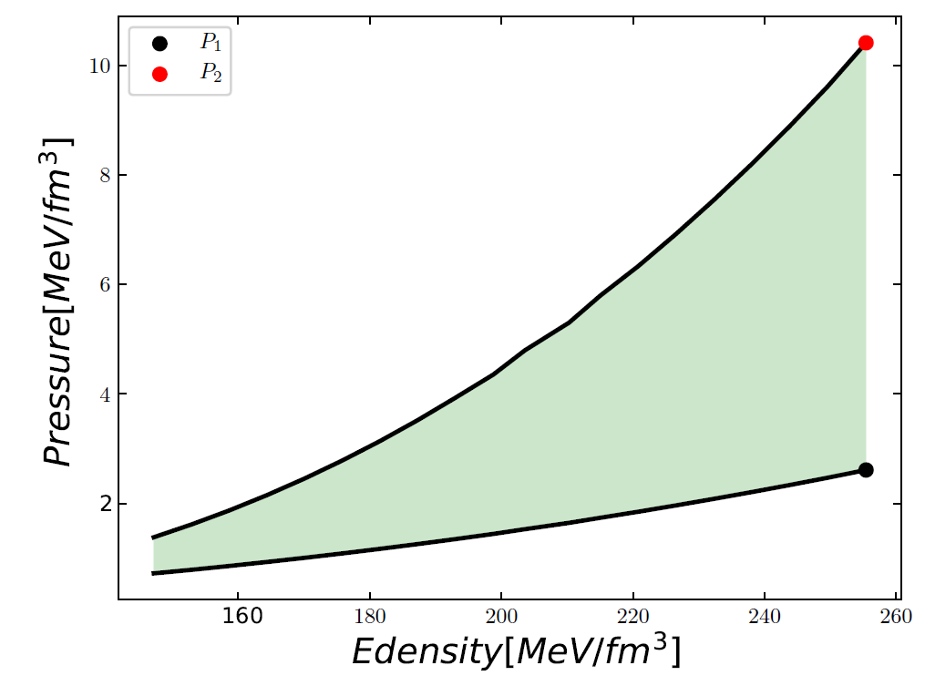
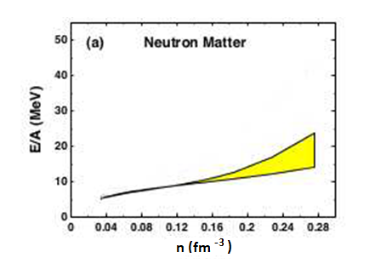

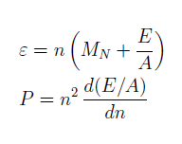
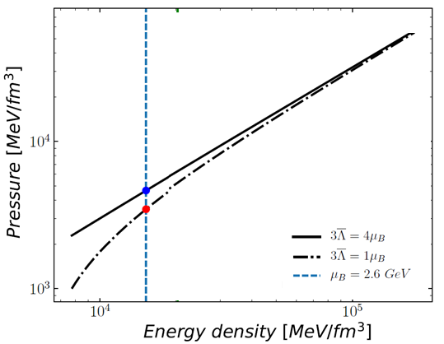
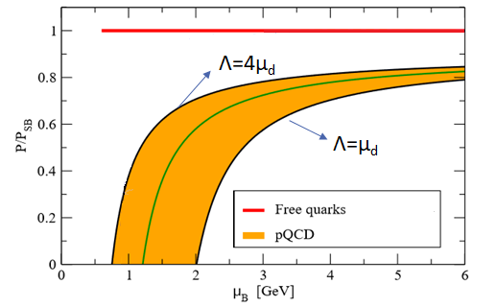

EoS from hadron physics and fundamental principles
Λ_{B} = 450- 600 MeV
EFT: hadron matter (n≤ 2 n_{s})
µ_{B} = 2.6 GeV
pQCD: quark matter
n≃ 40 n_{s}
Q₁ (µ_{B}, ε,P₁)
Q₂ (µ_{B}, ε,P₂)
A. Kurkela et al., Phys.Rev.D 81 (2010) 105021
E.S. Fraga et al. Eur.Phys.J.A 52 (2016) 3, 49

Slide 7

EoS from hadron physics and fundamental principles
CRUST
n≃ 40 n_{s}
pQCD
OUTER
CORE
INNER
CORE
P(µ_{B})
OUTER CORE
Neutron
Matter
?
?
CRUST
INNER CORE
n ≤ 2 n_{s}
E/A(n)
Maximun central density
EFT
Generate EoS from hadronic theory and by fundamental principles
Stability
Causality
Thermodynamic consistency

Slide 8
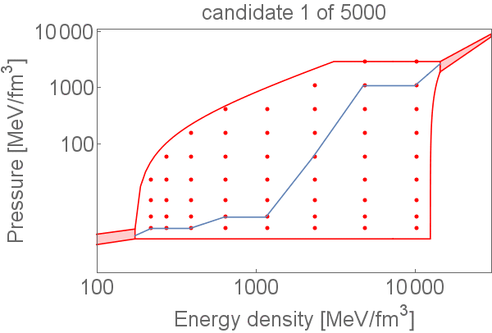



Interpolation: Allowable region by stability and causality
http://teorica.fis.ucm.es/nEoS
Stability
Causality
$$c_{s}^{2}=\frac{dP}{dε}≥0$$
$$c_{s}^{2}=\frac{dP}{dε}≤1$$
$$c_{s}^{2} ∈[0,1]$$
Interpolation with Von Neumann rejection
E. Lope Oter et al.,J. Phys. G 46 (2019) 08400

Slide 9
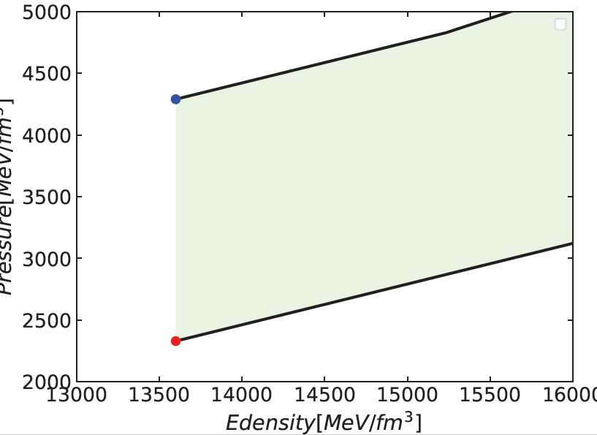

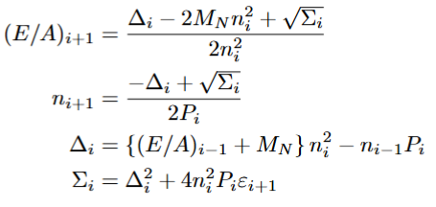
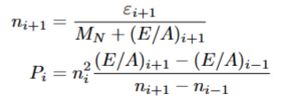


Thermodynamic consistency
Q₁
n ≥ 40 ns
µ=2.6 GeV
Q₁: (ε,P₁,µ)
Q₂: (ε,P₂, µ)
¿µ?
Q₂
Thermodynamic consistency
(µ, n)
  Stability
  Causality
$c_{s}^{2}=\frac{n}{μ}\frac{∂μ}{∂n}$ $∈[0,1]$
Integral constraints

Slide 10
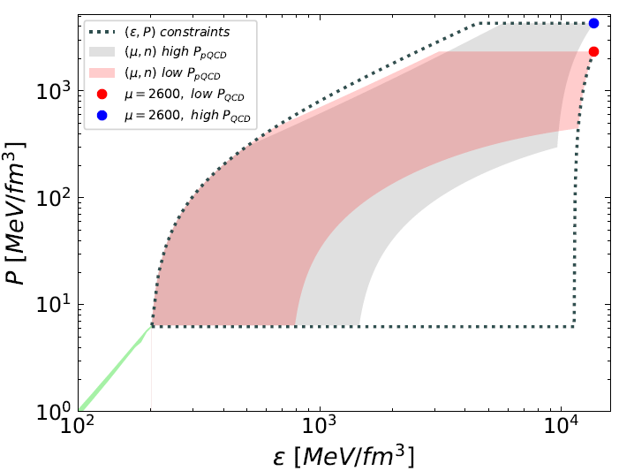

EoS band from first principles and pQCD constraints
EoS: (ε, P, E/A, n, µ)
The pQCD constraints considerably soften the EoS at high densities

Slide 11
EoS from PNM
We incorporate Oller-Alarcón EoSs [1] for pure neutron matter at zero temperature and very low densities expressed in terms of the nucleon scattering data.
These EoS are a renormalized result without any regulator dependence, like a cutoff.
It stems from the calculation of the neutron-neutron scattering amplitude in PNM as a sum of partial-wave amplitudes, which is then used to resum the ladder series for obtaining the energy per neutron E/A.
Extrapolation at higher densities by using two interpolations:
  From Oller-Alarcón band up to the saturation density with current constraints from nuclear experiments , such as symmetry energy (S) and its slope (L) at saturation density.
  Second interpolation between this band and pQCD regime, considering possible PT for $n≥{2.5 n}_{s}$following [2,3].
[1] .J. M. Alarcon and J. A. Oller, Phys. Rev. C 107, 044319 (2023).
[2].U. G. Meissner et al., Annals Phys. 297, 27 (2002)
[3].A. Lacour et al., J. Phys. G 37, 125002 (2010).

Slide 12
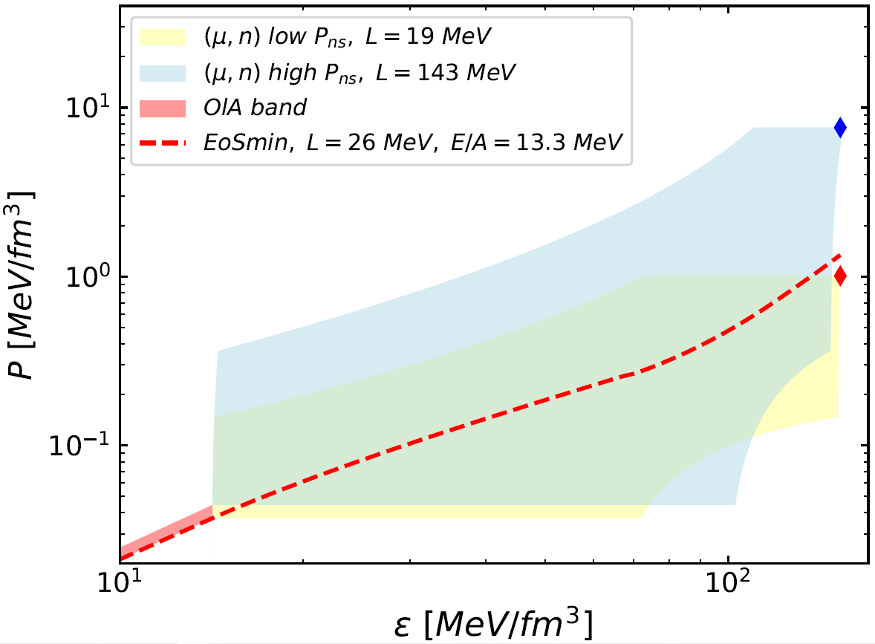

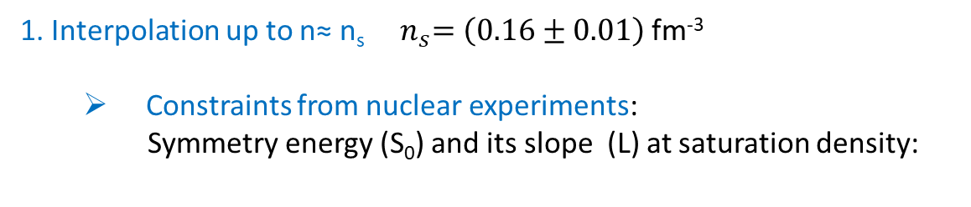

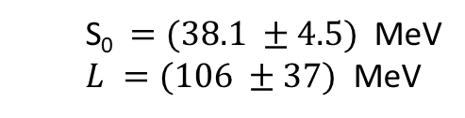


EoS from PNM: interpolation up to n=n_{s}
Band Oller-Alarcón: ${10}^{−8} ≤n≤1.5 {10}^{−2}$ fm⁻³.
1. Interpolation up to n≈ n_{s}${ n}_{s}=\left(0.16±0.01\right)$ fm⁻³
  Constraints from nuclear experiments:
  Symmetry energy (S₀) and its slope (L) at saturation density:
  ${\left(E/A\right)\left(n_{s}\right)}_{SM }=(−16 ±1)$ MeV
$$S_{0}={(E/A)}_{PNM}\left(n_{s}\right) −{(\frac{E}{A})}_{SM }(n_{s})$$
$$L ≅3P_{PNM}(n_{s})/n_{s}$$
PREX
  S₀$=(38.1 ±4.5)$ MeV
  $L =(106 ±37)$ MeV
CREX
  $L =(19 ±19)$ MeV

Slide 13
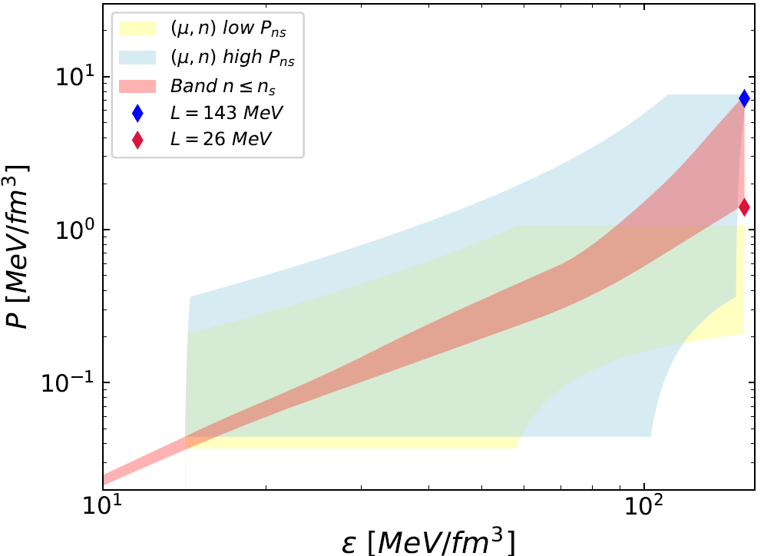

EoS from PNM: interpolation up to n=n_{s}
Constraints
  Upper bound: L= 143 MeV
  Lower bound: Unitary Gas Conjecture (UGC):
(E/A)_{U G} (n_{s} ) = 13 ± 0.3 MeV
Tews et al. , Astrophys. J. 848, 105 (2017), arXiv:1611.07133.
EoS band for ${n ≤n}_{s}$

Slide 14
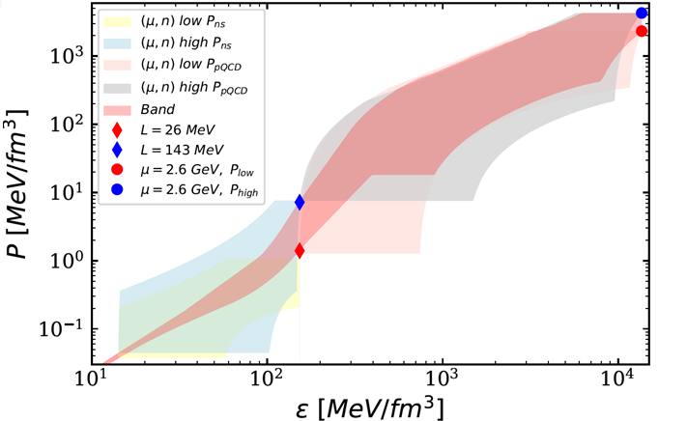
EoS from PNM band
[1] .J. M. Alarcon and J. A. Oller, Phys. Rev. C 107, 044319 (2023).
[2].U. G. Meissner et al., Annals Phys. 297, 27 (2002)
[3].A. Lacour et al., J. Phys. G 37, 125002 (2010).
Phase transitions for $n>2.5 n_{s}.$
Case 1: NO constraints from astrophysical observables.

Slide 15
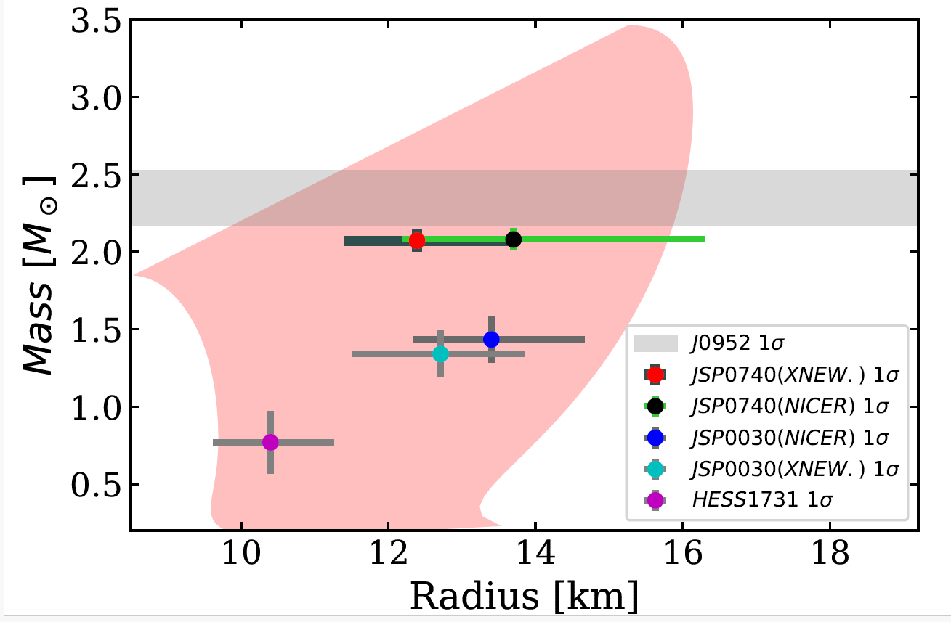
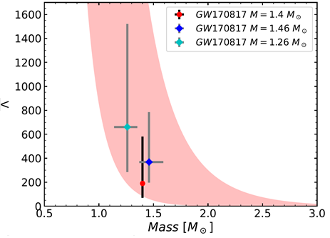
EoS from low PNM band
NO constraints from astrophysical observables

Slide 16












EoS from PNM band with astrophysical constraints
Case 2. Constraints from astrophysical observables
Observables
PSR J0952-0607
HESS 1731-347
PSR J0030+0451
(Riley)
PSR J0030+0451
(Miller)
PSR J0740+6620
(Riley)
PSR J0030+0451
(Miller)
Method of least squares by using these six observables as degrees od freedom to obtain the band of EoS that minimizes χ².

Slide 17
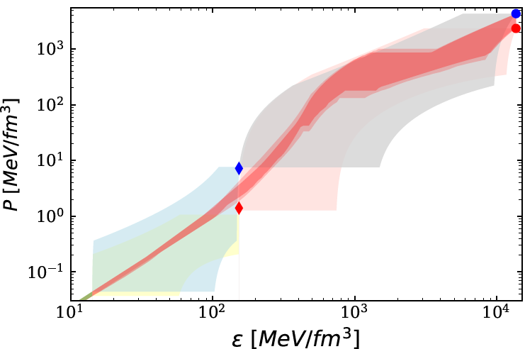
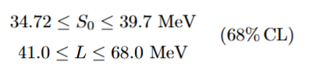

EoS from PNM band: with astrophysical constraints
Constraints from six pulsars and PTs for $n>2.5 n_{s}$

Slide 18
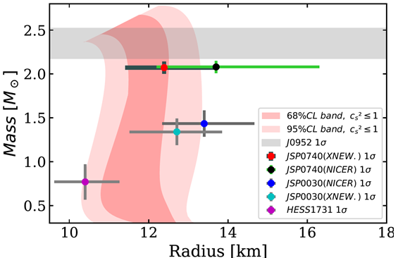
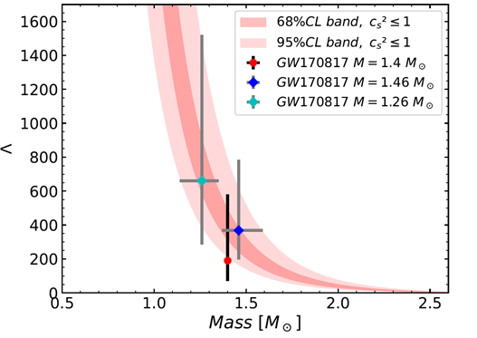
EoS from PNM band: with astrophysical constraints
Tidal deformability is not used as an independent measurement (it is correlated with the radius), but it is useful to check results.

Slide 19
Summary
We provide NS EoS from hadronic theory and first principles
If we constrain EoS by astrophysical observables, these EoS cannot be used to constrain theories beyond General Relativity.
EoS from low PNM up to high densities:
  Stiffer than EoS from EFT.
  Phase transitions for n> 2.5 n_{s} fulfilling constraints from astrophysical observables

Slide 20
Thank you

