Slide 1
Dense Baryonic Matter Equation of State with Quark Pauli Blocking
Oleksandr Vitiuk¹, David Blaschke^{1,2,3}, Gerd Röpke⁴ ¹University of Wroclaw, Poland ²Helmholtz-Zentrum Dresden-Rossendorf, Germany ³Center for Advanced Systems Understanding, Germany ⁴University of Rostock, Germany QNP2024 - The 10th International Conference on Quarks and Nuclear Physics July 8-12, 2024, Barcelona, Spain
Grant № 2022/45/N/ST2/02391

Slide 2
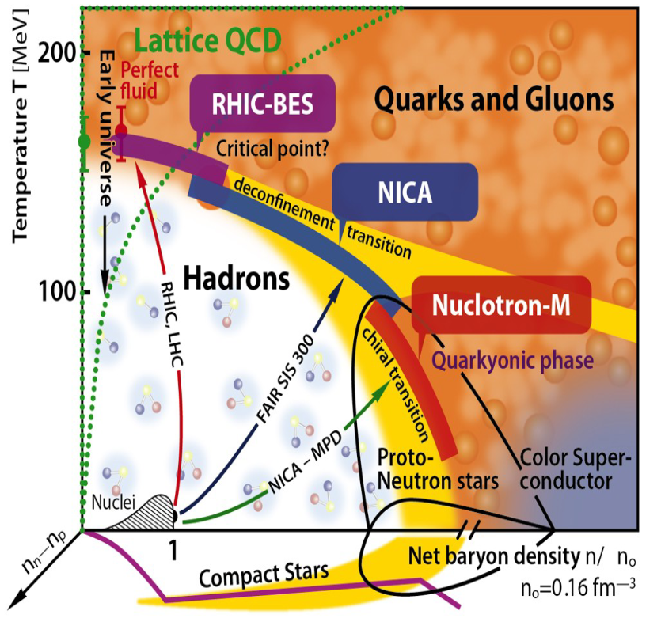
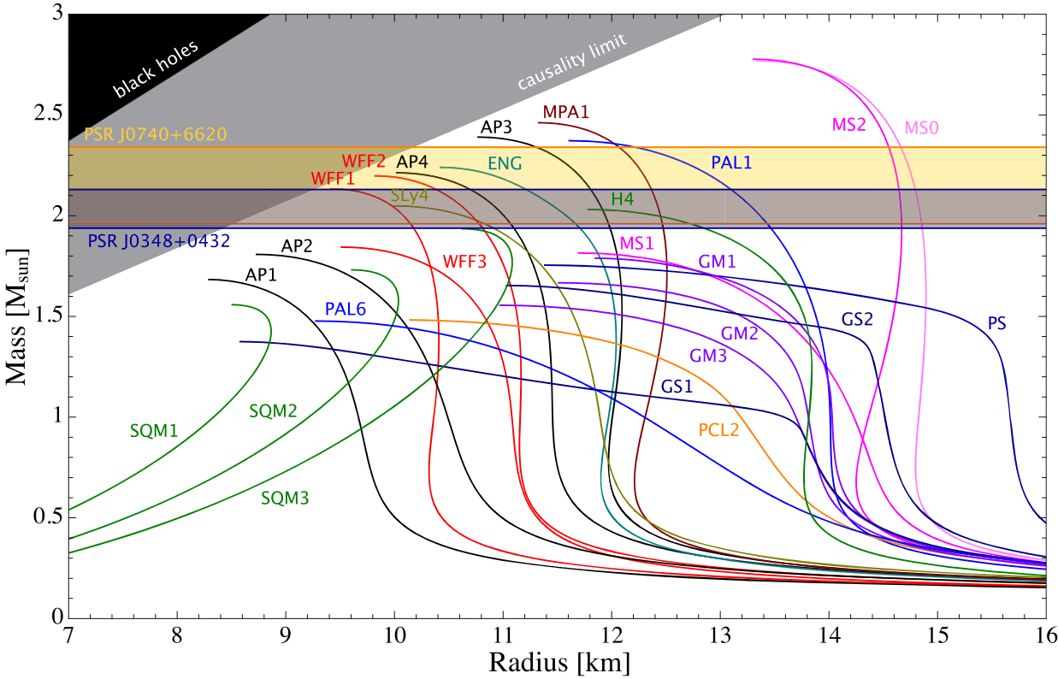
Introduction
The main goal of our community is to gain a better understanding of the theory of strong interactions by detecting phase transitions and critical phenomena.
$$\frac{dP}{dr}=−\frac{M\left(r\right)ε\left(r\right)}{r^{2}}\left(1+\frac{P\left(r\right)}{ε\left(r\right)}\right)\left(1+\frac{4πr^{3}P\left(r\right)}{M\left(r\right)}\right){\left(1−\frac{2M\left(r\right)}{r}\right)}^{−1} \\ \frac{dM}{dr}=4πr^{2}ε(r)$$
$T=0$ region can be probed by neutron stars!
[Figures: J. Phys.: Conf. Ser. 912 012016 (2017) & MNRAS 497, 3118–3130 (2020)]

Slide 3
$σ−ω$ Model
Let us consider a minimal model of relativistic nuclear dynamics where the degrees of freedom are nucleons which interact with each other by an exchange of scalar meson $σ$ and vector meson $ω_{μ}:$
$$ℒ_{σ−ω}=\overline{ψ}\left(i∂_{μ}γ^{μ}−m\right)ψ+\frac{1}{2}\left(∂_{μ}σ∂^{μ}σ−m_{σ}^{2}σ^{2}\right)−\frac{1}{4}ω_{μν}ω^{μν}+\frac{1}{2}m_{ω}^{2}ω_{μ}ω^{μ}+g_{σ}σ\overline{ψ}ψ−g_{ω}ω_{μ}\overline{ψ}γ^{μ}ψ$$
$$ℒ_{N,free}$$
$$ℒ_{σ,free}$$
$$ℒ_{ω,free}$$
$$ℒ_{int}$$
or regrouping the terms:
$$ℒ=\overline{ψ}\left[{iγ}^{μ}\left(∂_{μ}+ig_{ω}ω_{μ}\right)−\left(m−g_{σ}σ\right)\right]ψ+\frac{1}{2}\left(∂_{μ}σ∂^{μ}σ−m_{σ}^{2}σ^{2}\right)−\frac{1}{4}ω_{μν}ω^{μν}+\frac{1}{2}m_{ω}^{2}ω_{μ}ω^{μ}$$
$$D_{μ}$$
$$m^{∗}$$
The Euler-Lagrange equations for this model are given by:
$$\left(∂^{2}+m_{σ}^{2}\right)σ=g_{σ}\overline{ψ}ψ \\ \left(∂^{2}+m_{ω}^{2}\right)ω_{μ}−∂_{μ}∂^{ν}ω_{ν}=g_{ω}\overline{ψ}γ_{μ}ψ \\ \left[γ^{μ}\left(i∂_{μ}−g_{ω}ω_{μ}\right)−\left(m−g_{σ}σ\right)\right]ψ=0$$
$$m_{σ}^{2} \left\langle σ\right\rangle =g_{σ}\left\langle \overline{ψ}ψ\right\rangle \\ m_{ω}^{2}\left\langle ω_{μ}\right\rangle =g_{ω}\left\langle \overline{ψ}γ_{μ}ψ\right\rangle →m_{ω}^{2}\left\langle ω_{0}\right\rangle =g_{ω}\left\langle \overline{ψ}γ_{0}ψ\right\rangle \\ \left[γ^{μ}\left(i∂_{μ}−g_{ω}\left\langle ω_{μ}\right\rangle \right)−\left(m−g_{σ}\left\langle σ\right\rangle \right)\right]ψ=0$$
MFA

Slide 4
$σ−ω$ Model
To extract thermodynamics one can compute the energy momentum tensor $T^{μν}$ and relate its components to the pressure and energy density$:$
$$ε=\left\langle T^{00}\right\rangle =−\left\langle ℒ\right\rangle +\left\langle \overline{ψ}γ_{0}k_{0}ψ\right\rangle , P=\frac{1}{3}\left\langle T^{ii}\right\rangle =\left\langle ℒ\right\rangle +\frac{1}{3}\left\langle \overline{ψ}\vec{γ}\vec{k}ψ\right\rangle$$
In our case this yields to:
$$P_{σ−ω}=\sum_{τ=p,n}{P_{FG}\left(P_{F,τ},m_{τ}^{∗}\right)}+\frac{1}{2}m_{ω}^{2}ω_{0}^{2}−\frac{1}{2}m_{σ}^{2}σ^{2}, ε_{σ−ω}=\sum_{τ=p,n}{ε_{FG}\left(P_{F,τ},m_{τ}^{∗}\right)}+\frac{1}{2}m_{ω}^{2}ω_{0}^{2}+\frac{1}{2}m_{σ}^{2}σ^{2}$$
With the equations of motion of mesonic fields:
$$g_{σ}σ={\left(\frac{g_{σ}}{m_{σ}}\right)}^{2}n_{s}={\left(\frac{g_{σ}}{m_{σ}}\right)}^{2}\sum_{τ=p,n}{n_{s,τ}\left(P_{F,τ},m_{τ}^{∗}\right)}, g_{ω}ω_{0}={\left(\frac{g_{ω}}{m_{ω}}\right)}^{2}n={\left(\frac{g_{ω}}{m_{ω}}\right)}^{2}\sum_{τ=p,n}{n_{τ}\left(P_{F,τ}\right)}$$
Where:
$$E_{τ}^{∗}=\sqrt{P_{F,τ}^{2}+m_{τ}^{∗2}}, n_{τ}\left(P_{F,τ}\right)=\frac{g_{τ}P_{F,τ}^{3}}{{6π}^{2}},$$
$$P_{FG}\left(P_{F,τ},m_{τ}^{∗}\right)=g_{τ}\int_{0}^{P_{F,τ}}{\frac{d^{3}p}{{\left(2π\right)}^{3}}\frac{p^{2}}{3E_{τ}^{∗}}}, ε_{FG}\left(P_{F,τ},m_{τ}^{∗}\right)=g_{τ}\int_{0}^{P_{F,τ}}{\frac{d^{3}p}{{\left(2π\right)}^{3}}E_{τ}^{∗}}, n_{s,τ}\left(P_{F,τ},m_{τ}^{∗}\right)=g_{τ}\int_{0}^{P_{F,τ}}{\frac{d^{3}p}{{\left(2π\right)}^{3}}\frac{m_{τ}^{∗}}{E_{τ}^{∗}}}$$

Slide 5
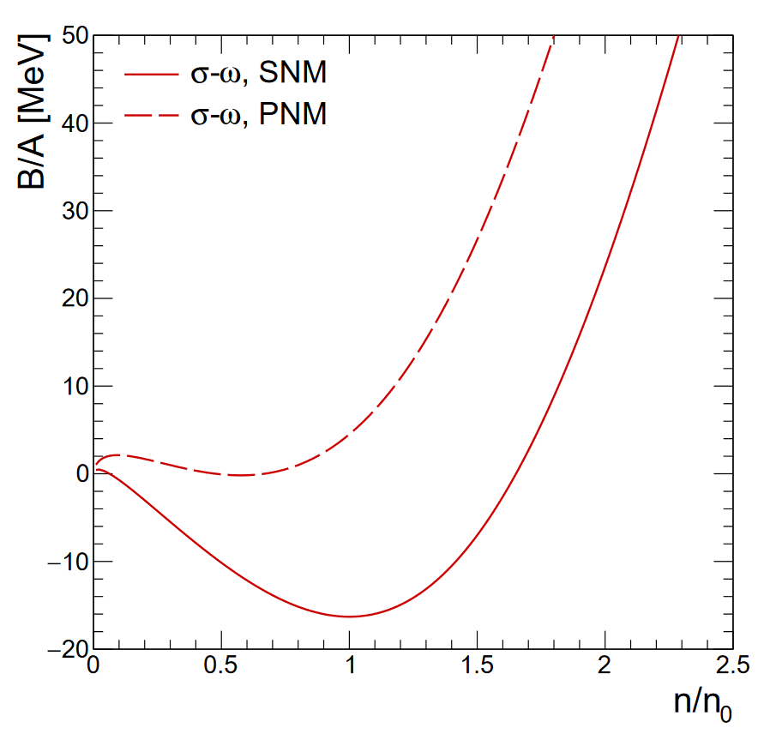
$σ−ω$ Model
There are two free parameters in the model: $G_{σ}={\left(\frac{g_{σ}}{m_{σ}}\right)}^{2}$ and $G_{ω}={\left(\frac{g_{ω}}{m_{ω}}\right)}^{2}$
We use the known nuclear matter properties to fix couplings
Nuclear matter (symmetric) properties:
We use these two conditions to fit model parameters
$$\left.1\right) n_{0}=0.153 fm^{−3}$$
$$\left.2\right) \frac{B}{A}={\left.\left(\frac{ε}{n}−m\right)\right|}_{n_{0}}=−16.3 MeV$$
What about other properties?
$\left.3\right) \frac{m^{∗}}{m}≈0.7−0.8$
$\left.4\right) K=9{\left[n^{2}\frac{d^{2}}{dn^{2}}\frac{ε}{n}\right]}_{n_{0}}≈240 MeV$
$\left.5\right) a_{sym}=\frac{1}{2}{\left[\frac{d^{2}}{dt^{2}}\frac{ε}{n}\right]}_{t=0}=32.5 MeV$
$$\frac{m^{∗}}{m}=0.538$$
$$K=562.9 MeV$$
$$a_{sym}=19.7 MeV$$

Slide 6
$σ−ω$ Model
There are two free parameters in the model: $G_{σ}={\left(\frac{g_{σ}}{m_{σ}}\right)}^{2}$ and $G_{ω}={\left(\frac{g_{ω}}{m_{ω}}\right)}^{2}$
We use the known nuclear matter properties to fix couplings
How to improve the model?
Add self-interactions $ℒ=ℒ_{σ−ω}−\frac{1}{3}bm{\left(g_{σ}σ\right)}^{3}−\frac{1}{4}c{\left(g_{σ}σ\right)}^{4}$ This allows to fulfil two more constraints with two more parameters
Add $ρ$ meson $ℒ=ℒ_{σ−ω}−g_{ρ}{\vec{ρ}}_{μ}{\vec{I}}^{μ}$
Use density dependent couplings
Add form factors
Account for the quark substructure of the nucleons
…

Slide 7
Quark Substructure Effect
Let us consider nonrelativistic massive quarks with a confining two-body interactions in the form of a harmonic oscillator potential [Particles 2020, 3, 477–499]: :
$$H\left(123\right)=\sum_{i=1}^{3}{\left(m+\frac{p_{i}^{2}}{2m}\right)}+\sum_{i<j=2}^{3}{V_{ij}}, where V_{ij}=\frac{mω^{2}}{2}{\left({\vec{r}}_{i}−{\vec{r}}_{j}\right)}^{2}$$
Now, we can solve Schrödinger equation:
$$ψ\left(123\right)=φ_{P}\left(123\right)χ_{ν}\left(123\right) → H\left(123\right)φ_{P}\left(123\right)=E_{n}φ_{P}\left(123\right)$$
Orbital part
SFC part
This yields to the following ground state:
$$φ_{P}\left(123\right)=\frac{8π^{3}}{V}{\left(\frac{\sqrt{3}b^{2}}{π}\right)}^{3/2}δ_{\vec{P},{\vec{P}}_{R}}e^{−\frac{b}{2}\left(p_{ρ}^{2}+p_{λ}^{2}\right)}, E_{n}=\frac{P^{2}}{6m}+3m+3\sqrt{3}ω$$
$$b^{−2}=\sqrt{3}mω, {\vec{P}}_{R}={\vec{p}}_{1}+{\vec{p}}_{2}+{\vec{p}}_{3}, {\vec{p}}_{ρ}=\frac{1}{\sqrt{2}}\left({\vec{p}}_{1}−{\vec{p}}_{2}\right), {\vec{p}}_{λ}=\frac{1}{\sqrt{6}}\left({\vec{p}}_{1}+{\vec{p}}_{2}−2{\vec{p}}_{3}\right)$$
We want to represent the six-quark wave function as a product of two nucleonic wave functions that behaves antisymmetrically with respect to each exchange of quantum numbers belonging to quarks or nucleons:
$Φ_{nn^{′}}\left(123456\right)=\left(1−\sum_{i=1}^{3}{{\hat{P}}_{i,i+3}}\right)\left(1−{\hat{P}}_{nn′}\right)$ $ψ_{n}\left(123\right)ψ_{n′}\left(456\right)$

Slide 8
The antisymmetrization of the two-nucleon wave function with respect to the quark degrees of freedom leads to a shift in the two-nucleon energy:
$$ΔE_{nn^{′}}^{Pauli}=\frac{\left\langle Φ_{nn^{′}}|H|Φ_{nn^{′}}\right\rangle }{\left\langle Φ_{nn^{′}}|Φ_{nn^{′}}\right\rangle }−E_{n}−E_{n′}$$
We are actually interested in the energy shift for a single nucleon in a many-nucleon system:
$$ΔE_{τP}^{Pauli}\left(P_{F,n},P_{F,p}\right)=\sum_{n′}{V}\int_{P′<P_{F}}{\frac{d^{3}\vec{P}′}{{\left(2π\right)}^{3}}}ΔE_{nn^{′}}^{Pauli}=\sum_{τ^{′}=p,n}{\sum_{α=1,2}{c_{ττ′}^{(α)}W_{α}\left(P,P_{F,τ′}\right)}}$$
Where:
$$W_{α}\left(P,P_{F,τ′}\right)=\frac{9\sqrt{3}}{64\sqrt{π}}\frac{b}{m}\frac{1}{λ_{α}^{3}}\left\{12\sqrt{π}\left[\operatorname{erf}\left(λ_{α}\left(P_{Fτ′}−P\right)\right)+\operatorname{erf}\left(λ_{α}\left(P_{Fτ′}+P\right)\right)\right]\left.−\frac{1}{λ_{α}P}\left\{\left[11−2λ_{α}^{2}P_{Fτ′}\left(P_{Fτ′}−P\right)\right]e^{−λ_{α}^{2}{\left(P_{Fτ^{′}}−P\right)}^{2}}\right\}\right\}\right. \\ +\frac{1}{λ_{α}P}\left\{\left[11−2λ_{α}^{2}P_{Fτ′}\left(P_{Fτ′}+P\right)\right]e^{−λ_{α}^{2}{\left(P_{Fτ^{′}}+P\right)}^{2}}\right\} \\ \left.−\frac{1}{λ_{α}P}\left\{\left[11−2λ_{α}^{2}P_{Fτ′}\left(P_{Fτ′}−P\right)\right]e^{−λ_{α}^{2}{\left(P_{Fτ^{′}}−P\right)}^{2}}\right\}\right\}$$
$$τ$$ | $$c_{nτ}^{(1)}$$ | $$c_{nτ}^{(2)}$$
$$n$$ | $$\frac{15}{81}$$ | $$−\frac{16}{81}$$
$$p$$ | $$\frac{12}{81}$$ | $$−\frac{14}{81}$$
Coefficients $c_{nn^{′}}^{(α)}$ entail the symmetry condition:
$$ΔE_{pP}^{Pauli}\left(P_{F,n},P_{F,p}\right)=ΔE_{nP}^{Pauli}\left(P_{F,p},P_{F,n}\right)$$

Slide 9
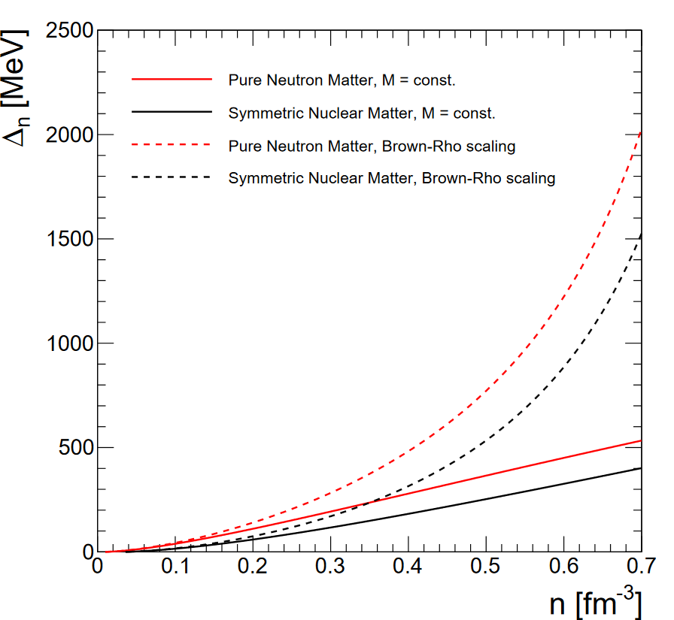
Now, we introduce the quark exchange self-energy contribution in the relativistic mean-field EoS:
$$μ_{ex,τ}=ΔE_{τP_{F,τ}}^{Pauli}\left(P_{F,n},P_{F,p}\right)=Δ_{τ}\left(n,x\right) \\ ε_{ex}=\int_{0}^{n}{dn′\left[xΔ_{p}\left(n′,x\right)+\left(1−x\right)Δ_{n}\left(n′,x\right)\right]} \\ P_{ex}=\sum_{τ=n,p}{μ_{ex,τ}n_{τ}}−ε_{ex}$$
$$P=\sum_{τ=p,n}{P_{FG}\left(P_{F,τ},m_{τ}^{∗}\right)}+\frac{1}{2}m_{ω}^{2}ω_{0}^{2}−\frac{1}{2}m_{σ}^{2}σ^{2}+P_{ex} \\ ε=\sum_{τ=p,n}{ε_{FG}\left(P_{F,τ},m_{τ}^{∗}\right)}+\frac{1}{2}m_{ω}^{2}ω_{0}^{2}+\frac{1}{2}m_{σ}^{2}σ^{2}+ε_{ex}$$
In this work we consider two cases:
Constant quark mass:$m_{q}=m_{q0}=350 MeV$
Brow-Rho mass scaling:$m_{q}=m_{q0}−αn$

Slide 10
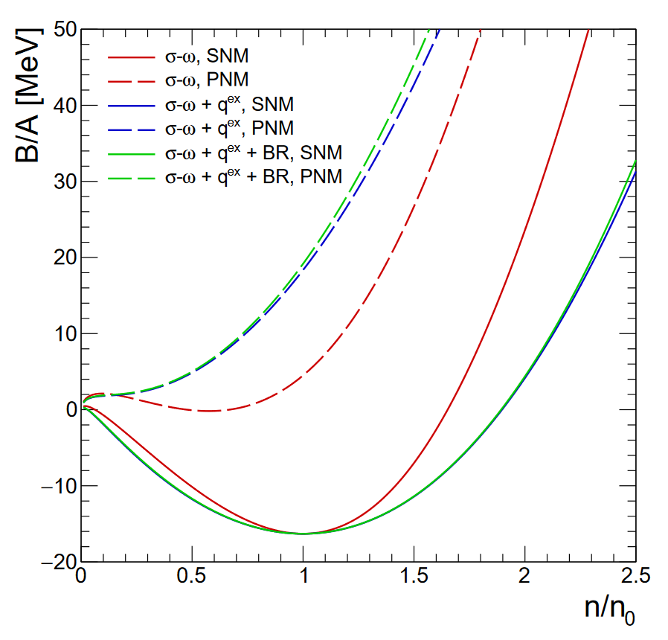
Results
Model | $$σ−ω$$ | $$σ−ω+q^{ex}$$ | $$σ−ω+q_{BR}^{ex}$$
$$G_{σ}, fm^{2}$$ | 15.4256 | 10.1948 | 7.7822
$$G_{ω}, fm^{2}$$ | 11.4741 | 6.3356 | 4.0066
$$m^{∗}/m$$ | 0.538 | 0.687 | 0.759
$$K, MeV$$ | 562.9 | 335.9 | 341.5
$$a_{sym}, MeV$$ | 19.7 | 33.8 | 34.7
Partial replacement of vector meson
Improvement of the compression modulus
Improvement of the effective nucleon mass
Correct value of the symmetry energy coefficient without iso-vector meson

Slide 11
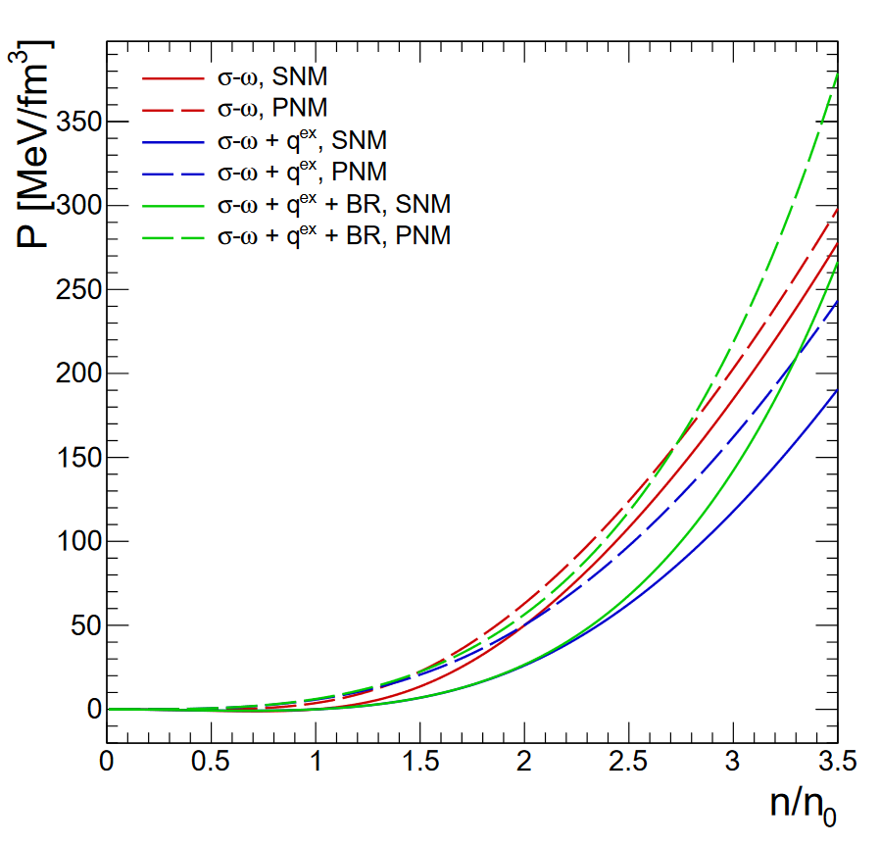
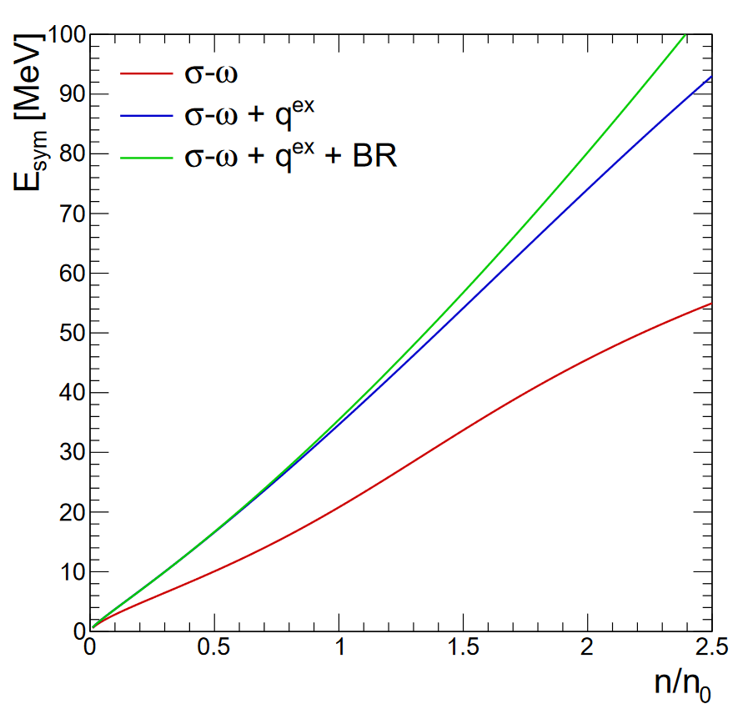
Results: SNM & PNM

Slide 12
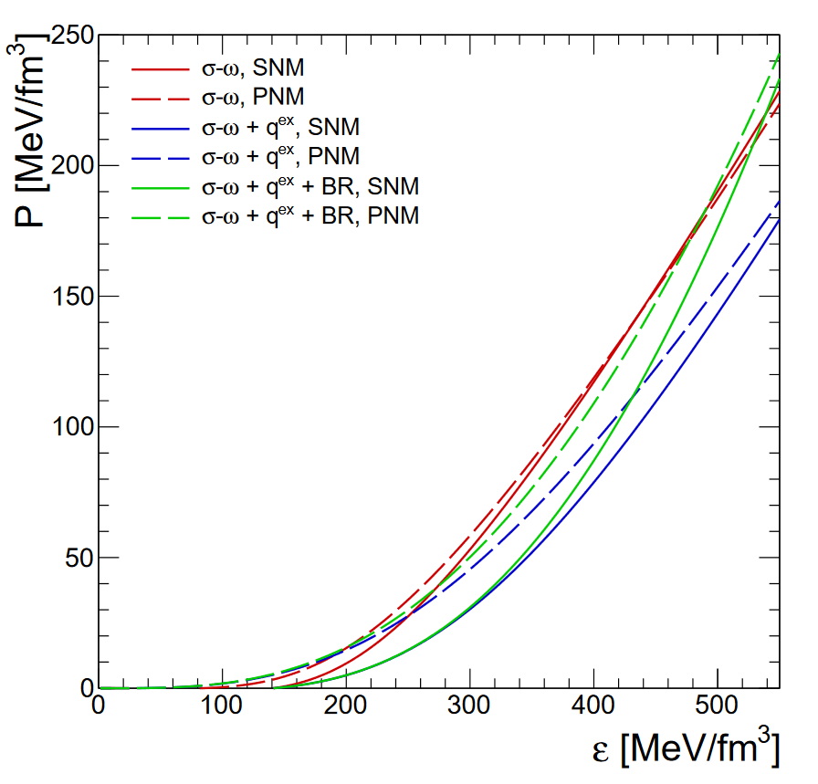
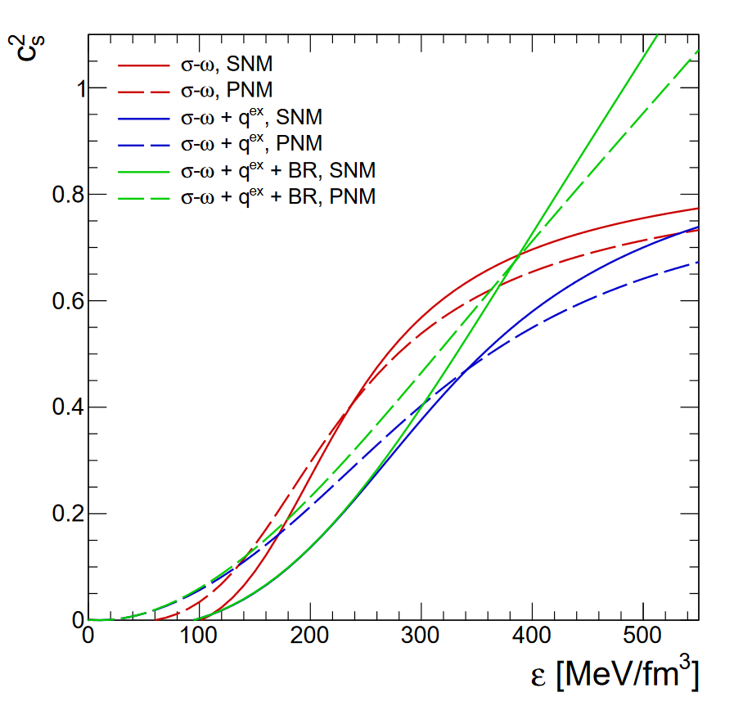
Results: SNM & PNM

Slide 13
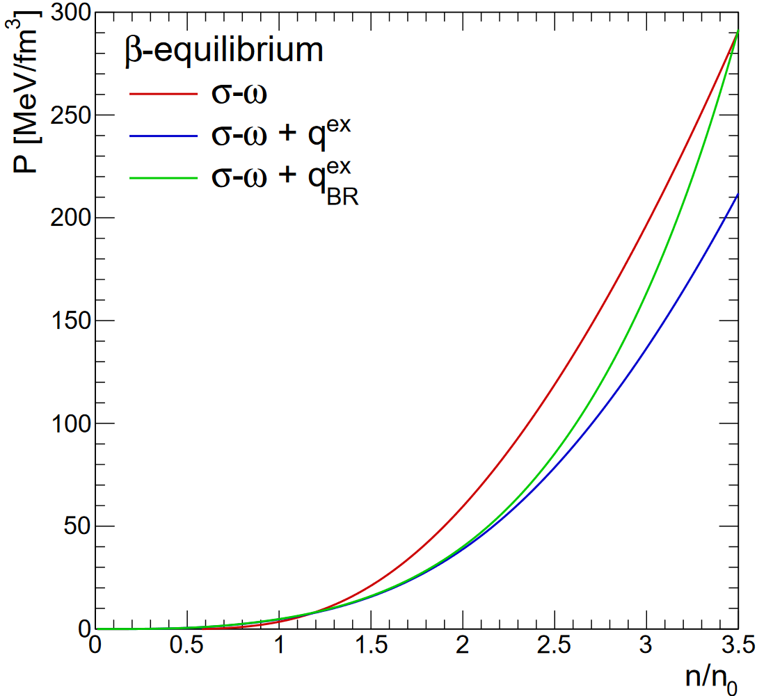
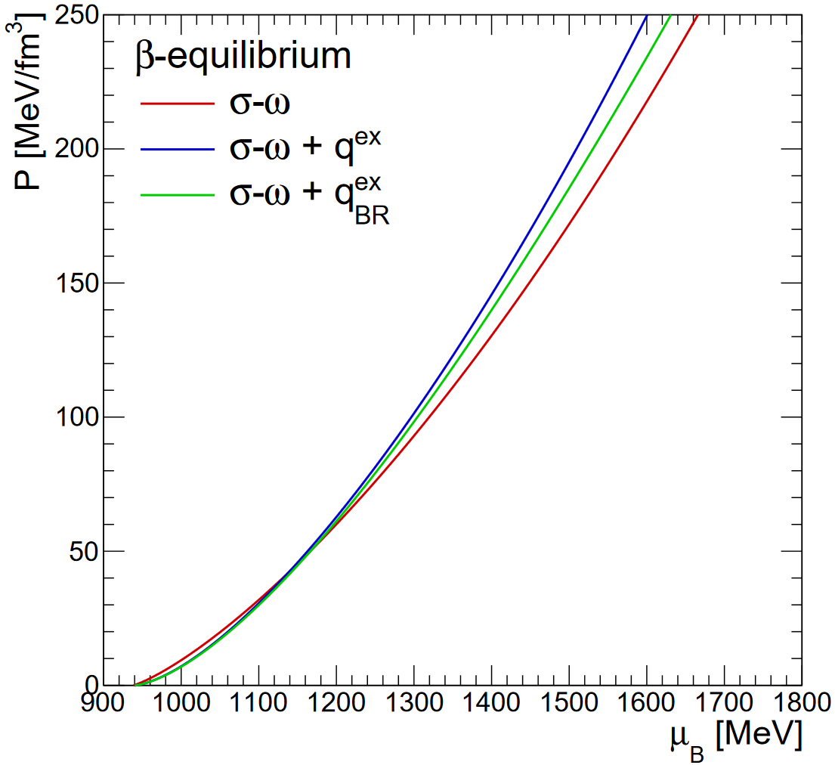
Results: $β$-equilibrium

Slide 14
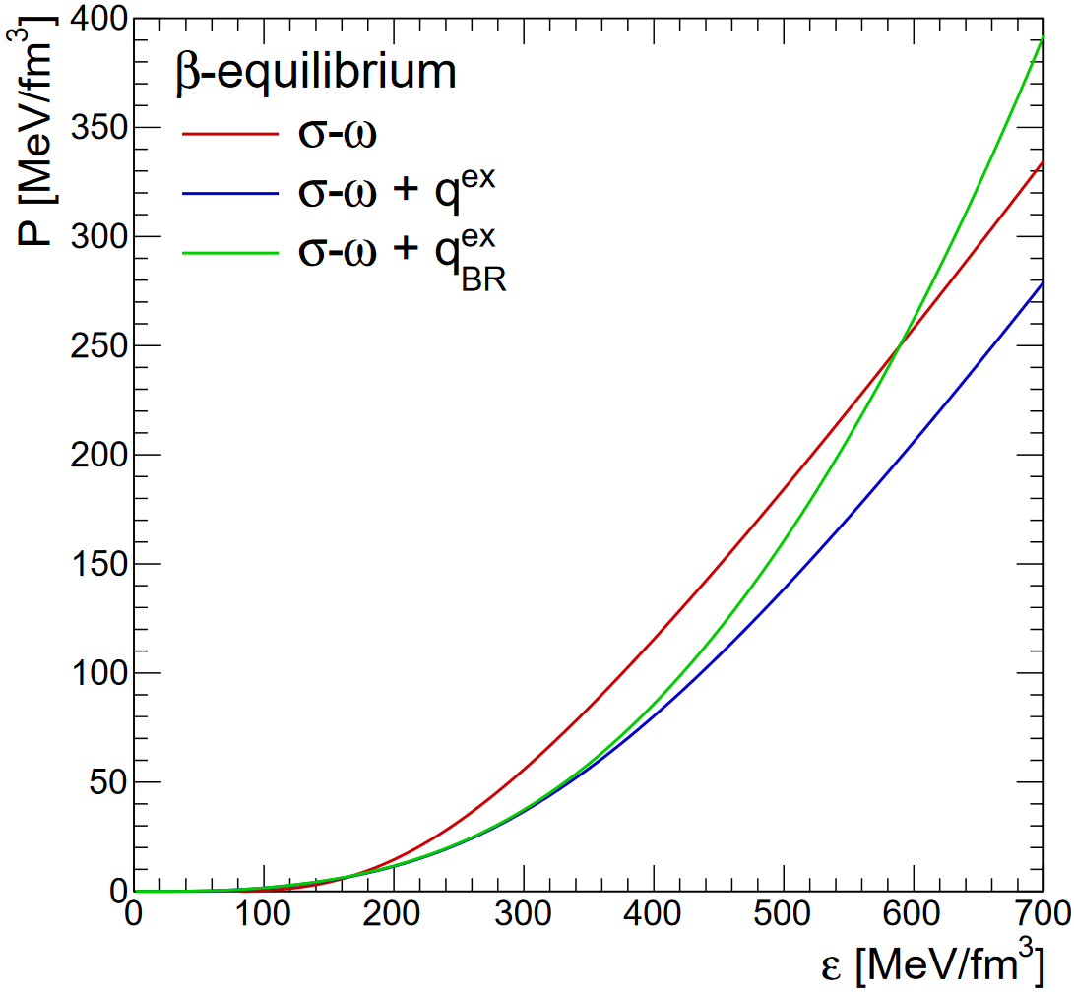
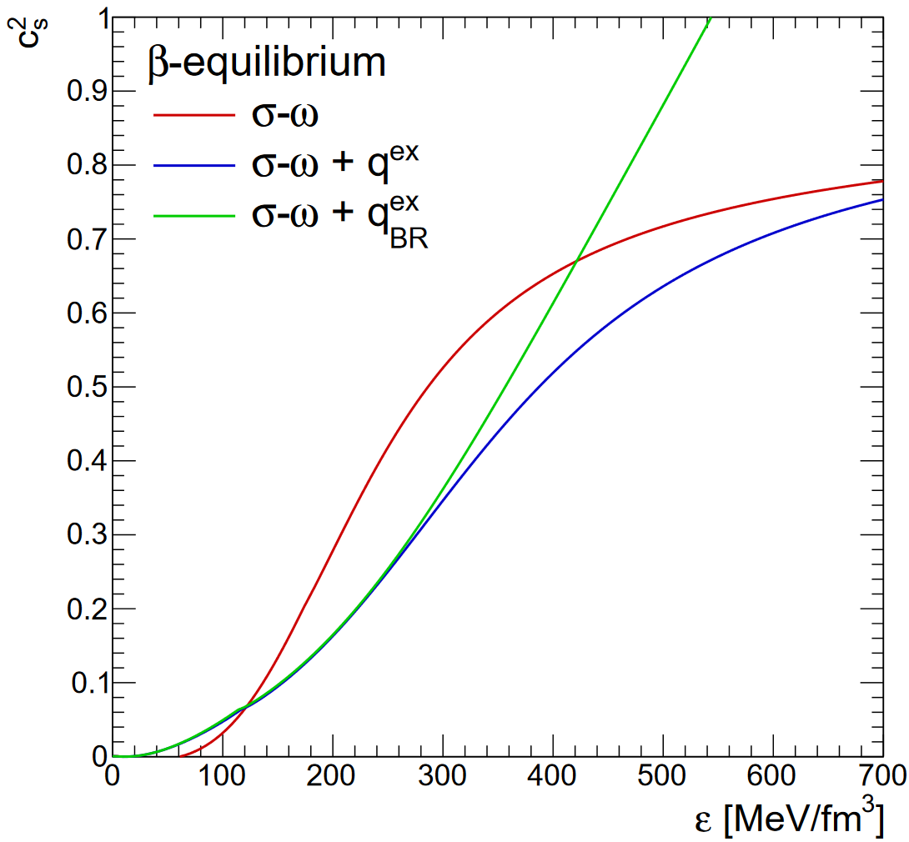
Results: $β$-equilibrium

Slide 15
Summary & Outlook
Summary:
The relativistic mean field model of the nuclear matter equation of state was modified by including the effect of Pauli-blocking owing to quark exchange between the baryons
A chiral enhancement of the quark Pauli blocking due to a density-dependent reduction of the value of the dynamical quark mass was considered
Onset of chiral symmetry restoration (mimicked by Brown-Rho scaling) enhances nucleon swelling and Pauli blocking at high baryon densities
Partial replacement of other short-range repulsion mechanisms ($ω_{μ}$ exchange)
The nuclear symmetry energy was obtained in fair accordance with phenomenological constraints, i.e. full replacement of the iso-vector vector ${\vec{ρ}}_{μ}$meson
Outlook:
Introduction of other hadronic states (hyperons)
Relativistic generalization
Finite temperature case

