Slide 1
Report on VIRGO Computing Data Processing Infrastructure (DPI)
Franco Carbognani

Slide 2
Foreword: ECC 2012/2013 Recommendations
Recommendations:
1: Obsolete components decommissioning
2: Computing farm upgrade
3: Cascina network upgrade
9: Integration with DAQ
15: Network link upgrade
explicitly inserted in to AdVirgo Project planning and successfully completed within scheduled time and budget

Slide 3
Foreword: ECC 2012/2013 Recommendations
Recommendations:
4: AdV data recording directly at CCs: not attempted because not fulfilling AdVirgo use cases
5-7: AdV Computing Model: Completed -> VIR-0129H-13, 2014
8-14: Data access for commissioners at CCs: Implementation strongly but unsuccessfully attempted, ultimately not corresponding to AdVirgo use cases
10: File Catalog functionality: Difficult to implement because of not unified environments at CC's
13: Remote Data Recording: up and running (except for problems at CCs and asymmetries between the 2 CCs)

Slide 4
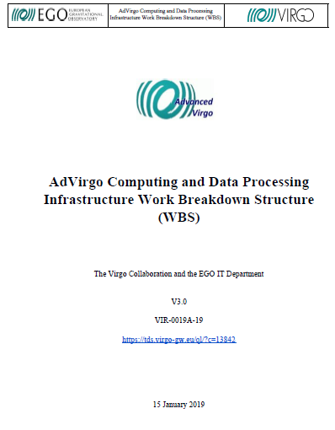
ECC 2018 report first reaction: the Strawman doc
As first reaction to the ECC 2018 report we started from scratch straw man document initially targeted as AdV Computing Model
Current agreement is that the original AdVirgo Computing Model (VIR-0129H-13), Implementation Plan and Management Plan documents will be updated as deliverables of WP10
Initial document then renamed as: “AdVirgo Computing and Data Processing Infrastructure Work Breakdown Structure (WBS)”
Made first public release of the document and collecting feedback

Slide 5
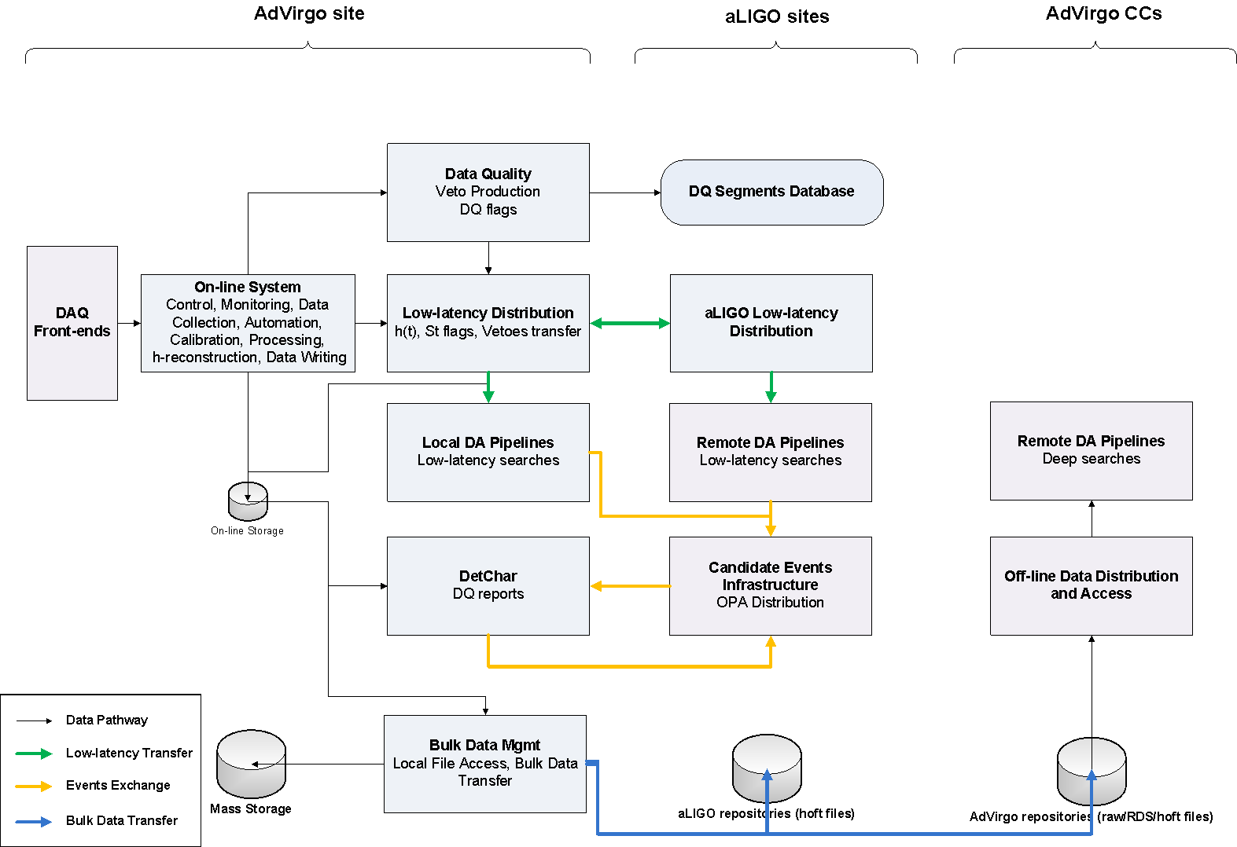
AdVirgo Data Flow schema

Slide 6
AdVirgo Data Flow: The GW170814 case
The signal arrives
Data composed into frames
Calibration of the data
Veto, DQ flags production
h(t) transfer
Low-latency matched-filter pipelines
Upload to GraceDB
Data written into on-line storage
Low-latency data quality
Low-latency sky localization
GCN Circular sent out
Data written into Cascina Mass Storage
Data transfer toward aLIGO and CCs

Slide 7
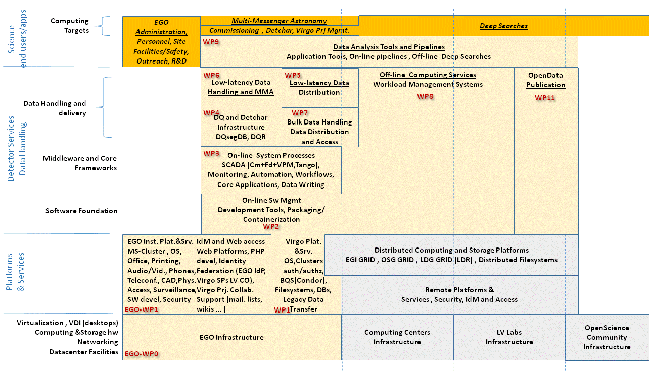
AdVirgo Computing Layers

Slide 8
Data Processing Infrastructure
DPI
Franco Carbognani
WP1
Virgo Platform & Services
Stefano Cortese
WP2
Software Management
Franco Carbognani
WP3
Online System Processes
WP4
Data Quality & Detchar
Nicolas Arnaud
WP5
Low Latency Data Distib.
Loic Rolland
WP6
MMA
Sarah Antier
WP7
Bulk Data Handling
(EGI/OSG based solution)
WP5.1
Kafka Evaluation
Franco Carbognani

Slide 9
ECC 2018 Recommendations: RADAR
Raw AdV Data Archiving and Retrieval (RADAR) goals:
“to safely archive to the collaborating data centers in quasi-real time all raw data generated by the AdV DAQ”: The evolution of the current bulk data transfer architecture with hopefully a common Transfer Method ^{[need 1]} should fulfill this goal (currently using iRODS for CC-IN2P3 and GFAL for CNAF, WebDAV being tested).
“Provide agile recall of selected raw data back to the Cascina disk buffer in order to efficiently and effectively support the interferometer characterization team”: Detchar team or Commissioners are not accessing data in CCs. Within current AdVirgo use cases this RADAR component seems not needed.
The Retrieval side of RADAR obviously need to be supported by a File Catalog ^{[need 2]} solution currently completely missing

Slide 10
ECC 2018 Recommendations: D3
AdV Derived Data Delivery (D3) system goal:
“Deliver to the collaborating data centers in quasi-real time all derived data and metadata products produced in Cascina”: As shown on the AdVirgo Data Flow schema we are not transferring any Low Latency data to CCs . Our statement is that an AdVirgo D3 system is already in operation.

Slide 11
ECC 2018 Recommendations: Tier1 CCs limited use
Limited use of AdV assigned computing resources because Data Analysis pipelines strongly dependent on HTCondor. Cascina is already supporting HTCondor and some European CCs are beginning to provide native HTCondor support so a solution of this problem seems ongoing. Do we still have a need for an alternative Workload Management ^{[need 3]} solution?

Slide 12
Is DIRAC THE solution?
Which tool can provide a common solution for needs 1,2 and 3?
Bulk Data Transfer
File Catalog
Workload Management
DIRAC in principle can.
DIRAC can use HTCondor as backend batch system, can DIRAC and Condor smoothly interoperate for our needs?
Those questions need to be soon answered. Investigations are underway

Slide 13
ECC 2018 Recommendations: Storage Space in Cascina
The EGO IT Dep. is already currently managing a Petabyte level storage system. With current ongoing enlargement plan, going from a 6 months to 1 year circular buffer, will not increase significantly the load on human resources (the new system is also fitting on the same 2 racks as the old one) and should fulfill our needs toward O3.

Slide 14
Storage Space in Cascina
Deeply discussed at 29 Oct Meeting in Cascina:
Archival of relevant data out of the Circular Buffer
Notifications on Circular Buffer data deletion
Raw data flux reductions
O2 data
Both Commissioning and DetChar agree that a buffer of around 1 year of data in Cascina should be sufficient.

Slide 15
Storage Space in Cascina
As of today the raw data circular buffer has been expanded to 700TB (using both the old and new array systems) => ~ 6.3 months at 45 MB/s
Compatibility of 1PB final expansion in 2019 with EGO budget is being evaluated together with possible alternative solutions.
Also the space requested by on-line pipelines (MBTA) for 140TB more and new archiving has been set aside

Slide 16
Software Management (WP2)
Supporting release cycles associated to Engineering Runs and Science Run
Streamlining newly created joint Ligo-Virgo SCCB Board workflow
O3 timeframe
Reimplementation of Fd and Cm libraries Python bindings
Progressing on porting to Python3
Redefinition of Production Area installation policy for lowering the impact of Code Freeze software restarts
Post O3 timeframe
Transition from SVN to Git
“Sustainable software development and distribution with the conda package manager and the conda-forge” joint Ligo-Virgo proposal
………..

Slide 17
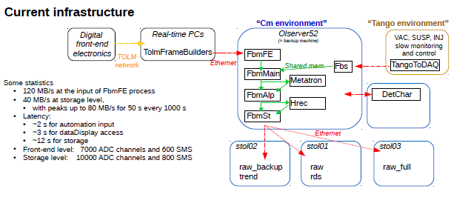
Online System Processes (WP3)
Activities and plans for after O3
evaluating replacement of Cm (RabbitMQ, … ?)
towards using a single SCADA environment? (instead of Cm and Tango currently)

Slide 18
Data Quality & Detchar (WP4)
• DetChar: “Detector Characterisation” group
→ In charge of the quality of the Virgo data as a whole
Detector monitoring, noise analysis
Online data quality for analysis pipelines, event vetoes
Vet gravitational-wave candidates
• All analysis run at Cascina on EGO machines
One dedicated machine for high CPU/memory analysis
5 virtual machines for online analysis
Condor farm for the data quality reports (DQRs)
Outputs uploaded to GraceDB to produce joint LIGO-Virgo DQRs
Analysis of the past day run on a nightly basis
Interactive machines: farmn & ctrl
• Main input: raw data
• Few TB of storage
• DBs: segments, noise lines, etc.
• Web server to display results and browse the associated reports

Slide 19
Data Quality & Detchar (WP4), O3 Roadmap
Improve and consolidate the framework developed for O2
Documentation, user interfaces
Develop more synergies with LIGO
Code robustness and monitoring
Interface more with systems at both ends of the DetChar range
Commissioning, noise hunting
Data analysis
Core projects
Tools
Analysis pipelines, monitoring modules
Online data quality
Real-time data quality, pipeline-specific vetoes
Validation of gravitational-wave candidates
Open public alerts, larger rate of events expected
Shift coverage (2 shifters / week) for the whole duration of O3
Started last Fall to help commissioning / noise hunting

Slide 20
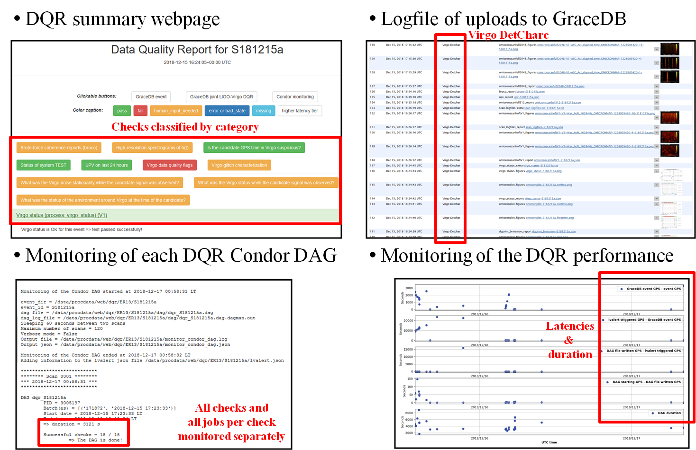
Data Quality & Detchar (WP4), Data quality reports

Slide 21
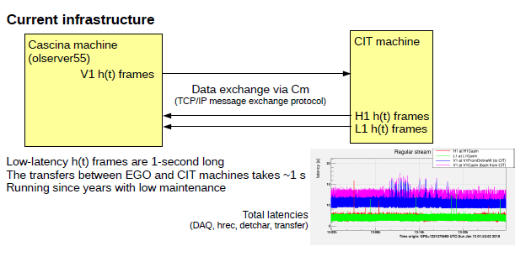
Low Latency data distribution (WP5)
Activities and plans
transfer LIGO h(t) frames from LLH and LHO to EGO directly (by-passing the CIT node)
evaluating use of Kafka instead of Cm for intersite h(t) frame exchange (WP5.1)

Slide 22
Low Latency data distribution (WP5)
Kafka evaluation (WP5.1)
We are evaluating the use of Kafka for the Cascina – aLIGO link as a replacement for the current Cm (Virgo specific) based solution. Kafka is a modern message-query which embed a smart fail-over mechanism and will be used by aLIGo for all other Low Latency links (including toward Kagra). We have the hope that the use of Kafka could improve reliability and enhance maintainability of the overall Low Latency data distribution architecture by aligning on the same solution on all links.
Status:
Cascina -> UWM transfer of O2 replay 1sec gwf data from /dev/shm ongoing for some weeks and no transfer problems so far observed.
LHO / LLO -> Cascina transfer links being tested
Next steps: Verification of robustness and assessment of latency performances

Slide 23
Bulk Data Handling, Legacy solution (WP1)
O3 timeframe
Working toward making exiting solution, the GFAL2/iRODS + custom_scheduler point-to-point architecture used for O2, as robust as possible
Link bandwidth increase from to 1Gb/s to 10Gb/s. Not being anymore marginal on quasi real-time data transfer (50MB/s x 2 -> 0.8-0.9Gb/s) ease and shorten a lot the eventual recovery from problems

Slide 24
Bulk Data Handling, Legacy solution (WP1)
Current on-going improvements:
Two separate machines for the 2 legs of the transfer => decoupling of troubleshooting
Better handling of md5sum computation under load (asynchronous)
Better management of certificates for the Bologna transfer: CNAF provided the right procedure to renew the certificate up to 1 week using MyProxy
Still to be solved:
Performance to Bologna limited to ~120MB/s: Filed to CERN developers a bug in the GFAL2 client that current does not handle multiple gridftp parallel stream
Waiting for the fix, promised to be delivered in time for O3 ( not anyway a big problem, throughput is more than 2 times the normal DAQ flux )

Slide 25
Bulk Data Handling (WP7)
Post O3 timeframe
Unified and EGI/OSG framework based solution
Investigate and implement a unifying solution based on a EGI/OSG framework in coordination with Tier1 CCs
Will provide a full Data Transfer and Access integrated solution for a full mesh topology among all AdVirgo/LIGO data endpoints

Slide 26
Low Latency Pipelines / On-line Computing
cWB
A “Cascina compliant” installation has been finalized for ER13.
Overall computing power requests made explicit: the equivalent of 128 physical cores for Condor jobs for the 2 variants of the algorithm to be completed in the 24 hours time window
MBTA
computing being re-evaluate with realistic noise curve.
Condor farm, used also for Noemi and Detchar DQR, is being expanded to reach 160 cpus, the missing cpus are being procured and will be installed in January 2019

