Slide 1
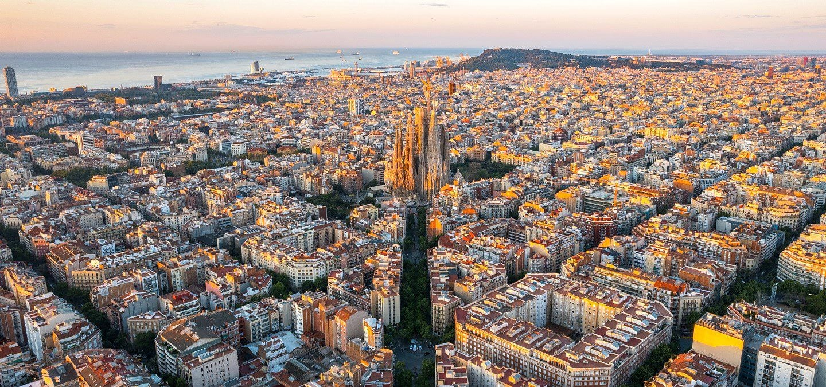
Symmetries in Neural Quantum States
Javier Rozalén Sarmiento
Advisor: Arnau Rios Huguet

Slide 2
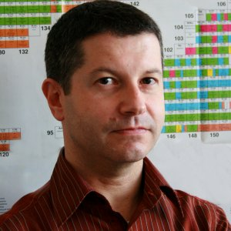
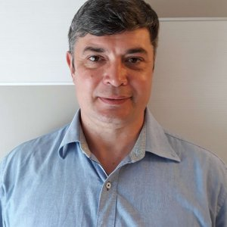
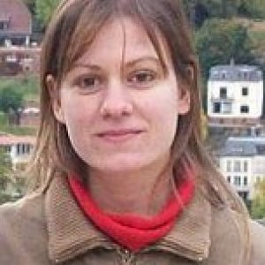
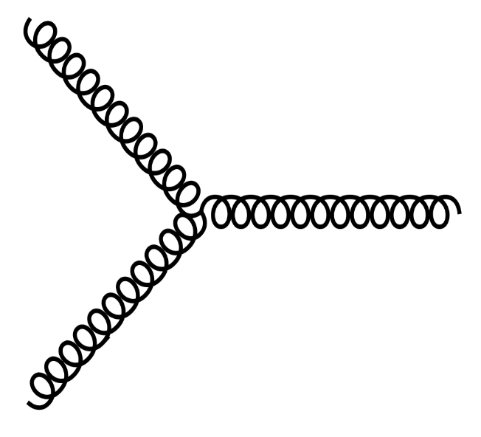
The Hadronic, Nuclear and Atomic Physics Group ($∈$ FQA)
People
+
PhD/PostDoc Students
HadNuc@UB Seminars
ICCUB has $≈80$ PhDs & Postdocs (as of 2022)

Slide 3
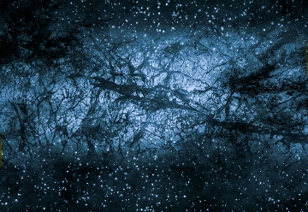
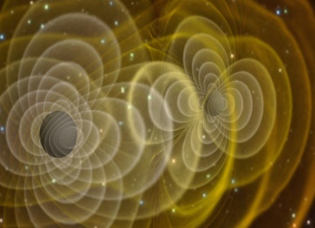
Nuclear Physics
Dark Matter detection: baryonic DM interacts with nuclei!
Gravitational waves: strong interaction determines the GW signal in NS mergers
Nuclear structure: static properties of nuclei

Slide 4
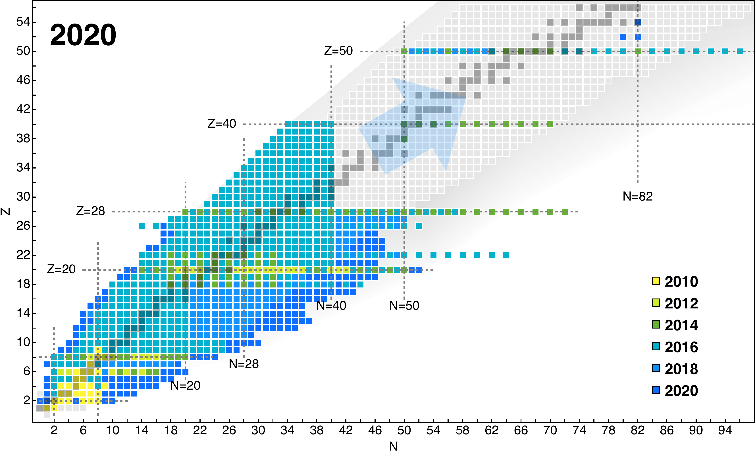
Ab Initio Nuclear Structure
IT-NCSM
Lattice EFT
MR-IMSRG
CCSD
VS-IMSRG
$Λ$-CCSD
ADC
NQS
[1]
[1] H. Hergert, A Guided Tour of ab initio Nuclear Many-Body Theory, 2020

Slide 5
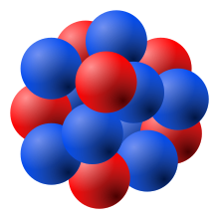
The Quantum Many-Body Problem
Goal: Solve for the wave function of an atomic nucleus, $ψ$
$$|ψ⟩$$
How? Rayleigh-Ritz variational principle
$$\frac{\left.⟨ψ_{θ}|\hat{H}|ψ_{θ}\right.⟩}{\left.⟨ψ_{θ}|ψ_{θ}\right.⟩}{≥E}_{GS}$$
$$\left|ψ_{θ}\right\rangle =∫\left|p\right\rangle ψ_{θ}\left(p_{1},p_{2},…,p_{N}\right)d^{3N}p$$
$W^{\left(1\right)},B^{\left(1\right)}$
$$p_{1}$$
$W^{\left(2\right)},B^{\left(2\right)}$
NQS Ansatz: $ψ_{NQS}\left(p_{1},p_{2},…,p_{N}, ;θ\right)$
$$p_{2}$$
$$ψ_{NQS}(p;θ)$$
$$⋮$$
$$p_{N}$$
$θ={\left\{W^{\left(i\right)},B^{\left(i\right)}\right\}}_{i=1}^{L}$

Slide 6
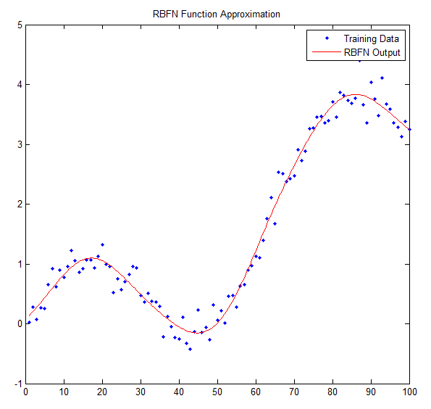
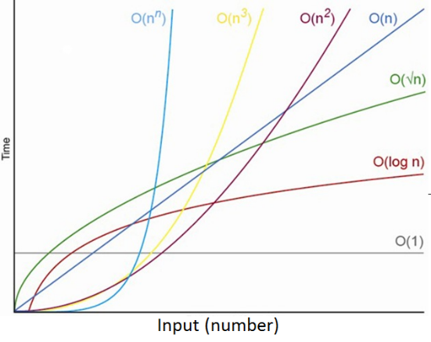
Why Neural Networks?
NNs have “$∞$ power”: a neural network can approximate any continuous function [2], [3].
Space complexity: polynomial scaling of memory resources… possibly!
[2] G. Cybenko, Approximation by superpositions of a sigmoidal function, 1989
[3] K. Hornik M. Stinchcombe, H. White, Multilayer feedforward networks are universal approximators, 1989

Slide 7
Live Neural-Network Training
$$p$$
$$n$$
Deuteron
$$|ψ_{ANN}^{L=0}\left(q\right)〉$$
$$q$$
$$|ψ_{ANN}^{L=2}\left(q\right)〉$$
$N_{hid}=20$ neurons

Slide 8
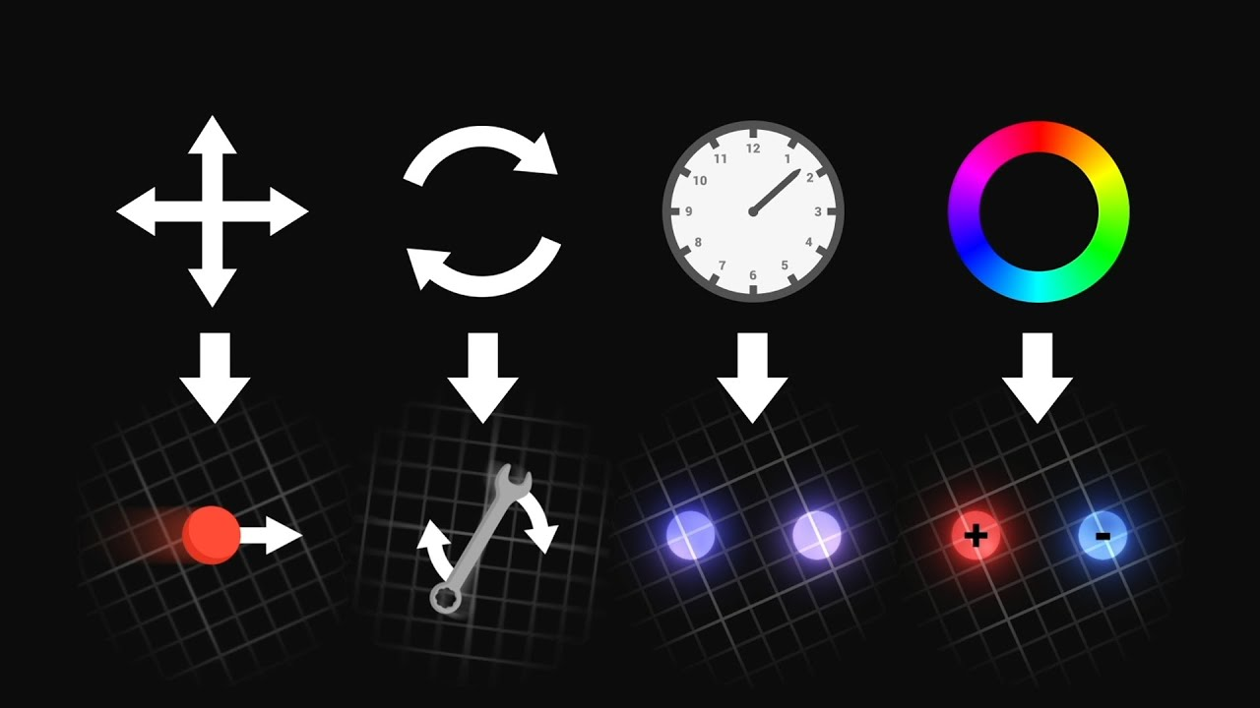
Physics-Inspired Neural Networks
Encoding physics in NNs: symmetries of $\hat{H}$, boundary conditions, etc.
My current work!
https://www.youtube.com/watch?v=hF_uHfSoOGA&ab_channel=ScienceClicEnglish

Slide 9
Symmetries in Quantum Mechanics
$\left[\hat{H}, \hat{O}\right]=0⇒\{|ψ⟩$ solution kets} are eigenstates of $\hat{O}$
Example: 1D HO
$\hat{H}=\frac{1}{2}∇^{2}+\frac{1}{2}mw^{2}x^{2}⟶\left[\hat{H}, \hat{P}\right]=0$, where $\hat{P}$ is the parity operator
$ψ\left(x\right)=±ψ\left(−x\right)$, solutions are either parity-even or parity-odd
Example: Hydrogen atom
$$\hat{H}=−\frac{ℏ^{2}}{2μ}\left\{\frac{1}{r^{2}}\frac{∂}{∂r}\left(r^{2}\frac{∂}{∂r}\right)+\frac{1}{r^{2}}\left[\frac{1}{ sinθ}\frac{∂}{∂θ}\left( sinθ\frac{∂}{∂θ}\right)+\frac{1}{\sin^{2}θ}\frac{∂^{2}}{∂φ^{2}}\right]\right\}−\frac{Ze^{2}}{r}⟶\left[\hat{H}, \hat{L^{2}}\right]=\left[\hat{H}, \hat{L_{z}}\right]=0$$
$$ψ_{nlm}\left(r,θ,φ\right)=\sum_{n=1}^{∞}{\sum_{l=0}^{n−1}{\sum_{m=−l}^{+l}{{c_{nlm}P}_{nl}\left(r\right)Y_{lm}(θ,φ)}}}$$

Slide 10
Symmetries in neural networks
1D HO: naive approach (but good!)
Fermionic particle exchange: common approach
$$\hat{H}=−\frac{1}{2}∇^{2}+\frac{1}{2}mw^{2}x^{2}⟶ψ\left(x\right)=±ψ\left(−x\right)$$
Spin-statistics theorem $⟶$
$$ψ\left(x_{1}, …,x_{i},…, x_{j}, …, x_{N}\right)=±ψ\left(x_{1}, …,x_{j},…, x_{i}, …, x_{N}\right)$$
$$ψ_{NQS}\left(x\right)≔ψ_{NN}\left(x\right)±ψ_{NN}(−x)$$
$ψ_{NQS}\left(x_{1},x_{2},…,x_{N}\right)=φ_{EQUIV}∘det φ_{GSM}(x_{1},x_{2},…,x_{N}$)
$W^{\left(1\right)},B^{\left(1\right)}$
$W^{\left(2\right)},B^{\left(2\right)}$
$$x$$
$$ψ_{NN}(x)$$
[4]
Is this the best way?
What about other symmetries (continuous groups)?
[4] J Keeble, A Rios et al, Machine learning one-dimensional spinless trapped fermionic systems with neural-network quantum states

Slide 11
Convolution is all you need
$Φ$is equivariant under a group $G$ if:
$$Φ\left(T(g)x\right)=T′(g)Φ\left(x\right)$$
$T_{g}$: representation of $g∈G$ on $X∋x$
Group convolution $⟺$ Group equivariance (2016-2018) [5, 6, 7]
$$\left(f⋆χ\right)\left(g\right)=\sum_{u∈G }{f\left(u^{−1}g\right)χ(u)}$$
Can we re-think past networks as G-CNNs?
(WIP)
Should we design NQSs within this framework?
[5] T S Cohen and M Welling, Group Convolutional Neural Networks
[6] T S Cohen and M Welling, Steerable CNNs
[7] R Kondor and S Trivedi, On the Generalization of Equivariance and Convolution in Neural Networks to the Action of Compact Groups

Slide 12
Re-thinking past networks
$ℤ/2ℤ$,$C_{2}=\{e, a\}$ (parity)
$$ψ_{NQS}\left(x\right)≔ψ_{NN}\left(x\right)±ψ_{NN}(−x)$$
Irreps of $ℤ/2ℤ$ :
$D^{t}\left(e\right)=\left(1\right), { D}^{t}\left(a\right)=\left(1\right)$ Trivial rep
$D^{s}\left(e\right)=\left(1\right), { D}^{s}\left(a\right)=\left(−1\right)$ Sign rep
Projection onto invariant subspaces yields: $\left\{\begin{aligned}f_{+}\left(x\right)≔f\left(x\right)+f(−x) \\ \\ f_{−}\left(x\right)≔f\left(x\right)−f(−x) \end{aligned}\right.$
$ψ_{NQS}\left(x\right)≔ψ_{NN}\left(x\right)+ψ_{NN}(−x)$ → $ψ$ transforms with trivial rep.
$ψ_{NQS}\left(x\right)≔ψ_{NN}\left(x\right)−ψ_{NN}(−x)$ → $ψ$ transforms with trivial rep.

Slide 13
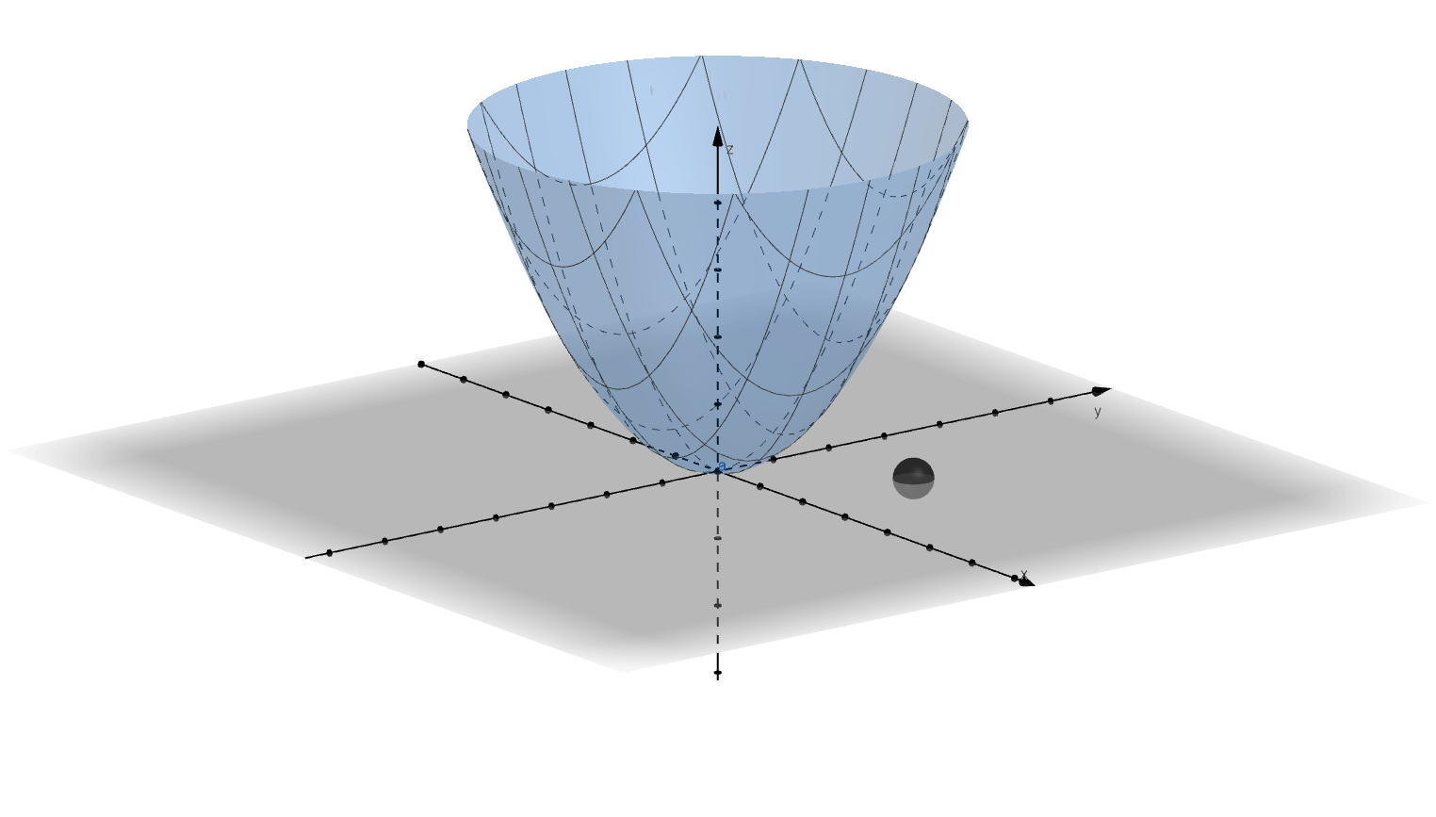
Toy exemple: $G=SO(2)$
$N=1$ particle, 2D HO
$$Neural network$$
$k= channels$
$\left|G\right|=16$
$L=1 layer$
$SO(2)$-Conv
$$x$$
$$ψ_{NQS}(x,y)$$
$$y$$
$$\sum_{R∈SO(2)}{W(R)D\left(R^{−1}\right)\left(\begin{matrix}x \\ y\end{matrix}\right)}$$
$$PRELIMINARY$$
Loss
Epochs

Slide 14
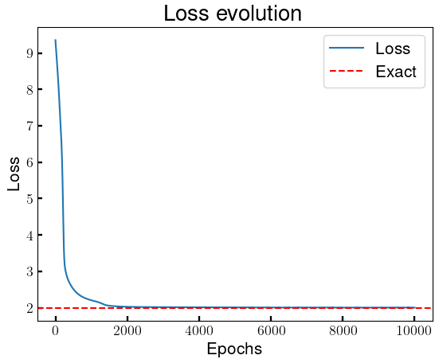
Toy exemple: ${G=S}_{N}$
$N=2$ fermions, 1D HO
$$Neural network$$
$k=25 channels$
$\left|G\right|=2$
$L=1 layer$
$S_{N}$-Conv
$$x_{1}$$
$$ψ_{NQS}(x_{1},x_{2})$$
$$x_{2}$$
$$\sum_{σ∈S_{N}}{{\left(−1\right)}^{sgn\left(σ\right)}W(σ)D\left(σ^{−1}\right)\left(\begin{matrix}x_{1} \\ x_{2}\end{matrix}\right)}$$

Slide 15
Next steps and open questions…
Why is the Slater “so good”? Can we explain it from the irreps of $S_{N}?$ Can we find something even better?
Can we compute any excited state?
What about continuous groups ($SU(N))$?
THANK YOU FOR YOUR ATTENTION

Slide 16
Training example: the deuteron
Network hyperparameters:
${− N}_{hid}=20$ neurons
$− L=1$ layer
$−$ Learning rate = ${10}^{−2}$
$−$ Optimizer = RMSprop
Developed with

Slide 17
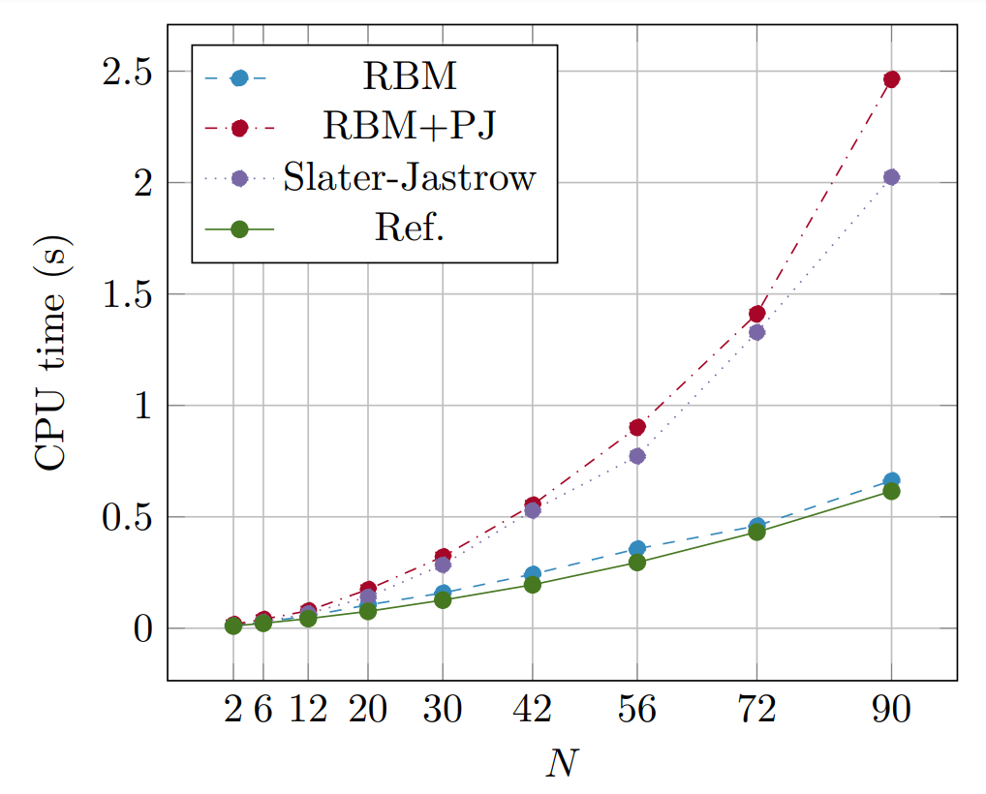
Advantage: mild scaling
[2]
[2]. E M Nordhagen et al, Hidden-nucleons neural-network quantum states for the nuclear many-body problem, arXiv:2210.00365

Slide 18
Anti-symmetric neural networks
[4]
J Keeble, A Rios et al, Machine learning one-dimensional spinless trapped fermionic systems with neural-network quantum states, arXiv:2304.0475

Slide 19
Group theory
Def. (linear representation, informal): a linear representation of a group $G$ is a map $ρ:G⟶GL(ℂ)$ such that matrix
multiplication is associated with the group product: $D rep:g_{1}g_{2}=g_{3}→D\left(g_{1}\right)D\left(g_{2}\right)=D(g_{3})$
Example (rotation in 2D). $G=SO\left(2\right)=\{R\left(θ\right), θ∈\left[0, 2π\right)\}$. This is a cyclic group (only one generator).
Trivial representation
$R\left(θ\right)⟶D\left(θ\right)=\left(1\right), ∀θ∈[0, 2π)$ $D\left(θ\right)D\left(φ\right)=\left(1\right)\left(1\right)=\left(1·1\right)=\left(1\right)=D(θ+φ)$
Defining representation over $ℝ^{2}$
$$R\left(θ\right)⟶D\left(θ\right)=\left(\begin{matrix}\cos{θ} & −sin{θ} \\ \sin{θ} & \cos{θ}\end{matrix}\right),∀θ∈\left[0, 2π\right) D\left(θ\right)D\left(φ\right)=D(θ+φ) (2−dimensional representation)$$
Defining Representation over $ℂ$
$R\left(θ\right)⟶D\left(θ\right)=\left(\begin{matrix}e^{−iθ} & 0 \\ 0 & e^{+iθ}\end{matrix}\right),∀θ∈\left[0, 2π\right), in the basis spanned by e_{±}=\frac{1}{\sqrt{2}}\left(∓e_{1}−ie_{2}\right)$, $D\left(θ\right)D\left(φ\right)=D(θ+φ)$

Slide 20
Artificial Neural Networks (ANNs)
Hidden layer
$$σ\left(x\right)$$
· $\frac{1}{1+e^{−x}}$ → Sigmoid
· $\log\left(1+exp⁡(x)\right)$→ Softplus
...
Input layer
Output layer
$W_{1}^{\left(2\right)},b_{1}^{(2)}$
$W_{1}^{\left(1\right)},b_{1}^{(1)}$
$W_{2}^{\left(1\right)},b_{2}^{(1)}$
$W_{2}^{\left(2\right)},b_{2}^{(2)}$
$$f(x;W,B)$$
$$x$$
$W_{3}^{\left(1\right)},b_{3}^{(1)}$
$W_{3}^{\left(2\right)},b_{3}^{(2)}$
$W_{4}^{\left(2\right)},b_{4}^{(2)}$
$W_{4}^{\left(1\right)},b_{4}^{(1)}$
$W_{j}^{\left(i\right)}$ → Weights
$B_{i}$ → Bias
$σ(z(x))$ → Activation function
$$f\left(x;W,B\right)=\sum_{i=1}^{N_{hid}}{W_{i}^{\left(2\right)}σ\left(W_{i}^{\left(1\right)}x+b_{i}^{(1)}\right)+b_{i}^{(2)}}$$

Slide 21
Core idea
Neural Quantum States (NQSs)
$W^{\left(1\right)},B^{\left(1\right)}$
$$p_{1}$$
$W^{\left(2\right)},B^{\left(2\right)}$
Neural Quantum State: $ψ_{NQS}\left(p_{1},p_{2},…,p_{N}, ;θ\right)$
$$p_{2}$$
$$ψ_{NQS}(p;θ)$$
$$⋮$$
$$p_{N}$$
$θ={\left\{W^{\left(i\right)},B^{\left(i\right)}\right\}}_{i=1}^{L}$
Variational parameters: $θ={\left\{W^{\left(i\right)},B^{\left(i\right)}\right\}}_{i=1}^{L}$, $L=\#$ of layers
“Training”
“Learning”
+ numerical minimisation algorithm or Optimizer
Minimise the loss function: $Loss=E=\frac{\left.<ψ_{NQS}| \hat{H}|ψ_{NQS}\right.>}{\left.<ψ_{NQS}|ψ_{NQS}\right.>}$

Slide 22
Training process
2
COST FUNCTION
1
3
ANN PREDICTION
OPTIMIZER
$ΔW^{\left(1\right)}$, $ΔW^{\left(2\right)}$
4
1
2
3
Minimisation Algorithm
$$C(f(x;W))$$
$W^{\left(2\right)}, B^{\left(2\right)}$
$W^{\left(1\right)}, B^{\left(1\right)}$
$$f(x)$$
$$x$$

Slide 23
State-of-the-art: FermiNet
The biggest projects to this day are in quantum chemistry [9].
FermiNet
[9] D. Pfau, J. S. Spencer et al, 2020, Phys. Rev. Res. 2. (Preprint @ arXiv:1909.02487)

Slide 24
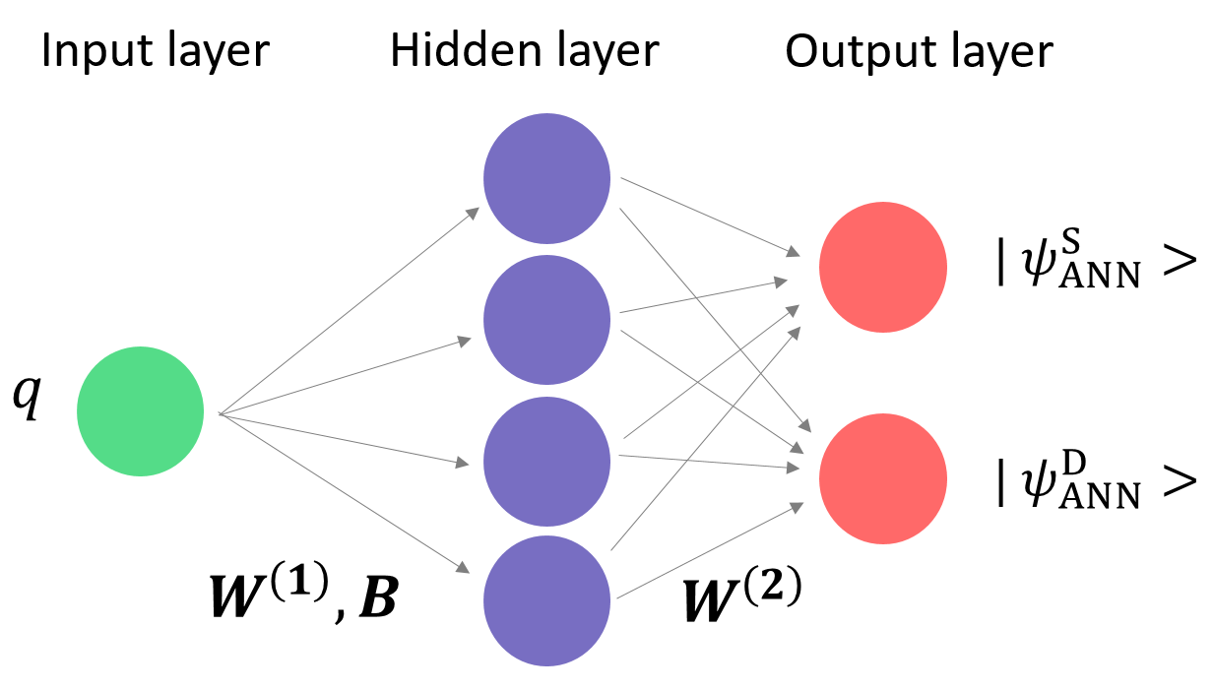
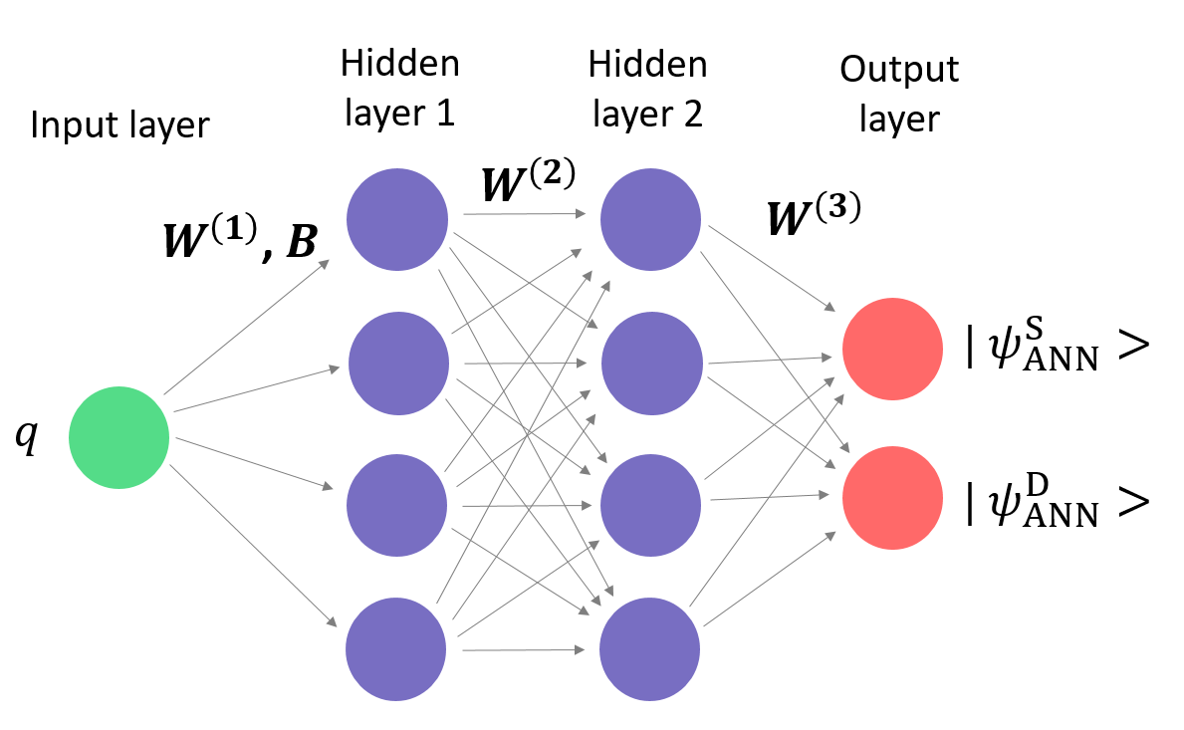
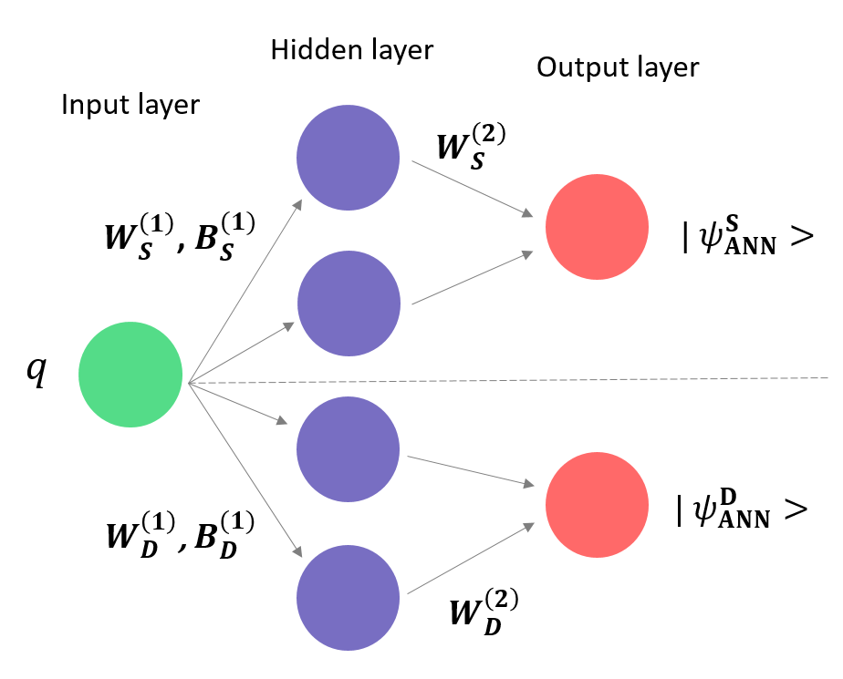
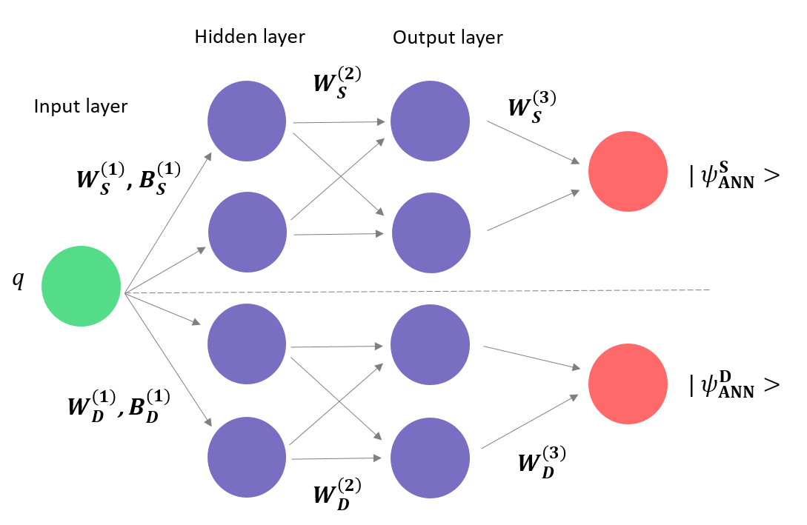
Different Architectures
J Rozalén Sarmiento, A Rios, J W T Keeble, Machine learning the deuteron: new architectures and uncertainty quantification, arXiv:2205.12795

