Slide 1
Anomaly detection for non-Gaussian transient noise characterization in LIGO data using auxiliary channel information
ICCUB Machine Learning Workshop 2023
https://arxiv.org/abs/2310.03453
plgonzalez99@gmail.com
Paloma Laguarta

Slide 2
INTRODUCTION
HIGH PRECISION OF
LIGO DETECTORS
HIGH RATES OF APPEARANCE OF GLITCHES
DIFFICULTIES IN TRANSIENT GW SEARCHES
big range of glitch morphologies
instrumental and environmental causes, mostly unknown

Slide 3
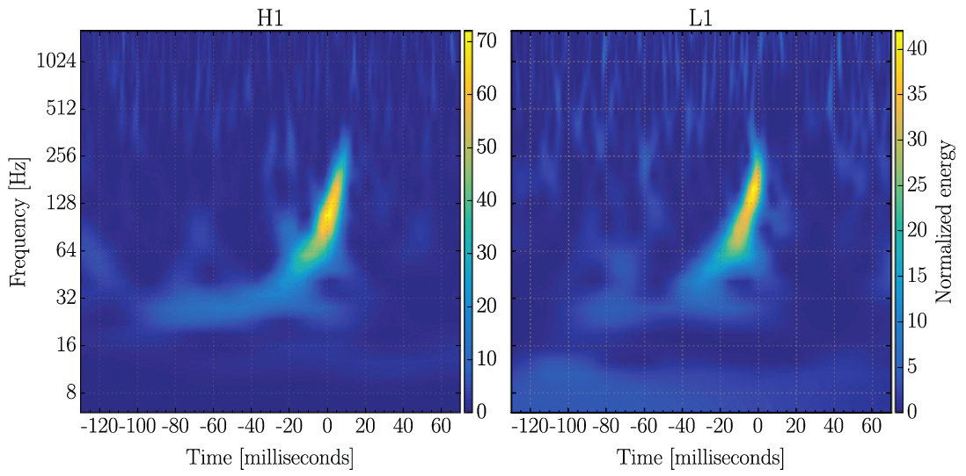
HOW ARE GRAVITATIONAL WAVES DETECTED?

Slide 4
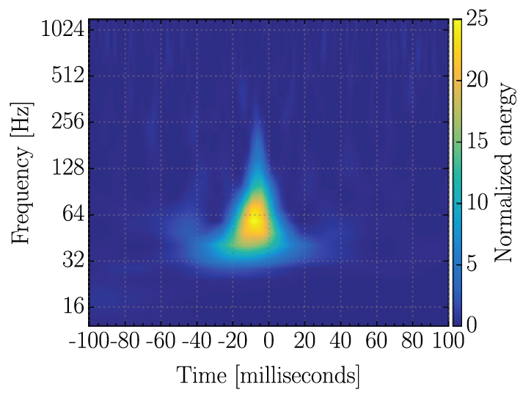
GLITCH
GW150914

Slide 5
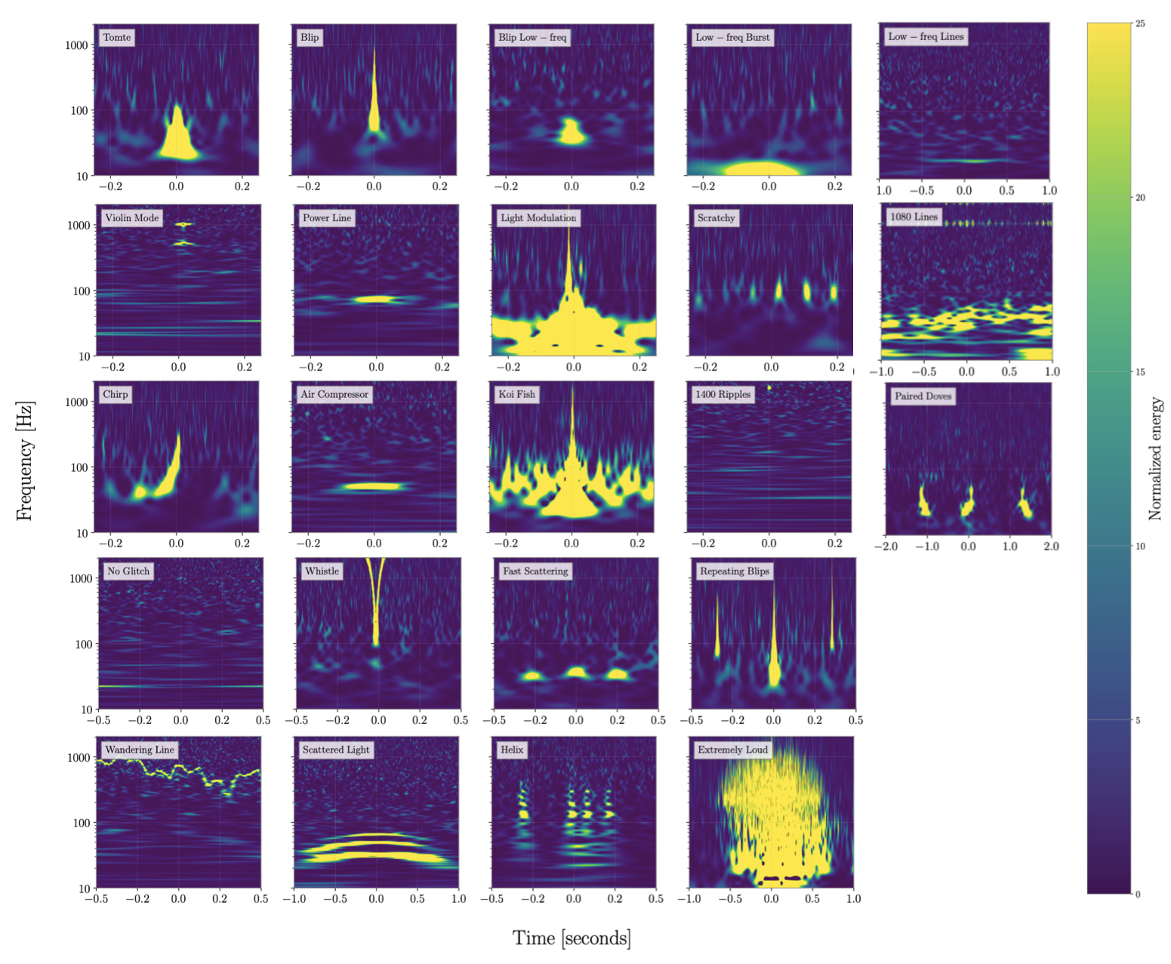

Slide 6
MOTIVATION
Glitches observed and recorded by the detector
Understanding glitches and their physical process
Mitigation of glitches
for transient GW searches
State of the art:
only supervised approaches
some with auxiliary channel information
Too much data for humans: Machine Learning models
We move on to unsupervised methods with only auxiliary channel information
these channels are distributed throughout the detector and monitor its instrumental and environmental state

Slide 7
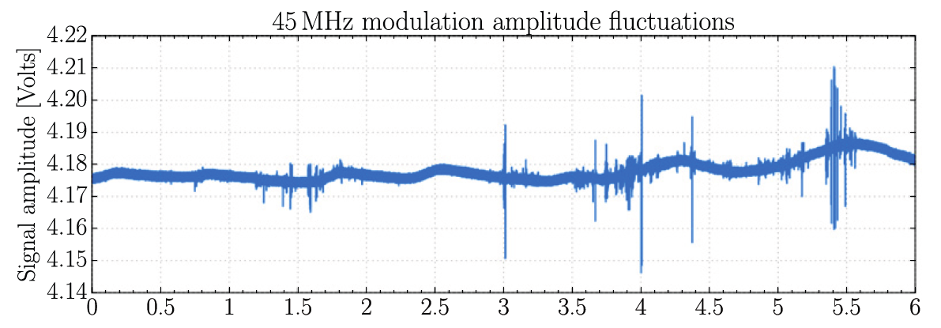
Example of the signal recorded by an auxiliary channel for a data stretch of 6 hours.
Notes:
(a monitor for amplitude fluctuations in the signal used to generate the 45 MHz optical sidebands)

Slide 8
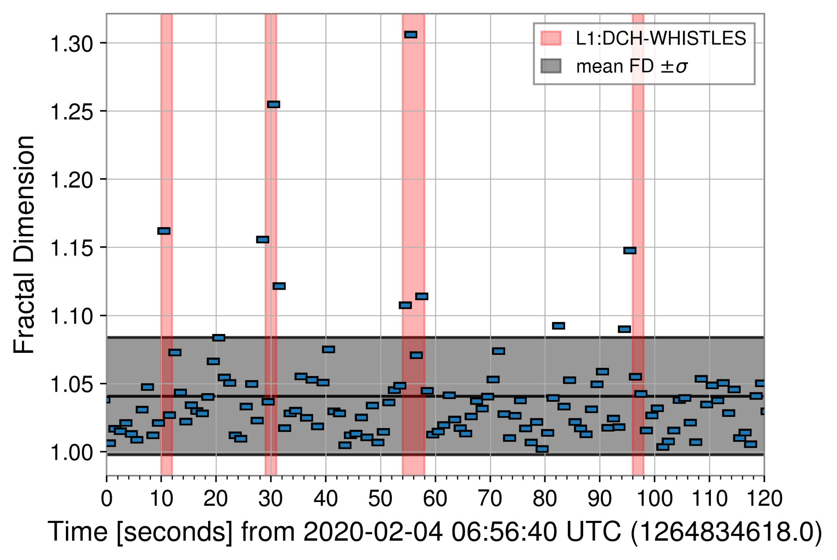
FRACTAL DIMENSION (FD)
Valuable information of signals is contained in how they evolve, not their specific shape.
The fractal dimension measures the complexity of the time series.
Sudden changes in signal complexity are correlated with glitch occurrences.
Current studies use signals from the strain.
1
Cavaglia, M. (2022). Characterization of gravitational-wave detector noise with fractals. Classical and Quantum Gravity, 39(13), 135012.
1

Slide 9
APPROACH
Auxiliary channel information encoded in FD
State of the art limitations
Potential of this glitch representation
Exploratory study
Unsupervised, data-driven ML model

Slide 10
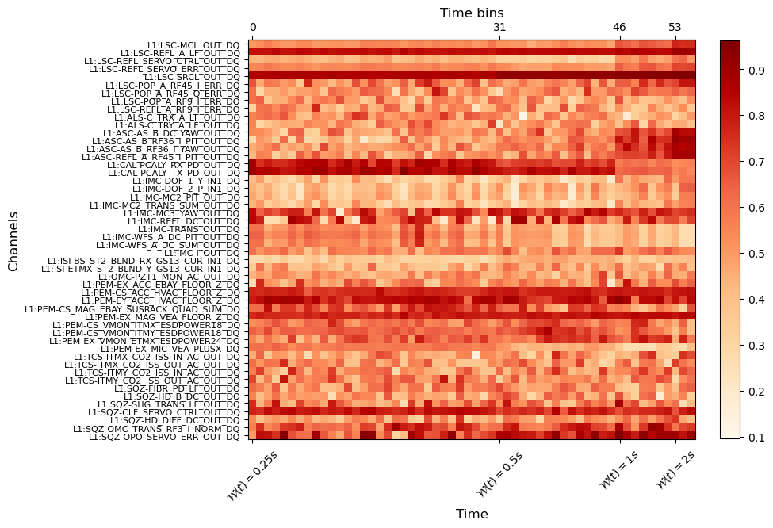
DATASET

Slide 11
CLEAN INSTANCE
WHISTLE MORPHOLOGY

Slide 12
TOMTE MORPHOLOGY
SCATTERED LIGHT MORPHOLOGY

Slide 13
ML ALGORITHM: AUTOENCODER
ORIGINAL
INSTANCE
RECONSTRUCTED
INSTANCE
COMPRESSED
INSTANCE
EMBEDDED SPACE
COMPRESS
RECONSTRUCT

Slide 14
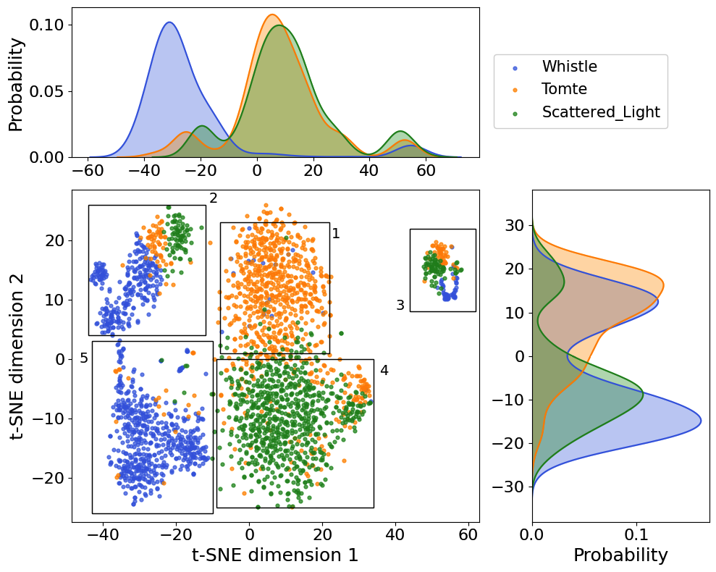
RESULTS: EMBEDDED SPACE and ANOMALIES

Slide 15
SECTION 1

Slide 17
SECTION 2

Slide 19
SECTION 3

Slide 21
SECTION 4

Slide 23
SECTION 5

Slide 24
ANOMALOUS GLITCH FINDINGS
In total 177 anomalies were found, which constitute 6,6% of the data.
Anomalous whistles (49):
45% unknown morphologies, 28% misclassifications, 27% overlaps.
Anomalous Tomtes (57):
32% unknown morphologies, 21% misclassifications, 47% overlaps.
Anomalous Scattered Lights (71):
28% unknown morphologies, 72% misclassifications, 1 overlap.

Slide 25
CONCLUSIONS
The glitch representation using auxiliary channels and FD is complementary to the strain.
The autoencoder learns the underlying data patterns, which reveal anomalous glitches that include: state of the art misclassifications, new morphologies and glitch overlaps.
This work showcases the potential of this glitch representation together with unsupervised approaches to study glitches.
Future work: analysis could be extended to the whole glitch population from all detectors, correlations could be found between auxiliary channels and glitches for automated glitch characterization.

Slide 26
Thank you for your attention!
https://arxiv.org/abs/2310.03453
plgonzalez99@gmail.com

Slide 27
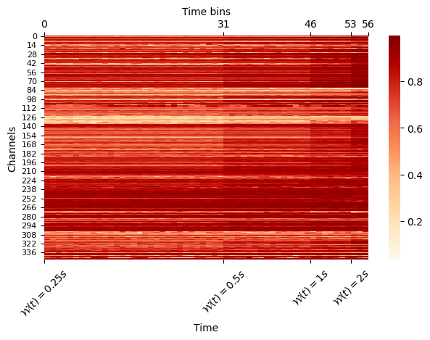
Fractal Dimension

Slide 28
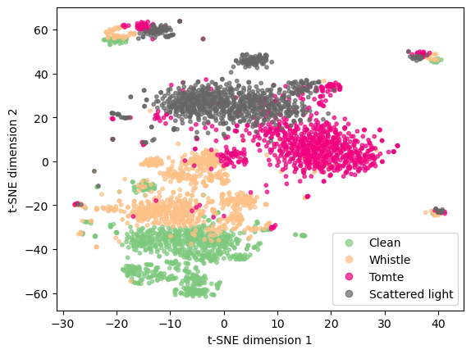
Initial Distribution

Slide 29
Preprocessing

Slide 30
Model Architecture
periodic convolution

Slide 31
Periodic Convolutions

Slide 32
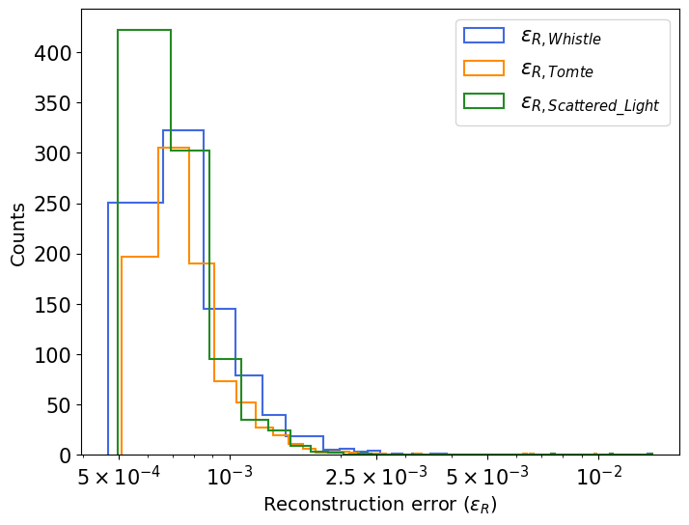
Results on Auxiliary Channel dataset

