Slide 1
Anomaly detection with not-so-dense(ity) estimators at ATLAS
Jack Harrison¹
¹ Institut de Física d'Altes Energies, Barcelona
Cross-Collserola Meeting in Astrophysics, Cosmology and Particles

Slide 2
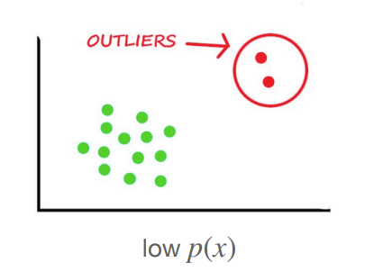
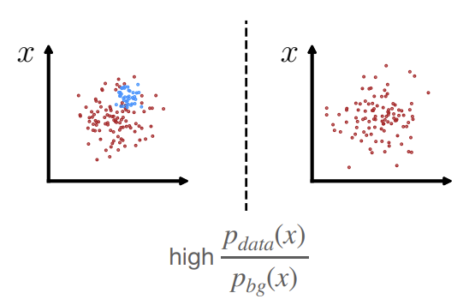
What is anomaly detection?
Machine learning generally falls under three categories:
Supervised learning
Distinct labels for all examples
Semi-supervised learning
A small number of examples are labelled
Unsupervised learning
No labels
Anomaly detection is a branch of unsupervised learning, where we try and learn directly from the distribution in order to detect outliers. It’s generally split into two themes:
Outlier detection
Over-density detection
Shameless grab from David Shih's talk.

Slide 3
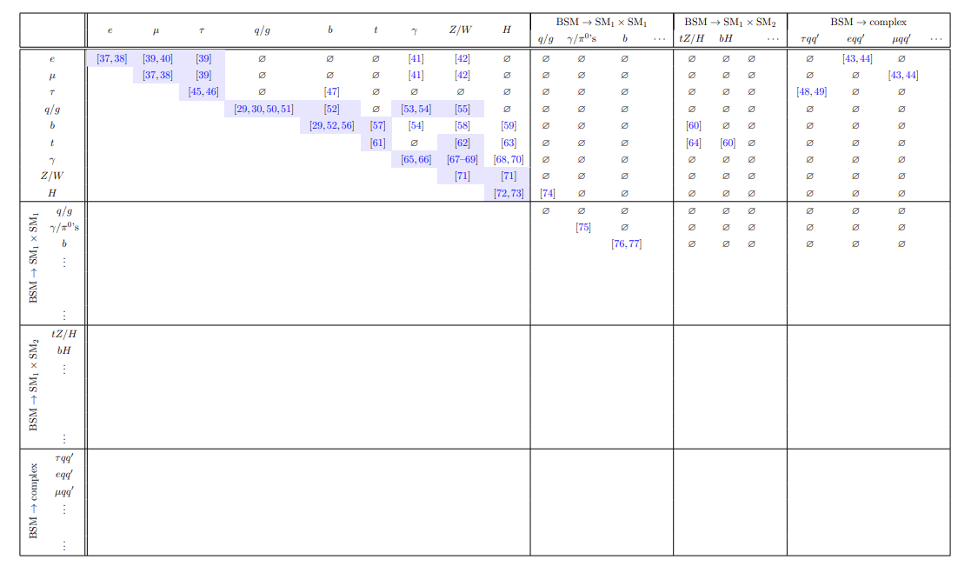
Why do we need anomaly detection?
The picture gets worse when including BSM resonances:
arXiv:1610.09392
arXiv:1907.06659
The phase-space of potential BSM models is too large to be covered by dedicated analyses.
We need a way of casting a broad net, that is sensitive to a range of new physics.

Slide 4
A standard search
Problems:
Pick a signal model
What if you pick wrong?
Generate it with your chosen masses + couplings
Define a specific signal region, where signal populates.
Define orthogonal control regions, where signal mustn’t populate
What if your signal populates your control regions, or only part of your signal regions?
Check modelling in control regions and assume it holds in signal regions
Compare the number of recorded events in your signal region, with the number you expect from your simulation
What if your background modelling doesn’t hold across orthogonal regions?

Slide 5
Normalising flows
We want some model that can take an input $z \sim p_{z}$, which is easy to sample, and can generate our complicated distribution $p_{x}$. We do this by learning an invertible mapping $x=f_{θ}(z)$ and $z=f_{θ}^{−1}\left(x\right).$
We rely on the change of variables formula for probability densities;
$p_{x}\left(x;θ\right)=p_{z}\left(f_{θ}^{−1}\left(x\right)\right)|det⁡(\frac{∂f_{θ}^{−1}(x)}{∂x}$)|
In order to use this, we require;
Input and output dimensionality is the same
The learnt mapping must be invertible
The determinant of the Jacobian needs to be tractable (and efficient).
There are several ways to ensure 1-3, here we focus on the Real Non-Volume Preserving (RealNVP) model where we separate $z$ into two disjoint subsets, $z_{1}$ and $z_{2}$ and then apply two neural networks ($s_{θ}, m_{θ})$:
$x_{1}=z_{1},$
$x_{2}=e^{s_{θ}(z_{1})}+m_{θ}(z_{1})$

Slide 6
Normalising flows
Stacking layers of transforms leads us to a loss function that is allows us to explicitly minimise the negative log-likelihood of our input data ($D$):
$$\log{p_{x}\left(x;θ\right)=\log{p_{z}\left(z_{0}\right)−\sum_{i=1}^{k}{\log\left|\det{\frac{df_{i}}{dz_{i−1} }}\right|, }}}$$
$$ℒ\left(D\right)=−\frac{1}{D} \sum{\log{p_{x}}}$$
Base density
Transformed density
Further reading here.

Slide 7
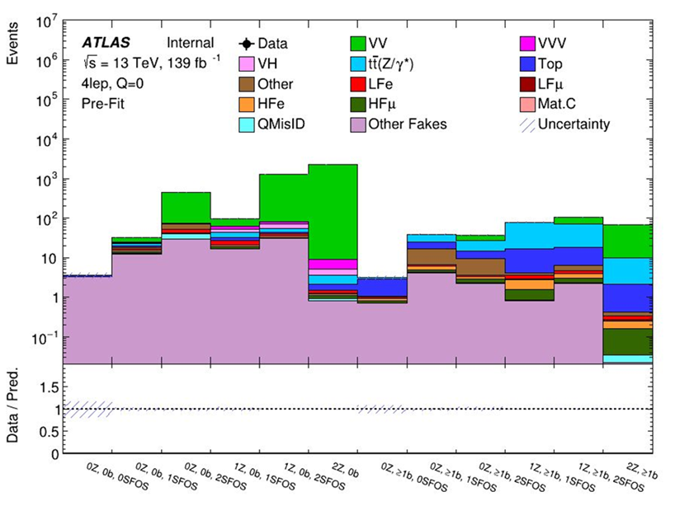
Model-independent multi-lepton analysis
Search for new physics in events with ≥4 light leptons ($e,μ$);
Gives us a large scope for potential BSM models, as heavy resonances can easily decay through chains that produce high lepton multiplicities.

Slide 8
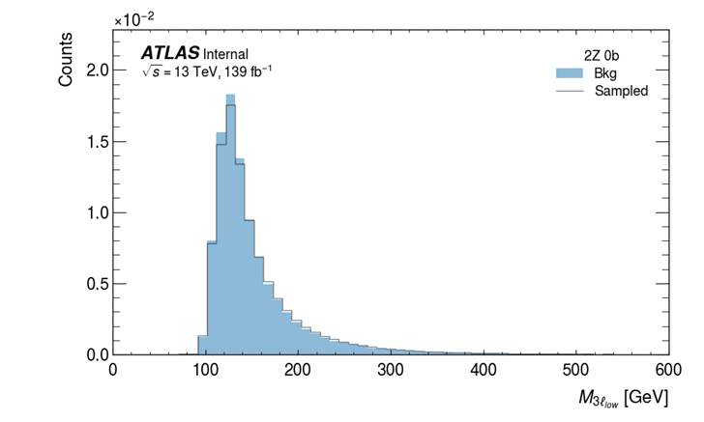
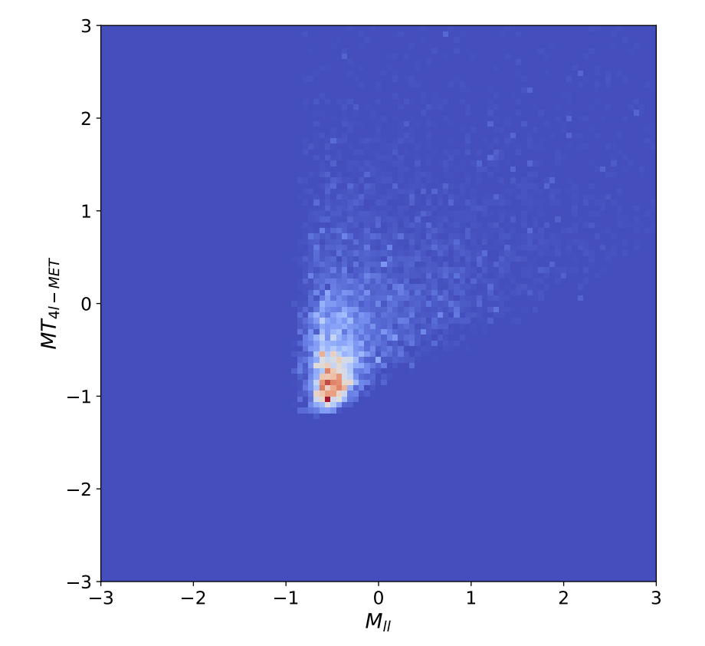
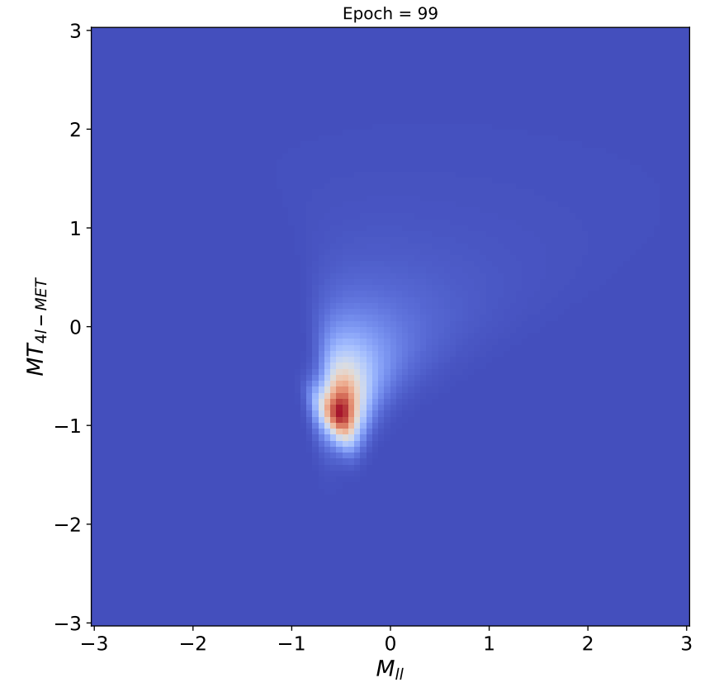
Using normalising flows
We then train one normalising flow per region, training on our simulated MC background only, before evaluating on signal and background.
Target density
Learned density
Since the normalising flow is a generative model, we can check the learnt distribution by sampling.

Slide 9
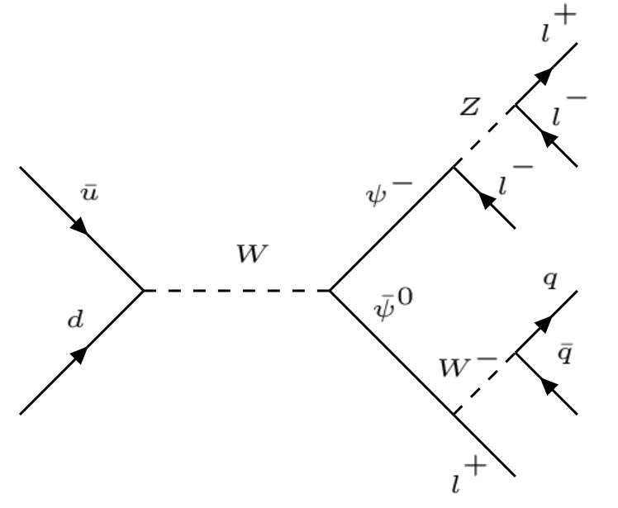
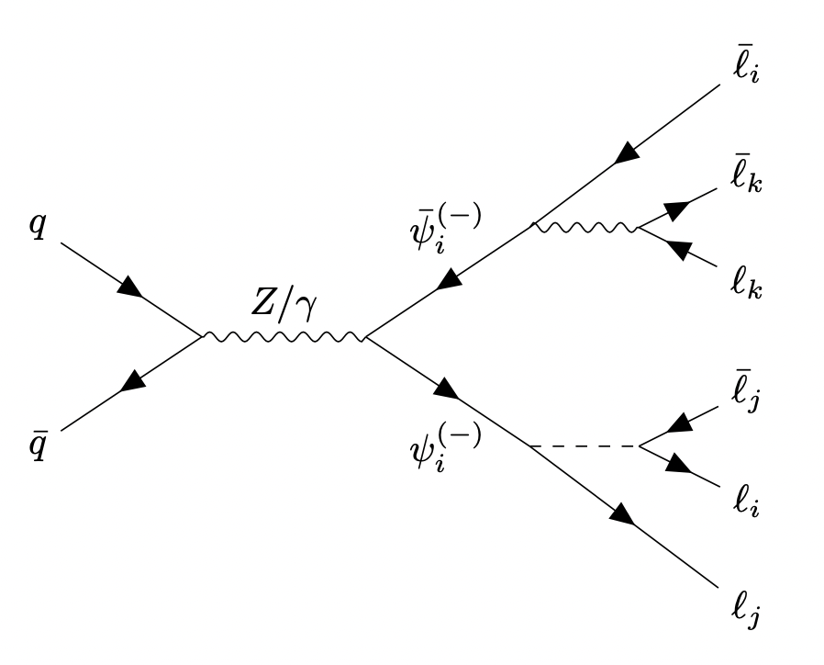
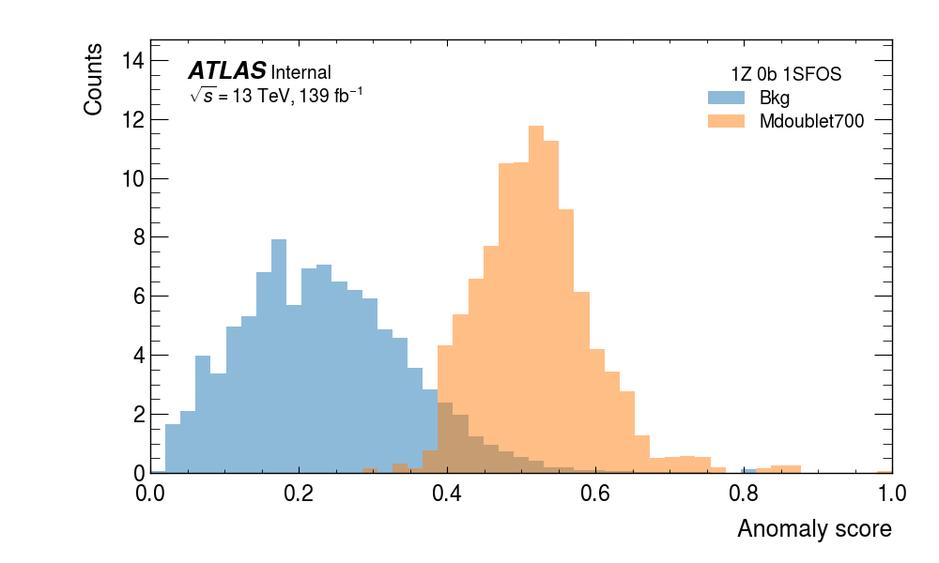
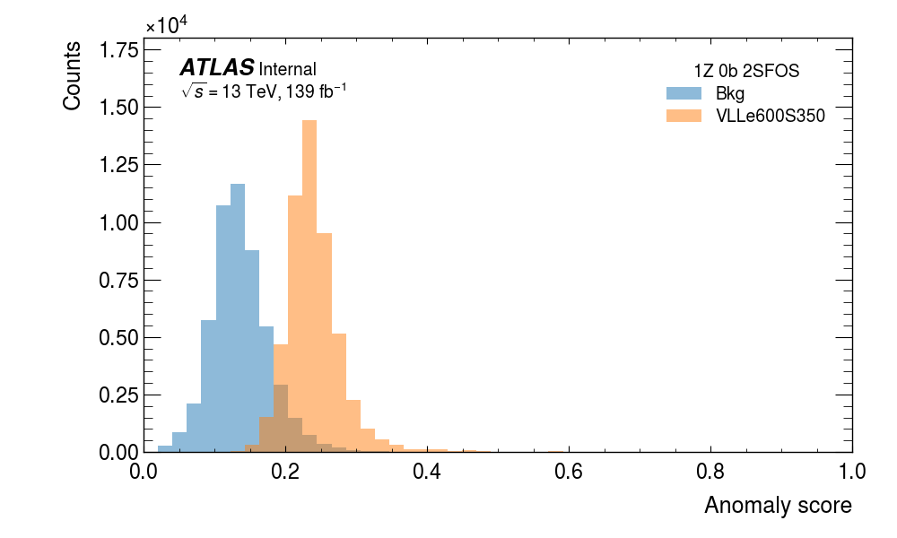
Example signal models:
$$s$$
$$s$$
VLL decaying through W/Z/h.
VLL decaying through BSM scalar S.

Slide 10
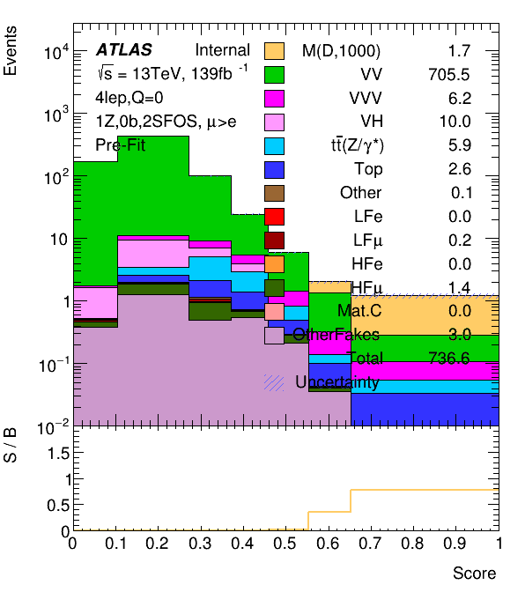
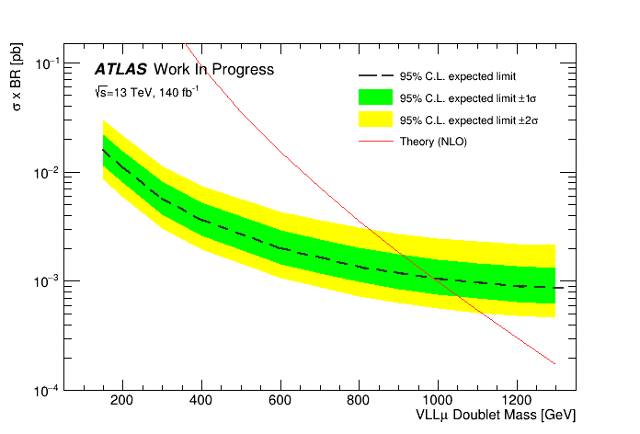
Sensitivity plots
We can then use the anomaly score as a discriminating variable, which we can fit to and produce model-dependent limits.
We can drastically reduce the background count in a model-independent way, and produce competitive limits with the model-dependent search (although not better).

Slide 11
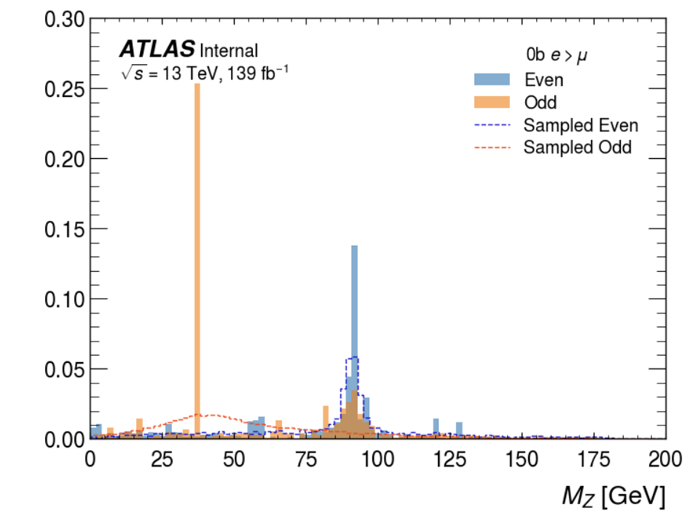
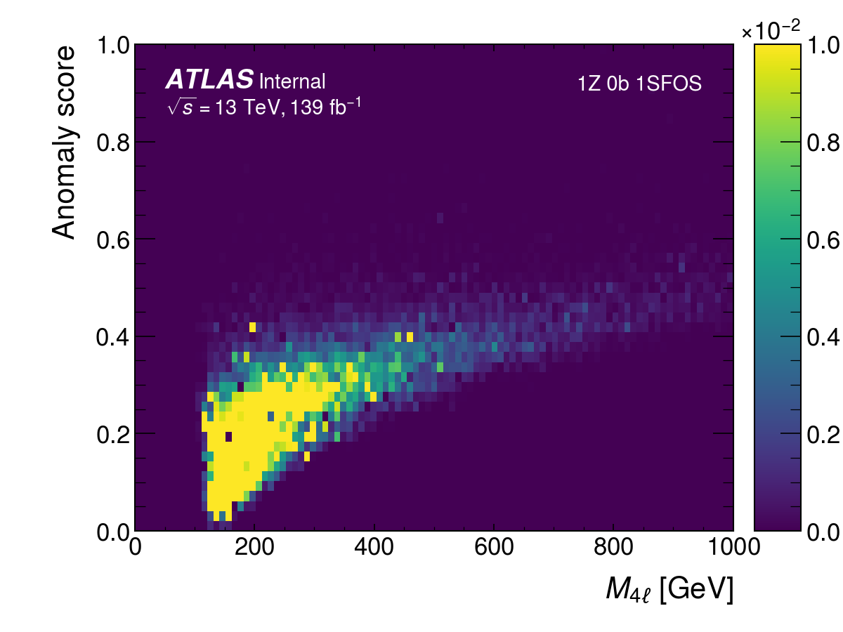
Potential challenges
Only searches for ‘low-probability’ models, what about excesses of background-like events?
Reduced expressive-ness, and trouble with discrete inputs.
Overfitting to low-statistics:
Difficult to explain the model’s choice of low-probability. Motivates our choices of using physically-motivated input variables.

Slide 12
Summary
Anomaly detection provides a way to cover the vast phase space of potential new BSM models.
We can use normalising flows to explicitly learn the probability density of the background.
We can use them to produce sensitive searches with a wide scope, significantly reducing the background level while remaining signal-agnostic.
Several challenges remain with this technique, and the sensitivity is still lower than the ideal scenario, meaning further improvements to model-agnostic searches are still out there.

Slide 13
Backup

Slide 14
Normalising flow trained on background
Target density
Learned density

