Slide 1
ICECAL65 Architecture
E. Picatoste
29/9/2023

Slide 2
Input signal and gain
Front-End ASIC
Detector cells
Energy
ASIC
ADC
Digital Back-End
Optical Link
FPGA
GBT
50Ω
I
12-20m cable
PMT
Time
ASIC
ADC
Front End Board
Amplifier + Shaper circuit included on the PMT base or FEB under consideration, to compensate cable attenuation, improve SNR, reduce spill-over effort and split the signal between the energy and time paths.
Placement in PMT base only if demonstrated that parts can withstand radiation levels
  Radiation tests to be performed on components proposed
  2 stages: transimpedance amplifier + buffer before cable
  SE
  SE to differential buffer at FEB?
Gain must be defined as 3 different paths are needed:
  Time measurement
  LG and HG for energy measurement

Slide 3
Input signal and gain (II)
Front-End ASIC
Detector cells
Energy
ASIC
Digital Back-End
Optical Link
ADC
FPGA
GBT
50Ω
I
12-20m cable
PMT
Time
ASIC
opamp
Front End Board
At FEB
  50 Ohm termination
  2 stages: inverter + SE/differential buffer
ICECAL65 SE vs differential input
  SE inputs: half input pins but requires internal SE to differential block
  Differential inputs: more robust against noise
HG + LG in chip?
  BW↓
  Need of linearity studies

Slide 4
ASIC specifications
Initial approach: assume similar specifications as ICECAL.
Pedestal subtraction from previous event
Data transmission at 40MHz, continuous readout with no deadtime.
Energy range(E_{T}): 0 – 10 GeV/c
Calibration:
  High Gain 5 MeV/LSB
  Low Gain 50 MeV/LSB
Dynamic range: 11bit per gain
Noise: < 1 LSB
Termination: 50 ± 5 Ω
Shaping: 25 ns (99% of the charge)
Spillover residue level: ±1%
Linearity: < 1%
Crosstalk: < 0.5%
Sampling phase: per channel.

Slide 5
OTA
Development of a Rail-to-rail fully differential OTA in TSMC 65 nm technology to be used
The main specifications that the OTA must achieved are the following ones:
  TSMC 65nm technology
  Fully differential
  Rail-to-Rail (0-1.2 V)
  Low frequency gain > 70 dB
  GBW > 500 MHz
  PM > 65º
  SR > 0.5 V/ns
  VCM ~0.6V
  Power optimization

Slide 6
Analog processing chain
Detector cells
PMT
Pre-amp
Filter
Integrator
Track-
and-Hold
Multiplexer
CHANNEL
OUTPUT
50Ω
PZ
ʃ
TH
ADC
driver
I
Drv
11b
ADC
12b ADC
12b ADC
Different lengthes
12b ADC
50Ω
PZ
ʃ
TH
x4
MEM
Integrator clock
Track-and-Hold clock
ADC clock
Clock Input
DLL
Front End Board
Input Stage
PZ cancellation Shaper
Integrator
Track & Hold
MUX and output buffer
DLL

Slide 7
ICECAL65 channel blocks: PZ filter
Detector cells
PMT
Pre-amp
Filter
Integrator
Track-
and-Hold
Multiplexer
CHANNEL
OUTPUT
50Ω
PZ
ʃ
TH
ADC
driver
I
Drv
11b
ADC
12b ADC
12b ADC
Different lengthes
12b ADC
50Ω
PZ
ʃ
TH
x4
MEM
Integrator clock
Track-and-Hold clock
ADC clock
Clock Input
DLL
Front End Board
Pole-zero filter
  Different shape signals depending on channel tecnologies, cable and PMT
    Channel tecnologies: SpaCal W+crystal, Pb+poly, Shashlik
    Cable: new thinner cables with diferent lengthes depending on the detector zone
    PMT t_{r}
  Try to minimize capacitor value (for OTA)
  Adjustable values around expected ones
    At least ±20%
    R, C or both

Slide 8
ICECAL65 channel blocks: integrator
Detector cells
PMT
Pre-amp
Filter
Integrator
Track-
and-Hold
Multiplexer
CHANNEL
OUTPUT
50Ω
PZ
ʃ
TH
ADC
driver
I
Drv
11b
ADC
12b ADC
12b ADC
Different lengthes
12b ADC
50Ω
PZ
ʃ
TH
x4
MEM
Integrator clock
Track-and-Hold clock
ADC clock
Clock Input
DLL
Front End Board
Adjust RC value to reduce C (OTA)
Gain adjust
  Variable capacitor

Slide 9
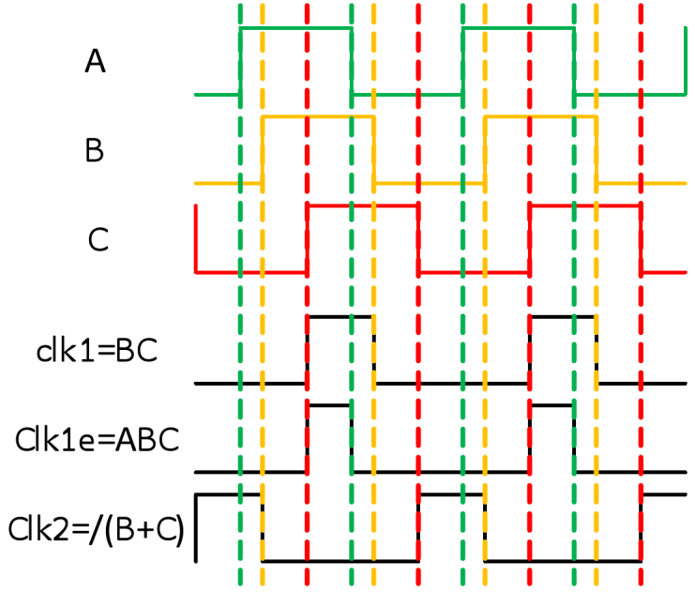
ICECAL65 channel blocks: TH
CMOS switches
Precision for 11 bits
High slew rate
Bottom plate sampling technique:
→ Add fixed ΔQ
→ fixed charge error (indep of Vi)
Hold capacitor
Tracking switch
Clock signal generation
Bottom plate sampling technique to minimize non-linearities

Slide 10
ICECAL65 channel blocks: TH
clk1 = 1
clk1e = 1
clk2 = 0
Bottom plate off
Tracking phase
clk1 = 1
clk1e = 0
clk2 = 0
Clock signal generation
→ Add fixed ΔQ
→ fixed charge error (indep of V_{i})
clk1 = 0
clk1e = 0
clk2 = 0
Input switches off
clk1 = 0
clk1e = 0
clk2 = 1
Hold phase
→ V_{bx} = ct
→ Q α V_{ix}

Slide 11
ICECAL65 channel blocks: mux
Detector cells
PMT
Pre-amp
Filter
Integrator
Track-
and-Hold
Multiplexer
CHANNEL
OUTPUT
50Ω
PZ
ʃ
TH
ADC
driver
I
Drv
11b
ADC
12b ADC
12b ADC
Different lengthes
12b ADC
50Ω
PZ
ʃ
TH
x4
MEM
Integrator clock
Track-and-Hold clock
ADC clock
Clock Input
DLL
Front End Board
4:1
  One gain → need of a comparator at the input
  One of two sub-channels
One output per channel
  If one output per several channels,
    Need higher frequency clock
    Output buffer needed to cope with ADC parasitic capacitor

Slide 12
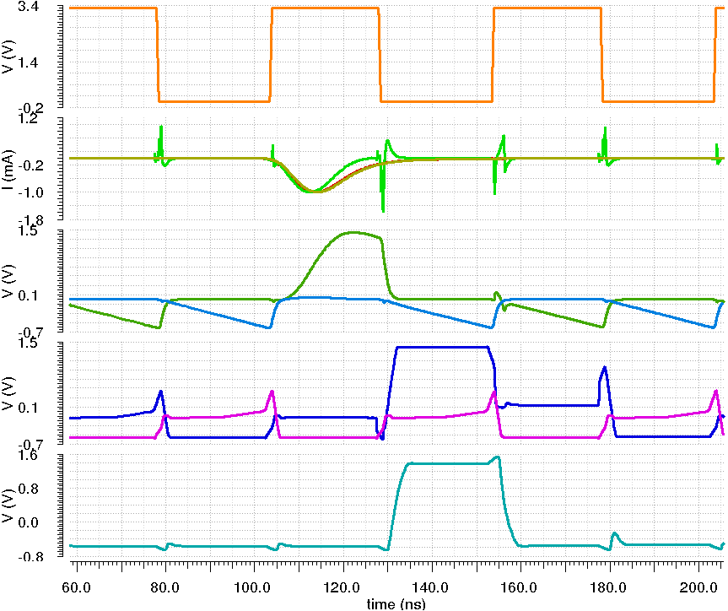
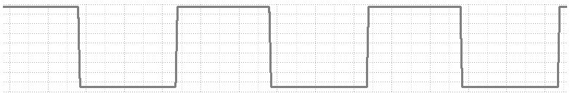
Synchronization (previous ICECAL version)
Current
amplifier
Filter
Integrator
Track-
and-Hold
Multiplexer
CHANNEL
OUTPUT
PMT
signal
PZ
ʃ
TH
ADC
driver
I
Drv
12b
ADC
12b ADC
12b ADC
    Clock management is internally done by the chip
    Three clock phases are generated from an input reference (REF_CLK):
      Track & Hold clock phase (Φ_{TH}). f_{CLK} = 20 MHz.
      Integrator clock phase (Φ_{INT} = Φ_{TH} + ΔΦ_{INT}). f_{CLK} = 20 MHz.
      ADC clock phase (Φ_{ADC}). f_{CLK} = 40 MHz.
    Predictable subchannel selection after reset/power-up.
    Internal digitization is also considered but low priority.
12b ADC
PZ
ʃ
TH
x4
MEM
Integrator clock
Track-and-Hold clock
ADC clock
Clock Input
DLL
Clock input
PZ output
Current Amp
output
input
PMT signal
Main
signal
TH output
Tail
Main
signal
Channel output
Tail

Slide 13
Pinout
Aproximated expected number of pins
2 versions expected: prototype and “final”
Number of channels
  Prototype: 4(or less) + parcial channel or blocks? 8?
  Final: 8 or 16
Input channel variations
  SE or differential
  1 or 2 gains
Channel outputs: 2 x channel
Other pins: 38+2*channel
  Voltage sources, GND, bias, common mode: ~ 29
  Digital (5): 2 x I2C, 1 x RST, 1 x BXI_RST, 1 x Refresh
  DLL(4+2*ch): 2 x ctrl, 2 x IN, 2 x channel
CHIP | SE INPUTS INTERNAL GAIN | SE INPUTS EXTERNAL GAIN | DIF INPUTS INTERNAL GAIN | DIF INPUTS EXTERNAL GAIN
PROTO 4x ch | 58 PINS QFN64 | 62 PINS QFN64 | 62 PINS QFN64 | 70 PINS QFN80
PROTO o FINAL 8x ch | 62 PINS QFN64 | 70 PINS QFN80 | 70 PINS QFN80 | 86 PINS QFN88
FINAL 16x ch | 70 PINS QFN80 | 86 PINS QFN88 | 86 PINS QFN88 | 118 PINS BGA144 (?)

Slide 14
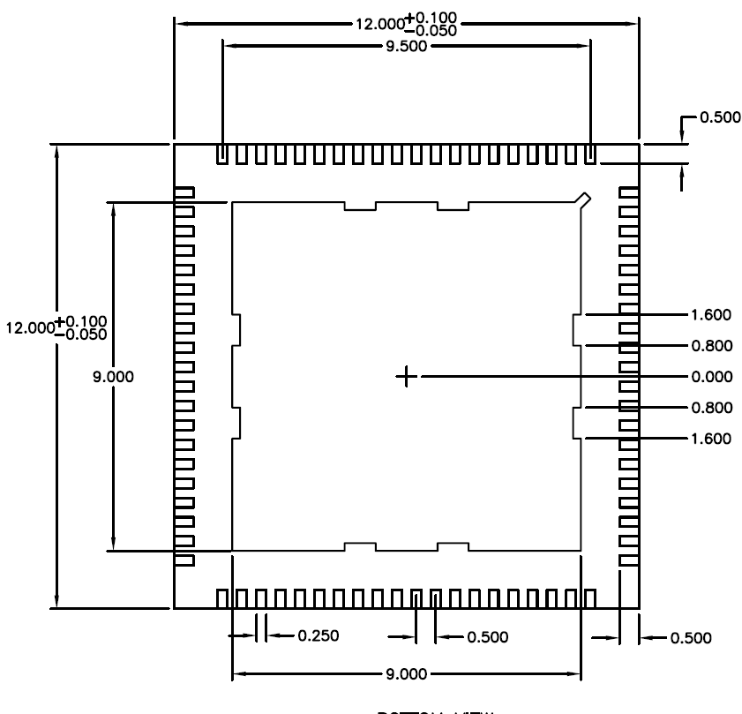
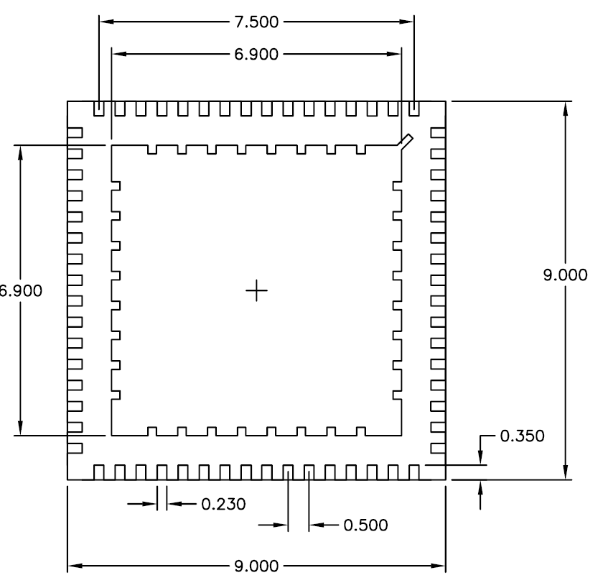
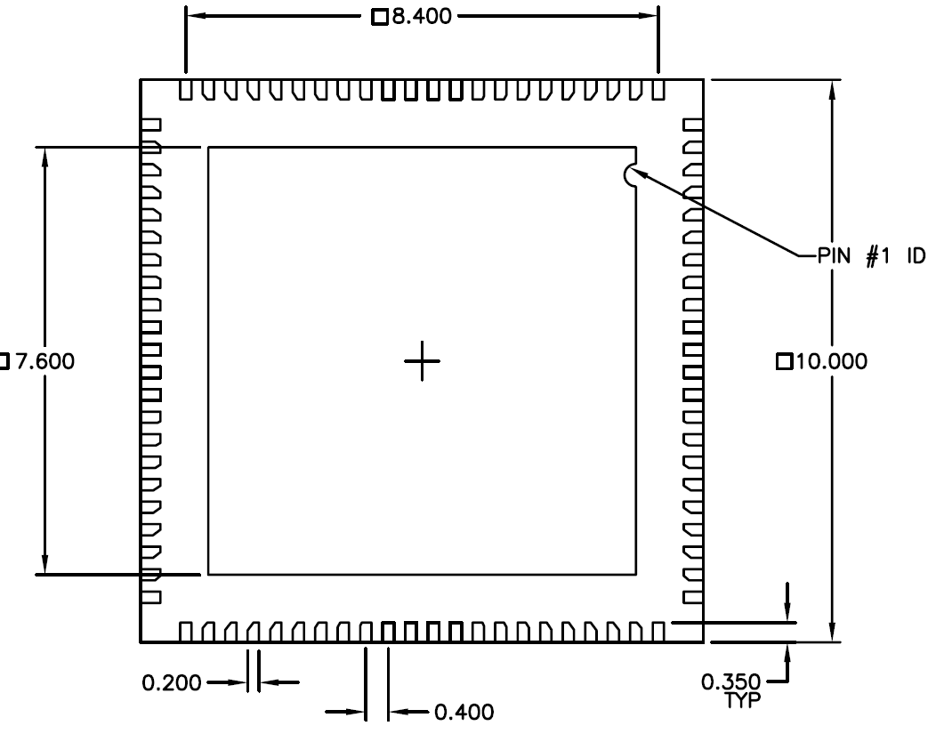
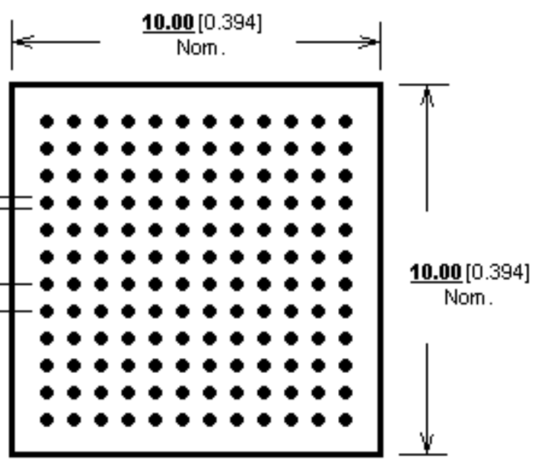
Possible packages
QFN80
12x12 mm²
QFN64
9x9 mm²
QFN88
10x10 mm²
BGA144
10x10 mm²

Slide 15
Tasks
Define and control common space for ICECAL65 libraries
Define gain at the input: specification
Study OTA with diferent capacitive loads
Gain stage LG/HG in ASIC effect: study linearity
PZ filter adjust to diferent known signal shapes (PZ values)
Switches
Comparator
TH
MUX
Output buffer
Pinout and packaging options study
Commercial ADC available
DLL vs PLL

Slide 16
Thank you for your attention!

Slide 17
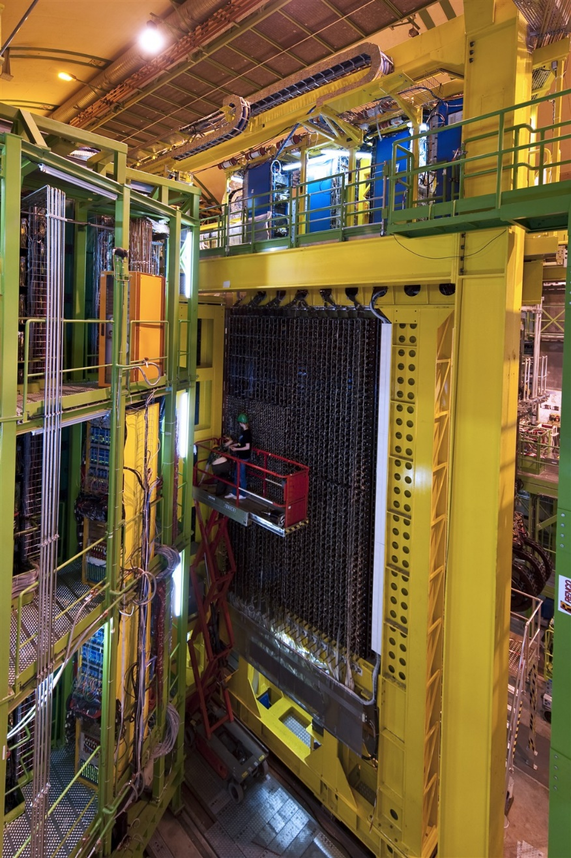
Readout architectures: Run 3 (Upgrade I)
Front End Board
ICECALv3 ASIC
FRONT-END
CRATES
Current
amplifier
Filter
Integrator
Track-
and-Hold
Multiplexer
Detector cells
PZ
ʃ
TH
ADC
driver
PMT
50Ω
I
Drv
12b ADC
12b ADC
12b ADC
12m cable
12b ADC
FPGA
ECAL
clip
PZ
ʃ
TH
MEM
x4
MEM
Bias
LVDS Clock
Phase detector charge pump
CMOS Clock
Ref clock
ADC clock
Serial Reg. bus
SPI slave
25
x4
MISO, MOSI, !SS, SCLK
MEM
Notes:
No dead-time operation with in-channel integration and sampling.
- dual gated time-interleaved architecture to allow reset time.
- switching noise => differential signal as soon as possible.

