Slide 1
Anomalous quantum transport in fractal lattices
Abel Rojo-Francàs
Anomalous quantum transport in fractal lattices
Abel Rojo-Francàs, Priyanshu Pansari, Utso Bhattacharya, Bruno Juliá-Díaz, Tobias Grass
ArXiv: 2401.16077

Slide 2
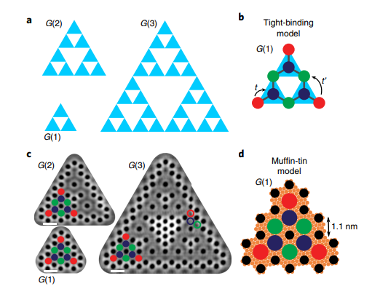
Outline
Motivation
Brief introduction about ultracold atoms
Bose-Hubbard models
Transport in a regular lattice
Fractals
Transport in fractal lattices
Summary and conclusions
Kempkes et al, Nature Physics (2019)

Slide 3
Motivation
Recent experiments in the group of Prof. Morais Smith (Utrecht) have prepared electrons in fractal geometries (solid state).
Our goal is to simulate these kind of systems in a controllable setup, in our case, ultracold atoms
Kempkes et al, Nature Physics (2019)

Slide 4
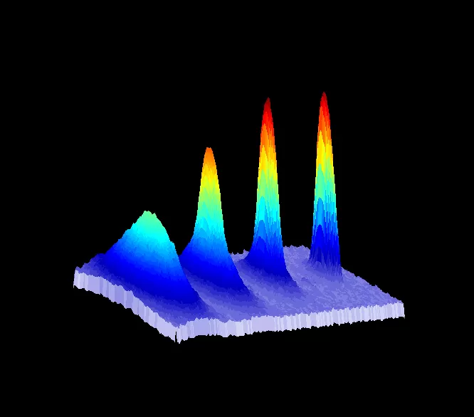
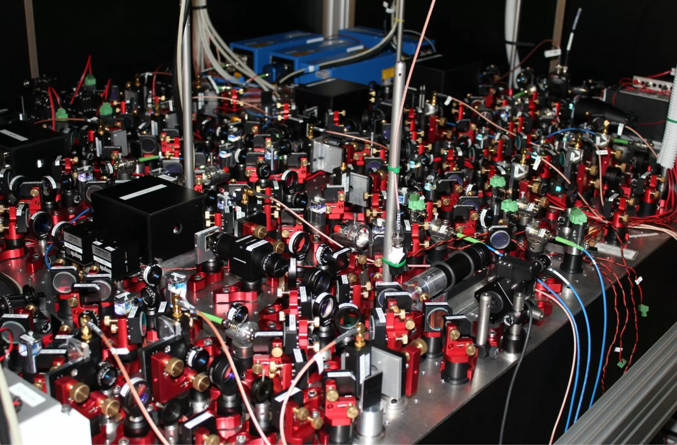
Ultracold Atoms
Bose Einstein condensates made of ultracold atoms are routinely prepared in laboratories worldwide
Ultracold atom laboratories are nowadays a fantastic platform to study many-body quantum physics
First Spanish BEC, 04/06/2015
Prof. Leticia Tarruell’s group @ICFO

Slide 6
Bose Hubbard model
Tunneling
Onsite interaction

Slide 7
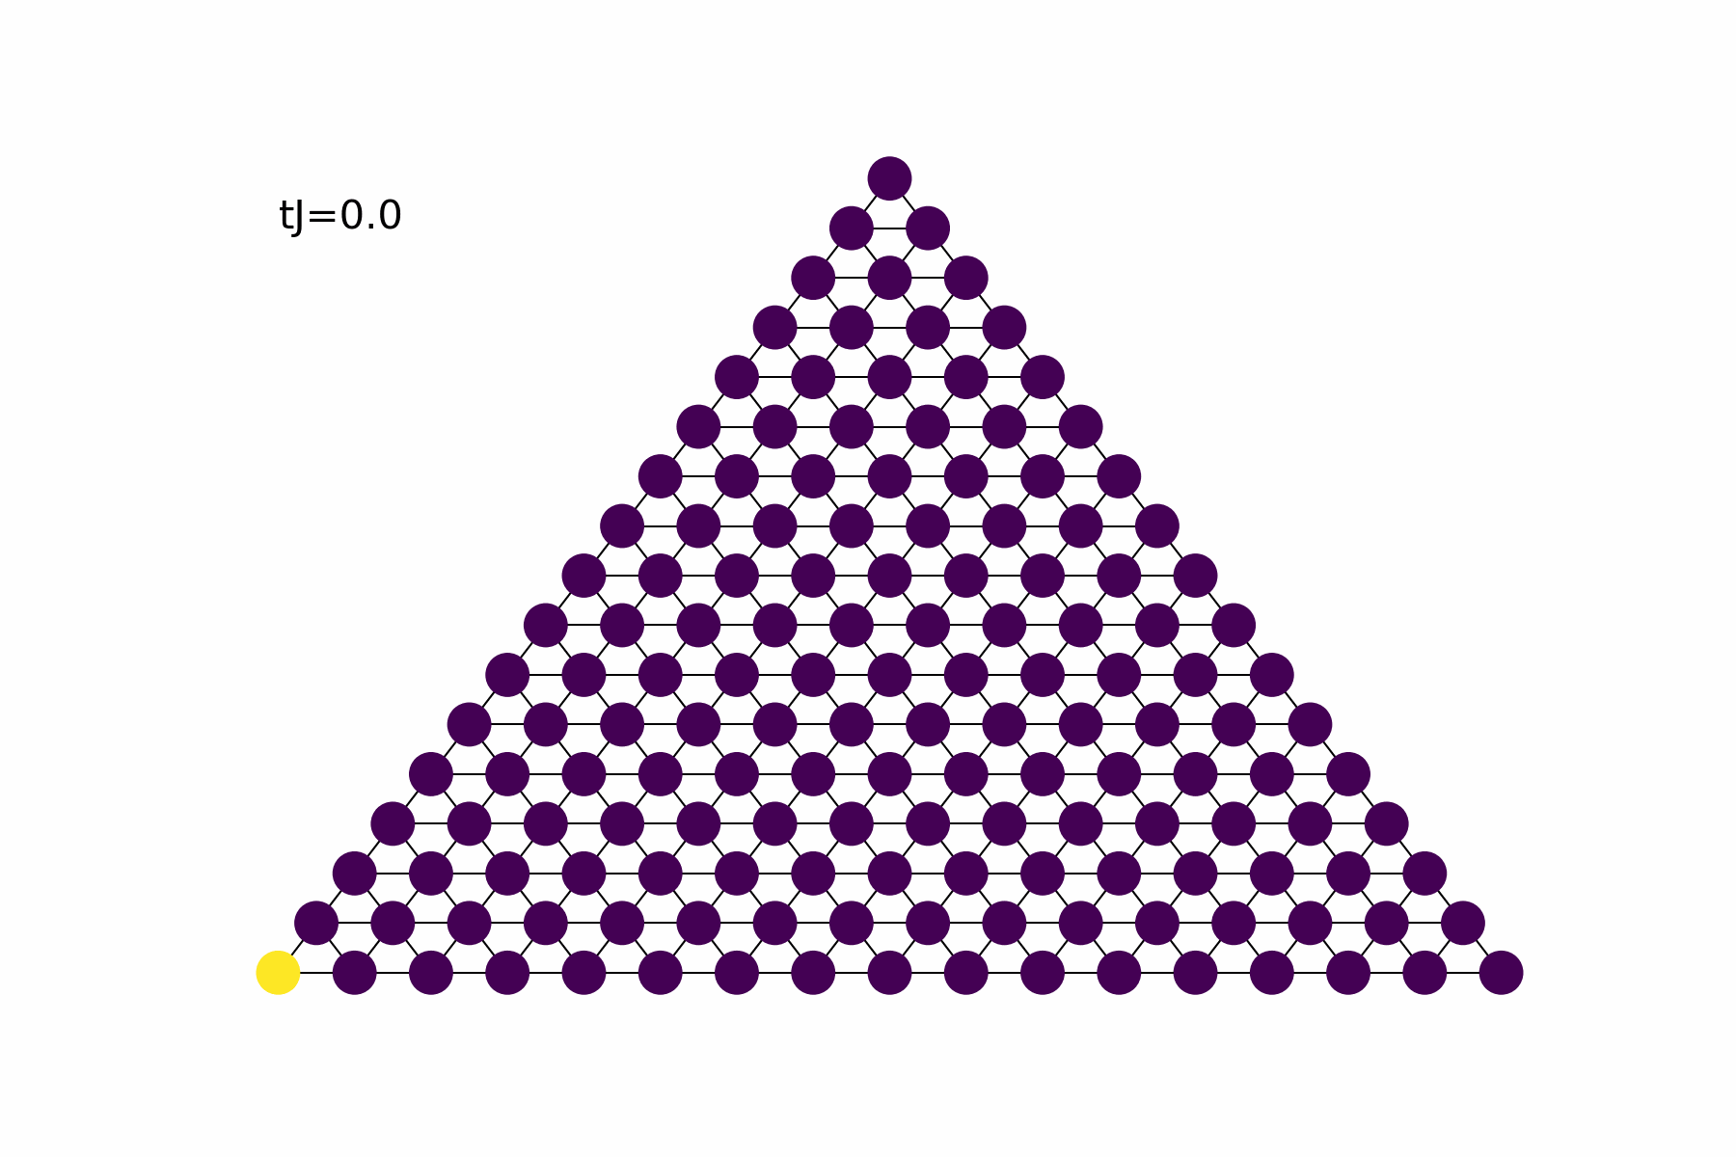
Transport in a triangular lattice
Prepare the initial state populating the lower left corner
Solve the time dependent Schrödinger equation to obtain the time evolution of the state
We observe the diffusion of the probability with time
The color is proportional to the probability density

Slide 8
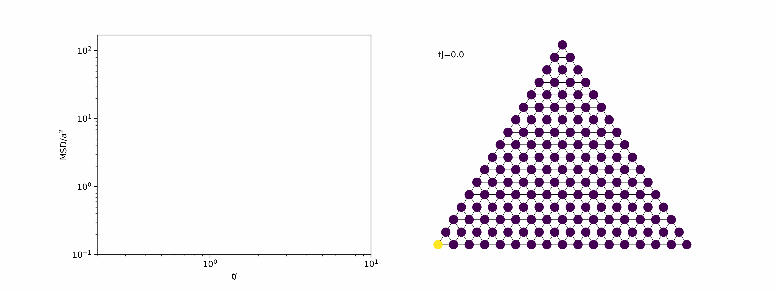
Characterization of the transport

Slide 9
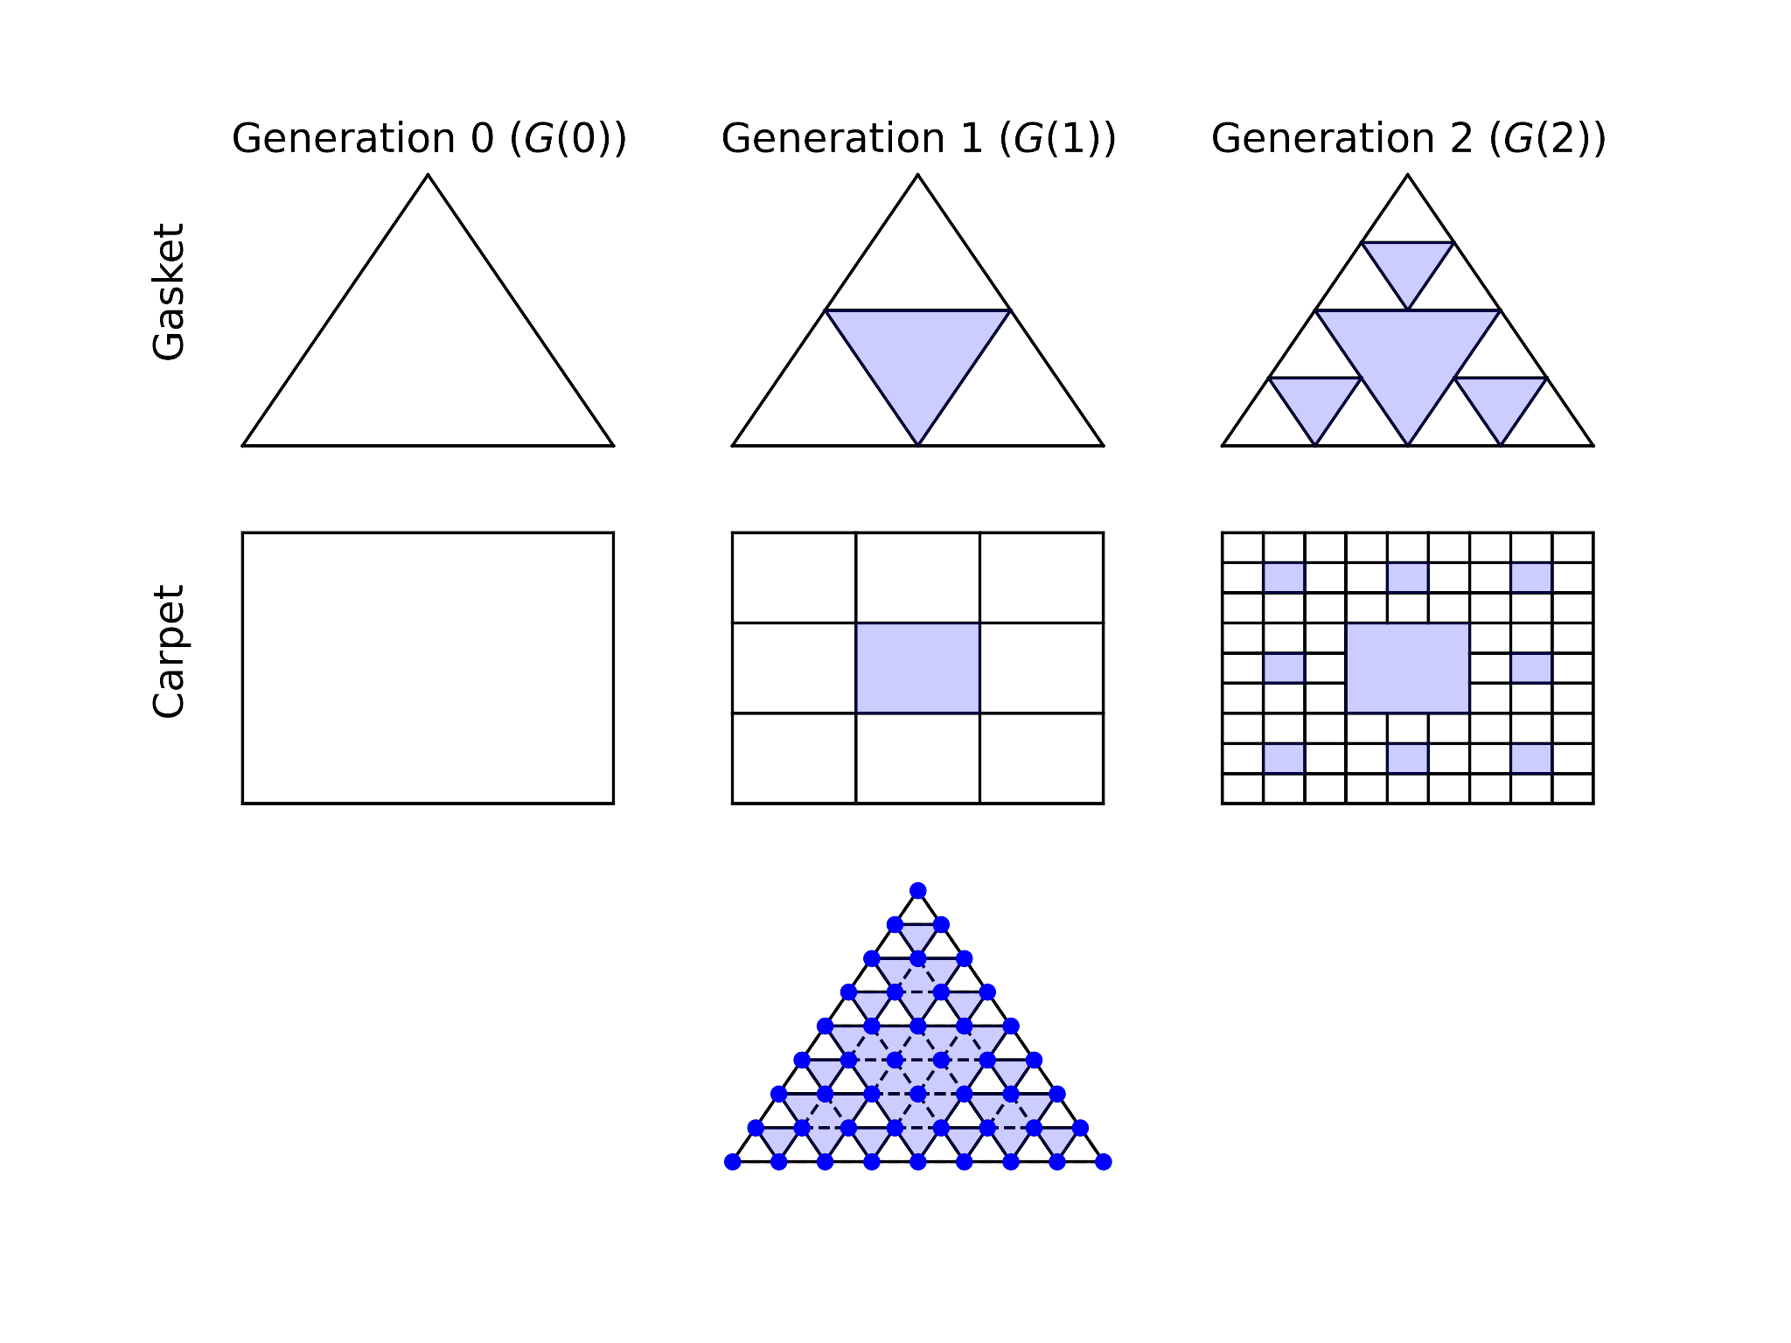
Fractal geometry: Sierpiński gasket (and carpet)
Fractals repeats its structure at different scales.
One property is the fractal dimension
For the gasket,
For the carpet,

Slide 10
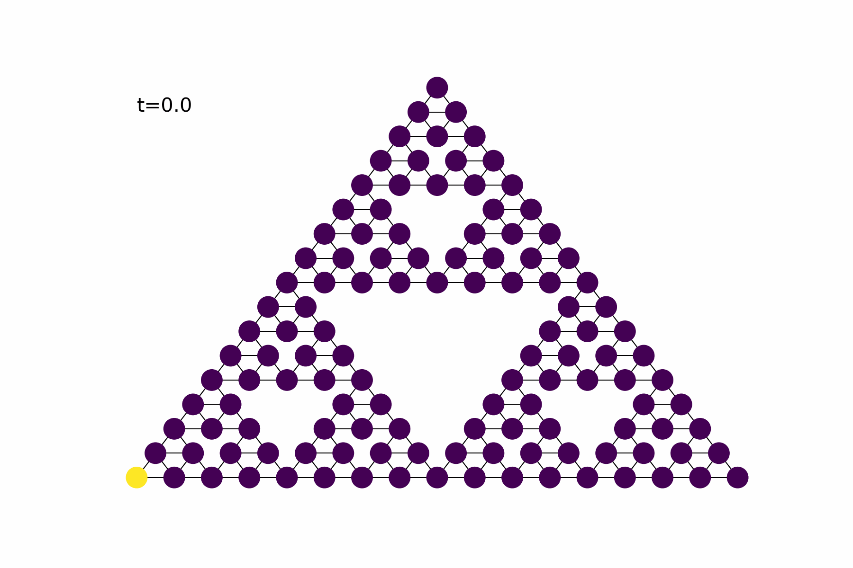
Transport in a fractal geometry
Now we consider the case of a triangular gasket, fourth generation.
The initial state is again a full population of the lower left corner
We solve the TDSE to obtain the evolution of the state

Slide 11
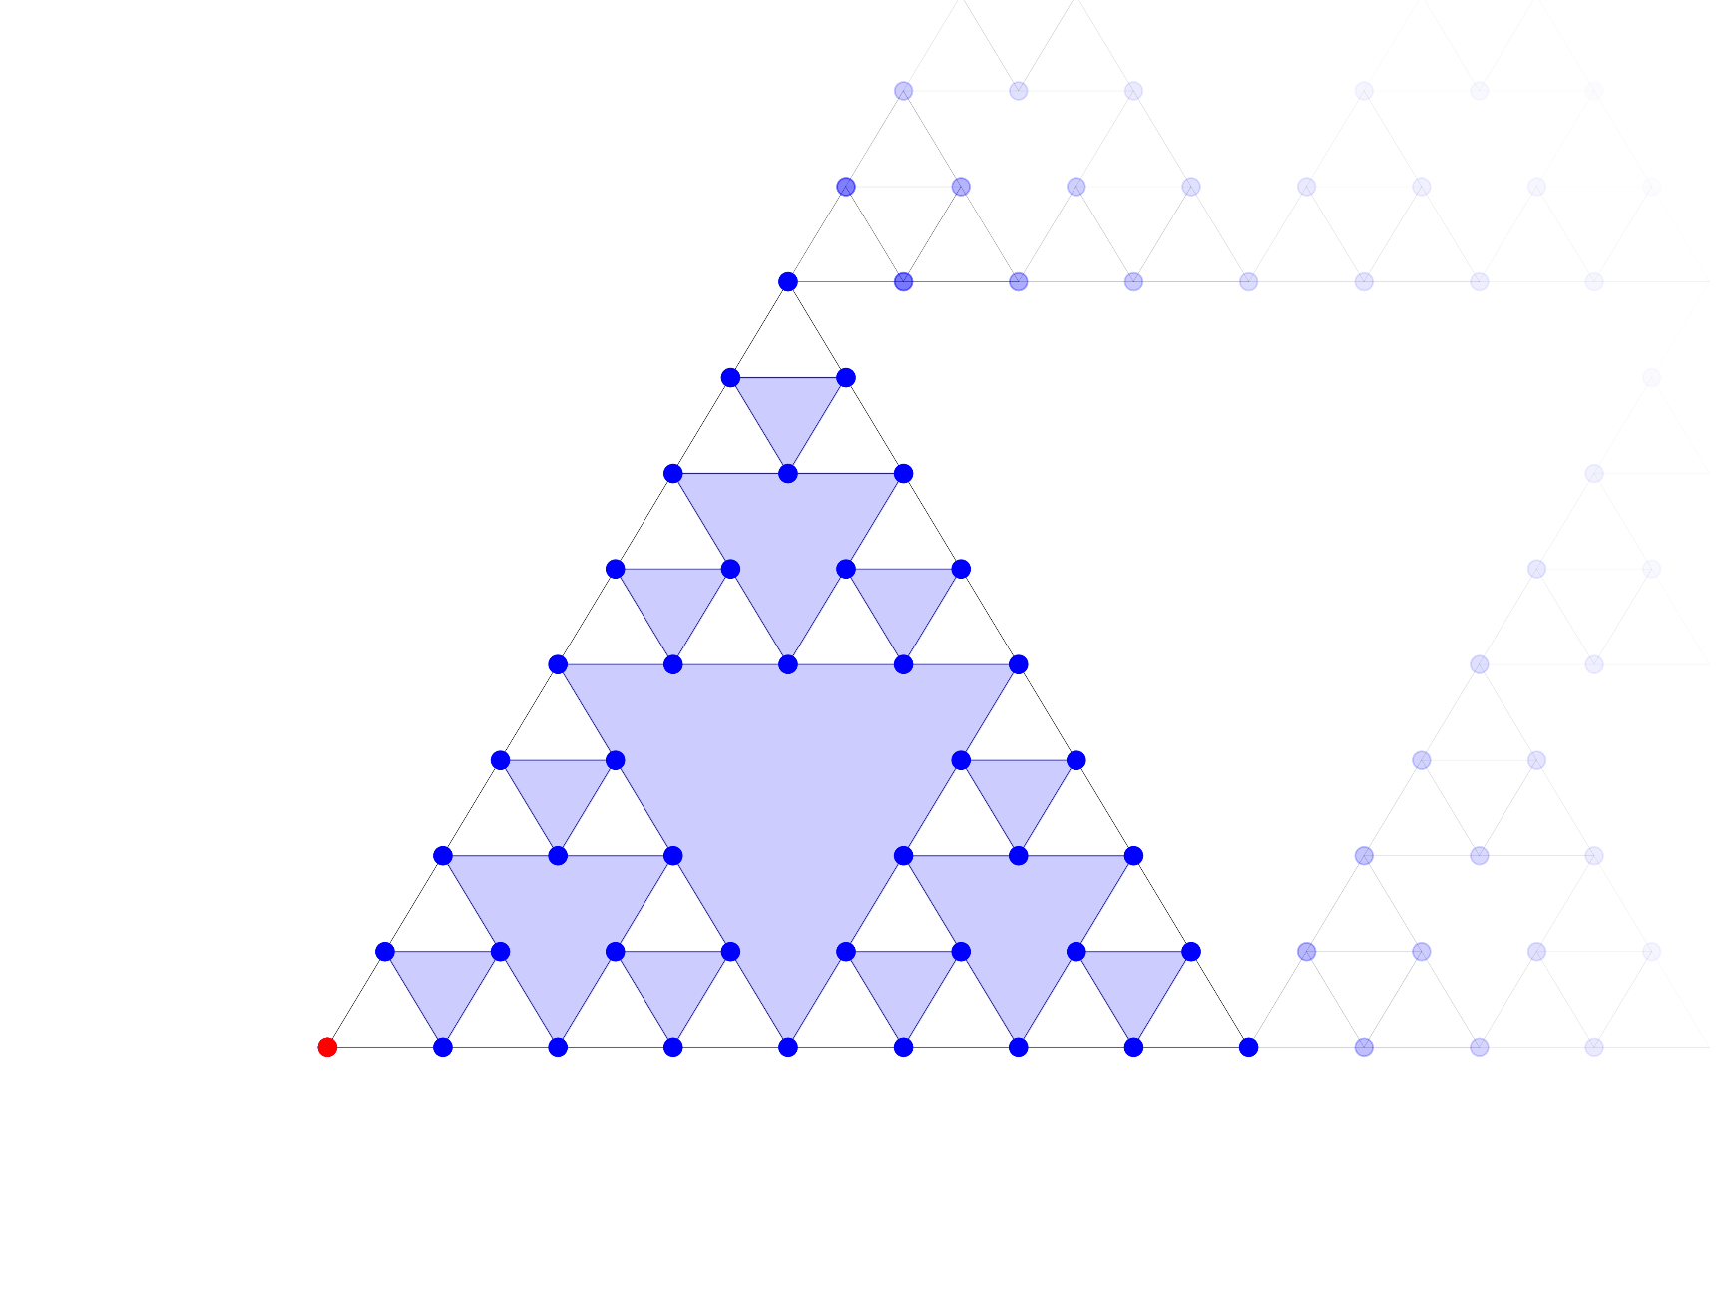
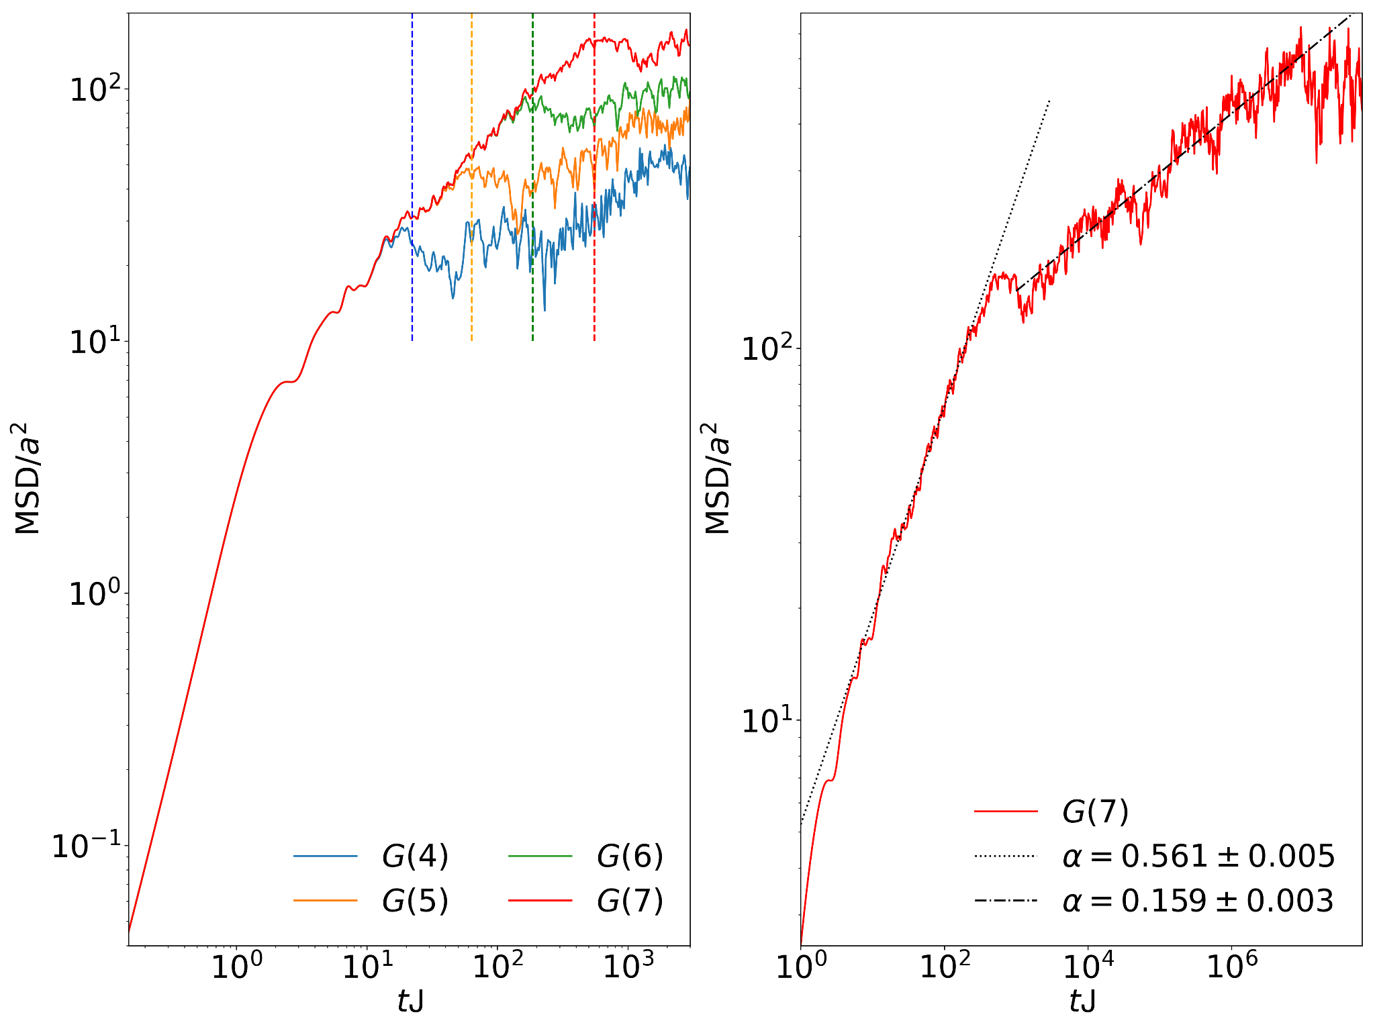
Mean Square Distance
Using as a initial state the particle in the corner
The Mean Square Distance (MSD) have the behaviour
In that case, we fit the exponent in three regions

Slide 12
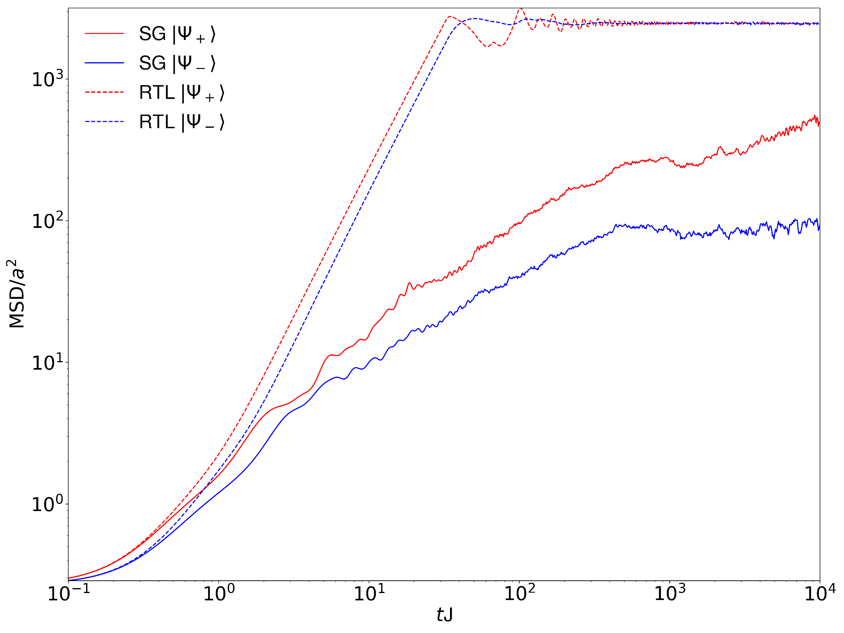
Non-classical initial state
Using as a initial state a superposition of the particle in two sites,
We compare the symmetric and the antisymmetric evolution in a Sierpiński gasket (SG) and in a Regular Triangular Lattice (RTL).
In both cases, the symmetric initial state expands faster than the antisymmetric.
But for the fractal geometry this effect is enhanced and continues for very large times.

Slide 13
Summary and conclusions
The ultracold atoms are useful to study many-body quantum physics.
The Bose Hubbard model is useful to describe the motion of some systems as ultracold atoms in lattices.
The fractal geometry allows different physical properties.
We found a sub-diffusive behavior in the time evolution of a particle in a fractal.
We show that the fractal geometry keeps the initial information for longer times than the standard lattices.

Slide 14
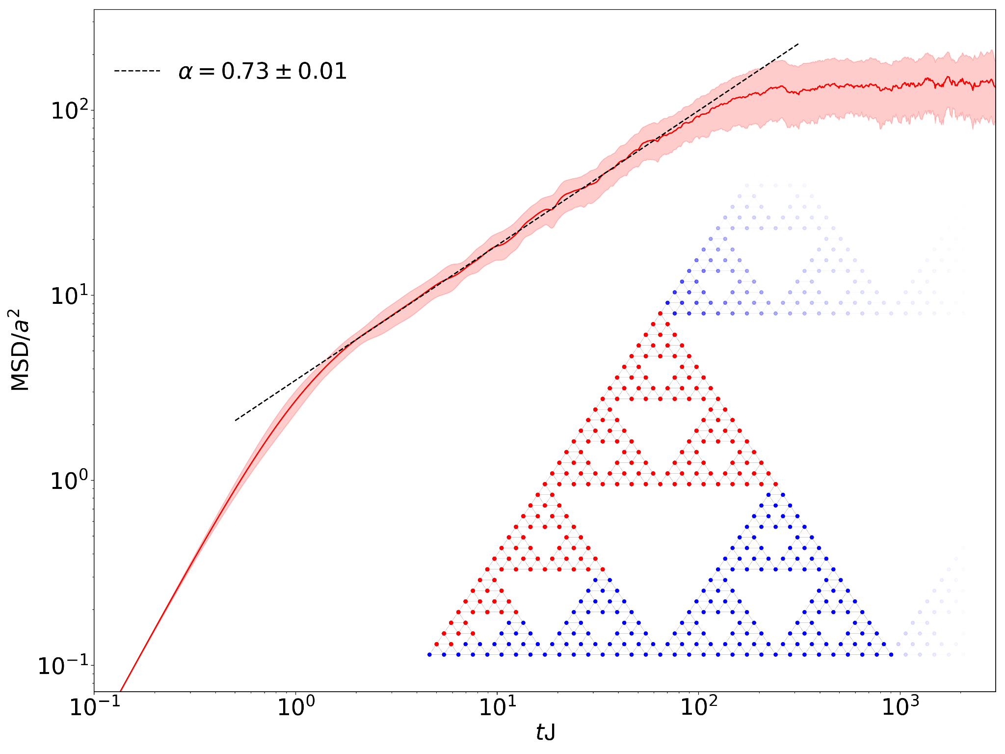
Averaging over all initial configurations
Using as a initial state the particle localized in the site |i>
Taking the MSD(t)_i and averaging over i,

Slide 15
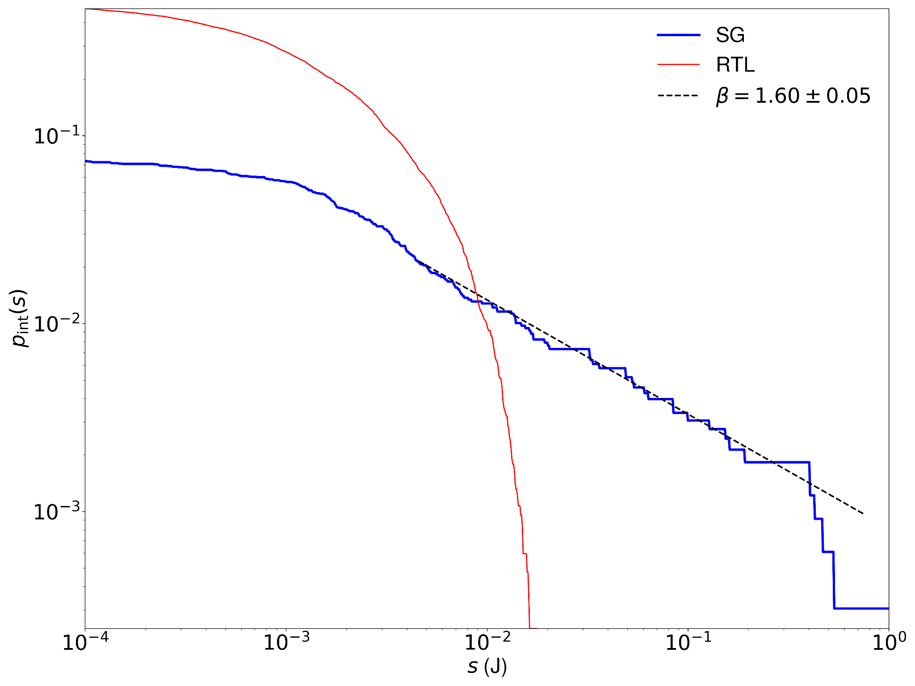
Integrated Level Spacing
By taking the energy gaps (s) of the Hamiltonian, we define the integrated level spacing
It counts the number of states separated by a gap larger than s, and have a distribution of

Slide 16
Relation between dynamics and spectral properties
A fractal of length L have a volume . At the same time, the integrated level spacing counts the number of states resolved by s, so, occupying a volume
. With that, we have the relation .
On the other hand, we know and so, . Being also
Then .
Combining the two expressions, we found the relation
Obtaining a relation between a dynamical expansion and the energy spectrum.
With our fit on the integrated level spacing, we predicts
In agreement with the value fitted in the averaged case.

Slide 17
Numerical methods

