Slide 1
Gravitational waves and Nucleosynthesis in Binary Neutron-stars simulations
F. Venturi, E. Ghai, G. Rivieccio, M.Ruiz and A.Rios
giuseppe.rivieccio@uv.es
Ayuda CPI-23-478 financiada por CIDEGENT/2021/046
and Prometeo CIPROM/2022/49
NIC XVIII Girona - 20 June 2025

Slide 2
Why Neutron stars Merger?
Graphic by Jennifer Johnson Image credits: ESA/NASA/ASSNova

Slide 3
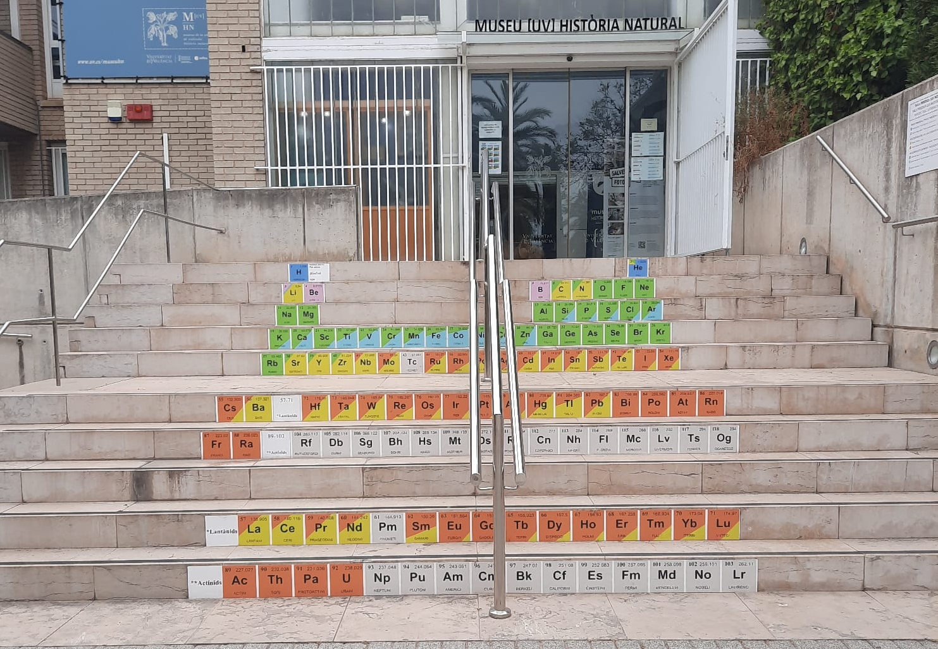
Why Neutron stars Merger?
Graphic by Jennifer Johnson Image credits: ESA/NASA/ASSNova

Slide 4
Why Neutron stars Merger?
Graphic by Jennifer Johnson Image credits: ESA/NASA/ASSNova

Slide 5
Merger Phases
Inspiral
Merger
Post merger phase/Collapse
Stable NS/Collapse
Venturi, GR et al. (in prep)

Slide 6
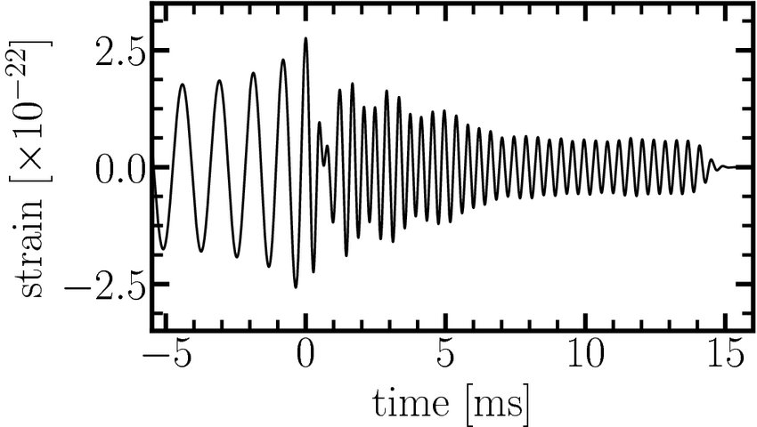
Merger Phases
Inspiral
Merger
Post merger phase/Collapse
Stable NS/Collapse
Venturi, GR et al. (in prep)

Slide 7
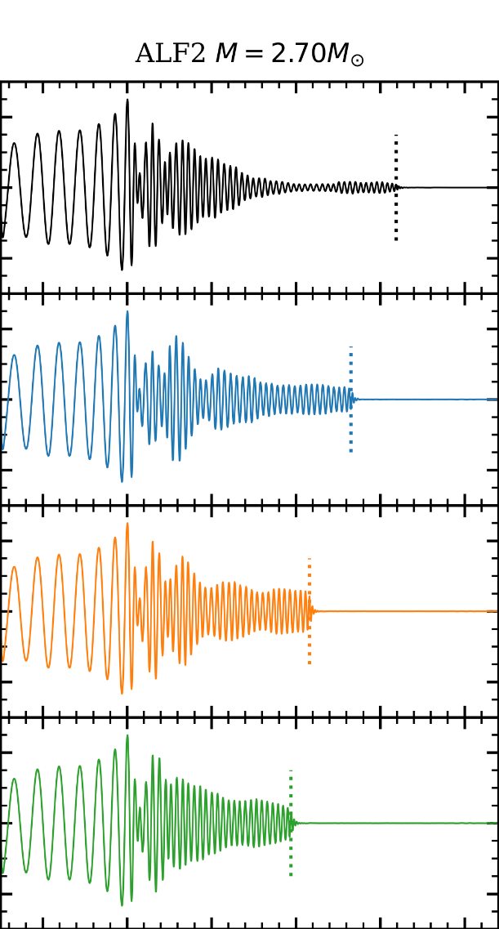
B-field in BNS
$$B^{2}$$
Faster collapse to black hole
Frequency shift in GWs
Other references about B-field and nucleosynthesis:
De Haas et al. (2025), 10.1093/mnras/stad2931
Kelsey A. Lund et al 2024 ApJ 964 111
Bamber et al. (2025), PhysRevD.111.044038

Slide 8
Our Setup
Toroidal
EoSs:
SFHo (soft) $q = 1$,25
DD2 (intermediate) $q = 1,25$
HShen (stiff) $q = 1$
Poloidal
Venturi, GR et al. (in prep)

Slide 9
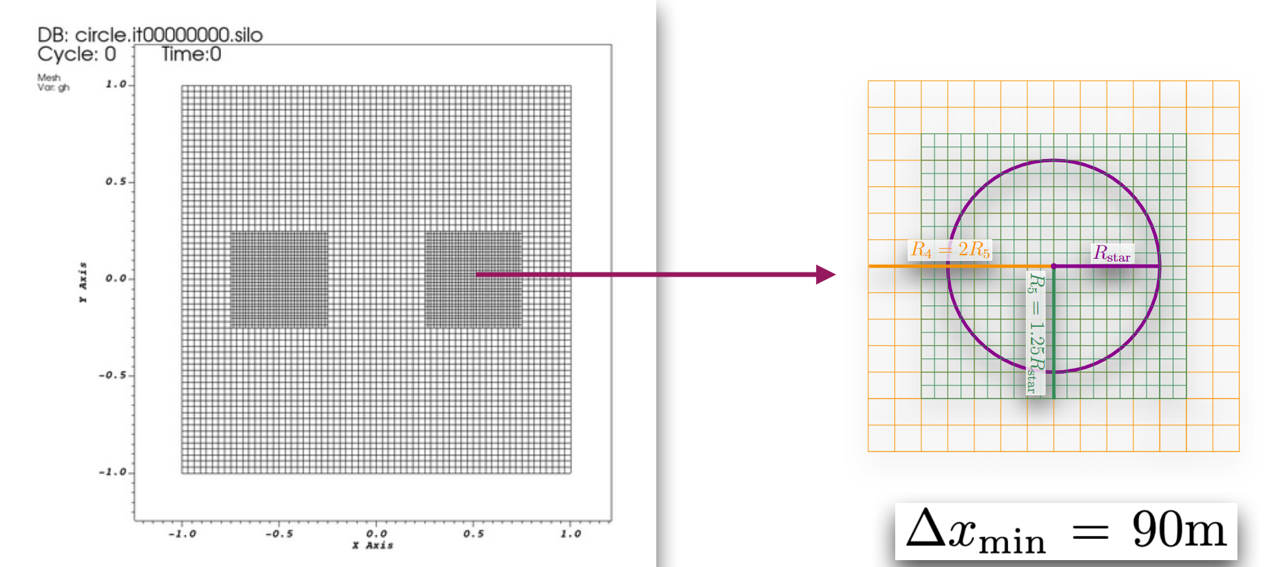
Our Setup
BNS simulation using:
Einstein Toolkit + IllinoidGRMHD
adding tracer particles evolution
(up to 40 ms after merger)
Nucleosynthesis using WinNet
Of the ejected tracers
www.einsteintoolkit.org
www.illinoisgrmhd.net
nuc-astro.github.io/WinNet/

Slide 10
Our Setup
B-fields:
Toroidal
Poloidal
EoSs:
SFHo (soft) $q = 1$,25
DD2 (intermediate) $q = 1,25$
HShen (stiff) $q = 1$
Venturi, GR et al. (in prep)

Slide 11
Our Setup
Venturi, GR et al. (in prep)

Slide 12
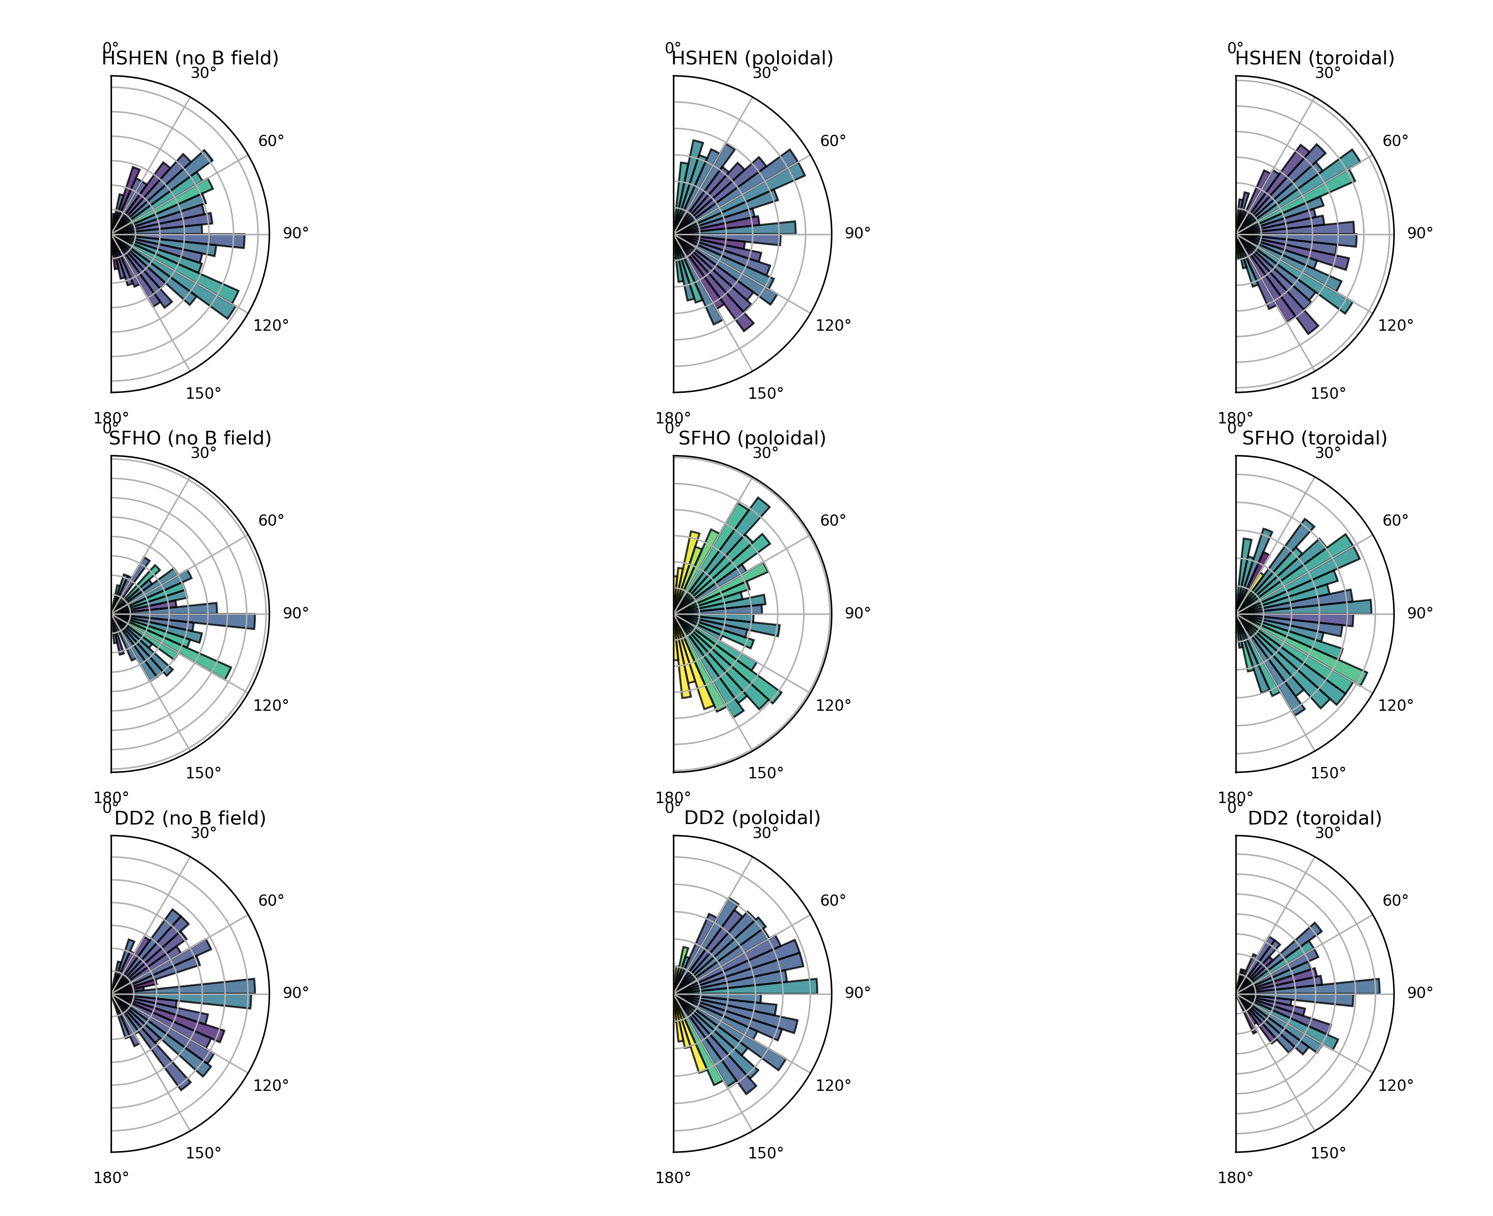
Ejecta Properties
Venturi, GR et al. (in prep)
$q = 1$seems not affected!
$q = 1,25$ Poloidal shows fast ejection at the poles!
$q = 1,25$ Toroidal is not affected!
$$q = 1$$
$$q = 1,25$$
$$q = 1,25$$

Slide 13
Ejecta Properties
Higher Velocities and Temperature for Poloidal and Unequal Masses
Venturi, GR et al. (in prep)

Slide 14
Ejecta Properties: Jet?
Venturi, GR et al. (in prep)

Slide 15
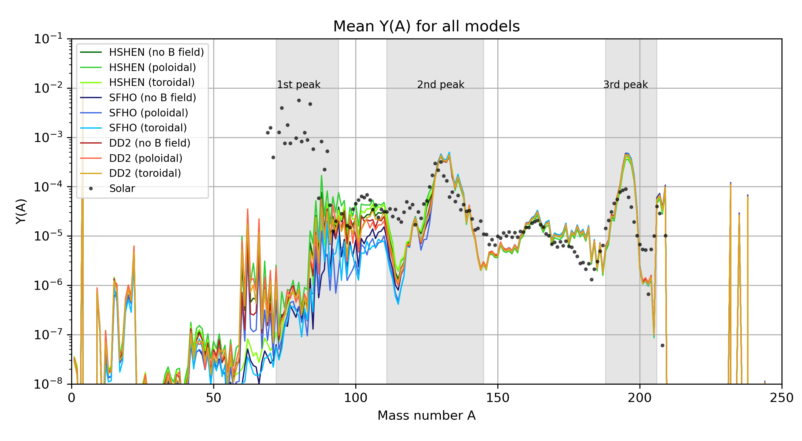
Nucleosynthesis
x $2$ Poloidal vs Hydro
x$2$ for Poloidal vs Hydro
Venturi, GR et al. (in prep)

Slide 16
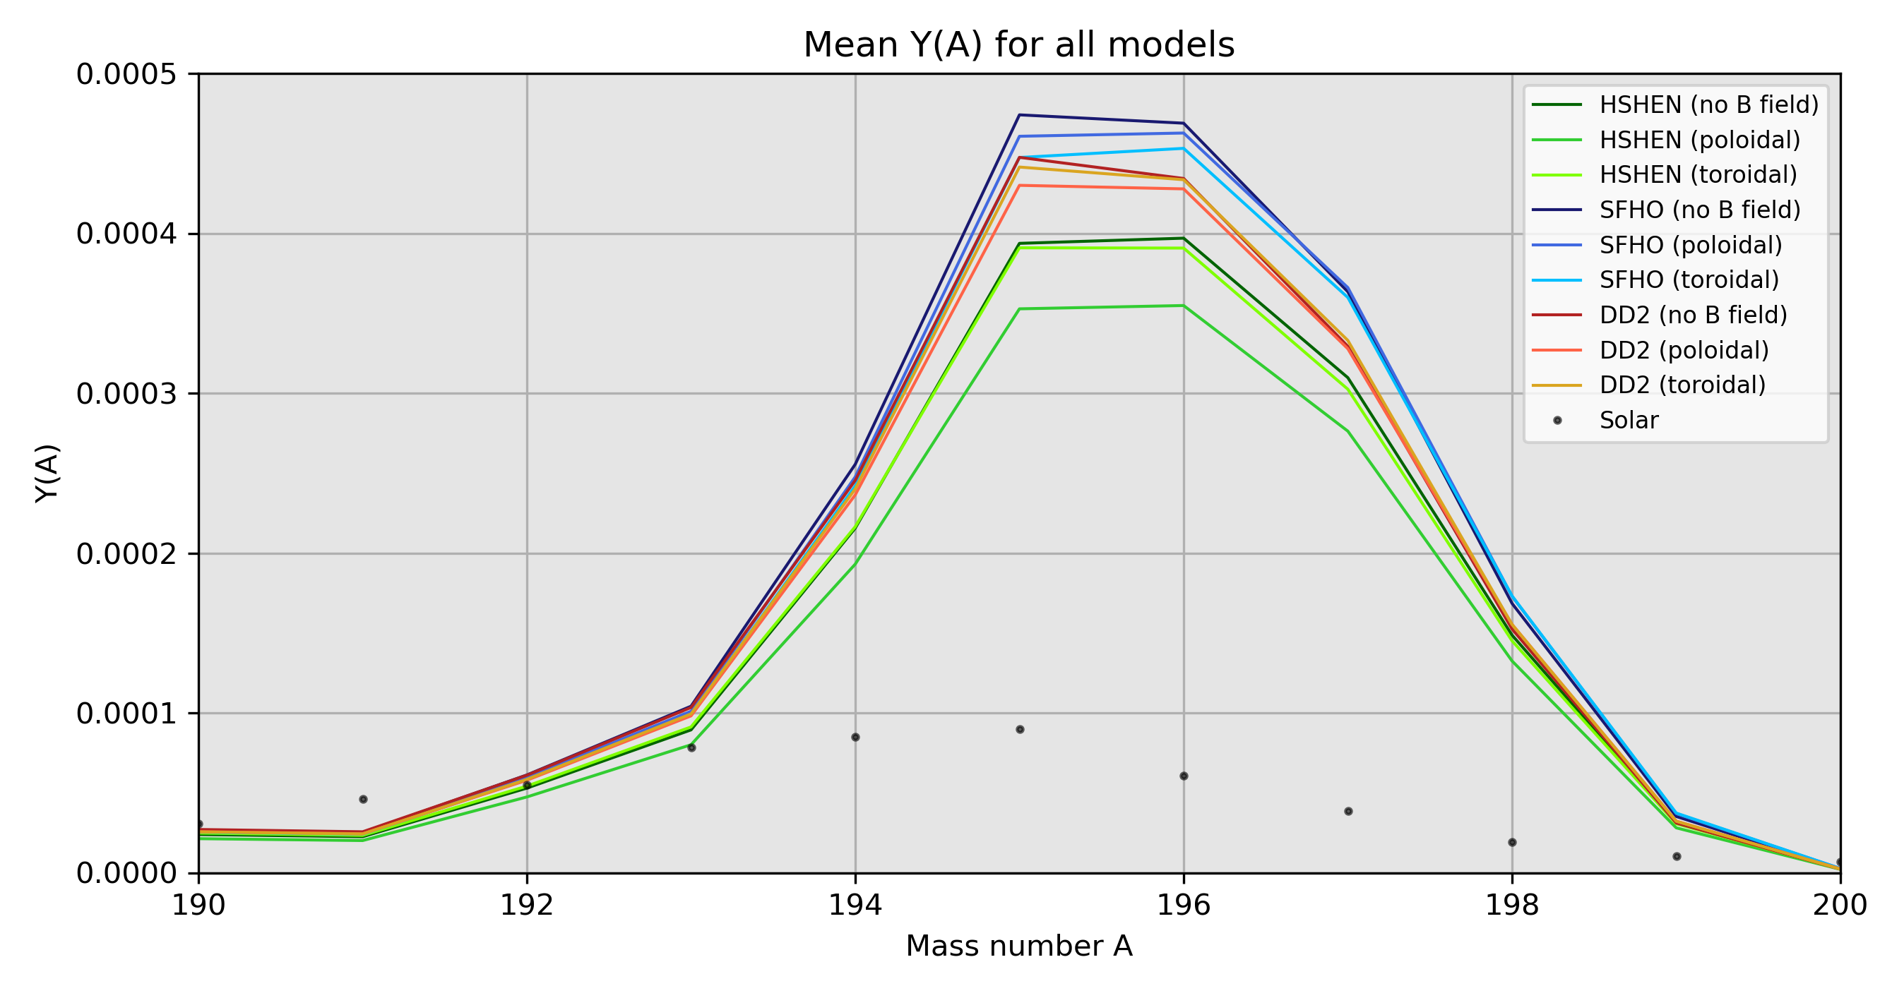
Nucleosynthesis: 3rd Peak
$EoS$ has $7\%$ difference
Stiff EoS $q = 1$
Poloidal has $10\%$ difference
Venturi, GR et al. (in prep)

Slide 17
Conclusion

Slide 18
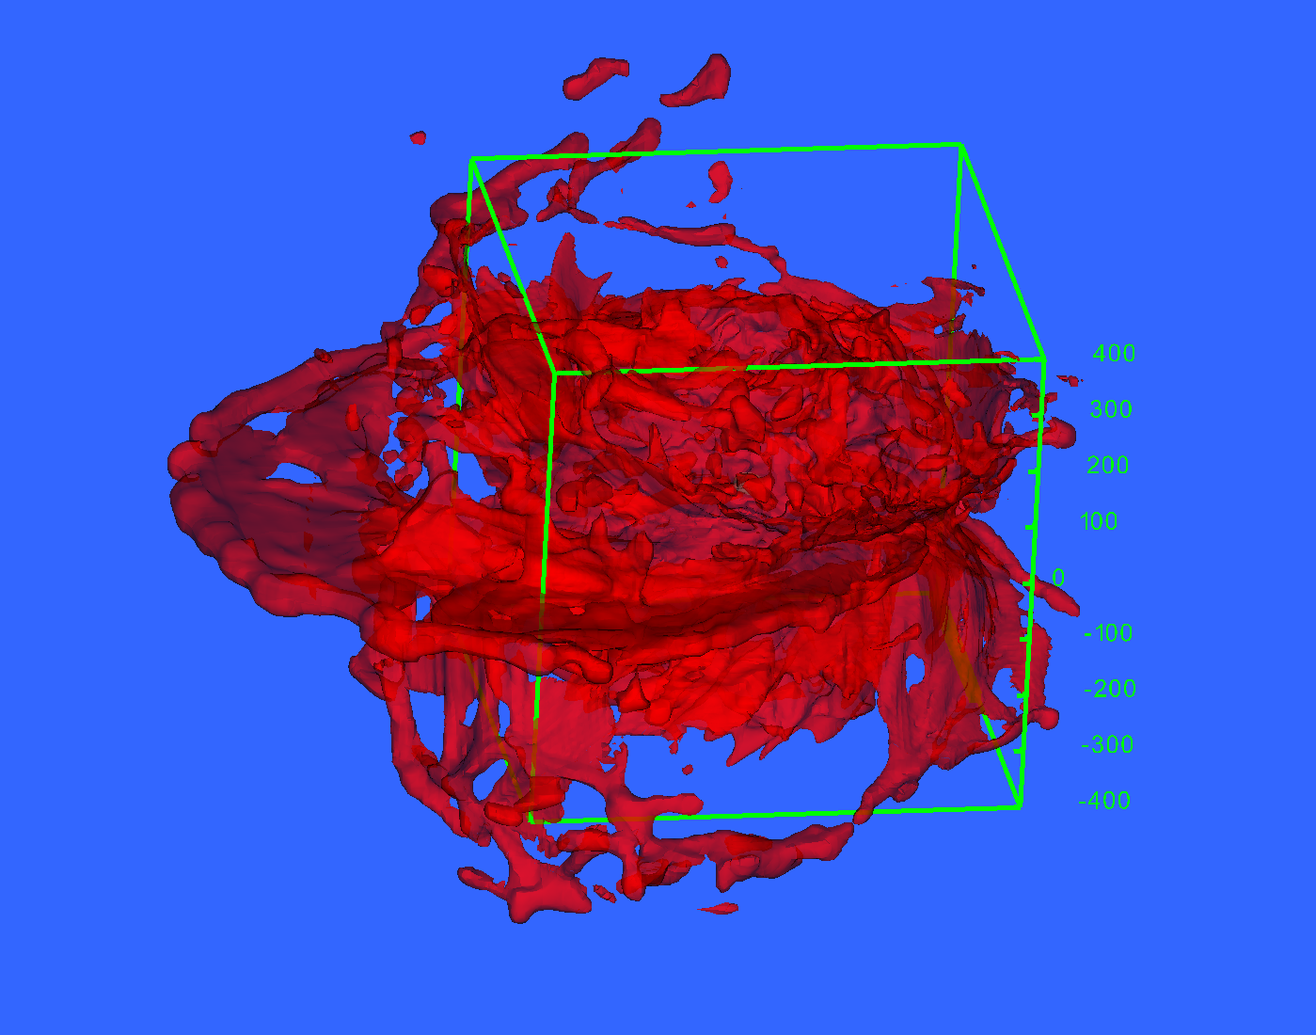
Conclusion &
Future Prospective
Poloidal Magnetic field suppress the 3rd peak
Effect comparable to EoS contribution
Enhanced ejection in the pole
Nucleosynthesis in the "Jet"/Angular distribution
Post-processing code to extract tracer data!
Venturi, GR et al. (in prep)

Slide 19
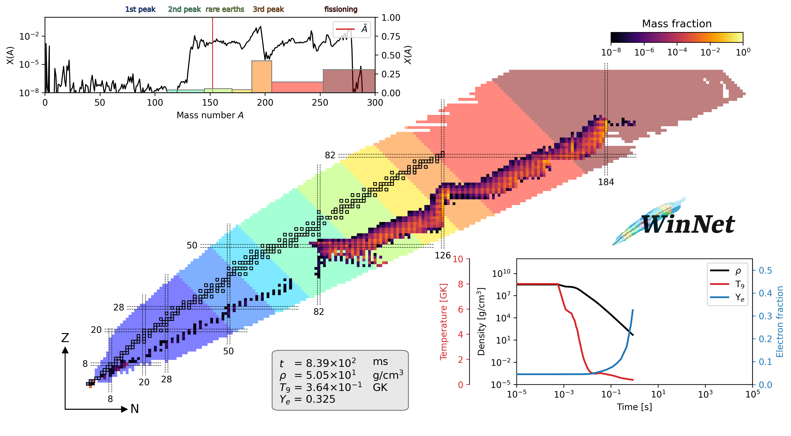
Elina Ghai
Fabrizio Venturi
Arnau Rios
Milton Ruiz
Thanks!
giuseppe.rivieccio@uv.es
Ayuda CPI-23-478 financiada por CIDEGENT/2021/046
and Prometeo CIPROM/2022/49
NIC XVIII Girona - 20 June 2025

