Slide 1

The black hole interior
RB, Medved,
1902.07990
1805.11667
============
1602.07706
1607.03721
1709. 03566
=============
Similar ideas for deSitter/big-bang 1906.00989
Ram Brustein
אוניברסיטת בן-גוריון
Three points of view
Maximal entropy state resolves singularity
Black hole as maximal entropy state of strings
“Dual” description – maximal negative pressure

Slide 2
Introduction
  Existence, composition of the interior of BHs ?
  Hawking’s principle of ignorance
Three points of view about interior, singularity
  Modern: GR + horizon + singularity + thermodynamics
  Skeptic: GR + (horizon) − singularity
  Postmodern: quantum supremacy ➔singularity, horizon artifacts
☒ ☒
☑

Slide 3
What is the final state of matter that collapses under its own gravity ?
Until recently:
Schwarzschild solution: horizon + singularity
  Singularity thms. (Penrose, Hawking) + physical considerations, in classical GR + “normal” matter (Buchdahl, Chandrasekhar) ➔ singularity is “real”
Lore: singularity OK because it is surrounded by a horizon
  At horizon, weak gravity ➔ nothing special happens
  Separation of scales between singularity and horizon
  Understanding of spacetime fine, ignore singularity and reversal of space and time

Slide 4
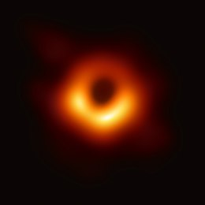
Meaning of “Interior”
Interior ~ r < 2 GM (Inside gravitational barrier ?)
State of interior quantum state of collapsed object
Classically
Interior causally separated from exterior

Slide 5
Hawking’s “principle of ignorance”
The interior is, by definition, causally separated from the exterior, so how can we tell what’s inside?
“Principle of ignorance” : any explanation is fine, as long as
  It is consistent with the laws of physics
  It is consistent with results of experiments in the exterior
Our perspective: only external observers get a vote
(only boundary observables in QG)

Slide 6




Quantum considerations
  ========= Modern era of BH physics =========
BH thermodynamics (Bekenstein, Hawking)
Evaporation inconsistent with QM
  ======= Postmodern era of BH physics =======
“Firewall” (AMPS): this is a real problem
  Cannot “just ignore” the interior
  Cannot dismiss the singularity
Causality (Mathur): interior is causally disconnected so information *cannot* be transferred to the exterior

Slide 7
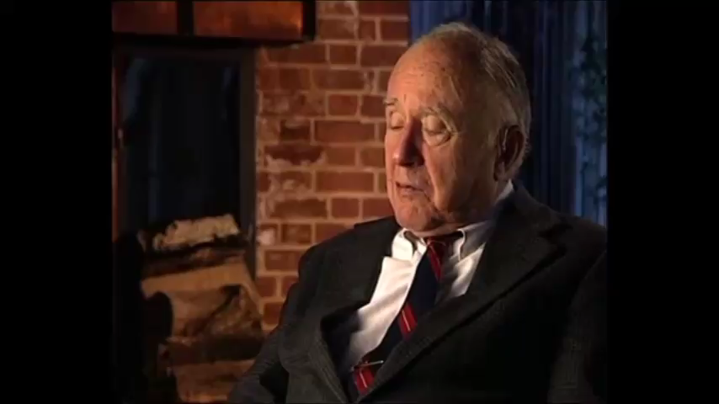
Can we ignore the interior, singularity ?
Dr. Wheeler made it his mission to alert the rest of his colleagues to the paradoxical vision of physics predicting its own demise.

Slide 8
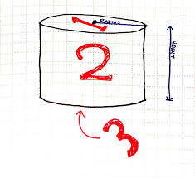

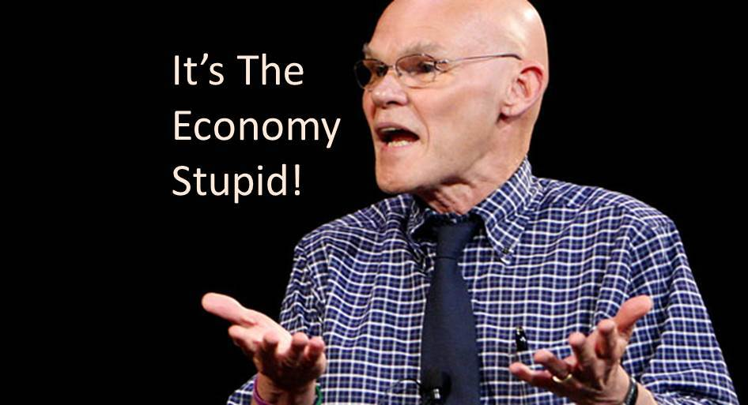
Quantum considerations: our perspective
Singularity/remnant problem, tension between evaporation and unitarity, causality ⬅➔ sides of the same three sided coin
Any model that obeys the laws of quantum mechanics must be non-singular and will respect
  Unitarity
  Strong subadditivity (linearity of QM)
  Causality
“It’s the singularity, stupid”


Singularity
What James Carville should have said

Slide 9
Plan
Three points of view
Maximal entropy state resolves singularity
Black hole as maximal entropy state of strings
“Dual” description – maximal negative pressure

Slide 10

The modern perspective
GR - geometry
QFT - Semiclassical physics
Deus ex machina resolution of the singularity
  Regularized singularity = remnant
  Assume remnant is OK
  Assume scale separation singularity/horizon

Slide 11

The modern perspective
GR – geometry
Scattering cannot be unitary

Slide 12

The skeptic perspective
GR - geometry
QFT - Semiclassical physics
Resolution of the singularity by classical terms in Einstein’s equations (could originate from quantum effects)
Find loophole to the singularity theorems
Do not worry about unitarity, or other aspects of QM ➔ generically, problems when QM is considered.
The Skeptics Society is a nonprofit, member-supported organization devoted to promoting scientific skepticism and resisting the spread of pseudoscience, superstition, and irrational beliefs.

Slide 13


The postmodern perspective
Supremacy of Quantum mechanics
Eliminate the singularity
Accept strong gravity/non-geometric description
Accept exotic matter
Examples:
  Fuzzballs (Mathur, Skenderis + Taylor)
  Graviton Condensates (Dvali, Gomez)
  ER=EPR (Maldacena, Susskind)
  “Polymer model” – highly excited strings

Slide 14
Plan
Three points of view
Maximal entropy state resolves singularity
Black hole as maximal entropy state of strings
“Dual” description – maximal negative pressure

Slide 15

Maximal entropy Causal Entropy Bound (RB+Veneziano '99)
S(V)=S_{BH}
“Maximally quantum”

Slide 16
Maximal entropy➔
Maximal positive pressure

Slide 17
Blackholes as maximal entropy states
BH as a bound state of highly excited strings:
“quantum star” , “string ball”, “collapsed polymer”

Slide 18
Maximal entropy state resists collapse
Maximal entropy ⬅➔ large quantum fluctuations
Semiclassical geometry/Einstein’s equations not valid
Collapse is prevented entropically: entropy is maximal
BH singularity is resolved by quantum effects (the uncertainty principle), as for the classical hydrogen atom

Slide 19
Plan
Three points of view
Maximal entropy state resolves singularity
Black hole as maximal entropy state of strings
“Dual” description – maximal negative pressure

Slide 20
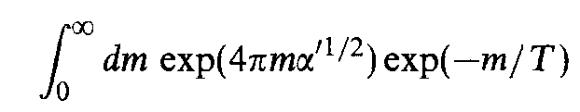


Highly excited (Hagedorn) phase of strings
Long string: Energy, Entropy ~ Length
T< T_{Hag} , Energy dominates
T ~ T_{Hag} , Entropy dominates (strong coupling)
~
Credit: Martens
Dominated by long string(s) : entropically favourable

Slide 21
Maximal entropy state of strings in the Hagedorn phase
Free energy of the bosonic string in the Hagedorn phase
-
2D radiation independent on actual D

Slide 22
Free energy of maximal entropy state:
Hagedorn strings as “collapsed polymers”
RB+ Medved
1602.07706
1607.03721

Slide 23
Maximal entropy state: free strings
RB+ Medved
1602.07706
1607.03721
Free energy –free string

Slide 24
Free long string ←→ Random walk
R

Slide 25
Highly excited strings in a bounded region
Salomonson & Skagerstan ‘86
Low+Thorlacius ’94
==================
Horowitz+Polchinski ’98
Damour + Veneziano ‘00
Closed strings
Total length L
R
Dominated by long strings
Zero modes

Slide 26
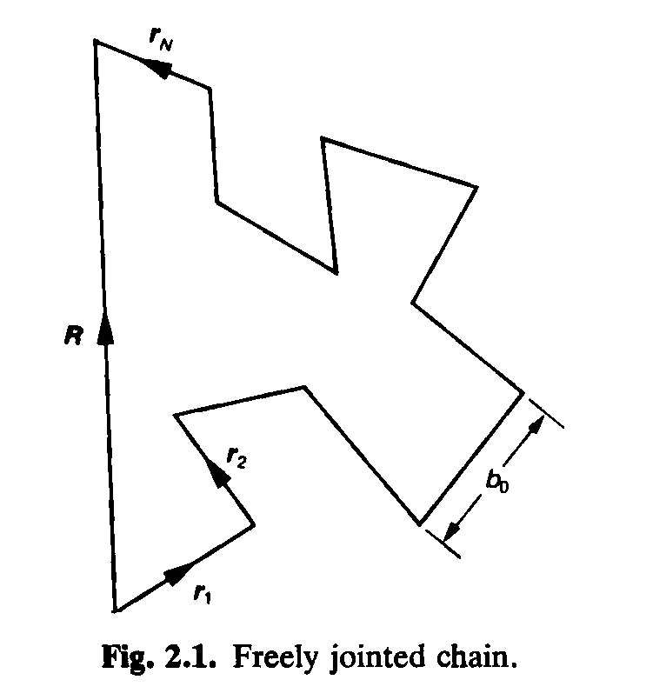

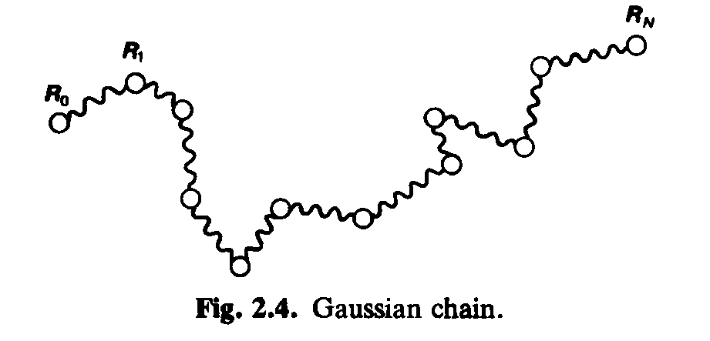
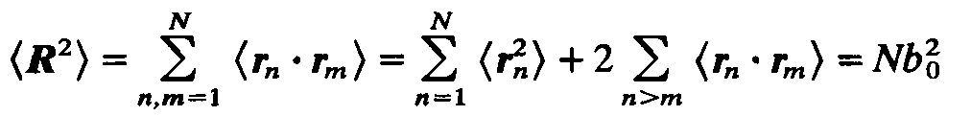
Polymers
Ideal chain ←→ Random walk
Doi & Edwards – Theory of Polymer Dynamics ’94
De Gennes – Scaling Concepts in Polymer Physics ‘79
Gaussian chain
Gyration radius

Slide 27
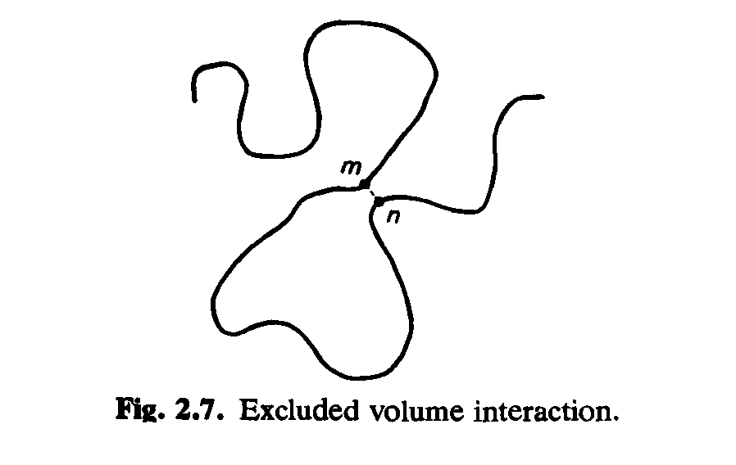

Interacting Polymers
Flory-Huggins theory of interacting polymers
Flory (Nobel, Chemistry ’74)
Flory exponent ν
Repulsive
Area law
Attractive

Slide 28
Bound state of highly excited strings as a collapsed polymer : interactions
Free energy – effective interactions – joining and splitting

Slide 29
Bound state of highly excited strings: quadratic free energy (a “collapsed polymer”)
RB+ Medved
1602.07706
$$s$$
Extremely complicated in terms of asymptotic fields
Solution “non-perturbative” not valid as $g_{s}$ → 0

Slide 30

Bound state of highly excited strings
$$s$$
Entropy density
Energy density
$$s$$
(local/internal) Pressure
Tension/Elastic force

Slide 31
BH as a bound state of highly excited strings
Gravitational energy dominates
Solutions of all sizes!

Slide 32
BH as a bound state of highly excited strings
Alternatively,
double-scaling limit
Solutions of all sizes!

Slide 33

Emergent horizon, Hawking radiation
RB+ Medved
1607.03721
In 4D, ΔR~ l_{P}
Rate of escape ~
Unitarity
Causality
Locality
☑ ☑
From an external perspective: Horizon absorbs negative null energy & becomes a little smaller
$$\boxed{\sim }$$

Slide 34
BH as a bound state of highly excited strings – “collapsed polymer”
From the outside, in equilibrium, looks exactly like a BH
  Mass and entropy scale correctly
  Does not collapse – entropy dominated/random walk
  Extremely sharp horizon
  Correct rate of Hawking radiation

Slide 35
Plan
Three points of view
Maximal entropy state resolves singularity
Black hole as maximal entropy state of strings
“Dual” description – maximal negative pressure

Slide 36
Example: the polymer model
Example: the graviton condensate model (Cunillera, Germani 1711.01282)

Slide 37

The skeptic perspective
Example: the gravastar model
the polymer model
1805.11667
Mazur, Mottola `01- present
Quantum mechanics ➔ addressed in a completely different way
Quantum mechanics ➔ problems
Entropy a mechanical quantity
Thermodynamics different

Slide 38
The “polymer model”: a non-singular BH from skeptic & postmodern perspectives
Skeptic/GR perspective: maximal negative pressure
Postmodern/Quantum perspective:
  Maximal entropy
  Maximal positive pressure
Hawking’s “principle of ignorance” – if exterior perspectives agree, then OK, but laws of QM generically not obeyed for the skeptic description

Slide 39
GR/Skeptic perspective: geometry, sourced by maximal negative pressure

Slide 40
GR/Skeptic perspective: maximal negative pressure
“polymer model”

Slide 41
“Polymer model” solution: regularity
Einstein equations, curvature invariants, metric determinant are all as regular as at horizon of a Schwarzschild BH
“polymer model”
p_{r} = −ρ for static matter just outside a Schwarzschild horizon (MMV '04)
Gauss’ Law + spherical symmetry, ➔ p_{r} = −ρ in the interior.

Slide 42
“Polymer model” from skeptic perspective: matter resisting collapse p = - ρ
Collapse prevented mechanically
Regular,
Hydrodynamic equilibrium,
Stable

Slide 43
“Polymer model” solution: equilibrium
Following Chandrasekhar '64
“polymer model”

Slide 44
Are quantum effects observable ?
In equilibrium – No (*in practice)
(Way) Out of equilibrium –Yes!
  Exponential decay to equilibrium
  In GR – one scale R_{S}
  Internal structure ➔ additional scale(s)

Slide 45
Summary & Conclusions
Modern perspective – contradicts QM
  Relies too much on singularity thms., semiclassical gravity
Skeptic perspective – contradicts QM, but
  Identified correct escape route from singularity thms.
  Requires exotic matter
☒
☒
How can matter inside a BH resist collapse? The “polymer model”
Skeptic: Negative (maximal) pressure p= − ρ , mechanical resistance
Postmodern: Positive (maximal) pressure p= + ρ , entropic resistance
& maximal entropy sT = 2 ρ,
Exotic matter + Strong gravity
➔ only postmodern perspective compatible with the laws of QM and known properties of BHs
RB, Medved, 1805.11667
1902.07990

Slide 47
“Reading” the interior

Slide 48
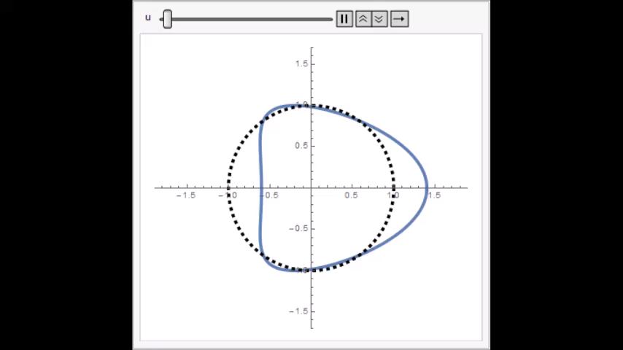
Q:What’s inside a large BH?
A1: We’ll never know – it’s inside the horizon
A2: Specific form of exotic matter
RB+ Medved
1709.03566
Quantum mechanically
  -ive null energy → horizon shrinks
  causality (Mathur ’17, Maldacena + …’17)
Classically: horizon tidal deformation (Hartle ’73, O’Sullivan & Hughes ‘14)
  +ive null energy ←→ horizon grows
  causality

Slide 49
RB+ Medved
1709.03566
  Amount of information that can be “read” determined by the degree of excitation ΔE/E
  Standard Hawking radiation
  Need to wait a Page time to “read the interior”
  “Supersized” Hawking radiation:
  Faster, stronger coherent emission ➔ large # of “equivalent Hawking modes”, “early Page time”

Slide 50
Spectrum of additional ringdown modes:
Frequency (without rotation)
Two perspectives ➔ same estimate
Exterior
Velocity = c
redshift z ➔ f ∼ c/ R_{S} (-g_{tt})^{1/2} << c/ R_{S}
Interior
Non-Relativistic wave & frequency v/c << 1
➔ f ~ v/R_{S} << c/ R_{S}
redshift ~ v/c
No additional relativistic modes that interfere with the GR ringdown modes
Frequency with rotation ➔ ~ m Ω

Slide 51
Summary of results:
Sound velocities in the “collapsed polymer”

Slide 52

The skeptic perspective
Example: the Hayward model
Hayward ‘06
Quantum mechanics ➔ problems
Energy of emitted radiation >> M
Frolov, Zelnikov, 1704.03043
Carballo-Rubio et al 1805.02675

Slide 53
The skeptic perspective
Example: the FrolovMarkovMukhanov Model
Join a de Sitter “universe” to Schwarzschild BH
Quantum mechanics ➔ problems
Unitarty

Slide 54
The skeptic perspective: summary
GR - geometry
QFT - Semiclassical physics
Resolution of the singularity by classical terms in Einstein’s equations (could originate from quantum effects)
Find loophole to the singularity theorems
Do not worry about unitarity, or other aspects of QM ➔ generically problems when QM is considered.

Slide 55

Example: the “polymer model” from a postmodern perspective

