Slide 1

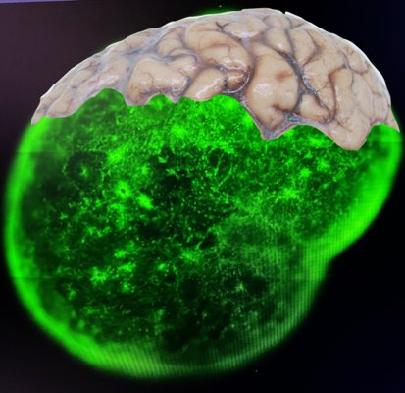
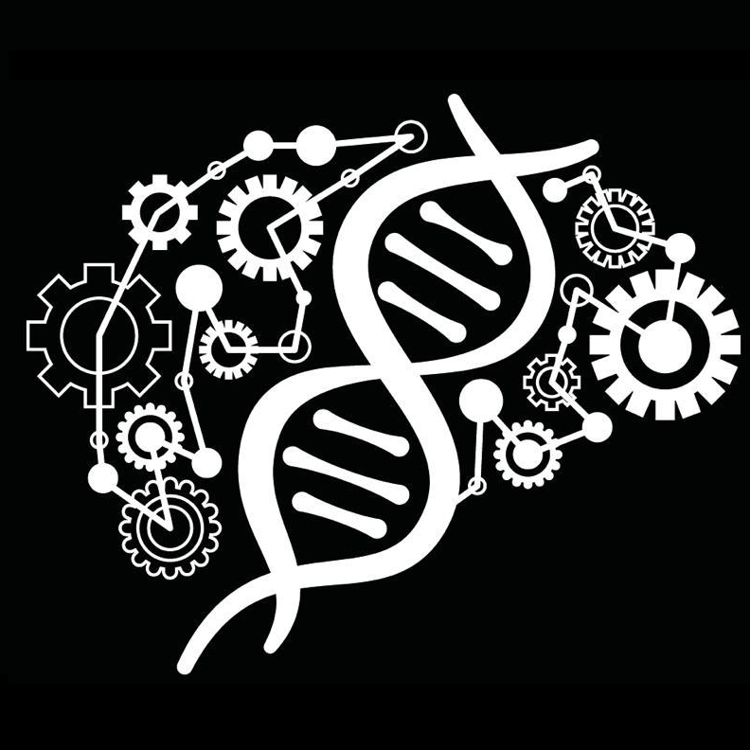
Variability vs Phenotype in brain organoids: AI is the answer
Sandra Acosta, PhD
Functional neurogenomics lab
UB Neuro
Universitat de Barcelona

Slide 2
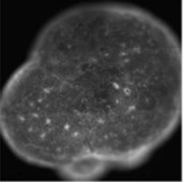
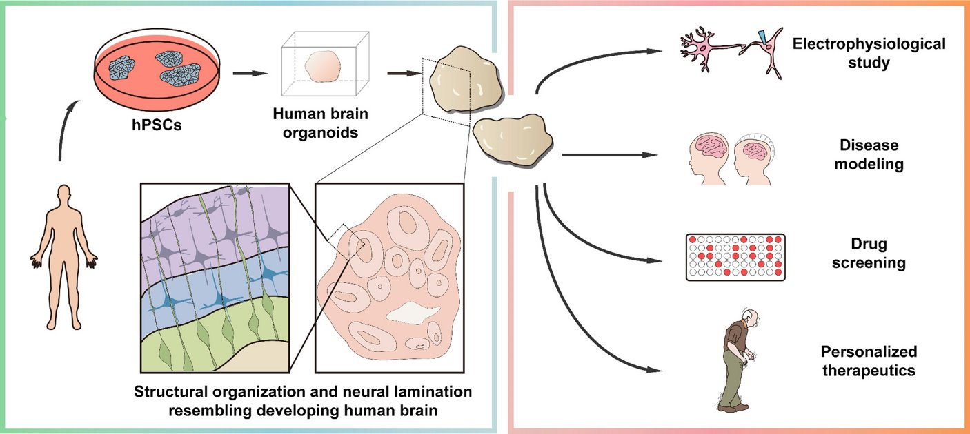
BRAIN ORGANOIDS AS A MODEL

Slide 3
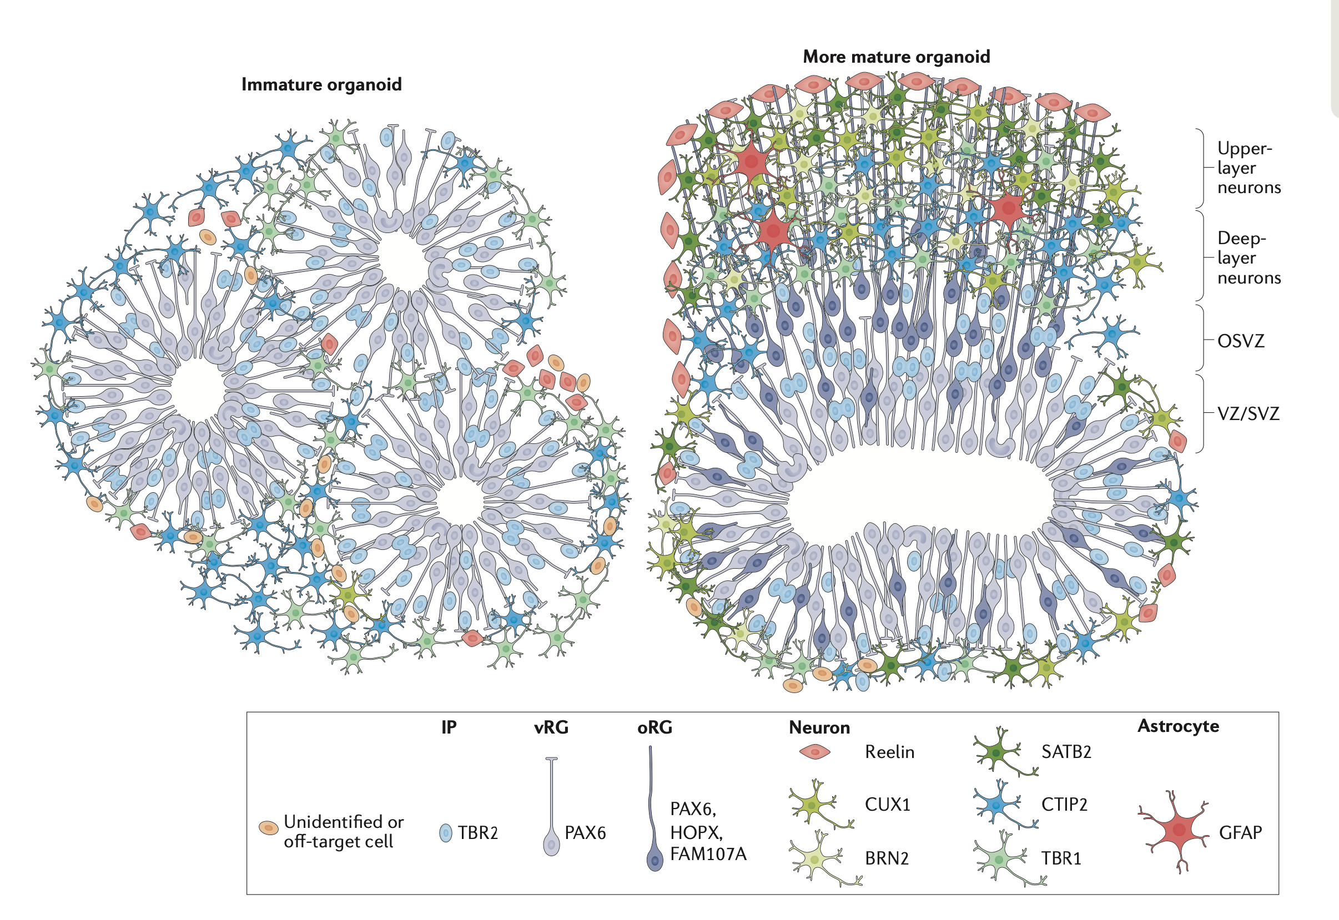
Brain organoids reproduce human developmental milestones
Di Lullo & Kriegstein, 2017

Slide 4
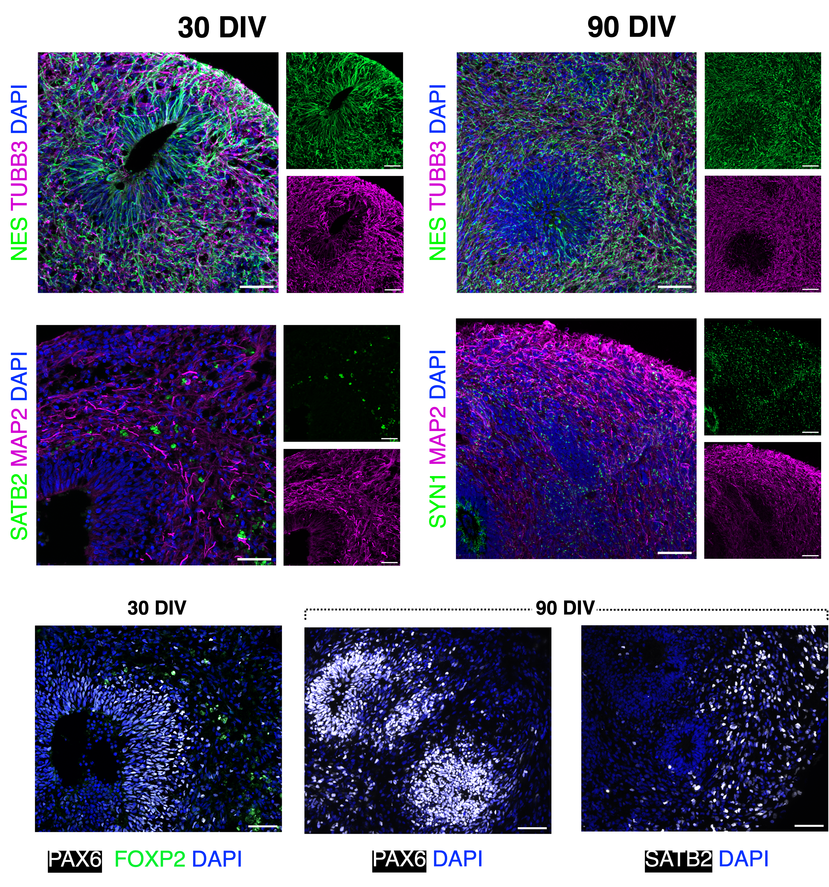
CELLULAR COMPOSITION IN hBO

Slide 5
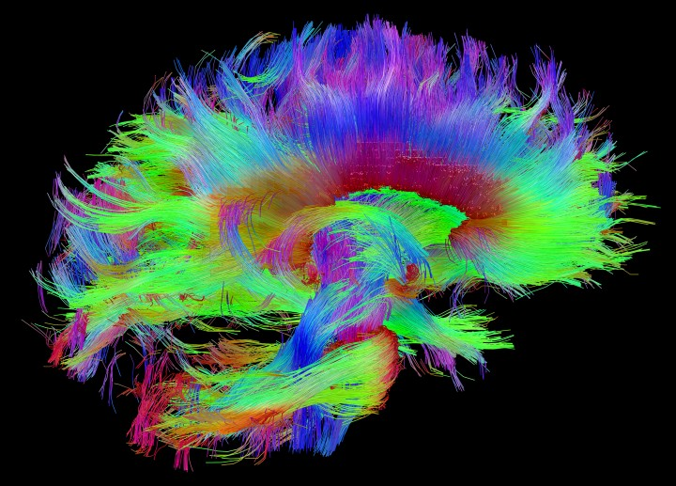
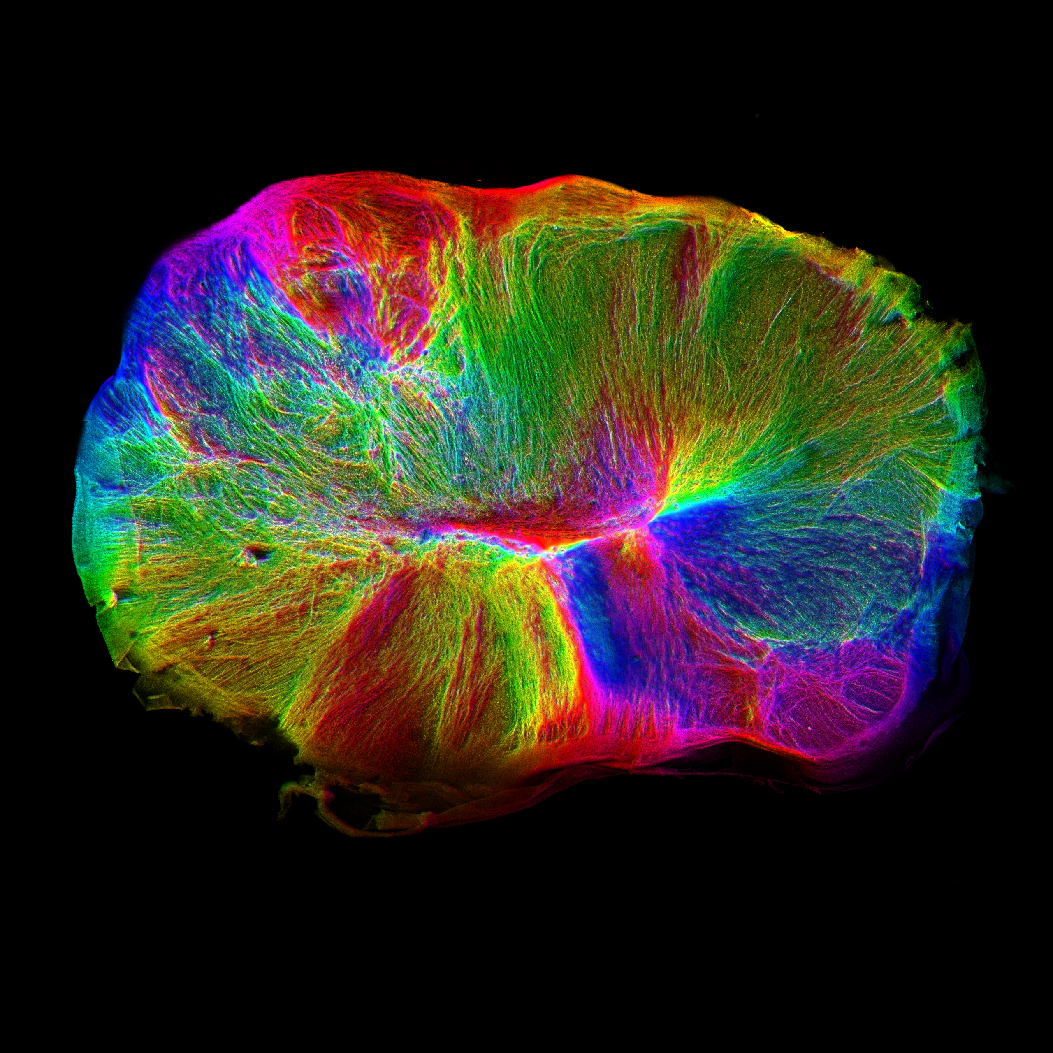
CAN BRAIN ORGANOIDS MODEL CONNECTIVITY?
HUMAN BRAIN CONNECTOME
ORGANOID CONNECTOME

Slide 6
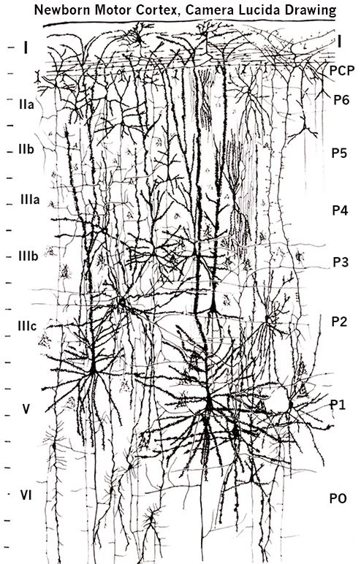
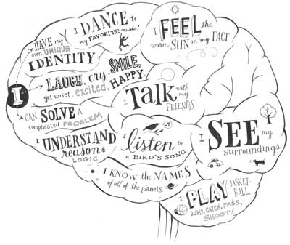
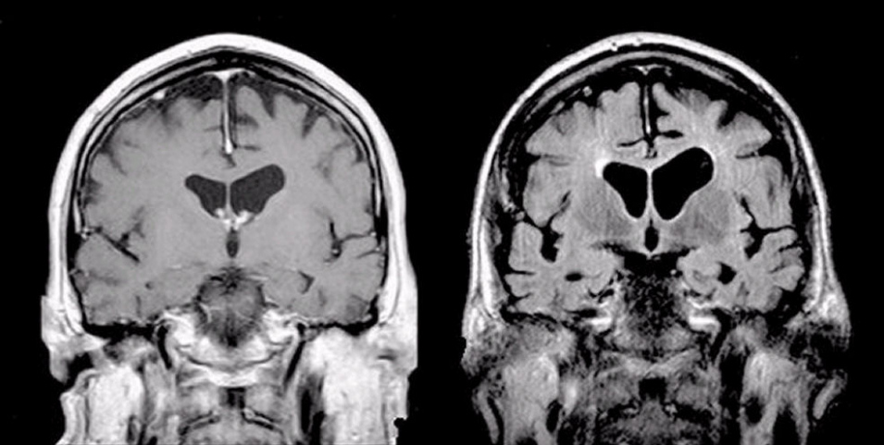
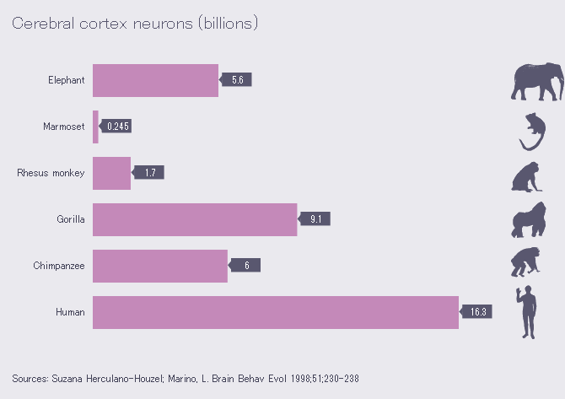
What can we model with hBO?
Cytoarchitecture
Functions
Diseases
Evolution
Mouse
Chimp
Human

Slide 7
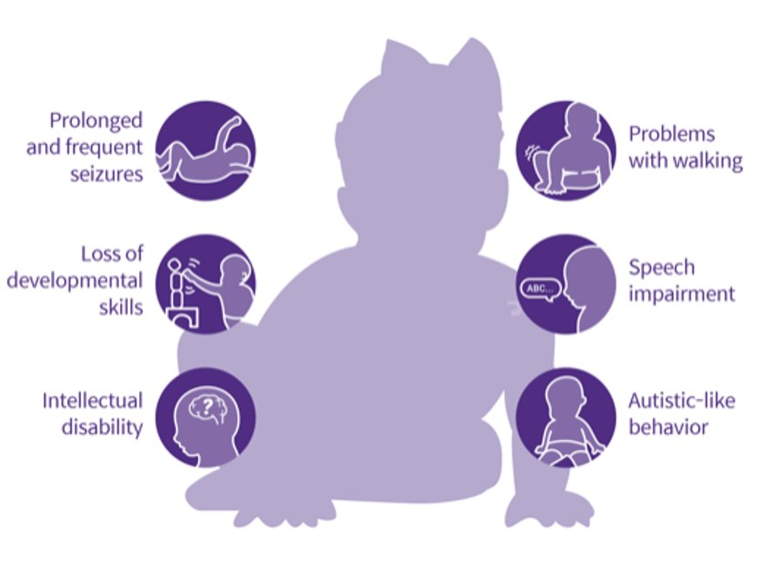
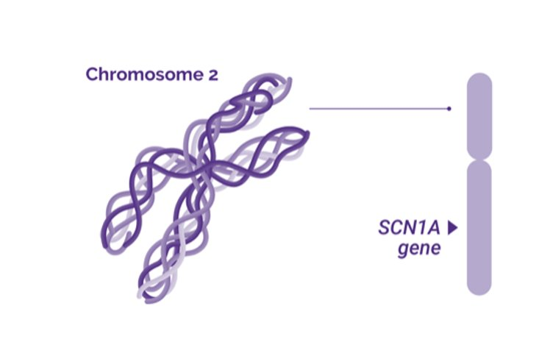
Dravet syndrome
SODIUM CHANNELOPATHY
EXCITATORY-INHIBITORY IMBALANCE
EARLY-ONSET DEVELOPMENTAL ENCEPHALOPATHY
PHARMACORESISTANT DISORDER

Slide 8
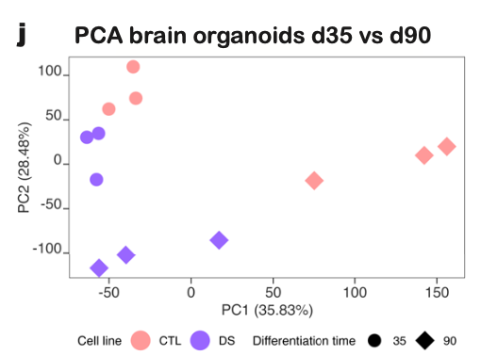
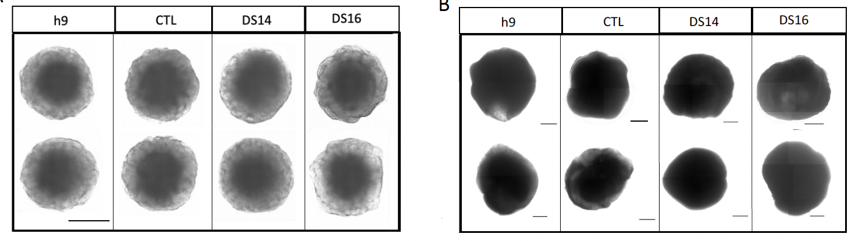
DRAVET PHENOTYPE RISES LATE-STAGES
DAY 15
DAY 90

Slide 9
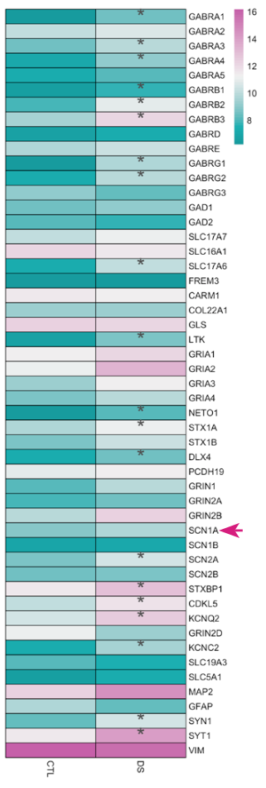
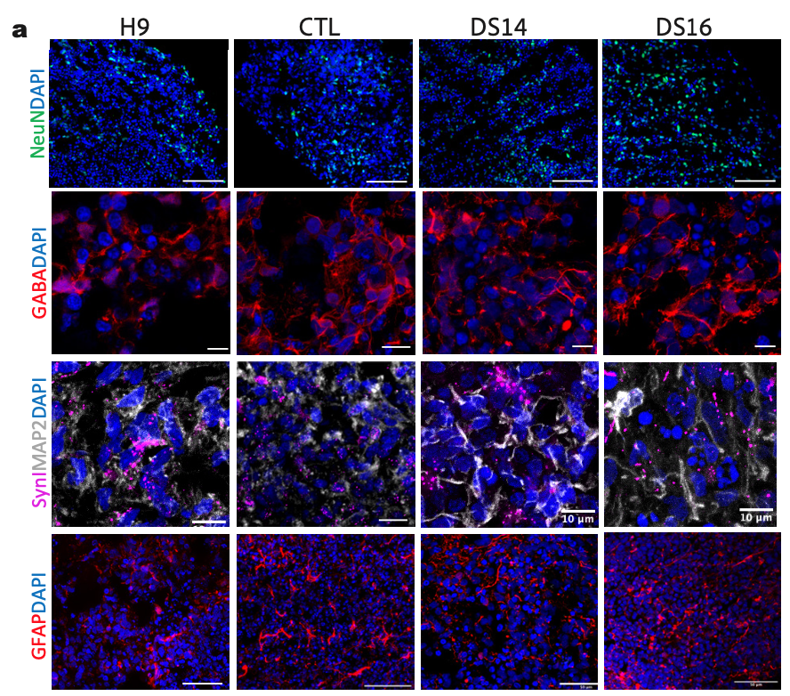
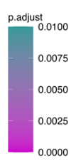
ACCELERATED NEURONAL MATURATION

Slide 10
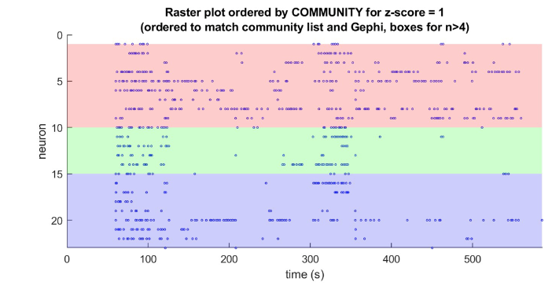
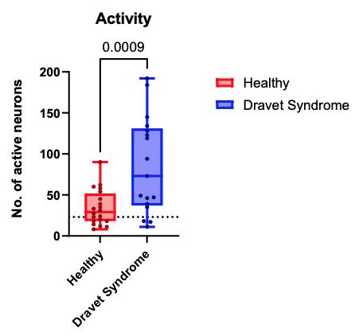
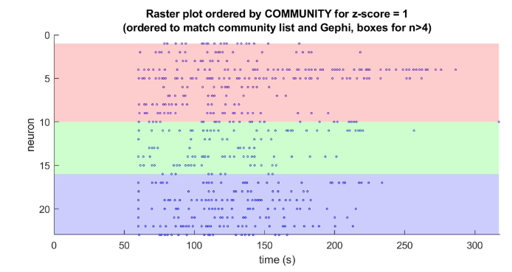
Dravet circuits have more neuronal connexions
Coll: Dr. Tornero

Slide 11
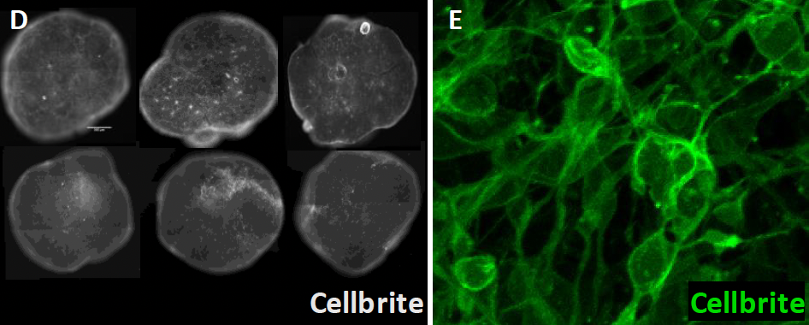
hBO VARIABILITY

Slide 12
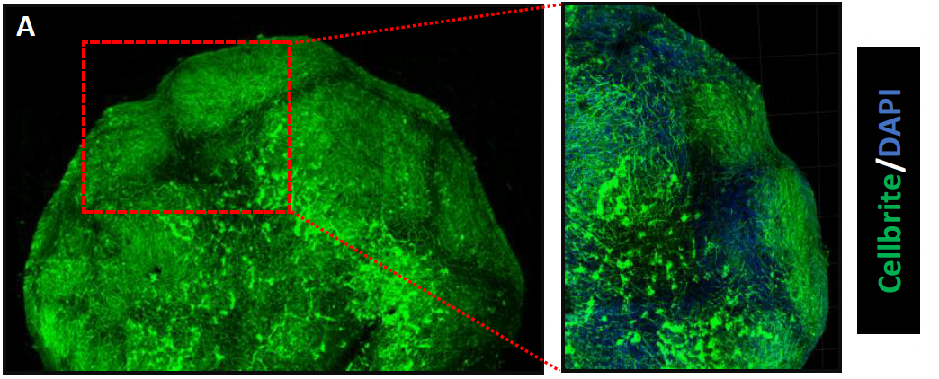
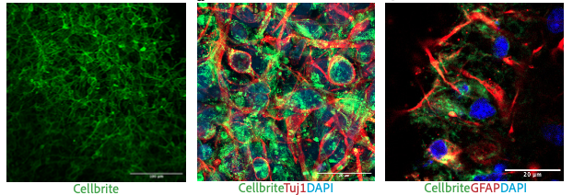
HBO variability
Can we detect the neural network in live imaging?

Slide 13
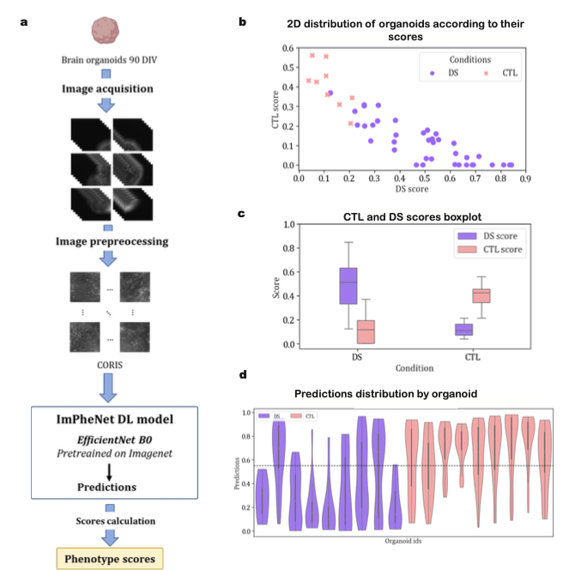
Image Phenotype Network:
ImPhenet
A classifying tool for live imaging in brain organoids

Slide 14
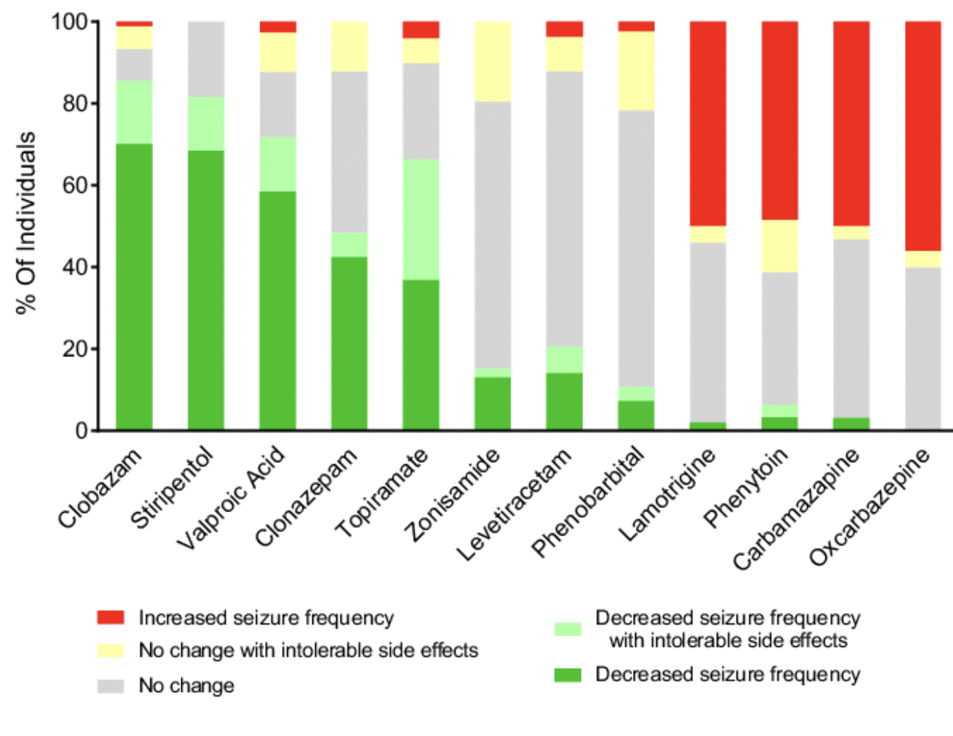
Toxicity in antiepileptic drugs
DOI: 10.1002/acn3.413
Annals of Clinical and Translational Neurology

Slide 15
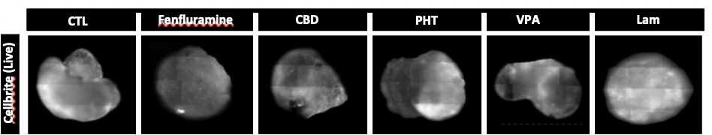
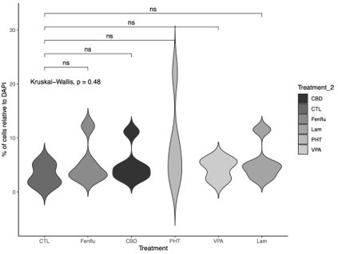
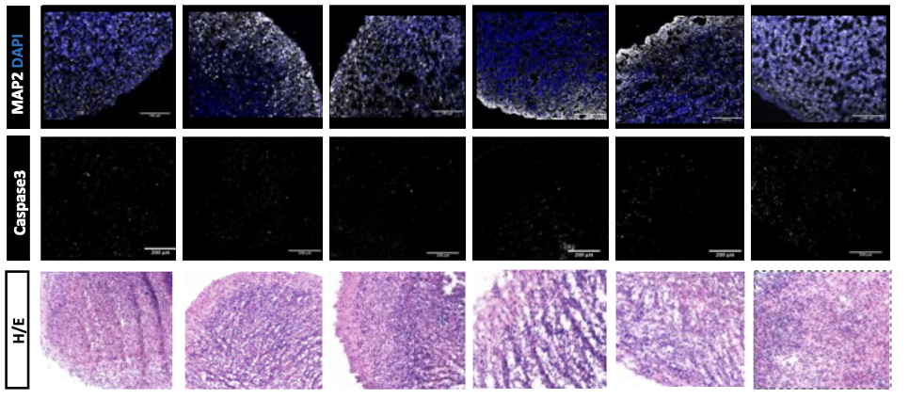
hBO do not show major differences upon treatments

Slide 16
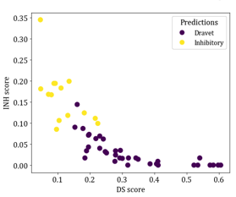
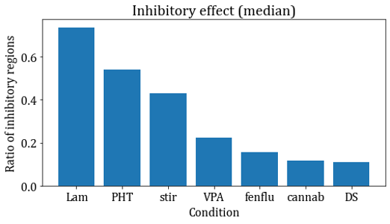
ImPheNet classifies upon toxicity

Slide 17
SUMMARY
VARIABILITY IS INTRINSIC OF THE hBO AT A CELLULAR, MORPHOLOGICAL AND NEURONA NETWORK LEVEL
DRAVET SYNDROME hBO MODEL THE CHANNELOPATHY
CELLULAR PHENOTYPING NEEDS INTEGRATIVE METHODS AND WHOLE ORGANOID ANALYSIS
ImPheNet HELPS PREDICTING PHENOTYPE AND DRUG TOXICITY IN hBOs

Slide 18

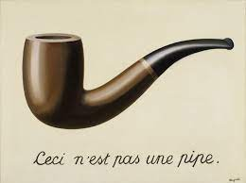
BRAIN ORGANOIDS AS A MODEL

Slide 19
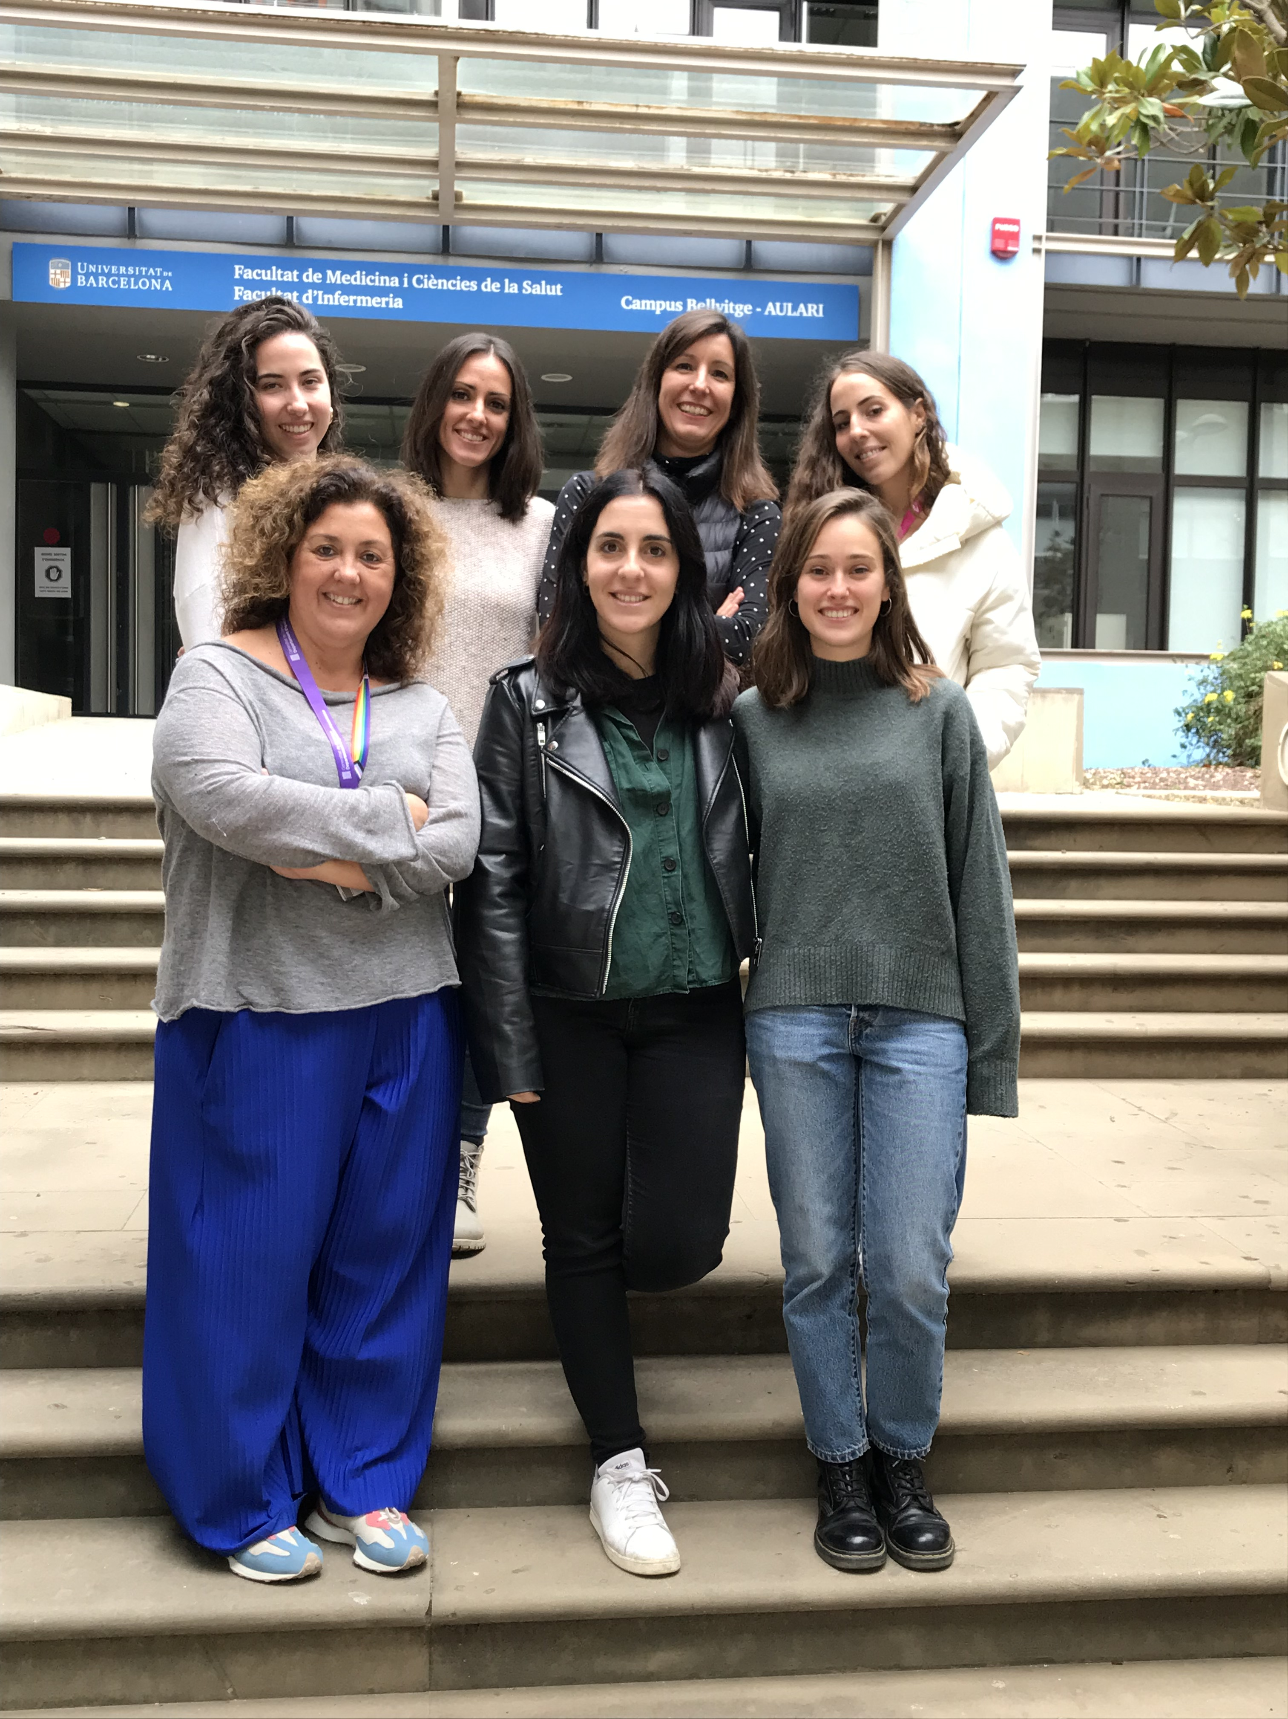
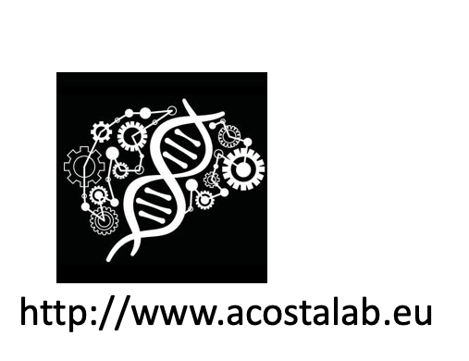


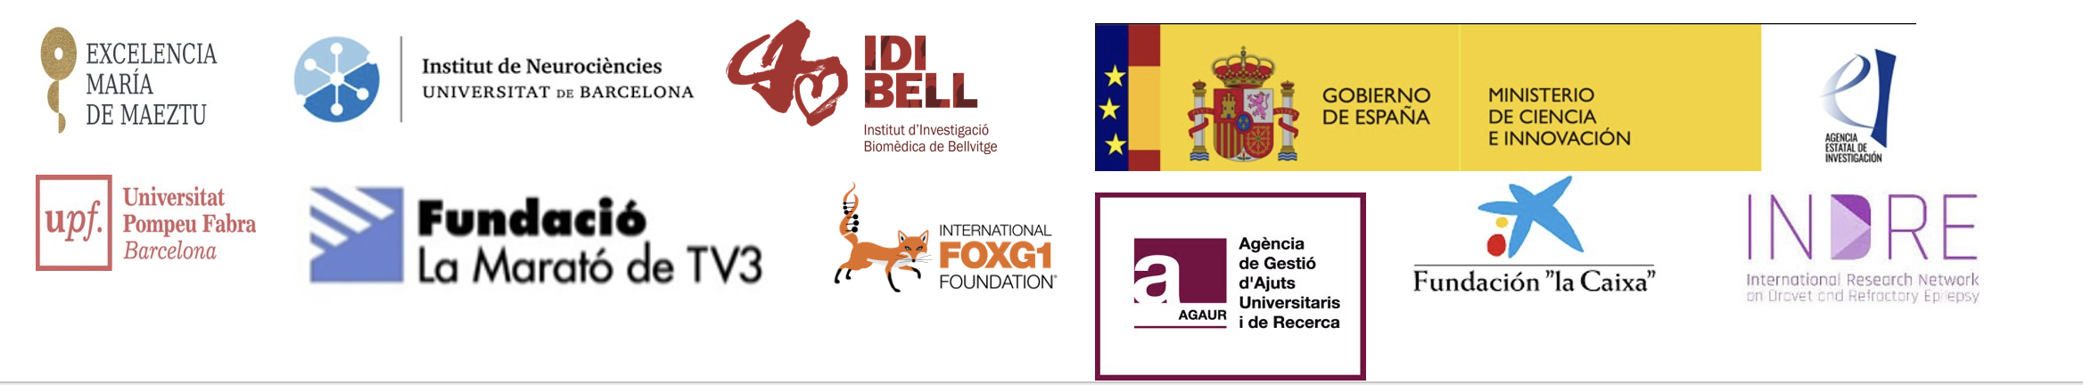
Collaborations
TEAM
Daniel Tornero, UB , Spain
Pablo Loza, ICFO, Spain
Arcadi Navarro, UPF/BBRC , Spain
Oscar Lao, IBE-CSIC, Spain
Stephanie Baulac, ICM, Paris
Luciano Fiore, CONEA, Argentina
Núria Ruiz, MD
Laura García, PhD
Isabel Turpín
Andrea Sarrias
Adriana Modrego
Ruth Pareja
Jan Arderiu
Aafke Kerkhof

Slide 20
