Slide 1


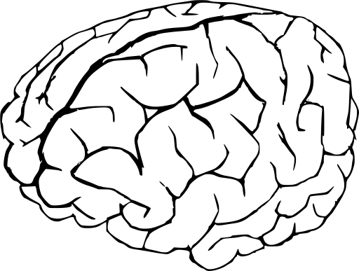

“Data Science i Machine Learning: una nova era per a la química computacional”
HΨ=ΕΨ
f=-dE/dx
III JORNADA DELS INSTITUTS DE RECERCA PROPIS DE LA UB
Albert Bruix (abruix@ub.edu)
Institut de Química Teòrica i Computacional
Deptartament de Ciència de Materials i Química Física

Slide 2


57 established researchers
60 PhD students and postdocs
~ 7176 processors
~ 105 TB RAM
~ 19k gigaFLOPS

Slide 3
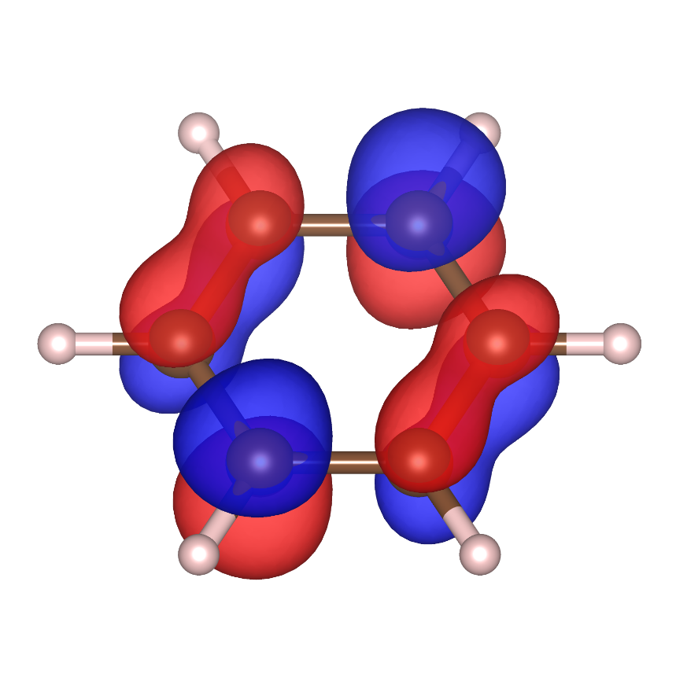
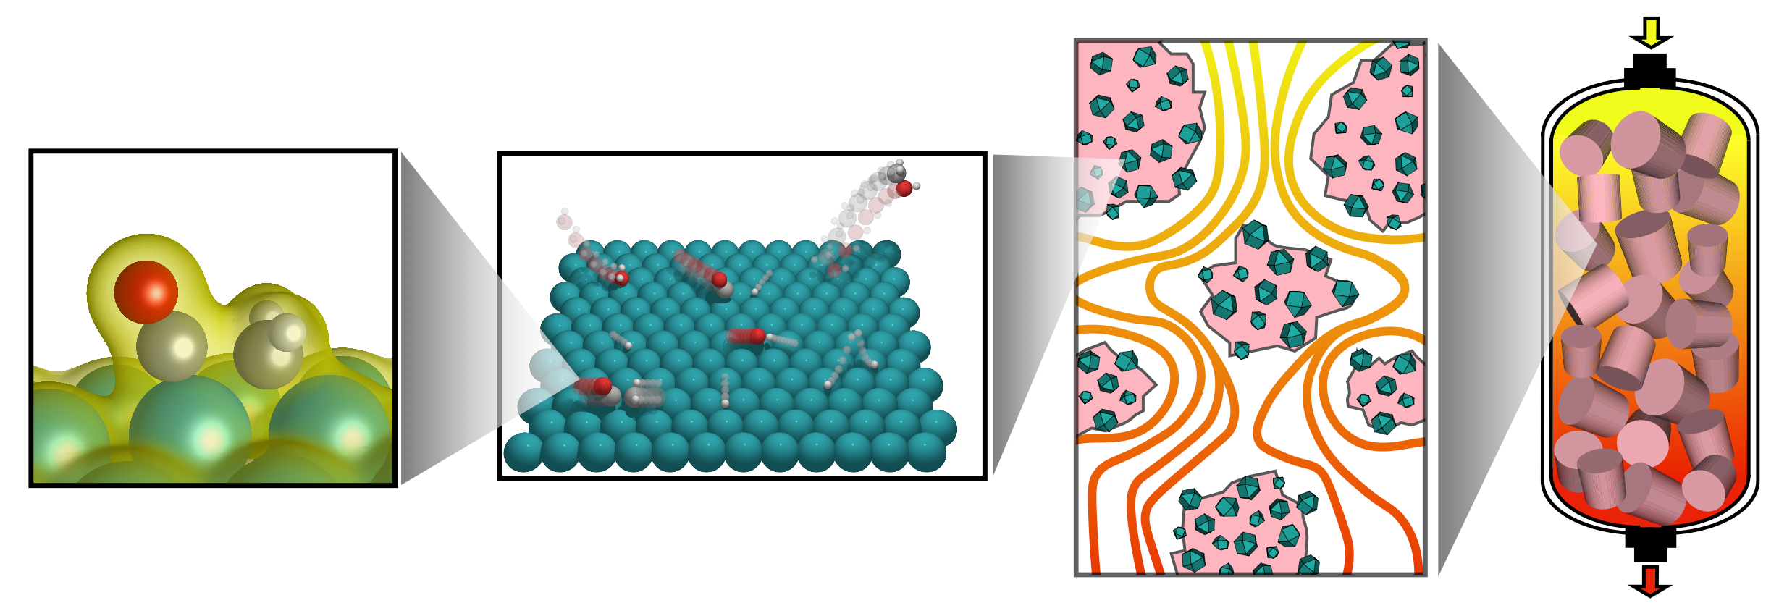
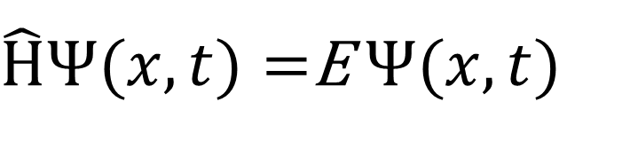
Theoretical and computational chemistry
Schrödinger Equation:
$\hat{H}Ψ(x,t)=$E $Ψ(x,t)$
Electronic structure calculations
Cost of approximations vs
number of electrons (N)
Configuration Interaction: N⁶ – N^{2m+2}
Coupled Cluster: N⁶ – N⁷
Møller-Plesset PT: N⁴ – N⁷
Hartree Fock: N⁴
Density Functional Theory: N³
COST & ACCURACY
Notes:
https://scicomp.stackexchange.com/questions/5515/how-does-density-functional-theory-scale-with-system-size

Slide 4
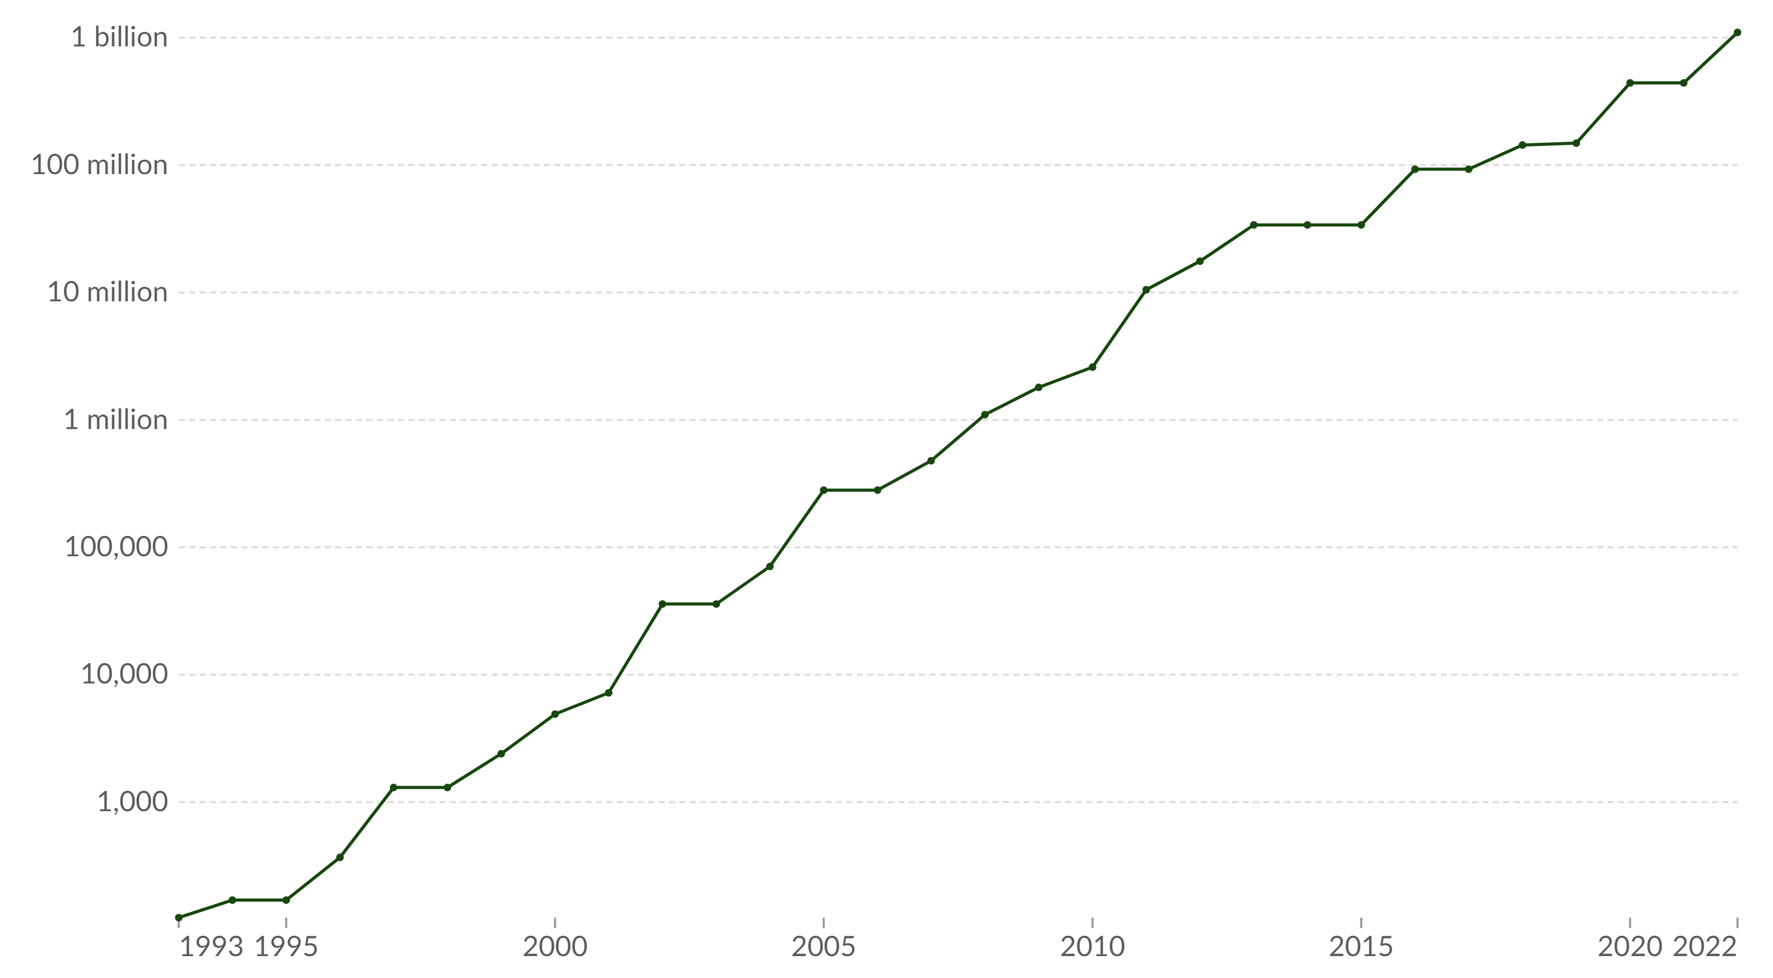
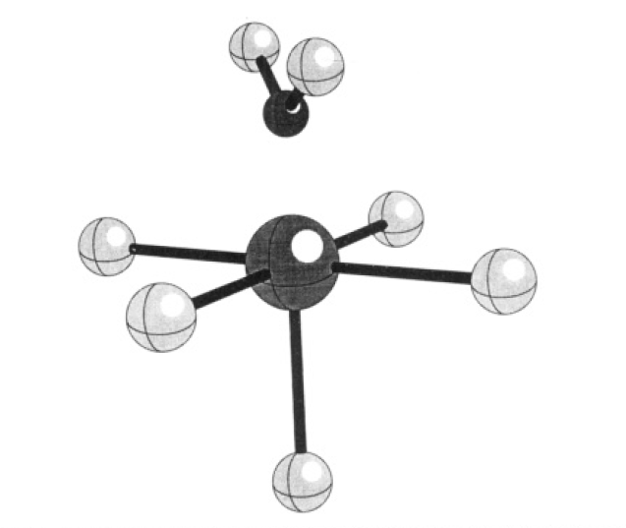
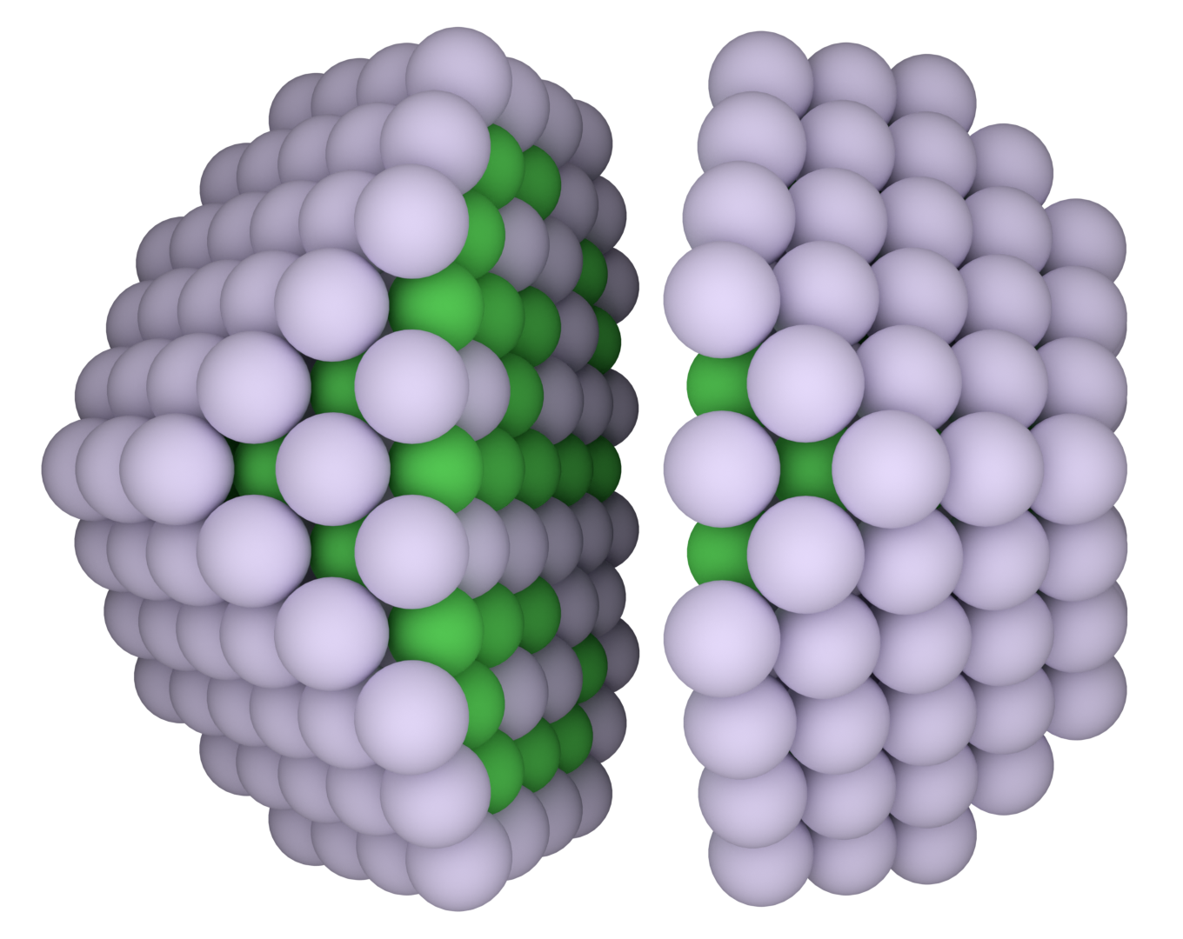

Capacity of fastest supercomputers (gigaFLOPS)
Pacchioni, Ricart, Illas
J. Am. Chem. Soc., 1994
Farris, Merinov, Bruix, Neyman
J. Chem. Phys., 2024
Source: ourworldindata.org

Slide 5
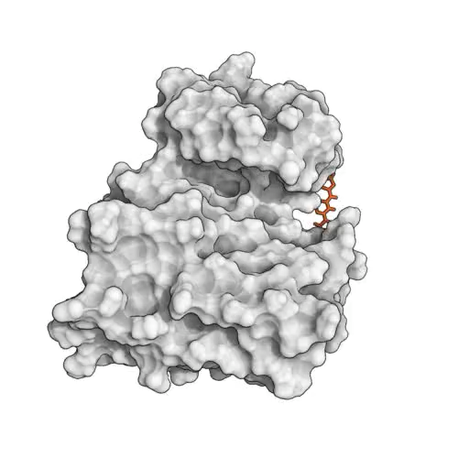
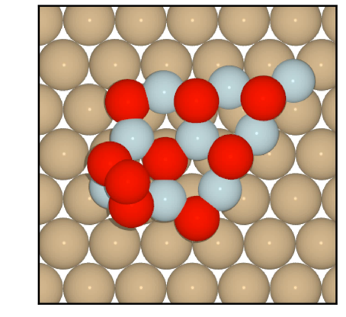

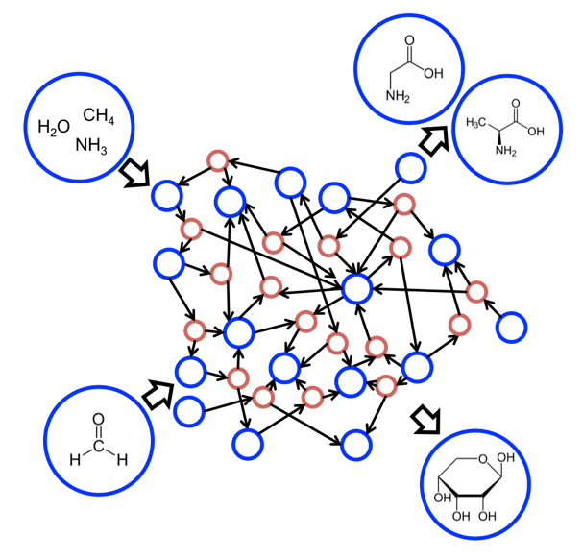

Some current challenges
Complex Networks in
Vast Chemical Spaces
Large- and long-scale molecular dynamics
Structure Prediction
Bruix, Margraf, Andersen, Reuter, Nature Catalysis, 2019
Shaw group, JACS, 2011
Reichenbach ,…, Bruix, JPCC, 2019

Slide 6
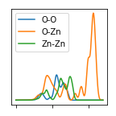
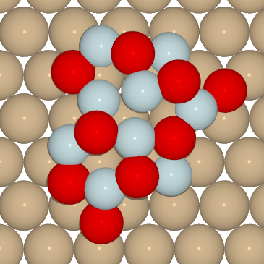


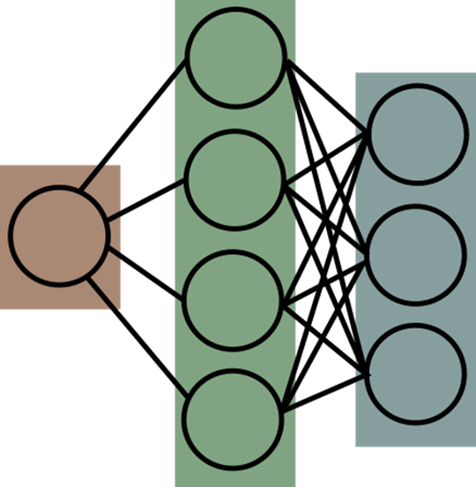


Atomistic machine learning potentials/force fields
Structure
Representations
Databases from high-throughput
User-contributed data repositories
HΨ=ΕΨ
f=-dE/dx
Property
Learning model

Slide 7
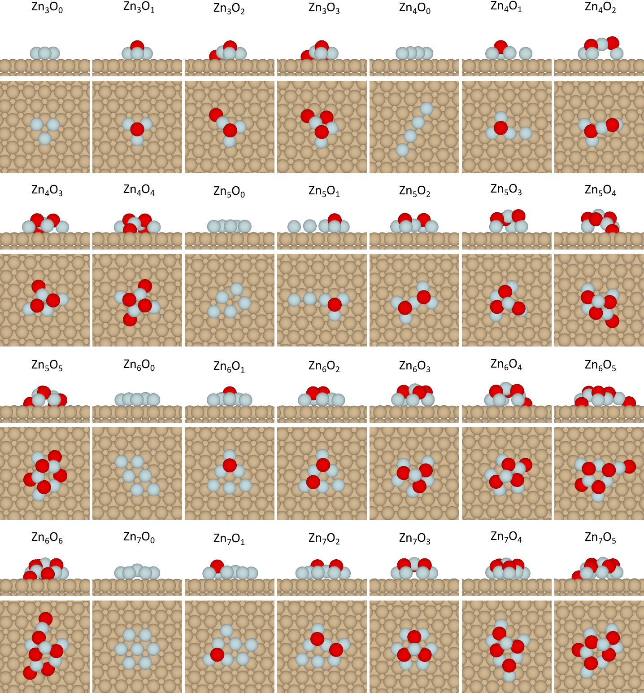
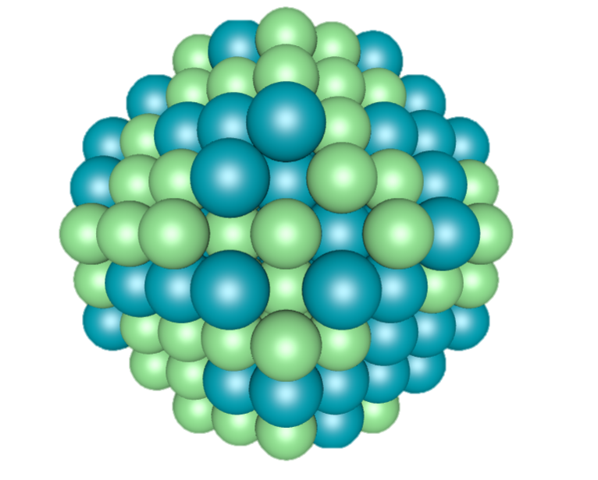
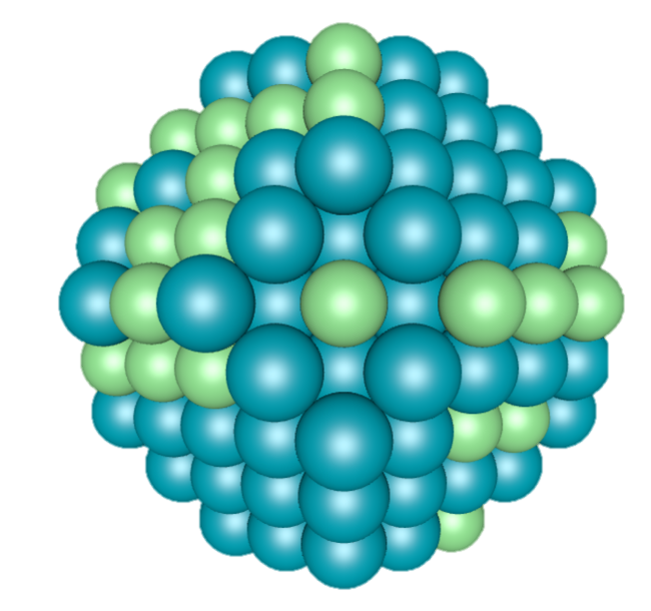
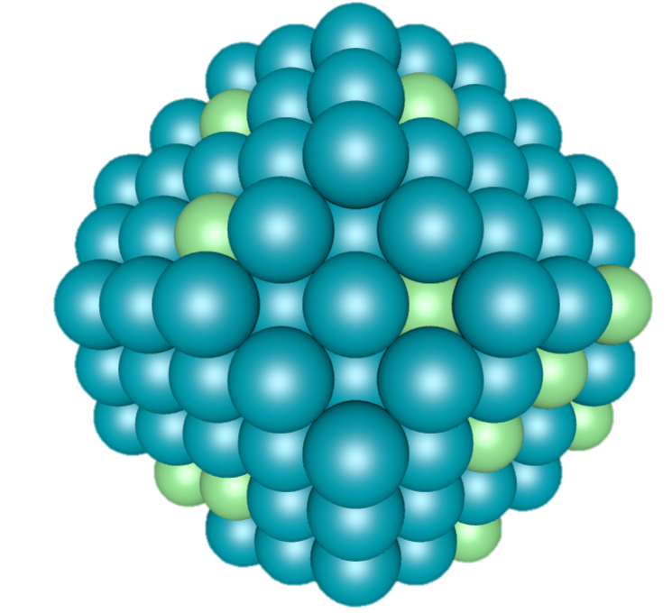
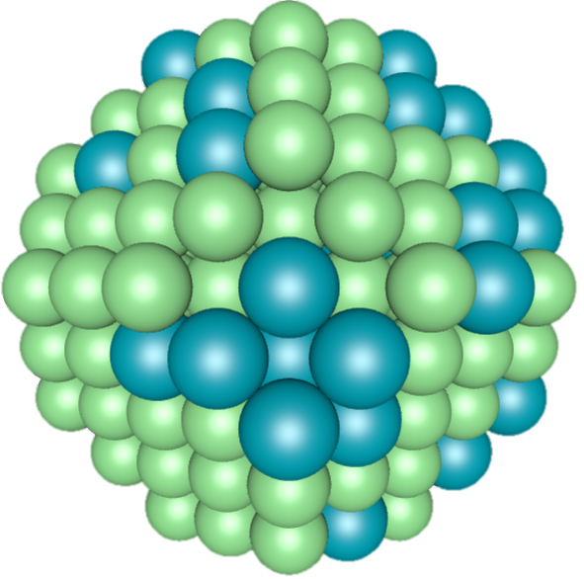
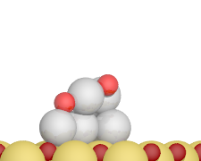
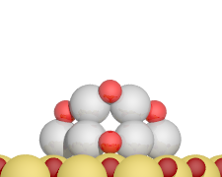
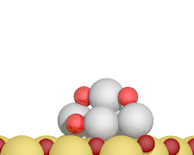
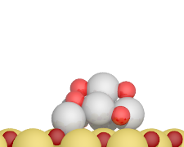
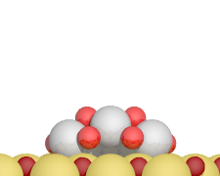
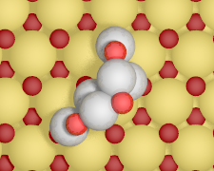
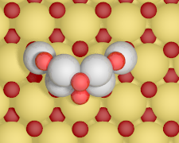
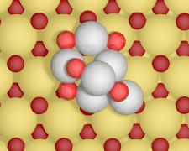
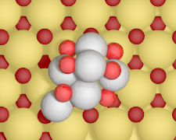
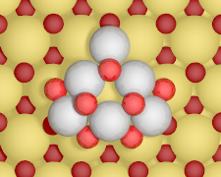
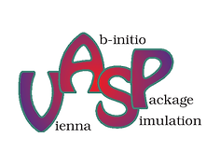
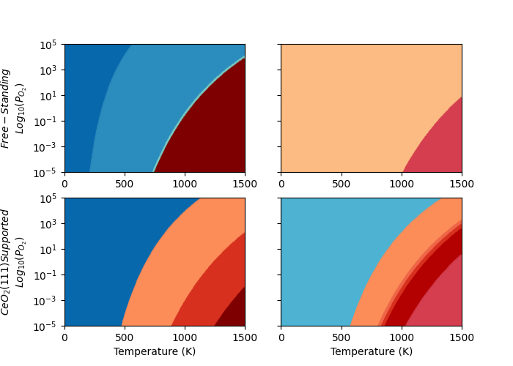
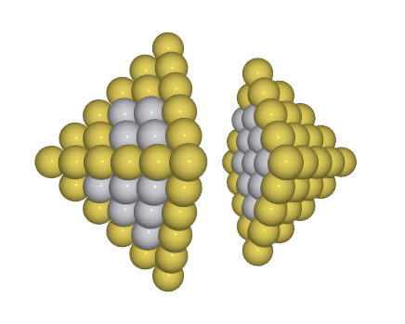

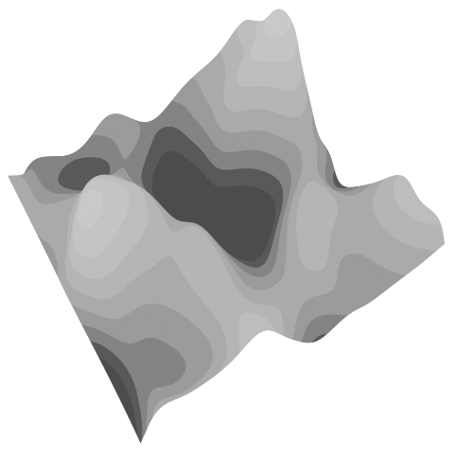
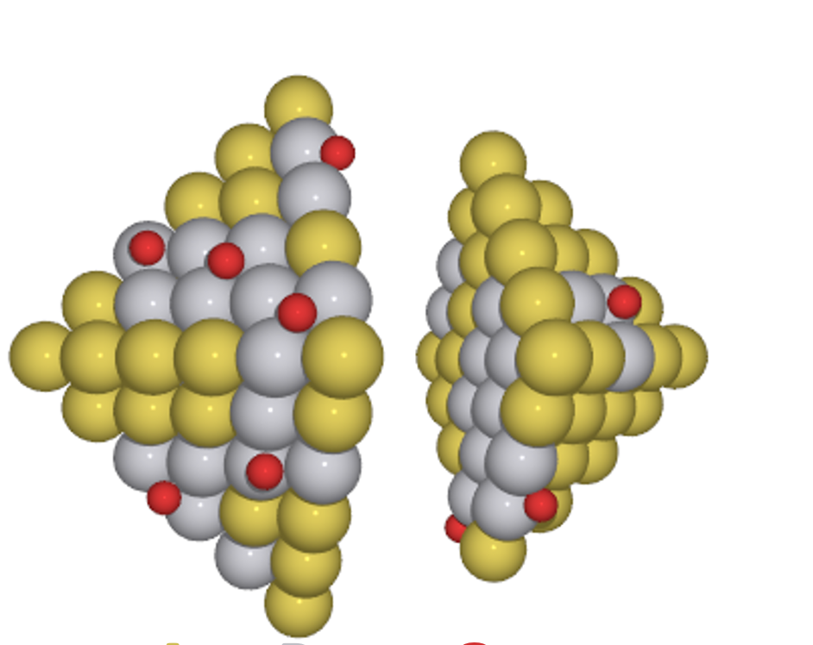

Prediction of structure and state of catalysts under reaction conditions
Database
Descriptors
$$\{N_{1}^{desc},$$
$$N_{2}^{desc},$$
$$…,$$
$$N_{N}^{desc}\}$$
ZnO_{x}@Cu
Energy Calculators
Training
PtO_{x}@CeO₂
EMT
Pt₆O₉
Pt₆O₆
Global Optimization
Pt₆O₂
O_{n}@PtAu
p(O₂) (atm)
Monte Carlo
Genetic Algorithm
Optimal Exchange
Basin Hopping
Pt₆O₀
github.com/reac-nps
Farris, Quinlivan, Neyman, Bruix, 2020-2024
Notes:
It should be clear by now from the examples I have given that it is very importnat to consider how a material responds to reaction conditions, since different stable states may be relevant. But it turns out that in many cases these materials are not just transformed to a new, more stable, state, but are instead continuosuly changing.
The finding of such dynamic behavior is actually not that new: the seminal work of Ertlin the 90s already showed this for oxidation reactions on transition metal surfaces, and it has recently also been seen in metal nanoparticles.
This makes things quite complicated, because it completely shatters the text-book static view of catalysis involving relatively rigid solid surfaces and means that improving our understanding of the catalytic process requires a conceptual (and computational modeling) framework that considers the catalyst substrate as a dynamic entity.

Slide 8
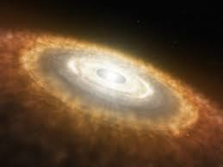
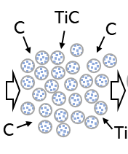
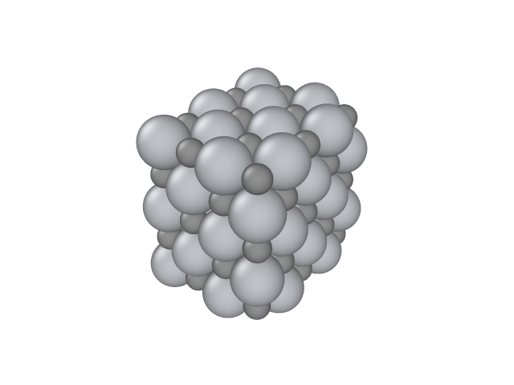
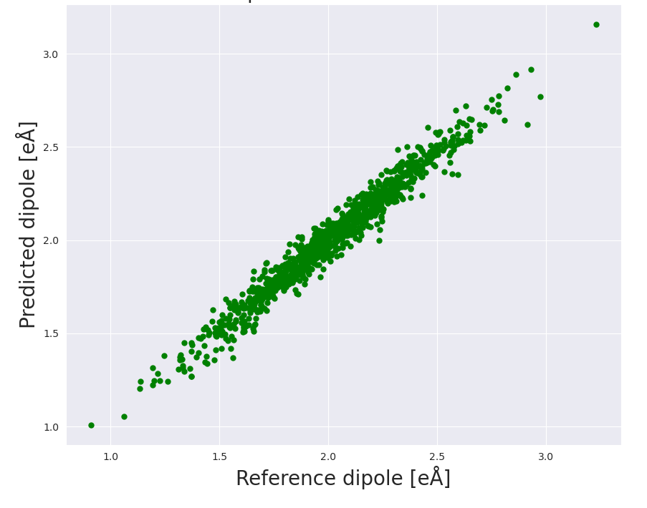
Rationalizing formation of cosmic dust with ML potentials
Carbon-based dust around dying stars
High-temperature dynamics with ML
100 atom TiC nanoparticle at 1500 K
Predicted vs calculated dipoles
Astronomical observation
G. von Helden, et al.
Science 288, 313 (2000)
Ti₃₂C₃₂
Cluster beam experiment
Fabila, Bromley, 2023
Notes:
Assignment of observed IR peak to TiC nanoparticles very controversial!
Accurate and objective atomic scale confirmation needed
High temperature IR spectra of TiC nanoparticles very expensive for electronic structure modelling…
Particles modelled as graphs: atoms → nodes, bonds → edges
Element types embedded into neural networks layers
Positional representation obtained from chemical environment and passed through a neural network
Graph transformer applied to embeddings for a high dimensional representation (a vector in latent space)
Readout function samples latent space to predict desired property (e.g. dipoles)

Slide 9
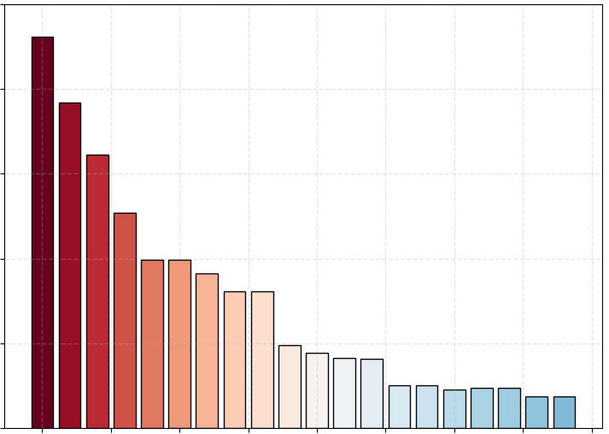
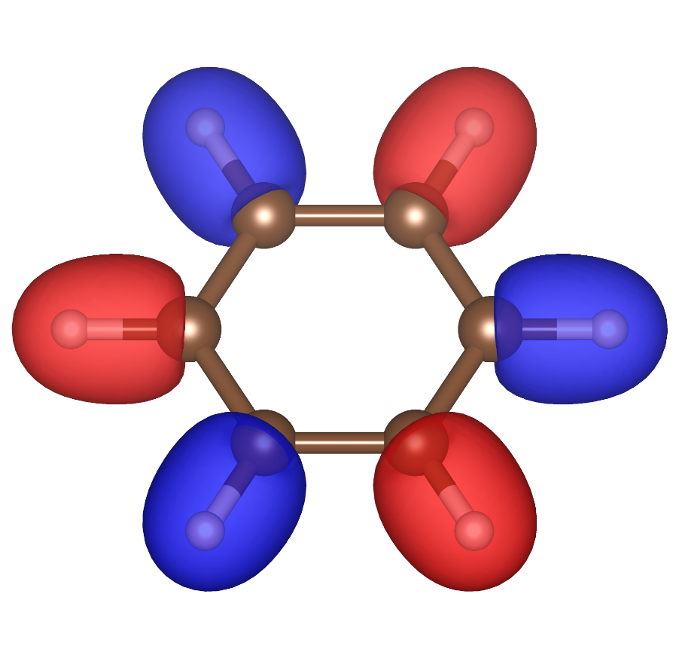
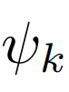
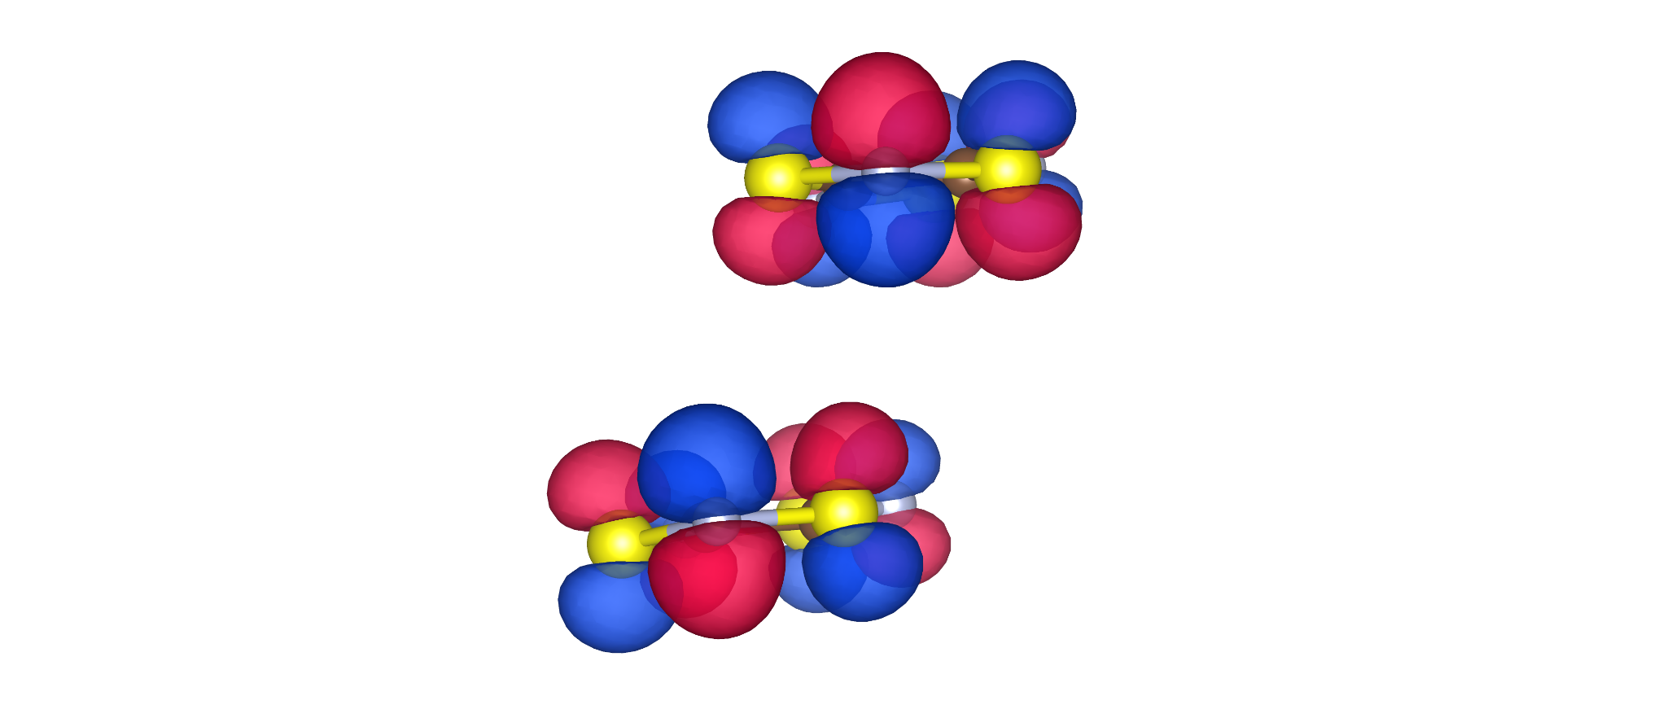
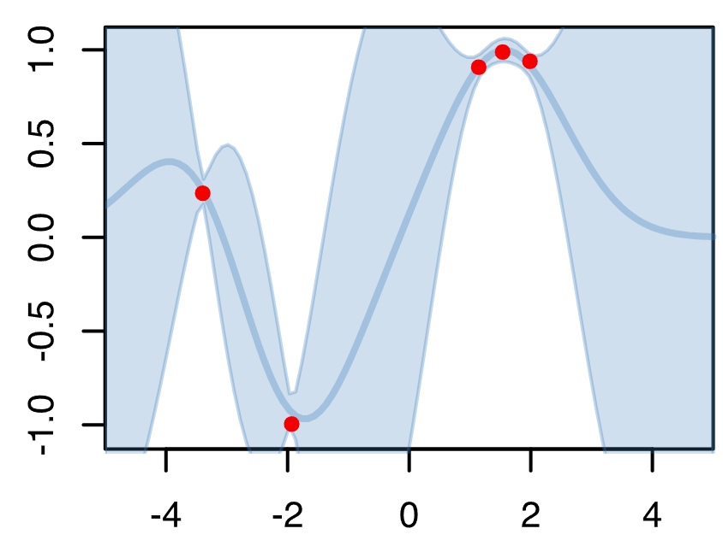
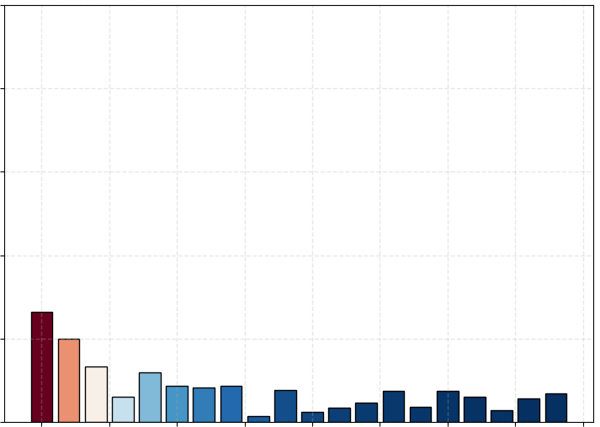
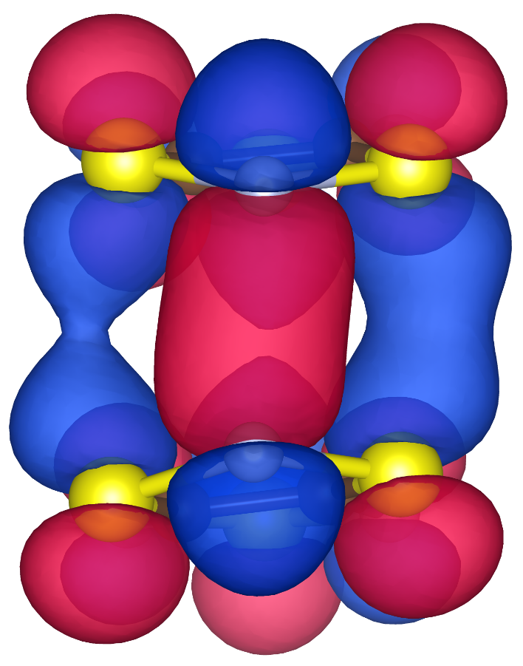
Development of new representations for electronic structure phenomena
Interacting molecules
Quantum-informed representations
MODA: Molecular Orbital Decomposition and Aggregation
MODA (Quantum-Informed)
100
80
High covariance
Good performance
Decomposition
60
…
Covariance Cov(J_{AB},ρ)
Aggregation
40
Sorting
20
0
Bag of Bonds (Classical)
100
A
80
Low covariance
Poor performance
d_{AB}
d_{AB}
y
60
B
Covariance Cov(J_{AB},ρ)
40
Intermolecular spin- exchange coupling , J_{AB}
20
x
0
Property
Learning model: Kernel-Ridge Regression
Santiago, Vela, Deumal, Ribas, Digital Discovery, 2024

Slide 10
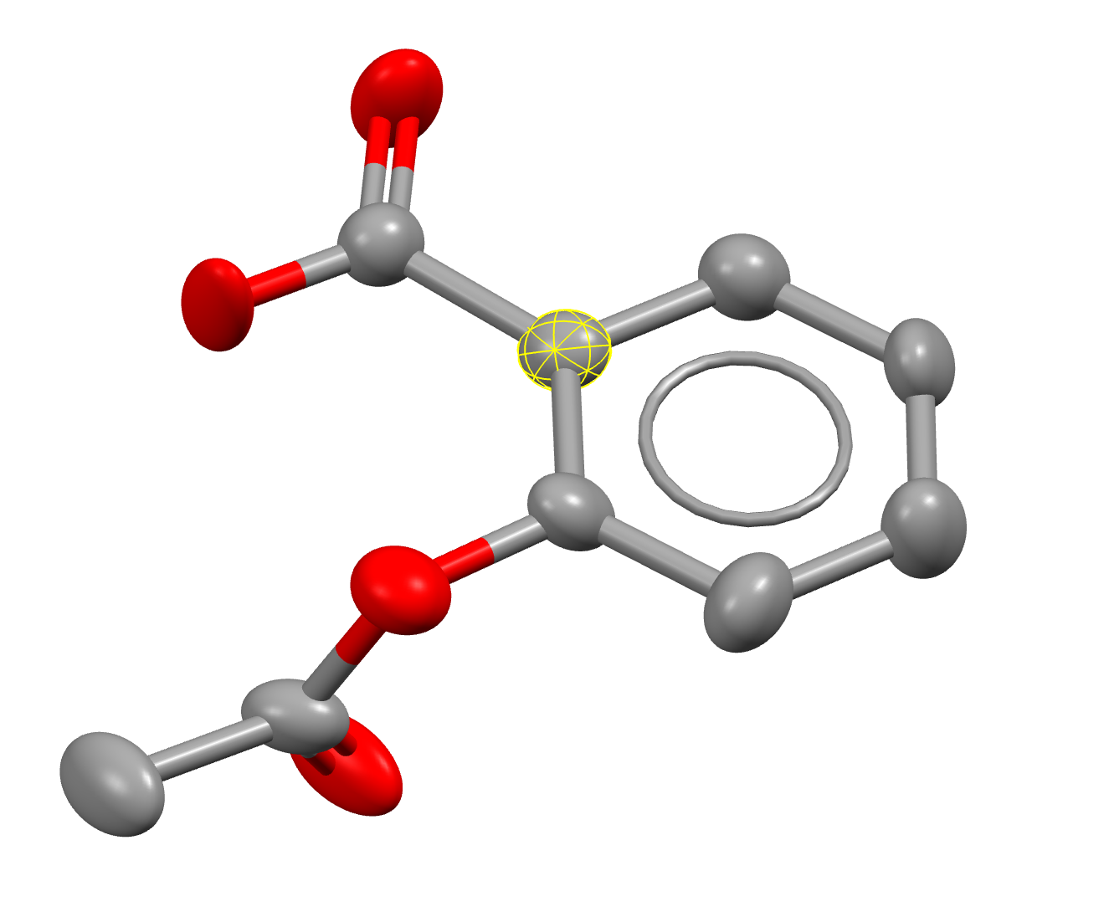
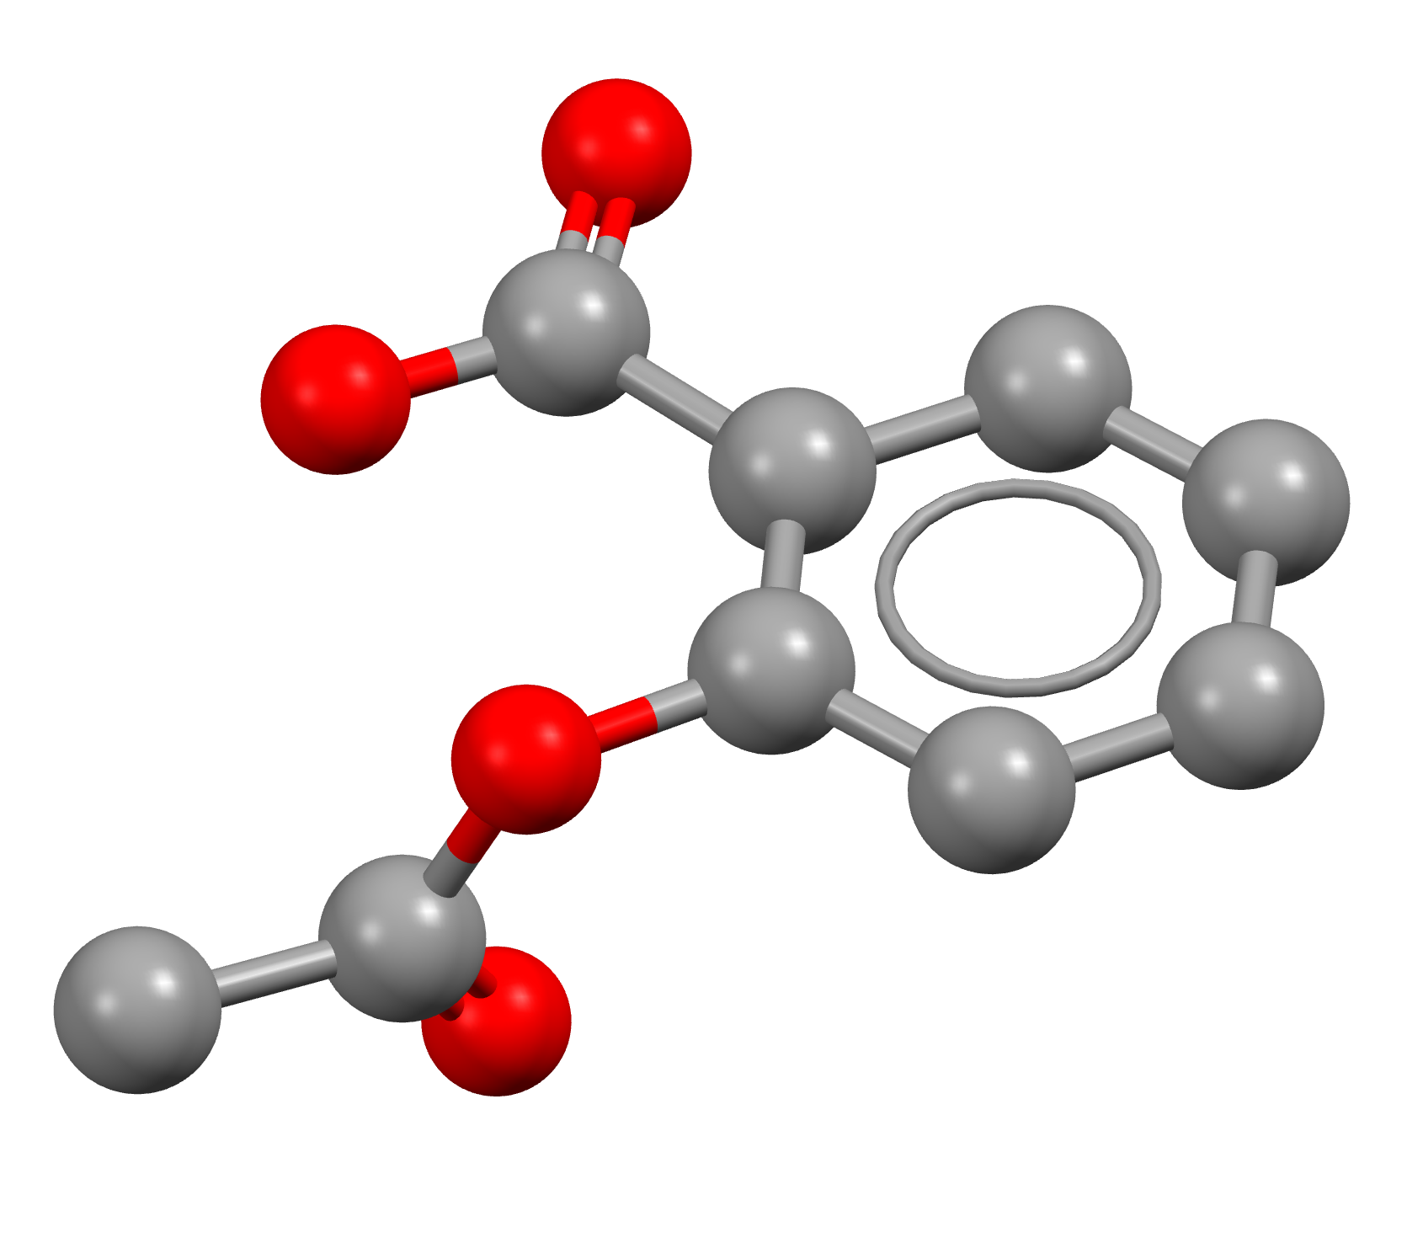

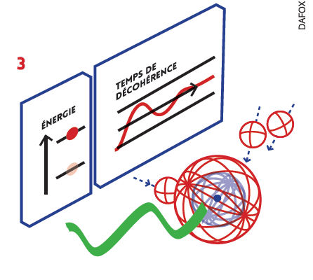
Prediction of physical properties for molecular crystals and qubits
Cambridge Database
350.000 Molecules
Molecular Crystal Thermal Ellipsoids
Graph Neural Networks
Qubit Coherence Time
QUANTUMMADESIMPLE.COM
[V(C₈S₈)₃]²⁻
Electronic Structure Group
Silvia Gómez-Coca, Joan Cardona, Àlex Solé, Eliseo Ruiz
UPC Group
Javier Ruiz, Àlex Solé
USACH (Chile)
Daniel Aravena
Notes:
We use graph neural networks to predict experimental properties from molecules that apply to quantum computing. For example, we are trying to predict the coherence time of the qubit, which is critical in quantum computing, as it determines how long quantum information can be reliably stored and processed before it collapses. In addition, we pretend to extend our model to other tasks, such as thermal ellipsoid prediction that can be understood as an atom vibration measurement. Thermal ellipsoids can be used as a pretraining of the model or can be expanded to other vibration related tasks, for instance the enthalpy of sublimation.

Slide 11
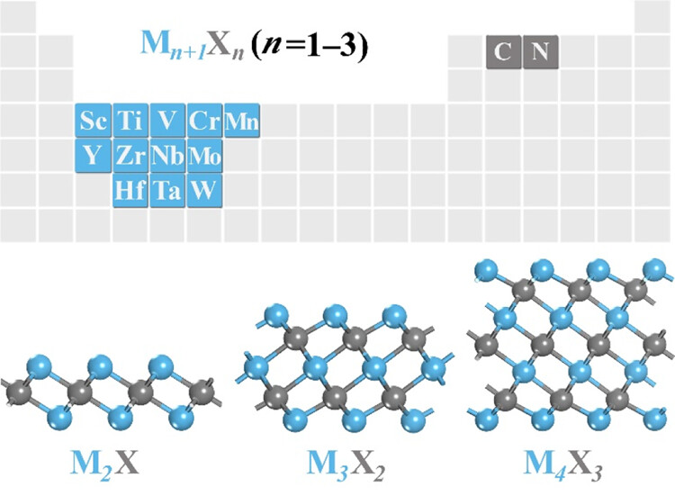
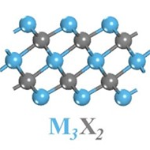



ML-Driven Discovery of Key Descriptors for CO₂ Activation
Surfaces
Descriptors:
Surface properties
CO₂ adsorption energy:
E_{ads}(CO₂)
Property
Learning model: Random Forest
Moses Abraham, Piqué, Aamir Khan, Viñes, Illas, Singh, ACS Appl. Mater. Interfaces, 2023
Notes:
The fundamental goal of the this study is to develop and understand ML models for activated CO₂ adsorption on MXenes, which can be quantitatively implemented for the predictive analysis in drawing useful information into the process of CO₂ posterior conversion. The data required to nurture the developed ML tools were collected from our previous literature on Mxenes for CO₂ capture.
Various ML models are developed to screen over 114 pure and defective Mxenes, where the random forest regressor(RFR) ML scheme exhibits the best predictive performance for the CO₂ adsorption energy, with a mean absolute error of 0.16 and 0.42 eV for training and test data sets, respectively.
Feature importance analysis revealed d-band center (ε_{d}), and surface metal electronegativity(χ_{M}) as key descriptors for CO₂ activation.

Slide 12


Take-home message: Computation + data + machine-learning
HΨ=ΕΨ
Property
f=-dE/dx
Higher complexity, larger length and longer time scales
Bruix, Margraf, Andersen, Reuter, Nature Catalysis, 2019

Slide 13











Acknowledgements
Konstantin Neyman, Jon Quinlivan, Lorena Vega, Albert Bruix, Riccardo Farris. Pablo Castro Latorre, Andreu de Donato

