Slide 1
ICECAL65 Status
Alberto López Barcelona University
LHCb PicoCal Electronics meeting
19 March 2024

Slide 2
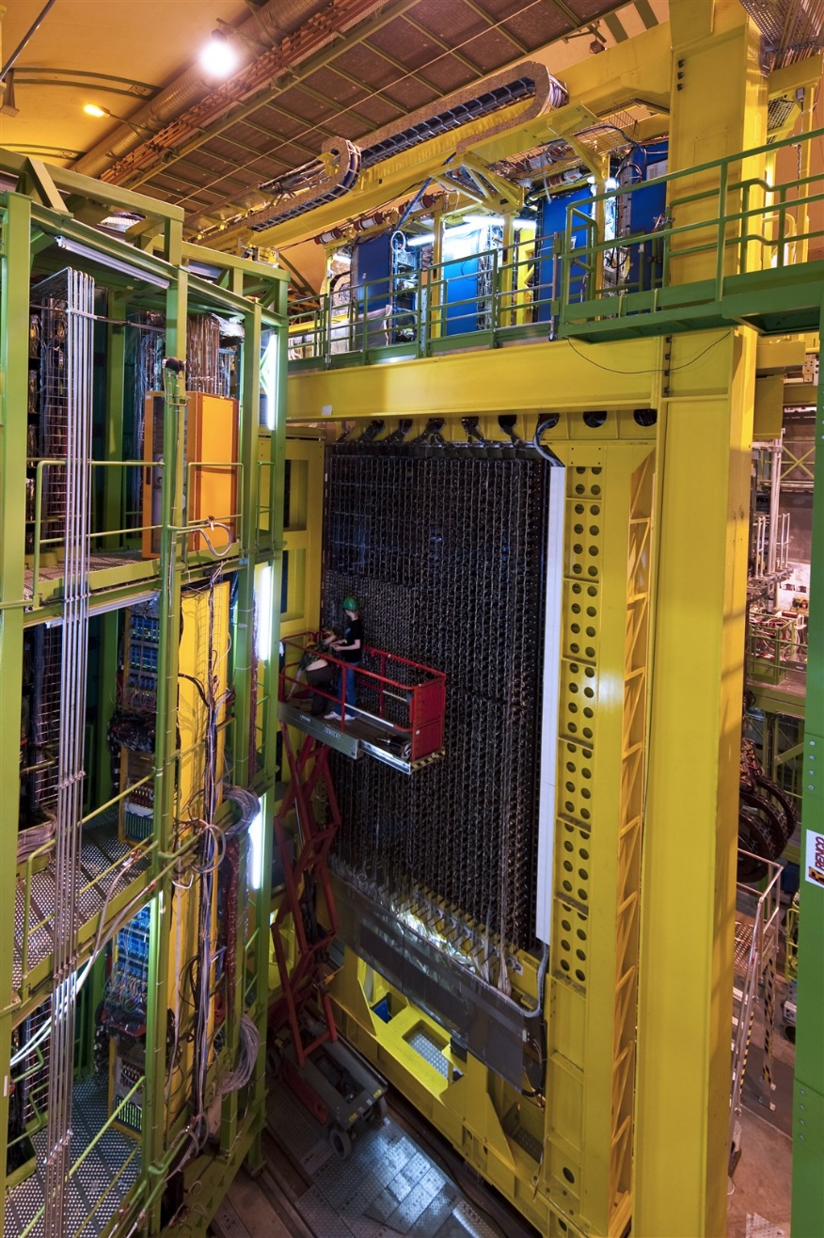
1. Introduction 1.1. Readout electronics architecture
Front-End ASIC
Energy ASIC
ADC
Digital Back-End
Detector cells
Optical Link
FPGA
GBT
FRONT-END CRATES
?
50Ω
I
?
12-20m cable
PMT
Time ASIC
opamp
Front End Board
ECAL
Photodetectors readout solution follows the same scheme as in current ECAL:
Minimal light transport with PMT sensors near modules
Electronics in crates on top of the detector (reduced radiation)
Connection via analog link (coaxial) up to 20m considered
ASIC/chipset in TSMC 65nm with separate energy and timing processing paths
Amplifier + Shaper circuit included on the PMT base or FEB to compensate cable attenuation, improve SNR, if necessary, and reduce spill-over effort (IFIC)
Energy ASIC (ICECAL65) designed by IFIC, UPC and UB
Timing ASIC (SPIDER) designed by IJC Lab, LPC
FEB designed by IJC Lab

Slide 3
1. Introduction. 1.2. Energy ASIC
Detector cells
PMT
Pre-amp
Filter
Integrator
Track- and-Hold
Multiplexer
CHANNEL OUTPUT
50Ω
PZ
ʃ
TH
ADC driver
I
Drv
11b ADC
12b ADC
12b ADC
Different lengthes
12b ADC
50Ω
PZ
ʃ
TH
x4
MEM
Integrator clock
Track-and-Hold clock
ADC clock
Clock Input
DLL
Front End Board
Initial approach: assume similar specifications as ICECAL (U-I)
Time-interleaved double channel scheme for integrator recovery
Pedestal subtraction from previous event
Data transmission at 40MHz, continuous readout with no deadtime
Dynamic range 1V with two-gain system and 11bit resolution for optimal SNR → noise/1LSB at ~500μV (optimistic)
Fully differential to improve noise rejection
Internal digitization is not a requirement but could be considered for future versions

Slide 4
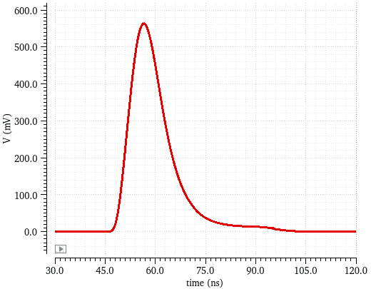
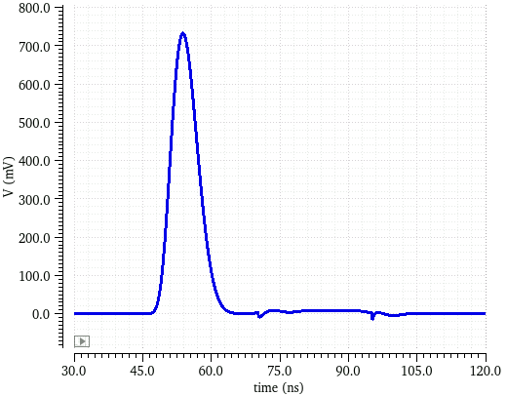
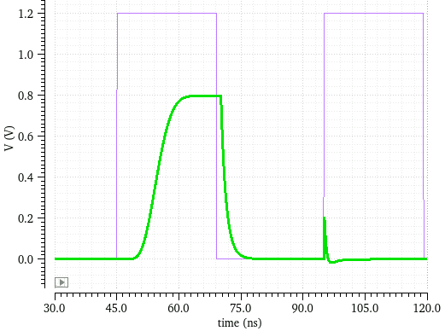
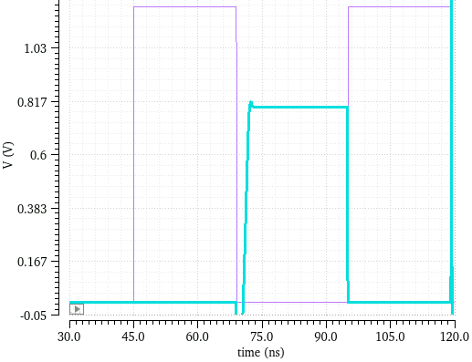
1. Introduction. 1.2. Energy ASIC: Analog processing chain
Detector cells
CHANNEL OUTPUT
Analog blocks based on FDOA
4:1 MUX (1 channel, 40MHz)
Output buffer needed to cope with IO+pack+ADC parasitics
Need to calibrate clk phase with < 1ns resolution
A preliminary DLL based on a VCDL has been designed
VCDL 32 stages (~780 ps)
Delay control with varactors
PMT
Pre-amp
Filter
Integrator
Track- and-Hold
Multiplexer
50Ω
PZ
ʃ
TH
ADC driver
I
Drv
11b ADC
12b ADC
12b ADC
Different lengthes
12b ADC
50Ω
PZ
ʃ
TH
x4
MEM
Integrator clock
Track-and-Hold clock
ADC clock
Clock Input
DLL
Front End Board
PREAMP
PZ FILTER
INTEGRATOR
TH
25 ns
PZ shaper filter
≠ shape signals (techno, cable and PMT)
Adjustable RC
Integrator
Gain adjust
Variable capacitor
Flip-around T&H
Precision for 11 bits
Bottom plate sampling technique
3 non-overlapped 20MHz clocks

Slide 5
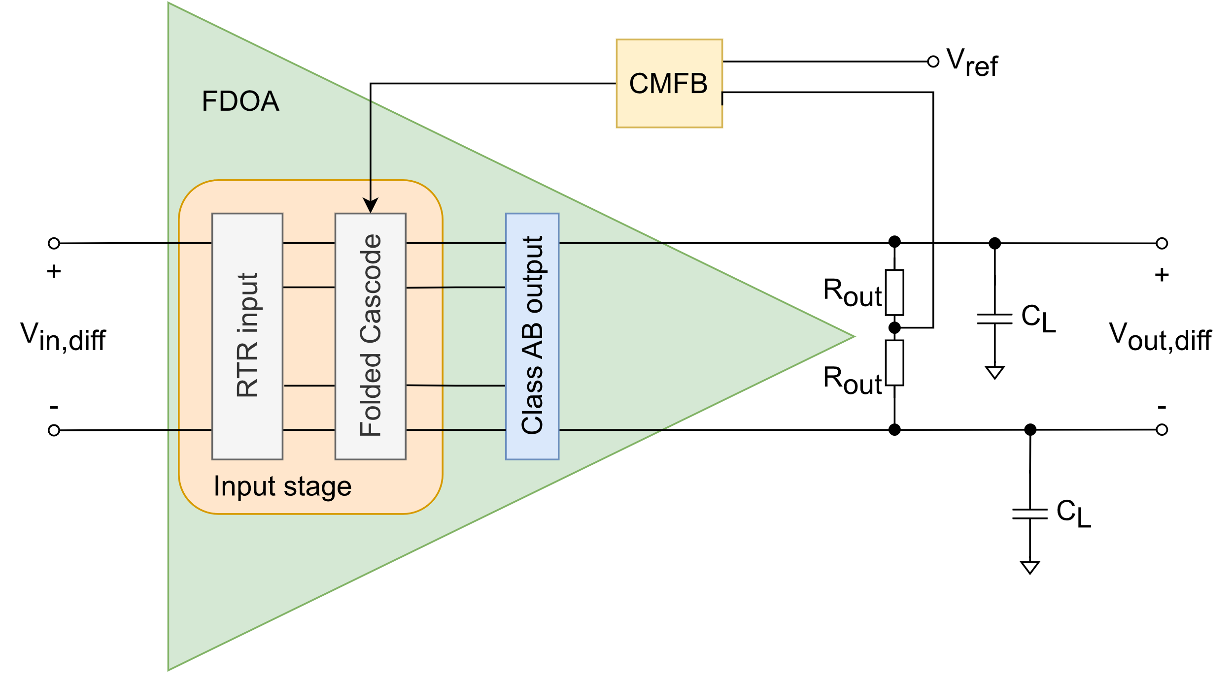
1. Introduction. 1.3. Fully differential operational amplifier (FDOA)
Development of a Rail-to-rail fully differential OTA in TSMC 65 nm technology to be used
The OTA must achieved the following specifications:
TSMC 65nm technology
Fully differential
Rail-to-Rail (0-1.2 V)
Low frequency gain > 70 dB
GBW > 500 MHz
PM > 65º
SR > 0.5 V/ns
VCM ~0.6V
Power optimization

Slide 6
1. Introduction. 1.3. Fully differential operational amplifier (FDOA)
Common mode feedback
Use of average resistors and a moderate gain amplifier
Rail-to-rail input to use the maximum voltage range
Challenge of RTR input stages is to achieve constant g_{m} across the CM range.
Folded cascode for high gain
Gain-boosting technique included in the cascode
Class AB output stage
Ensure rail-to-rail swing at the output

Slide 7
FDOA Architecture
Alberto López Barcelona University
LHCb PicoCal Electronics meeting
19 March 2024

Slide 8
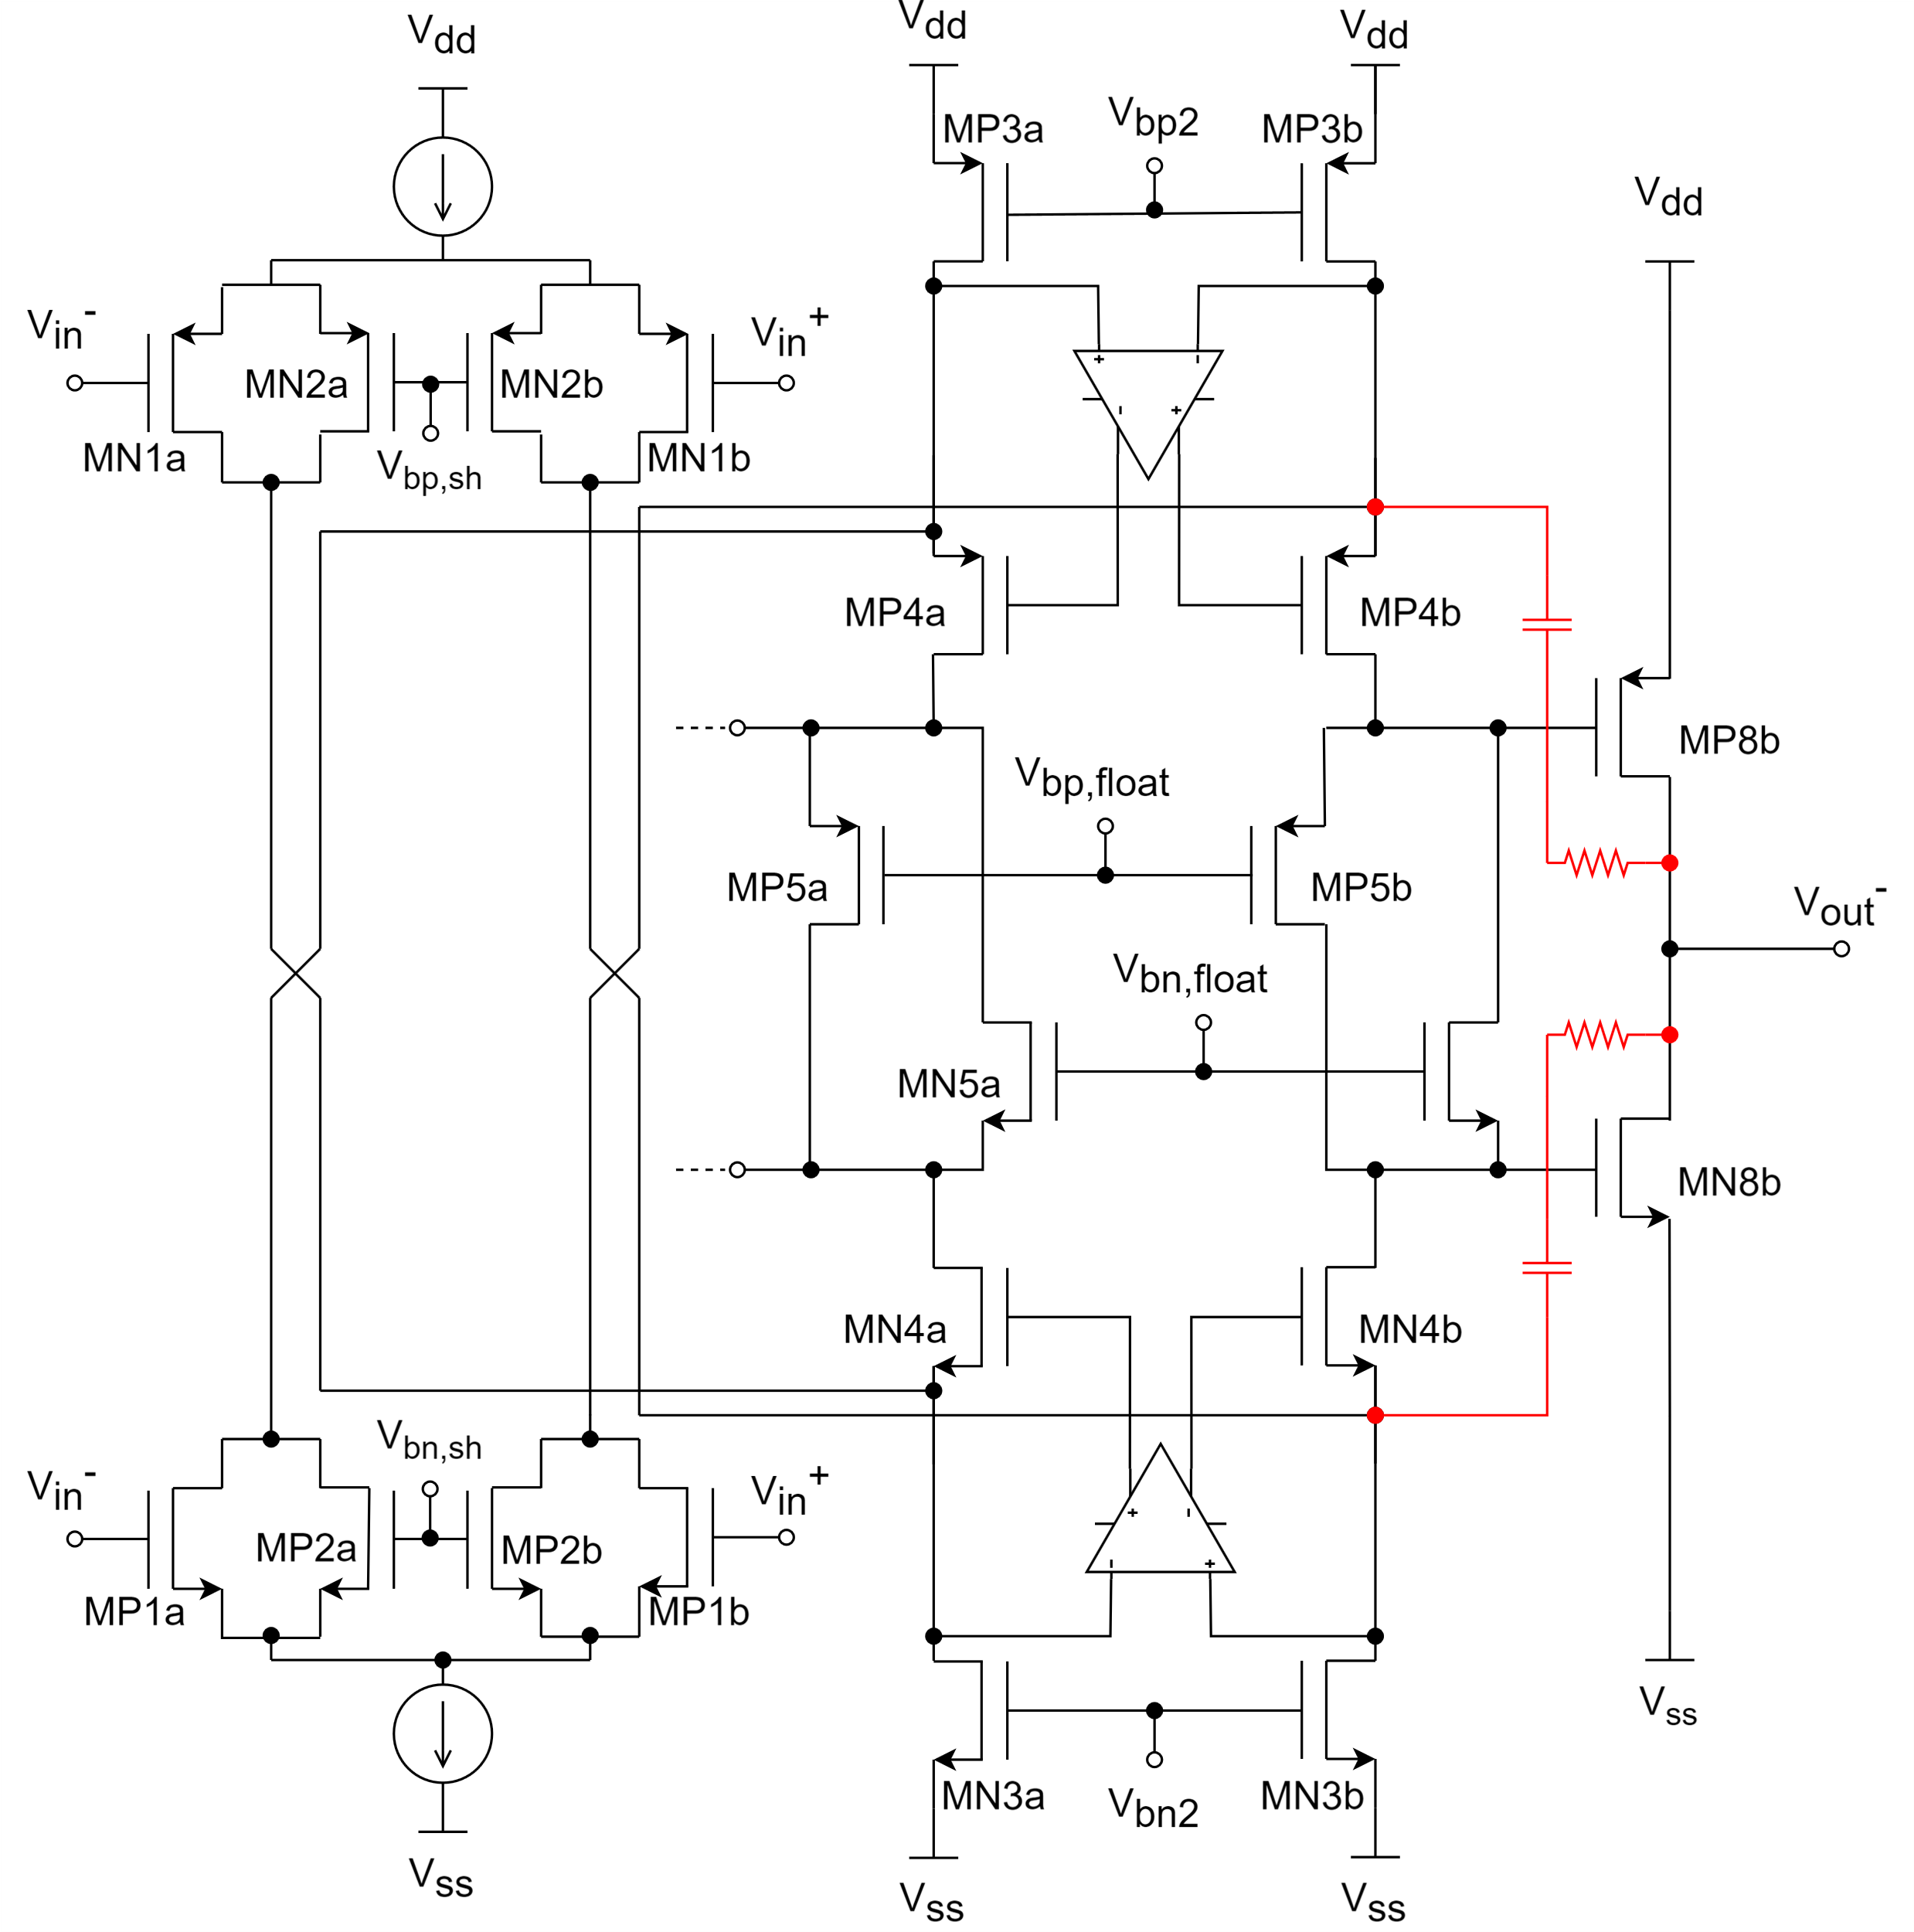
2. FDOA architecture 2.1. Detailed FDOA architecture design
Detailed design (transistor level)
Rail-to-rail input stage equalized by means of two shifter transistors.
Folded cascode loading the input stage for high gain.
Two fully-differential amplifiers regulating the cascode for gain-boosting porpuses.
Class AB output to keep the rail-to-rail at the OTA’s output.
Floating transistors included in the cascode to control the DC voltage shift that bias the class AB output transistors.
V_{bn2} generated by the CMFB to stabilize the DC output level at 600 mV (máximum dynamic range).

Slide 9
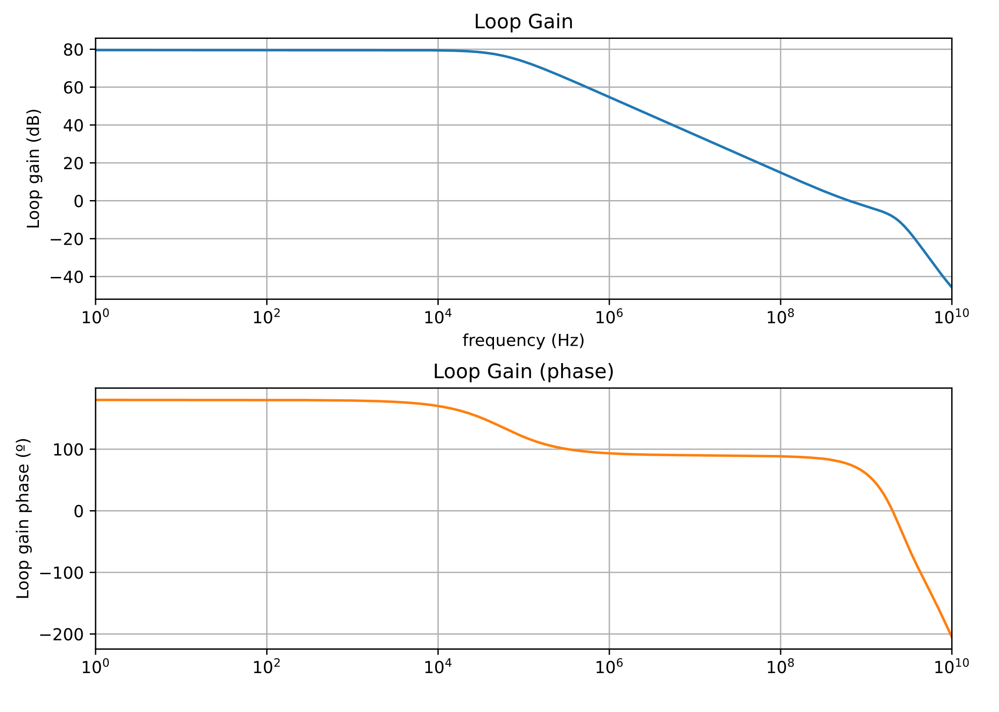
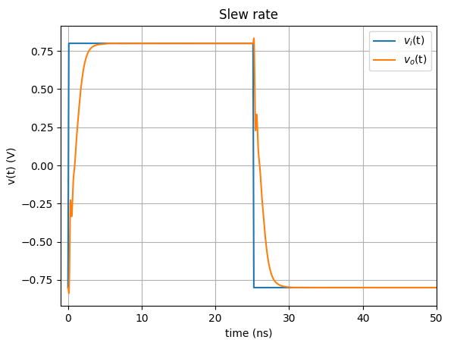
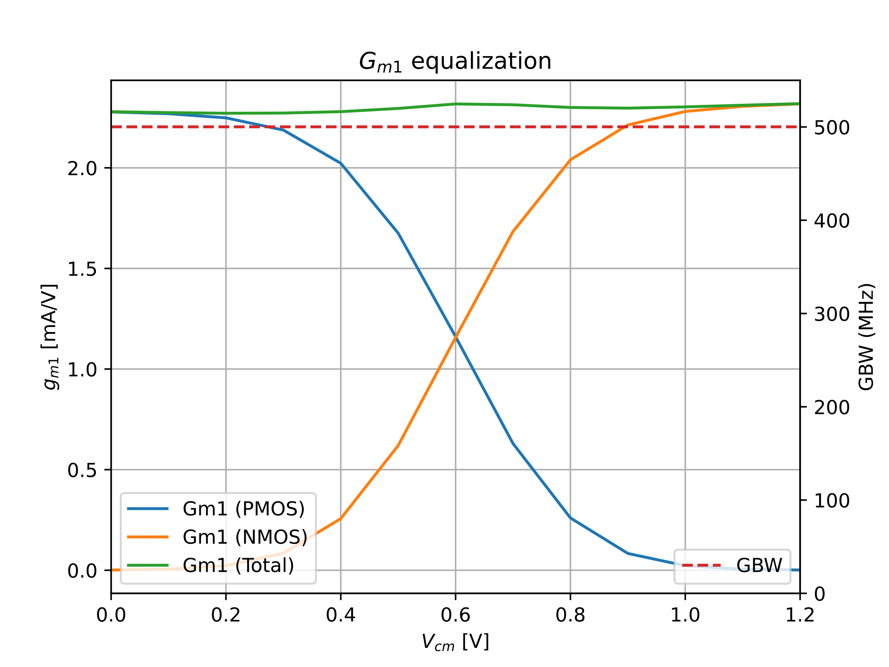
2. FDOA architecture 2.2. Pre-layout results
With latest improvements in the CMFB, gain-boosting amplifiers and compensation networks, the simulations report the results shown in the table below.
All the results above the specification with some margin for tunning if needed.
Acceptable power consumption
Proper stabilization of the DC output voltage to 601 mV
Input transconductance constant along the V_{cm} range with low error → Constant GBW
Test | Result
Av0 | 79.79 dB
GBW | 526.1 MHz
Phase margin | 77.19 º
Phase margin frequency | 644 MHz
Gain margin | 7.563 dB
Gain margin frequency | 1.964 GHz
Slew rate (rise) | 693.1 V/us
Slew rate (fall) | -693.4 V/us
Power | 3.081 mW

Slide 10
ICECAL65 Analog Processing Chain
Alberto López Barcelona University
LHCb PicoCal Electronics meeting
19 March 2024

Slide 11
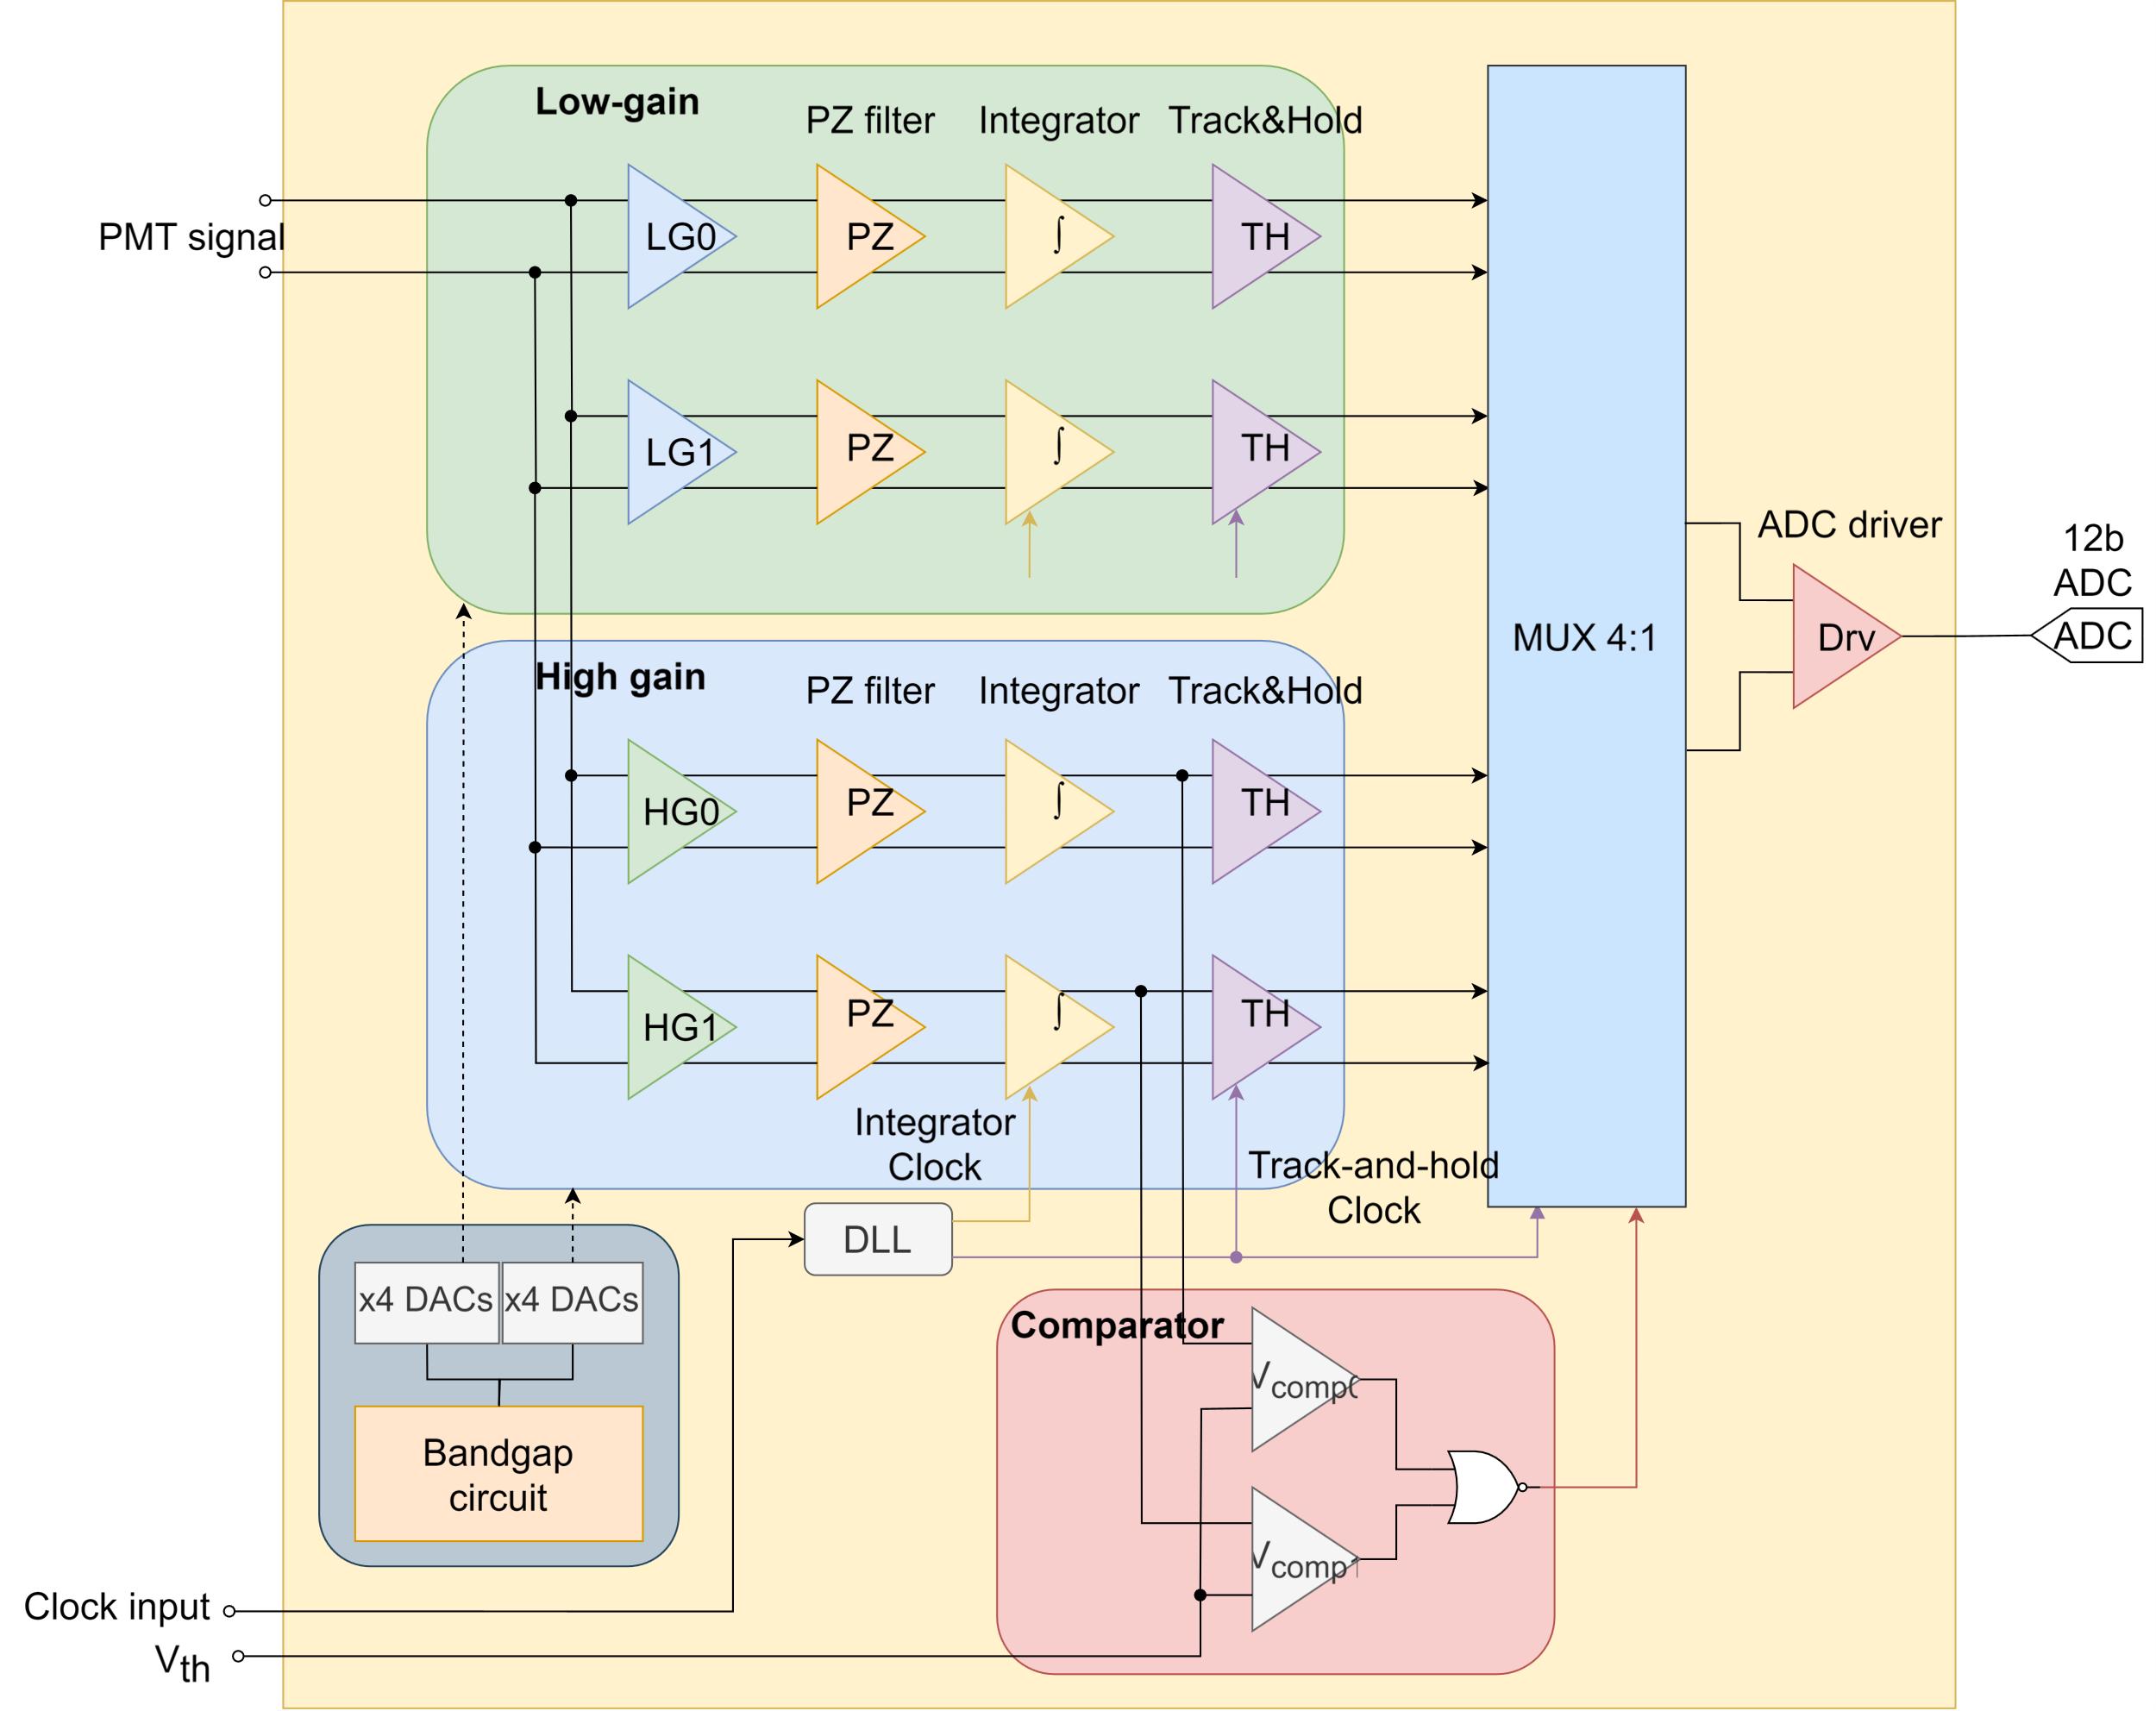
3. Analog processing chain 3.1. Energy ASIC (detailed)
Energy ASIC summary:
2x gain paths to increase bit resolution.
2x time-interleaved sub-channels per gain path to recover the integrator signal.
4x DACs per gain path to bias the FDOA separately.
Voltage comparator to select the gain path.
Mux 4:1 to drive the suitable signal to the output.
ADC driver capable of driving high capacitances.

Slide 12
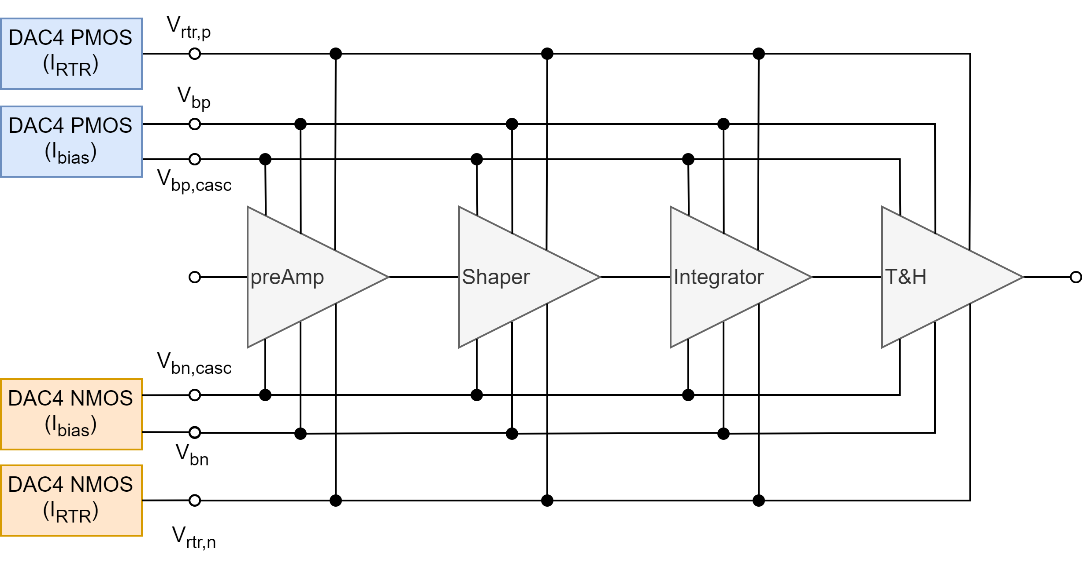
3. Analog processing chain 3.2. Biasing. DACs
Bias voltages generated using 4 different DACs per gain sub-channel (LG0&1 and HG0&1) to equalize the output against PVT variations:
(2x) 4-bit DACs to control the PMOS and NMOS biasing currents of the FDOA.
(2x) 4-bit DACs to control the shifting of the PMOS and NMOS input transconductances, Gm1, to keep it constant along V_{cm} in every scenario. This control, plus the CMFB amplifier, is responsible for keeping the GBW constant along the V_{cm}. range.
Folded cascode current and floating transistors gate voltages are generated individually for each OTA.
x2 subchannels

Slide 13
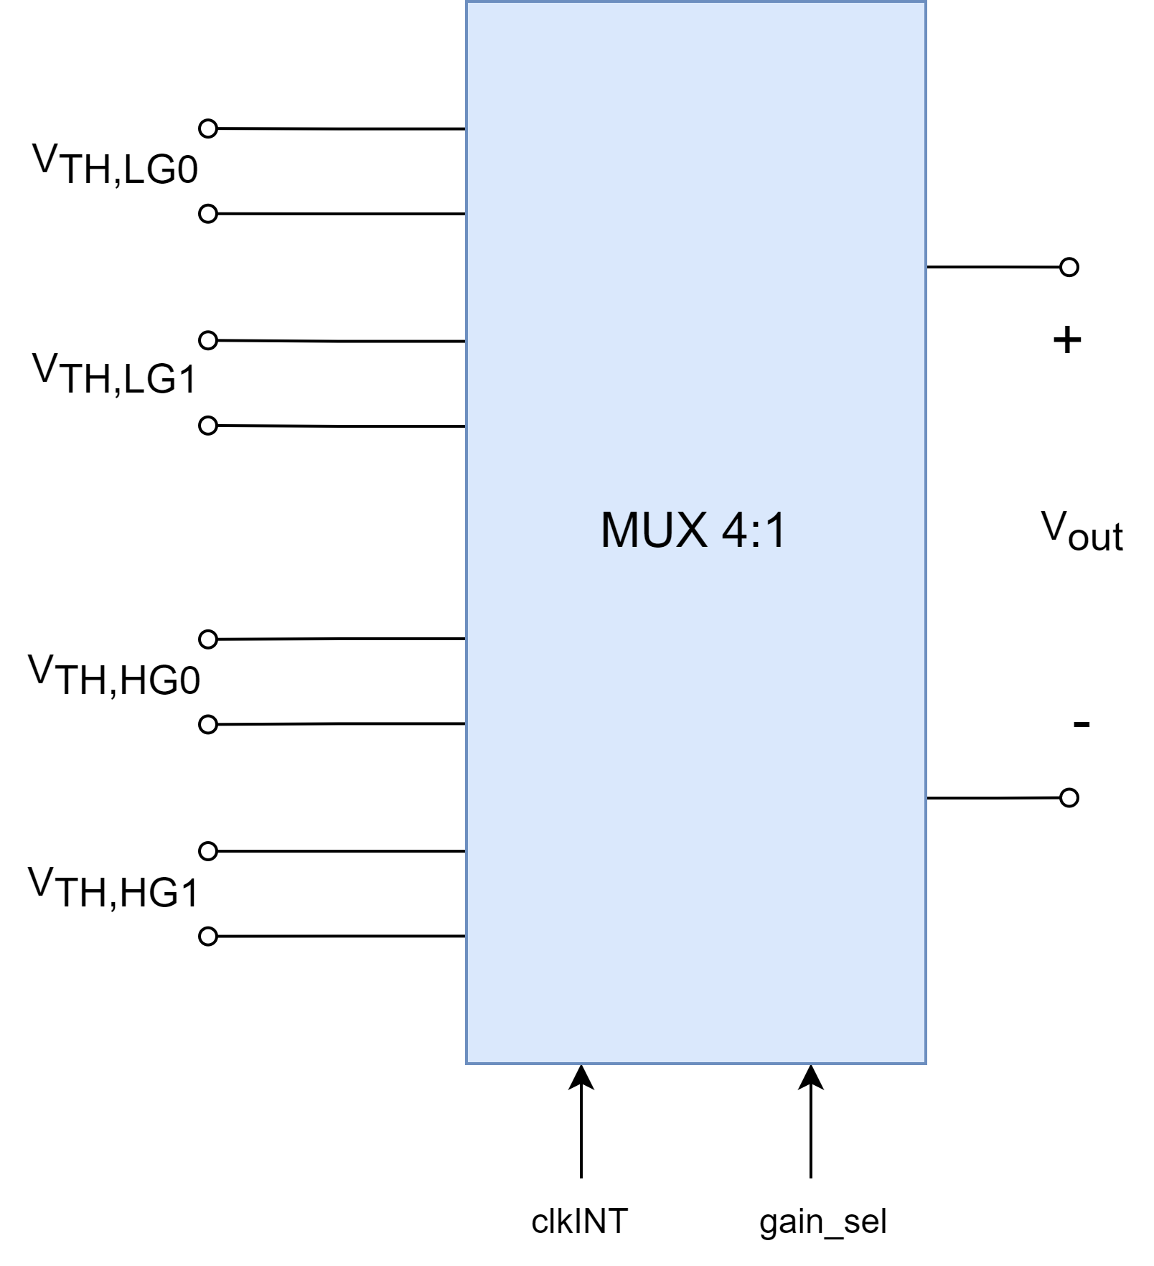
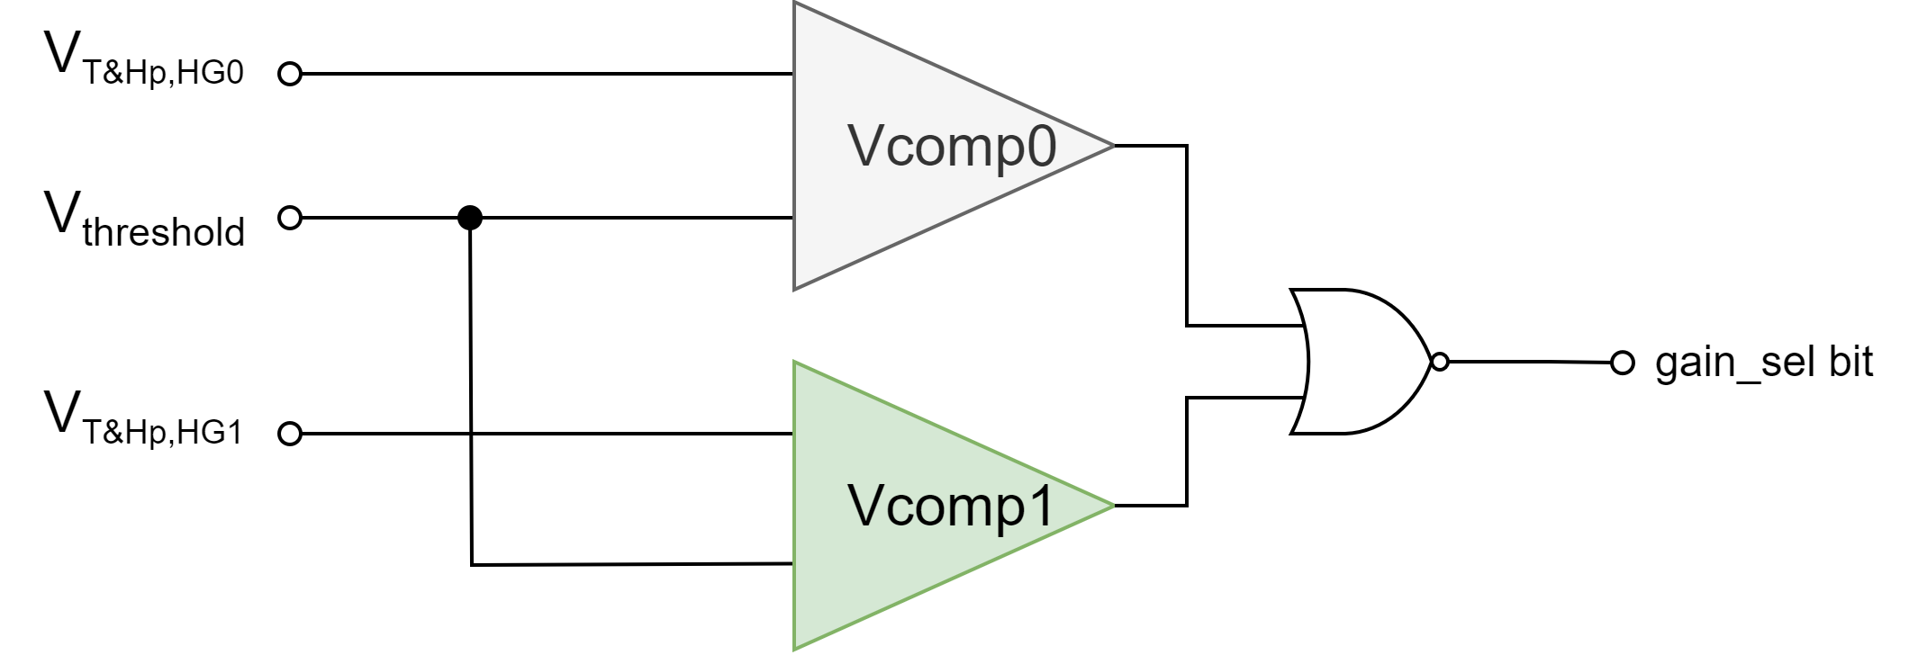
3. Analog processing chain 3.3. Gain selector. Comparators
To select when to acquire the HG or LG output, a voltage comparator is needed.
Compare the high-gain T&H output from both phase paths to a threshold voltage and generate the gain_sel bit using a NOR gate.
The gain_sel bit, plus the integration clk signal controls the mux output, driving the suitable signal to the output ADC every 25ns.

Slide 14
3. Analog processing chain 3.4. ADC driver
Finally, an output driver is needed to attack an off-chip ADC.
Taking into account the pads and the ADC input load, the driver must be capable of driving high capacitances.
The OTA used in the processing chain works well enough against load capacitances up to 2pF → Need to design a new OTA.
The T&H output signal is not as fast as the PMT signal → GBW specification can be lowered.
A new OTA capable of driving capacitances up to 10 pF has been designed by increasing the cascode and class AB currents, and tunning the compensation network to guarantee stability.
I_{casc}↑
I_{out}↑
Test | C_{L}=1pF | C_{L}=5pF | C_{L}=10pF
Av0 | 73.26 dB | 73.26 dB | 73.26 dB
GBW | 304 MHz | 303.7 MHz | 303.5 MHz
Phase margin | 91.67º | 76.78º | 60.16º
Phase margin frequency | 344.6 MHz | 366.3 MHz | 350.1 MHz
Gain margin | 8.759 dB | 7.056 dB | 7.752 dB
Gain margin frequency | 1.842 GHz | 990.7 MHz | 744.3 MHz
Slew rate (rise) | 368.2 V/us | 387.5 V/us | 376.5 V/us
Slew rate (fall) | -368.9 V/us | -387 V/us | -376.3 V/us
Power | 5.715 mW | 5.715 mW | 5.715 mW

Slide 15
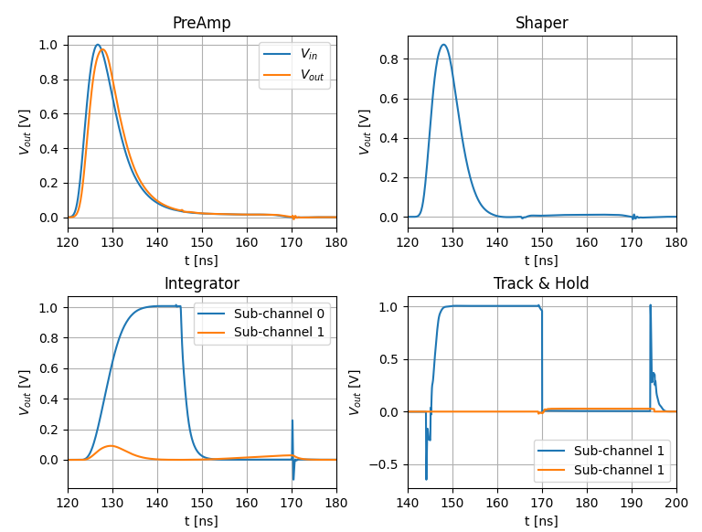
3. Analog processing chain 3.5. LG subchannel simulations. Transient output
Subchannel LG simulations:
Maximum preamplifier integration error of 0.64 % for |v_{IN}(t)| = 1 V and low-gain (LG) subchannel.
Transient noise at channel output range 600-700 µV (need < 500 µV for 11 bits resolution).

Slide 16
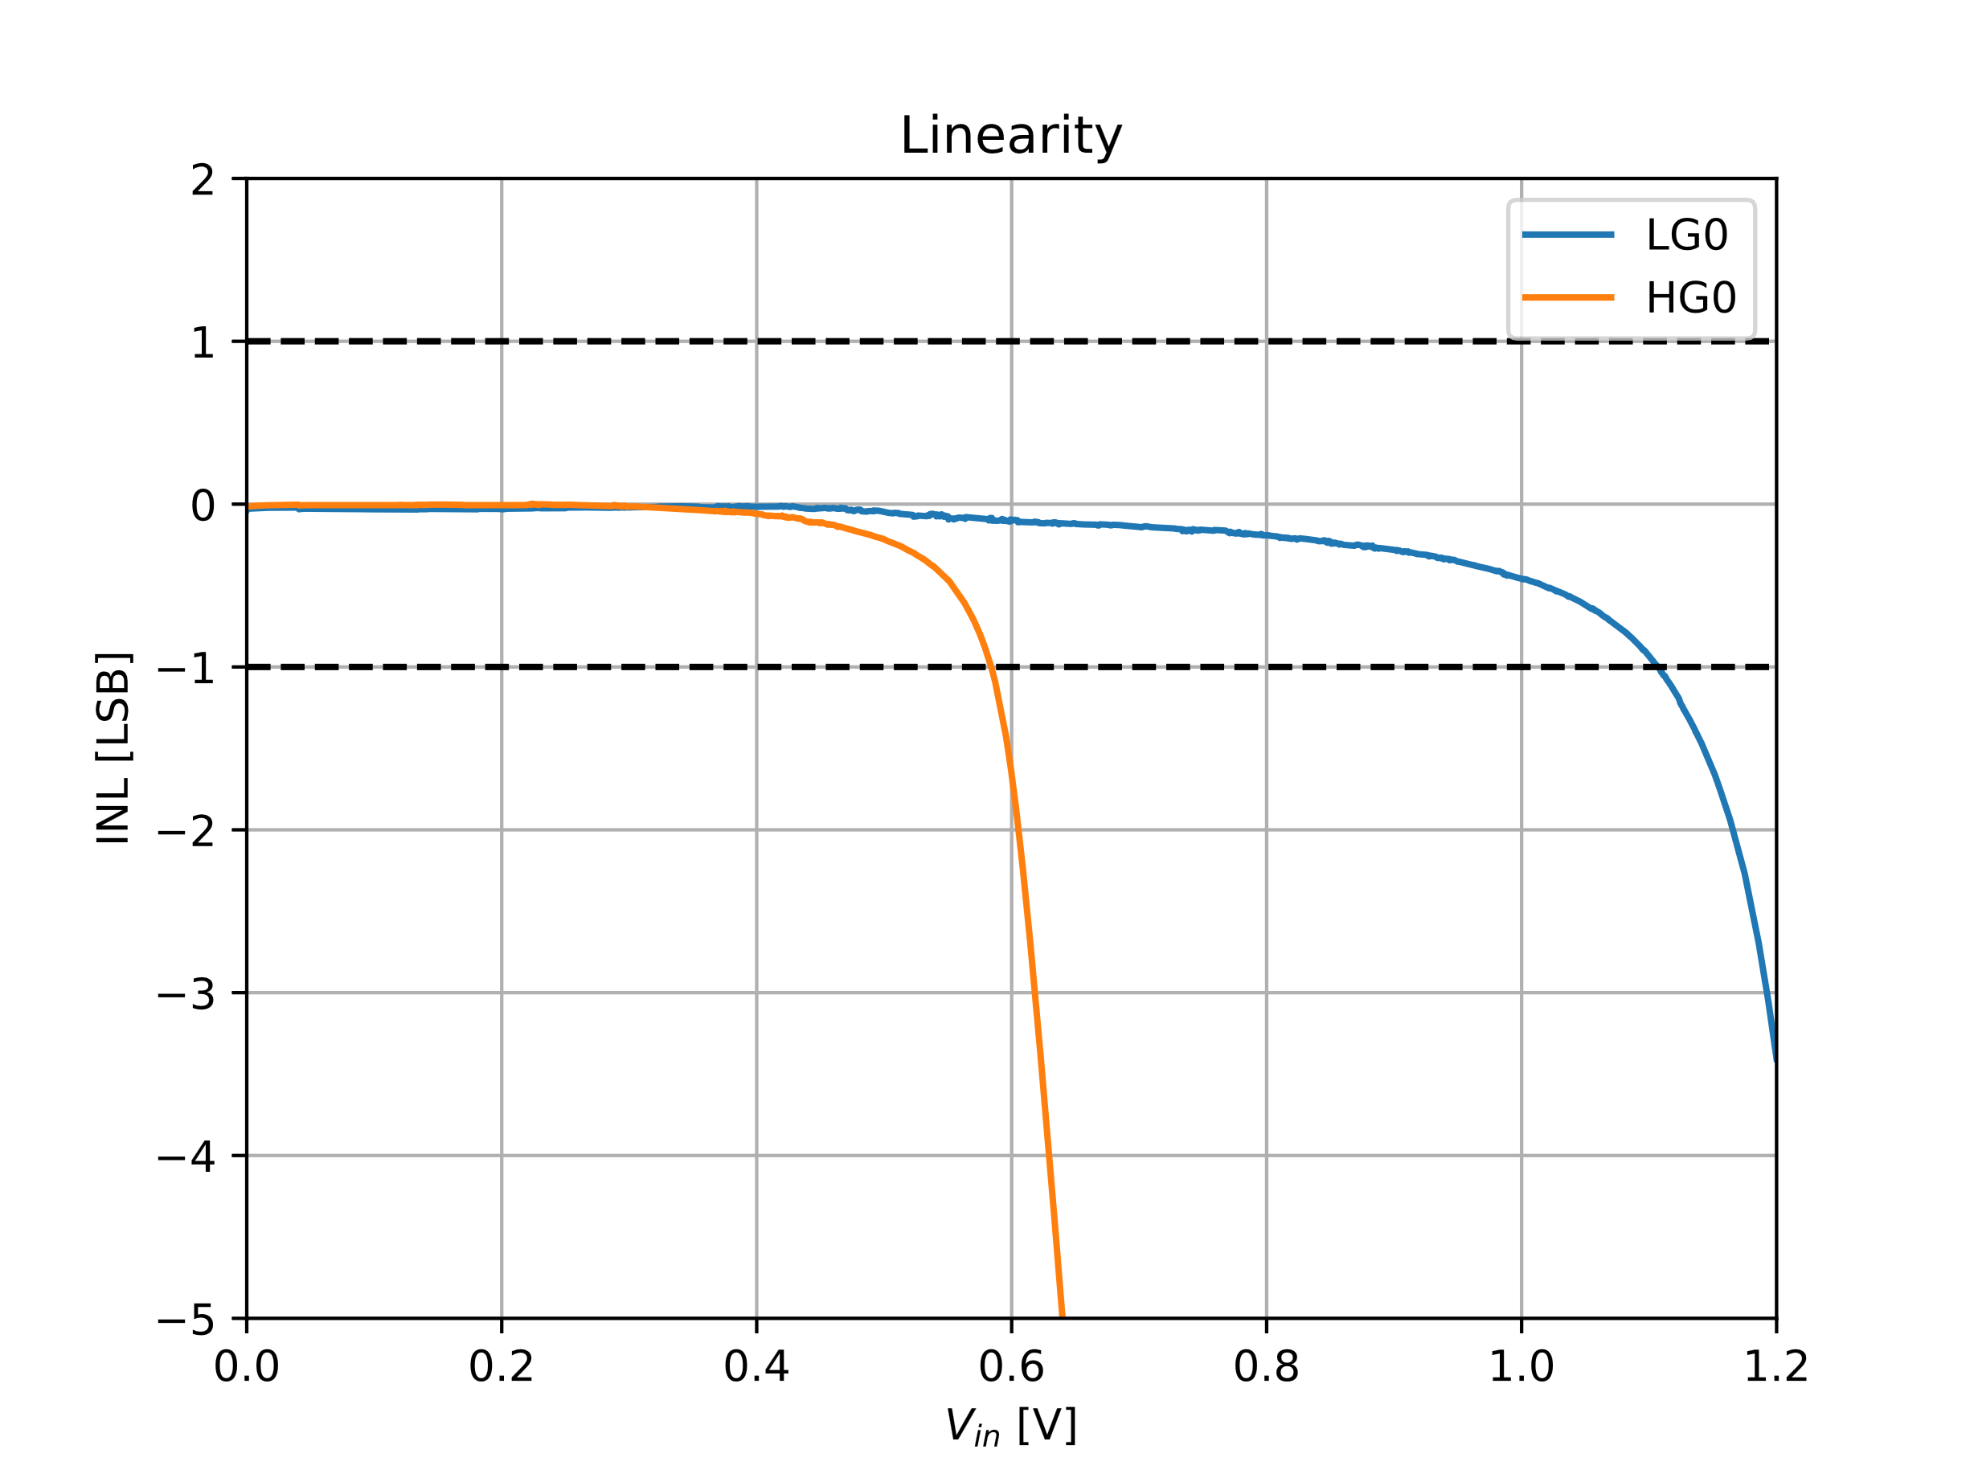
3. Analog processing chain 3.5. LG subchannel simulations. Linearity
Subchannel LG simulations:
Maximum preamplifier integration error of 0.64 % for |v_{IN}(t)| = 1 V and low-gain (LG) subchannel.
Transient noise at channel output range 600-700 µV (need < 500 µV for 11 bits resolution).
Linearity below 1LSB for V_{cm} up to 1.1V.

Slide 17
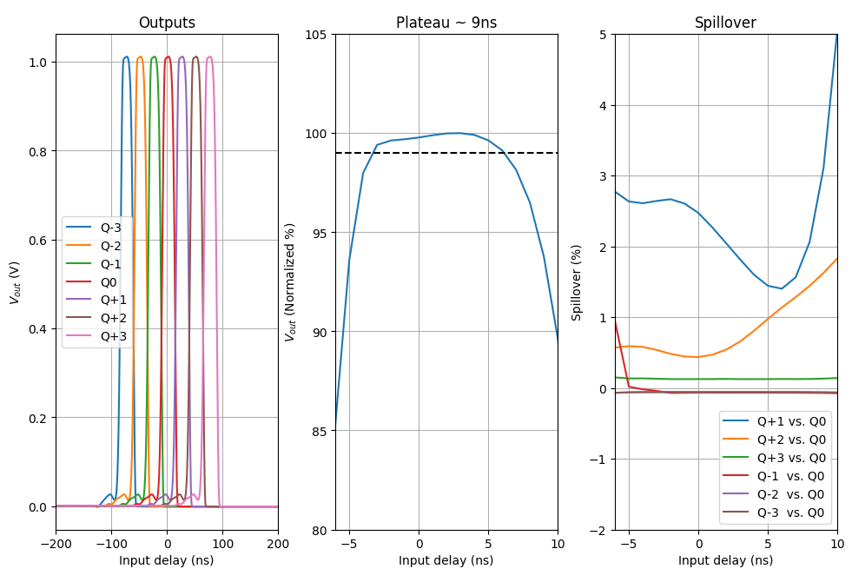
3. Analog processing chain 3.5. LG subchannel simulations. Plateau & spillover
Subchannel LG simulations:
Maximum preamplifier integration error of 0.64 % for |v_{IN}(t)| = 1 V and low-gain (LG) subchannel.
Transient noise at channel output range 600-700 µV (need < 500 µV for 11 bits resolution).
Linearity below 1LSB for V_{cm} up to 1.1V.
Plateau ~ 9ns (above specification, > 5ns) for LG subchannel.
Spillover ~ 2.7% (< 1% specification). PMT pulse tail difficult to remove with the PZ filter.

Slide 18
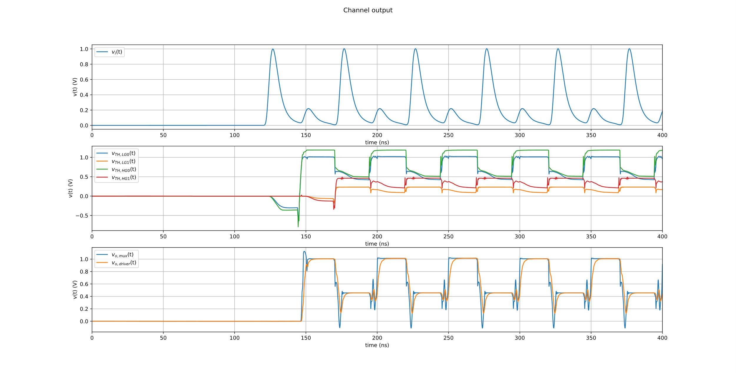
3. Analog processing chain 3.6. ASIC transient simulation
$$\left|v_{in,0}(t)\right|=1V$$
$$\left|v_{in,1}(t)\right|=200mV$$
HG output saturates
HG output (400mV) below comparator V threshold (1V)
LG output driven to ADC
HG output driven to ADC

Slide 19
Conclusions and future work
Alberto López Barcelona University
LHCb PicoCal Electronics meeting
19 March 2024

Slide 20
4. Conclusions and future work
From the pre-layout results, it can be concluded:
The OTA fulfills every specification requested, achieving the expected performance at channel output.
The channel performance must be improved in terms of transient noise and spillover, but it shows a low integration error and good metrics for plateau and linearity.
While working on the layout design of the different blocks, the following modifications are being considered to improve the performance of the ASIC:
Redesign the class AB translinear loop to improve robustness against PVT corners.
Finer tunning of transistor parameters to optimize area, power consumption and SNR.
Add a fully-differential driver at the output of each single block (preamp, PZ filter, and integrator) for testing purposes.
Replace the MUX 4:1 to 2xMUX2:1 to allow subchannel pedestal subtraction.

Slide 21
Thank you for listening

Slide 22
Spares
FDOA Architecture (detailed)
Alberto López Barcelona University
LHCb PicoCal Electronics meeting
19 March 2024

Slide 23
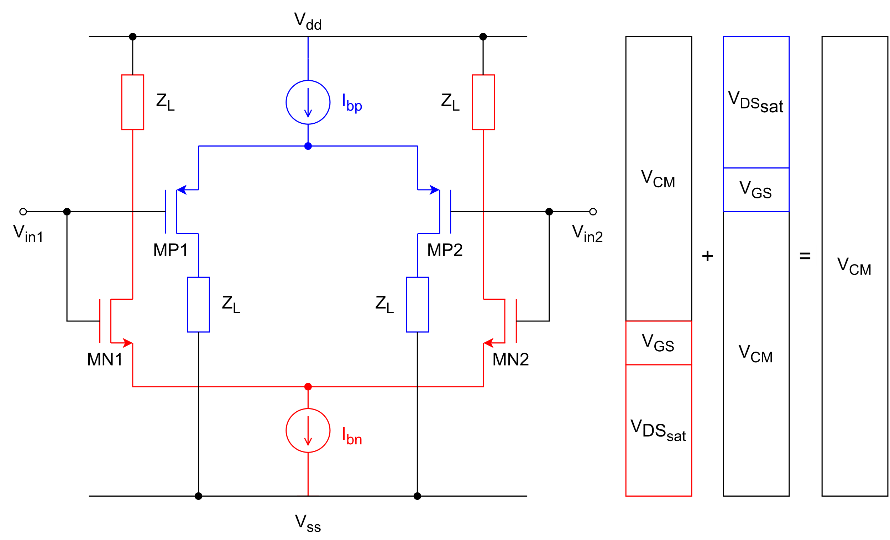
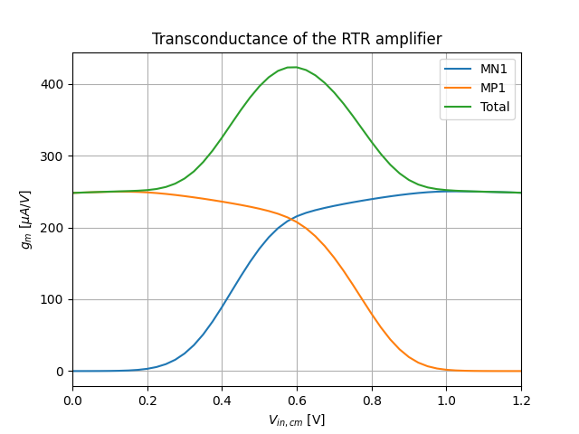
2. FDOA architecture 2.1. Rail-to-rail input stage
At least, one input pair active for any V_{cm}
PMOS active
${ V}_{ss} <{ V}_{CM} <V_{dd}−(V_{{DS,sat}_{bp}}+V_{{GS}_{P1}})$
NMOS active
${ V}_{dd} <{ V}_{CM} < V_{{DS,sat}_{bn}}+V_{{GS}_{N1}}$
Transconductance not constant along V_{cm}
Variable GBW → Compromise linearity
Need g_{m} equalization

Slide 24
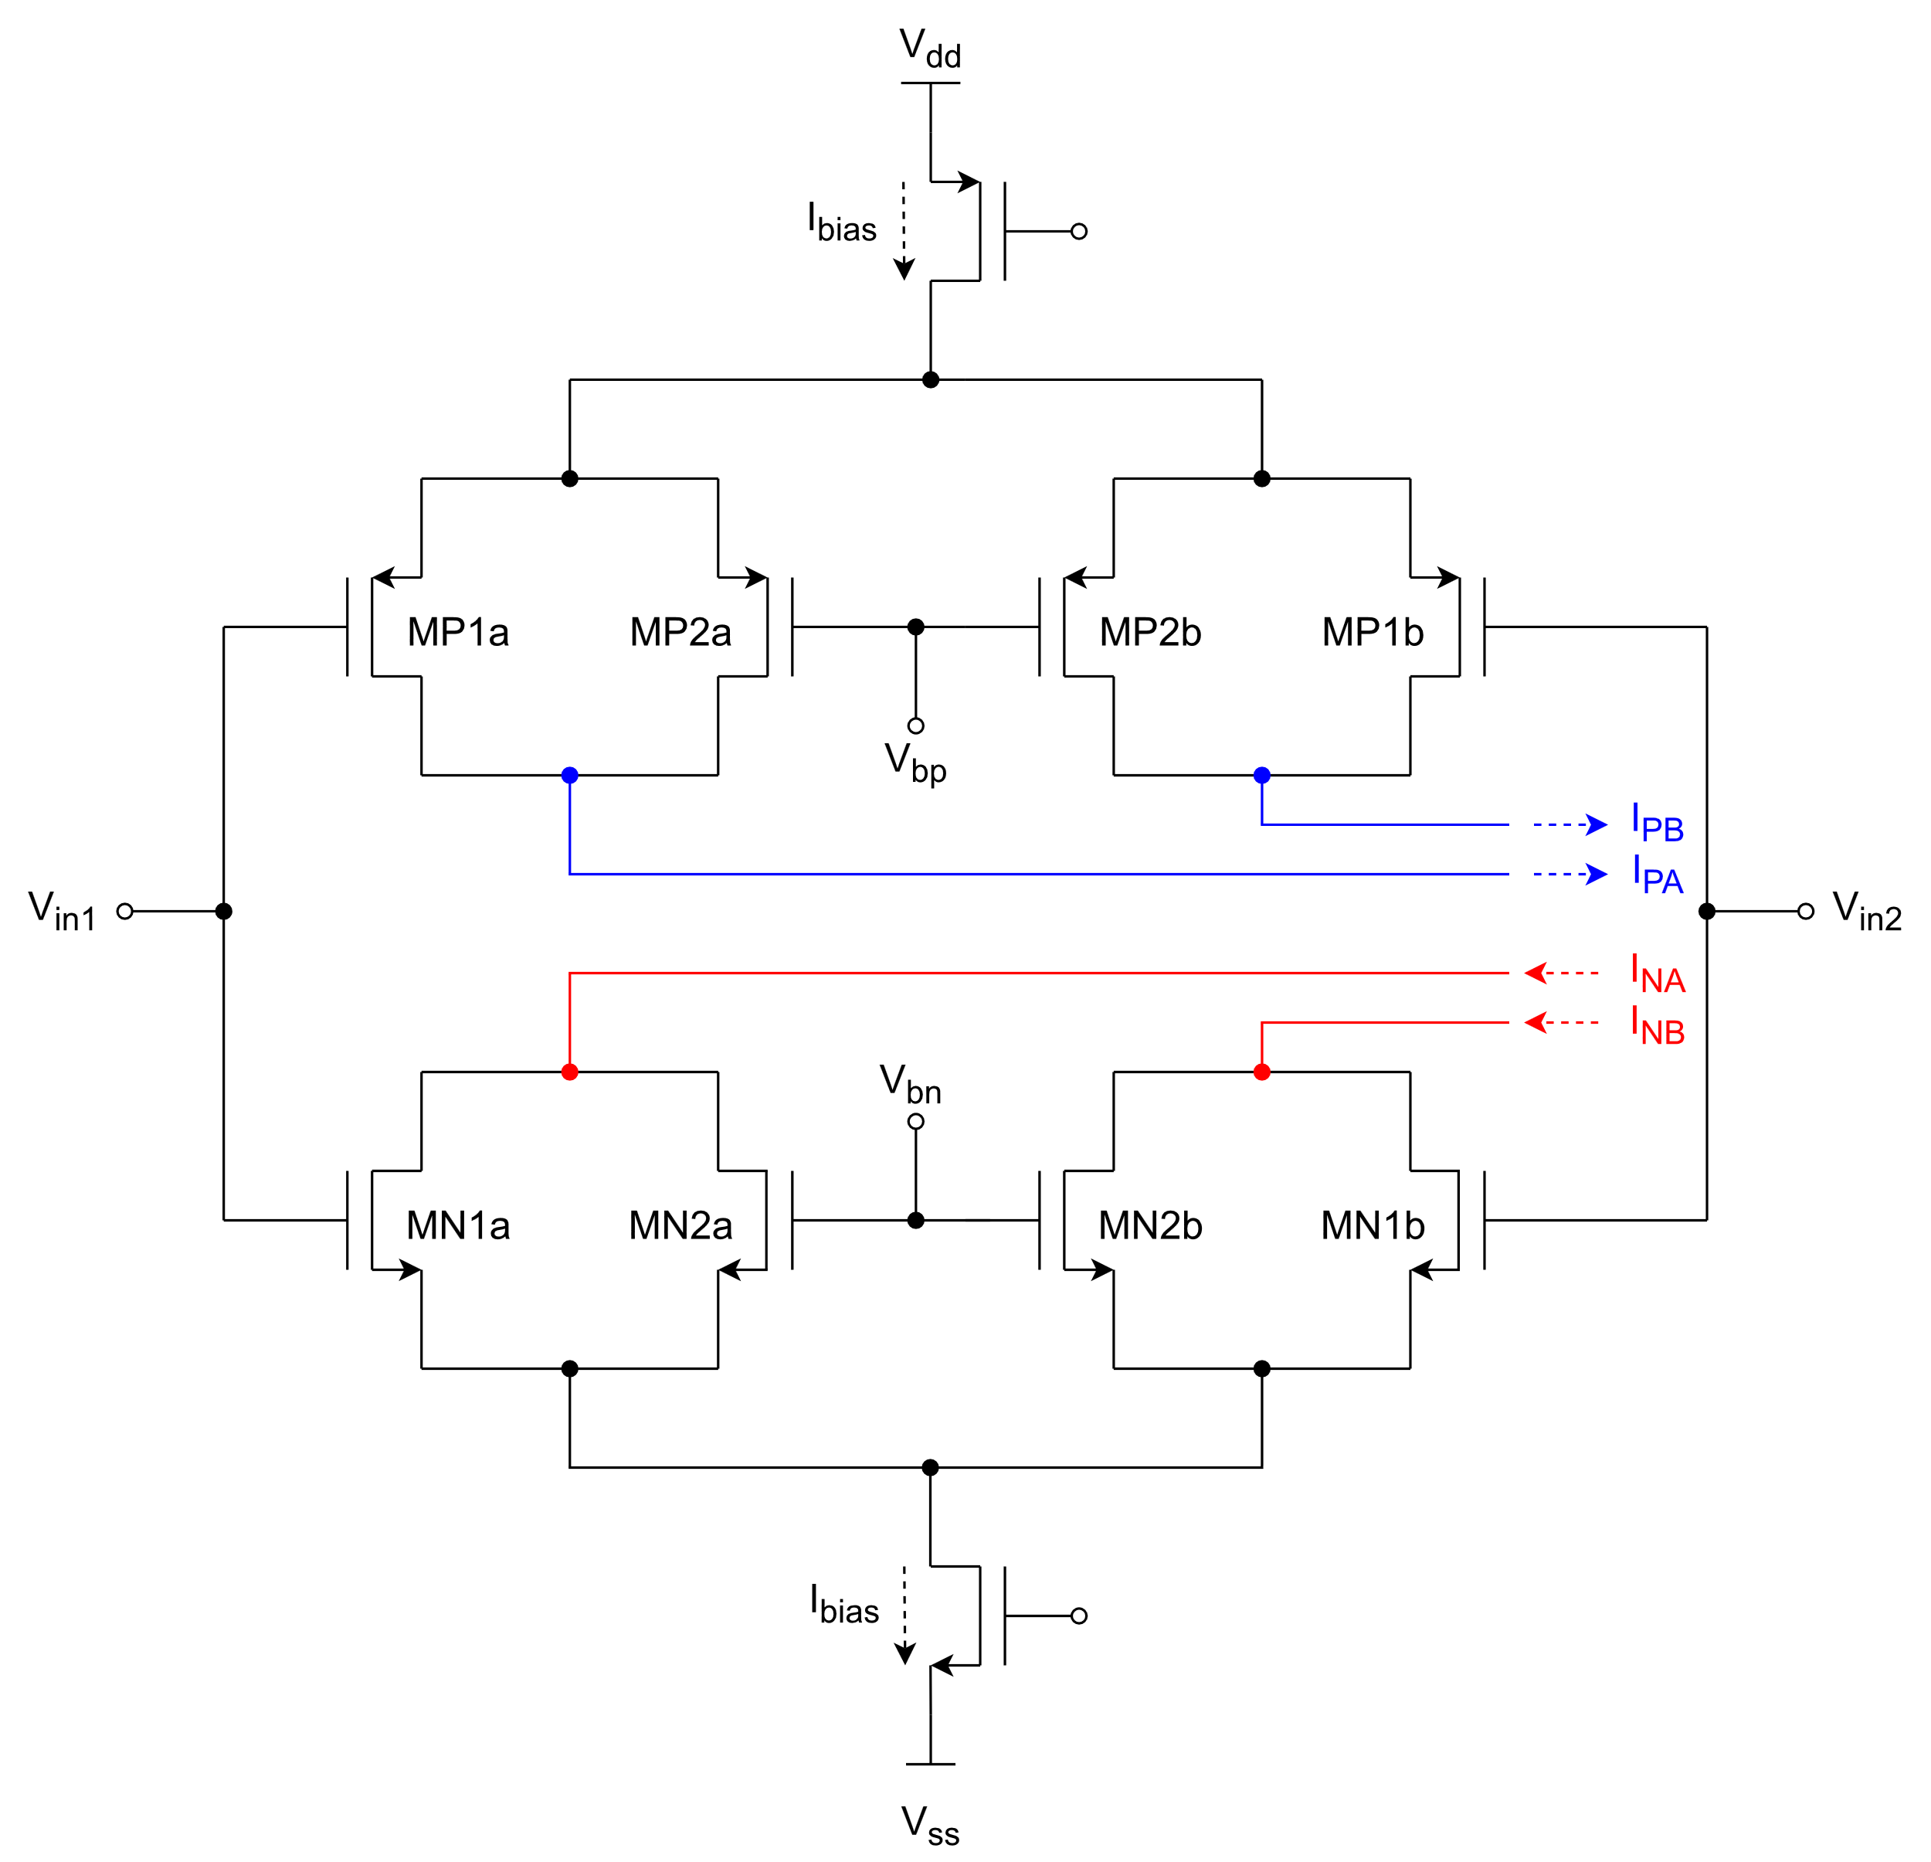
2. FDOA architecture 2.1. Rail-to-rail input stage. G_{m}-equalization
MX2a and MX2b connected in parallel to the differential input pairs to subtract current when needed.
At the V_{cm} extreme levels, I_{bias} only flows through the input transistors
$$I_{MP1}\left\{V_{cm}=0V\right\}=I_{MN1}\left\{V_{cm}=V_{dd}\right\}=I_{bias}/2$$
When Vcm decreases, the current start flowing through MX2, decreasing the current at the input transistor
$$I_{MP1}\left\{V_{cm}=V_{bp}\right\}=I_{MN1}\left\{V_{cm}=V_{bn}\right\}=I_{bias}/4$$

Slide 25
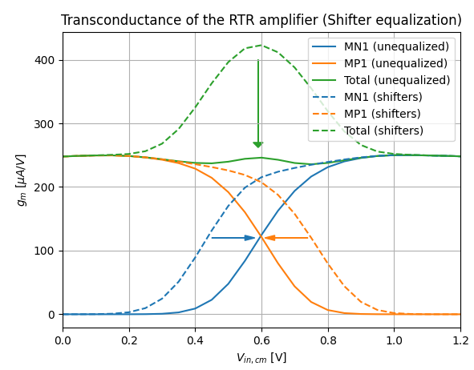
2. FDOA architecture 2.1. Rail-to-rail input stage. G_{m}-equalization
As a result, the g_{m} of NMOS and PMOS input pairs are displaced towards each other.
Assuming, the NMOS and PMOS input pairs are designed to have the same g_{m} at the extreme values
$g_{m,P1}\left\{0V\right\}=g_{m,N1}\left\{V_{dd}\right\}=G_{m1}$
shifting must be controlled by V_{bn} and V_{bp}, fulfilling:
$$g_{m,P1}\left\{V_{cm}=\frac{V_{dd}}{2}\right\}=g_{m,N1}\left\{V_{cm}=\frac{V_{dd}}{2}\right\}= \frac{G_{m1}}{2}$$

Slide 26
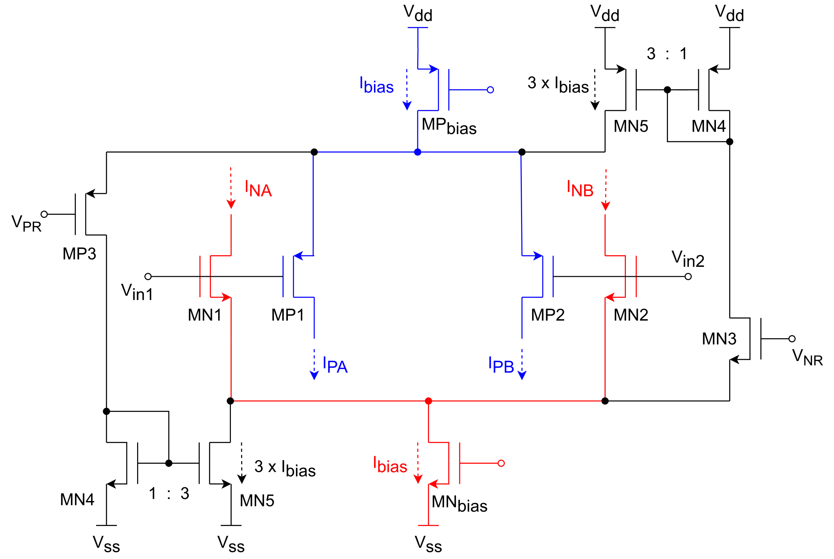
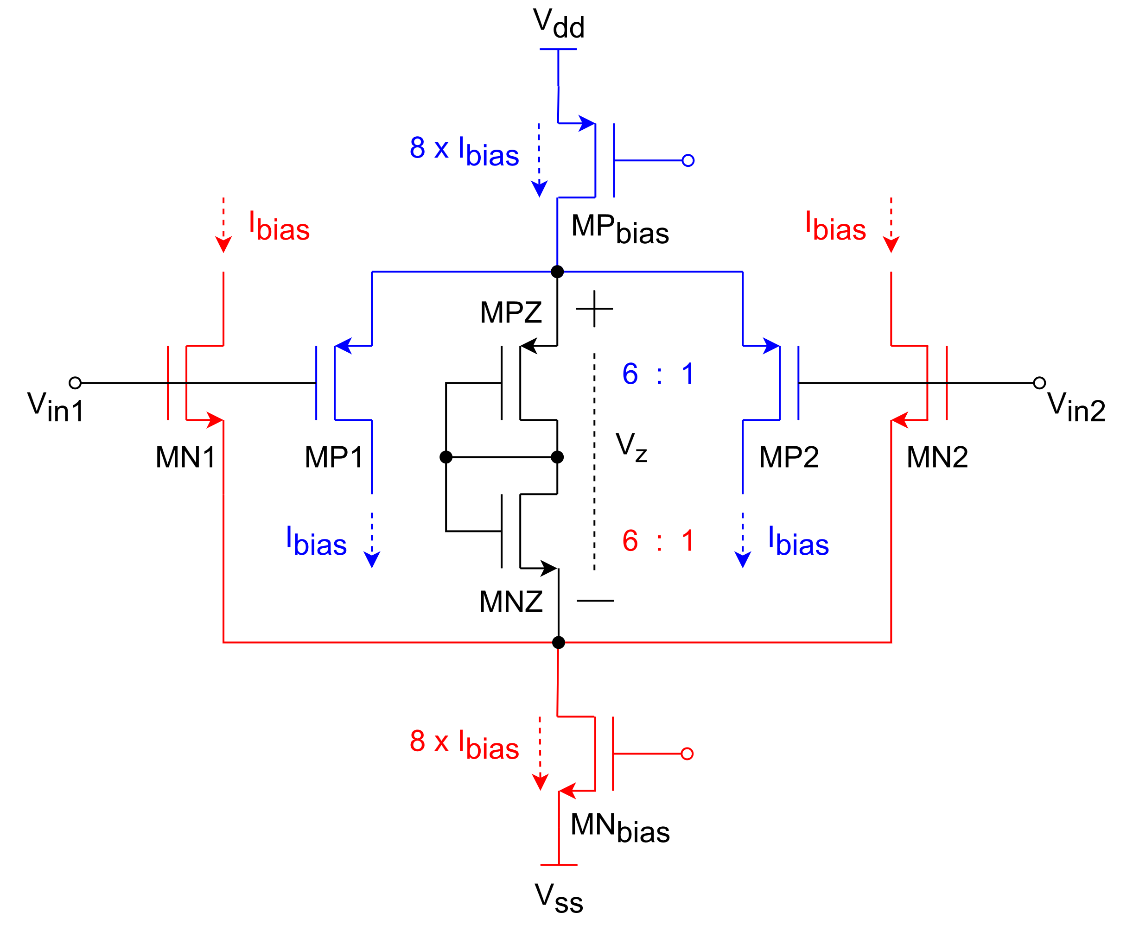
2. FDOA architecture 2.1. Rail-to-rail input stage. G_{m}-equalization (alternative techniques)
CMOS Zener diode
Current injection x3

Slide 27
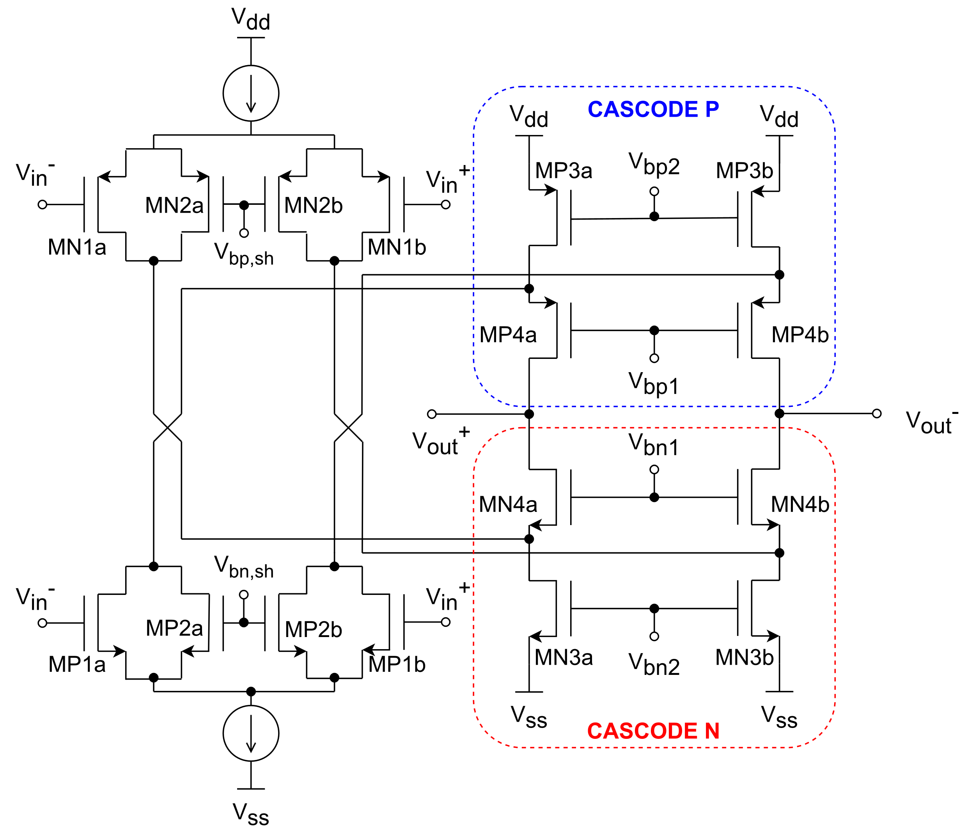
2. FDOA architecture 2.2. Folded cascode
A folded cascode is added to load the input stage with a high impedance.
Increase gain
Cascode design trade-offs:
Slew-rate limitation
$$R_{casc,n}≈r_{ds,n4}+\left(r_{ds,p1}\left| \right| r_{ds,psh} \left| \right| r_{ds,n3}\right)+g_{m,n4}r_{ds,n4}\left(r_{ds,p1}\left| \right| r_{ds,psh} \left| \right| r_{ds,n3}\right)$$
$$R_{casc,p}≈r_{ds,p4}+\left(r_{ds,n1}\left| \right| r_{ds,nsh} \left| \right| r_{ds,p3}\right)+g_{m,p4}r_{ds,p4}\left(r_{ds,n1}\left| \right| r_{ds,nsh} \left| \right| r_{ds,p3}\right)$$
$$I_{D}↓ → r_{ds}↑ ;g_{m4}↓$$
$$Gain↑$$
$${{\left(W/L\right)}_{4}↑ → V}_{{DS}_{sat4}}↓ → g_{m4}↑$$
$$I_{D}↓ →Gain↑ ; SR↓$$

Slide 28
2. FDOA architecture 2.2. Folded cascode. Gain-boosting
Add 2 amplifiers to regulate the cascode
It increase the impedance of MP4 and MN4 by the same amount as the gain of the new amplifiers
It allows to boost the gain of the cascode without decreasing the current, removing the gain-slewrate trade-off.

Slide 29
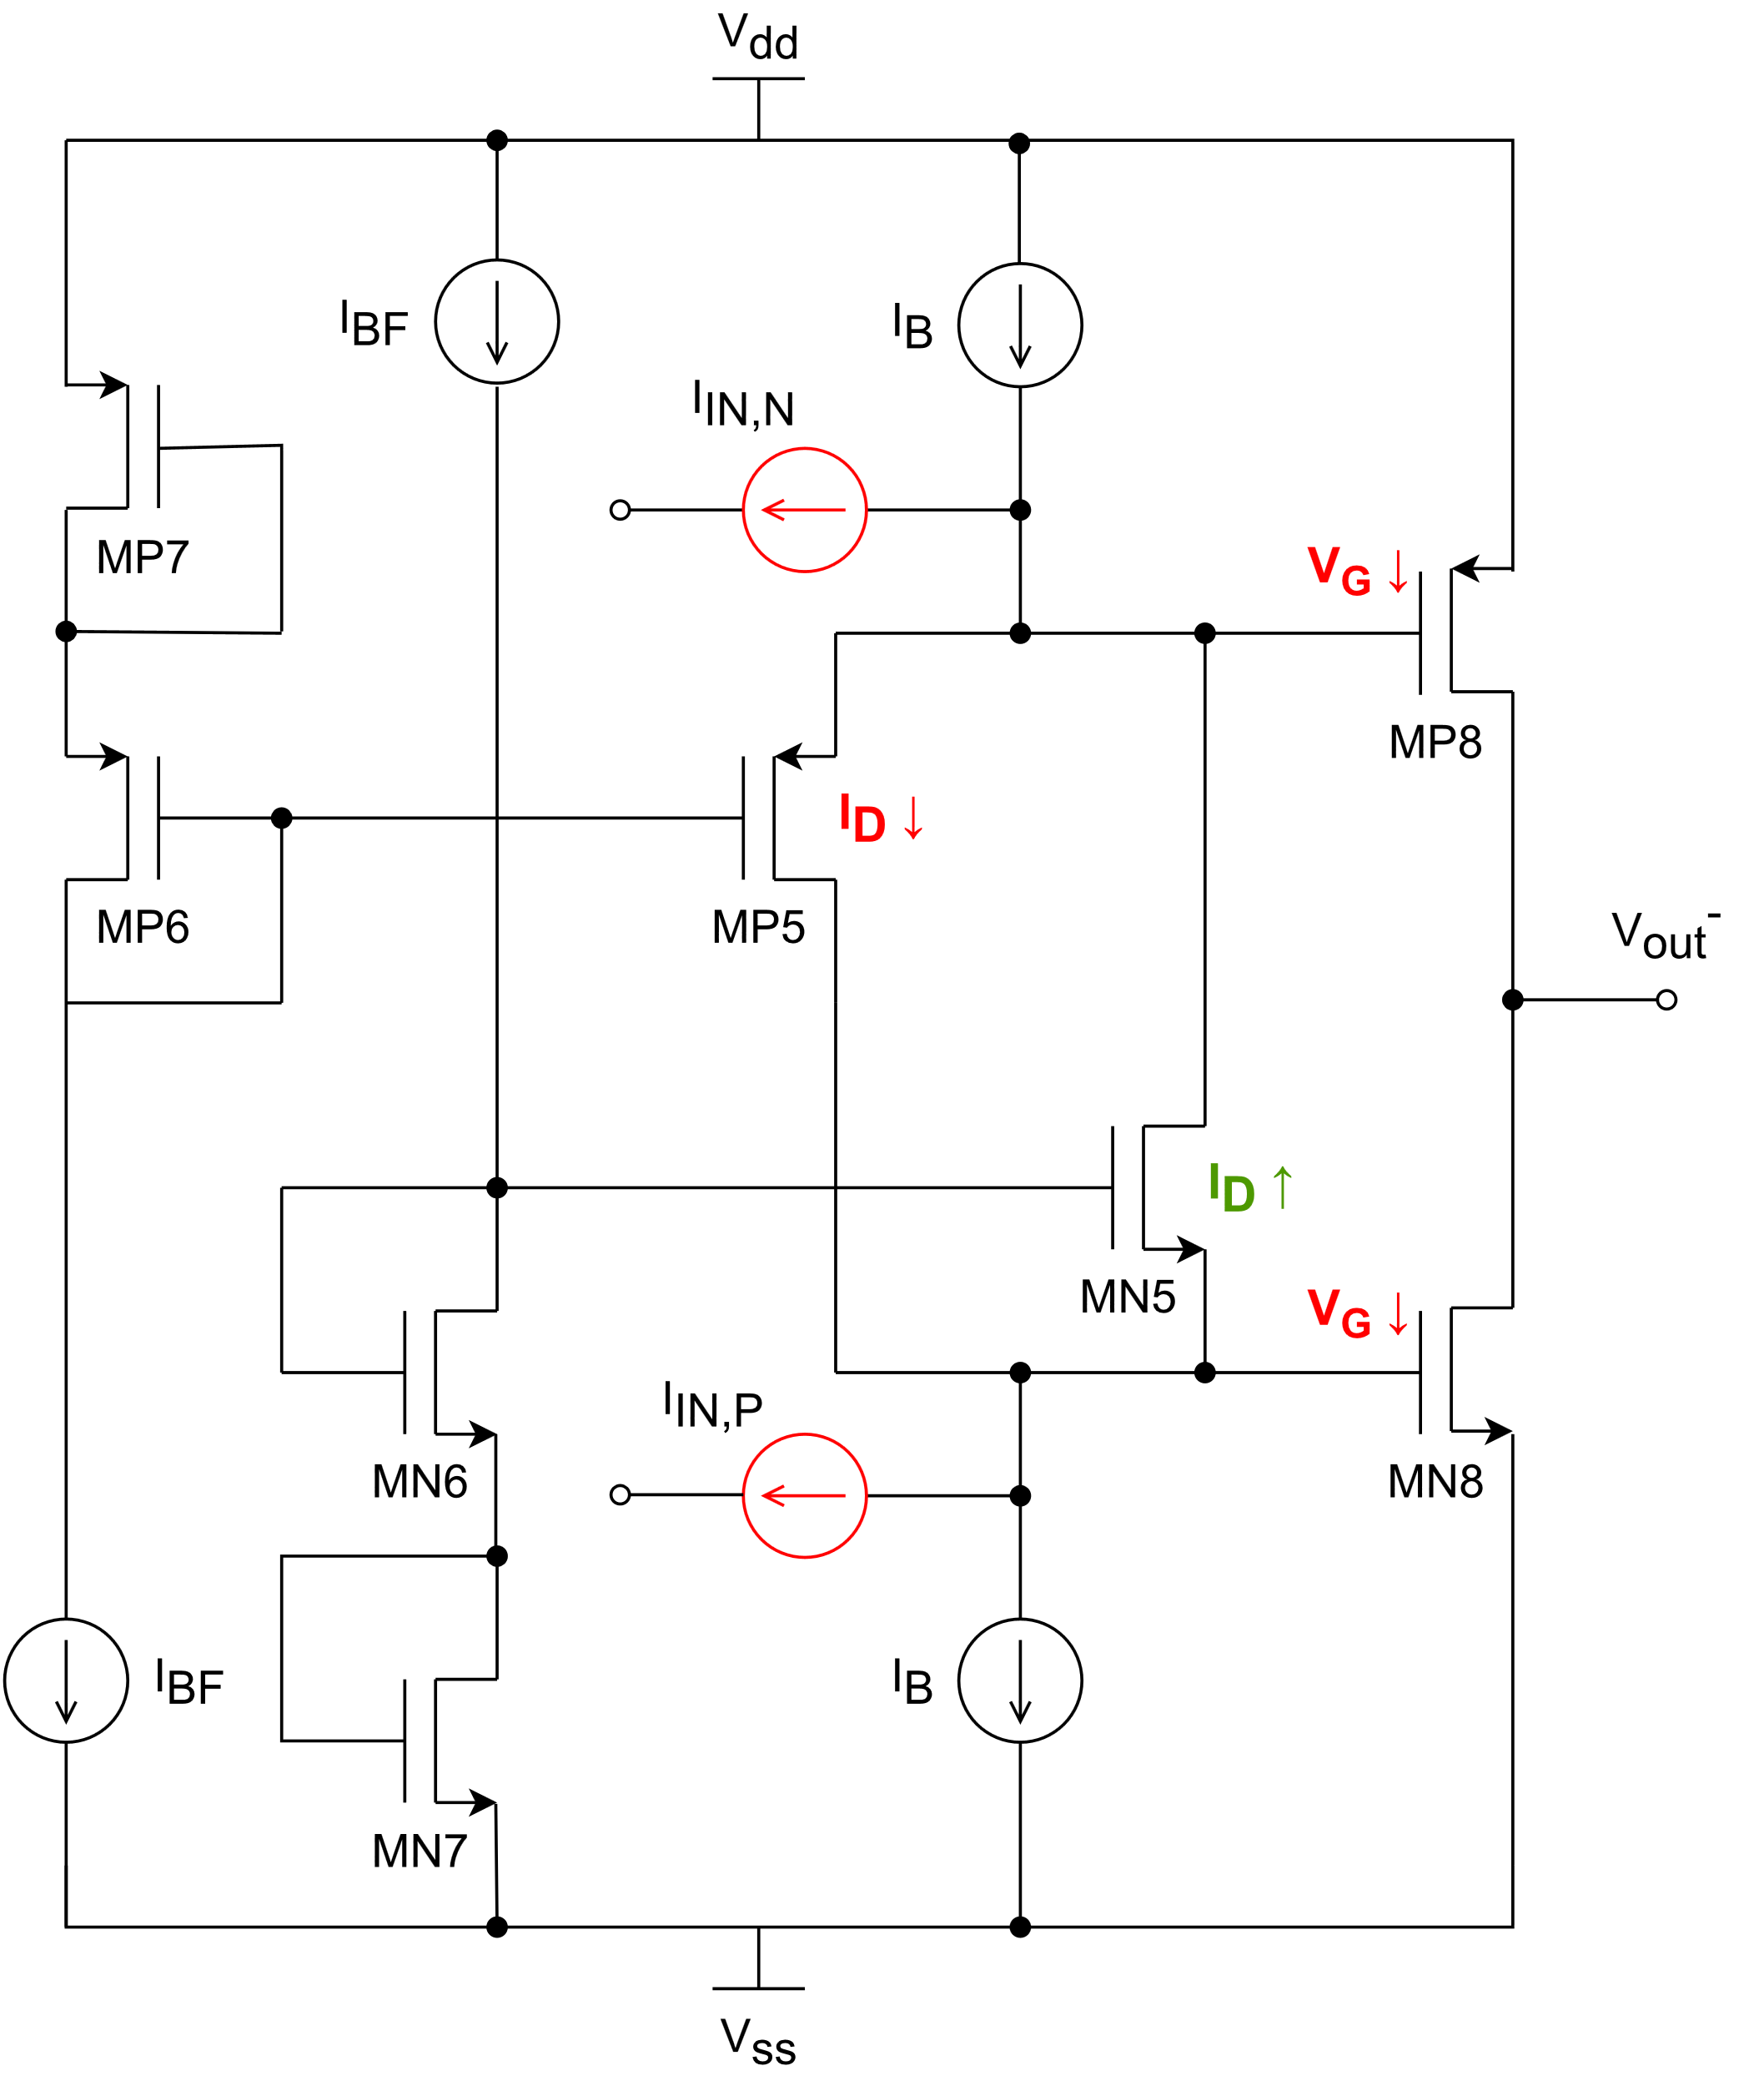
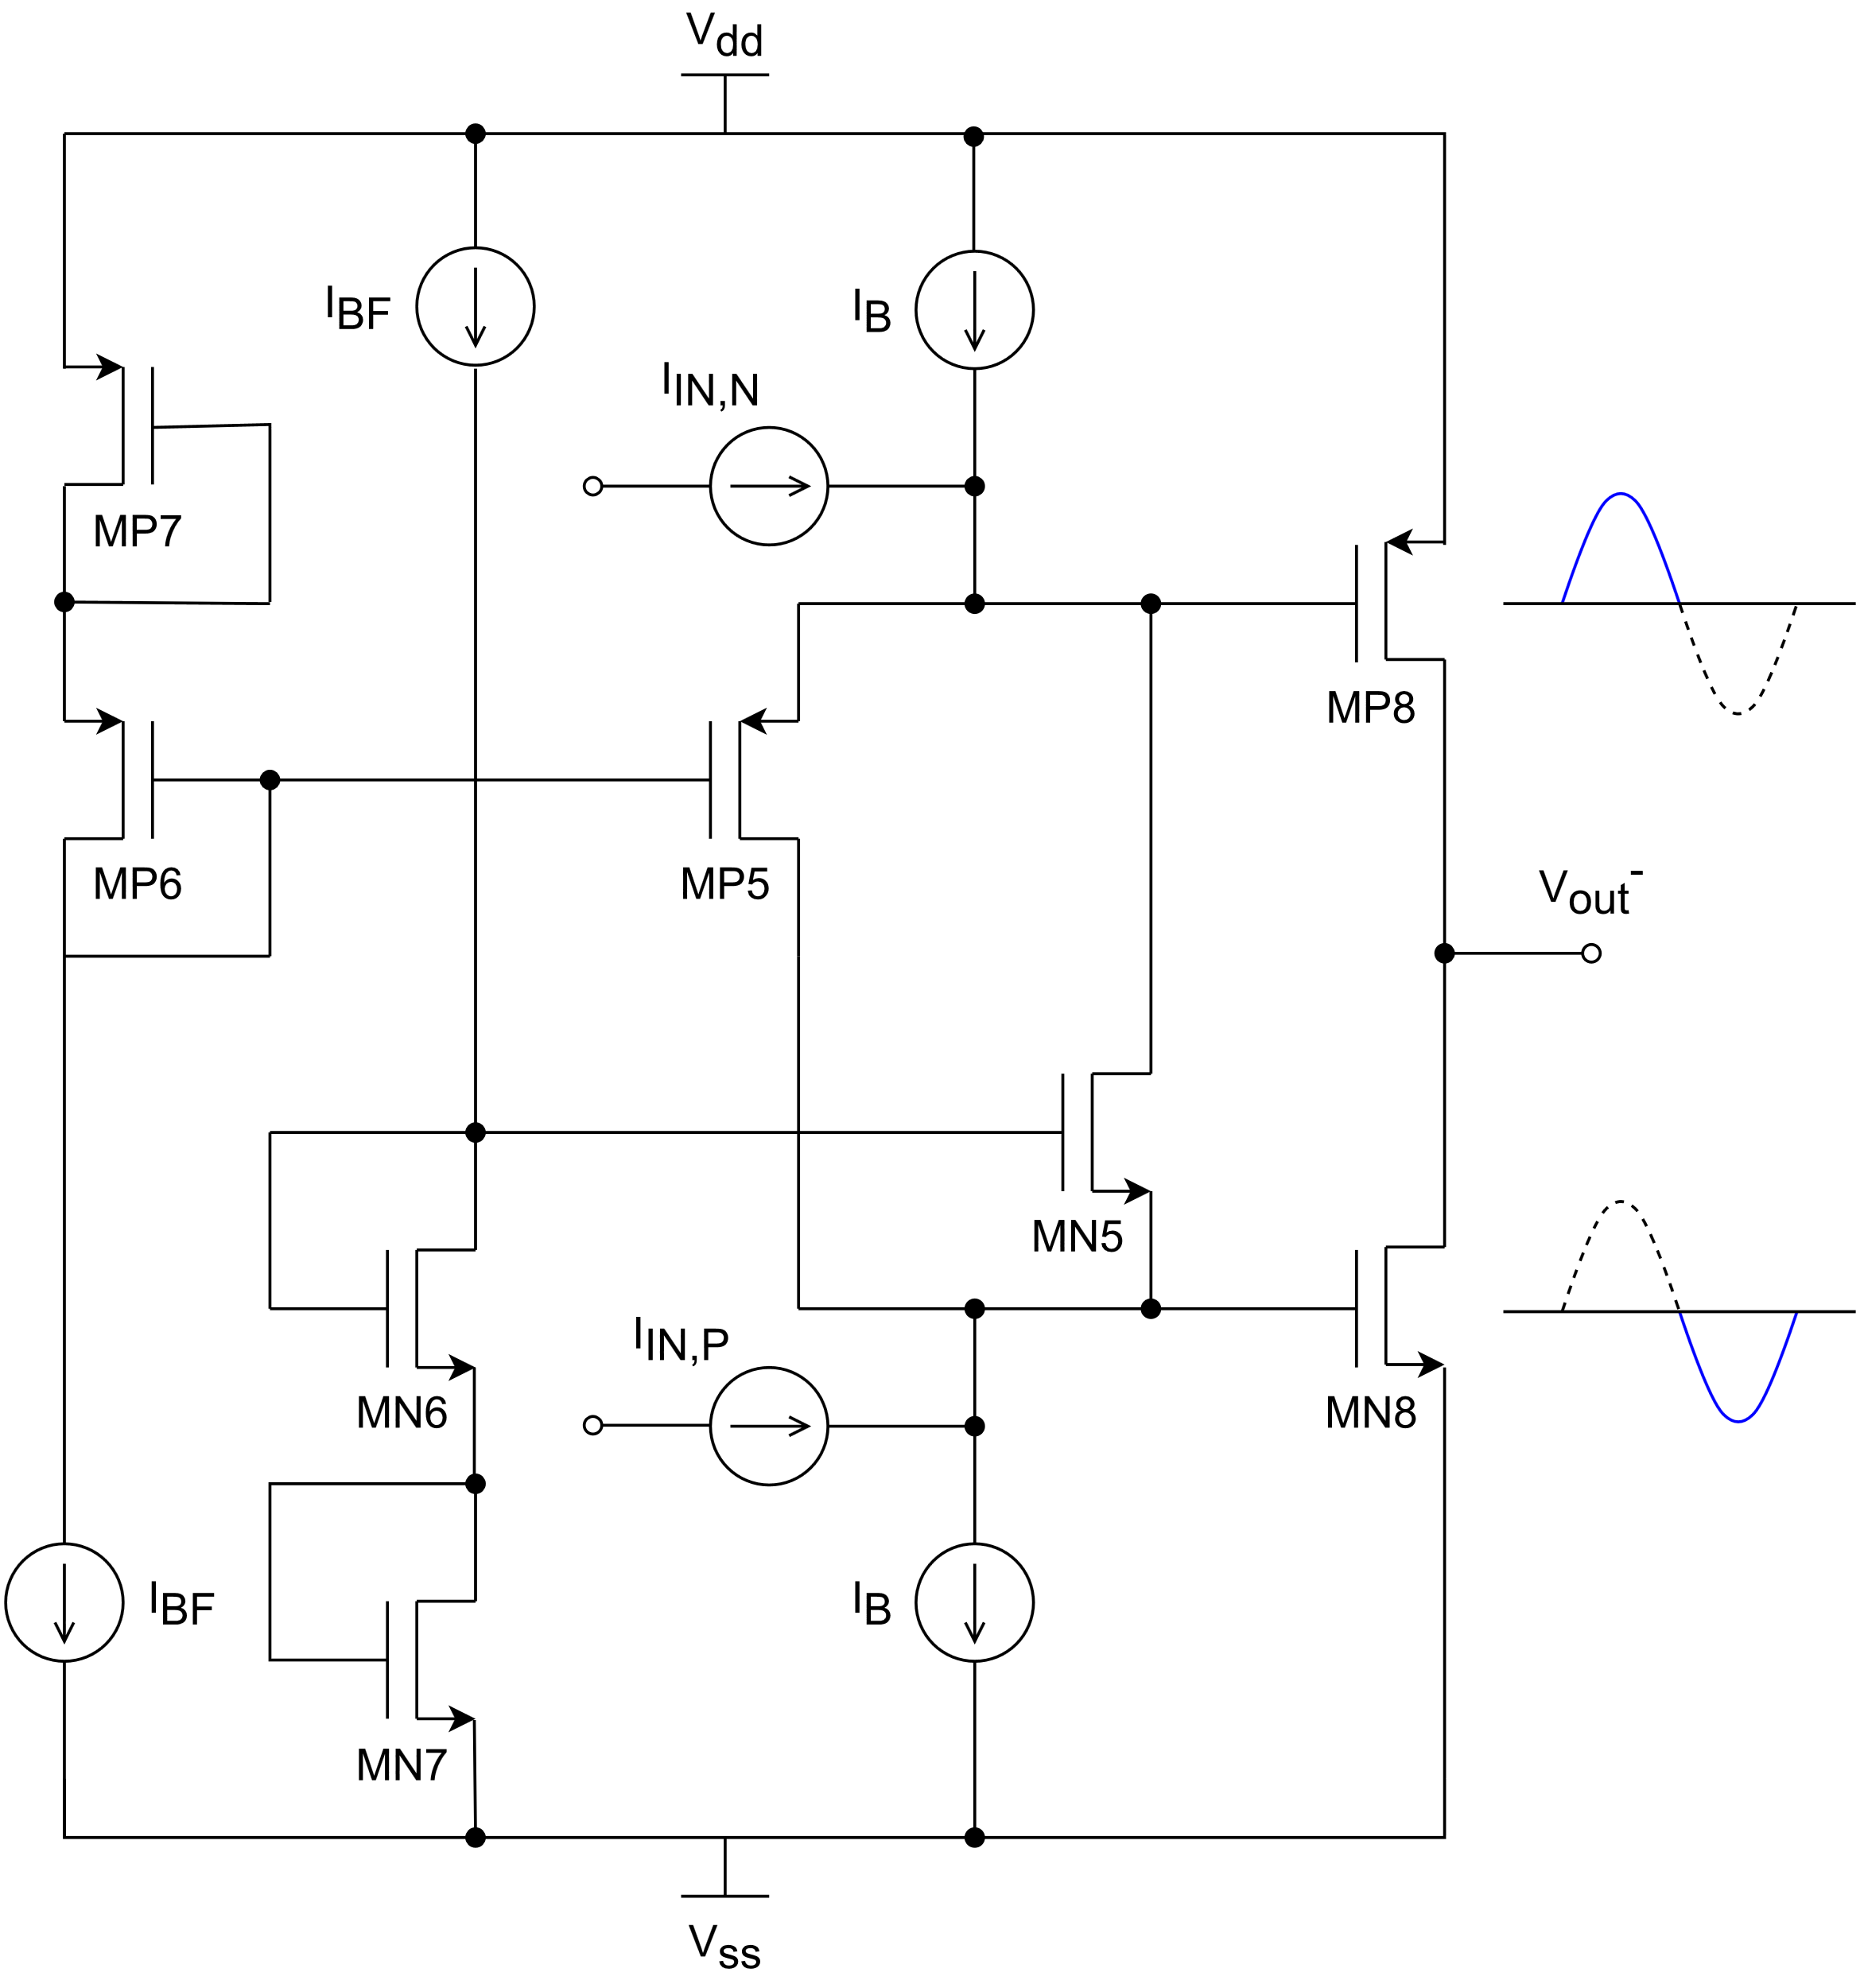
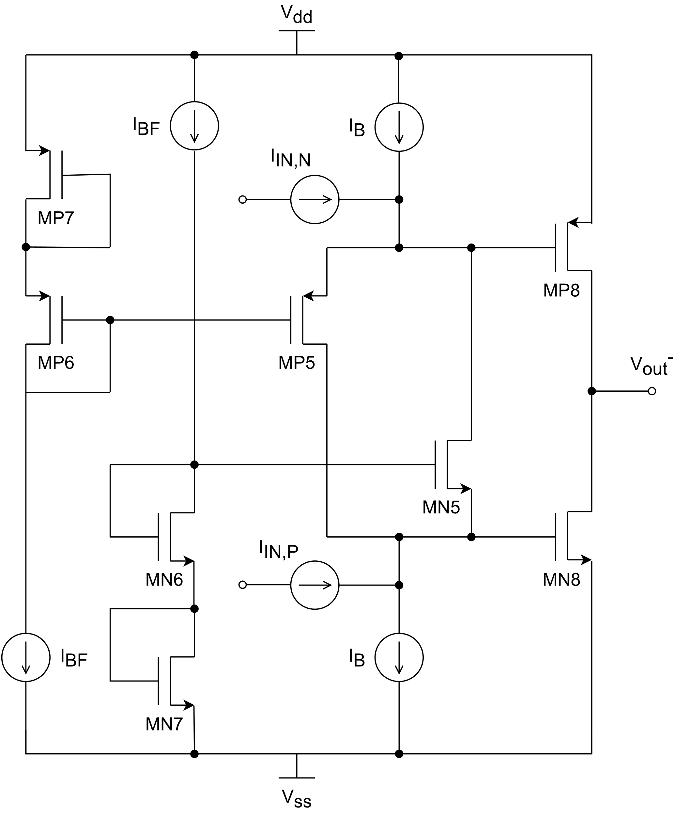
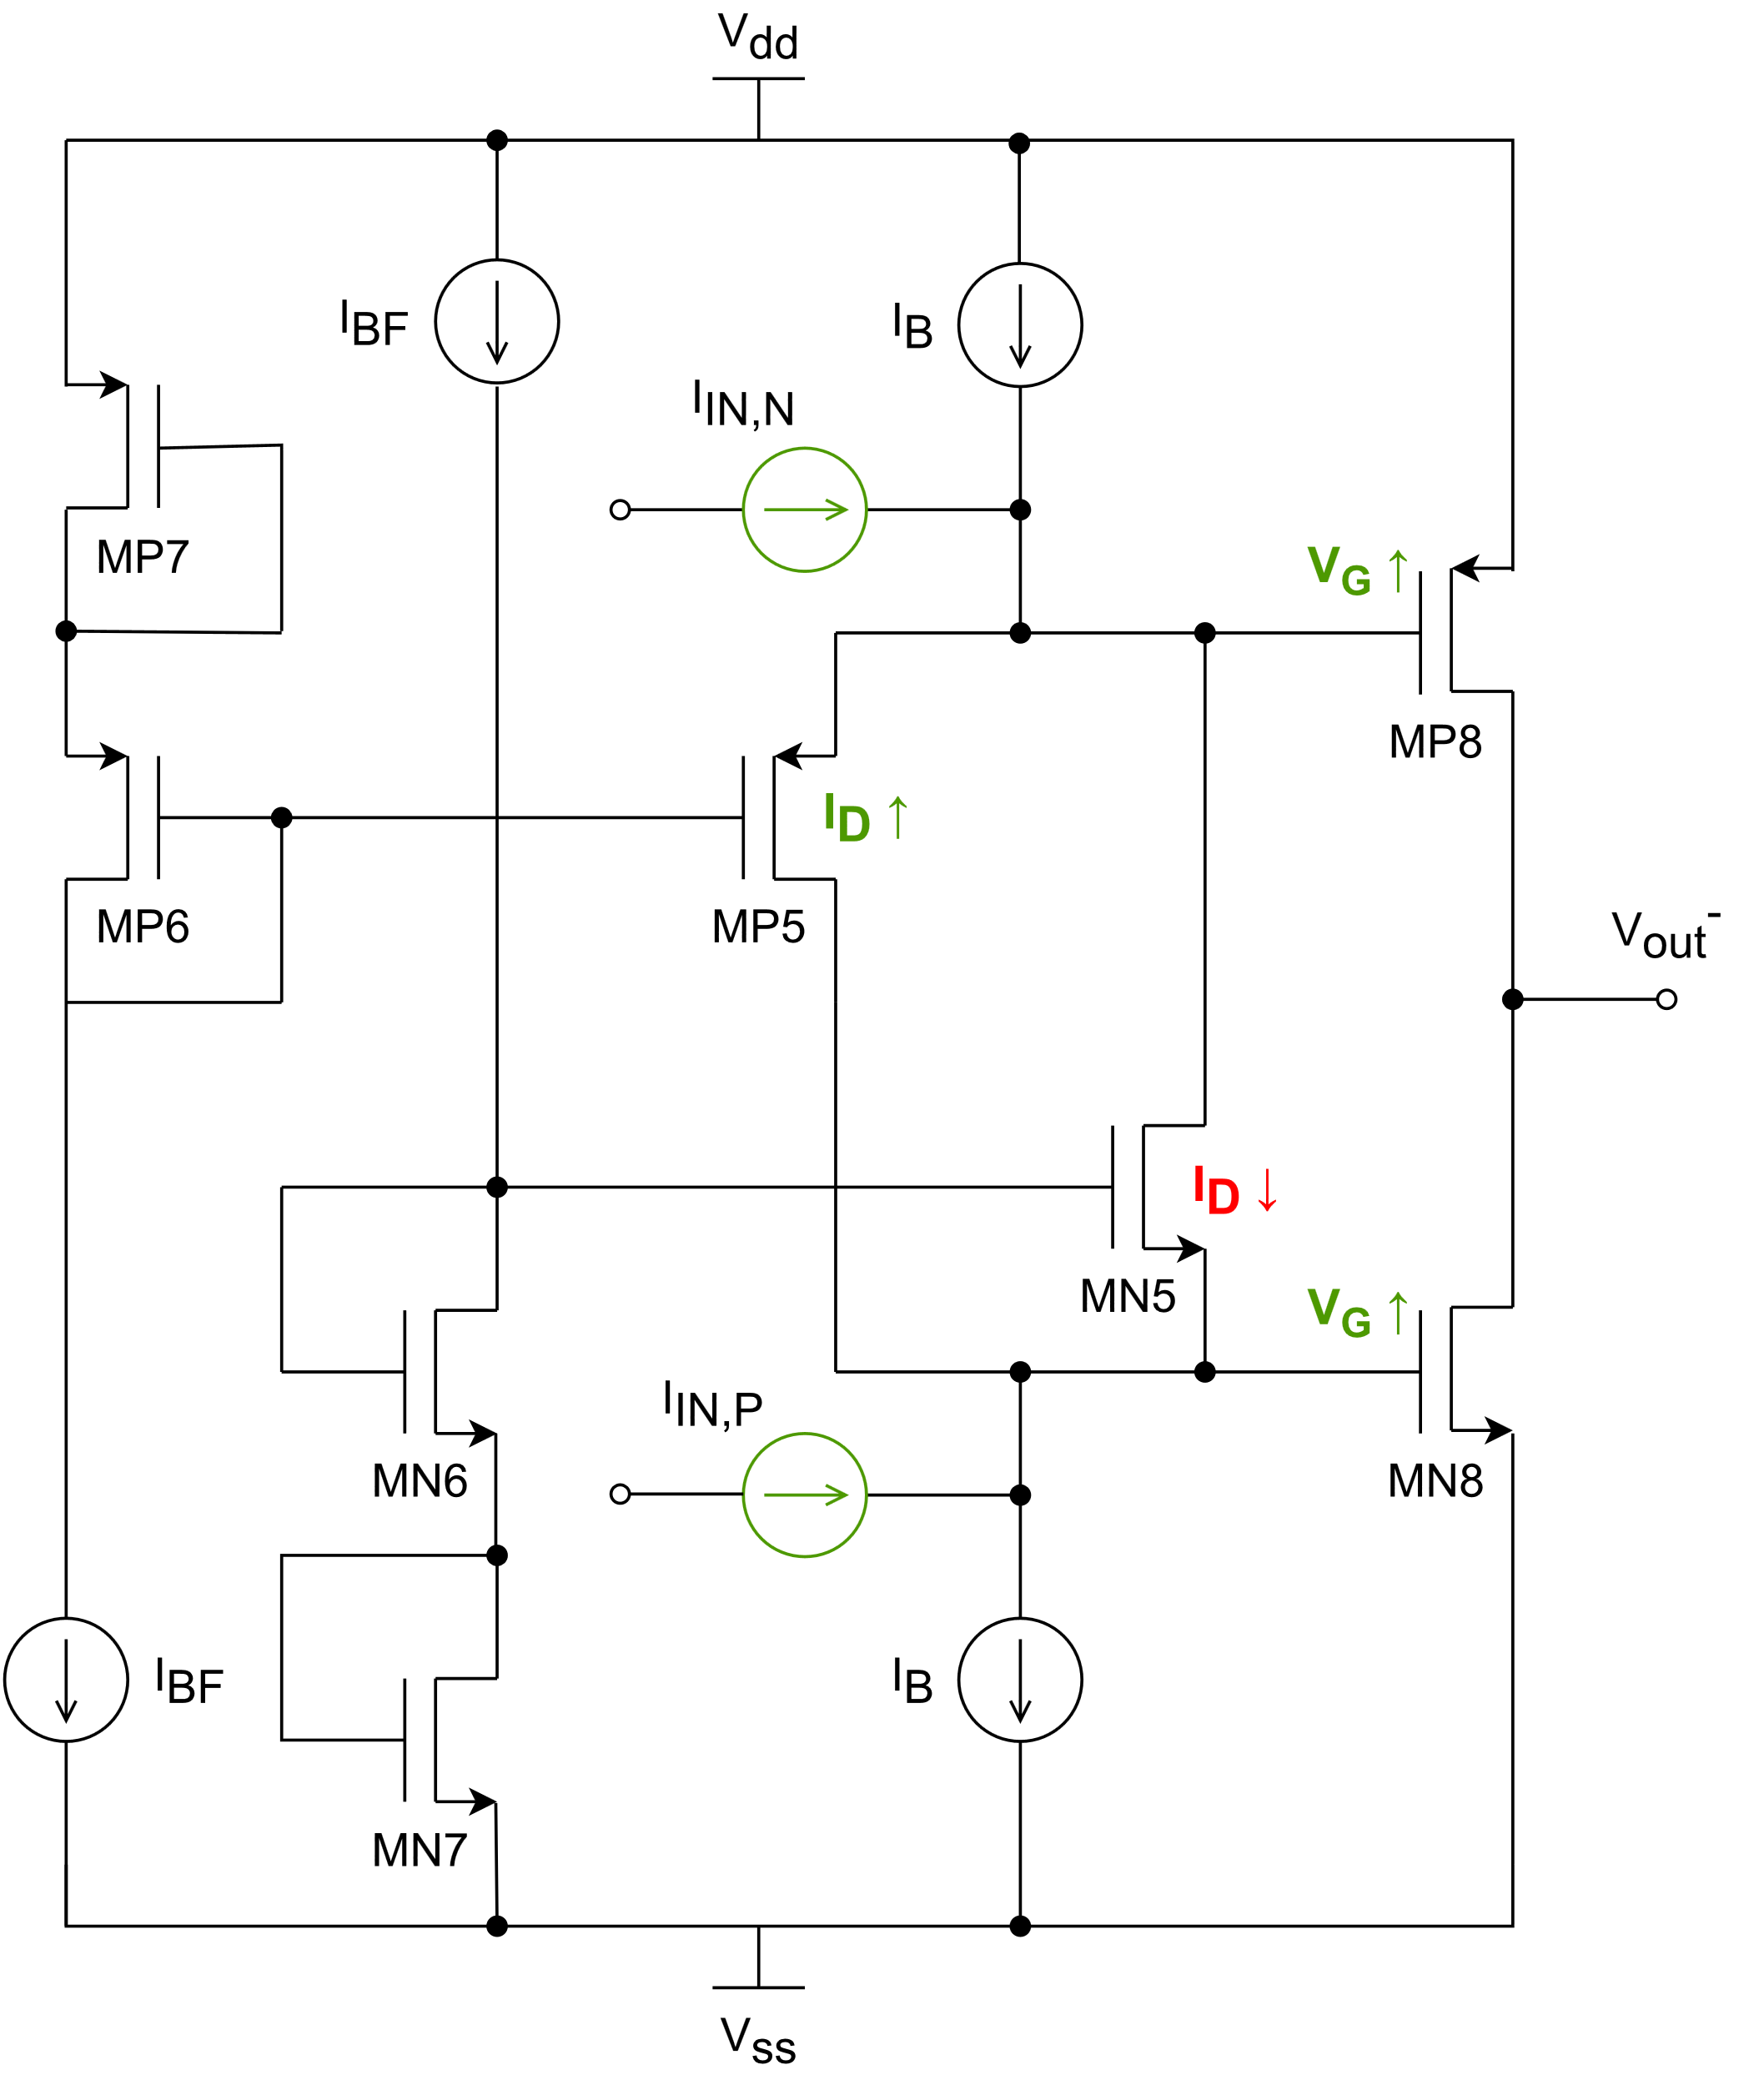
2. FDOA architecture 2.3. Class AB output
Class AB → Keep the RTR behavior at the output.
It is based on a common-source configuration (MP8-MN8), but the signal is driven to both transistors with a DC shift between them.
The DC shift is controlled by the floating transistors MP5 and MN5.
When Input currents are pushed into the circuit, I_{DP5} ↑ ; I_{DN5} ↓ → V_{GP8} ↑ ; V_{GN8} ↑
When Input currents are pulled into the circuit, I_{DP5} ↓ ; I_{DN5} ↑ → V_{GP8} ↓ ; V_{GN8} ↓
For small signals, both MP8 and MN8 are active with a moderate DC current. For large signals:
MP8 active for the pulse positive half.
MN8 active for the pulse negative half.

Slide 30
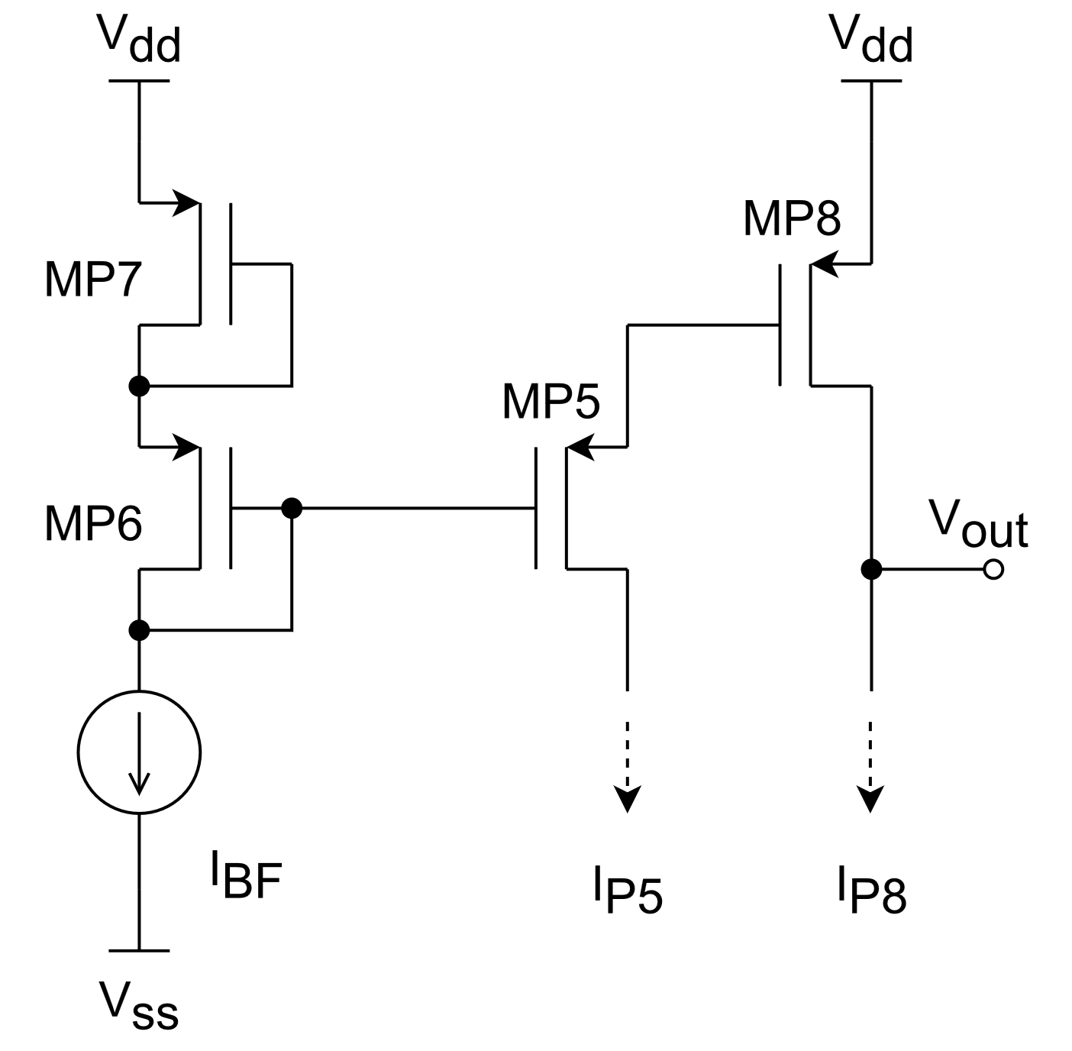
2. FDOA architecture 2.3. Class AB output
DC quiescent output current is controlled by a translinear loop formed by MP5…MP8.
Overdive voltages can be related as:
$$2V_{OD,6}=V_{OD,5}+V_{OD,8}$$
If overdrive voltages of MP6, and MP5 match, the output current can be calculated as:
$$I_{D8}=\frac{{\left(W/L\right)}_{8}}{{\left(W/L\right)}_{6,7}}I_{D6,7}$$

Slide 31
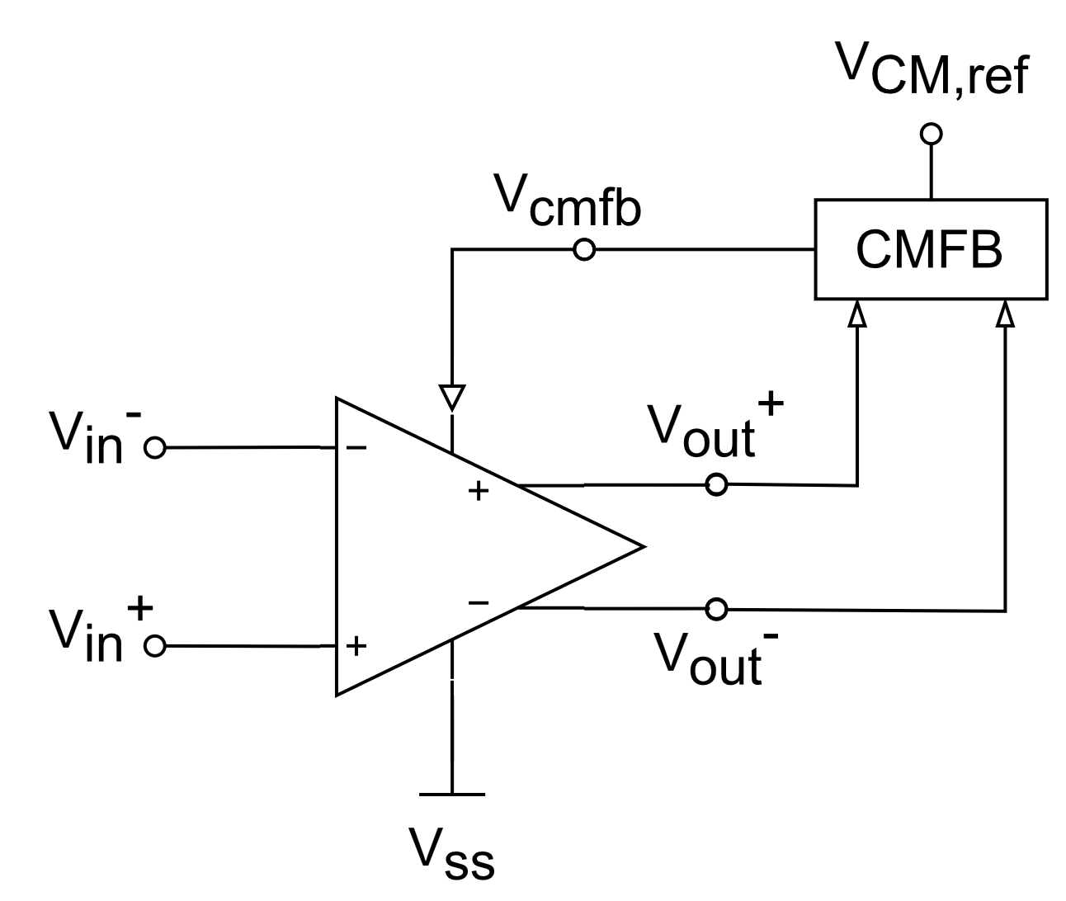
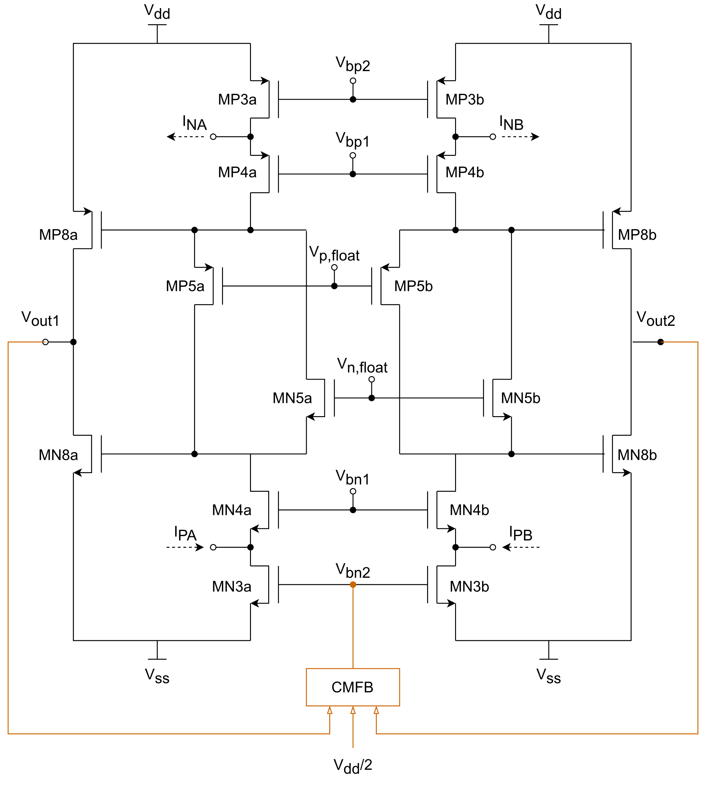
2. FDOA architecture 2.4. Common-mode feedback (CMFB)
CMFB senses output DC level and stabilize it to a reference value (V_{cm,ref}) that maximizes the amplifier’s dynamic range (V_{dd}/2).
CMFB creates a feedback loop that must be stable and ensure a very high gain for proper stabilization.

Slide 32
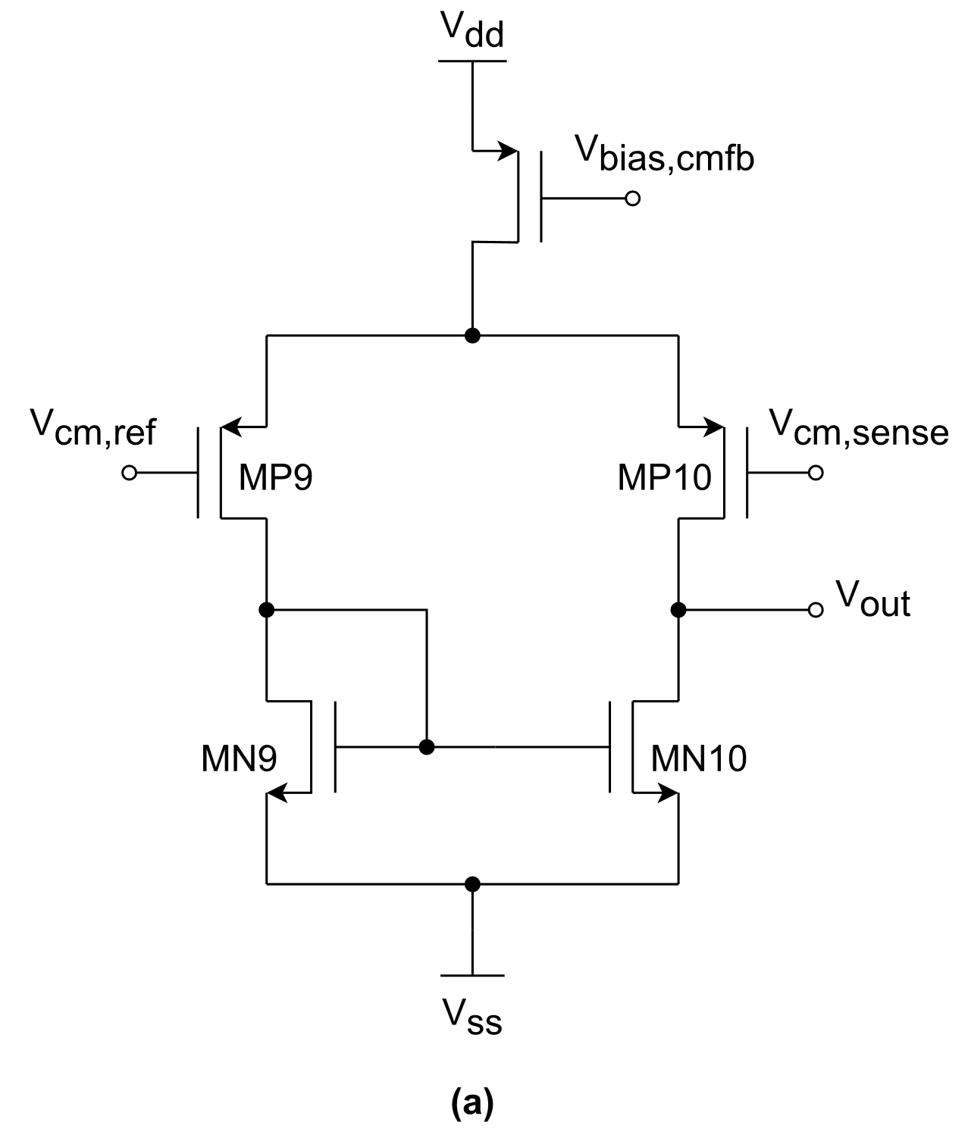
2. FDOA architecture 2.4. Common-mode feedback (CMFB) amplifier
The architecture of the CMFB amplifiers consists in:
Averaging the differential DC outputs by means of 2 resistors R_{cmfb}.
High resistance to avoid gain degradation.
Differential pair amplifier to achieve an open-loop gain high enough to guarantee the proper stabilization of the DC output level.

