Slide 1
Revisiting particle acceleration at ultra-relativistic shocks
Gamma 2022, Barcelona
Zhi-Qiu Huang
Brian Reville
John Kirk
Gwenael Giacinti

Slide 2
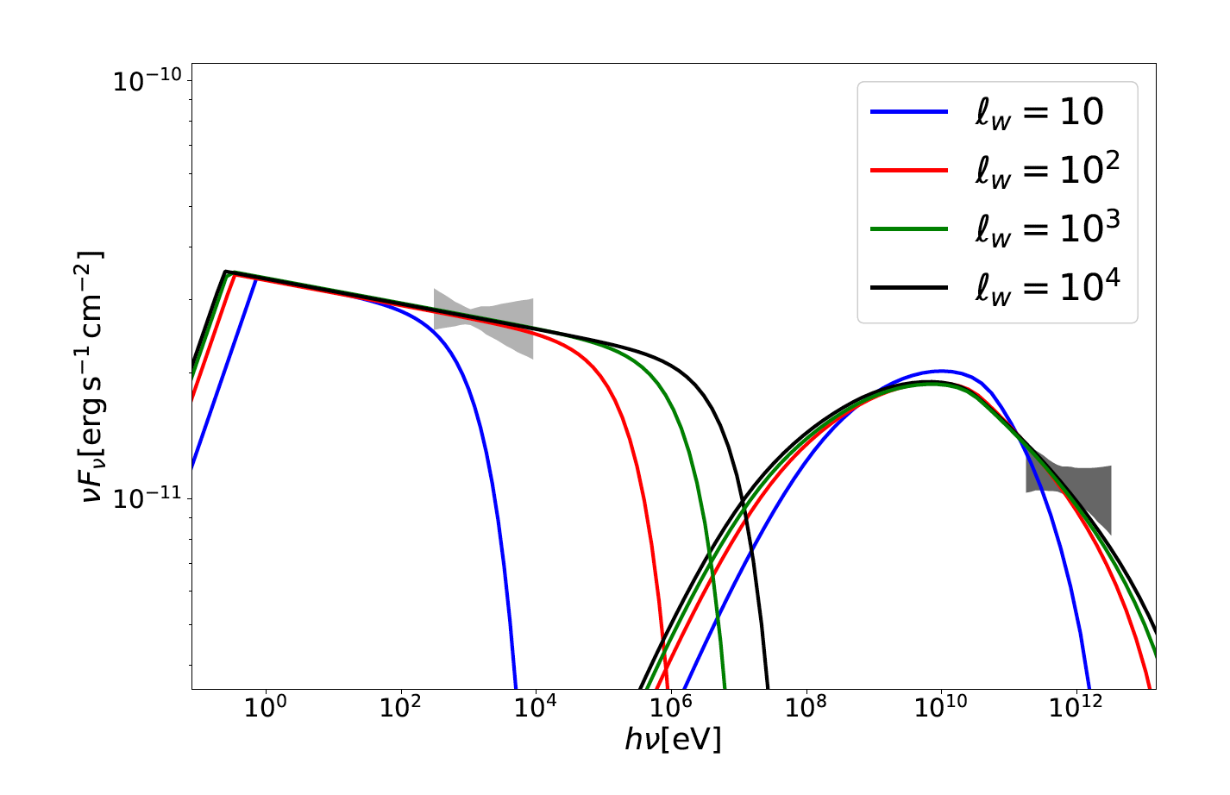
Why do we revisit?
lw = 10: characteristic scale of
magnetic fluctuations in
terms of ion skin depths
from PIC simulations
(e.g., Sironi et al. 2013)
GRB 190829A
Huang et al. 2022
ApJ 925 182

Slide 3
Relativistic shocks
downstream
upstream
downstream
upstream
Bd
1/γs
particle
particle
Bu
γs: >> 1
shock
shock

Slide 4
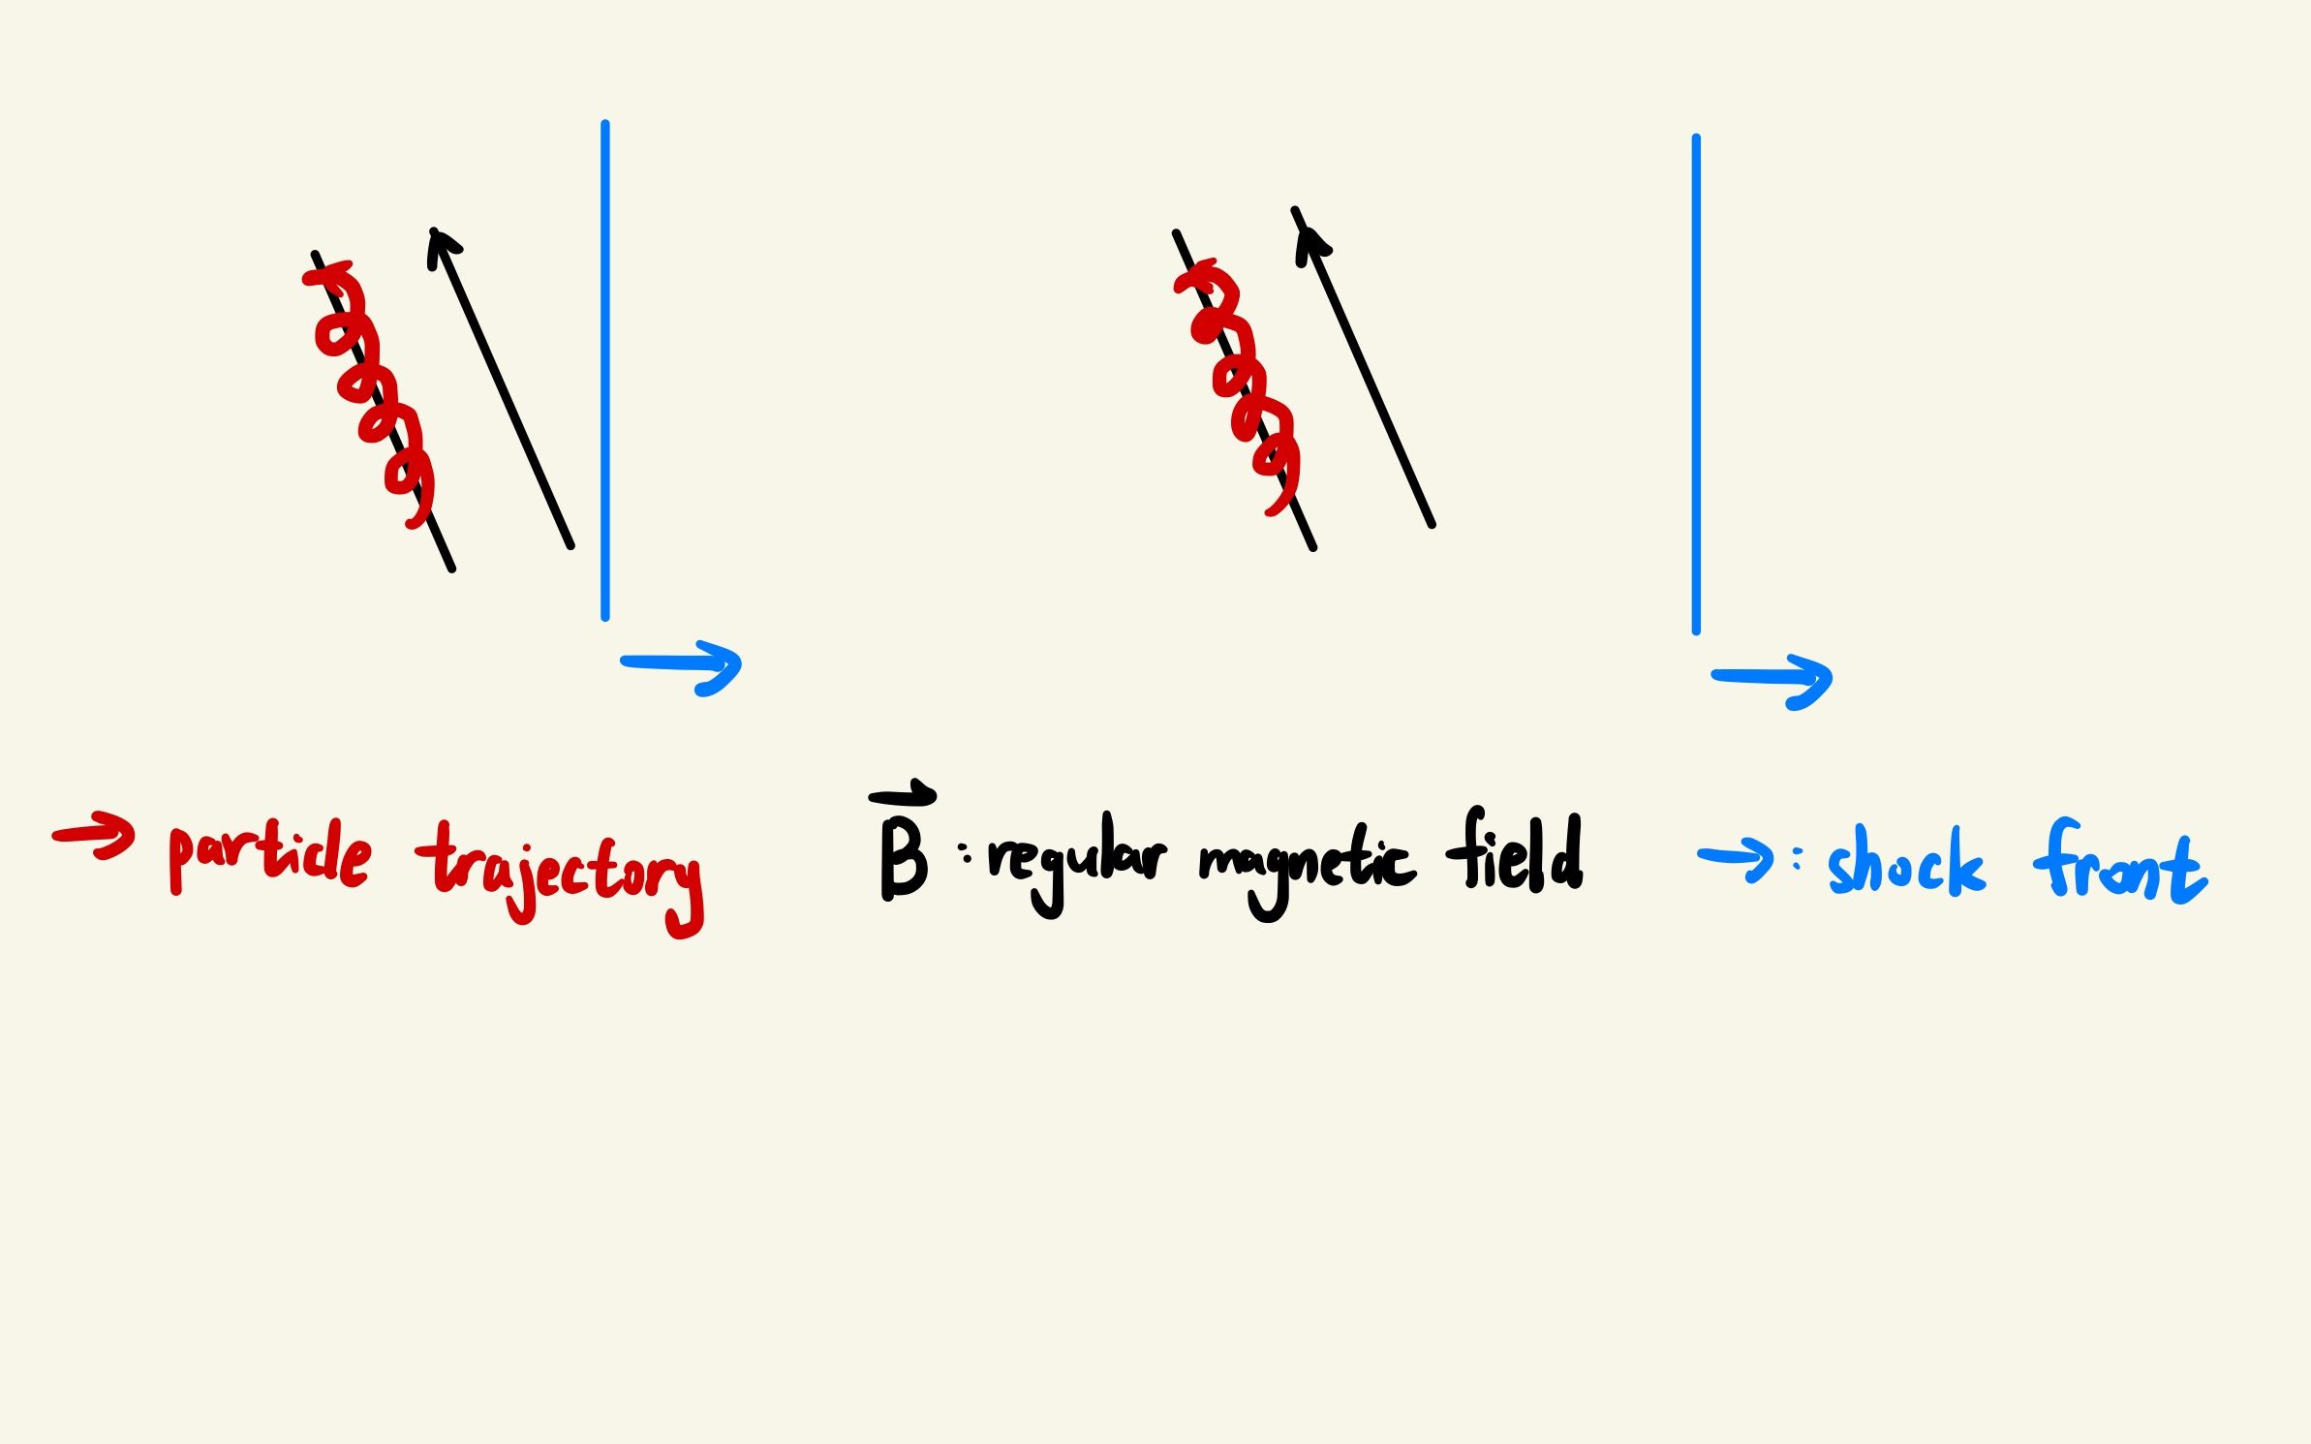
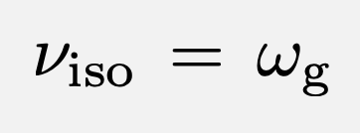
Magnetized limit
For acceleration to proceed,
the isotropization rate in
downstream must exceed the
gyro-frequency.
Achterberg et al. 2001
Magnetized limit:

Slide 5
Code
Monte-Carlo simulation to calculate particle trajectory
Regular magnetic field (jump condition when crossing the shock)
Small angle scattering
Particle splitting method
Energy losses

Slide 6
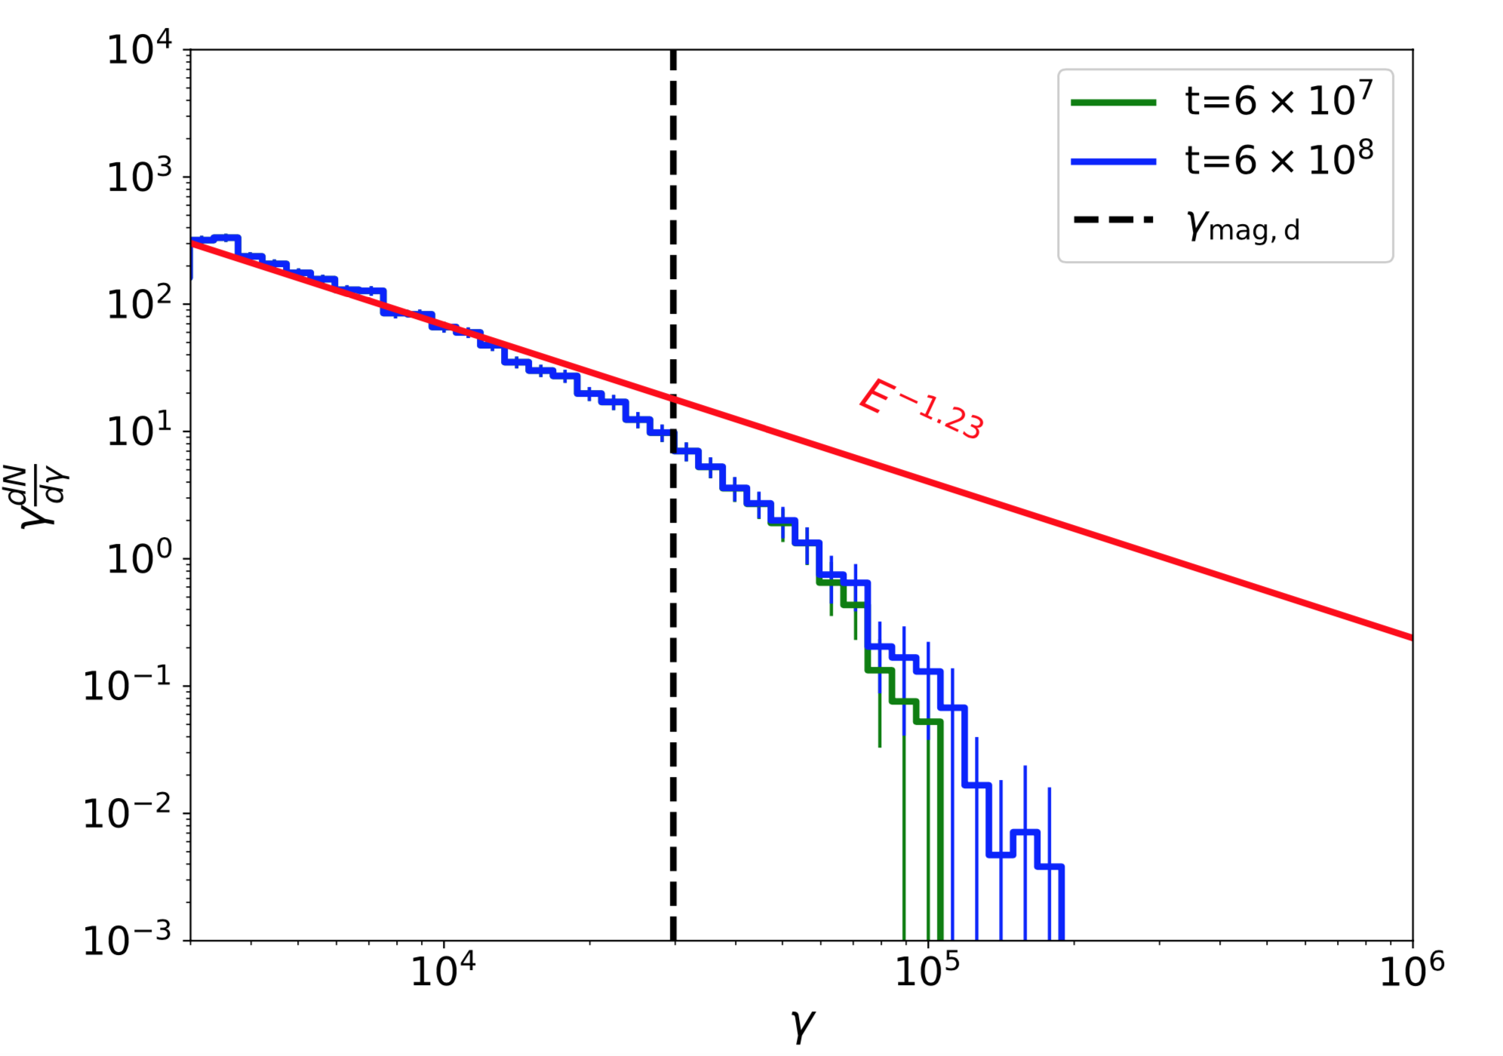
Perpendicular case
Scattering rates in upstream and downstream are both proportional to γ^-2, as expected for particle scattering in small scale fluctuations
Red: Kirk, Guthmann et al. 2000
Weak scattering in upstream

Slide 7
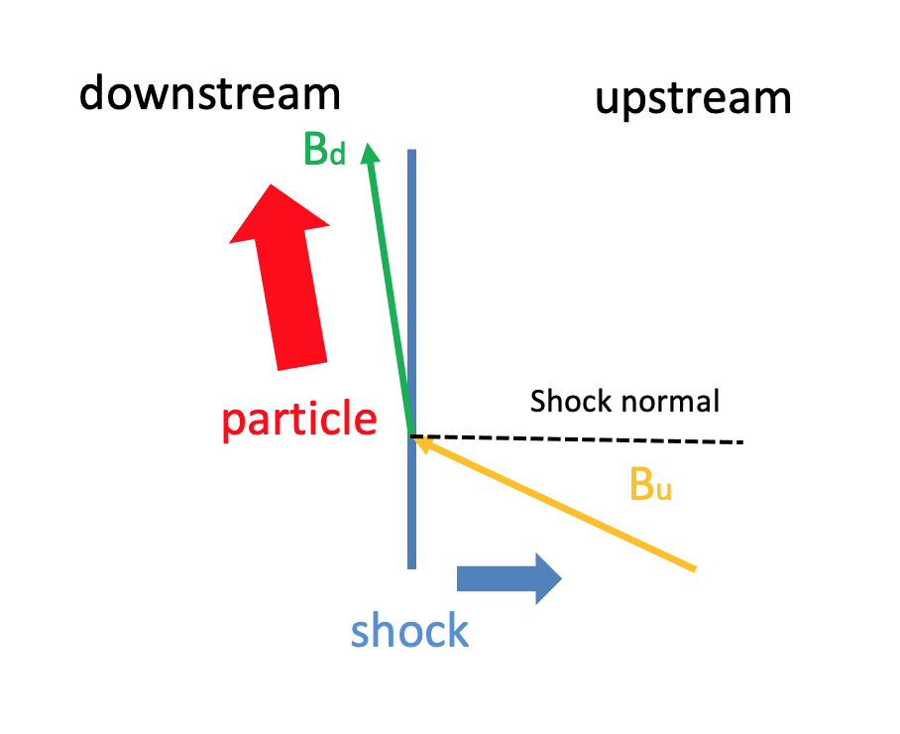
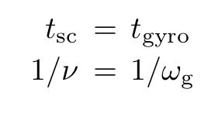
Magnetized limit in downstream

Slide 8
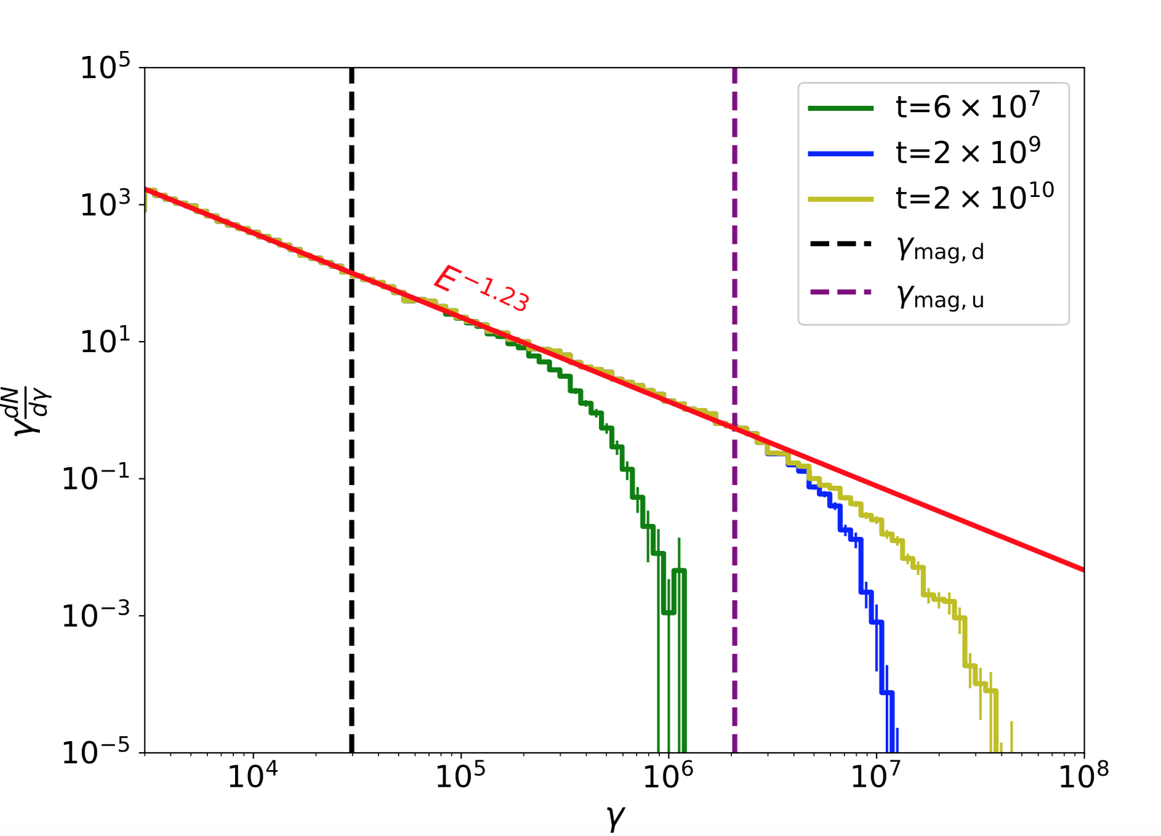
Perpendicular case
Strong scattering in upstream

Slide 9
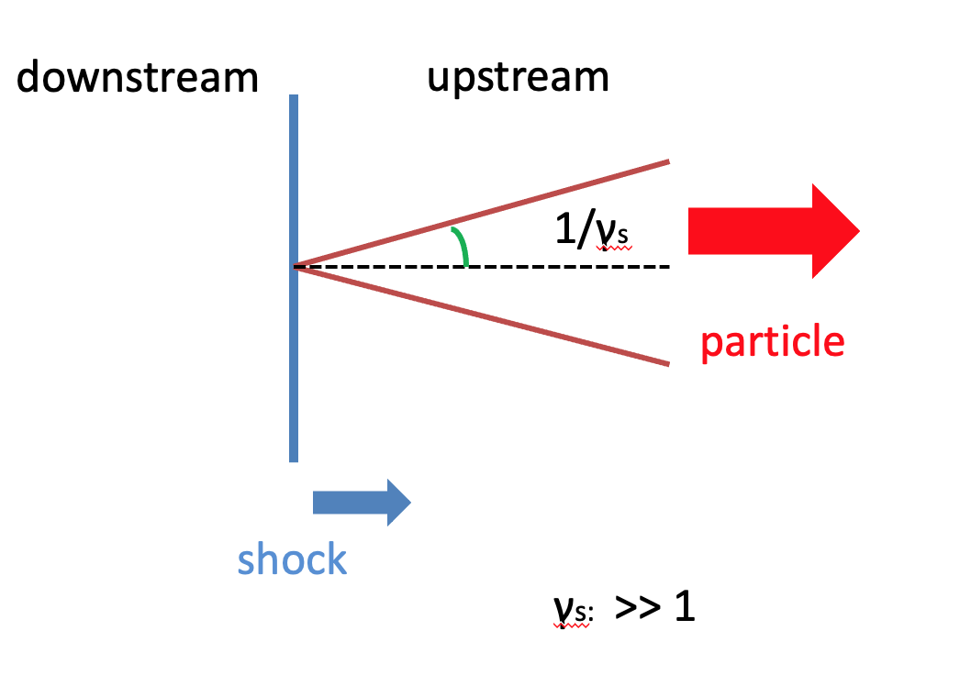
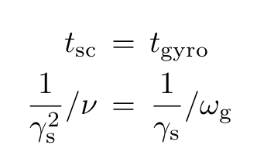
Magnetized limit in upstream

Slide 10
Perpendicular case
Strong scattering in upstream
How can these particles return back to upstream?

Slide 11
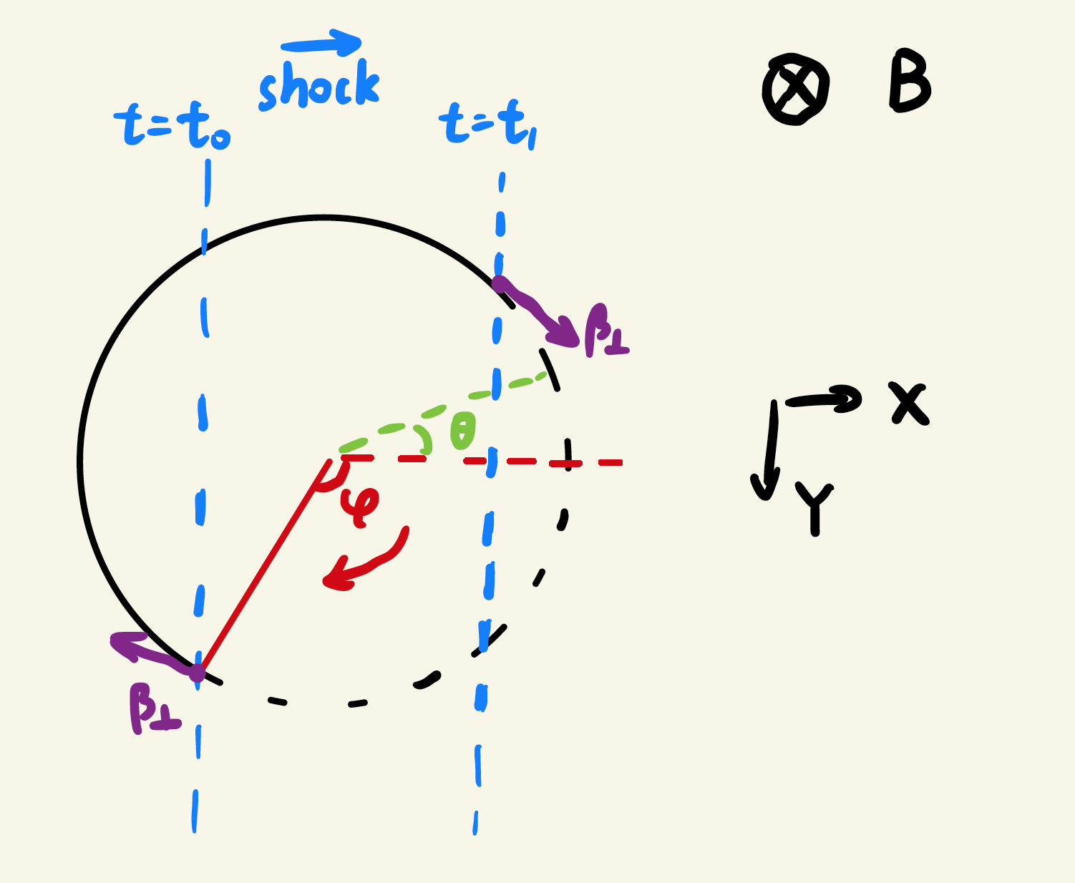
Particle trajectory
down
up
t=t0
t=t1
particle
shock

Slide 12
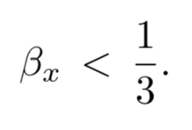
Conditions
When moving to upstream (t=t1)
When moving to downstream (t=t0)
Condition A
Condition B

Slide 13
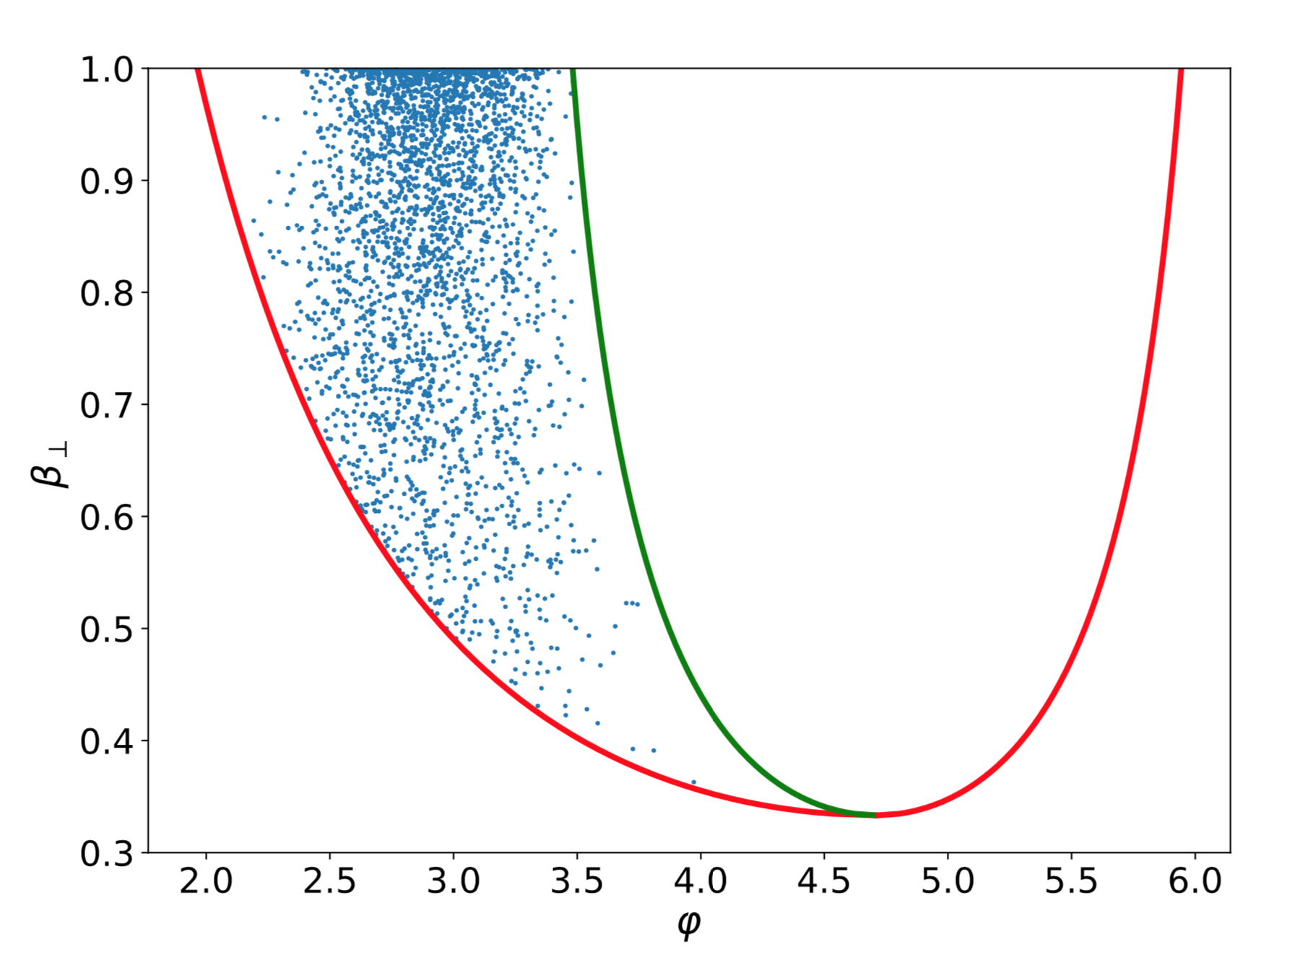
Phase distribution
Red: condition A
Green: condition B
Blue: particle phases
Phase distribution is not uniform!

Slide 14
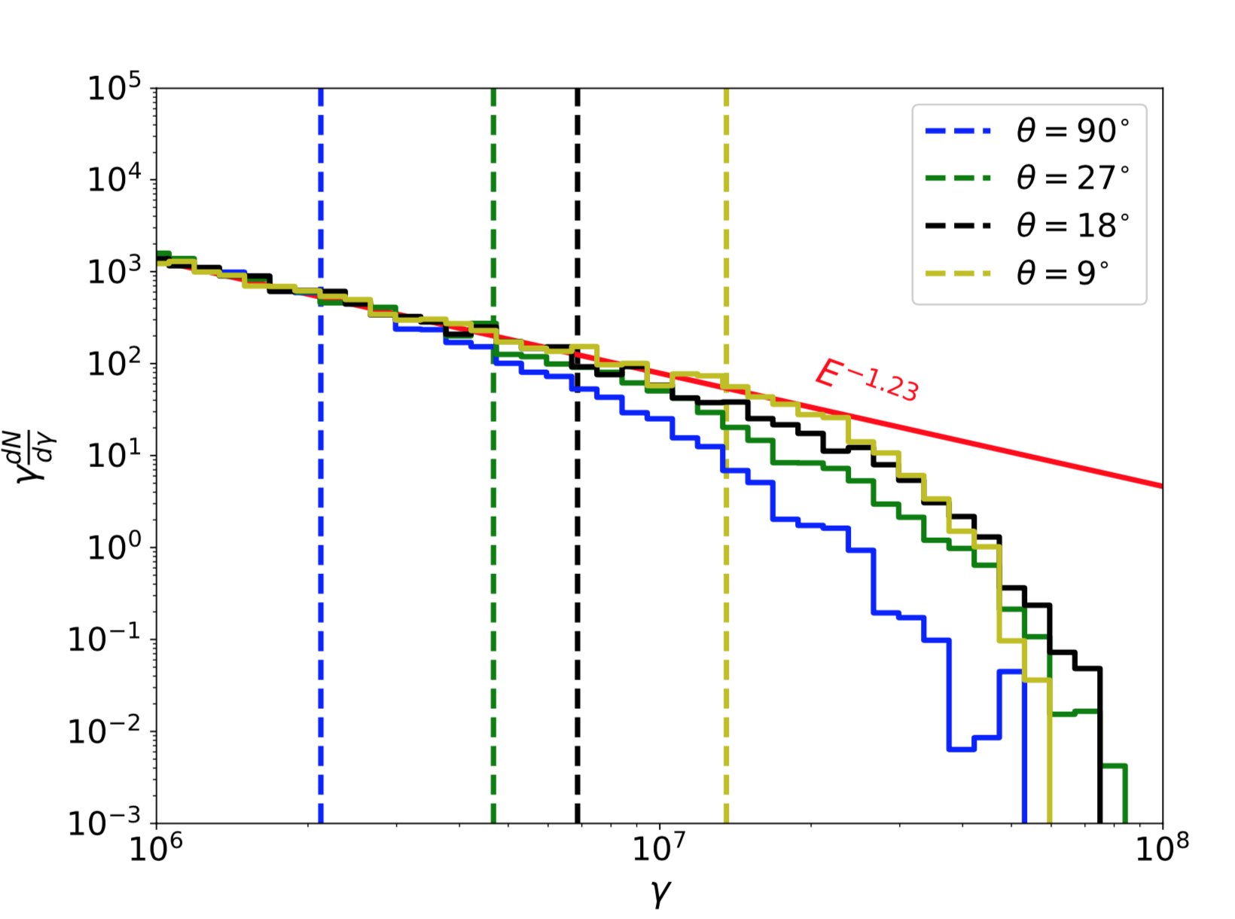
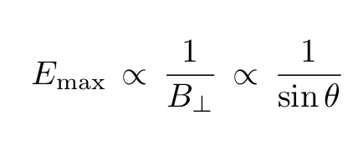
Oblique case
θ: declination angle with
shock normal (>> 1/γs)
Btotal: constant

Slide 15
Role of large scale fields
Consider the existence of a large-scale magnetic field,
small scale
large scale
It is possible that particles are always unmagnetized in upstream. External
turbulence in progenitor’s environment might be sufficient to provide the
necessary upstream scattering at large energies.

Slide 16
Conclusions
Scattering in upstream is also important for shock acceleration.
The magnetized limit in downstream is a weak condition.
The maximum accelerated energy can exceed the magnetized limit in
downstream, and may reach the Bohm limit.

Slide 17
Thank you!

