Slide 1
Test Pulse System
status
By Daniel Marín

Slide 2
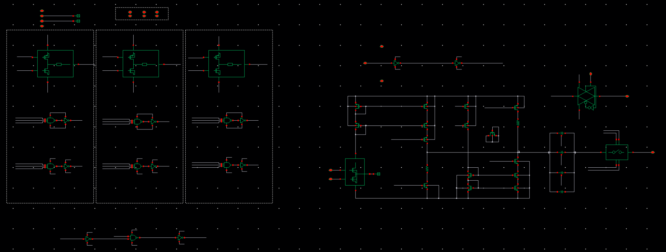
Test pulse system schematic

Slide 3
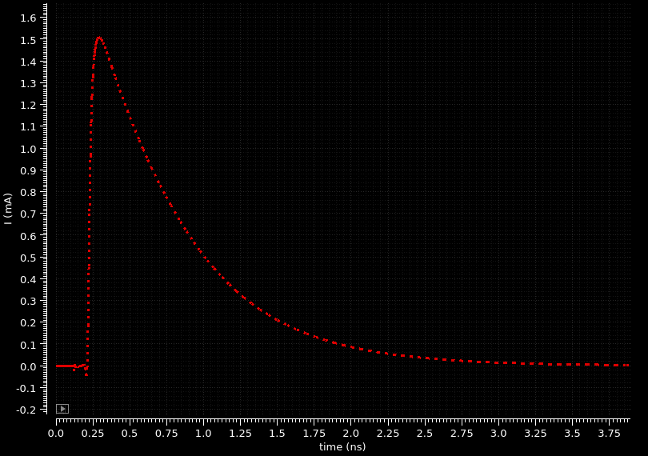
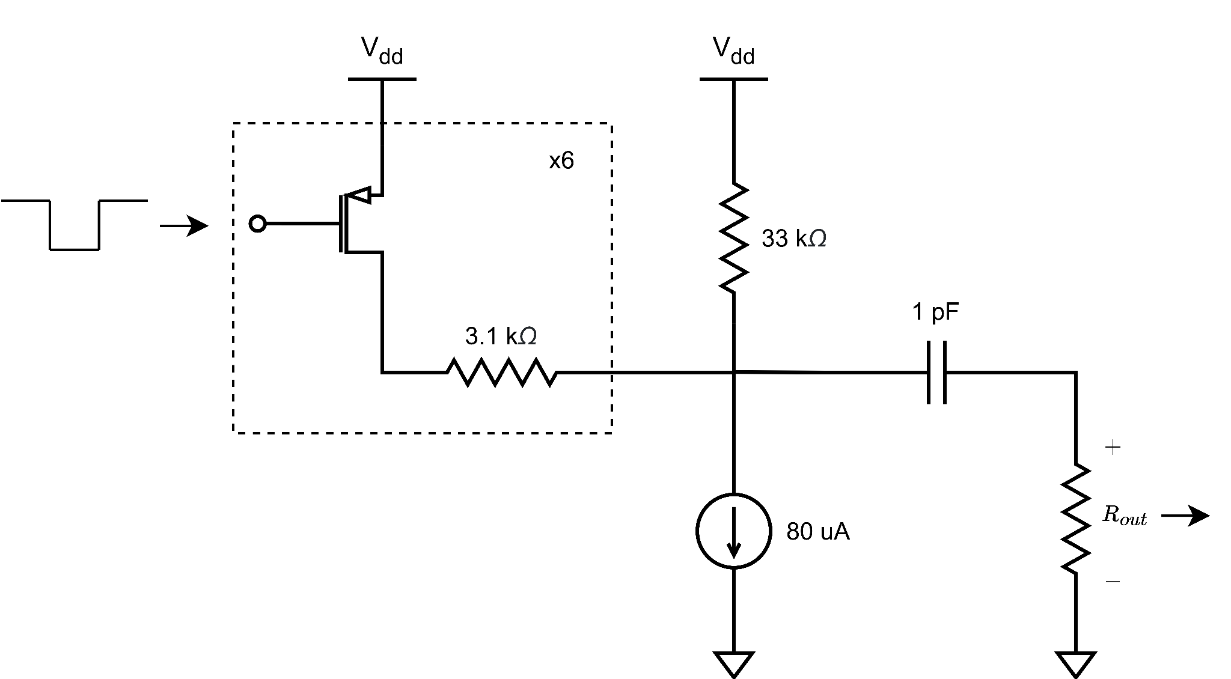
Test pulse system simplified schematic

Slide 4
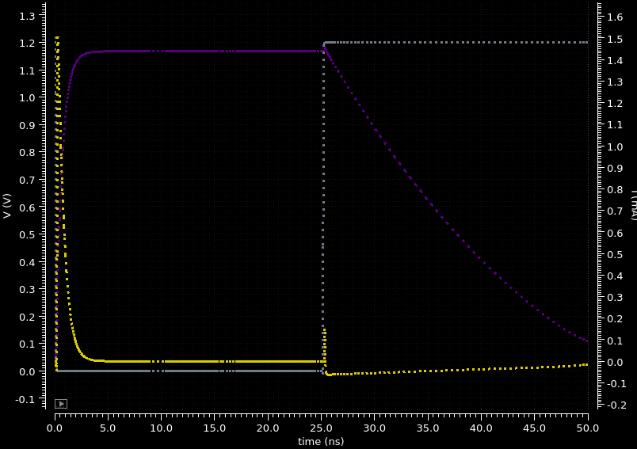
Test pulse system WF

Slide 5
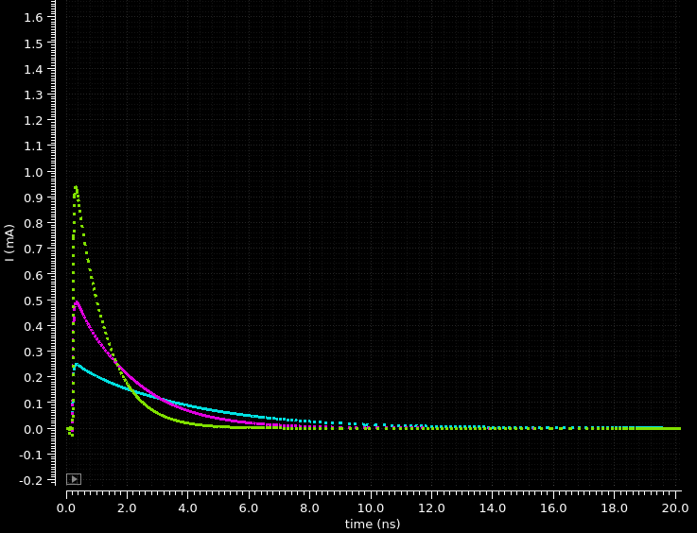
Test pulse system Resistance select

Slide 6
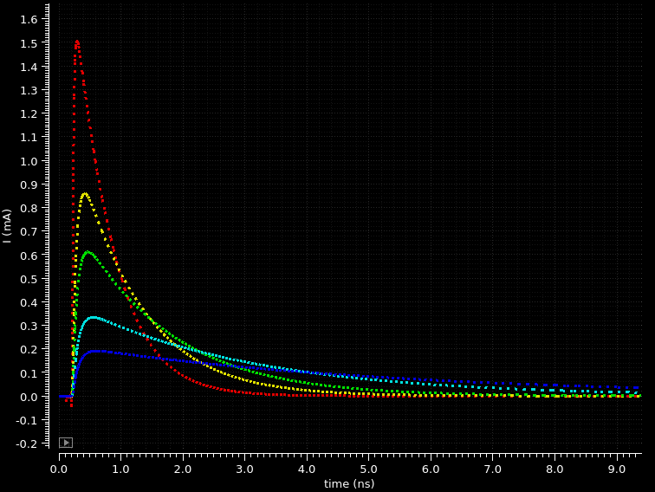
Test pulse system Capacitor

