Slide 1
A search for molecular-type hidden charm pentaquarks with an improved unitarization method
Erick Garcia
Collaborators: Volodymyr Magas (UB), Àngels Ramos (UB)

Slide 2
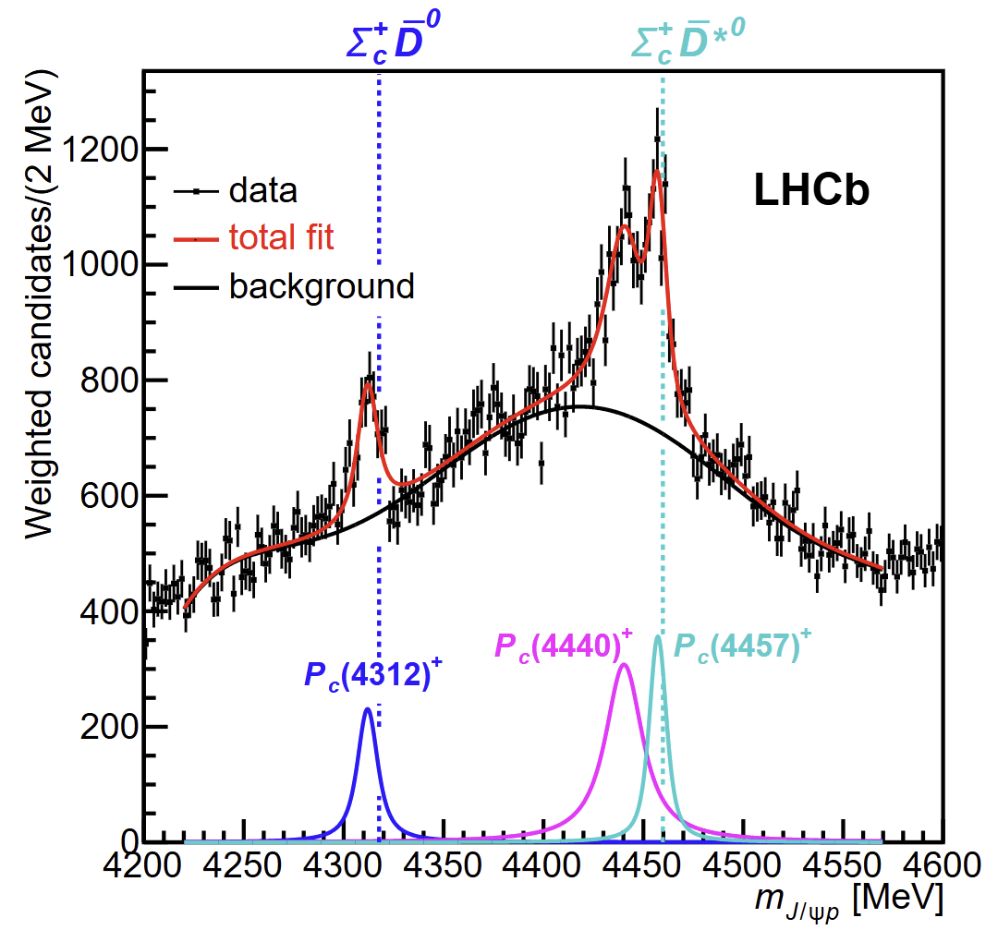
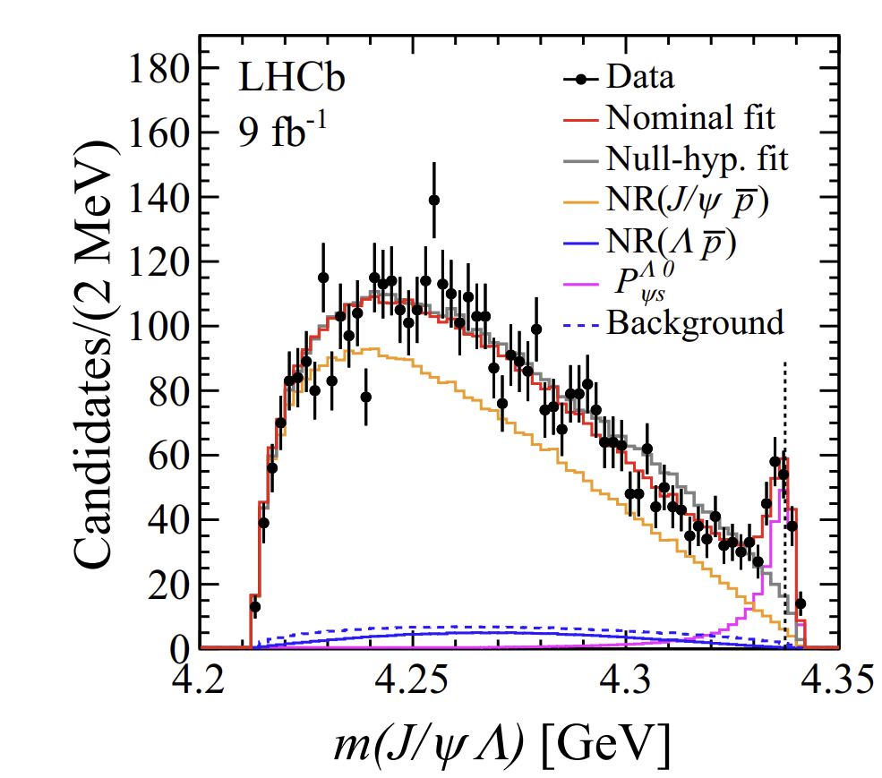
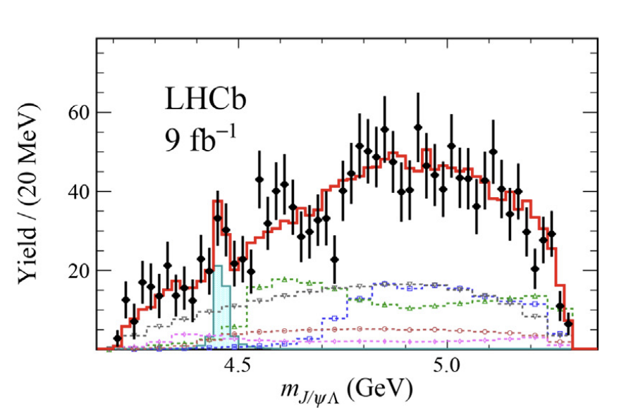


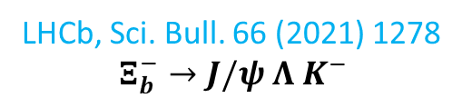

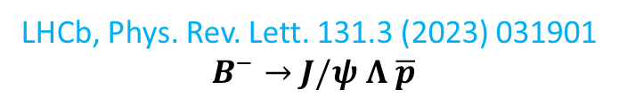

Experimental evidence of hidden charm pentaquarks states ($c\overline{c}qqq$)
We focus in the hidden charm sector, where six exotic baryons were found: $P_{c}{\left(4312\right)}^{+},P_{c}{\left(4380\right)}^{+},P_{c}{\left(4440\right)}^{+},P_{c}{\left(4457\right)}^{+},P_{cs}{\left(4338\right)}^{0},P_{cs}{\left(4459\right)}^{0}$
LHCb, Phys. Rev. Lett. 131.3 (2023) 031901
$$B^{−}→J/ψ Λ \overline{p}$$
LHCb, Sci. Bull. 66 (2021) 1278
$$Ξ_{b}^{−}→J/ψ Λ K^{−}$$
$S=−2$?
Marsé-Valera, Magas & Ramos, PRL (2023)
LHCb Coll., Phys. Rev. Lett. 122 (2019) 222001
$$Λ_{b}^{0}→J/ψ K^{−} p$$

Slide 3
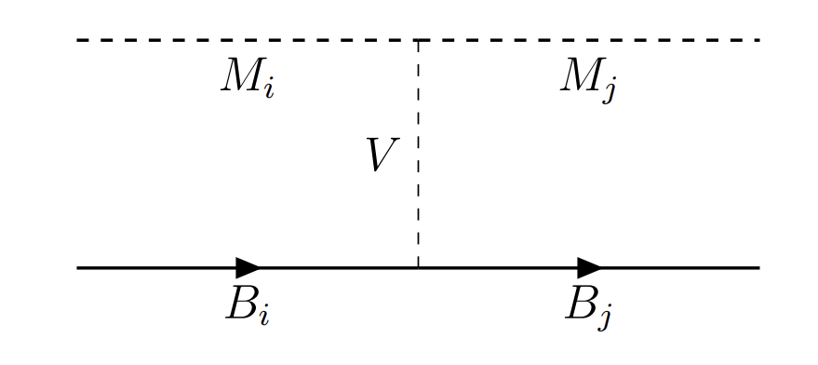
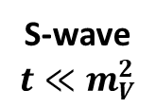
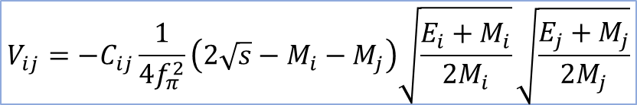

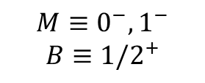
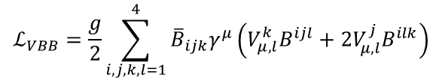

Vector Meson Exchange scheme
J. Hofmann and M. F. M. Lutz. Nucl. Phys. A 763 (2005), pp. 90
$$ℒ_{VPP}=−ig\left\langle \left[φ,∂_{μ}φ\right]V^{μ}\right\rangle$$
$$ℒ_{VVV}=ig\left\langle \left[V^{μ},∂_{ν}V_{μ}\right]V^{ν}\right\rangle$$
$$M≡0^{−}, 1^{−}$$
$$B≡{1/2}^{+}$$
$$ℒ_{VBB}=\frac{g}{2}\sum_{i,j,k,l=1}^{4}{{\overline{B}}_{ijk}γ^{μ}\left(V_{μ,l}^{k}B^{ijl}+2V_{μ,l}^{j}B^{ilk}\right)}$$
S-wave
$$t≪m_{V}^{2}$$
$$V_{ij}=−C_{ij}\frac{1}{4f_{π}^{2}}\left(2\sqrt{s}−M_{i}−M_{j}\right)\sqrt{\frac{E_{i}+M_{i}}{2M_{i}}}\sqrt{\frac{E_{j}+M_{j}}{2M_{j}}}$$
Interaction kernel:

Slide 4
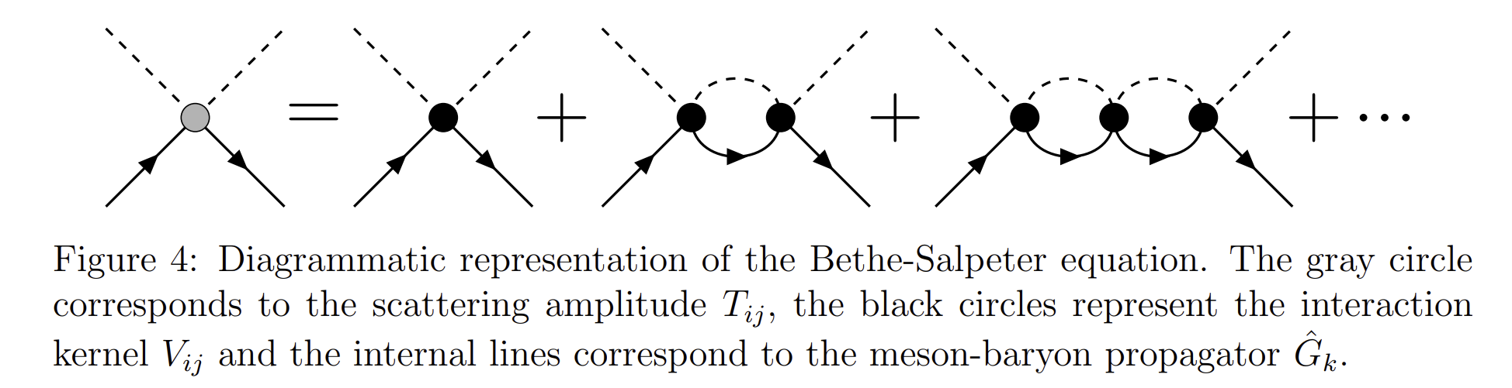




Unitarized Chiral Perturbation Theory (UChPT) I
Resonances are dynamically generated as poles of the scattering amplitude $T_{ij}$, which is unitarized via the Bethe-Salpeter equation:
$$T_{ij}\left(\sqrt{s},k_{i},k_{j}\right)=V_{ij}\left(\sqrt{s},k_{i},k_{j}\right)+\sum_{k}{i}\int{\frac{d^{4}q_{k}}{{\left(2π\right)}^{4}}V_{ik}\left(\sqrt{s},k_{i},q_{k}\right)\hat{G}\left(\sqrt{s},q_{k}\right)T_{kj}\left(\sqrt{s},q_{k},k_{j}\right)}$$
$${\hat{T}}_{ij}$$
$${\hat{V}}_{ij}$$
$${\hat{G}}_{k}$$

Slide 5
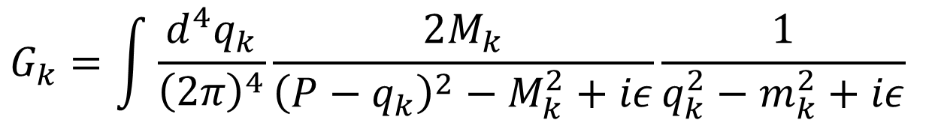


UChPT II
UChPT solves the Bethe-Salpeter equation non-perturbatively considering the on-shell approximation:
$$T_{ij}=V_{ij}+V_{ik}G_{k}T_{kj}$$
$$T={\left(1−VG\right)}^{−1}V$$
where now $G_{k}$ is the meson-baryon loop function:
$$G_{k}=\int{\frac{d^{4}q_{k}}{{\left(2π\right)}^{4}}\frac{2M_{k}}{{\left(P−q_{k}\right)}^{2}−M_{k}^{2}+iε}\frac{1}{q_{k}^{2}−m_{k}^{2}+iε} }$$
The loop function requires regularization: $G^{DR}$ or $G^{cut}$.

Slide 6
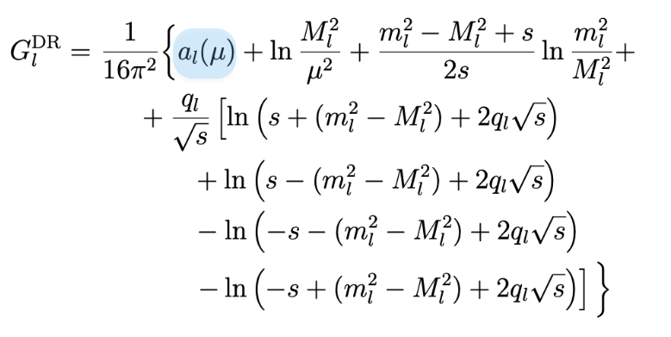
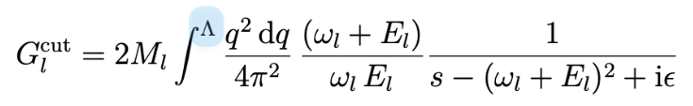


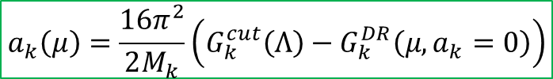
Loop function regularization (I)
$$μ=1000 MeV$$
$$Λ=600−1000 MeV$$
We impose that $G^{cut}$ and $G^{DR}$ match at threshold:
$$a_{k}\left(μ\right)=\frac{16π^{2}}{2M_{k}}\left(G_{k}^{cut}\left(Λ\right)−G_{k}^{DR}\left(μ,a_{k}=0\right)\right)$$

Slide 7
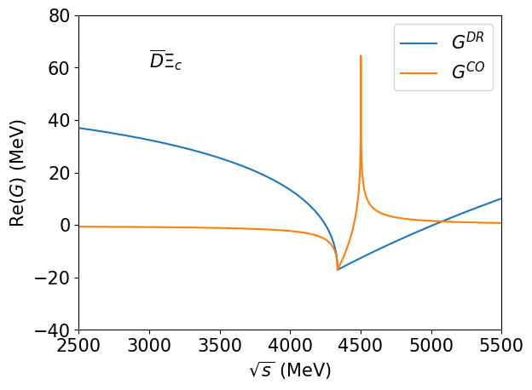
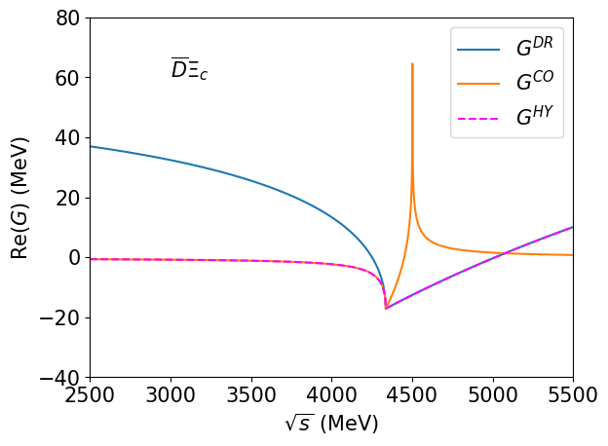

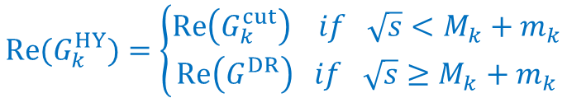
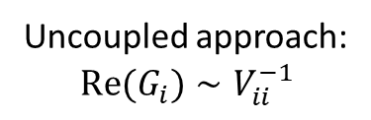

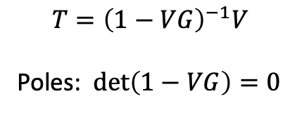

Loop function regularization (II)
$$T={\left(1−VG\right)}^{−1}V$$
Poles: $\det\left(1−VG\right)=0$
Uncoupled approach:
$$Re(G_{i})∼V_{ii}^{−1}$$
$$V^{−1}$$
Repulsive
Hybrid Loop:
$$V^{−1}$$
$$Re(G_{k}^{HY})=\left\{\begin{aligned}Re\left(G_{k}^{cut}\right) if \sqrt{s}<M_{k}+m_{k} \\ Re\left(G^{DR}\right) if \sqrt{s}≥M_{k}+m_{k}\end{aligned}\right.$$
Attractive
$$Im\left(G_{k}^{HY}\right)=Im\left(G_{k}^{DR}\right)$$

Slide 8
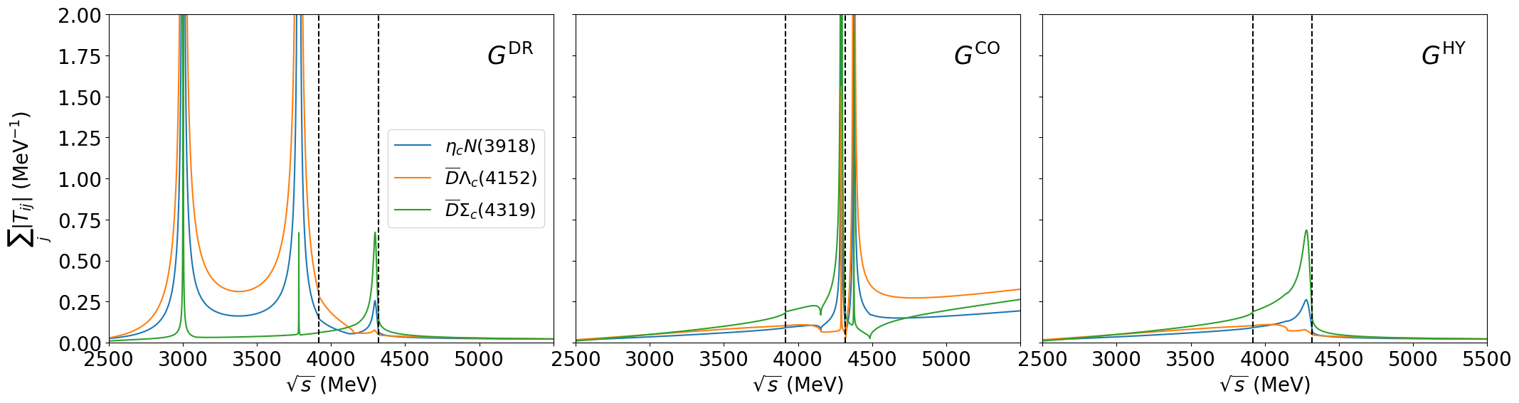

Sector $S=0, I=1/2$

Slide 9
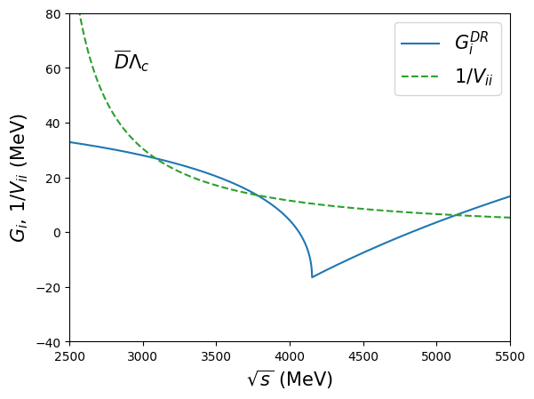
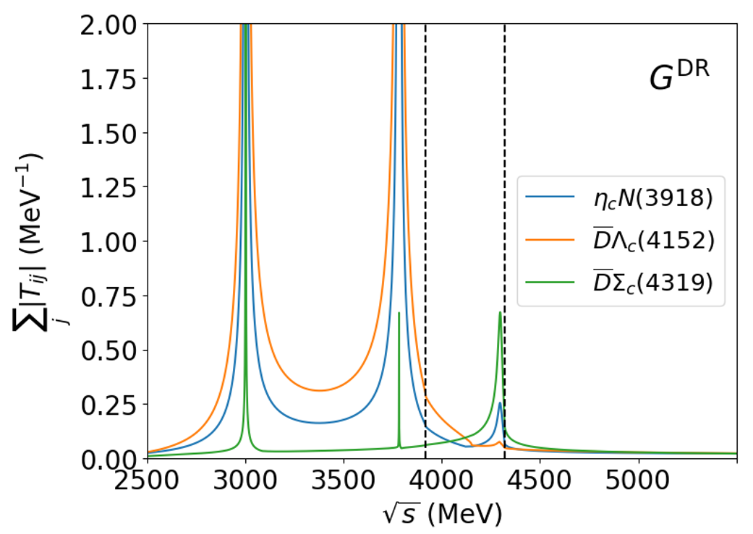
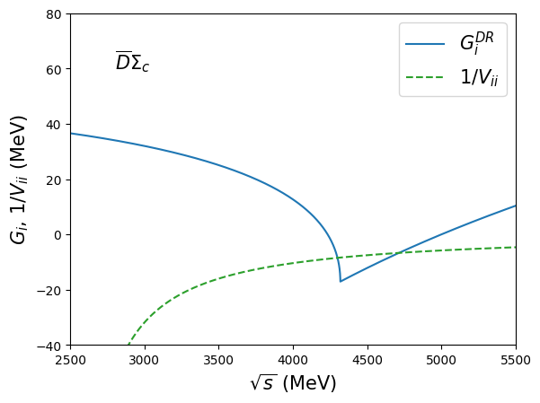

Sector $S=0, I=1/2$ ($G^{DR}$)

Slide 10
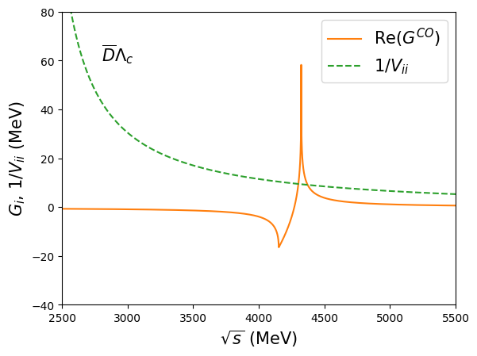
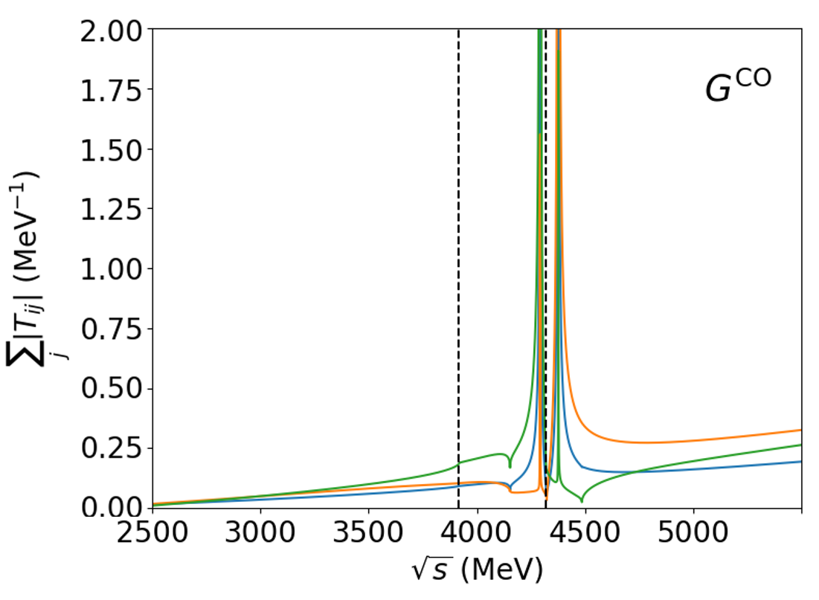
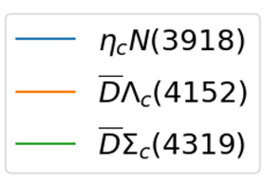
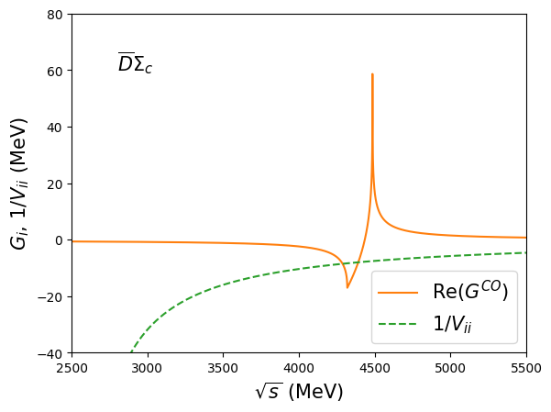

Sector $S=0, I=1/2$ ($G^{cut}$)

Slide 11
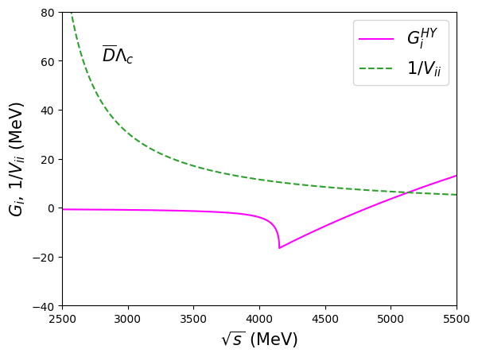
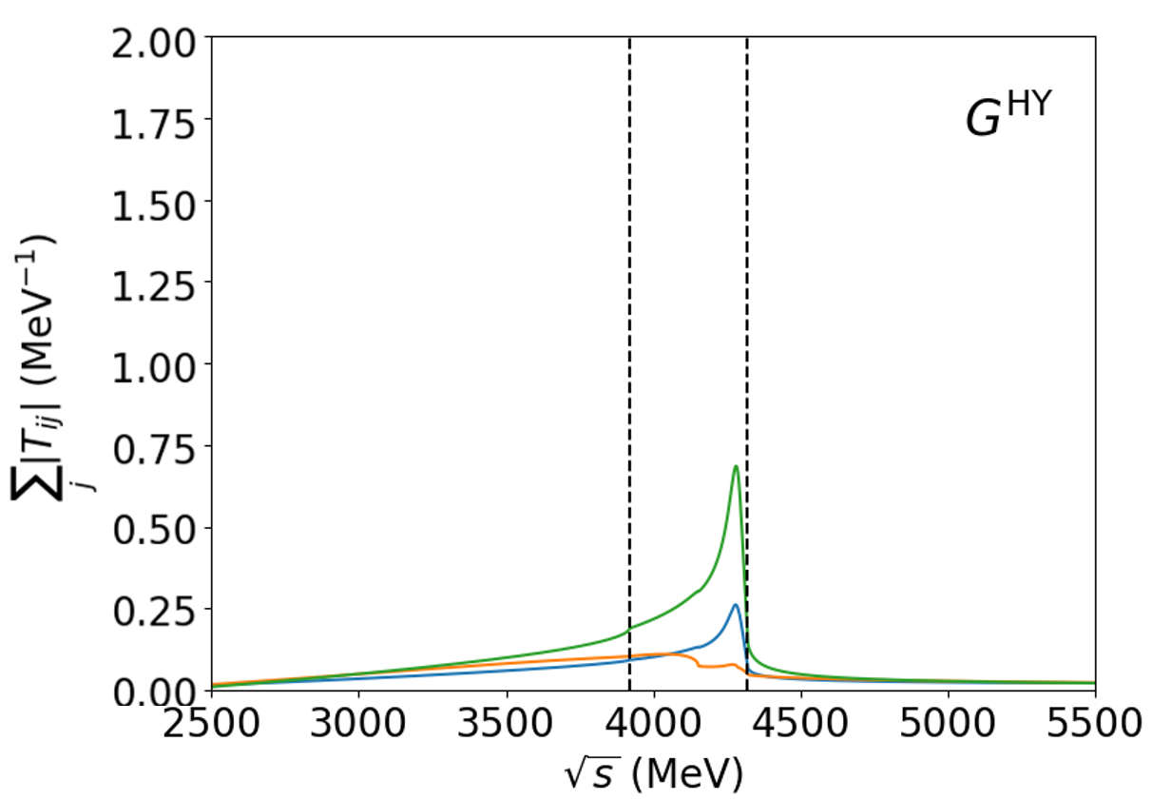
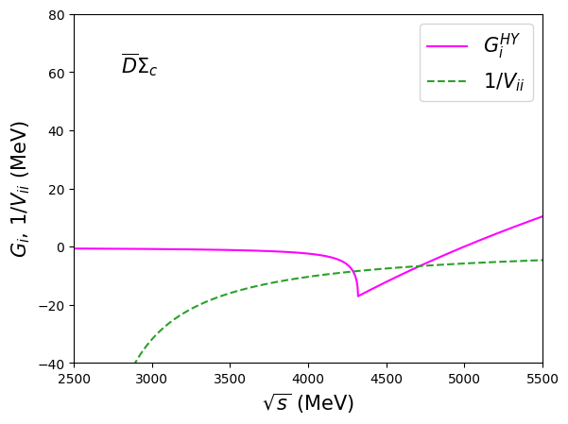

Sector $S=0, I=1/2$ ($G^{HY}$)

Slide 12
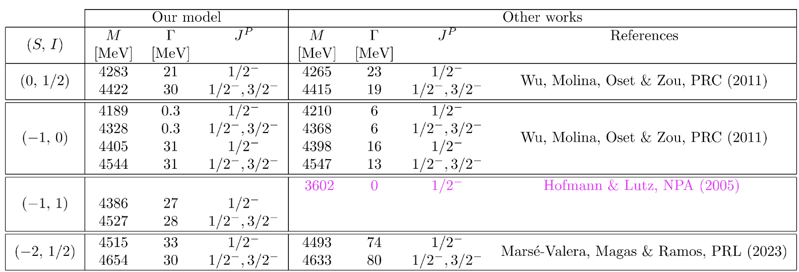

Comparison with other theoretical studies
Fake pole!
Consistent results with the reported states in the literature.
New predictions in the $S=−1, I=1$ sector.

Slide 13
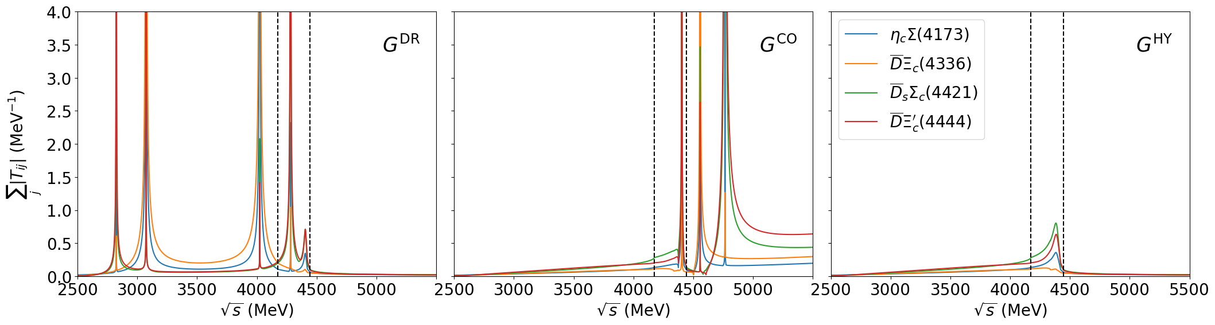

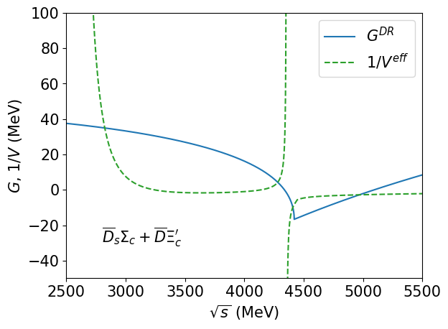
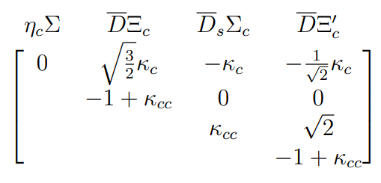




Sector $S=−1, I=1$
A. Feijoo et al. PLB 839 (2023) 137760
We have to build a $V^{eff}$
$$C^{S=−1,I=1}=$$
Unphysical states
$$κ_{c}=1/4$$
$$κ_{cc}=1/9$$

Slide 14
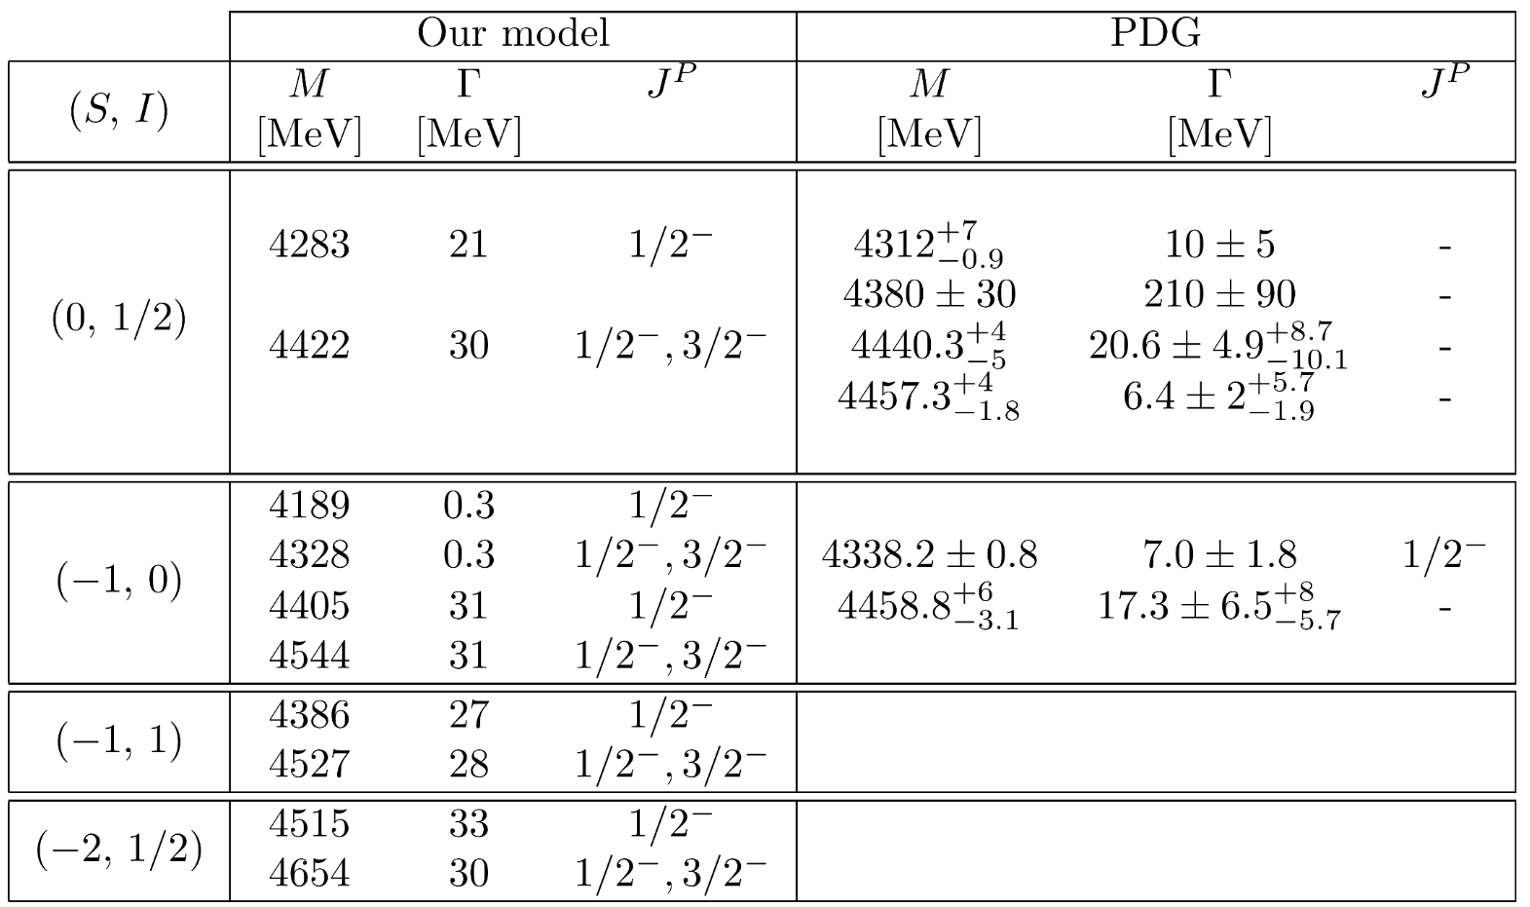
Comparison with experimental data

Slide 15
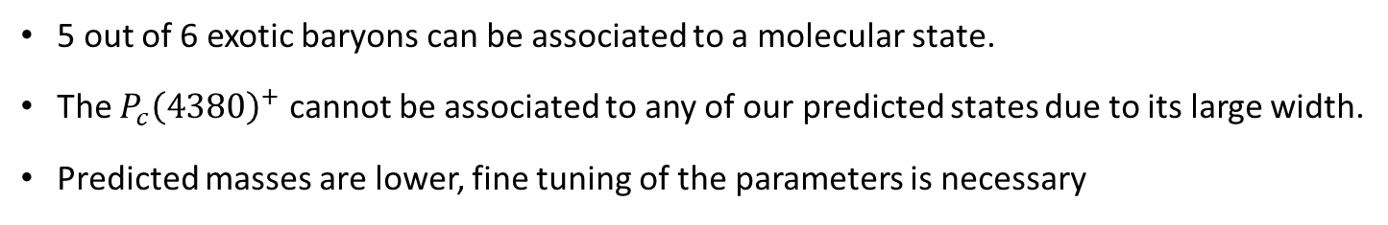
Comparison with experimental data
5 out of 6 exotic baryons can be associated to a molecular state.
The $P_{c}{\left(4380\right)}^{+}$ cannot be associated to any of our predicted states due to its large width.
Predicted masses are lower, fine tuning of the parameters is necessary

Slide 16
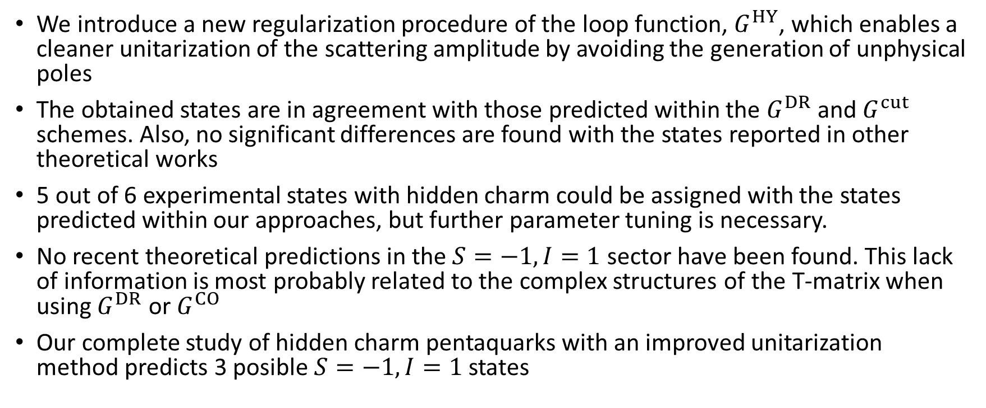
Conclusions
We introduce a new regularization procedure of the loop function, $G^{HY}$, which enables a cleaner unitarization of the scattering amplitude by avoiding the generation of unphysical poles
The obtained states are in agreement with those predicted within the $G^{DR}$ and $G^{cut}$ schemes. Also, no significant differences are found with the states reported in other theoretical works
5 out of 6 experimental states with hidden charm could be assigned with the states predicted within our approaches, but further parameter tuning is necessary.
No recent theoretical predictions in the $S=−1, I=1$ sector have been found. This lack of information is most probably related to the complex structures of the T-matrix when using $G^{DR}$ or $G^{CO}$
Our complete study of hidden charm pentaquarks with an improved unitarization method predicts 3 posible $S=−1, I=1$ states

Slide 18
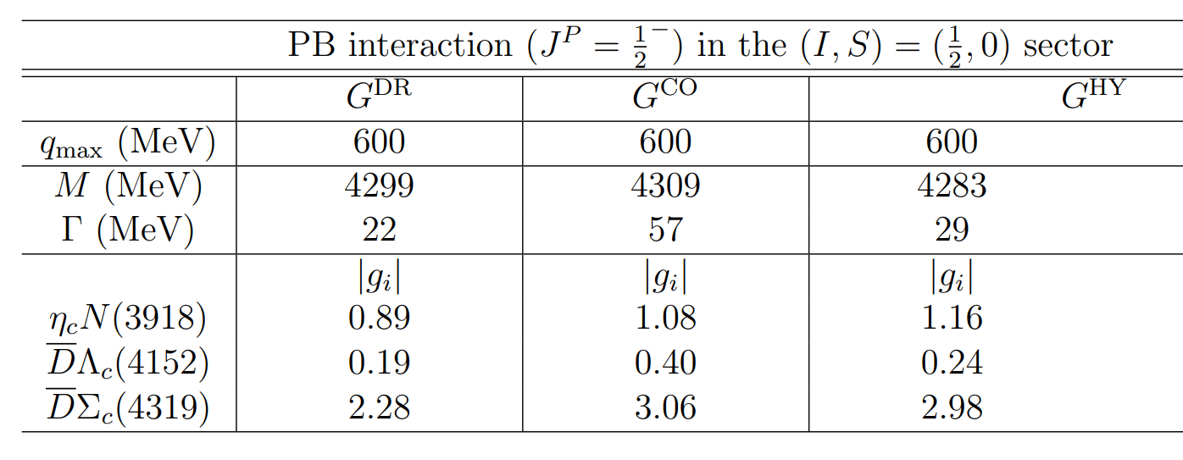


Sector $S=0, I=1/2$ (Results)

Slide 19
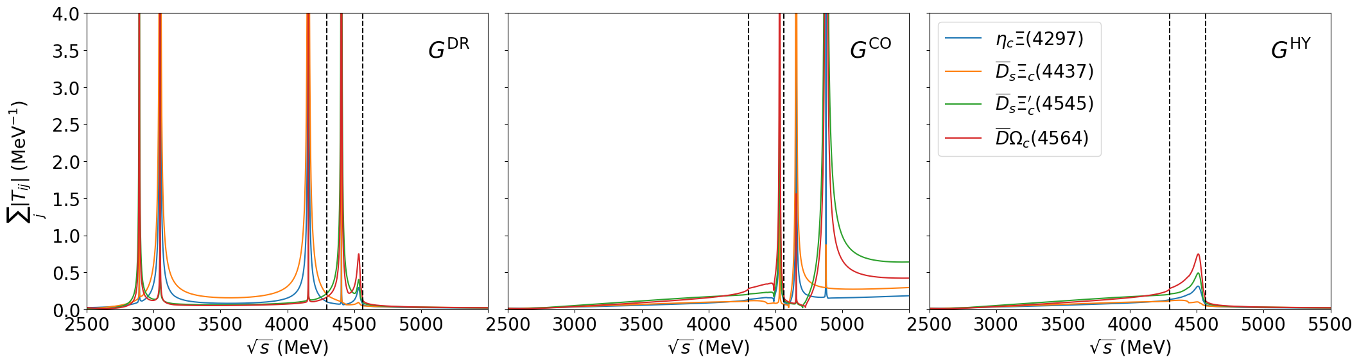
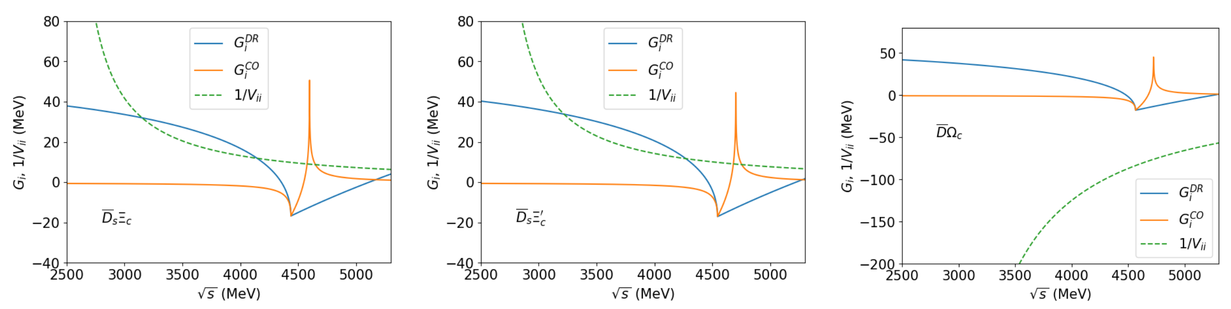
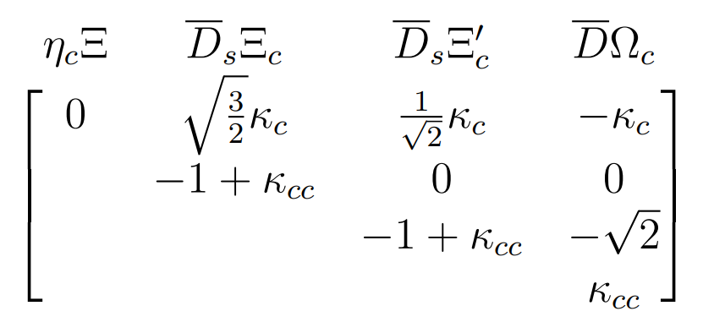



Sector $S=−2, I=1/2$ (I)
[1] Jia-Jun Wu et al. (2011).
[2] J. A. Marsé-Valera, V. K. Magas, and A. Ramos (2023).
$$κ_{c}=\frac{1}{4}$$
$$κ_{cc}=\frac{1}{9}$$
$$C^{S=−2,I=1/2}=$$

Slide 20

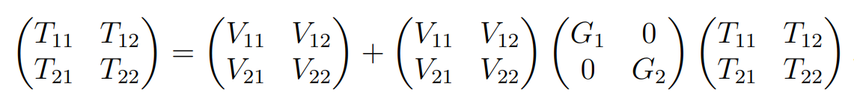
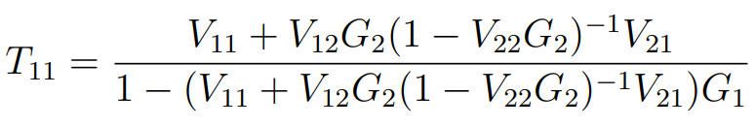

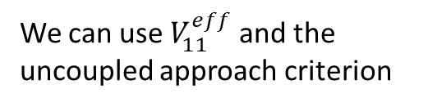
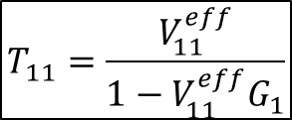

Sector $S=−2, I=1/2$ (II)
[1] Jia-Jun Wu et al. (2011).
[2] J. A. Marsé-Valera, V. K. Magas, and A. Ramos (2023).
$$C^{S=−2,I=1/2}=$$
We need to build an effective potential that takes into account coupled channel.
The scattering amplitude is computed using: $T=V+VGT$ or $T={\left(1−VG\right)}^{−1}V$
In matrix notation the above equation reads:
Focusing in $T_{11}$:
$$T_{11}=\frac{V_{11}^{eff}}{1−V_{11}^{eff}G_{1}}$$
We can use $V_{11}^{eff}$ and the uncoupled approach criterion

Slide 21



Effective potential:
Diagonal potentials:

Slide 22


Slide 23



Sector $S=−1, I=1$ (I)
[2] Jia-Jun Wu et al. (2011).
No state reported
$$C^{S=−1,I=1}=$$
$$C^{S=−2,I=1/2}=$$

Slide 24



Comparison of Unitarization methods
$G^{DR}∼G^{HY}$ for $q_{max}=600 MeV$
$G^{CO}$ larger widths
$G^{CO}∼G^{HY}$ for a single state in the $S=−1, I=0$
PB

Slide 25

Comparison of Interaction Kernel prescriptions
Changes related to the off diagonal kernel coefficients
Larger widths within the LGHA-SU(4) model
Changes in the coupling strengths: states with larger widths are more coupled to the open decay channels

Slide 26


LHGA-WF with baryons $3/2^{+}$ (B*)

