Slide 1

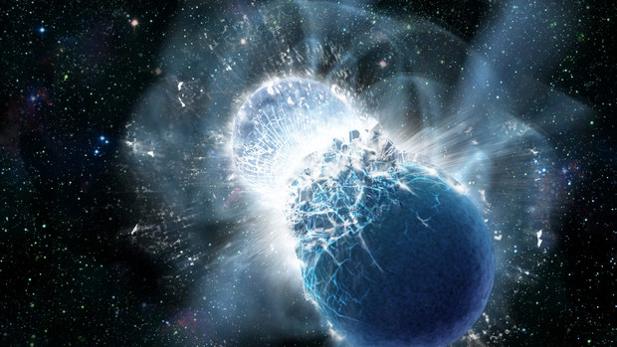


Hyperons in neutron star mergers
In collaboration with G. Lioutas, S. Blacker, A. Bauswein, A. Ramos and L. Tolos
Hristijan Kochankovski
HADNUCMAT workshop
Barcelona
26/01/2026

Slide 2
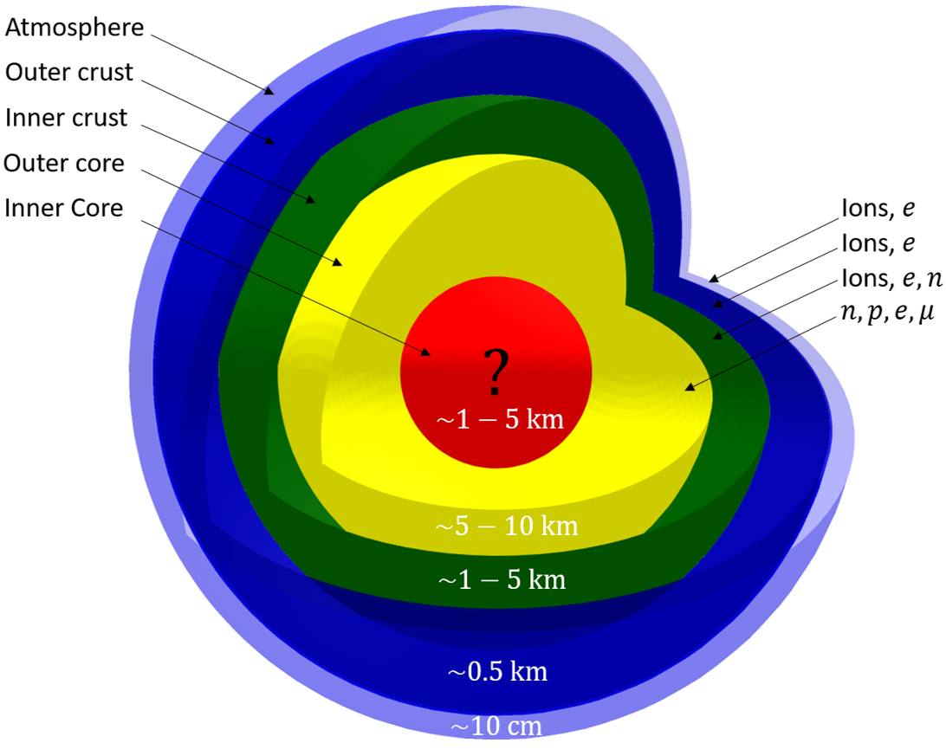
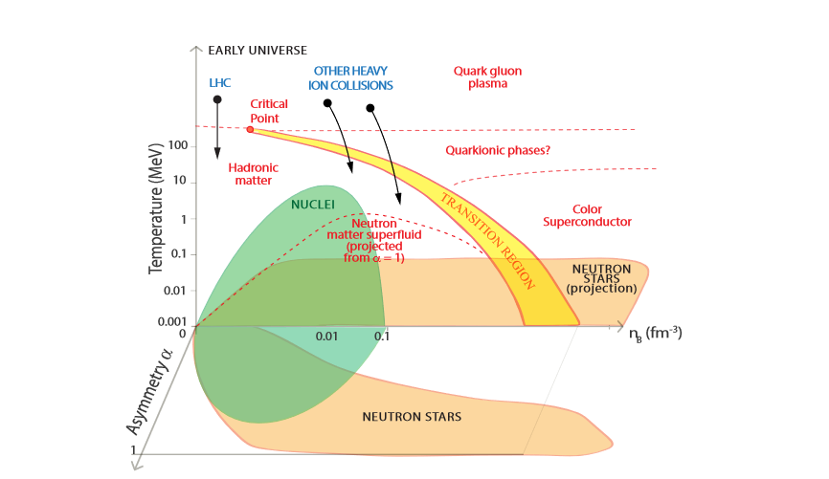
Cold neutron stars
Watts et al., PoS (AASKA14), 2014
Notes:
Evolved neutron stars are beta-equilibrated cold objects with exotic properties – Masses that can exceed 2 solar masses and radii of around 10-15 km . Due to the extreme density, the central part, the core is not well understood, so its composition is model dependent. In those densities, the strong force between the baryons is crucial for finding the composition of matter. Some models predict that hyperons – baryons with strange content could be present in the core of NS.
If we compare the conditions that are present in neutron stars with conditions found in terrestrial experiments, we will see that most of the region that NSs fill can not be accessed with experiments. Studying the properties of NS is the only way to obtain information about the phase of matter that we have in the NS interior and to learn something about the interaction in those conditions.

Slide 3
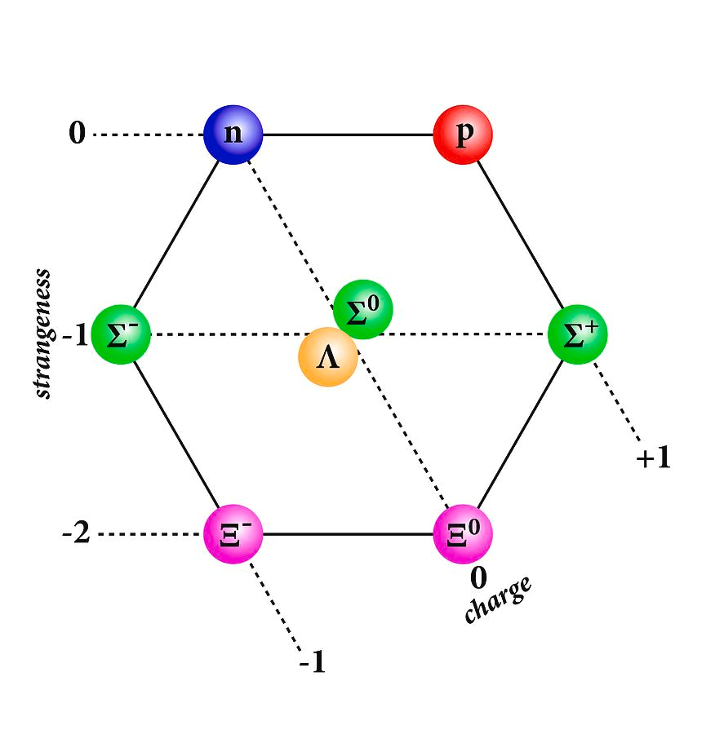
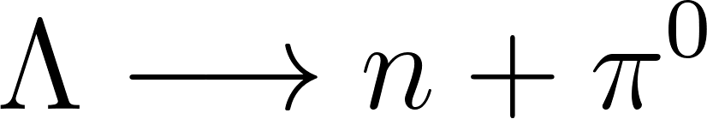
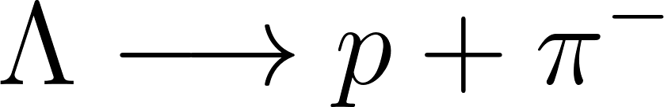
Hyperons
Hyperons are baryons made of one or more strange quarks.
In free space, they can decay to nucleons via electroweak force
SciencePhotoGallery
Notes:
So what actually are hyperons. Hyperons are baryons just like protons and neutrons, meaning they are composed of three quarks, but at least one "strange" quark, setting them apart. On the graph of the right, the baryon octet is shown which is composed of the two nucleons and the six lightest hyperons. They are heavier than the nucleons, with the lightest hyperon, the lambda having a mass of around 1100 MeV. That is why they have relatively short lifetimes due to the decay via the electroweak force and can’t be stable on the Earth. The decay of the neutral sigma and lambda hyperon are shown on the feynman diagram.
Do not explain it in detail!! (jump the part after electroweak force)

Slide 4
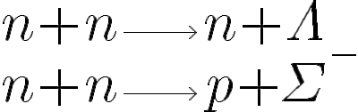
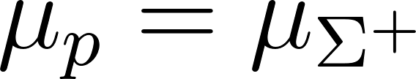

Hyperons
In dense matter, nucleons are highly energetic and the reactions of hyperons production are allowed
In equilibrium, the reactions of hyperons creation and destruction are balanced
SciencePhotoGallery
Notes:
So what actually are hyperons. Hyperons are baryons just like protons and neutrons, meaning they are composed of three quarks, but at least one "strange" quark, setting them apart. On the graph of the right, the baryon octet is shown which is composed of the two nucleons and the six lightest hyperons. They are heavier than the nucleons, with the lightest hyperon, the lambda having a mass of around 1100 MeV. That is why they have relatively short lifetimes due to the decay via the electroweak force and can’t be stable on the Earth. The decay of the neutral sigma and lambda hyperon are shown on the feynman diagram.
Do not explain it in detail!! (jump the part after electroweak force)

Slide 5
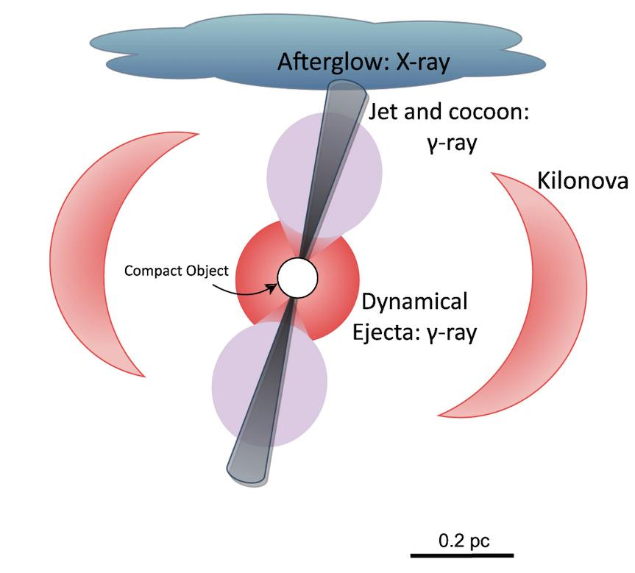
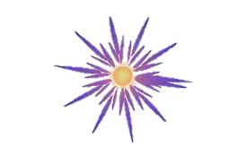
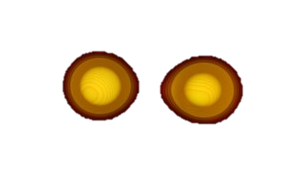
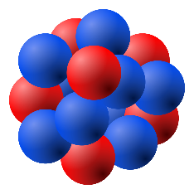
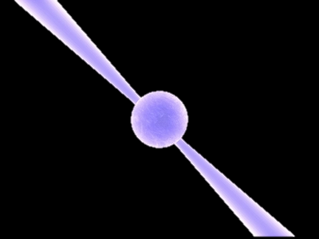
Neutron star matter at finite temperature
100
Nuclear experiments
Supernovae
Neutron star
mergers
10
Temperature [MeV]
Nuclei
Cooling
Proto-neutron stars
1
Neutron stars
0.5
Charge fraction
0
Perkins et al., ApJ, 2024
Notes:
While already evolved neutron stars can be considered as cold objects in beta-equilibrium, this does not hold for neutron star matter found in other phenomena. Hot matter outside of beta eq. can be met both in the early evolution of the star, after the core-collapse supernova occurs, and during the merging of two neutron stars, the process known as binary neutron star mergers. Especially during the post-merger phase of the BNS merger event, the temperature can exceed 100 MeV. That means that any effects that the appearance of hyperons can leave on the finite-temperature EoS could become important. We will focus on answering the question if hyperons are present in dense matter by finding signatures in the BNS observables and quantities, which are sensitive to the finite-temperature EoS.

Slide 6
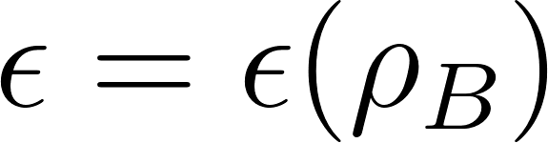
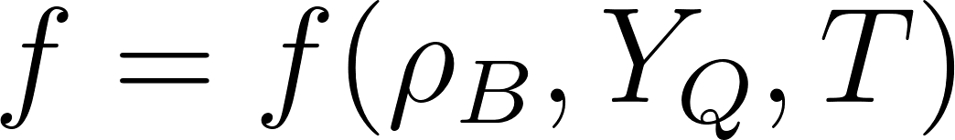
Relativistic mean field framework
We are interested in the Equation of State (EoS) of dense matter
AB INITIO
PHENOMENOLOGY
Brueckner–Hartree–
Fock
RMF methods
Cold beta-equilibrated EoS
Variational approach
Skyrme potentials
Self-consistent Green Function
Quark-meson coupling method
Hot EoS, out of beta-equilibrium
Notes:
In order to model different phenomena related to neutron stars, one needs to know the EoS of dense matter, or with other words, to know the proper thermodynamic potential that describes the system. When the matter is cold and in equilibrium that potential is the energy density, when the matter is hot and outside of beta-equilibrium that is the free energy density. The difficult part that we need to resolve is the strongly correlated system of baryons. Since first principles calculations are difficult to achieve, the majority of calculations are performed in phenomenological frameworks. One of those methods is the relativistic mean field method where the interaction between the species is mediated via mesons exchange. The parameters are tuned as for the model to satisfy the properties of bulk nuclear matter, finite nuclei and finite hypernuclei.

Slide 7
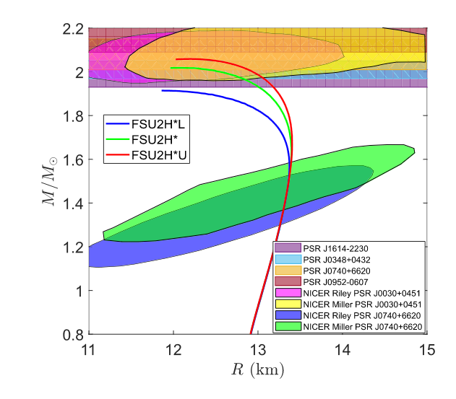
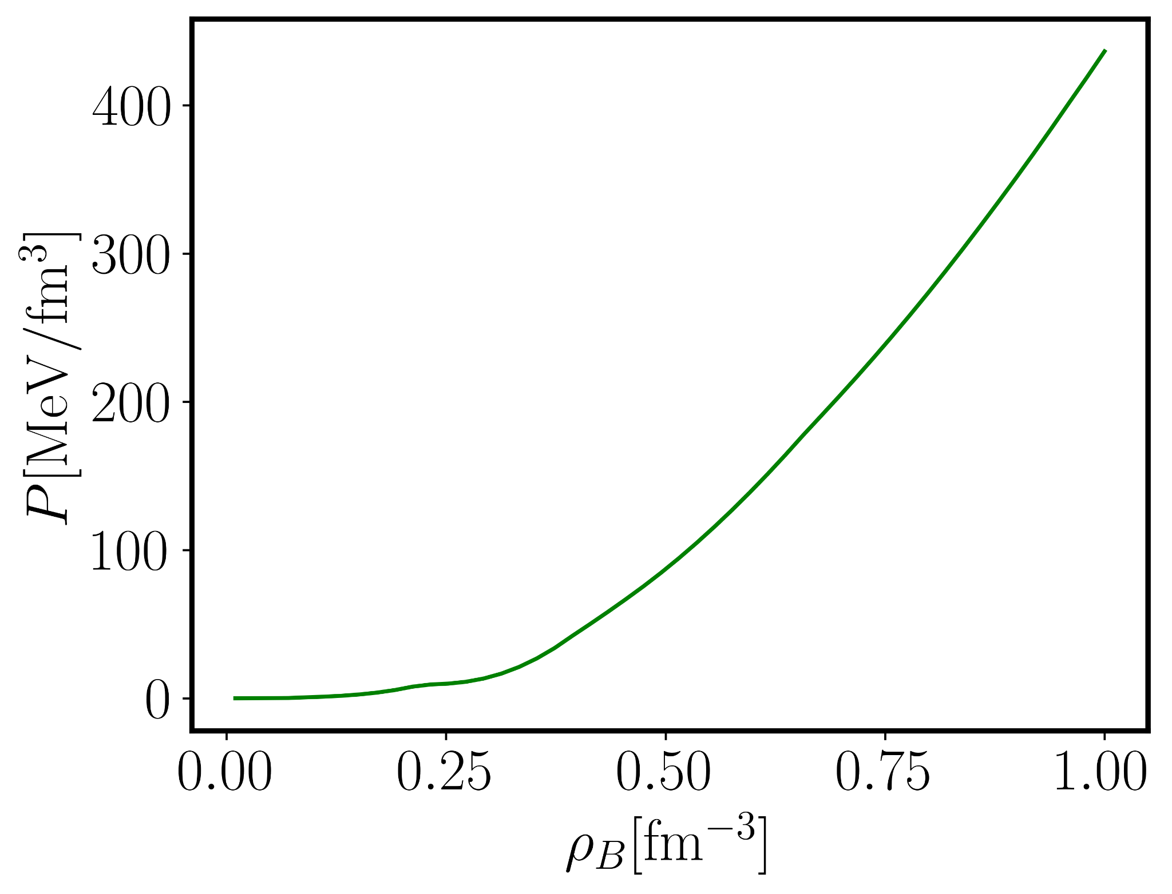
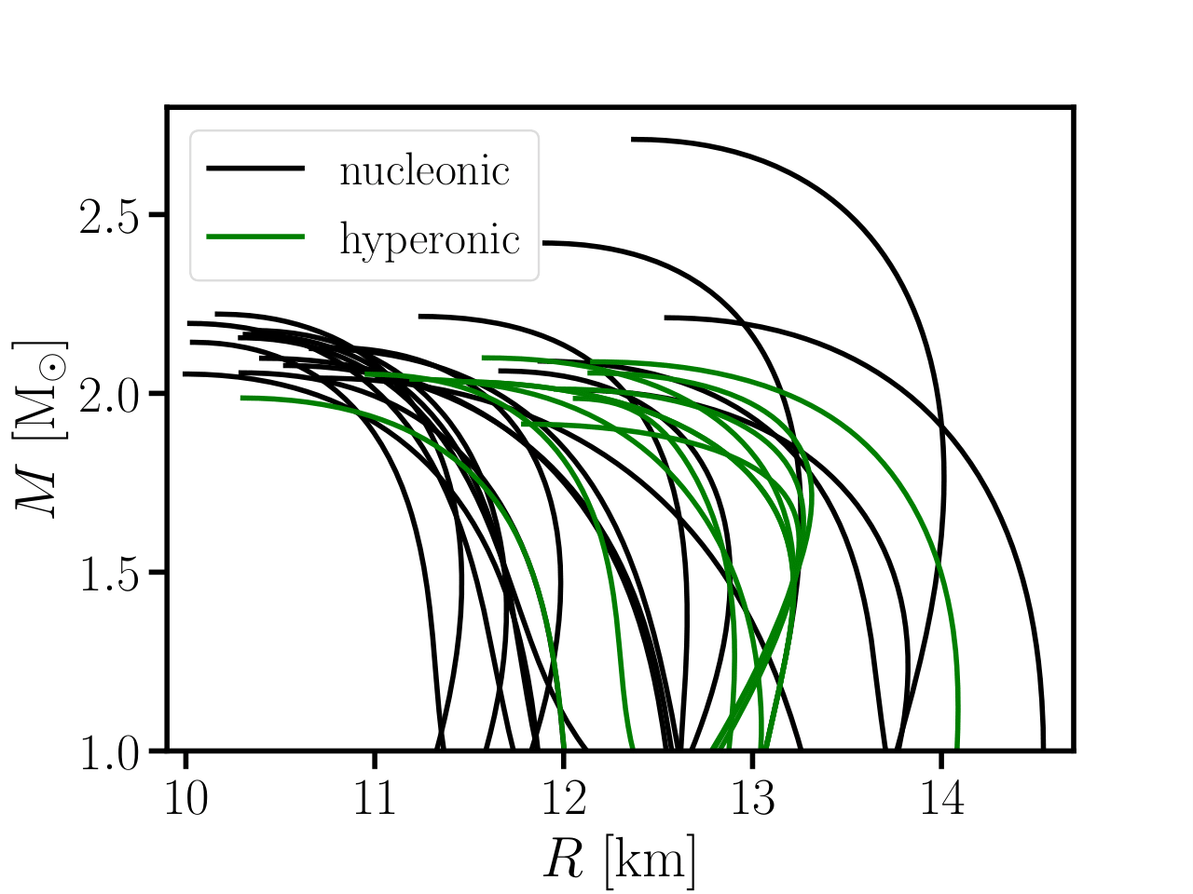
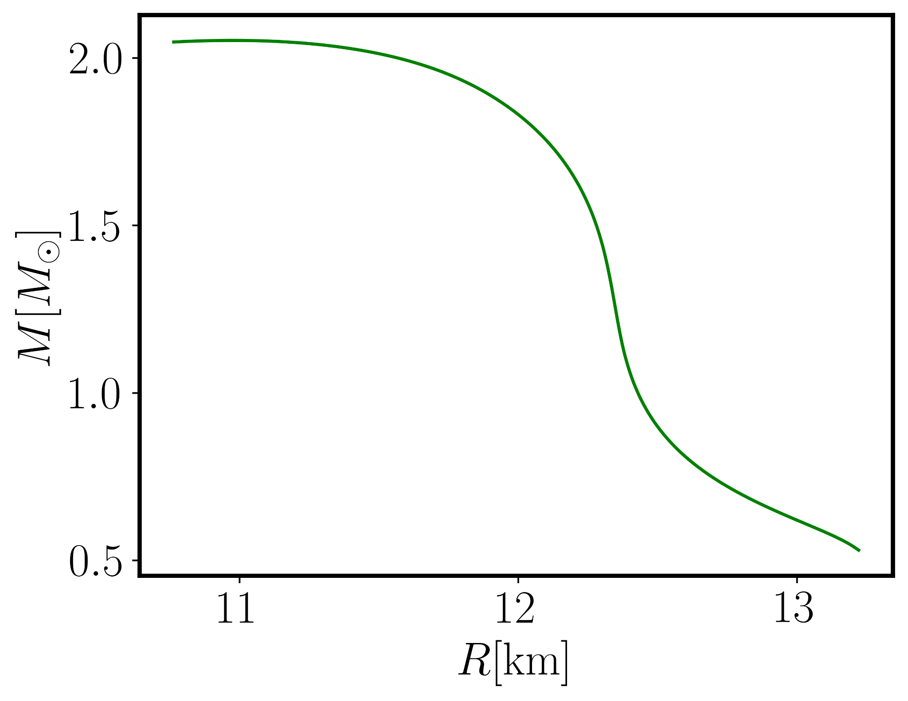
Hyperon signatures in cold star observables?
Nucleonic – nucleons as only baryons
Hyperonic – hyperons and nucleons as baryons
Blacker et al., PRD, 2024
Kochankovski et al., MNRAS, 2024
Notes:
A way to understand better the interior of the NS and the baryon interaction in ultra-dense matter is to study observables of NSs. One of those observables are the mass and the radius. Indeed, there is a one to one correspondence of the EoS and the mass-radius relation relation. If a central density of the star is fixed and the EoS is integrated with the so called TOV equation, a single point on the mass-radius diagram will be obtained. If, another central density is selected, a second point is obtained, explaining how the whole MR diagram can be predicted with a specific EoS. However, the EoS is far from constrained. There is a large uncertainty present. Indeed, if we plot the mass-radius relations for many models that have consider nucleons as a degree of freedom – we will call them nucleonic, and the ones that also consider hyperons – hyperonic model, we see that it is difficult to distinguish the internal composition based only on cold matter observables. Although we have one-to-one correspondence between our EoS and the corresponding M( R) curve, that is done through the TOV equation, it is difficult to distinguish this curve from other nucleonic curves with different nucleonic interaction. The theoretical uncertainty that we have in our nuclear models is significant and cannot be eliminated only by studying cold star observables.

Slide 8
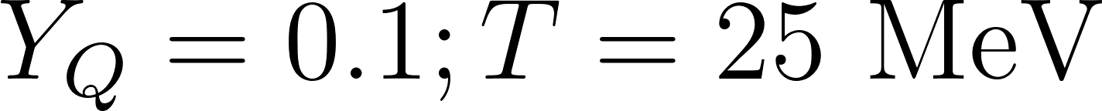
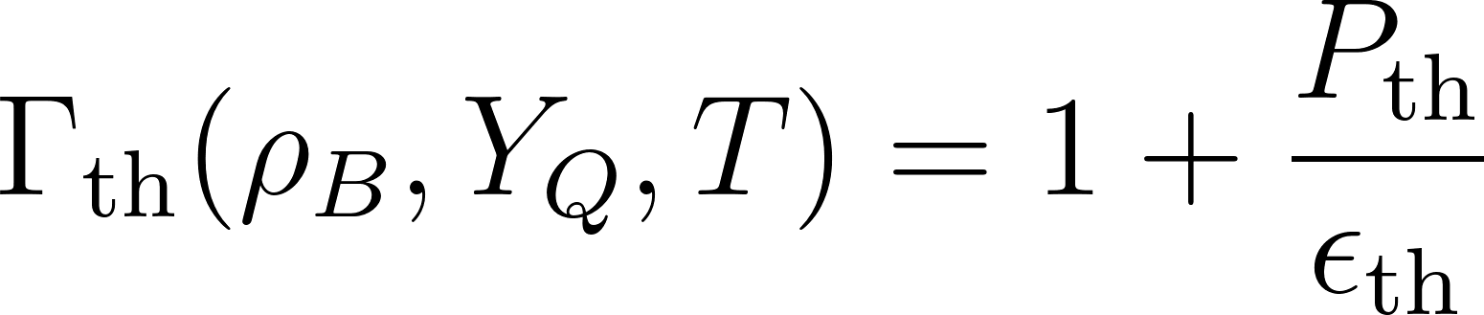
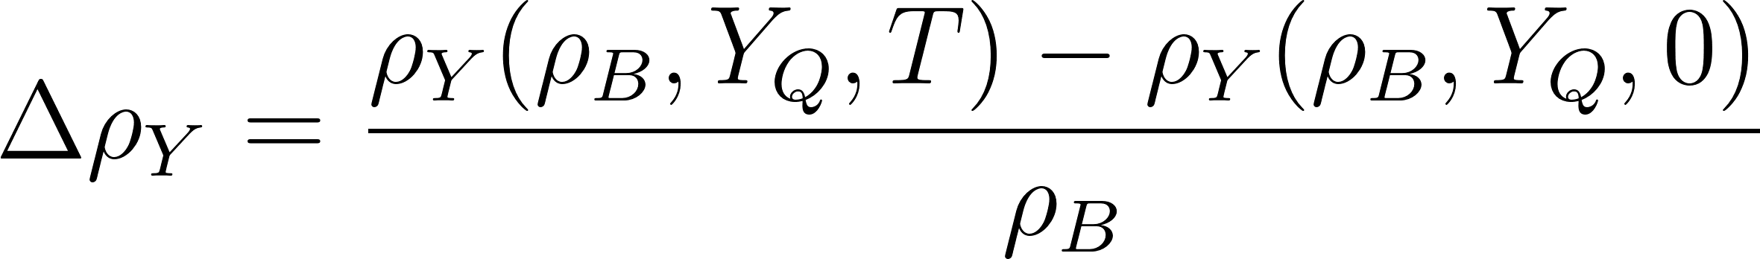
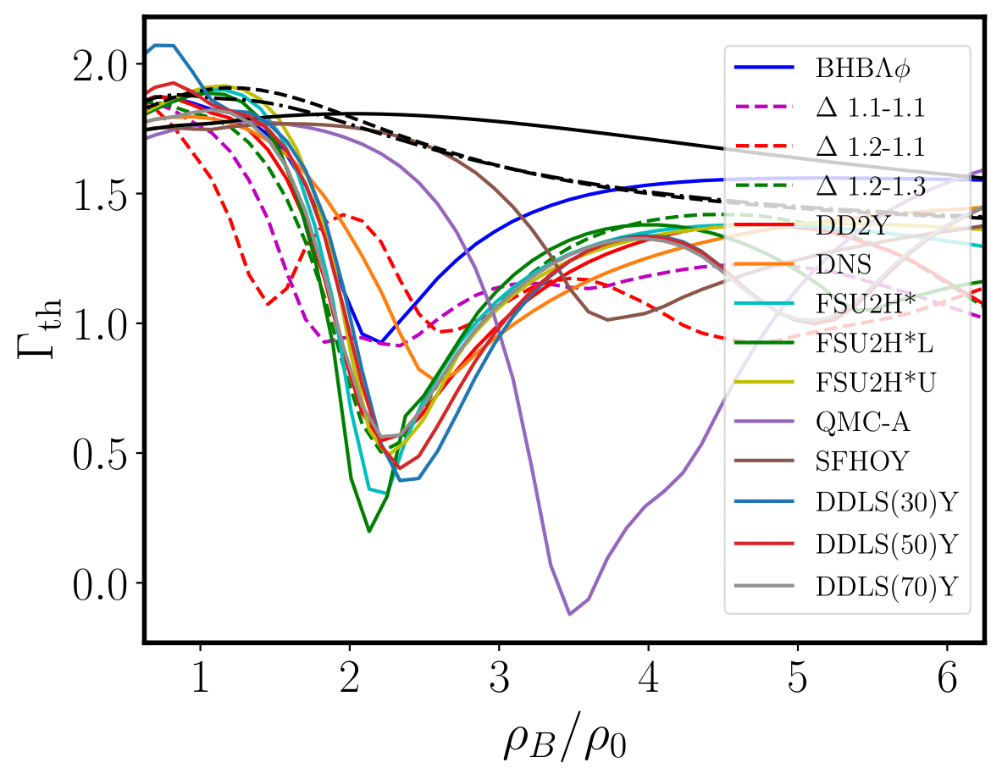
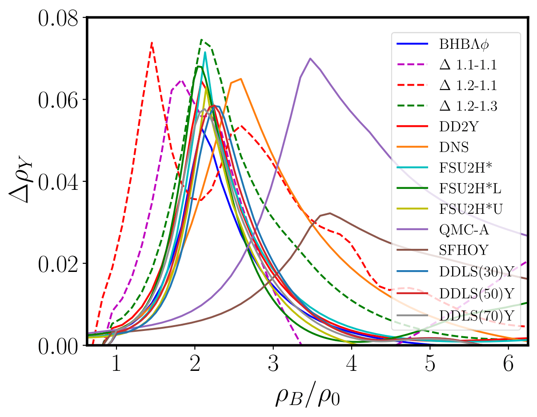
Thermal index and hyperon excess
Thermal index
Hyperon excess
Colored lines—
hyperonic models
black lines—reference nucleonic models
Kochankovski et al,. PRD, 2025
Notes:
The thermal index is another quantity that is related to the ratio of the thermal pressure and the thermal energy density. We can see that the behavior of Gth is directly reflecting the behavior of Pth. Notice that a constant value of 1.75 seem on average to describe well what happens with the nucleonic models, while at the same time this approximation is completely invalid. To show that this effect is caused by the loss of degeneracy pressure when hyperons are produced at finite temperature, at the right graph we show the quantity that we call hyperon excess. That quantity measures the amount of thermal hyperons produced in matter. We can see that the two quantities correlate well—when the hyperon excess has a spike, the thermal index drops, confirming our conclusion that the appearance of thermal hyperons is producing the drop in the thermal pressure.

Slide 9
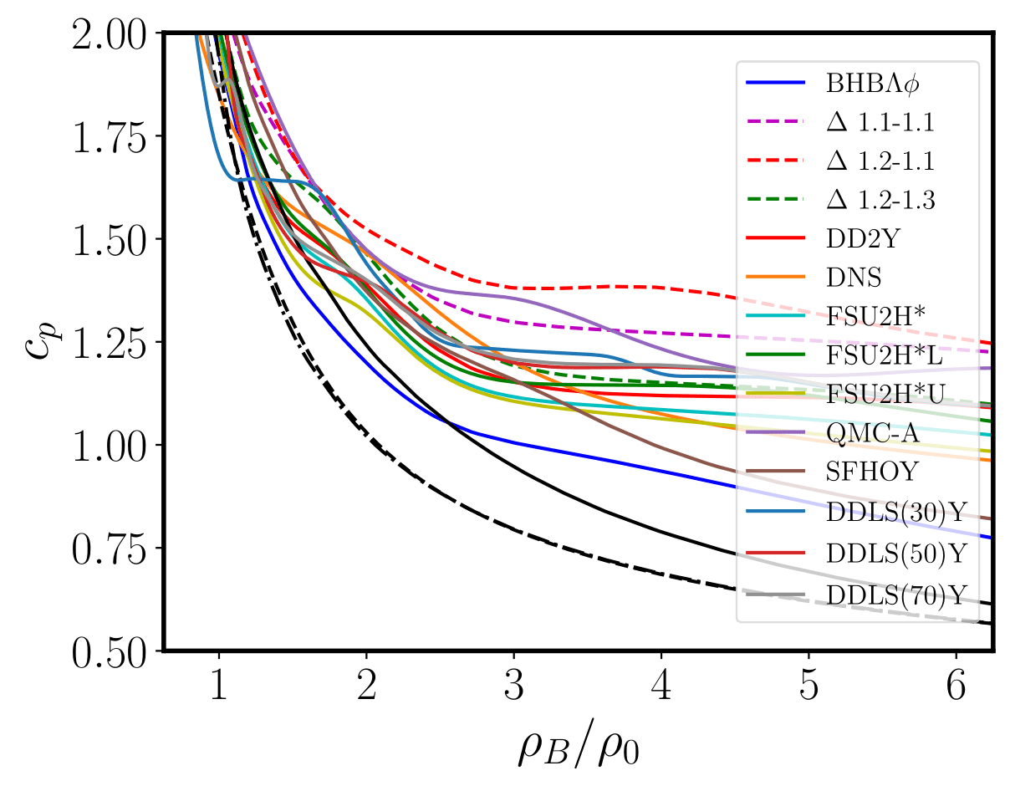
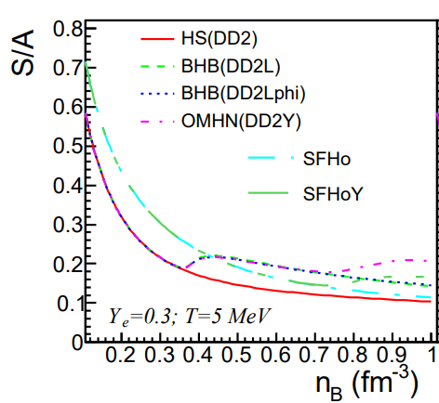
Specific heat
Related with the entropy per baryon’s increase when hyperons are present
Kochankovski et al., PRD, 2025
Raduta, EPJA, 2022
Notes:
The thermal index is another quantity that is related to the ratio of the thermal pressure and the thermal energy density. We can see that the behavior of Gth is directly reflecting the behavior of Pth. Notice that a constant value of 1.75 seem on average to describe well what happens with the nucleonic models, while at the same time this approximation is completely invalid. To show that this effect is caused by the loss of degeneracy pressure when hyperons are produced at finite temperature, at the right graph we show the quantity that we call hyperon excess. That quantity measures the amount of thermal hyperons produced in matter. We can see that the two quantities correlate well—when the hyperon excess has a spike, the thermal index drops, confirming our conclusion that the appearance of thermal hyperons is producing the drop in the thermal pressure.

Slide 10
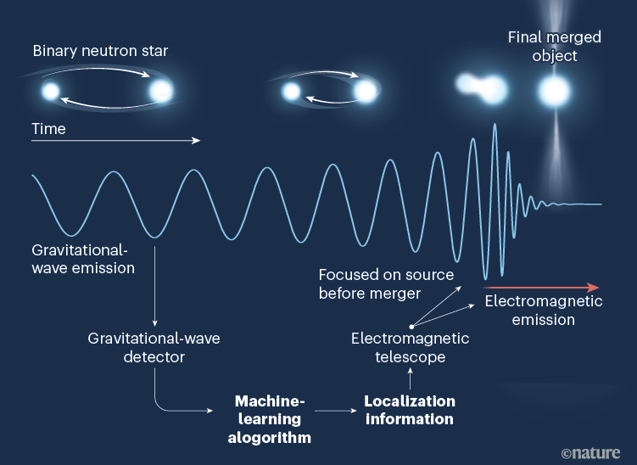


Scheme of a binary neutron star merger event
Sensitive to the cold, beta-equilibrated EoS
- Tidal deformability
Sensitive to the hot EoS out of beta-equilibrium
Notes:
Here, the scheme of a BNS merger event is presented. The process of merging can last billions of years. The initial phase is known as inspiral phase. During that phase, the orbital speed is increasing and the radius of the orbit keep decreasing. The stars are too far away so they can be considered as cold and in beta-equilibrium. The GW emitted from this phase are not sensitive to the finite-temperature EoS. The second phase is the merging phase. If the mass of the remnant is not too high (we say that the remnant mass does not surpass the threshold mass for a black hole collapse), a HMNS is formed and the merger enters in a phase known as GW phase. In these two phases, the matter gets heated and goes out of beta-equilibrium. The GWs from this phase are sensitive to the finite-temperature EoS.

Slide 11
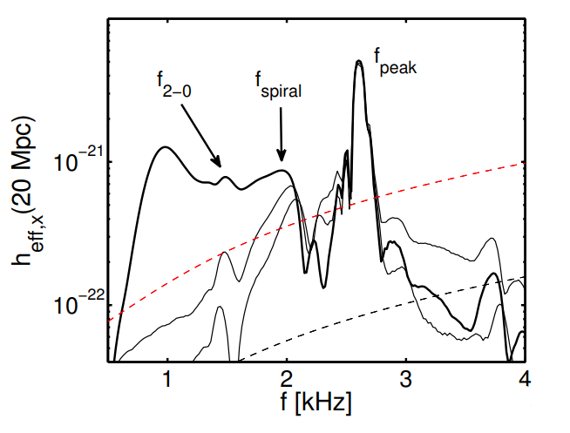


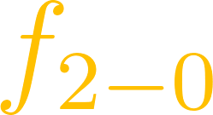
Gravitational-wave spectrogram
Post-merger spectral features are affected by the finite-temperature EoS
Advanced
LIGO
– dominant frequency peak
– secondary frequency peak
Einstein
Telescope
– secondary frequency peak
Bauswein et al, J. Phys. G, 2019
Notes:
The most important observational feature that is sensitive to the finite-temperature EoS is the frequency of the dominant post-merger peak. It represents the strongest GW spectra feature, as can be seen from the plot where the effective strain as a function of the frequency is shown. This peak corresponds to the fundamental frequency of the quadrupole oscillation mode of the remnant. On the plot, we see that for each EoS we obtain two values for fpeak—one where the full three-dimensional EoS is used, and one where the reference simulation with the approximate thermal treatment is used. The small difference between the frequency values of the peaks is called a frequency shift.

Slide 12
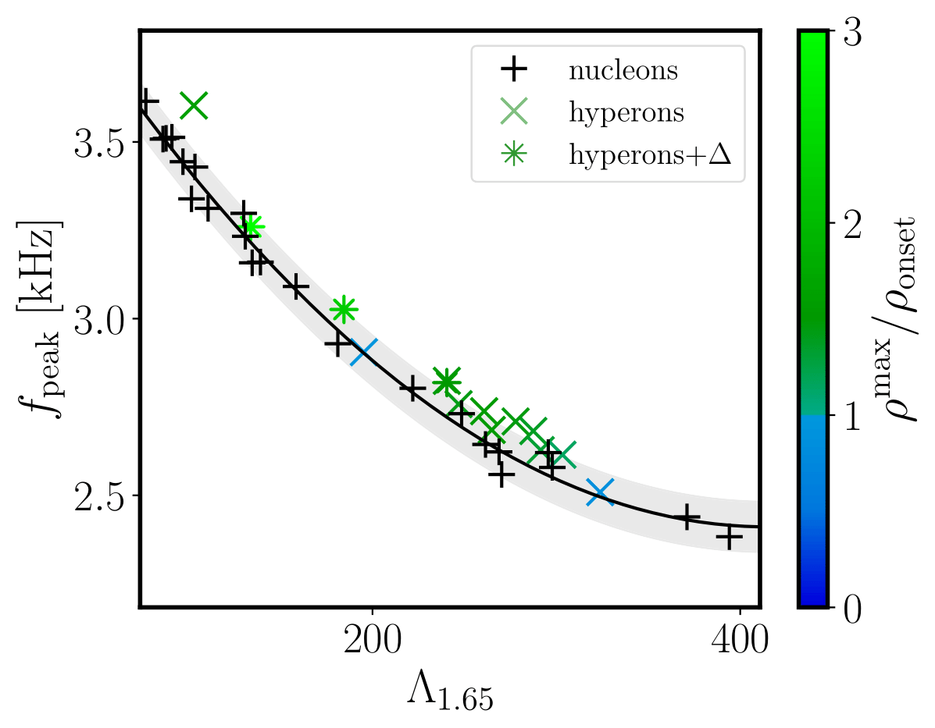
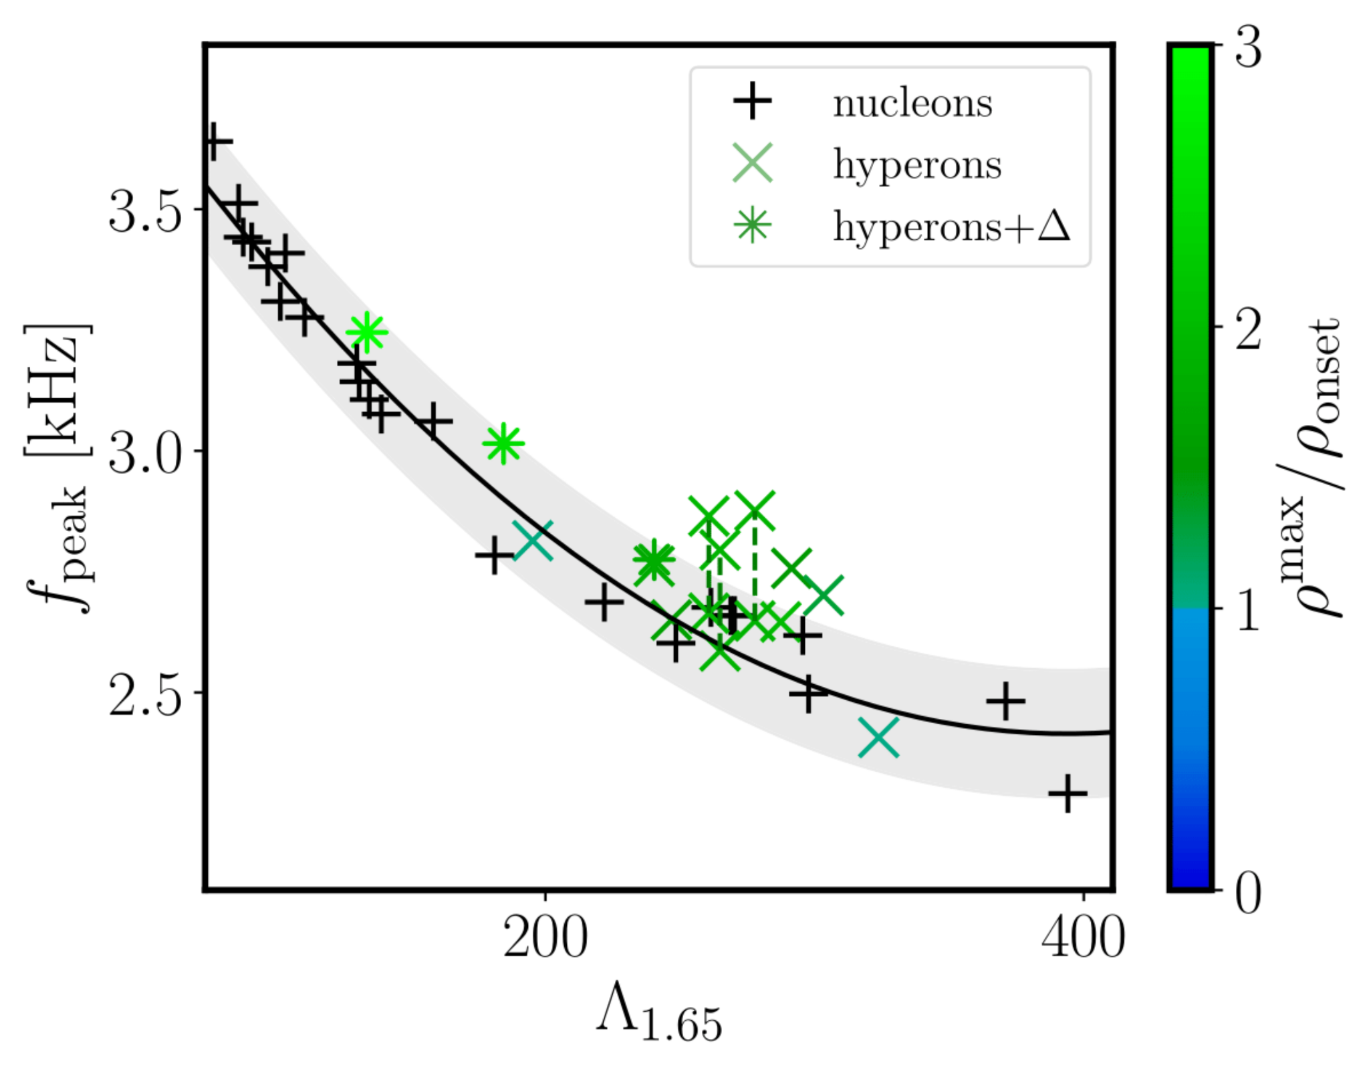
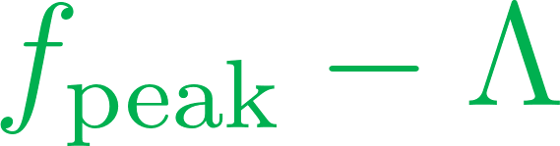
Frequency shift and tidal deformability
Second-order polynomial fit
Maximum nucleonic residual
Hyperonic EoS do not follow the nucleonic relation
The conclusion does not depend on the initial configuration
Kochankovski et al., PRD, 2025
Notes:
To ensure that the observed shift is related to the drop of the thermal index that hyperons produce in matter, we also plot the relative frequency shift as a function of the average thermal index computed in the remnant for the 3D simulation set. We can see that there is a strong anticorrelation between the two quantities—for hyperonic EoSs the average thermal index is small and the shift is high; for the nucleonic ones, the average thermal index is large, and the shift is around 0.
From an observational point, it is interesting to relate two quantities that can be measured. For example, the dominant frequency and the tidal deformability. If we do a second-order polynomial fit of the nucleonic models, we can see that some of our hyperonic models lie outside of the band that covers the maximum nucleonic residual. Meaning that if an event is detected, and the event lies outside of the expected nucleonic corridor, that could suggest that hyperons are present in matter.

Slide 13
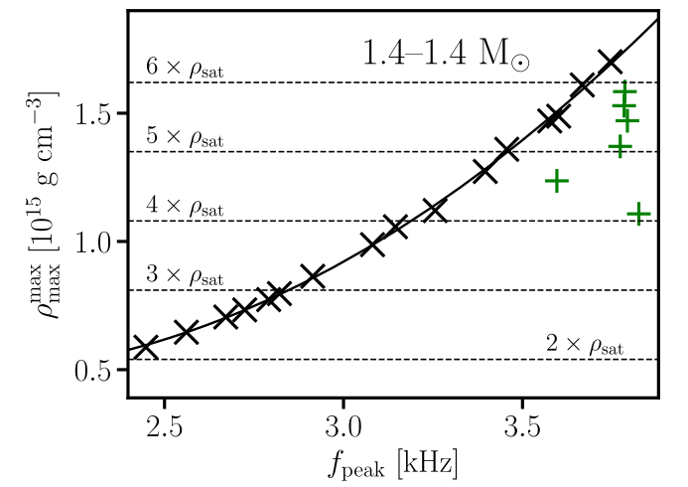
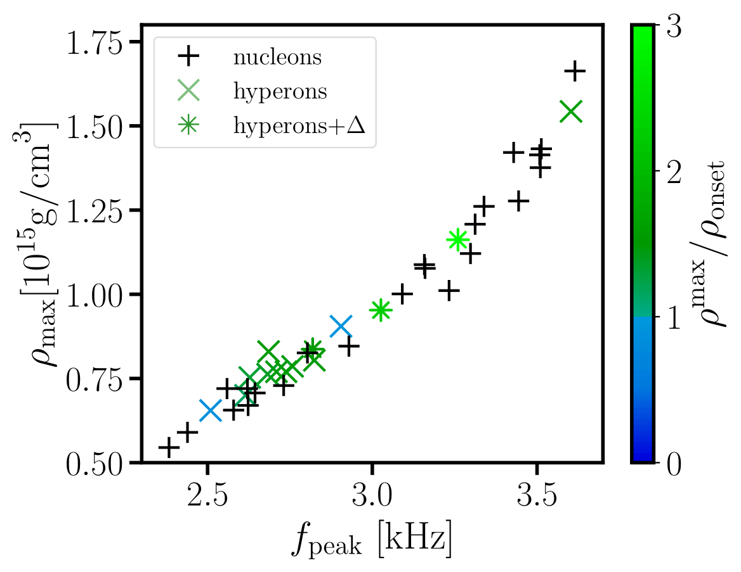
Impact of hyperons on the merger observables and quantities
Frequency shift and maximum density
With quark matter
With hyperons
Nucleonic matter only
Remnants with quark matter
Kochankovski et al, PRD, 2025
Bauswein et al., PRL, 2019
Blacker et al., PRD, 2020
The empirical relations can be used even if hyperons are present in matter!
Notes:
We also investigated how the maximum density in the remnant correlates with the frequency of the dominant peak when hyperons are present in matter. This was motivated by some previous works that showed that when quark matter is present in remnant the empirical relations between fpeak and rhomax do not hold anymore. We found that those relations hold with a high accuracy even when hyperons are present in matter. That gives us an ability to put a low/high density bound when hyperons start to be important/are not important in matter if we have a composition information from the future GW waves. For example, if a future GW suggests that hyperons are present in matter, using the empirical relations, we can put constrain at the highest density at which they certainly start to be abundant in matter. Conversely, if the event suggest that there are no hyperons, we put a constraint at the lowest density at which they are not present in matter.

Slide 14
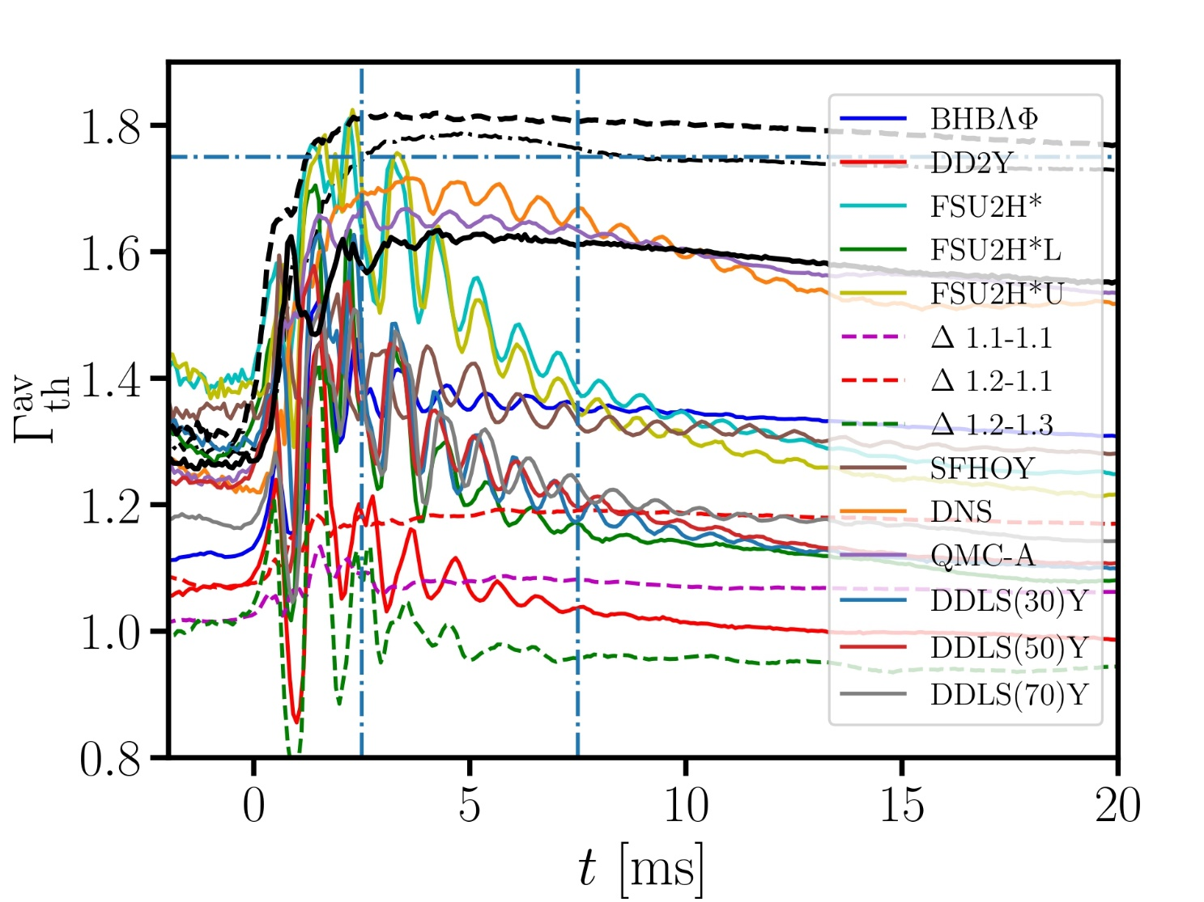
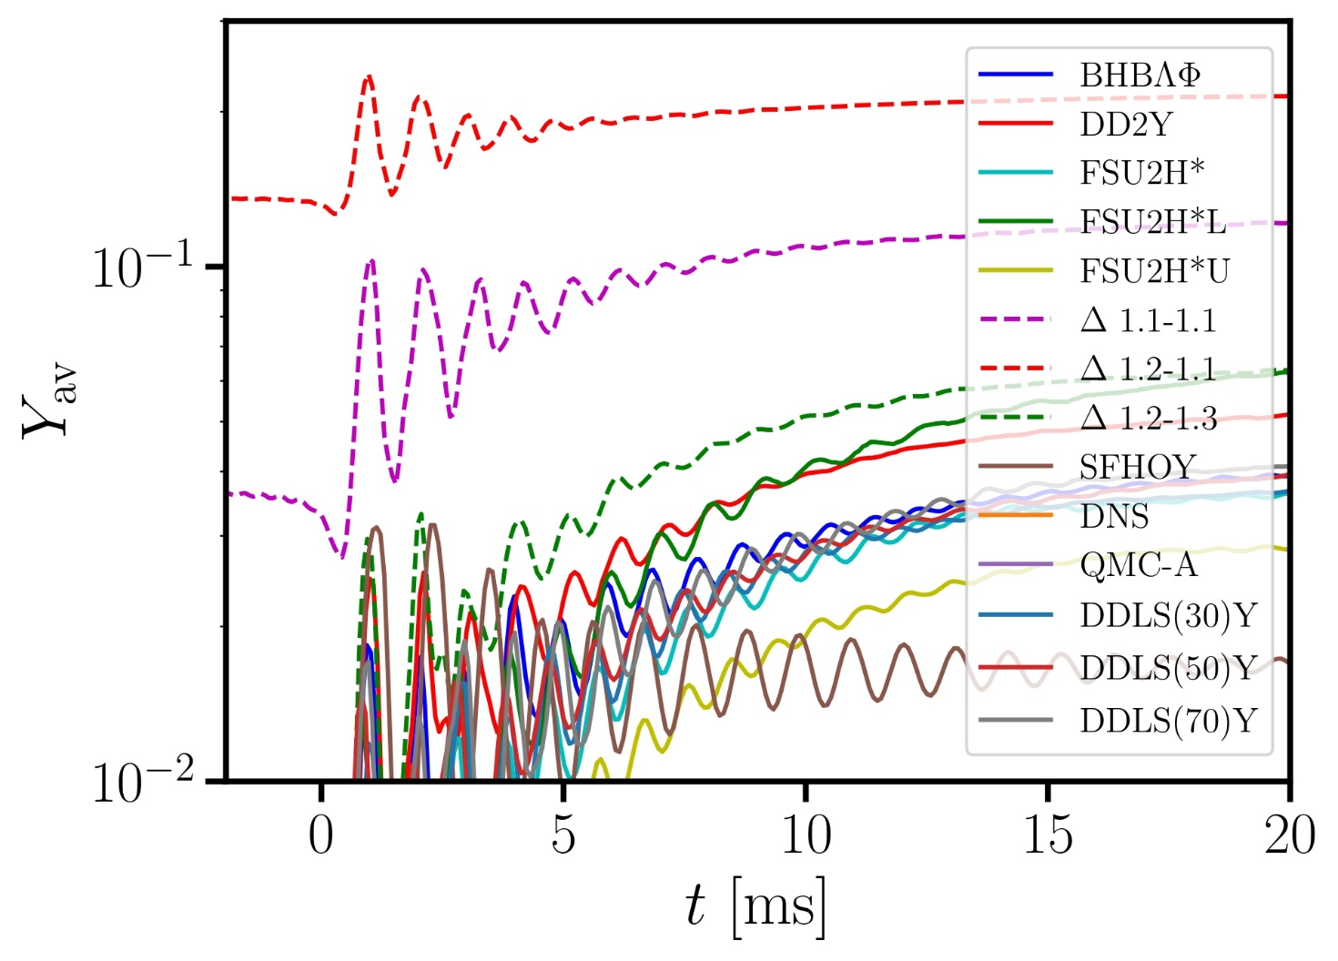
Hyperon abundance and thermal index evolution
Inspiral observables could be insensitive to hyperons
Thermal index oscillations are related with the hyperon’s abundance
Notes:
We also show how the average hyperon fraction and the average thermal index evolve with time. We can see that at the beginning of our simulations, only two models predict hyperons inside of the remnant. That means that even if one can deduce the hyperon content by studying cold properties, the inspiral observables will be probably insensitive to the hyperons since they are not present in matter. However, after the merging a significant content of hyperons is predicted to occur by 12 of our 14 models. Those two that do not are the same that did not show a shift of the GW. We can see that the oscillations in the hyperon fraction induce oscillations of the thermal index. For most of the EoS, the thermal index is lower than 1.4 at later times, significantly lower than the prediction of the nucleonic models.

Slide 15
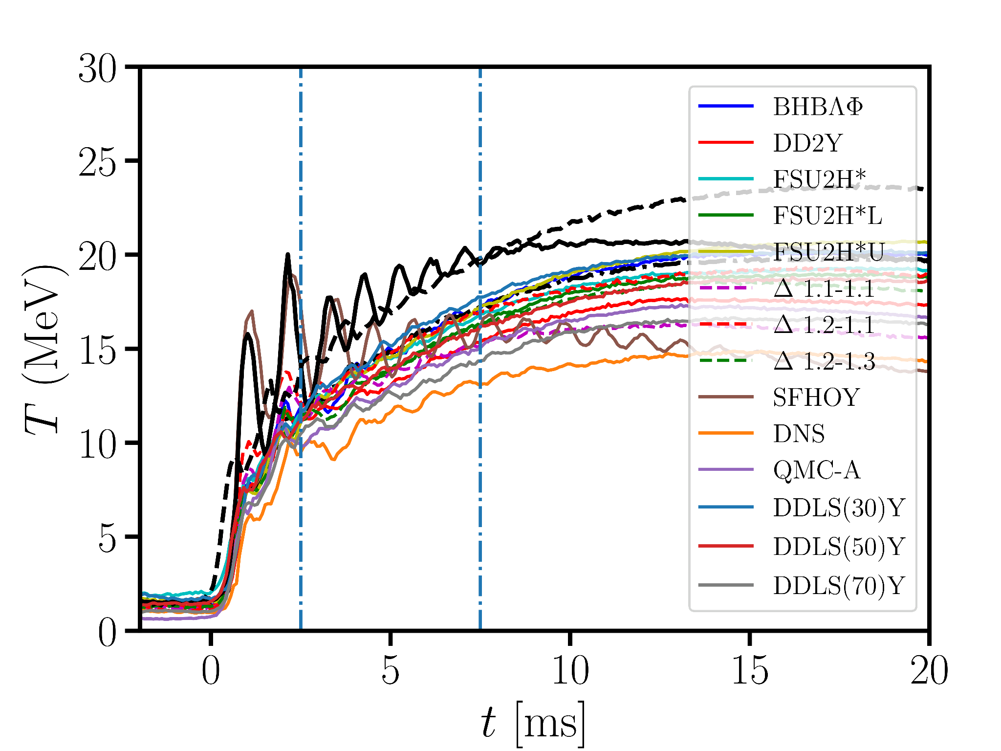
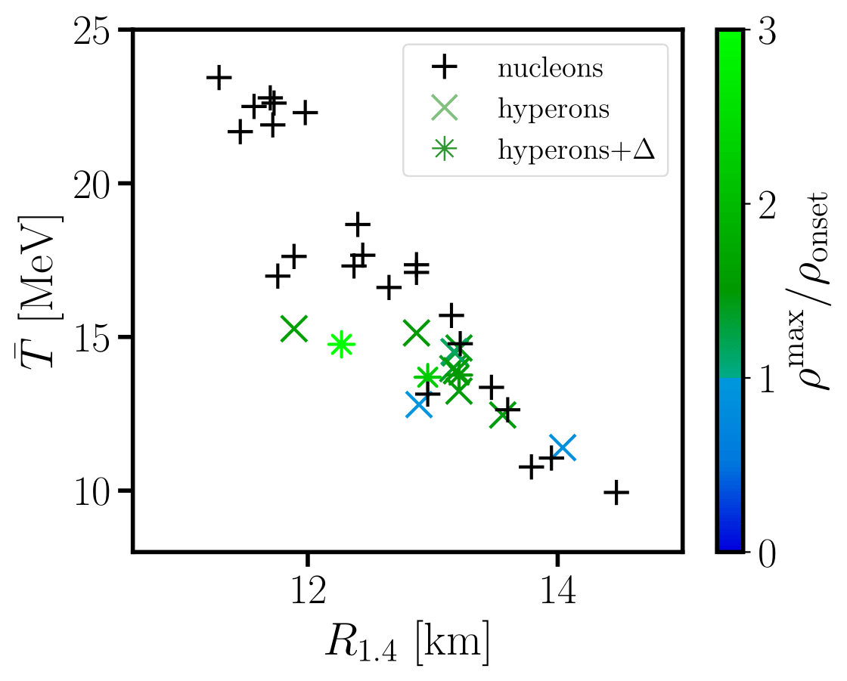
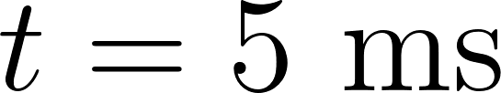
Temperature evolution
SFHO
SFHOY
Stiffer EoS
Remnants with hyperons have smaller temperature than their nucleonic counterparts
Hyperonic EoSs yield lower temperature for a fixed R_{1.4}
Notes:
We then studied the temperature evolution in the remnants. You can see that at the beginning the temperature of the remnants is close to 0. The matter starts to get heated at t=0—time of merging. We noticed that nucleonic EoSs like SFHO that have a corresponding hyperonic counterpart (SFHOY) with the same nucleonic interaction but do not include the hyperonic degree of freedom yield higher temperatures in the remnant than their hyperonic counterparts. This seems like an unexpected result since nucleonic models are stiffer than their hyperonic counterparts.
To investigate further, on the graph on the right we plot the average temperature 5 ms after the merging in the remnant for all EoSs as a function of the radius of a 1.4 solar mass star. While indeed stiffer EoS tend to have colder remnants, hyperonic EoSs for a fixed radius have smaller temperatures in the remnants than nucleonic ones. This is a consequence of the higher specific heat that they have.

Slide 16
Summary and outlooks
Hyperons are exotic baryons that could be present in the dense matter of neutron stars.
Their appearance softens both the cold and the hot equation of state.
The thermal index of hypernuclear matter is lower, while the specific heat is higher than that of pure nuclear matter.
The dominant frequency peak from the binary neutron star merger event shows systematically higher values when hyperons are produced in the remnant.
Future multimessenger measurements may finally answer the composition question of dense matter.
Notes:
Read it.

Slide 17

THANK YOU FOR YOUR ATTENTION

Slide 18




Simulation strategy
Big set of three-dimensional (3D) EoSs
HYPERONIC EOSs
NUCLEONIC EOSs
We simulate the merger of two neutron stars
FOR EACH EOS FROM BOTH SETS!
Discriminating the impact of the different thermal treatments associated with the different compositions!
3D EoS
Notes:
To investigate if these features of the hyperonic models leave imprint in the BNS observables and quantities, we did an extensive simulation campaign. The simulation campaign was conducted with big set of 3D EoSs that we divide in two categories whether they consider hyperons as degrees of freedom or not. We simulated mostly merger of two neutron stars with 1.4-1.4 solar masses, although we also did simulations with the same total mass, but different asymmetry and also more massive symmetric binaries. We do not consider the effects of neutrinos and magnetic fields. With all EoSs that are in our disposals we did two types of simulations. In the first one, with each EoS, we simulate the merging of the stars using as input the full 3D EoSs that we have. In the second type of simulation, that we call a reference one, we take the cold beta equilibrated slice of each EoS and we supplement that with a constant thermal correction corresponding to constant thermal index of 1.75. This choice is intentional; as we will see, it reproduces the nucleonic thermal behavior rather well. For each observable and quantity we get outputs X from the full 3D simulations and outputs X175 form the reference simulations. At the end the difference between those the values, for each quantity X, gives how much the quantity deviates due to the thermal behavior.

Slide 19
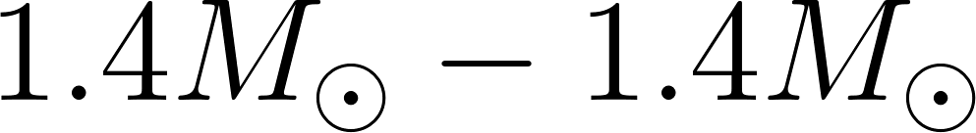
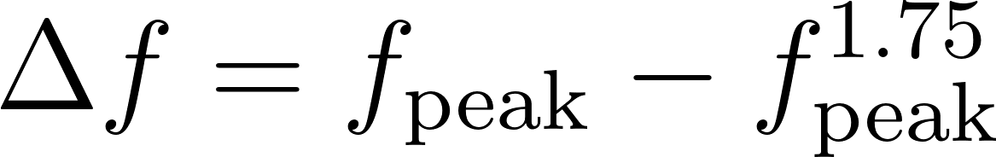
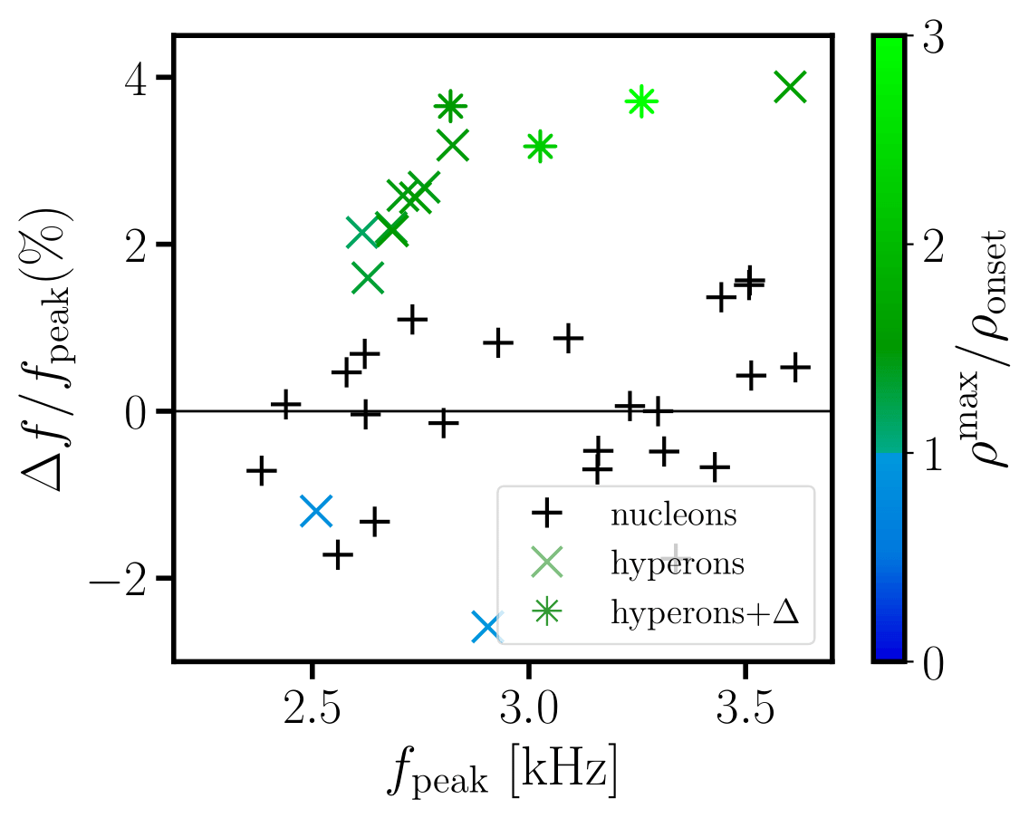
Frequency shift
Hyperonic EoSs show a systematic shift toward higher frequencies.
Nucleonic models are scattered around the reference values.
If the hyperons are present in matter only in very small quantities, the corresponding EoSs behave like nucleonic ones.
see also: Blacker et al., PRD, 2024
Notes:
We show the shift of the dominant frequency peak—which for each EoS is calculated as a difference between the dominant peaks extracted with our two types of simulations. What we can see in the graph is that hyperonic EoSs show a systematic shift toward higher frequencies, which means that the 3D EoS predicts up to 4% higher frequency than the reference one. Nucleonic models are scattered around the value of 0, suggesting that our choice for the reference simulation resembles nucleonic thermal behavior. Furthermore, if hyperons are present in matter only in very small quantities, the corresponding EoS behaves like a nucleonic one. In the graph those models are labeled with blue, and for them the maximum density in their remnant does not exceed the density at which the hyperons appear in cold beta-stable matter. This shift is an important feature since with a precise knowledge of the cold EoS could be possible to distinguish hypernuclear remnant matter with GW measurements.

Slide 20
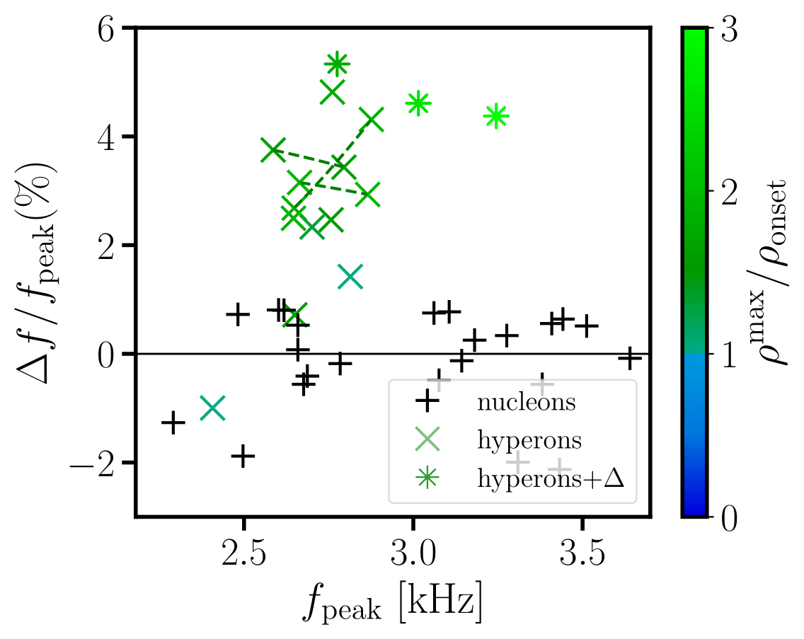
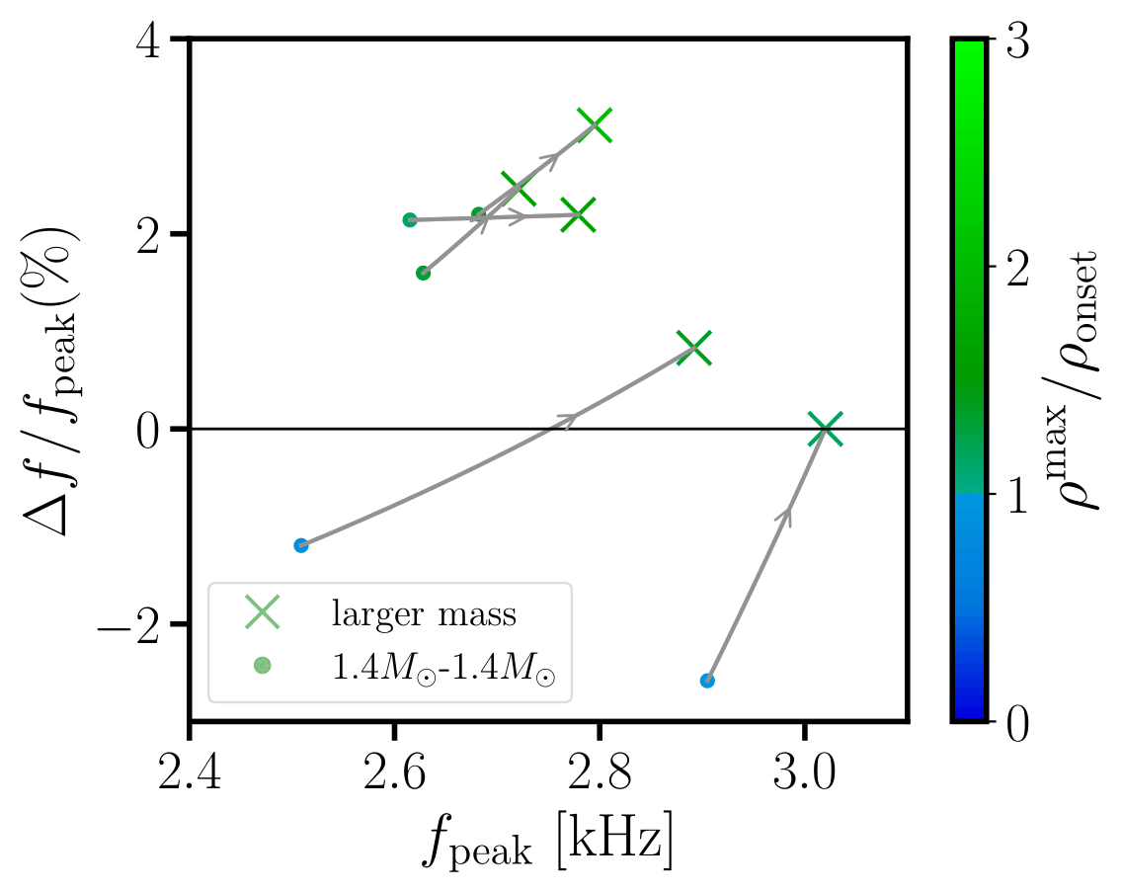
Impact of the configuration
Asymmetric binaries
More massive binaries
Notes:
We explicitly show that this conclusion is independent of the chosen initial configuration. On the graph on the left, we show the frequency shift in a case of asymmetric binaries with asymmetry 0.8, keeping the total mass of the system at 2.8 solar masses. We can see that in this case the nucleonic models show even smaller scatter, while some hyperonic models have frequency shifts of up to 6%. Furthermore, on the graph on the right, we show the frequency shift for a few EoSs that had small or negative shifts in the symmetric 1.4-1.4 configurations. For all EoSs the frequency shift increases with an increase of the total mass of the remnant.

Slide 21
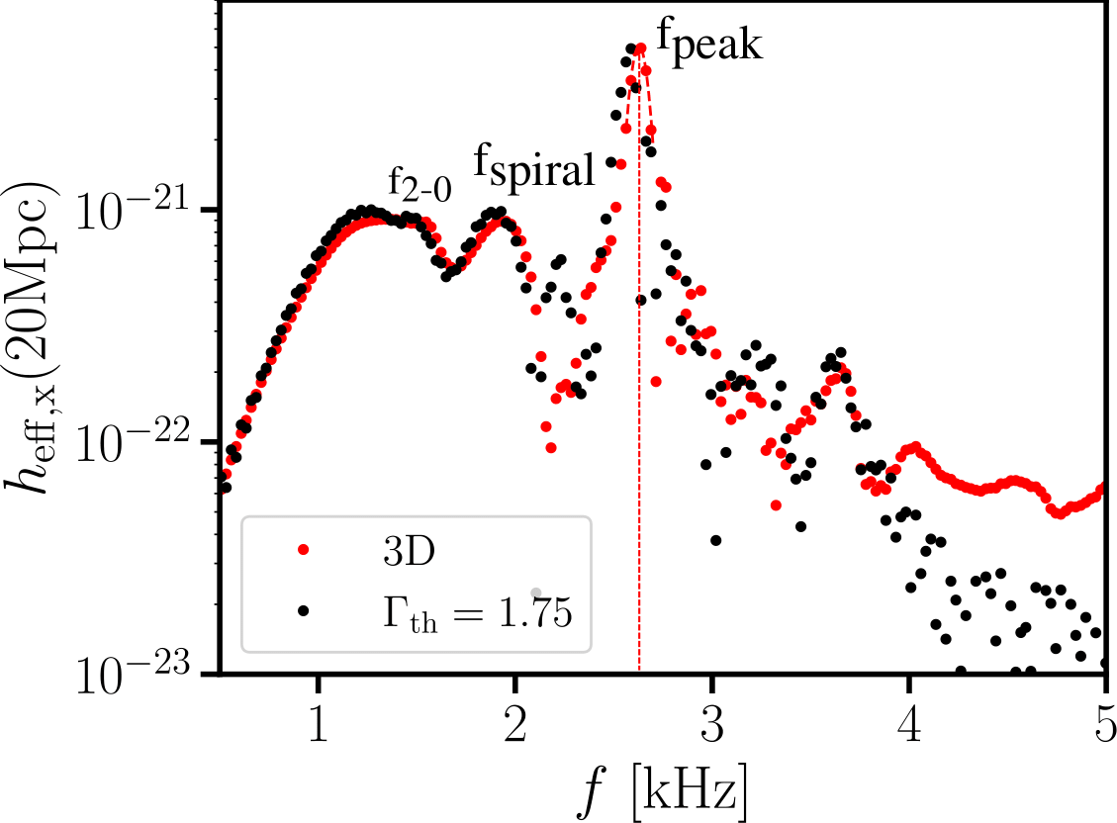
Impact of hyperons on the merger observables and quantities
Secondary spectral features
Notes:
Now lets focus on the results from other spectral features like the secondary peaks fspiral and f2-0, which are corresponding to smaller strain but they may be detected with the newest GW detectors.

Slide 22
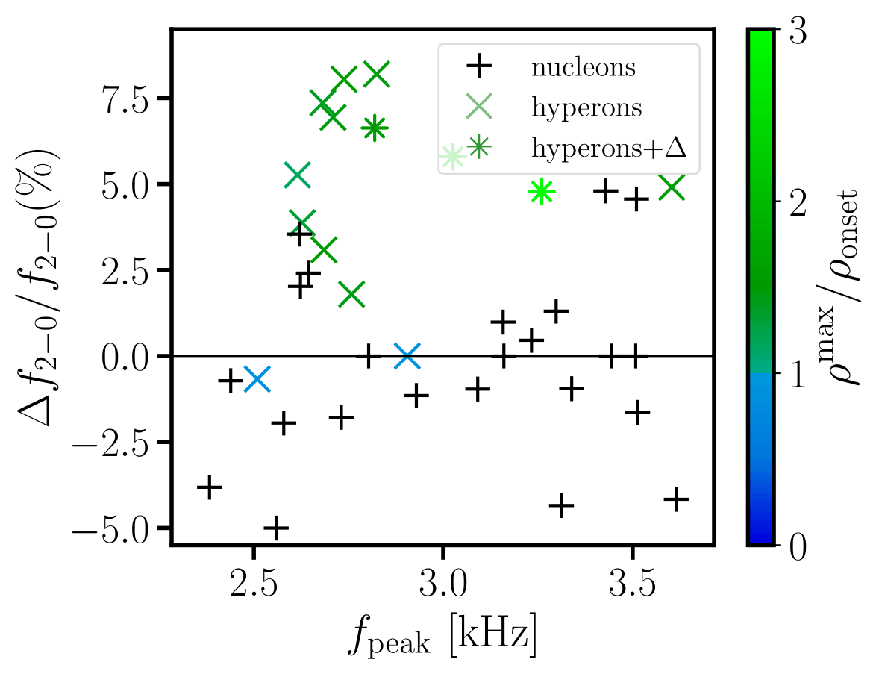
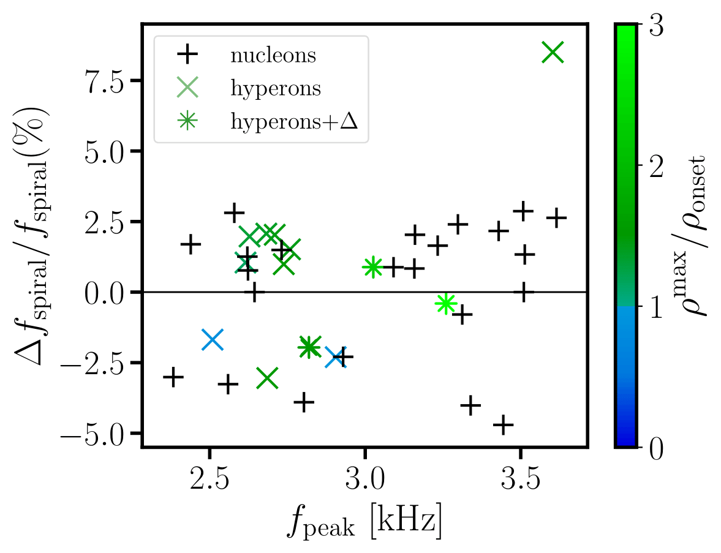
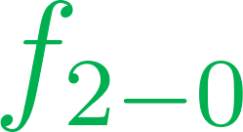
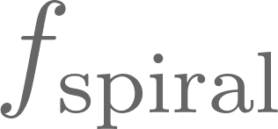
Impact of hyperons on the merger observables and quantities
is affected by the thermal behavior
is not affected by the thermal behavior
Notes:
Here we show the shifts of the secondary GWs. We see that f2-0 is impacted by the thermal behavior but fspiral is not affected by it. We suspect that the reason behind this is the mechanisms that produce these features. Without going into details, fspiral originates from the very early post merger phase, where the matter is still not significantly heated. That is not the case for f2-0, so that one is affected by the thermal behavior.

Slide 23
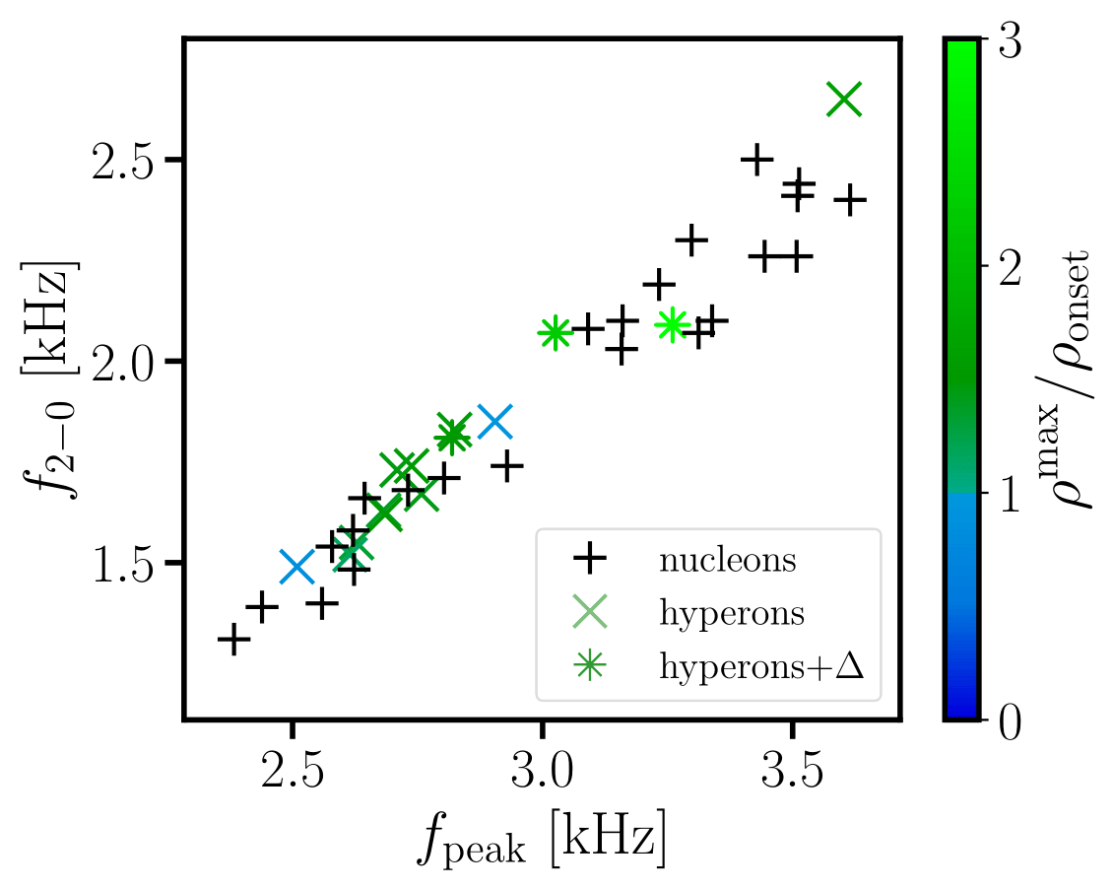

Impact of hyperons on the merger observables and quantities
There is no hyperon-induced deviation in the relations between the dominant peak and the secondary peaks
Notes:
However, if we try to find the correlation of the secondary peaks and the main peak, we see that There is no deviation induced by hyperons. This means that it will be difficult to extract information about the composition based on the secondary spectra infromations.

Slide 24

Impact of hyperons on the merger observables and quantities
TIME EVOLUTION OF DIFFERENT QUANTITIES
- TEMPERATURE
- THERMAL INDEX
- HYPERON FRACTION
Credits: GSI
Notes:
Now we focus our attention to the time evolution of several different quantities important during the merger evolution. Those quantities are the temperature, thermal index and hyperon fraction inside of the remnant.

Slide 25

Impact of hyperons on the merger observables and quantities
MASS
EJECTION
Radice et al, APJ, 2018
Notes:
Now we turn our attention to the mass ejecta.

Slide 26

Impact of hyperons on the merger observables and quantities
THRESHOLD MASS
T. Dietrich et al., Gen. Rel. Grav., 2021
Notes:
We close the discussion with the results relating the threshold mass.

Slide 27


Impact of hyperons on the merger observables and quantities
Threshold mass—maximum initial mass at which the remnant does not go to prompt collapse
Nucleonic
fit
It has been found that the threshold mass correlates with the cold mass star parameters
Bauswein et al, PRD, 2021
Notes:
The threshold mass represents the maximum remnant mass for fixed mass asymmetry at which the remnant does not go to a black hole prompt collapse. In the simulations it can be computed as an average of the highest mass at which the configuration is stable and the lowest mass at which the configuration collapses. In our work we focus on symmetric binaries. In some previous works it has been found that this quantity correlates rather well in bilinear relations with the radii of 1.6 solar mass cold stars and the maximum mass that the corresponding EoS predicts.
On the graph on the right we show our result of the threshold mass obtained with all models in our disposal as a function of the radius of 1.6 solar masses and the maximum mass of the cold star that the EoS predicts. The gray plane represents the nucleonic bilinear fit. We can see that hyperons do not induce deviation from this relation.

Slide 28


Impact of hyperons on the merger observables and quantities
Hyperonic EoSs are scattered around the nucleonic mean
Finite temperature behavior has an effect on the threshold mass too!
Notes:
The previous conclusion is even better seen if the results are projected on a plane. However, if we play the same game as in the case of the dominant peak and we compute the difference between the threshold masses obtained from the 3D EoSs and the ones obtained with our reference simulations, we find noticeable difference. For most of the nucleonic models the reference simulations are underestimating the true threshold masses, while for the hyperonic ones they are overestimating it. Finite temperature behavior has an effect on the threshold mass too, yielding a difference of .05 solar masses between hyperonic and nucleonic matter remnants.

Slide 29


Impact on the mass ejecta
Mass ejecta—unbound matter from the remnant that undergoes rapid neutron capture.
The amount of ejecta mass is related to the total amount of synthesized elements.
We focus on the dynamical (early) ejecta that can be affected by the appearance of hyperons.
Stiffer EoS
Baiotti et al, Rept. Prog. Phys, 2017
Shibata et al, Annu. Rev. Nucl. Part. Sci., 2019
Kochankovski et al, PRD, 2025
Notes:
Another interesting quantity is the mass ejecta that represents the unbound matter ejected during the remnant. It undergoes a rapid neutron capture, and its amount is related to the total amount of synthesized elements.
On the graph on the right we show the dynamical mass ejecta 10 ms after merging as a function of the radius of a cold 1.4 solar mass star computed with the same EoS. The black curve is a second order polynomial fit of the mass ejecta of nucleonic models. We see that the ejecta in general is sensitive to the radius of the initial stars, with smaller radii yielding significantly bigger ejecta. On the other hand it seems that hyperons could increase the ejecta for a fixed radius. However, the scatter of the nucleonic models is rather large and more investigation is needed for a definitive answer.

